Slide 1
Computer Organization and Software Systems (SS ZG516)
Nirmal Kr. Gupta
CSIS Deptt.

Slide 2
Interconnection Structures
Cache Memory Principles, Cache memory Design Considerations
Source: All the Slides are based on original slides of William Stallings

Slide 3
Characteristics of Memory Systems
Location
whether memory is internal and external to the computer
Capacity
Unit of transfer
the number of electrical lines into and out of the memory module
Access method
Performance
Physical type
Physical characteristics
Organisation

Slide 4
Location
CPU
Internal
External

Slide 5
Capacity
Word size
The natural unit of organisation
Number of words
or Bytes

Slide 6
Unit of Transfer
Internal
Usually governed by data bus width
External
Usually a block which is much larger than a word
Addressable unit
Smallest location which can be uniquely addressed
Word internally
Cluster on Memory disks

Slide 7
Access Methods (1)
Sequential
Start at the beginning and read through in order
Access time depends on location of data and previous location
e.g. tape
Direct
Individual blocks have unique address
Access is by jumping to vicinity plus sequential search
Access time depends on location and previous location
e.g. disk

Slide 8
Access Methods (2)
Random
Individual addresses identify locations exactly
Access time is independent of location or previous access
e.g. RAM
Associative
Data is located by a comparison with contents of a portion of the store
Access time is independent of location or previous access
e.g. cache

Slide 9
Memory Hierarchy
Registers
In CPU
Internal or Main memory
May include one or more levels of cache
“RAM”
External memory
Backup memory
Disk, Tapes

Slide 10
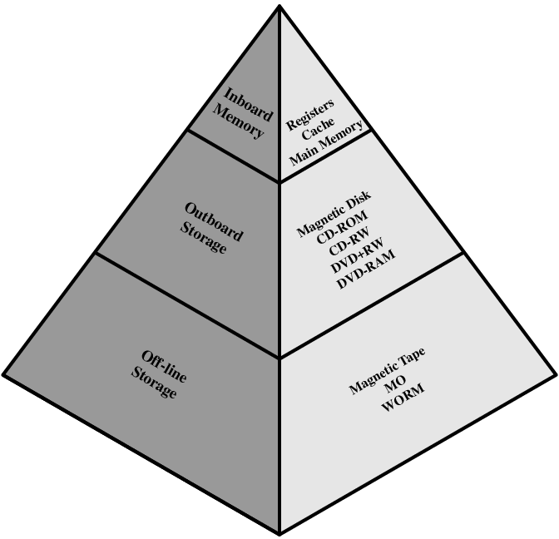
Memory Hierarchy - Diagram

Slide 11
Performance
Access time
Time between presenting the address and getting the valid data
Memory Cycle time
Time may be required for the memory to “recover” before next access
Cycle time is access + recovery
Transfer Rate
rate at which data can be transferred into or out of a memory unit.

Slide 12
Physical Types
Semiconductor
RAM
Magnetic
Disk & Tape
Optical
CD & DVD
Others

Slide 13
Physical Characteristics
Decay
Volatility
information decays naturally or is lost when electrical power is switched off.
In a nonvolatile memory, information once recorded remains without deterioration until deliberately changed; no electrical power is needed to retain information.
Erasable
Nonerasable memory cannot be altered, except by destroying the storage unit.
Power consumption

Slide 14
Organisation
For random-access memory, the organization is a key design issue.
By organization is meant the physical arrangement of bits to form words.
Not always obvious
e.g. interleaved

Slide 15
The Bottom Line
The design constraints on a computer’s memory can be summed up by three questions:
How much?
Capacity
How fast?
Time is money
How expensive?

Slide 16
Implementing memory systems
A variety of technologies are used to implement memory systems, and across this spectrum of technologies, the following relationships hold:
Faster access time, greater cost per bit
Greater capacity, smaller cost per bit
Greater capacity, slower access time

Slide 17
Hierarchy List
Registers
L1 Cache
L2 Cache
Main memory
Disk cache
Disk
Optical
Tape
As one goes down the hierarchy
Decreasing cost per bit
Increasing capacity
Increasing access time
Decreasing frequency of access of
the memory by the processor

Slide 18
So you want fast?
It is possible to build a computer which uses only static RAM
This would be very fast
This would need no cache
This would cost a very large amount

Slide 19
Locality of Reference
During the course of the execution of a program, memory references tend to cluster
e.g. loops

Slide 20
Cache
Small amount of fast memory
Sits between normal main memory and CPU
May be located on CPU chip or module

Slide 21
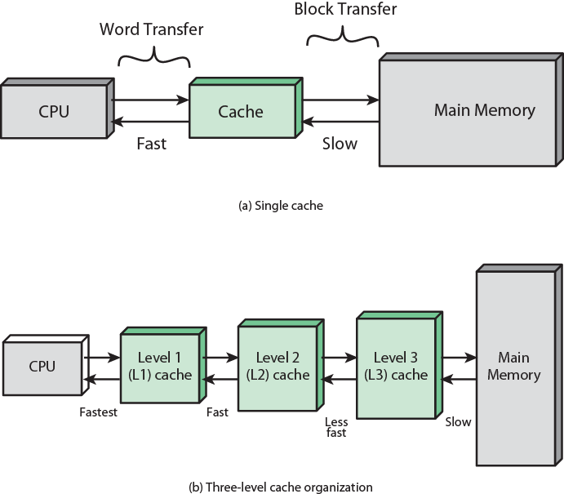
Cache and Main Memory

Slide 22
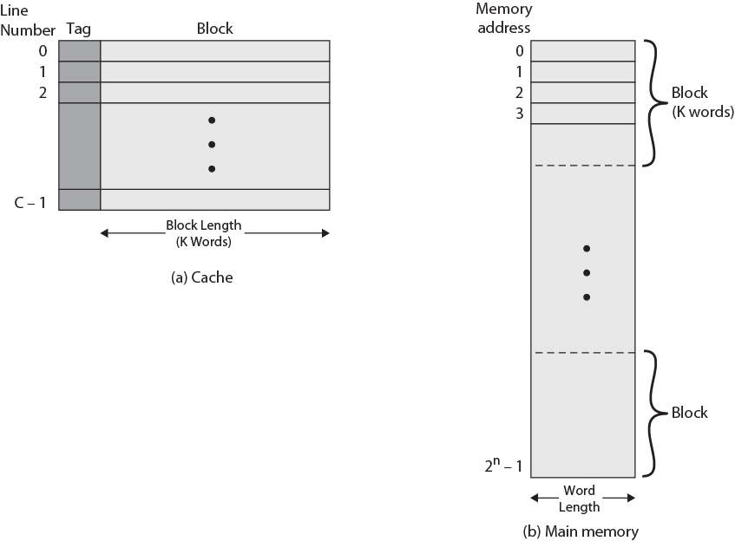
Cache/Main Memory Structure

Slide 23
Cache operation – overview
CPU requests contents of memory location
Check cache for this data
If present, get from cache (fast)
If not present, read required block from main memory to cache
Then deliver from cache to CPU
Cache includes tags to identify which block of main memory is in each cache slot

Slide 24
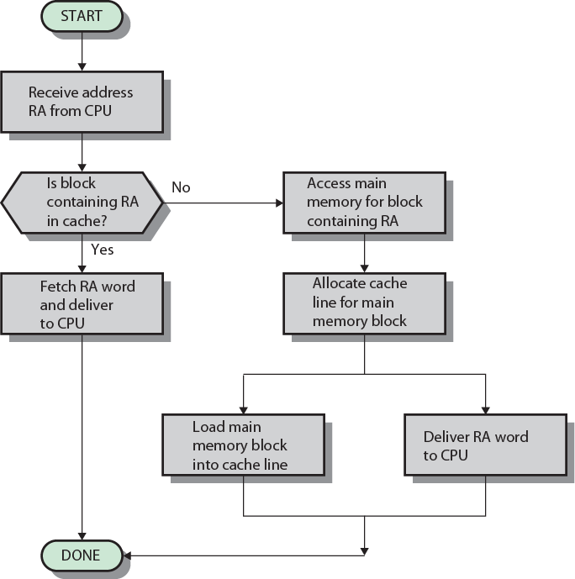
Cache Read Operation - Flowchart

Slide 25
Cache Design
Addressing
Size
Mapping Function
Replacement Algorithm
Write Policy
Block Size
Number of Caches

Slide 26
Cache Addressing
Where does cache sit?
Between processor and virtual memory management unit
Between MMU and main memory
Logical cache (virtual cache) stores data using virtual addresses
Processor accesses cache directly, not thorough physical cache
Cache access faster, before MMU address translation
Virtual addresses use same address space for different applications
Must flush cache on each context switch
Physical cache stores data using main memory physical addresses

Slide 27
Size does matter
Cost
More cache is expensive
Speed
More cache is faster (up to a point)
Checking cache for data takes time

Slide 28
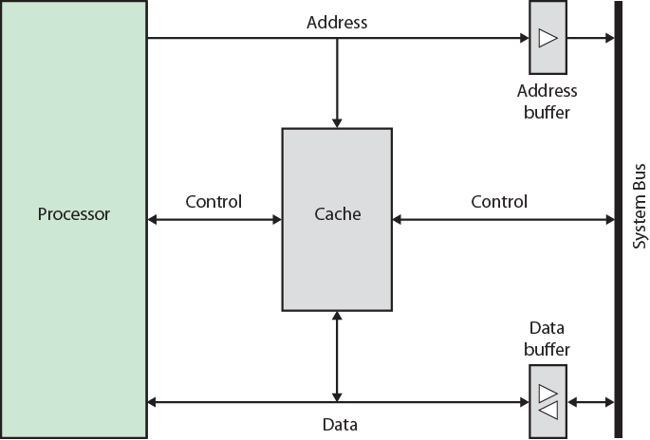
Typical Cache Organization

Slide 29
Mapping Function
Cache of 64kByte
Cache block of 4 bytes
i.e. cache is 16k (2¹⁴) lines of 4 bytes
16MBytes main memory
24 bit address
(2²⁴=16M)

Slide 30
Direct Mapping
Each block of main memory maps to only one cache line
i.e. if a block is in cache, it must be in one specific place
Address is in two parts
Least Significant w bits identify unique word
Most Significant s bits specify one memory block
The MSBs are split into a cache line field r and a tag of s-r (most significant)

Slide 31
Direct Mapping Address Structure
Tag s-r
Line or Slot r
Word w
8
14
2
24 bit address
2 bit word identifier (4 byte block)
22 bit block identifier
8 bit tag (=22-14)
14 bit slot or line
No two blocks in the same line have the same Tag field
Check contents of cache by finding line and checking Tag

Slide 32
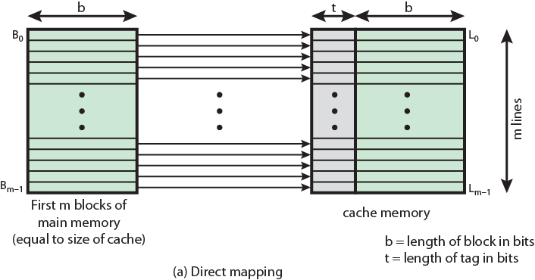
Direct Mapping from Cache to Main Memory

Slide 33
Direct Mapping Cache Line Table
Cache line | Main Memory blocks held
0 | 0, m, 2m, 3m…2s-m
1 | 1,m+1, 2m+1…2s-m+1
…
m-1 | m-1, 2m-1,3m-1…2s-1

Slide 34
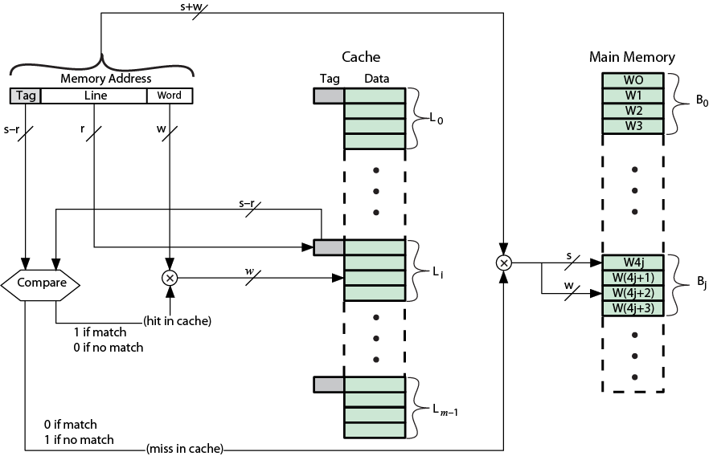
Direct Mapping Cache Organization

Slide 35
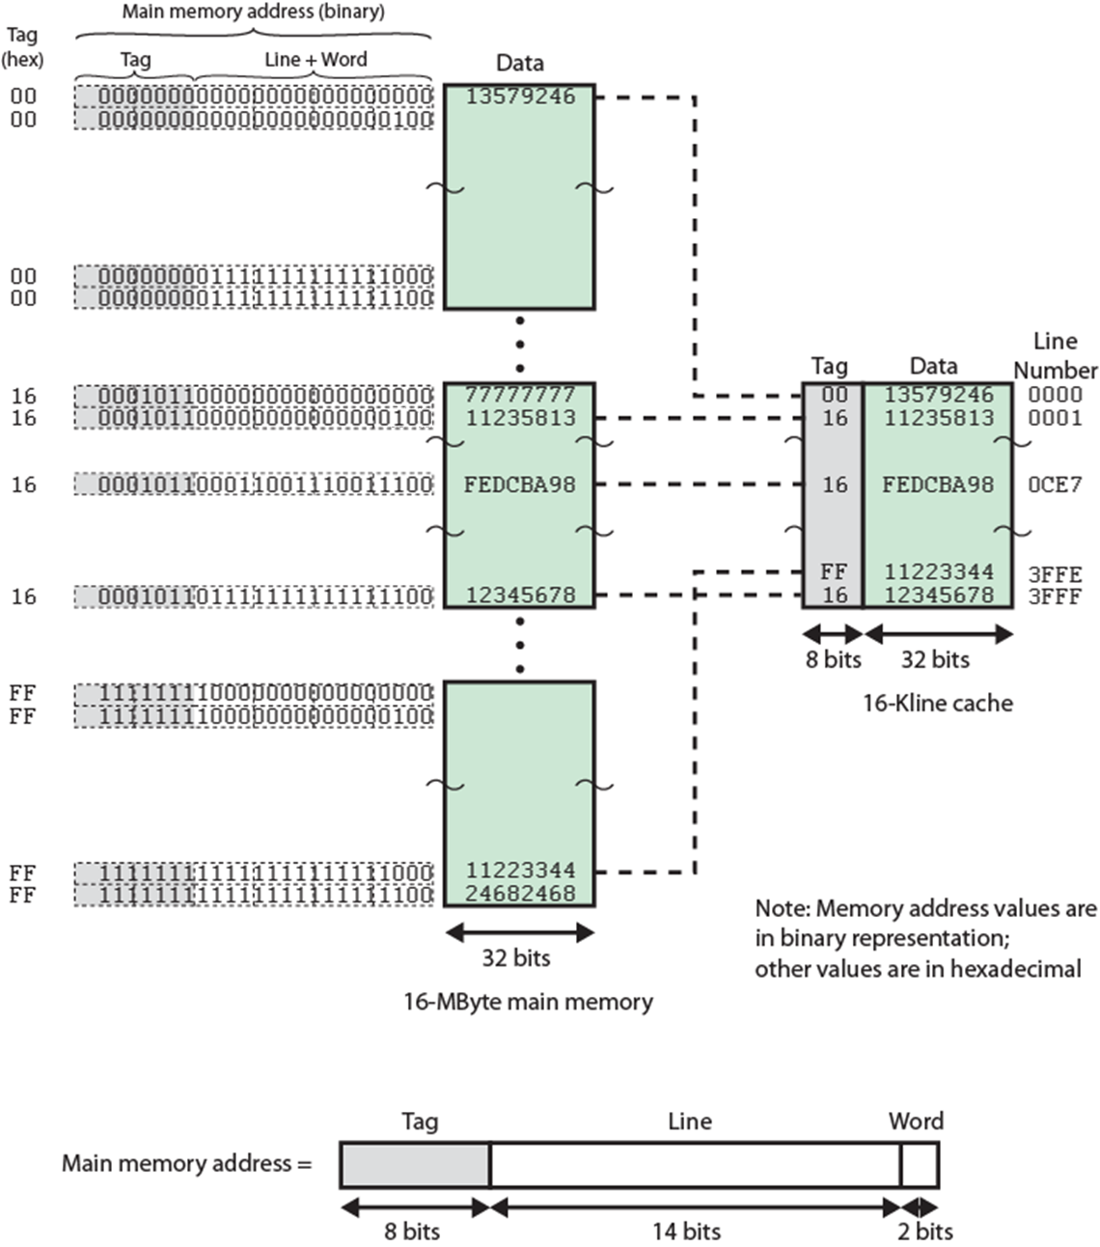
Direct Mapping Example

Slide 36
Direct Mapping Summary
Address length = (s + w) bits
Number of addressable units = 2^{s+w} words or bytes
Block size = line size = 2^{w} words or bytes
Number of blocks in main memory = 2^{s+ w}/2^{w} = 2^{s}
Number of lines in cache = m = 2^{r}
Size of tag = (s – r) bits

Slide 37
Direct Mapping pros & cons
Simple
Inexpensive
Fixed location for given block
If a program accesses 2 blocks that map to the same line repeatedly, cache misses are very high

Slide 38
Victim Cache
To lower the miss penalty
Remember what was discarded
Since discarded data has already been fetched, it can be
used again at a small cost
Victim cache was originally proposed as an approach to reduce the conflict misses of direct mapped caches
Fully associative
4 to 16 cache lines
Between direct mapped L1 cache and next memory level

Slide 39
Associative Mapping
A main memory block can load into any line of cache
Memory address is interpreted as tag and word
Tag uniquely identifies block of memory
Every line’s tag is examined for a match
Cache searching gets expensive

Slide 40
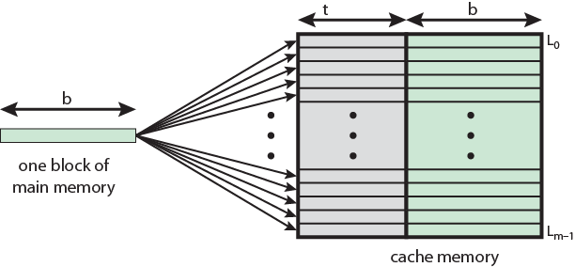
Associative Mapping from Cache to Main Memory

Slide 41
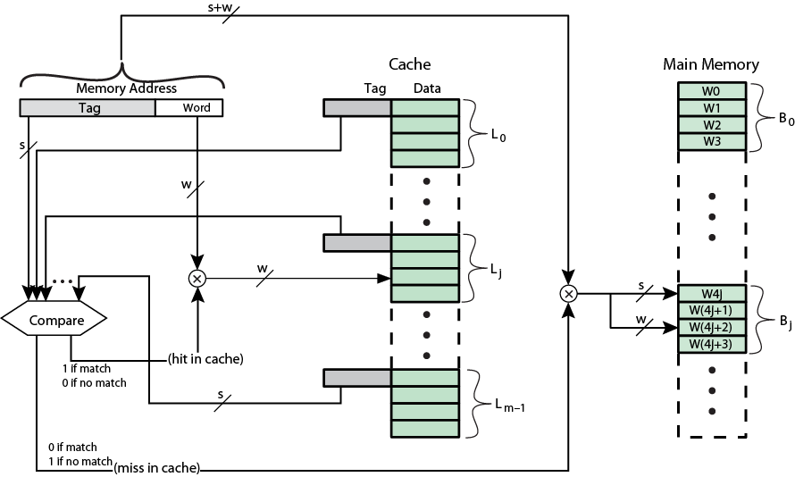
Fully Associative Cache Organization

Slide 42
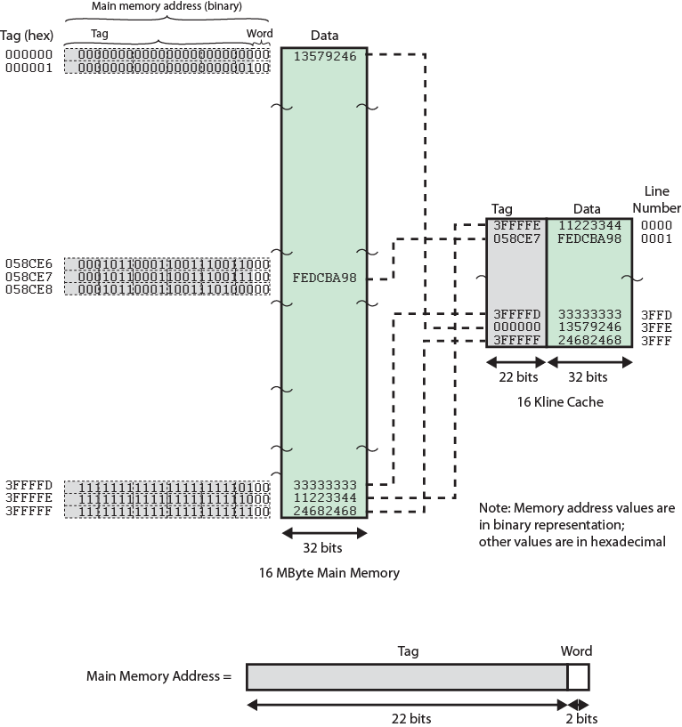
Associative Mapping Example

Slide 43
Associative Mapping Address Structure
22 bit tag stored with each 32 bit block of data
Compare tag field with tag entry in cache to check for hit
Least significant 2 bits of address identify which 16 bit word is required from 32 bit data block
e.g.
Address Tag Data Cache line
FFFFFC FFFFFC 24682468 3FFF
Word
2 bit
Tag 22 bit

Slide 44
Associative Mapping Summary
Address length = (s + w) bits
Number of addressable units = 2^{s+w} words or bytes
Block size = line size = 2^{w} words or bytes
Number of blocks in main memory = 2^{s+ w}/2^{w} = 2^{s}
Number of lines in cache = undetermined
Size of tag = s bits

Slide 45

Next Topic
Set Associative Mapping
Queries

