Slide 1
Ict chapter 2
Eng. Shahin sir

Slide 2
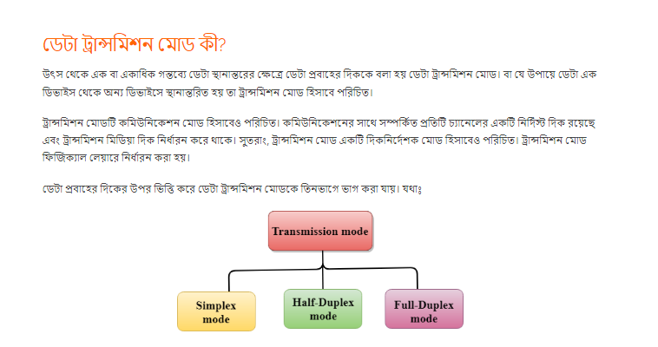

Slide 3
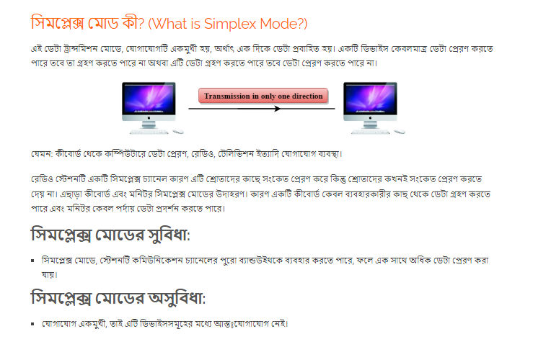

Slide 4
1010

Slide 5
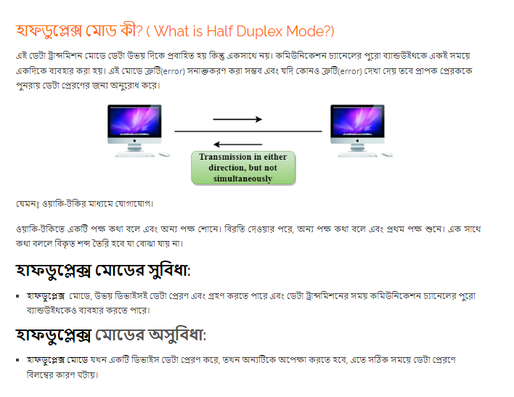

Slide 6
1111

Slide 7
5555
66666

Slide 8
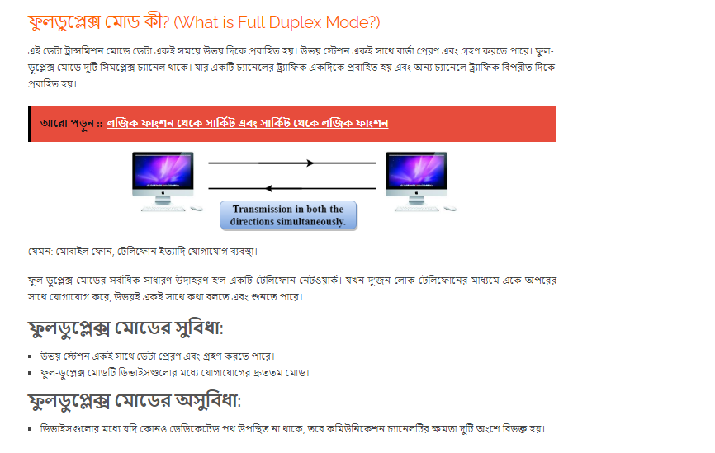

Slide 9
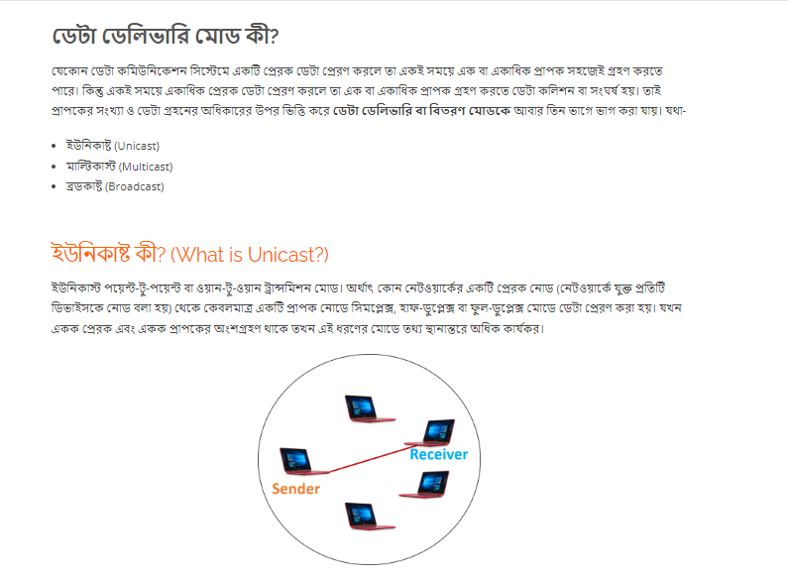

Slide 10
