Slide 1

Introduction to
Linux Administration
Day 1
IT Professional Program

Slide 2
Agenda
Welcome to Linux Administration!
Course/Block Introduction
Tips for Microsoft Teams
Online Search and AI
Ch.1 Introduction to Linux
Lab exercises/tasks

Slide 3
Course/Block Introduction
This block (Network and Linux Administration) is 16 weeks long:
  4 weeks of IT Service and Project Management
  4 weeks of Network Administration
  6 weeks of Linux Administration (this course)
    CompTIA Linux+ certification available
  2 weeks of Security Fundamentals

Slide 4
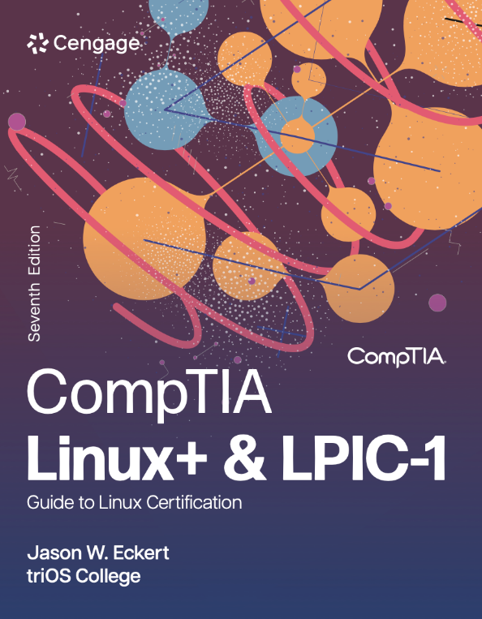
Course/Block Introduction
This course (Linux Administration):
  Covers the usage and administration of the Linux operating system (including services and cloud)
  CompTIA Linux+ certification available
  Book is available in Brightspace:

Slide 5
Course/Block Introduction
Attendance:
  Like or reply to the Welcome post in Teams before class (cuts down on the time it takes to do attendance at the beginning of class – I’ll update it on break from the Teams attendance spreadsheet)
  If you cannot make it to class, please message me beforehand if possible (email or Teams) and watch the recording for that day afterwards.
Marks:
  Assignment = 10%
  Quizzes = 20% (5 quizzes in total, each Monday)
  Final Project = 60%
  Professional Performance = 10%

Slide 6
Course/Block Introduction
Getting Additional Help
  An optional student-focused, instructor-led study lab is open to all IT students that need assistance outside of normal class hours.
    This lab runs from 1:00pm - 5:00pm, Monday to Friday in Microsoft Teams and will be facilitated by IT instructor Glenn Lankin.
    Join the Instructor-Led IT Study Lab Team to receive communication from Glenn and post questions (in Teams, navigate to Teams > Join or create team > Join team, and search for Instructor-Led IT Study Lab).
    For individual (1-on-1) help, click on this direct link to join the live lab session with Glenn.

Slide 7
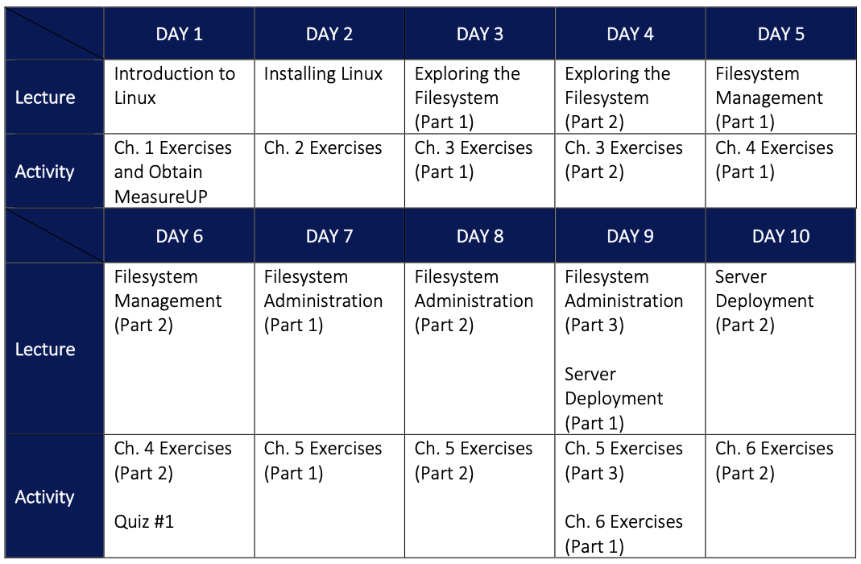

Slide 8
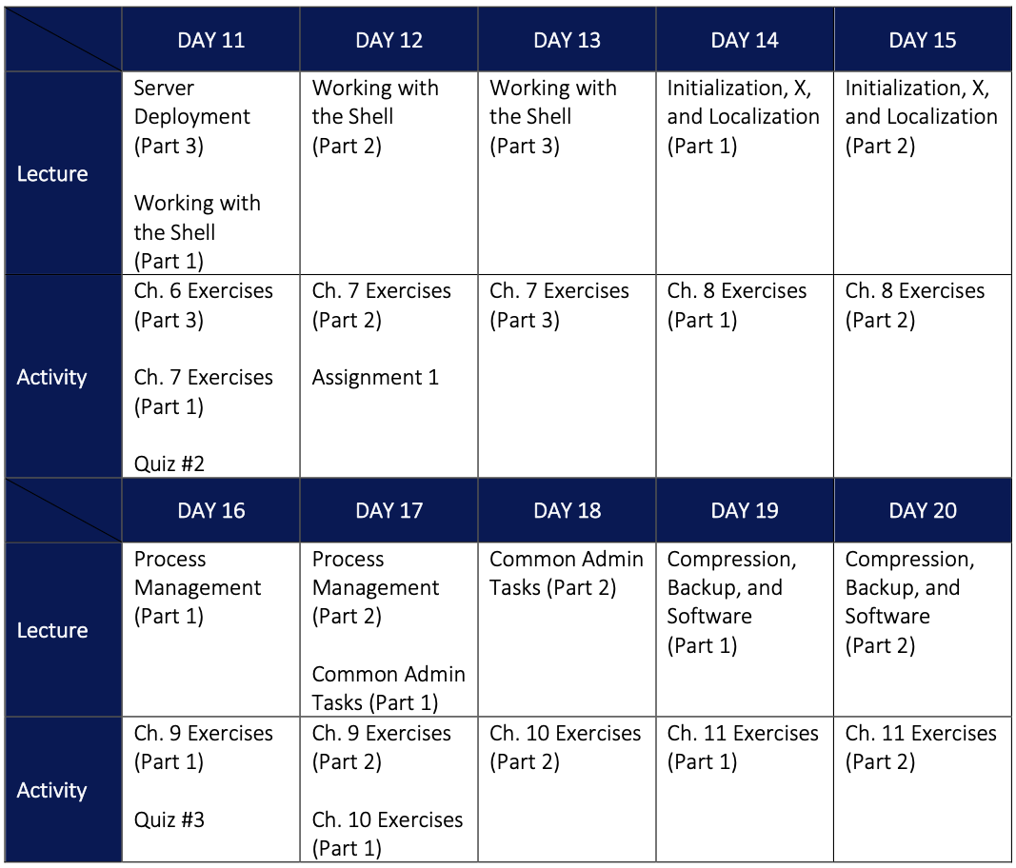

Slide 9
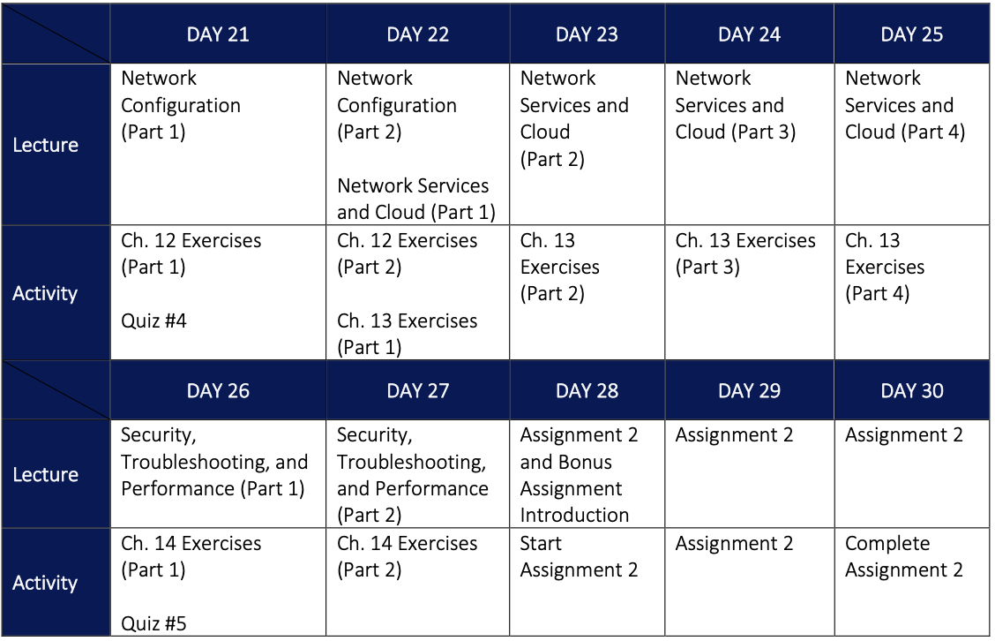

Slide 10
Tips for Microsoft Teams
The Microsoft Teams app currently uses a lot of system resources.
For better performance install Teams as a Microsoft Edge app:
  Install the Microsoft Edge web browser from https://www.microsoft.com/en-us/edge
  Open Microsoft Edge and log into https://teams.microsoft.com
  Click ... > Apps > Install this site as an app

Slide 11
Online Search and AI
For the deliverables in this course, we’ll leverage online resources to generate professional content where necessary
  This includes Googling examples available on the Internet, as well as leveraging AI tools such as ChatGPT or Microsoft Copilot in Bing
  Before that time, ensure you review the following LinkedIn Learning Course: Prompt Engineering: How to Talk to the AIs (29 min) and read the following blog: https://jasoneckert.github.io/myblog/using-google-like-a-pro/

Slide 12
Ch.1 Introduction to Linux
An open source, UNIX-like OS created by Linus Torvalds in 1991 (most powerful today!)
  Linus’ team develops the core Linux kernel, while other developers worldwide create the libraries and software that are packaged with it
    Kernel versions have major.minor.revision format
    e.g., the 6.3.18 kernel
  Different packaged versions are called distributions (distros) – e.g., Fedora, Red Hat, Debian, Ubuntu, SuSE, etc.

Slide 13
Ch.1 Introduction to Linux
If you develop and release software under an open source license:
  Others can access the original source code and make improvements
  Bugs & security are fixed quickly
  Supports any hardware platform
  Software evolves quickly
  This is not the case with closed source software (including freeware and shareware)

Slide 14
Ch.1 Introduction to Linux
Two major types of open source licenses:
  Copyleft
    Many restrictions on use
    Includes the GPL that Linux uses!
  Permissive
    Most other open source software (e.g., programming libraries, applications, etc.)
    Most common are the BSD and MIT licenses

Slide 15
Ch.1 Introduction to Linux
History (Figure 1-4 on pg 13)
  1960s MULTICS (failed)
  1969 AT&T Bell Labs UNIX – many vendors (flavors)
  1980s Richard Stallman’s FSF > GNU > GPL
  1991 GPL Linux = open source UNIX (distros)
  1998: 750,000 Red Hat Linux installs
  2000: Mainstream adoption (IBM commercial: https://www.youtube.com/watch?v=fJA9eiUktcA)
  2008: 64 million Linux installs
    Mobile, IoT, cloud, on-prem servers (https://www.youtube.com/watch?v=uxg17JlyFas)

Slide 16
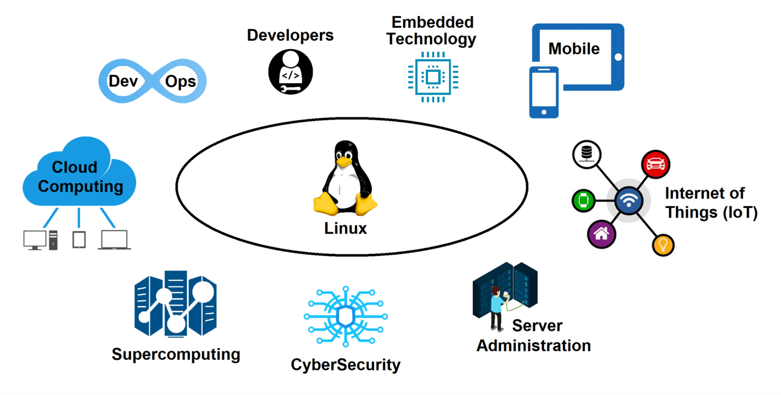
Ch.1 Introduction to Linux

Slide 17
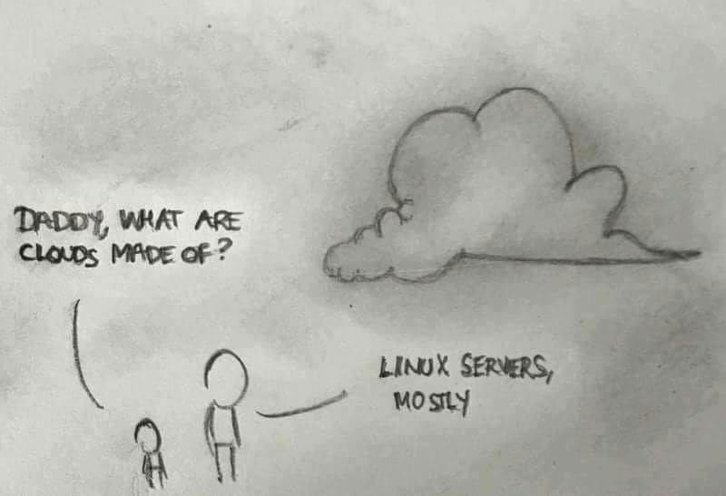
Ch.1 Introduction to Linux

Slide 18
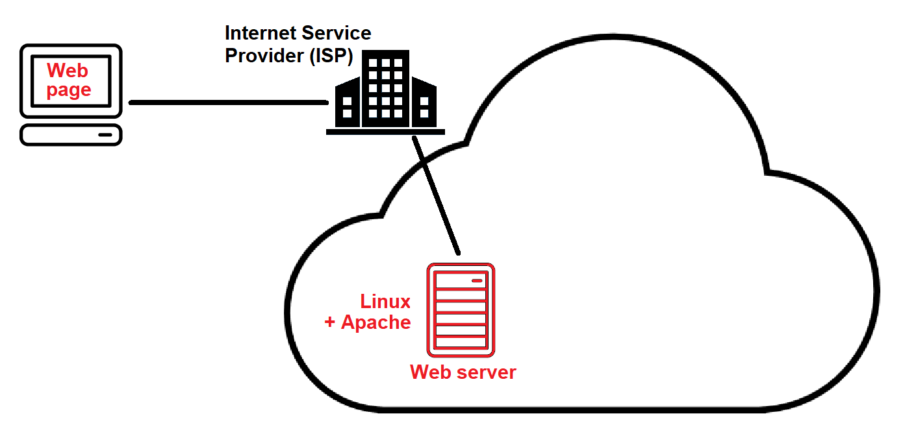
Ch.1 Introduction to Linux

Slide 19
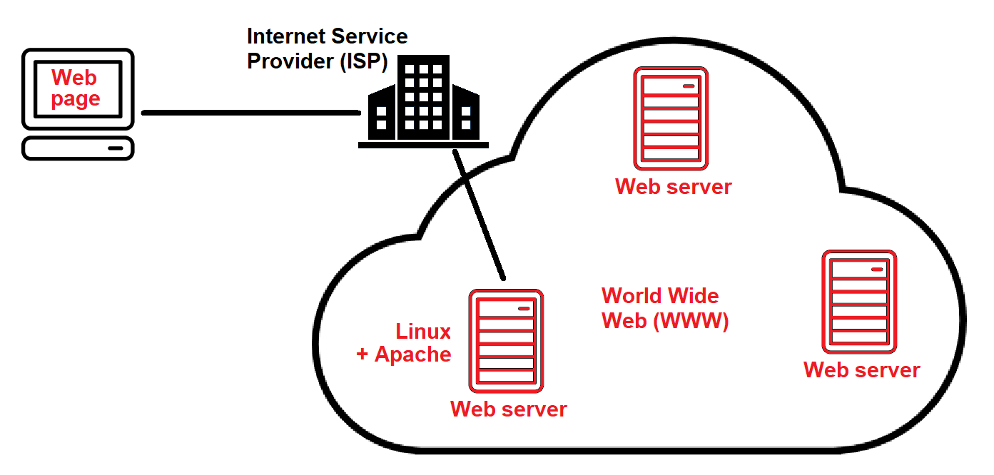
Ch.1 Introduction to Linux

Slide 20
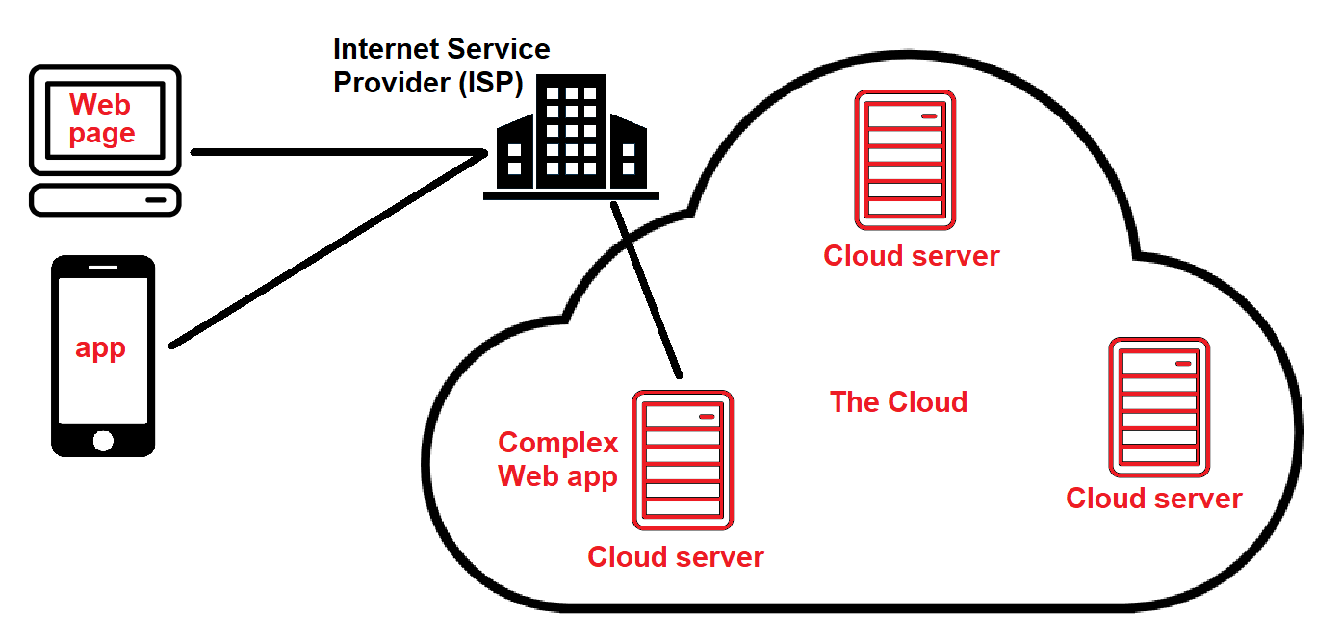
Ch.1 Introduction to Linux

Slide 21
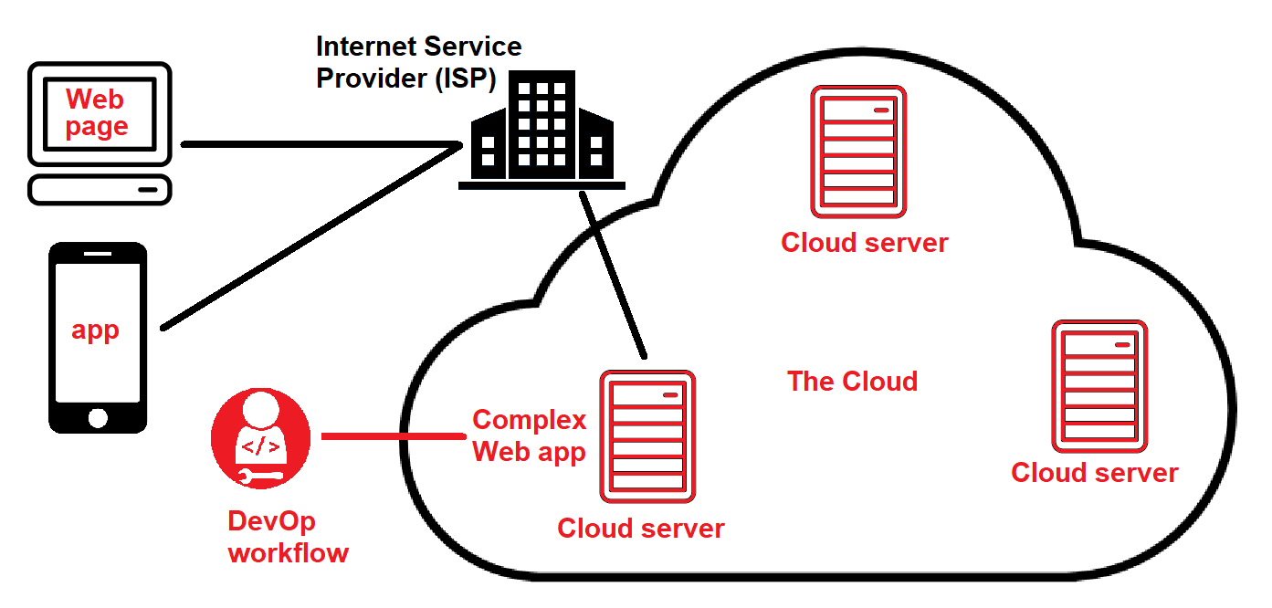
Ch.1 Introduction to Linux

Slide 22
Ch.1 Introduction to Linux
Gartner estimated that in 2020, over 90% of the world population is currently a Linux user in some way:
86% of embedded devices
100% of supercomputers
83% of smartphones/tablets/wearables (Android)
68% of servers (97% cloud, 29% on-premises)
96% of network appliances (routers, WAPs, NGFWs)
11% of desktops/laptops (includes Chromebooks and developer workstations)
=67% of all devices worldwide!

Slide 23
Ch.1 Introduction to Linux
Common Linux distributions/distros
  Table 1-4
  We’ll use Fedora Workstation & Ubuntu Server
Different distros often:
  Have different pre-packaged desktop environments (GNOME & KDE are the most common)
    Desktop environments run on top of the X Windows GUI (either X.org/X11 or the new Wayland)

Slide 24
Ch.1 Introduction to Linux
  Support different package managers
    Red Hat Package Manager (RPM) ~ Fedora
    Debian Package Manager (DPM) ~ Ubuntu
  Support different sandboxed (all-in-one) apps
    Snap (Ubuntu)
    Flatpak (Fedora)
    AppImage (both)
  You can also distribute software and source code in tarball format for any distro
    In this case, you run the compiled software, or compile the source code yourself to generate the program

Slide 25
Ch.1 Introduction to Linux
More on Linux in the cloud
  Cloud delivery models (IaaS, PaaS, SaaS)
    Figure 1-9, 1-10, and 1-11
  Cloud workflows (=Devops workflow)
    Continuous integration (CI) of code to GitHub
    Continuous deployment (CD) from GitHub to orchestrator and build automation in cloud (testing → production)
    Figure 1-13

Slide 26
Ch.1 Introduction to Linux
You know Linux? You also know UNIX!
  macOS/iOS, Cisco IOS, BSD, etc.
CompTIA Linux+ certification
  Very desirable for many jobs (cloud, cybersecurity, etc.)
  Everything on exam is in your book (plus more!)
  No substitute for practice in a virtual machine!
Lots of Internet resources:
  www.explainshell.com, www.ss64.com/bash
  @Fedora, @AskUbuntu, @LinuxQuestions
KW-LUG

Slide 27
Ch.1 Introduction to Linux
Linux installation types:
  Bare metal (write ISO to DVD/USB flash drive)
  WSLv2 (Linux running next to Windows – devs)
  Virtual machine (full Linux distro)
    Type 1 (Hyper-V), Type 2 (Oracle VM Virtualbox)
  Container (mini VM without a Linux kernel/libraries)
    Run on existing Linux system + container runtime (docker)

Slide 28
Lab exercises/tasks
Ensure you have Hyper-V installed
Create C:\SOURCE to store everything
  Download Fedora Workstation Linux ISO to this folder before tomorrow (latest version)
Read Ch.1 of the textbook and do the questions at the end
Optionally perform some of the Discovery Exercises at the end of Ch.1

