Slide 1
CSE-332 Computer Organization and Architecture

Slide 2
Topics to be discussed
Introduction, Organization and Architecture
IAS Structure
Computer Evolution and Performance
Pipelining
Superscalar and Parallel Processing
Multicore Processor and system
Bus Interconnection, PCI
Cache Memory
Semiconductor Main Memory
DRAM
ROM Technology
Topics to be discussed
ALU Design: Adder, Multiplier, Divisor
Booth’s Algorithm
Floating point Representation and Arithmetic, Hardware
Instruction Sets: Characteristics and Functions
Addressing Modes and Formats
Instruction-Level Parallelism
Control Unit Operation
Hardware Control Design
Micro-programmed control Design
Supercomputer Architecture
Cloud Computing Architecture

Slide 3
Textbooks
Computer Organization and Architecture (10th Edition) by William Stallings, Pearson Publisher: 10 edition, January 22, 2015.
Computer Organization and Design MIPS Edition, Fifth Edition: The Hardware/Software Interface, by David A. Patterson and John L. Hennessy, Publisher: Morgan Kaufmann; 5 edition
Digital Design and Computer Architecture, 2nd Edition, by David Harris Sarah Harris, Morgan Kaufmann, 24th July 2012.

Slide 4
Tests and Evaluation
Assignment: (average) 10%
Quiz: 20% (your best 4 out of 6 quizzes will be counted)
Mid Term-1: 15% (after 8th class)
Mid Term-2: 15% (after 16th class)
Lab: 10%
Term Final: 30%
Grading: NSU standard

Slide 5
Evaluation Report as commented in Summer 2020 (please read)
surprise quizes on that particular day lecture effetced our grade a lot, because we faced network issue ,so couldn't hear lecture but quiz on that same lecture bothered our grade
Who the hell takes MID as surprise? He also took all the quizzes as surprise. Even in the online semester. Totally wrong.

Slide 6
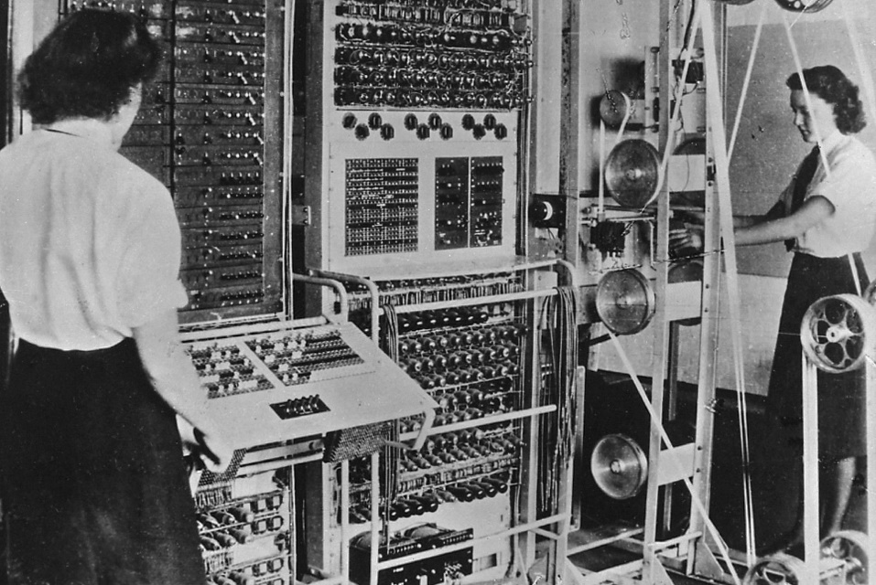
Colossus was an electronic digital computer, built during WWII (1943–1945 ) from over 1700 valves (tubes). It was used to break the codes of the German Lorenz SZ-40 cipher machine that was used by the German High Command. Colossus is sometimes referred to as the world's first fixed program, digital, electronic, computer.

Slide 7
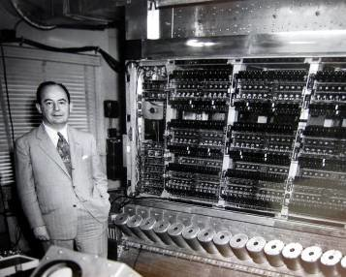
von Neumann (1913 – 1957) a Hungarian-American mathematician, physicist, computer scientist, and polymath.
proposed STORED-PROGRAM CONCEPT: that a program be electronically stored in binary-number format in a memory device so that instructions could be modified by the computer as determined by intermediate computational results.

Slide 8

The Institute for Advanced Study (IAS) in Princeton, New Jersey, in the United States, is an independent, postdoctoral research center for theoretical research and intellectual inquiry founded in 1930. Among its present and past Faculty and Members are 34 Nobel Laureates, 42 of the 60 Fields Medalists (mathematician's Nobel Prize)
The IAS machine was built from 1942 to 1951 under von Neumann's direction introduced the basic architecture of all modern digital computers.

Slide 9
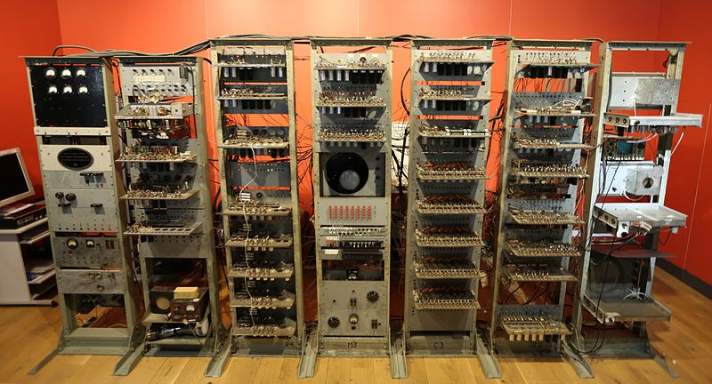
Stored program computer
The Manchester Baby, also called the Small-Scale Experimental Machine (SSEM), was the first electronic stored-program computer, was built at the University of Manchester by Frederic C. Williams, Tom Kilburn, and Geoff Tootill, and ran its first program on 21 June 1948.

Slide 10
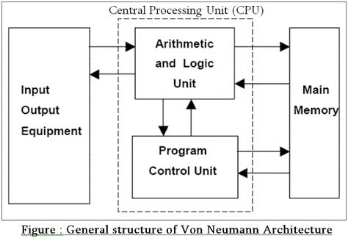

Slide 11
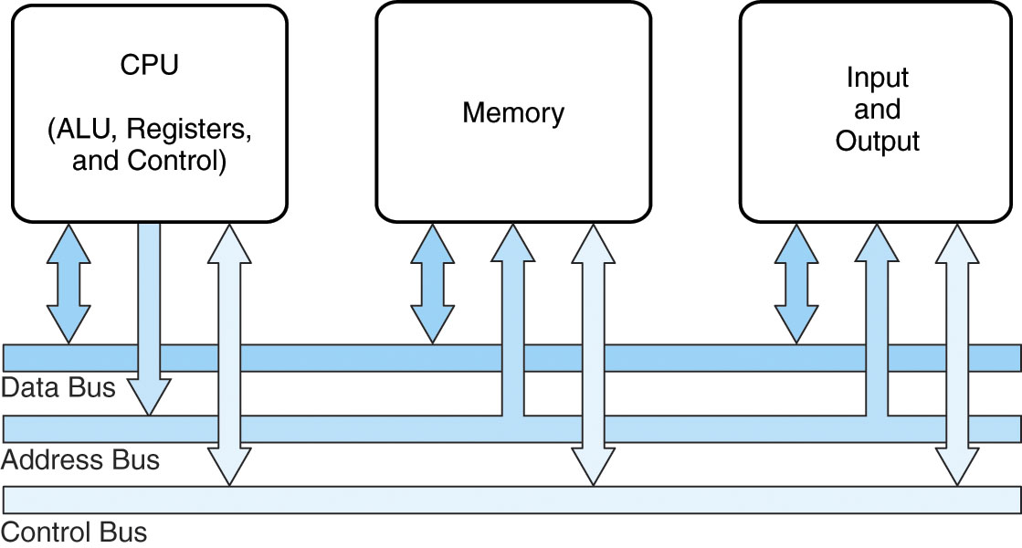
A modern computer is an electronic, digital, general purpose computing machine.

Slide 12

CPU: Central Processing Unit. CPU is considered as the brain of the computer. CPU performs all types of data processing operations. It stores data, intermediate results, and instructions (program). It controls the operation of all parts of the computer.
Memory: Holds program and data in binary form
Input and Output devices
Bus system: A system bus is a single computer bus that connects the major components of a computer system.

Slide 13
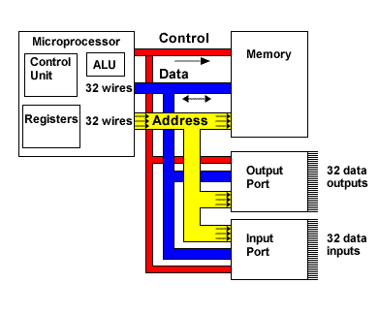
Three types of bus are used.
Address bus - carries memory addresses from the processor to other components such as primary storage and input/output devices.
Data bus - carries the data between the processor and other components.
Control bus - carries control signals from the processor to other components.

Slide 14
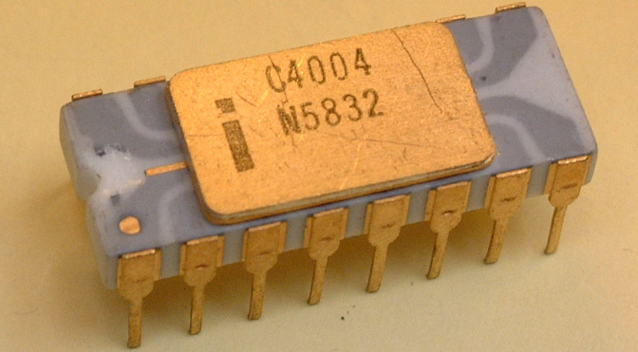
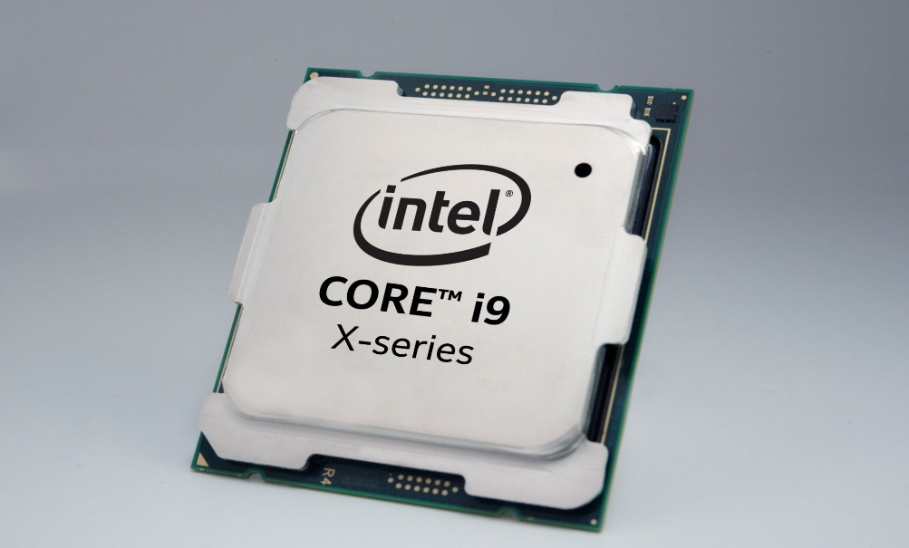
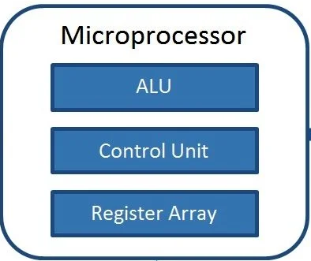
CPU
Intel 4004, the first CPU, is 40 years old today (November 15, 1971)
A 4-bit, 16-pin microprocessor that operated at 740KHz — and at roughly eight clock cycles per instruction cycle (fetch, decode, execute), that means the chip was capable of executing up to 92,600 instructions per second. We can’t find the original list price, but one source indicates that it cost around $5 to manufacture. It had 2,300 transistors and a feature size of 10 micron (a micron is one-millionth of a meter)
A family of 64-bit x86 CPUs with up to 18 cores from Intel (introduced in 2017). Designed for high-performance computing and gaming, the 3.3 GHz i9 chip can be overclocked to 4.5 GHz.
It contains around 7 billion transistors using 14 nm technology. CPU can carry out 3000,000000 (three thousand million) instructions per second!
Major functional units of a CPU

Slide 15
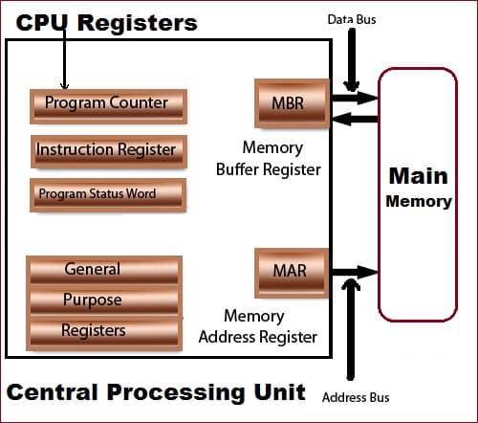
ALU: an arithmetic logic unit (ALU) is a combinational digital circuit that performs arithmetic and logical operations on binary numbers.
The control unit of the central processing unit regulates and integrates the operations of the computer. It selects and retrieves instructions from the main memory in proper sequence and interprets them so as to activate the other functional elements of the system at the appropriate moment.
Register Array: Registers are small amounts of high-speed electronic storage contained within the CPU. They are used by the processor to store small amounts of data that are needed during processing, such as: the address of the next instruction to be executed. the current instruction being decoded. Register array consists of registers identified by letters like B, C, D, E, H, L and accumulator.

Slide 16
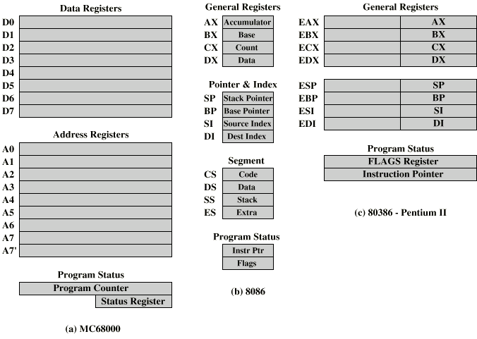

Slide 17
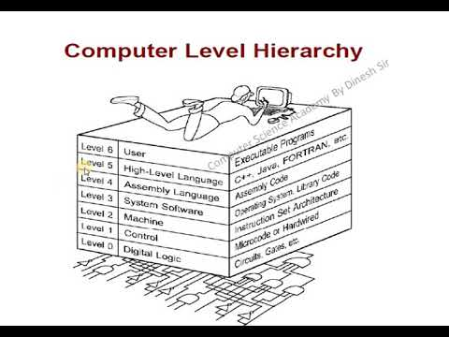
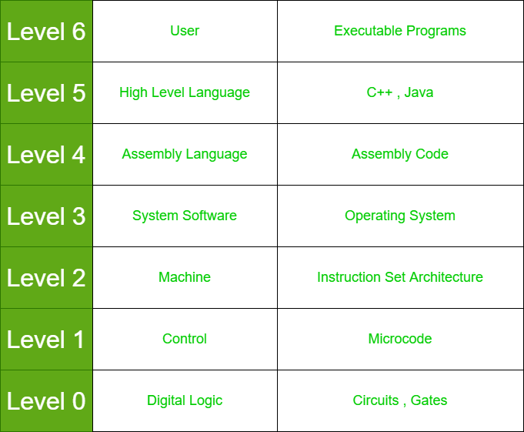

Slide 18
Computer Architecture: visible to programmer How do I design a computer?
Focuses on the structure: the way in which the components are interrelated
Computer architecture includes many elements such as
Instruction sets and formats
Operation codes
Data types & Data Representation
Register architecture with CPU
Addressing modes
Input/Output Mechanism
The architecture of a system directly affects the logical execution of programs.
The computer architecture for a given machine is the combination of its hardware components plus its instruction set architecture (ISA).
The ISA is the interface between all the software that runs on the machine and the hardware

Slide 19
Computer organization: How does a computer work?
Computer Organization refers to the level of abstraction above the digital logic level, but below the operating system level.
Encompasses all physical aspects of computer systems
Hardware details of the system
Circuit design
Control signals
Memory types & Technologies

Slide 20
A modern computer is an electronic, digital, general purpose computing machine.
At the most basic level, a computer consists of 3 pieces
A processor to interpret and execute programs
A memory ( Includes Cache, RAM, ROM) to store both data and program instructions
A mechanism for transferring data to and from the outside world.
I/O to communicate between computer and the world
Bus to move info from one computer component to another

Slide 21
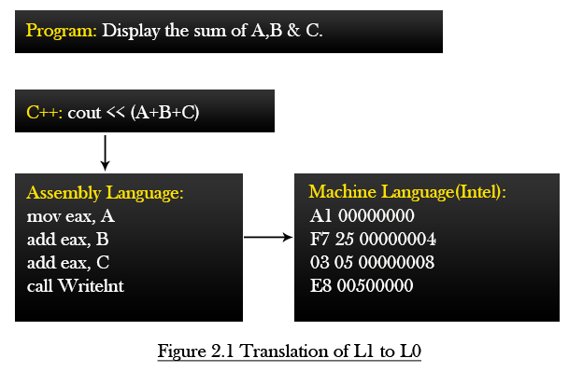
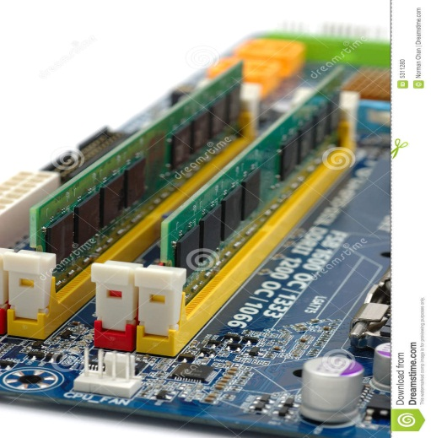
Levels of Program code
How the machine code is formed?
Machine code in binary
Stored in RAM
0101000001111111
1100000111100000
0101010100001111
1110000000111111
0101000001111111
1100000111100000
0101010100001111
1110000000111111

Slide 22
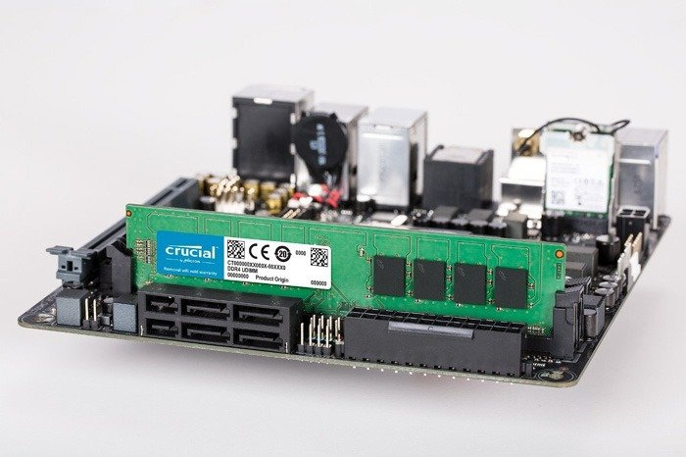
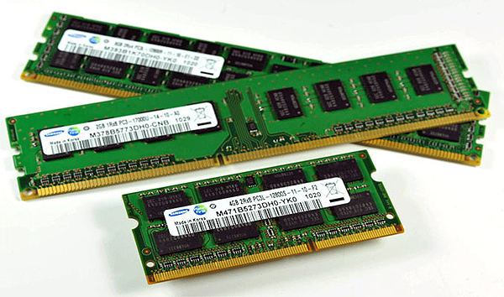
Main Memory: Semiconductor ICs
RAM(Random Access Memory)

Slide 23
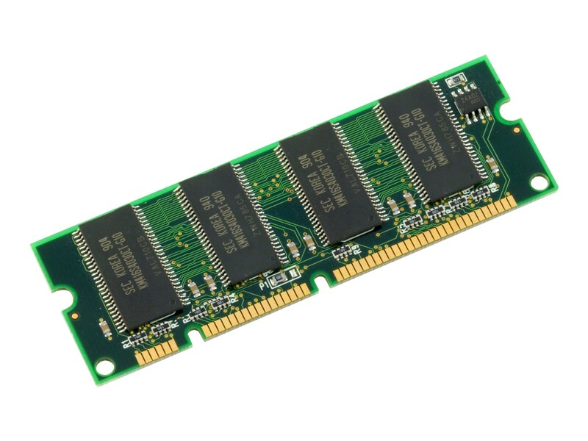
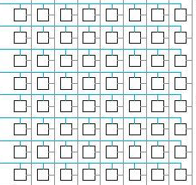
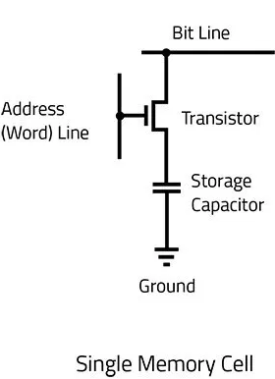
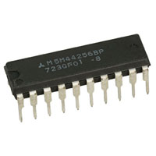
Module
Memory is an array of storage, each having capacity of 8 bits or so and holds program and data in binary format
User Program & Data
1
0
1
0
0
1
1
1
0101000001111111
1100000111100000
0101010100001111
1110000000111111
0101000001111111
1100000111100000
0101010100001111
1110000000111111
1
0
0
1
1
0
1
1
IC
Internal of Module/IC

Slide 24
Address in Binary
Address in HEX
Contents (Machine code & data)
Each row is uniquely identified by a number/code, starting from ‘0’, called Address, usually represented in Hexadecimal form and used in Assembly language programming
0H
1H
2H
3H
7H
0 | 0 | 0 | 0
0 | 0 | 0 | 1
0 | 0 | 1 | 0
0 | 0 | 1 | 1
0 | 1 | 1 | 1
1
0
0
0
1
1
1
0
0
1
0
0
0
1
1
1

Slide 25
Address in Binary
Address in HEX
Contents (Machine code or data)
If each location of memory contains 8 bits or 1 byte, then it is called
Byte-Addressable memory
0H
1H
2H
3H
7H
0 | 0 | 0 | 0
0 | 0 | 0 | 1
0 | 0 | 1 | 0
0 | 0 | 1 | 1
0 | 1 | 1 | 1
1
0
0
1
1
0
0
1
0
1
0
0
0
1
1
1
1
0
1
0
1
0
0
1

Slide 26
Capacity of Memory
Example: 1KB: Approximately 1 Thousand (exact value 1024) locations each having capacity of 8 bits/1Byte
Address starts at 0 and ends at 1 less than 1 Thousand, actually encoded in BINARY
In Binary, first address requires 1 bit (0) and final addressable location requires 10 bits (all 1’s: 11…11), since 2¹⁰ ⁼ 1K
For ease of Decoder design, uniform address format is used for all the locations; Maximum number of bits!
For convenience/ease of representation/programming/discussion, Hexadecimal number system is used to represent Memory address

Slide 27
Address of Memory (for 1KB)
Address (20 bits in binary) | Content (8 bits)
1111111111B | 11001100 (machine code/data)
…
0000000000B | 00110101(machine code/data)
Address (3 digits in hexadecimal) | Content(8 bits)
3FFH | 11001100 (machine code/data)
000H | 00110101(machine code/data)

Slide 28
Capacity of Memory
Example: 1MB: Approximately 1 Million (exact value 1024 x 1024) locations each having capacity of 1Byte
Address starts at 0 and ends at 1 less than 1 Million, actually encoded in BINARY
In Binary, first address requires 1 bit (0) and final addressable location requires 20 bits (all 1’s: 11…11), since 2²⁰ ⁼ 1M
For ease of Decoder design, uniform address format is used for all the locations; Maximum number of bits!
For convenience/ease of representation/programming/discussion, Hexadecimal number system is used to represent Memory address

Slide 29
Address of Memory (for 1MB)
Address (20 bits in binary) | Content (8 bits)
11111111111111111111B | 11001100 (machine code/data)
…
00000000000000000000B | 00110101(machine code/data)
Address (5 digits in hexadecimal) | Content(8 bits)
FFFFFH | 11001100 (machine code/data)
00000H | 00110101(machine code/data)

Slide 30
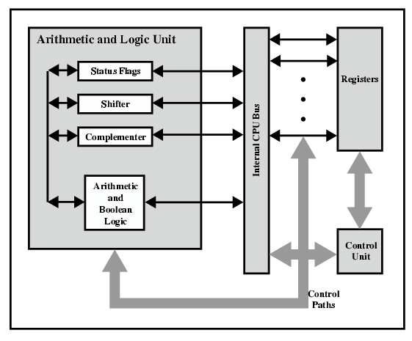
Internal Architecture of CPU
Register is an electronic storage inside the CPU
Used to hold data/address RAM where program is stored
Number & size of registers vary from CPU to CPU
Size means how many bit can be stored in a register

Slide 31
Registers
Size: 4 bits/8 bits/16 bits/32 bits/64 bits/128 bits…
In modern processors: Register size and number both are increasing
Register types: General purpose & special purpose
Must know register architecture for Assembly Language Programming
Since registers are few in numbers, they are addressed by Names in Assembly language Programs
Naming depends on processor series, usually upper case one/two/three letters are used. Example: A, AX, EAX etc

Slide 32
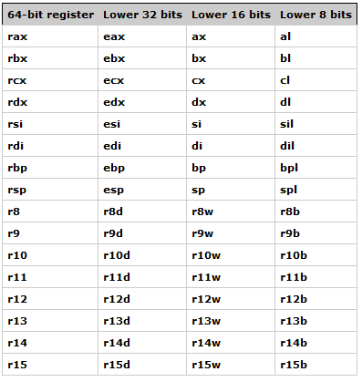
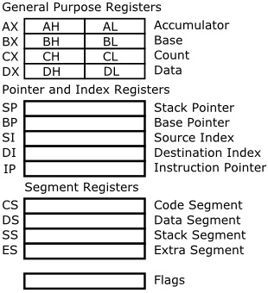
8086 (1978)
Core i7(2009)

Slide 33
Types of Registers
General purpose: Holds data to be used in ALU. Also holds partial results or final results generated by ALU.
Special Purpose:
Holds address of main memory locations where instructions are loaded by Operating system.
Holds address of main memory locations where data are stored
Holds address of main memory locations used for special purposes
Holds machine code of Instructions
Holds status of CPU

Slide 34
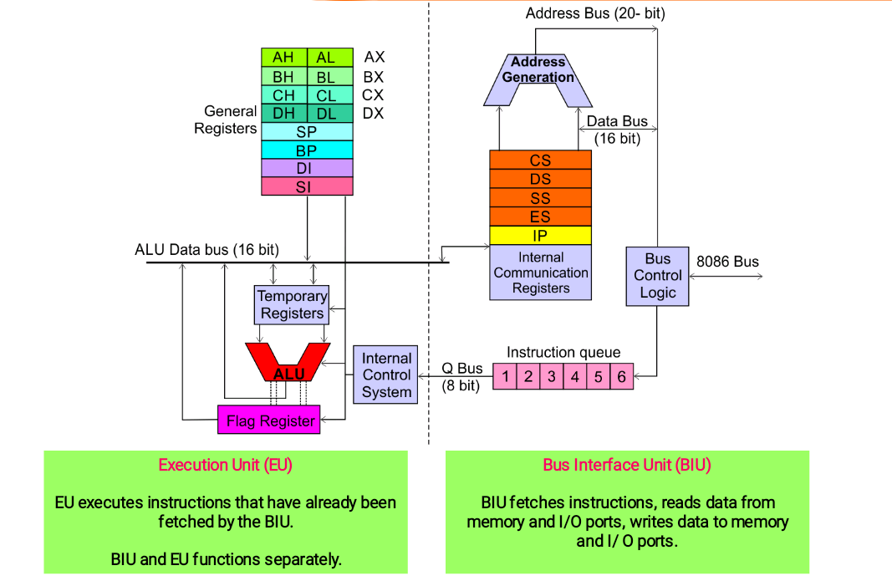
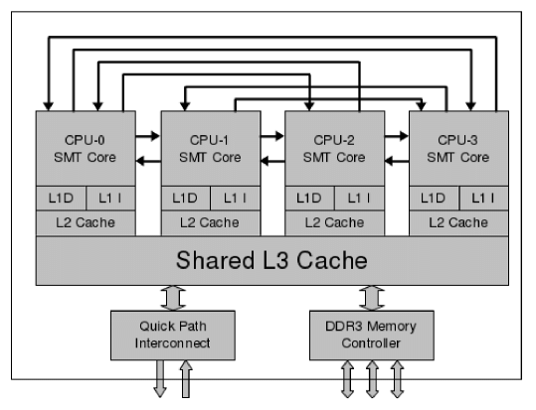
Intel Core i7 Processor
Intel 8086

Slide 35
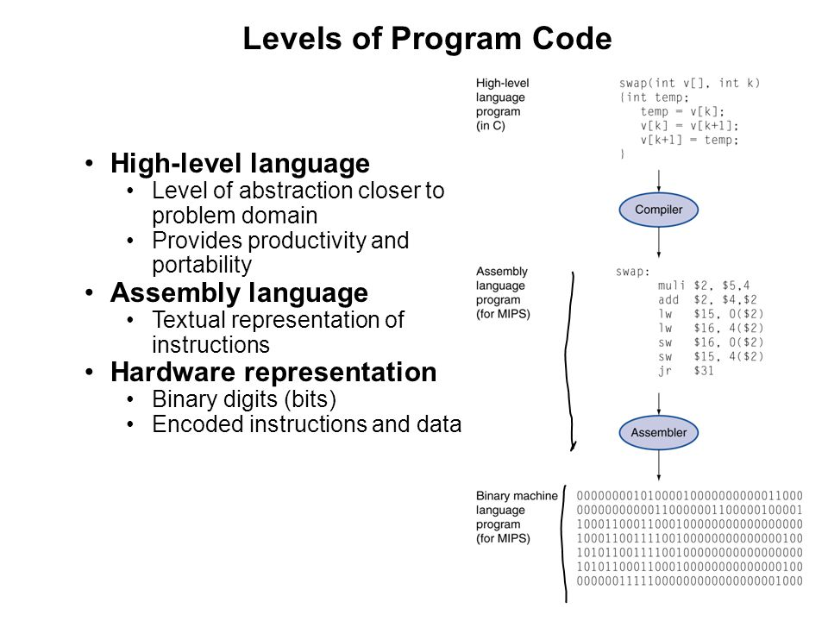

Slide 36
Levels of Program code
How the instructions are designed?
How the machine codes are formed?
Machine code in binary
Stored in RAM
0101000001111111
1100000111100000
0101010100001111
1110000000111111
0101000001111111
1100000111100000
0101010100001111
1110000000111111

Slide 37
Two key benefits of assembly language programming
– It takes up less memory
– It executes much faster
Assembly language is good for controlling hardware devices

Slide 38
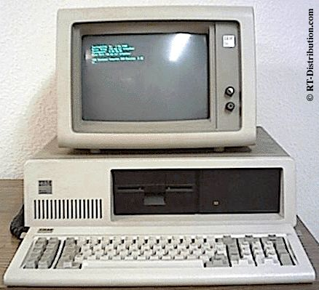
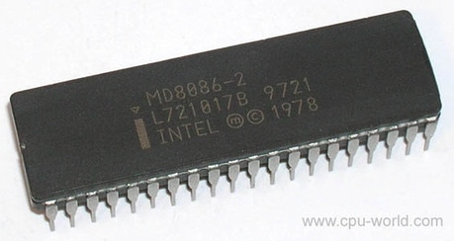
Program and Instructions
The sequence of commands used to tell a microcomputer what to do is called a program,
Each command in a program is called an instruction
8086 understands and performs operations for 117 basic instructions
IBM 5150, 8086 Processor 4,77 MHz, 640KB RAM, 10MB Hard Disk, 5,25" Floppy (August 12, 1981)

Slide 39
Instruction—An operation performed by the CPU and assigned a specific number
Instruction set—The list of CPU instructions for the operations

Slide 40
The 8086 microprocessor supports 8 types of instructions −
Data Transfer Instructions
Arithmetic Instructions
Bit Manipulation Instructions
String Instructions
Program Execution Transfer Instructions (Branch & Loop Instructions)
Processor Control Instructions
Iteration Control Instructions
Interrupt Instructions

Slide 41
Instruction format
OPCODE
Example: STD ; clear direction flag bit
OPCODE
OPERAND
Example: NOT AX ; complement content of AX
OPCODE
OPERAND-1
OPERAND-2
Example: MOV AX, BX; copy the contents of BX into AX

Slide 42
Instruction format
Instructions having only opcodes, everything is indicated within.
Some instructions may require only one operand
To reduce the size of instructions, only one operand is indicated in instructions whereas a default register/memory location is used for other operand.
Example: MUL BX ; AX holds other operand
PUSH AX; contents of AX is copied into memory location within Stack segment.

Slide 43

Machine Codes
An instruction can be coded with 1 to 6 bytes
Byte 1 contains three kinds of information
– Opcode field (6 bits) specifies the operation (add, subtract, move)
– Register Direction Bit (D bit) Tells the register operand in REG field in byte 2 is source or destination operand
1: destination 0: source
-Data Size Bit (W bit) Specifies whether the operation will be performed on 8-bit or 16-bit data
0: 8 bits 1: 16 bits
15 ------- 10 | 9 | 8 | 7 ---- 6 | 5 ---- 3 | 2 ---- 0

Slide 44
Example: MOV BL, AL (machine code: 10001000 11000011) (Hexcode: 88 C8H)
1 0 0 0 1 0 | 0 | 0 | 1 1 | 0 0 0 | 0 1 1
Opcode = 100010 MOV data transfer
D = 0 AL is source operand
W = 0 8-bit data transfer
Therefore byte 1 is 10001000₂=88₁₆
MOD = 11 register mode
REG = 000 code for AL
R/M = 011 destination is BL
Therefore Byte 2 is 11000011₂=C3₁₆

Slide 45
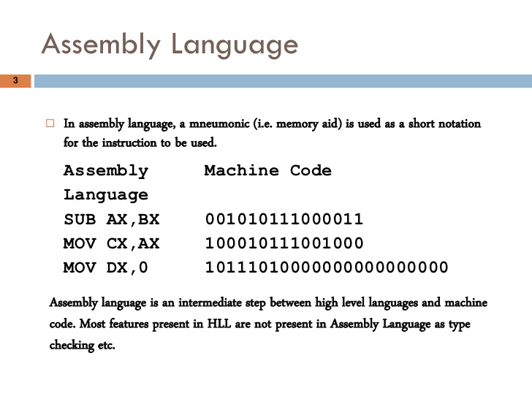
RAM(16 bits)
Address | Contents
1256H | 001010111000011
1257H | 100010111001000
RAM(8 bits)
Address | Contents
1256H | 11000011
1257H | 0010101
1258H | 11001000
1259H | 1000101

Slide 46
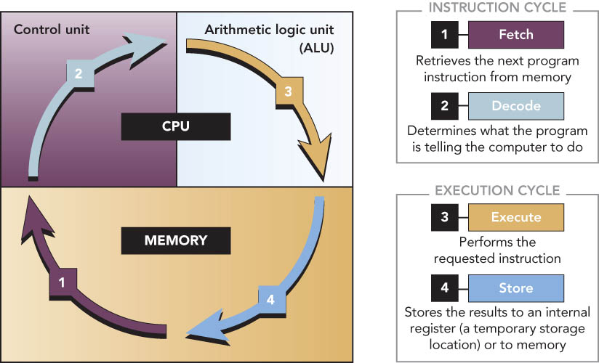

Slide 47
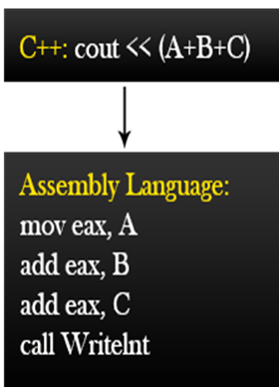
How a program & data are stored in Memory?
ADDRESS | CONTENTS
000100100101 (125H) | 11001101 (Machine code of Instruction-1)
000100100110 (126H) | 10001101 (Machine code of Instruction-2)
000100100111 (127H) | 11101101 (Machine code of Instruction-3)
000100101000 (128H) | 11011101 (Machine code of Instruction-4)
200H | 11000101 (DATA-1)
201H | 11000001 (DATA-2)
202H | 11000111 (DATA-3)
Machine codes
11001101
10001101
11101101
11011101
Stored in
RAM
Starting address of the program is set by operating system/user depending on system. Here starting address of memory (RAM) is chosen randomly as 125H.
Machine code of 1st Instruction is stored at 125H.
Following instructions are stored in consecutive locations of RAM.
Data, if used and if required to store in RAM, could be stored in a different segment but in consecutive locations of RAM

Slide 48
Accumulator-based
Accumulator is a special purpose register within CPU
Commonly indicated by AC
CPU uses this register in almost all instructions by default and it remains implicit (not written/indicated in instructions)
Results/partial results are also stored in AC by default
CPU
Accumulator
ALU
Control
Unit

Slide 49
Accumulator-based
Memory
CPU
ADDRESS | CONTENTS
200H | 11000101 (DATA)
201H | 11000001 (DATA)
202H | 11000111 (DATA)
Address
Bus
Accumulator(AC)
Data
Bus
ALU
Control
Unit
Control
Bus
Example: LOAD M1 ;M1= 200H
The content of memory location 200H is transferred/copied into AC

Slide 50
Accumulator-based
Memory
CPU
ADDRESS | CONTENTS
200H | 11000101 (DATA)
201H | 11000001 (DATA) 01101101
202H | 11000111 (DATA)
Address
Bus
Accumulator(AC)
01101101
Data
Bus
ALU
Control
Unit
Control
Bus
Example: STOR M2 ;M2 = 201H and [AC] = 01101101
Current content of AC is saved into RAM at 201H

Slide 51
General purpose
Memory
CPU
ADDRESS | CONTENTS
200H | 11000101 (DATA-1)
201H | 11000001 (DATA-2)
202H | 11000111 (DATA-3)
Address
Bus
AX
Data
Bus
ALU
Control
Unit
Control
Bus
Example: MOV AX, M1 ;M1= 200H
The content of memory location 200H is copied into AX register

Slide 52
General purpose
Memory
CPU
ADDRESS | CONTENTS
200H | 11000101 (DATA-1)
201H | 11000001 (DATA-2) 01101101
202H | 11000111 (DATA-3)
Address
Bus
AX
01101101
Data
Bus
ALU
Control
Unit
Control
Bus
MOV M2, AX ;M2 = 201H
; [AX] = 01101101

Slide 53
Computer Components
Memory
CPU
ADDRESS | CONTENTS
000100100101 (125H) | 11001101 (Machine code of Instruction-1)
000100100110 (126H) | 10001101 (Machine code of Instruction-2)
000100100111 (127H) | 11101101 (Machine code of Instruction-3)
000100101000 (128H) | 11011101 (Machine code of Instruction-4)
200H | 11000101 (DATA-1)
201H | 11000001 (DATA-1)
202H | 11000111 (DATA-1)
PC
MAR
Address
Bus
MDR
Register
File
Data
Bus
IR
ALU
Control
Unit
Control
Bus
PC-Program counter
MAR-Memory Address Register
IR-Instruction Register
MDR-Memory Data Register
Control Unit decodes Instructions & Generates control signals

Slide 54
How does computer work?
User program
SUB AX, BX ;001010111000011
MOV CX, AX ;100010111001000
MOV DX, 0
CPU
Stored in RAM(16 bits)
Address
Bus
PC
MAR
Address | Contents
0001001001010110 (1256H) | 001010111000011
0001001001010111 (1257H) | 100010111001000
Data
Bus
MDR
Register
File
IR
ALU
Control
Unit
Control
Bus

Slide 55
STEP-1: PC is loaded with address of 1st instruction of program
User program
SUB AX, BX ;001010111000011
MOV CX, AX ;100010111001000
MOV DX, 0
CPU
RAM(16 bits)
Address
Bus
PC 1256H
MAR
Address | Contents
1256H | 001010111000011
1257H | 100010111001000
1258H
Data
Bus
MDR
Register
File
IR
ALU
Control
Unit
Control
Bus

Slide 56
STEP-2: content of PC is loaded into MAR
User program
SUB AX, BX
MOV CX, AX
MOV DX, 0
CPU
RAM(16 bits)
Address
Bus
PC 1256H
MAR 1256
Address | Contents
1256H | 001010111000011
1257H | 100010111001000
1258H | 100111111001011
Data
Bus
MDR
Register
File
IR
ALU
Control
Unit
Control
Bus

Slide 57
STEP-3: content of MAR is placed on Address bus and applied to Memory, as a result memory location 1256H is selected
User program
SUB AX, BX
MOV CX, AX
MOV DX, 0
CPU
RAM(16 bits)
Address
Bus 1256H
PC 1256H
MAR 1256H
Address | Contents
1256H | 001010111000011
1257H | 100010111001000
1258H | 100111111001011
Data
Bus
MDR
Register
File
IR
ALU
Control
Unit
Control
Bus

Slide 58
STEP-4: Control unit send READ control signal to RAM, as a result machine code of 1st instruction is available on Data Bus
User program
SUB AX, BX
MOV CX, AX
MOV DX, 0
CPU
RAM(16 bits)
Address
Bus 1256H
PC 1256H
MAR 1256H
Address | Contents
1256H | 001010111000011
1257H | 100010111001000
1258H | 100111111001011
MDR
Data
Bus
001010111000011
Register
File
IR
ALU
Control
Unit
Control
Bus READ

Slide 59
STEP-5: Machine code of 1st instruction is loaded into IR
User program
SUB AX, BX ;001010111000011
MOV CX, AX ;100010111001000
MOV DX, 0
CPU
RAM(16 bits)
Address
Bus 1256H
PC 1256H
MAR 1256H
Address | Contents
1256H | 001010111000011
1257H | 100010111001000
1258H | 100111111001011
MDR
Register
File
Data
Bus
IR 001010111000011
ALU
Control
Unit
Control
Bus READ

Slide 60
STEP-6: PC is incremented by 1 to point next instruction to be executed. Contents of IR is fed to Control Unit
User program
SUB AX, BX
MOV CX, AX
MOV DX, 0
CPU
RAM(16 bits)
Address
Bus
PC 1257H
MAR
Address | Contents
1256H | 001010111000011
1257H | 100010111001000
1258H | 100111111001011
Data
Bus
MDR
Register
File
IR
Control
Unit
001010111000011
ALU
Control
Bus

Slide 61
STEP-7: 1st instruction is decoded at control unit: control signals are generated to activate ALU for specific operation as per instruction
User program
SUB AX, BX
MOV CX, AX
MOV DX, 0
CPU
RAM(16 bits)
Address
Bus
PC 1257H
MAR
Address | Contents
1256H | 001010111000011
1257H | 100010111001000
1258H | 100111111001011
Data
Bus
MDR
Register
File
IR
Control
Unit
001010111000011
ALU
Control
Bus

Slide 62
STEP-8: 1st instruction is Executed (that includes Data read from RAM followed by ALU operation, result stored as per instruction)
User program
SUB AX, BX
MOV CX, AX
MOV DX, 0
CPU
RAM(16 bits)
Address
Bus
PC 1257H
MAR
Address | Contents
1256H | 001010111000011
1257H | 100010111001000
1258H | 100111111001011
Data
Bus
MDR
Register
File
IR
Control
Unit
001010111000011
ALU
Control
Bus

Slide 63
STEPS-2:8 repeated for next instruction content of PC is loaded into MAR
User program
SUB AX, BX
MOV CX, AX
MOV DX, 0
CPU
RAM(16 bits)
Address
Bus
PC 1257H
MAR 1257H
Address | Contents
1256H | 001010111000011
1257H | 100010111001000
1258H | 100111111001011
Data
Bus
MDR
Register
File
IR
ALU
Control
Unit
Control
Bus

Slide 64
Instruction Set Design
# Types of Operations /Instructions and
Complete list of Instructions
# Mnemonics of Instructions or operations (Usually represented by assembly codes)
# Formats of Instructions (fields/subfields/size in binary bits/data format/memory address formats/addressing modes etc)
# Machine Codes in Binary
Notes:
2

Slide 65
Instruction Set Architecture
How many instructions and types of instructions processors can understand/decode/process/execute
How to perform any operation: Accumulator based or General?
Instruction Format?
Number of binary bits used to form Instructions
Same number of bits for all instructions or not?
How arithmetic/logical/data processing/data transfer operations are encoded in instructions
How data/main memory address/register names are indicated in instructions
Data types/formats/number of bits used/positive/negative numbers/ranges of numbers etc
Memory: Address format/addressing scheme/content of each addressable locations etc

Slide 66
Instruction Set Architecture

Slide 67
Instruction Formats (3-operand fields)
ADD M, D1, D2
[M] D1+ D2
Binary code for ALU operation (Op Code) | Memory address to store result (Binary) | Data -1 (Binary) | Data-2 (Binary)
ADD M1, M2, M3
[M1] [M2]+ [M3]
Binary code for ALU operation (Op Code) | Memory address to store result (Binary) | Memory address of Data -1 (Binary) | Memory address of Data-2 (Binary)
ADD R1, R2, R3
R1 R2+ R3
Binary code for ALU operation (Op Code) | CPU Register to store result (Binary) | CPU register containing Data -1 (Binary) | CPU register containing Data -1 (Binary)

Slide 68
Instruction Formats(2-operand field)
ADD M1, M2
[M1] [M1]+ [M2]
Binary code for ALU operation (Op Code) | CPU register or memory address that contains Data-1 (Binary) Result is stored in same CPU register or memory address after operation | CPU register or memory address that contains Data-2 (Binary)
ADD R1, R2
R1 R1 + R2
ADD M, R1
[M] R1 + [M]

Slide 69
Instruction Formats(one-operand field)
ADD M
AC [M] + AC
Binary code for ALU operation (Op Code) | CPU register or memory address that contains Data-2 (Binary)
Here Data-1 should be loaded into a predefined register, namely Accumulator (AC) prior to use this instruction. Moreover, the result is stored into Accumulator (AC) as well. Interestingly, the Accumulator (AC) is not explicitly indicated in the Instruction sub-field!
ADD R1
AC R1 + AC

Slide 70
Instruction Formats(Opcode only!)
CLC
Clear carry Flag bit
Binary code for ALU /special operation
Data to be used should be initially loaded into default CPU register. Result is also stored there as well.

Slide 71
Example: Opcode of Instructions
Operation | Mnemonic | Opcode
Addition | ADD | 001
Subtraction | SUB | 010
Data Transfer | MOV | 011
Load Accumulator | LOAD | 100
Multiply | MUL | 101
Read from Input device | READ | 110
Send to output device | STORE | 111

Slide 72
Format of an Instruction
OP CODE 4-BITS | OPERAND FIELD-1 4-BITS | OPERAND FIELD-2 4-BITS | OPERAND FIELD-3 4-BITS
OP CODE 4-BITS | OPERAND FIELD-1 4-BITS | OPERAND FIELD-2 4-BITS
OP CODE 8-BITS | OPERAND FIELD-1 16-BITS | OPERAND FIELD-2 16-BITS
Notes:
3

Slide 73
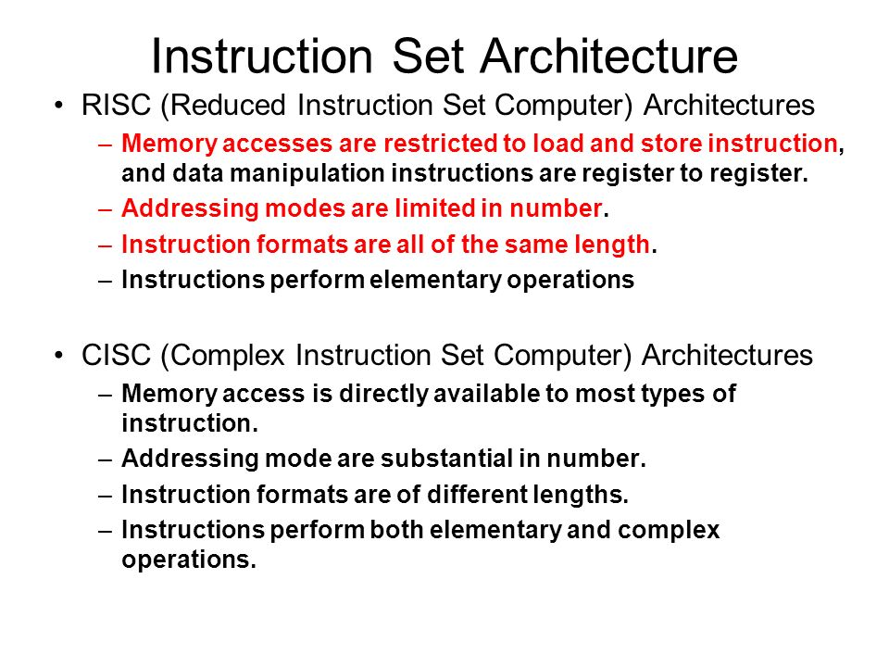

Slide 74
Sample questions
What do you understand by computer architecture?
What are the architectural attributes?
What are the main features of von Neumann architecture?
What is the concept of stored program computer?
What is computer organization?
What are the organizational attributes?
State/explain difference between computer architecture and organization.
What do you understand by Register and Register file? What do registers contain?
State the types of register. State the functions of Registers. What do you understand by size of Register?
What do you understand by Instruction and Instruction set and Instruction format?
State the classification of Processors based on instruction set architecture. Give examples. Also state relative merits and demerits.
What do you understand by machine code? Show general format of machine code/Instruction format.
What do you understand by main memory? Is it volatile or non volatile?
What do you understand by Random Access Memory? Why it is named so?
What do you understand by Memory address? How it is formed? How it is represented? Give examples.

Slide 75
Show the address formats of (i) 1KB, (ii) 1MB, (iii) 1K x 16 bits, 4K x 32 bits memory ICs.
What do memory locations contain? Give examples
What do you understand by Byte-addressable memory and Word-addressable memory? State differences, if any.
What do you understand by bus system? Discuss types, sizes of types and their impacts on performance of a computer.
Draw a simple schematic diagram of a computer and identify its main functional units.
Draw a simple schematic diagram of a CPU/Microprocessor and identify its main functional units.
List the steps usually followed by a general purpose processor to run a program.
List the steps usually followed by a general purpose processor to run a program.
List the steps usually followed by a general purpose processor to process a single instruction. Use suitable diagram.

Slide 76
What do you understand by Instruction fetch and Instruction Execution?
How does a CPU/Microprocessor run a program? Use a suitable schematic diagram and list the steps in chronological order.
What is program counter (pc)? What is Instruction register (IR)? Discuss the functions of each.
What do you understand by Port address? Why it is used?
Briefly explain Read / Write operation.
List the four main structural components of a computer and briefly state their functions.
Briefly describe IAS structure with a suitable diagram.
List the registers of IAS structure and state their functions.
Show the instruction and data format of IAS structure.
Briefly describe how IAS structure works?
List the steps how IAS structure runs a program?

Slide 77
Quiz-1(Summer-2020)
A program containing 2 Million instructions with the following instruction mix is run on a RISC machine having following CPI values:
Op Freq CPI
ALU 20% 2
Load 40% 6
Store 30% 5
Branch 10% 2
If the CPU runs at 200MHz, calculate the execution time of the program.
If a CPU design enhancement reduces the CPI of Load and Store instructions by 2 and 3 respectively. Calculate the resulting performance improvement from this enhancement using Amdahl’s law. Also calculate the execution time with enhancement.

Slide 78
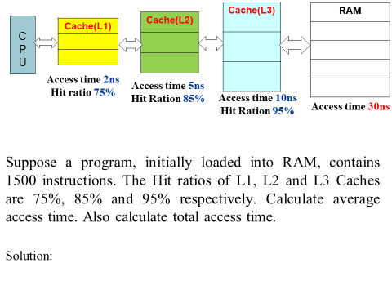
Quiz-2(Summer-2020)

