Slide 1
DRAM Memory Architectures

Slide 2
DRAM
A computer program is comprised of a set of instructions, and it manipulates data while it is being executed. The place where both instructions and data are loaded during program execution is main memory.
We have already seen that some of the most frequently used data are kept in cache to lower access time, but most of the memory addressing space used by a program usually is stored in main memory.

Slide 3
Almost every computer uses virtual memory, a technique that allows for an addressing space greater than the actual main memory capacity. When there is a request for memory allocation beyond main memory's boundaries, page swapping is used to temporarily send to the backing storage (usually disk) a set of memory pages that is not immediately needed and reclaim their space. When those pages are needed again, they are fetched from the backing storage in exchange of another set of pages, and so on. Since this is an expensive process, page swapping is avoided whenever possible.

Slide 4
Based on this understanding, we can devise some requirements for main memories:
1. They need to be big enough to hold most of the data needed by a program to execute (to avoid paying too often the performance price of page swapping).
2. They can be slower than caches, since the most frequently used data are already being cached.
3. Their cost/bit needs to be lower than caches, since they need more capacity.
The technology that best fits into this description today is Dynamic Random Access Memory (DRAM).

Slide 5
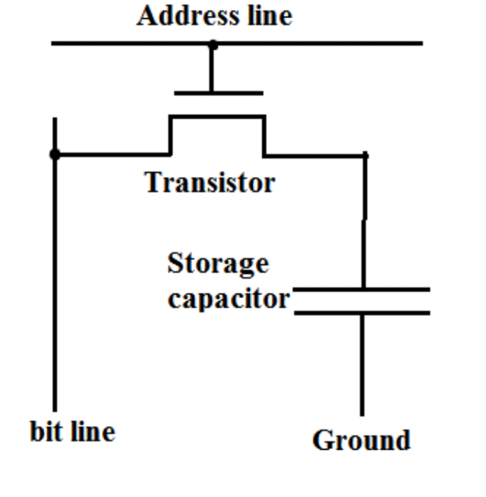
DRAM Basics: Internals, Operation
A random-access memory (RAM) that uses a single transistor-capacitor pair for each bit is called a dynamic random-access memory or DRAM. Figure shows the circuit for the storage cell in a DRAM. This circuit is dynamic because the capacitors storing electrons are not perfect devices, and their eventual leakage requires that, to retain information stored there, each capacitor in the DRAM must be periodically refreshed (i.e., read and rewritten).

Slide 6
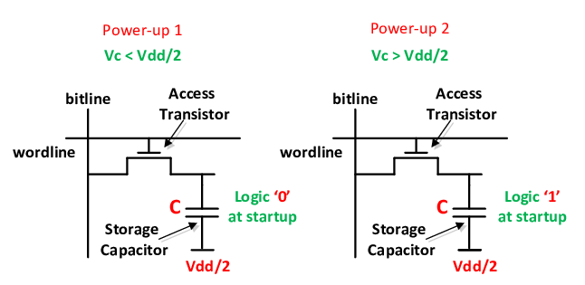

A typical DRAM cell has one transistor and one capacitor, as shown is Figure. It keeps its state in capacitor C. The transistor is used to provide access to the state. To read the state of the cell the access line Address Line is raised; this either causes a current to flow on the bit line or not, depending on the charge in the capacitor. To write to the cell the bit line is appropriately set and then Address Line is raised for a time long enough to charge or drain the capacitor. A DRAM cell is much simpler than a SRAM cell, allowing for greater memory density (being a smaller cell) and lower manufacturing cost.

Slide 7
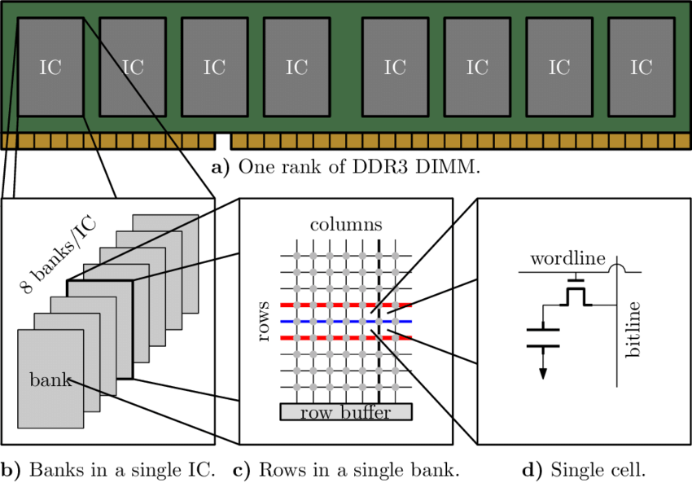

Slide 8
DRAM has a number of drawbacks:
In order to allow huge numbers of cells, the capacity of the capacitor must be low. It only takes a short time for the capacity to dissipate, which is known as current leakage.
In order to address this problem, DRAM cells must be refreshed frequently (every 64ms in most current DRAM devices).
This tiny charge also creates another issue: the information read from the cell is not immediately usable, since the data line must be connected to a sense amplifier which can distinguish between a stored 0 or 1.
Finally, the capacitor is discharged by read operations, so every read operation must be followed by an operation to recharge the capacitor. This requires time and energy.

Slide 9
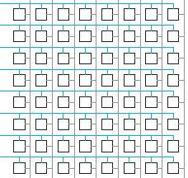
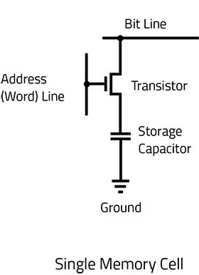
DRAM cells are grouped together in arrays, as shown in Figure. Each cell is at a cross-point of a row and a column. Both a row and a column need to be selected in order to read the content of that particular cell.

Slide 10
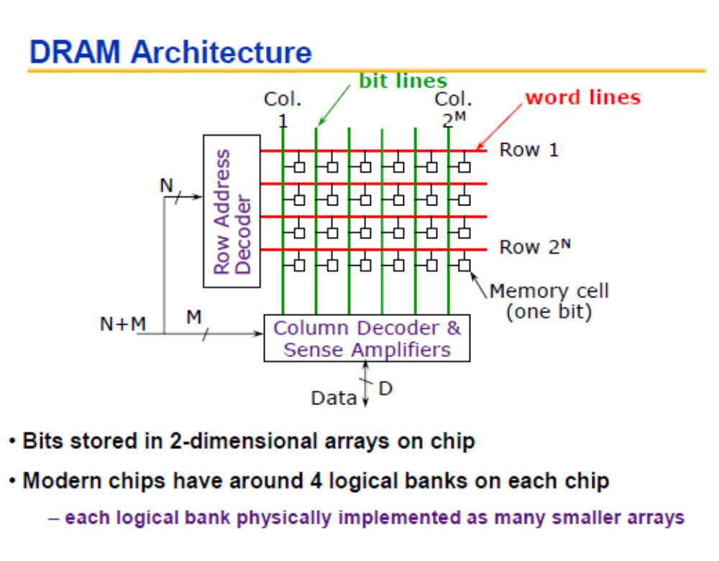

Slide 11

CPU
A0
A1
An-1
Read
Sense circuit/Amplifier
Write
An
Column decoder
An+p
D0
Dm-1

Slide 12
The essential characteristics of DRAM can be thus summarized: DRAM cells are simple, allowing high densities at a low cost/bit (when compared to SRAM).
DRAM is slower than SRAM, yet still fast.
Constant refreshes due to current leakage make DRAM power-consuming.

Slide 13
Several arrays are read at the same time to provide the contents of a memory word. This group of arrays ganged together are called banks.
Layer-0
Layer-1
Layer-2
Layer-3

Slide 14
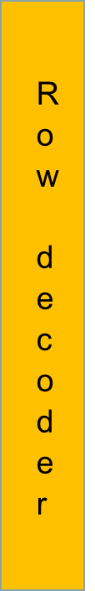
Several arrays are read at the same time to provide the contents of a memory word. This group of arrays ganged together are called banks.
C
P
U
Layer-0
Layer-1
Layer-2
Address lines
Address lines
Layer-3
For DRAM, Separate address lines for Row and Column
Row and Col addresses are applied simultaneously
Address lines
Address lines
Column Decoder
Data Lines

Slide 15
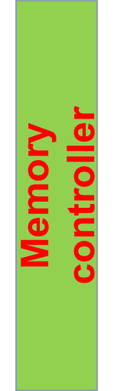


To reduce the size of DRAM IC, the number of address lines is reduced: Memory address pins are reduced to half the required number and multiplexed between row and column
RAS
C
P
U
Layer-0
Layer-1
Layer-2
Address lines
Layer-3
Address lines
Row Add
Col Add
Column Decoder
CAS

Slide 16
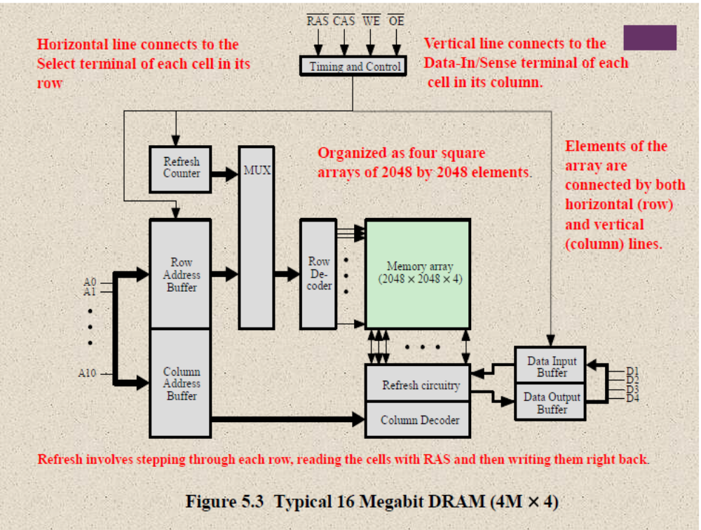

Slide 17
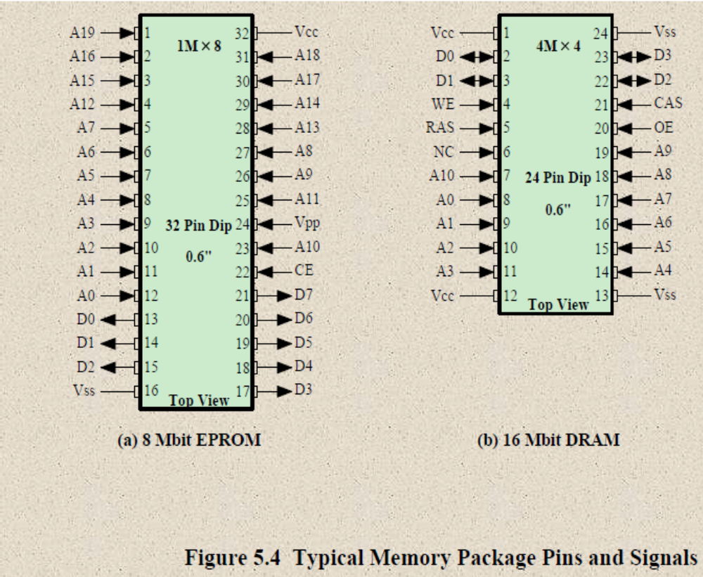

Slide 18
DRAM Architecture
DRAM chips are large, rectangular arrays of memory cells with support logic that is used for reading and writing data in the arrays, and refresh circuitry to maintain the integrity of stored data.
Memory Arrays
Memory arrays are arranged in rows and columns of memory cells called wordlines and bitlines, respectively. Each memory cell has a unique location or address defined by the intersection of a row and a column.
Memory Cells
A DRAM memory cell is a capacitor that is charged to produce a 1 or a 0. Over the years, several different structures have been used to create the memory cells on a chip. In today's technologies, trenches filled with dielectric material are used to create the capacitive storage element of the memory cell.

Slide 19
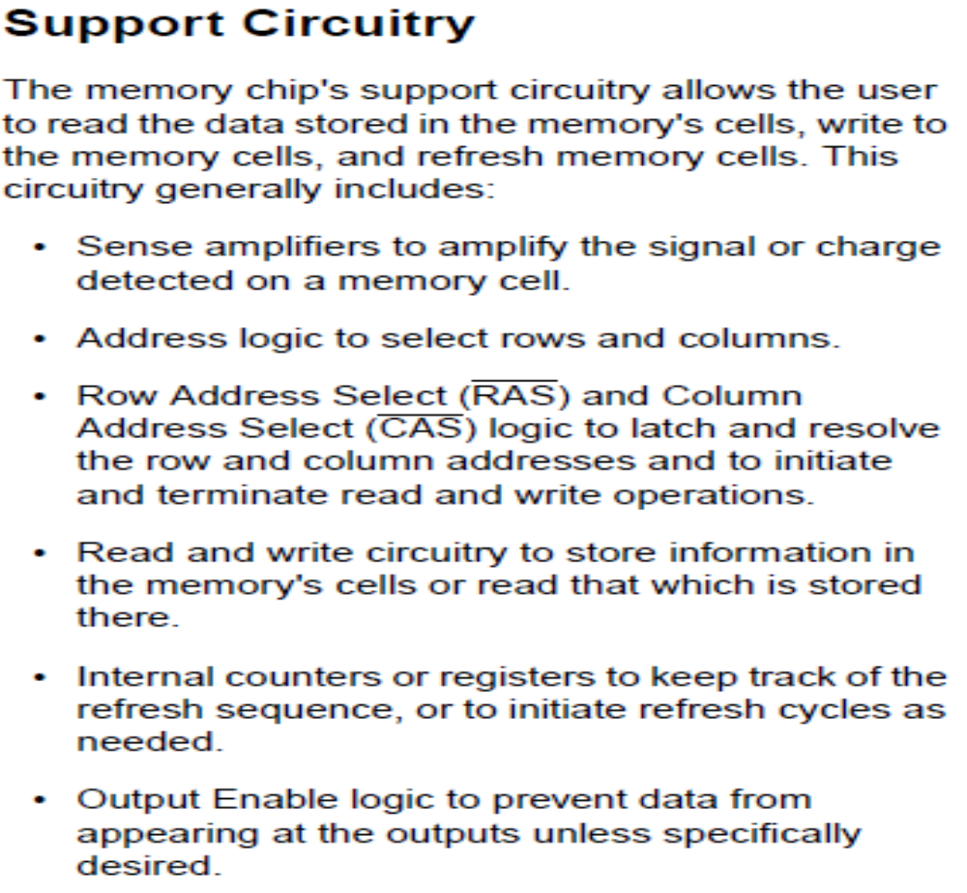

Slide 20
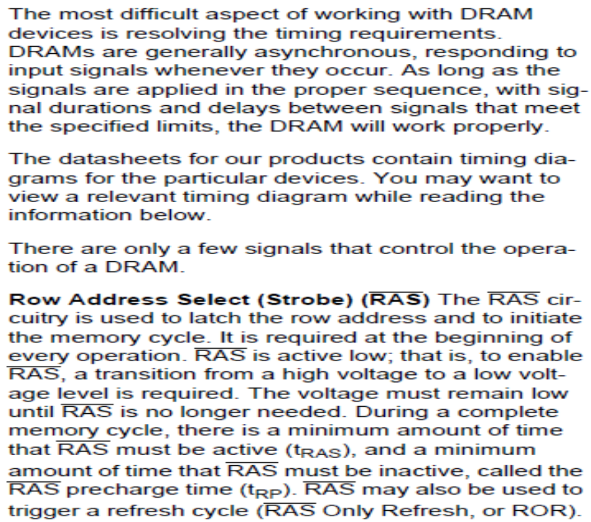
Timing diagram

Slide 21
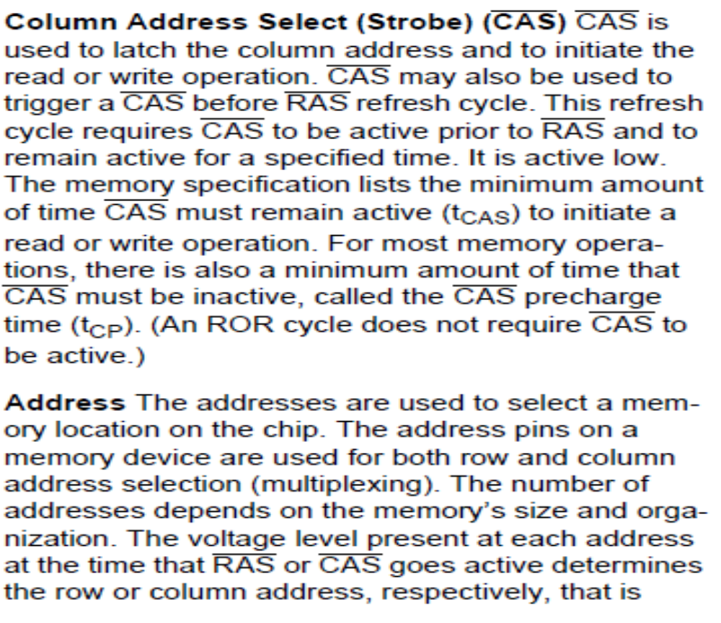
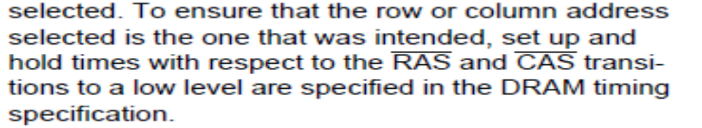

Slide 22
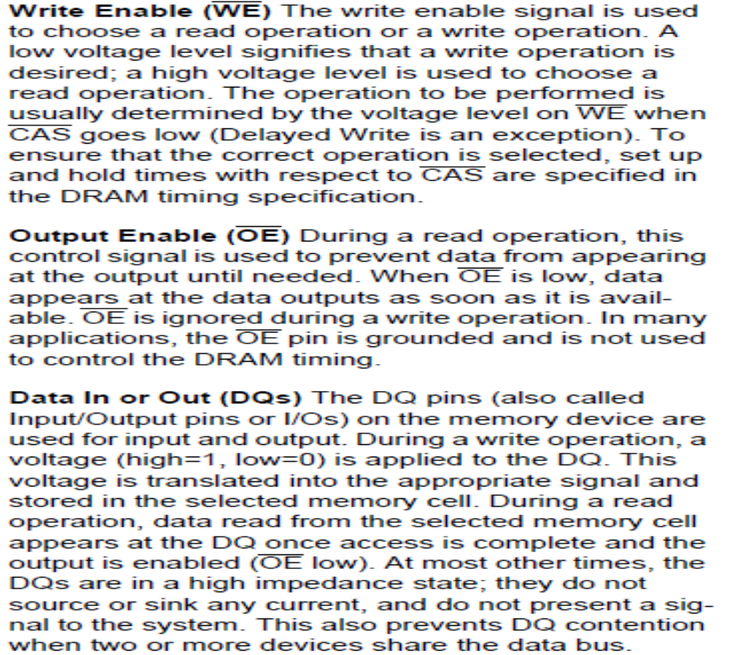

Slide 23
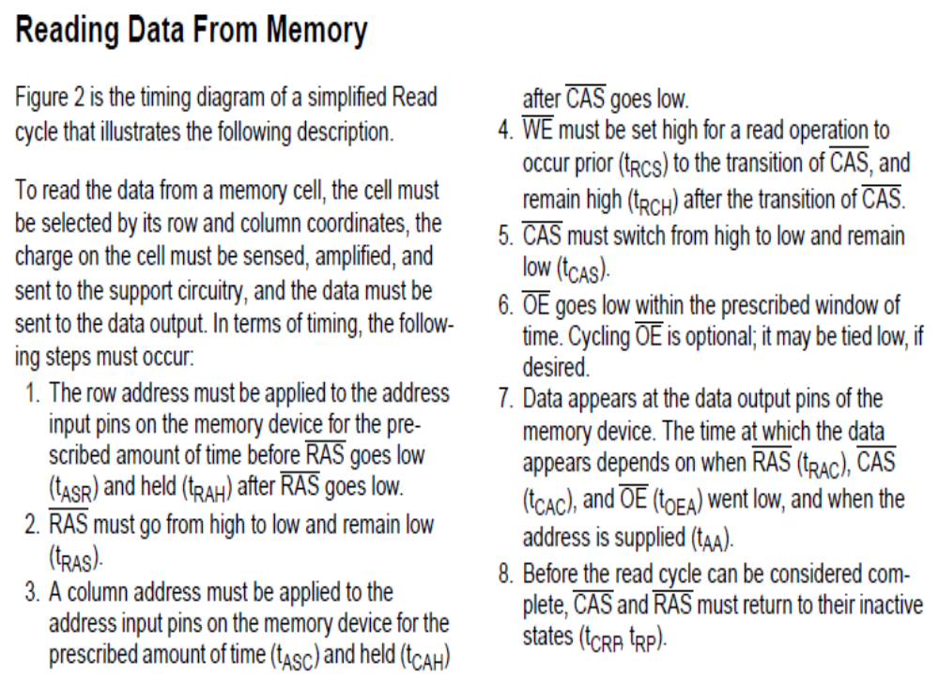

Slide 24
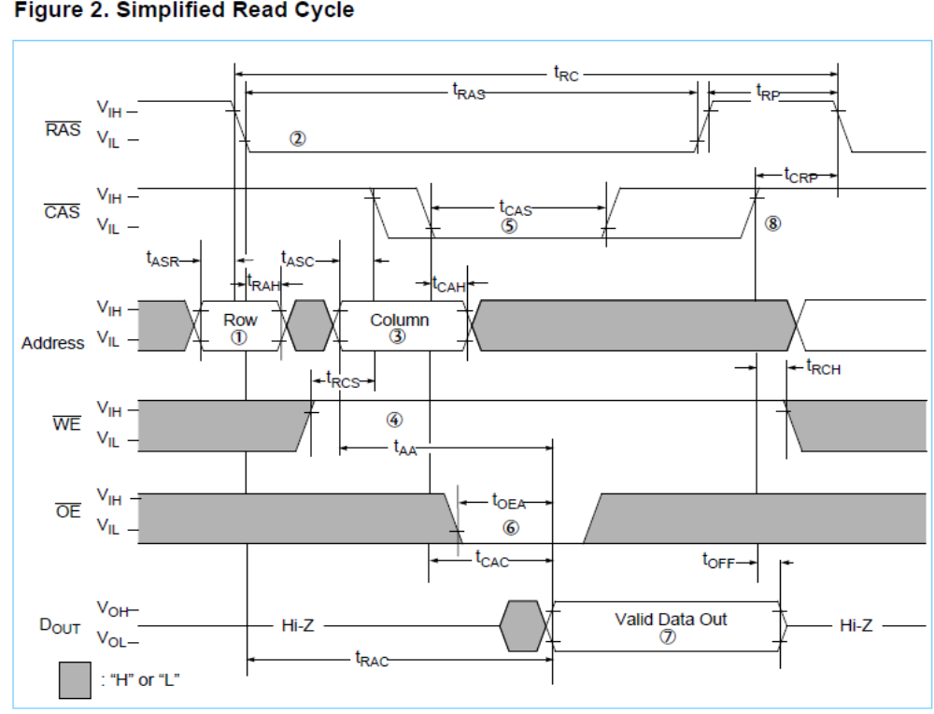

Slide 25
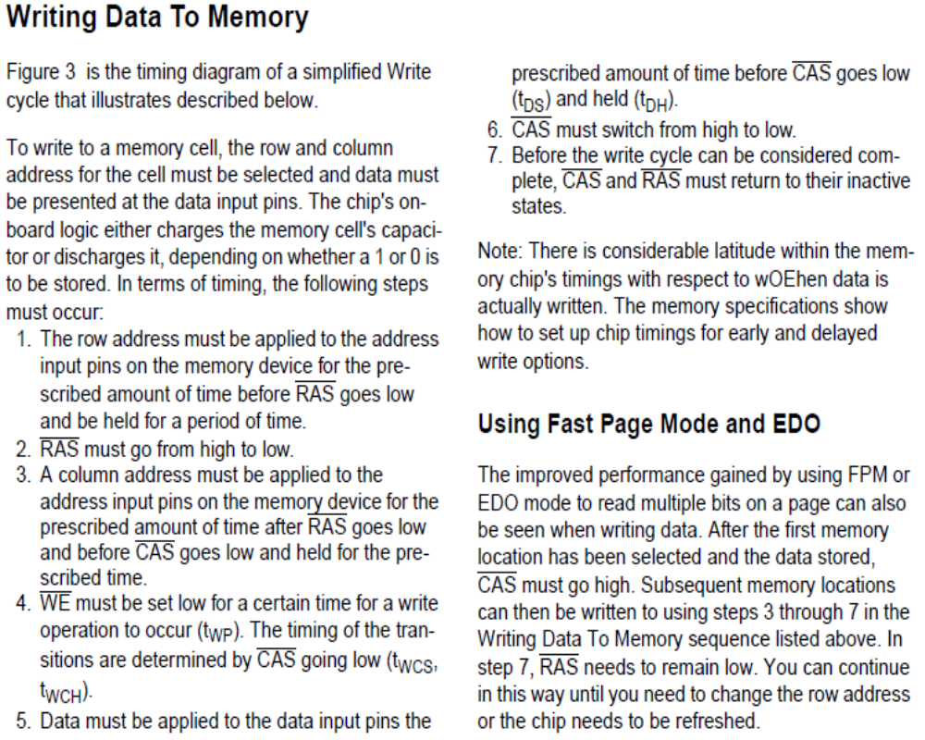

Slide 26
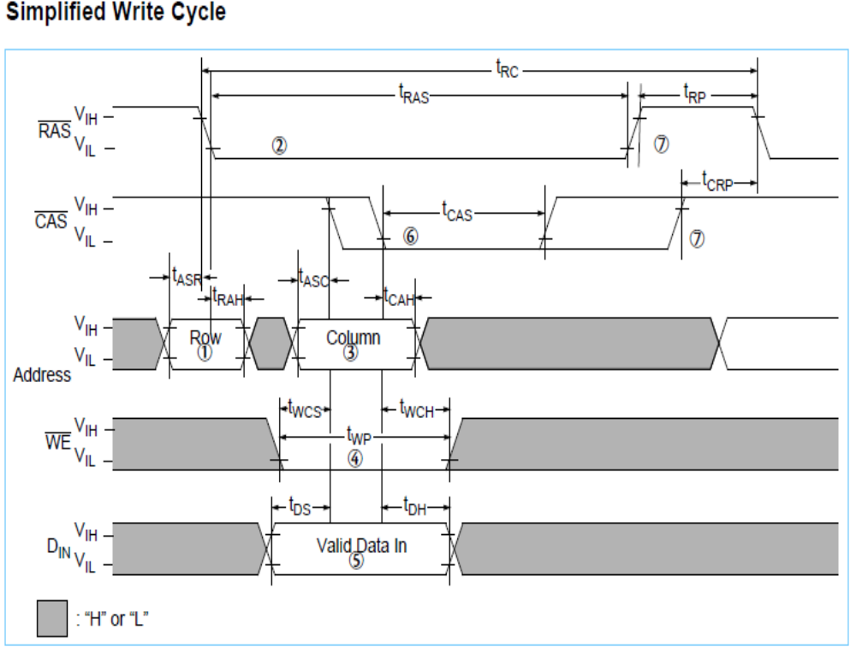

Slide 27
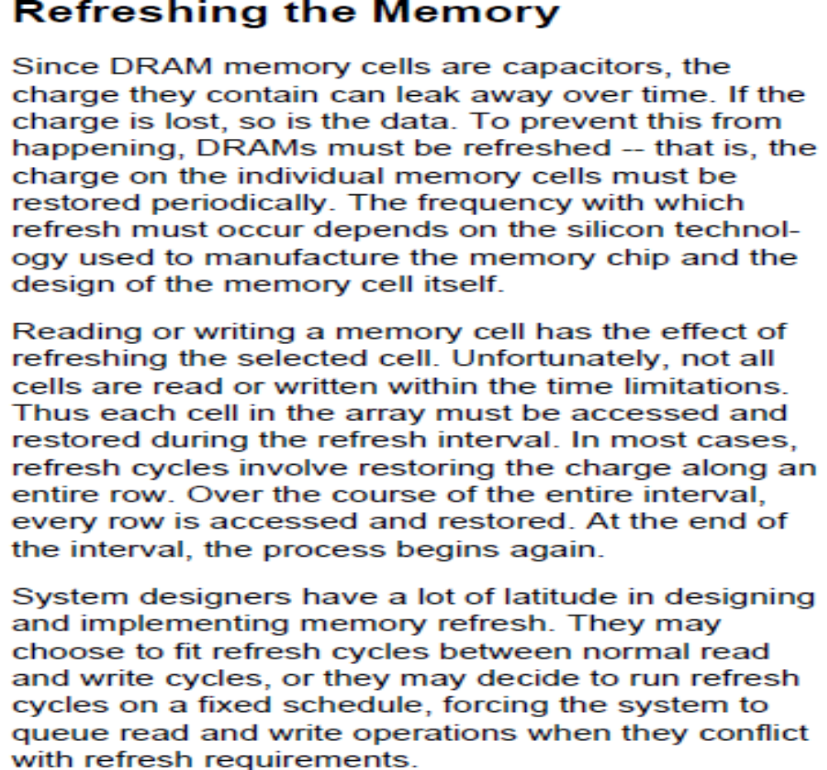

Slide 28
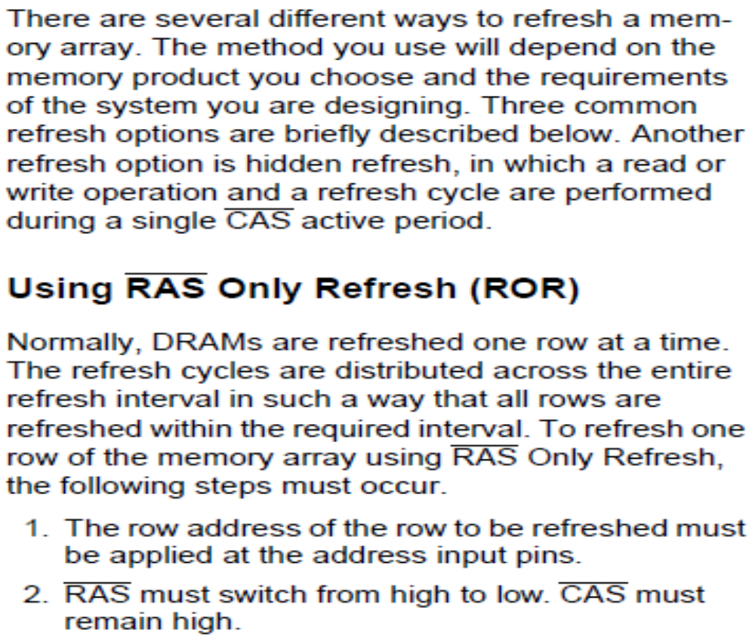
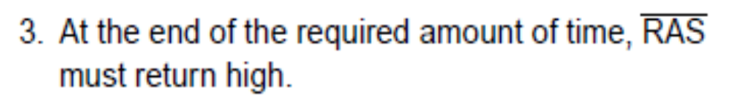

Slide 29
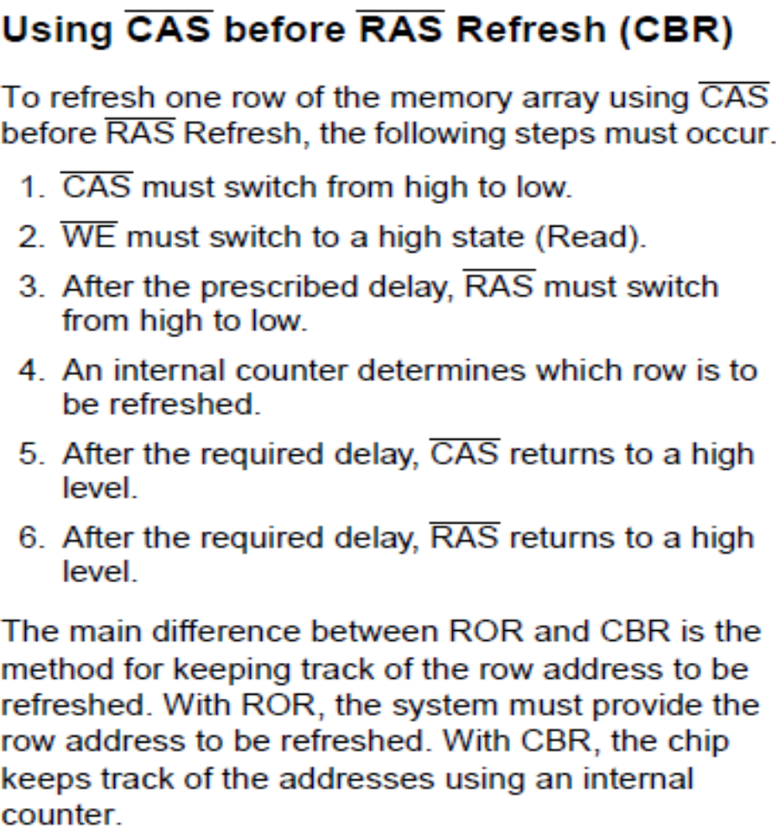

Slide 30
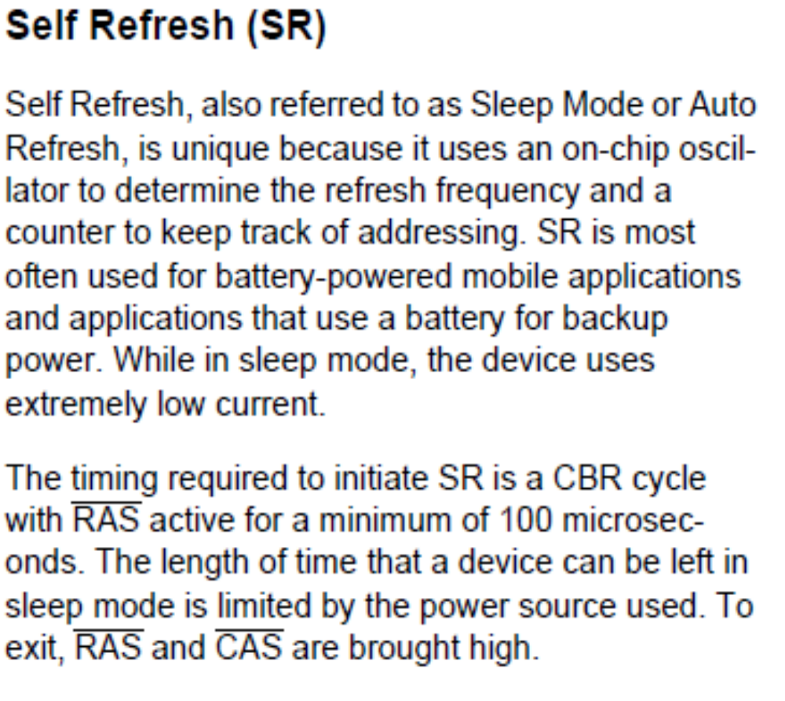

Slide 31
Several arrays are read at the same time to provide the contents of a memory word. This group of arrays ganged together are called banks. Banks are aggregated in hardware modules called Dual In-line Memory Modules (DIMMs). Each DIMM has one or two ranks of banks.
Figure: A dual in-line memory module (DIMM) with two ranks of nine banks each.

Slide 32
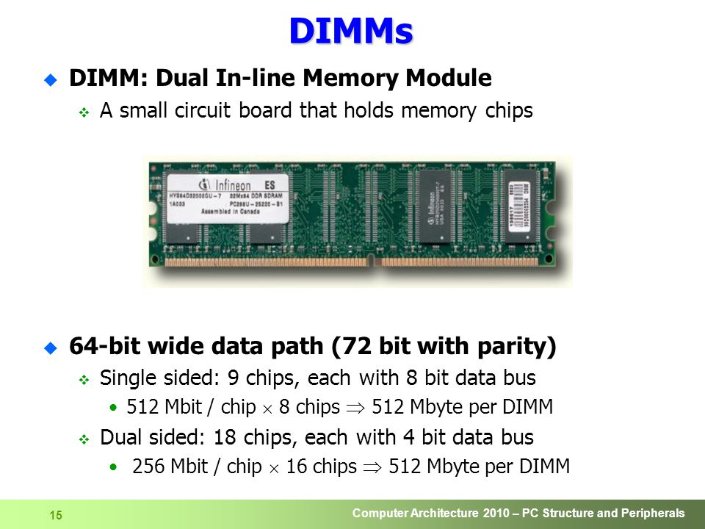

Slide 33
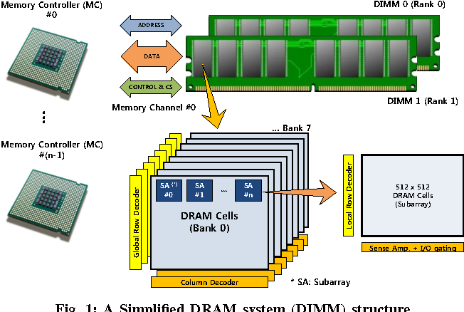

Slide 35
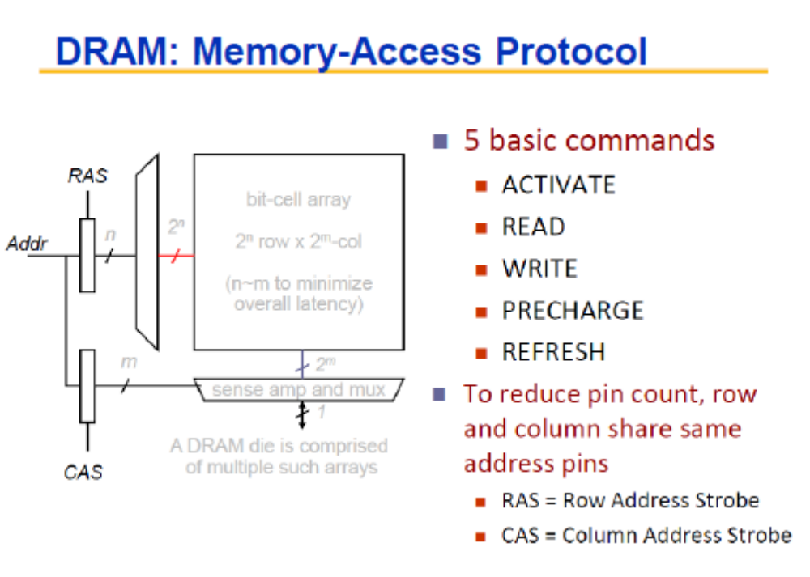

Slide 36
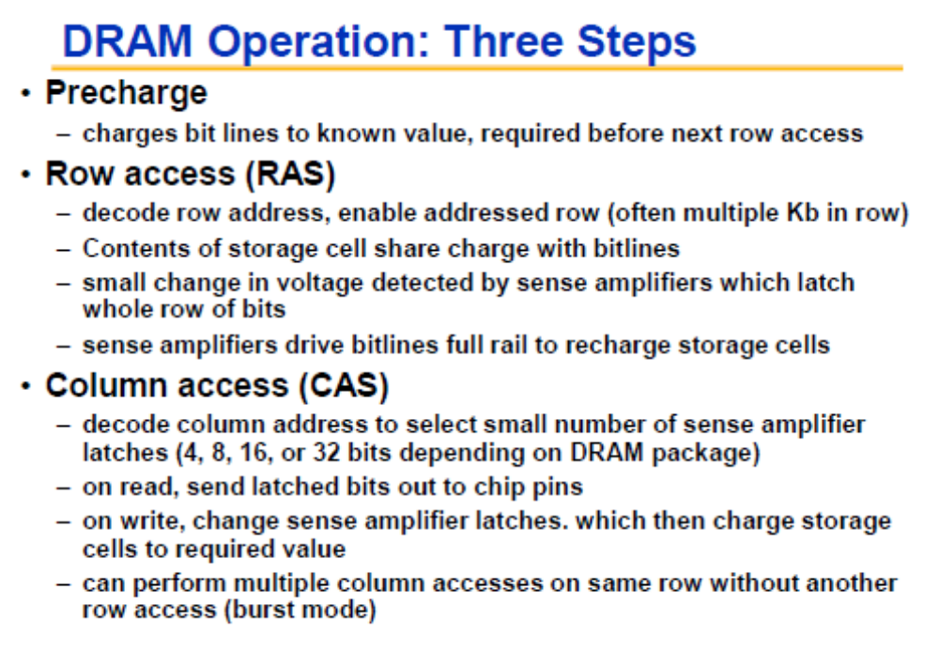

Slide 37
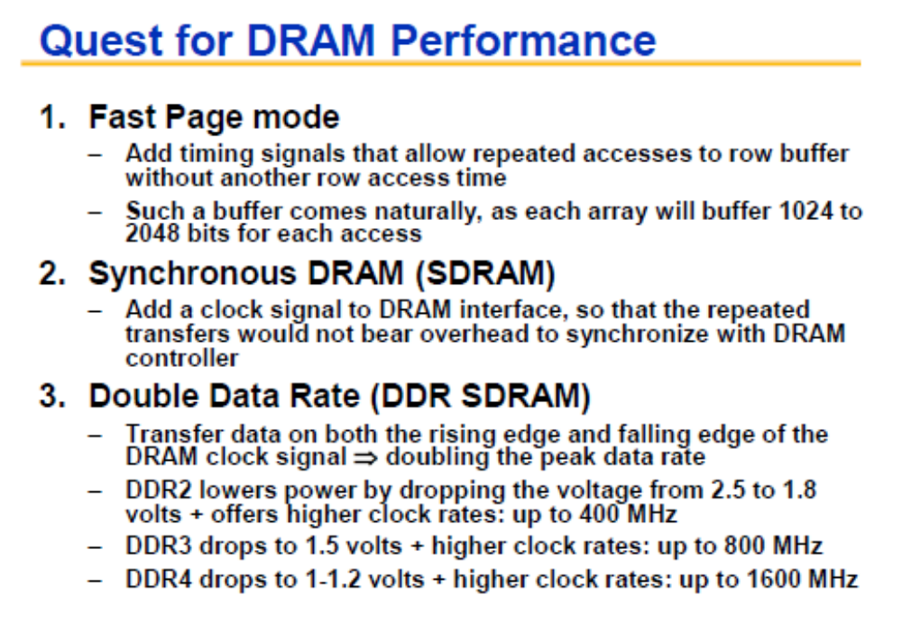

Slide 38
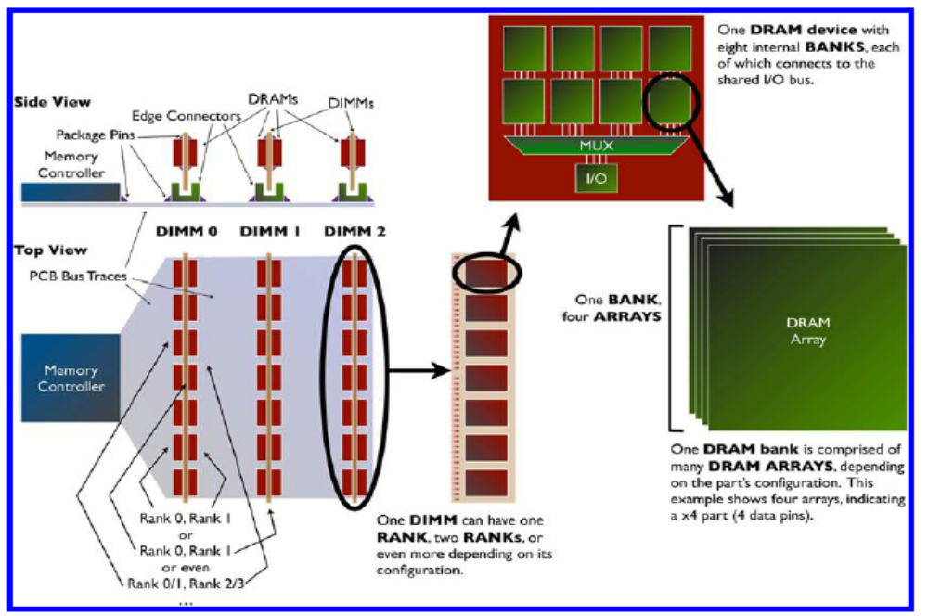
Figure 1.5: DIMMs, ranks, banks, and arrays. A system has potentially many DIMMs, each of which may contain one or more ranks. Each rank is a set of ganged DRAM devices, each of which has potentially many banks. Each bank has potentially many constituent arrays, depending on the parts data width.

Slide 39
Figure shows a detail of the DRAM system, illustrating the various levels of organization in a modern system. A system is comprised of potentially many independent DIMMs. Each DIMM may contain one or more independent ranks. Each rank is a set of DRAM devices that operate in unison, and internally each of these DRAM devices implements one or more independent banks. Finally, each bank is comprised of slaved memory arrays, where the number of arrays is equal to the data width of the DRAM part (i.e., a x4 part has four slaved arrays per bank).Having concurrency at the rank and bank level provides bandwidth through the ability to pipeline requests. Having multiple DRAMs acting in unison at the rank level, and multiple arrays acting in unison at the bank level, provides bandwidth in the form of parallel access.

Slide 40
Figure shows the detail of a DRAM device, corresponding of one or more DRAM arrays in Figure 1.5.Data is stored as charge or lack of charge on a capacitor; each DRAM device has billions of very small, but very powerful capacitors. Data is extracted from this array by first precharging the array (raising the potential on each bit line to a voltage halfway between a 0 and a 1), then selecting an entire row’s worth of data (called a row activation) by pulling one word line high (thereby turning on all of those pass transistors), then sensing the data on those bit lines and recovering the full 0/1 voltage values, and finally taking a subset of the sensed data and driving it out the I/O pins to the memory controller on the other side of the bus (called a column read ). Figure 1.7 shows the rough time delays relative to each other: a precharge places the bank in a voltage state that is suitable for activation, an activation reads an entire row of data bits (typically 8000 bits per DRAM device) into the sense amplifiers, and a column read or write transfers data to or from the memory controller. Usually precharge can be hidden to an extent by doing it as early as possible, even before the next request is known. A close-page operation is an explicit or implicit precharge that makes the bank ready for the next request (it is part of a following request but is usually done as soon as possible, even before the next request is known). A recharge operation is

Slide 41
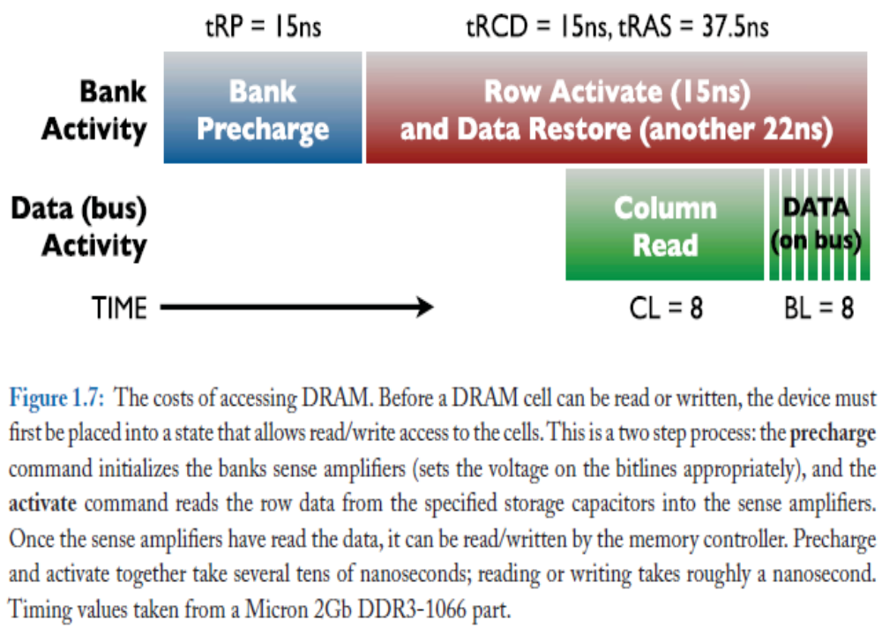

Slide 42
optional in some instances wherein multiple requests want to read or write data from the same large row, in which case it may make no sense to repeatedly open and close that row. Note that each of these operations (precharge, activate, column access) takes anywhere from a few nanoseconds to several tens of nanoseconds. Compare this to the handful of nanoseconds that it takes to transfer an entire burst of data bits over the bus, and it is easy to see why DRAM is considered a high-overhead technology: even for long data bursts (DDR3 is fixed at 8 beats of data for every read/write access), the cost of transferring the data is only a quarter of the total amount of time spent on the access. It should come as no surprise, then, that it takes significant effort to amortize the high access costs so that they do not become part of the visible access latency.

Slide 43
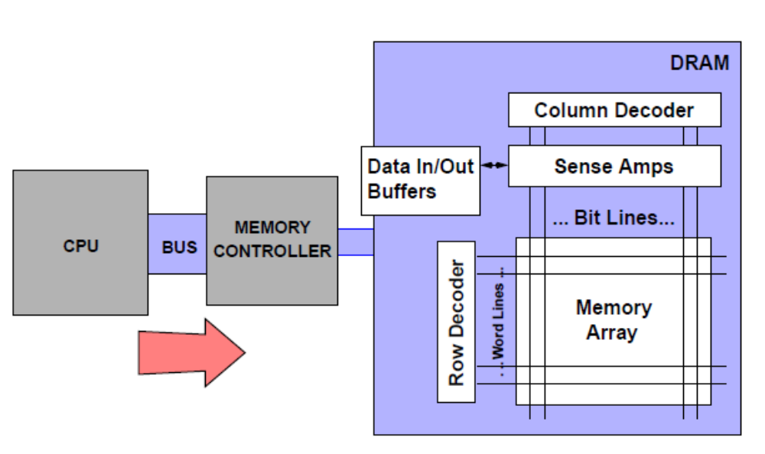
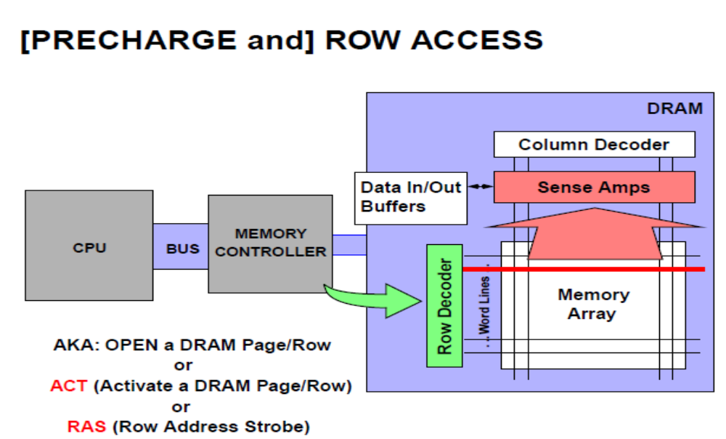

Slide 44
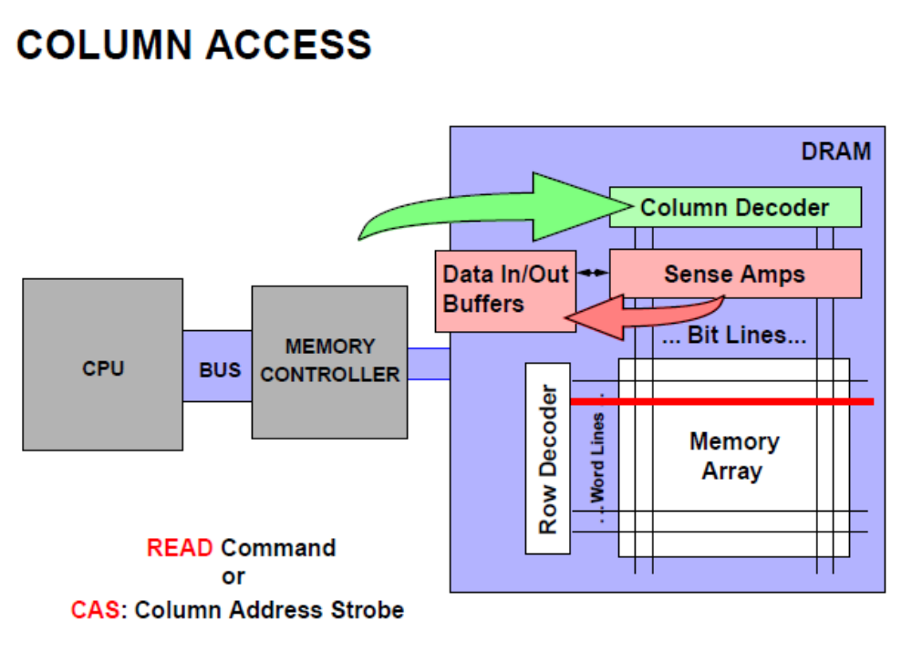
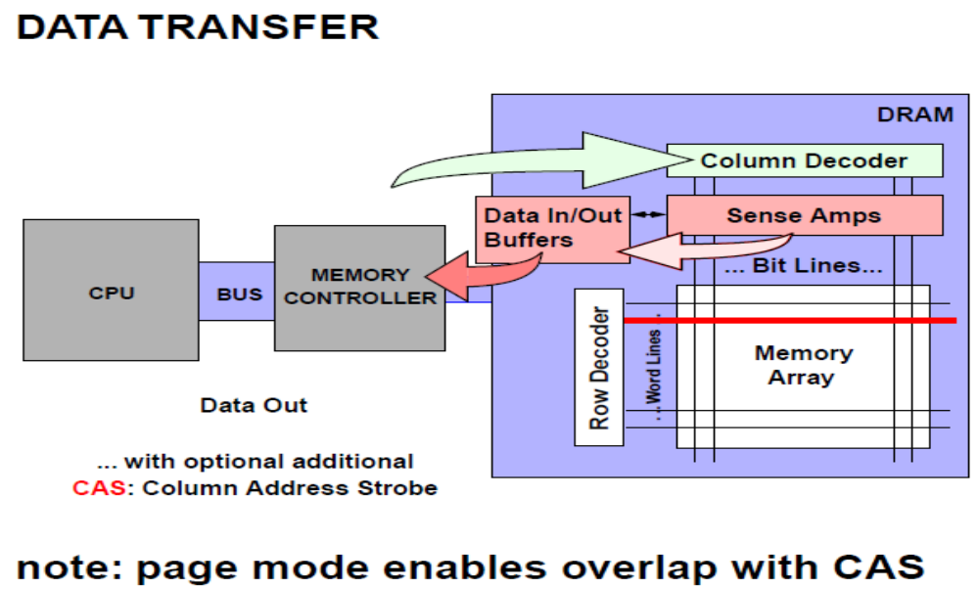

Slide 45
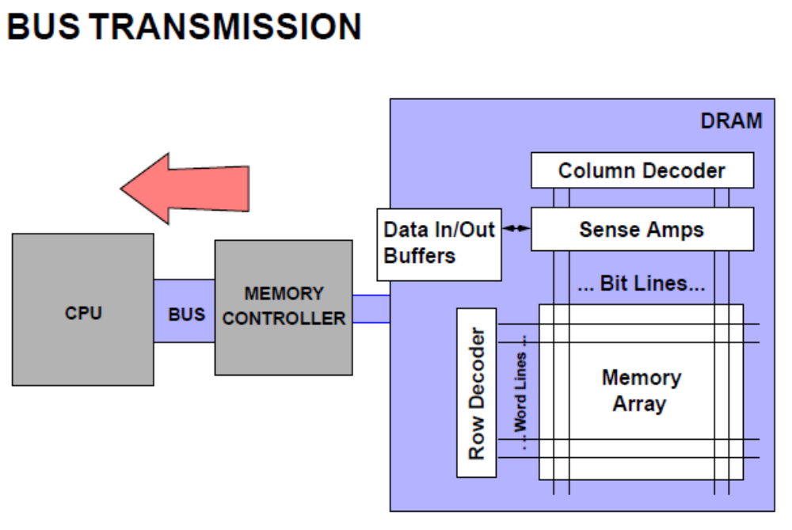
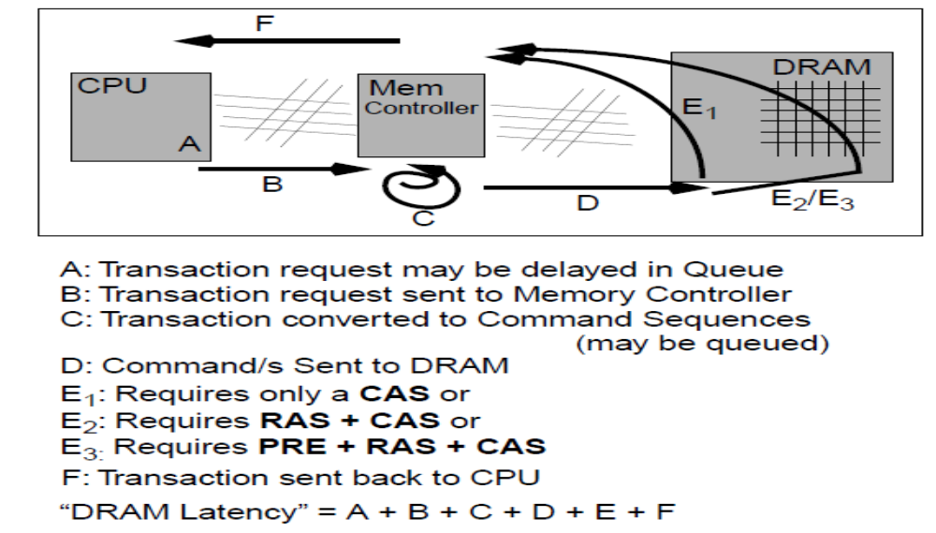

Slide 46
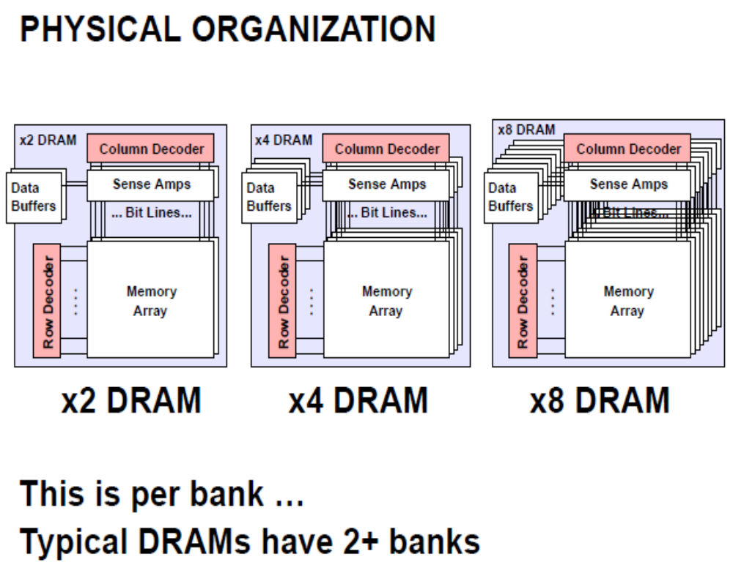

Slide 47
