Slide 1
Evaluation of a Factual Claim Classifier with and without Using Entities as Features
Abu Ayub Ansari Syed
Supervised by: Dr. Chengkai Li
University of Texas at Arlington
July 14th, 2017

Slide 2
Introduction
ClaimBuster modeled detecting check-worthy factual claim as a classification task
Presenting evaluation of entities on ClaimBuster
Extraction of entities by Illinois NE tagger
Performance of ClaimBuster using new features
Analysis of incorrect predictions
Conclusion on entities as features

Slide 3
Overview of ClaimBuster
Tool that helps finding claims to fact-check
Uses classification and ranking model
Assigns a score between 0 and 1
Problem description
Sentences are categorized into three types:
Non-Factual Sentence (NFS)
Unimportant Factual Sentence (UFS)
Check-worthy Factual Sentence (CFS)
Notes:
Larger score means sent is check worthy

Slide 4
Overview of ClaimBuster
Dataset
Transcripts of presidential debates: 30 debates
28029 sentences, remove too short
Data Collection
Labeled manually : 3 options
20617 labeled sentences
Feature Extraction
Sentiment, Length, Word (W), Part-of-Speech (POS), Entity Type (ET)
Notes:
too short i.e. less than 5 words and keeping only the presidential candidates

Slide 5
Overview of ClaimBuster
Classification
4-fold cross validation in supervised learning
Algorithms: NBC, SVM and RFC
precision (p), recall (r), f-measure (f)
Experiments using various feature sets
Evaluation
SVM using words and POS tag features
Notes:
79% precision and 74% recall; SVM was used to rank all 8015 sentences

Slide 6
Illinois NER Tool
NER : Identifying, categorizing strings to classes
Entities
Phrase that is representing a specific class
Recognize names : person, organization, locations
Numeric information : time, date, money, percentages
Entity Types
Specific named entity classes called Entity types
Main factors: language, genre/domain and Entity types

Slide 7
Illinois NER Tool
NER tools families:
Hand-made rule-based methods
Machine-Learning based methods
Hybrid methods (INET)
Standalone and as a service
Programmatically,
As a command line application, or
As a server called by clients
Notes:
Hand-made :manually constructed finite state patterns.
Machine-Learning : treats NER as a classification process.

Slide 8
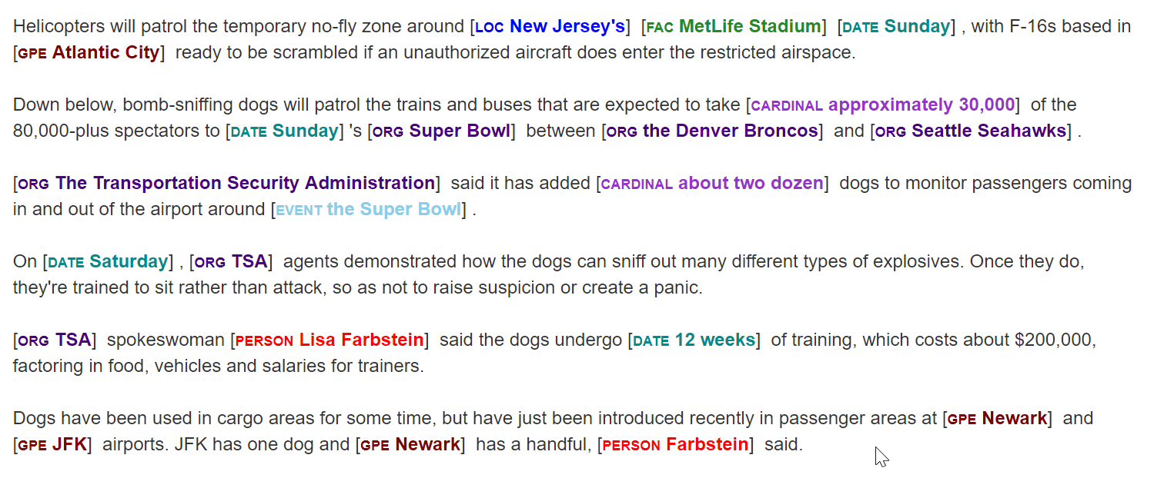
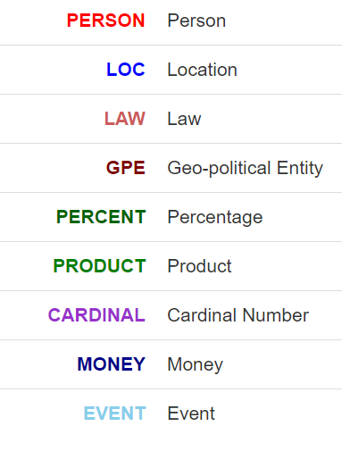
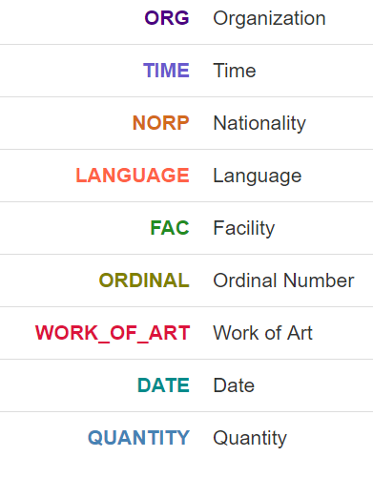
Illinois NER Tool
Illinois NER Entities tagged to Text
Illinois NER Entity Types

Slide 9
Illinois NER Tool
Extract all the 28029 sentences
18 distinct Entity types

Slide 10
Illinois NER Tool
Notes:
Entity Count = 19984
Sentence Count = 20617

Slide 11
Illinois NER Tool
Notes:
Numerical entities = 8047
Non numerical = 11937

Slide 12
Illinois NER Tool
 | Alchemy API | Illinois NE Tagger
Number of Sentences | 28029 | 28029
Total number of Entities | 18864 | 25601
Number of Unique Entities | 3309 | 5499
Number of Sentences with at least 1 Entity | 10918 | 13934
Notes:
llinois NE tagger has extracted more entities and also Number of Sentences with at least 1 Entity is larger

Slide 13
Evaluation of Classifiers
ClaimBuster modeled detecting check-worthy factual claim as a classification task
Algorithms+
Multinomial Naïve Bayes Classifier (NBC)
Support Vector Machine (SVM)
Random Forrest Classifier (RFC)
+ N. Hassan, C. Li, and M. Tremayne. Detecting check-worthy factual claims in presidential debates. In CIKM, pages 1835–1838, 2015
Notes:
NBC: Bayes theorem: probability of a test case that belongs to a class.
Conditional Independence assumption: word being processed is independent of other words
Uses the captured frequency information of features, such as words, POS tags, Entities etc.
Numeric values are tended to appear in news articles, factual claims etc.
Probabilities of each feature are calculated
RFC:
Make a random forest which is a set of trees created by bootstrapping cases of the training dataset
Predictions are made by majority vote
Number of trees in the forest are restricted to 500

Slide 14
Evaluation of Classifiers
Three-class classification labels
Non-Factual Sentence (NFS)
Unimportant Factual Sentence (UFS)
Check-worthy Factual Sentence (CFS)
Two-class classification labels
Non-Factual and Unimportant Factual Sentence (N_UFS)
Check-worthy Factual Sentence (CFS)

Slide 15
Evaluation of Classifiers
Feature sets:
Words (W),
Words + Illinois Entities (W_ET),
Words + POS Tags (W_P),
Words + POS Tags + Illinois Entities (W_P_ET)
Note: Sentiment and Length are included in all the combinations.

Slide 16
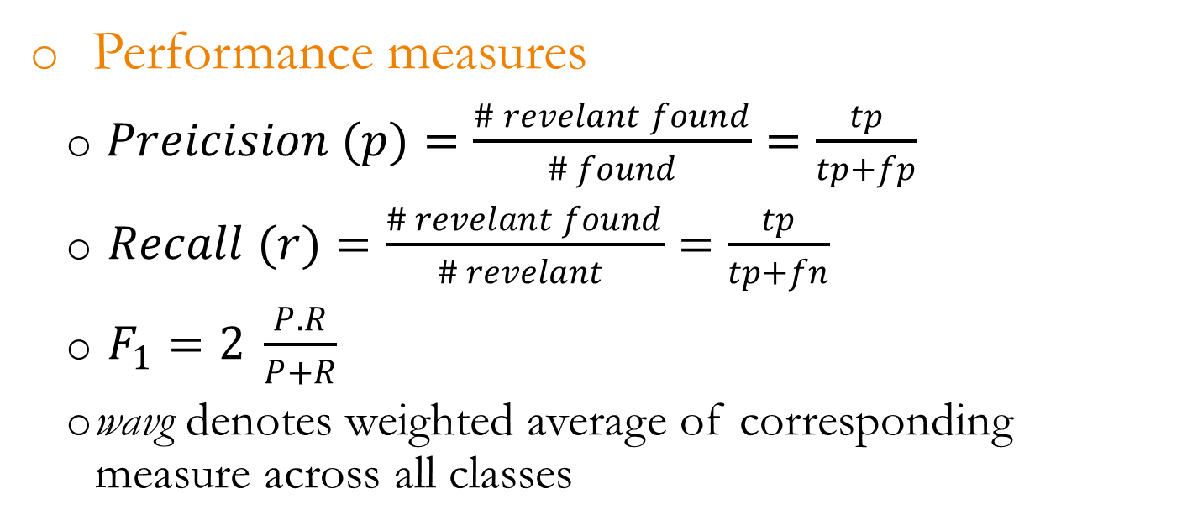
Evaluation of Classifiers
Performance measures
$Preicision (p)=\frac{\# revelant found}{\# found}=\frac{tp}{tp+fp}$
$Recall (r)=\frac{\# revelant found}{\# revelant }=\frac{tp}{tp+fn}$
$F_{1}=2 \frac{P.R}{P+R}$
wavg denotes weighted average of corresponding measure across all classes

Slide 17
Evaluation of Classifiers
algorithm | features | p_NFS | p_UFS | p_CFS | p_wavg | r_NFS | r_UFS | r_CFS | r_wavg | f_NFS | f_UFS | f_CFS | f_wavg
SVM | W | 0.83 | 0.43 | 0.69 | 0.76 | 0.90 | 0.30 | 0.62 | 0.77 | 0.86 | 0.34 | 0.65 | 0.76
NBC | W | 0.74 | 0.89 | 0.79 | 0.77 | 0.98 | 0.01 | 0.39 | 0.74 | 0.84 | 0.02 | 0.52 | 0.68
RFC | W | 0.74 | 0.74 | 0.76 | 0.75 | 0.97 | 0.04 | 0.40 | 0.74 | 0.84 | 0.08 | 0.52 | 0.69
SVM | W_P | 0.83 | 0.49 | 0.68 | 0.76 | 0.91 | 0.25 | 0.63 | 0.77 | 0.86 | 0.33 | 0.65 | 0.76
NBC | W_P | 0.81 | 0.48 | 0.63 | 0.74 | 0.91 | 0.13 | 0.62 | 0.76 | 0.86 | 0.21 | 0.62 | 0.74
RFC | W_P | 0.76 | 0.73 | 0.76 | 0.75 | 0.97 | 0.05 | 0.45 | 0.76 | 0.85 | 0.09 | 0.57 | 0.71
SVM | W_P_ET | 0.85 | 0.44 | 0.68 | 0.77 | 0.88 | 0.34 | 0.64 | 0.77 | 0.86 | 0.37 | 0.66 | 0.76
NBC | W_P_ET | 0.82 | 0.47 | 0.63 | 0.74 | 0.90 | 0.17 | 0.62 | 0.76 | 0.86 | 0.25 | 0.63 | 0.74
RFC | W_P_ET | 0.76 | 0.75 | 0.76 | 0.76 | 0.97 | 0.05 | 0.47 | 0.76 | 0.85 | 0.10 | 0.58 | 0.71
ClaimBuster Classifier performance results for three-class classification
Notes:
SVM paired with W_P_ET achieved 76%,77% and 76%

Slide 18
Evaluation of Classifiers
algorithm | features | p_N_UFS | p_CFS | p_wavg | r_N_UFS | r_CFS | r_wavg | f_N_UFS | f_CFS | f_wavg
SVM | W | 0.87 | 0.69 | 0.83 | 0.92 | 0.55 | 0.83 | 0.89 | 0.59 | 0.82
NBC | W | 0.82 | 0.84 | 0.82 | 0.98 | 0.29 | 0.82 | 0.89 | 0.43 | 0.78
RFC | W | 0.82 | 0.86 | 0.83 | 0.99 | 0.29 | 0.82 | 0.89 | 0.43 | 0.79
SVM | W_P | 0.87 | 0.72 | 0.84 | 0.93 | 0.56 | 0.84 | 0.90 | 0.63 | 0.84
NBC | W_P | 0.87 | 0.65 | 0.82 | 0.91 | 0.57 | 0.83 | 0.89 | 0.61 | 0.82
RFC | W_P | 0.82 | 0.86 | 0.83 | 0.98 | 0.32 | 0.83 | 0.90 | 0.46 | 0.80
SVM | W_P_ET | 0.88 | 0.70 | 0.84 | 0.92 | 0.60 | 0.84 | 0.90 | 0.64 | 0.84
RFC | W_P_ET | 0.83 | 0.85 | 0.83 | 0.98 | 0.34 | 0.83 | 0.90 | 0.48 | 0.80
NBC | W_P_ET | 0.88 | 0.64 | 0.82 | 0.90 | 0.58 | 0.83 | 0.89 | 0.61 | 0.82
ClaimBuster Classifier performance results for two-class classification

Slide 19
Analysis of three-class classifiers
Understand contribution and influence of Entities
Comparison of classification results
W vs W_ET
W_P vs W_ET
W_P vs W_P_ET
9 experiments: 3 classifiers; 3 comparisons
Performance results in terms of p, r, and f

Slide 20
Analysis of three-class classifiers
Extract the sentences in which the prediction we made incorrectly
27 cases:
3 classes: NFS, UFS, CFS
3 output data: verdicts, feature set 1 and feature set 2
Extracted to study which cases are helped by entities and which cases are being harmed

Slide 21
NBC: W vs W_ET
 | Verdicts | NBC_W | NBC_W_ET
#CFS (1) | 4843 | 2410 | 3426
#UFS (0) | 2103 | 26 | 78
#NFS (-1) | 13671 | 18181 | 17113
Total | 20617 | 20617 | 20617
algorithm | features | p_NFS | p_UFS | p_CFS | p_wavg | r_NFS | r_UFS | r_CFS | r_wavg | f_NFS | f_UFS | f_CFS | f_wavg
NBC | W | 0.74 | 0.89 | 0.79 | 0.77 | 0.98 | 0.01 | 0.39 | 0.74 | 0.84 | 0.02 | 0.52 | 0.68
NBC | W_ET | 0.77 | 0.71 | 0.71 | 0.75 | 0.96 | 0.03 | 0.50 | 0.75 | 0.85 | 0.05 | 0.58 | 0.71
Notes:
Verdicts_NFS 631
Verdicts_UFS 2082
Verdicts_CFS 3114
Total 5827

Slide 22
NBC: W_P vs W_ET
 | Verdicts | NBC_W_P | NBC_W_ET
#CFS (1) | 4843 | 4792 | 3426
#UFS (0) | 2103 | 587 | 78
#NFS (-1) | 13671 | 15238 | 17113
Total | 20617 | 20617 | 20617
algorithm | features | p_NFS | p_UFS | p_CFS | p_wavg | r_NFS | r_UFS | r_CFS | r_wavg | f_NFS | f_UFS | f_CFS | f_wavg
NBC | W_P | 0.81 | 0.48 | 0.63 | 0.74 | 0.91 | 0.13 | 0.62 | 0.76 | 0.86 | 0.21 | 0.62 | 0.74
NBC | W_ET | 0.77 | 0.71 | 0.71 | 0.75 | 0.96 | 0.03 | 0.50 | 0.75 | 0.85 | 0.05 | 0.58 | 0.71
Notes:
Verdicts_NFS 1428
Verdicts_UFS 2054
Verdicts_CFS 2669
Total 6151

Slide 23
NBC: W_P vs W_P_ET
 | Verdicts | NBC_W_P_ET | NBC_W_P
#CFS (1) | 4843 | 4794 | 4792
#UFS (0) | 2103 | 772 | 587
#NFS (-1) | 13671 | 15051 | 15238
Total | 20617 | 20617 | 20617
algorithm | features | p_NFS | p_UFS | p_CFS | p_wavg | r_NFS | r_UFS | r_CFS | r_wavg | f_NFS | f_UFS | f_CFS | f_wavg
NBC | W_P | 0.81 | 0.48 | 0.63 | 0.74 | 0.91 | 0.13 | 0.62 | 0.76 | 0.86 | 0.21 | 0.62 | 0.74
NBC | W_P_ET | 0.82 | 0.47 | 0.63 | 0.74 | 0.90 | 0.17 | 0.62 | 0.76 | 0.86 | 0.25 | 0.63 | 0.74
Notes:
Verdicts_NFS 1525
Verdicts_UFS 1836
Verdicts_CFS 2012
Total 5373

Slide 24
SVM : W vs W_ET
 | Verdicts | SVM_W | SVM_W_ET
#CFS (1) | 4843 | 4019 | 4442
#UFS (0) | 2103 | 1359 | 986
#NFS (-1) | 13671 | 15239 | 15189
Total | 20617 | 20617 | 20617
algorithm | features | p_NFS | p_UFS | p_CFS | p_wavg | r_NFS | r_UFS | r_CFS | r_wavg | f_NFS | f_UFS | f_CFS | f_wavg
SVM | W | 0.83 | 0.43 | 0.69 | 0.76 | 0.90 | 0.30 | 0.62 | 0.77 | 0.86 | 0.34 | 0.65 | 0.76
SVM | W_ET | 0.82 | 0.48 | 0.68 | 0.75 | 0.91 | 0.22 | 0.60 | 0.76 | 0.86 | 0.31 | 0.61 | 0.74
Notes:
Verdicts_NFS 1554
Verdicts_UFS 1668
Verdicts_CFS 2373
Total 5595

Slide 25
SVM: W_P vs W_ET
 | Verdicts | SVM_W_P | SVM_W_ET
#CFS (1) | 4843 | 4501 | 4442
#UFS (0) | 2103 | 1064 | 986
#NFS (-1) | 13671 | 15052 | 15189
Total | 20617 | 20617 | 20617
algorithm | features | p_NFS | p_UFS | p_CFS | p_wavg | r_NFS | r_UFS | r_CFS | r_wavg | f_NFS | f_UFS | f_CFS | f_wavg
SVM | W_ET | 0.82 | 0.48 | 0.68 | 0.75 | 0.91 | 0.22 | 0.60 | 0.76 | 0.86 | 0.31 | 0.61 | 0.74
SVM | W_P | 0.83 | 0.49 | 0.68 | 0.76 | 0.91 | 0.25 | 0.63 | 0.77 | 0.86 | 0.33 | 0.65 | 0.76
Notes:
Verdicts_NFS 1621
Verdicts_UFS 1694
Verdicts_CFS 2223
Total 5538

Slide 26
SVM: W_P vs W_P_ET
 | Verdicts | SVM_W_P_ET | SVM_W_P
#CFS (1) | 4843 | 4427 | 4501
#UFS (0) | 2103 | 1174 | 1064
#NFS (-1) | 13671 | 15016 | 15052
Total | 20617 | 20617 | 20617
algorithm | features | p_NFS | p_UFS | p_CFS | p_wavg | r_NFS | r_UFS | r_CFS | r_wavg | f_NFS | f_UFS | f_CFS | f_wavg
SVM | W_P | 0.83 | 0.49 | 0.68 | 0.76 | 0.91 | 0.25 | 0.63 | 0.77 | 0.86 | 0.33 | 0.65 | 0.76
SVM | W_P_iET | 0.85 | 0.44 | 0.68 | 0.77 | 0.88 | 0.34 | 0.64 | 0.77 | 0.86 | 0.37 | 0.66 | 0.76
Notes:
Verdicts_NFS 1447
Verdicts_UFS 1623
Verdicts_CFS 1979
Total 5049
** UFS improves when W_P_ET, but W_ET and W_P are poor **

Slide 27
RFC: W vs W_ET
 | Verdicts | RFC_W | RFC_W_ET
#CFS (1) | 4843 | 2525 | 2794
#UFS (0) | 2103 | 128 | 88
#NFS (-1) | 13671 | 17964 | 17735
Total | 20617 | 20617 | 20617
algorithm | features | p_NFS | p_UFS | p_CFS | p_wavg | r_NFS | r_UFS | r_CFS | r_wavg | f_NFS | f_UFS | f_CFS | f_wavg
RFC | W | 0.74 | 0.74 | 0.76 | 0.75 | 0.97 | 0.04 | 0.40 | 0.74 | 0.84 | 0.08 | 0.52 | 0.69
RFC | W_ET | 0.75 | 0.81 | 0.76 | 0.76 | 0.97 | 0.03 | 0.44 | 0.75 | 0.85 | 0.06 | 0.55 | 0.70
Notes:
Verdicts_NFS 462
Verdicts_UFS 2040
Verdicts_CFS 3074
Total 5576

Slide 28
RFC: W_P vs W_ET
 | Verdicts | RFC_W_P | RFC_W_ET
#CFS (1) | 4843 | 2919 | 2794
#UFS (0) | 2103 | 134 | 88
#NFS (-1) | 13671 | 17564 | 17735
Total | 20617 | 20617 | 20617
algorithm | features | p_NFS | p_UFS | p_CFS | p_wavg | r_NFS | r_UFS | r_CFS | r_wavg | f_NFS | f_UFS | f_CFS | f_wavg
RFC | W_P | 0.76 | 0.73 | 0.76 | 0.75 | 0.97 | 0.05 | 0.45 | 0.76 | 0.85 | 0.09 | 0.57 | 0.71
RFC | W_ET | 0.75 | 0.81 | 0.76 | 0.76 | 0.97 | 0.03 | 0.44 | 0.75 | 0.85 | 0.06 | 0.55 | 0.70
Notes:
Verdicts_NFS 516
Verdicts_UFS 2055
Verdicts_CFS 3000
Total 5571

Slide 29
RFC: W_P vs W_P_ET
 | Verdicts | RFC_W_P_ET | RFC_W_P
#CFS (1) | 4843 | 3002 | 2919
#UFS (0) | 2103 | 127 | 134
#NFS (-1) | 13671 | 17488 | 17564
Total | 20617 | 20617 | 20617
algorithm | features | p_NFS | p_UFS | p_CFS | p_wavg | r_NFS | r_UFS | r_CFS | r_wavg | f_NFS | f_UFS | f_CFS | f_wavg
RFC | W_P | 0.76 | 0.73 | 0.76 | 0.75 | 0.97 | 0.05 | 0.45 | 0.76 | 0.85 | 0.09 | 0.57 | 0.71
RFC | W_P_iET | 0.76 | 0.75 | 0.76 | 0.76 | 0.97 | 0.05 | 0.47 | 0.76 | 0.85 | 0.10 | 0.58 | 0.71
Notes:
Verdicts_NFS 441
Verdicts_UFS 2026
Verdicts_CFS 2778
Total 5245

Slide 30
Analysis of three-class classifiers
(0, -1, -1) and (1, -1, -1) have maximum errors
Presence of entities is subdued by POS tags
NBC: Entities have helped classify more CFSs
SVM(best performing): Entities have less contribution
RFC(worst performing): Entities do not influence

Slide 31
Analysis of two-class classifiers
Comparison of classification results
W vs W_ET
W_P vs W_ET
W_P vs W_P_ET
9 experiments: 3 classifiers; 3 comparisons
Performance results in terms of p, r, and f

Slide 32
Analysis of two-class classifiers
Extract the sentences in which the prediction we made incorrectly
8 cases:
2 classes: N_UFS, CFS
3 output data: verdicts, feature set 1 and feature set 2
Extracted to study which cases are helped by entities and which cases are being harmed

Slide 33
2C NBC : W vs W_ET
 | Verdicts | NBC_W | NBC_W_ET
#CFS (1) | 4843 | 1671 | 2666
#N_UFS (-1) | 15774 | 18946 | 17951
Total | 20617 | 20617 | 20617
algorithm | features | p_N_UFS | p_CFS | p_wavg | r_N_UFS | r_CFS | r_wavg | f_N_UFS | f_CFS | f_wavg
NBC | W | 0.82 | 0.84 | 0.82 | 0.98 | 0.29 | 0.82 | 0.89 | 0.43 | 0.78
NBC | W_ET | 0.84 | 0.76 | 0.82 | 0.96 | 0.42 | 0.83 | 0.90 | 0.54 | 0.81
Notes:
Verdicts_N_UFS 698
Verdicts_CFS 3542
Total 4240

Slide 34
2C NBC : W_P vs W_ET
 | Verdicts | NBC_W_P | NBC_W_ET
#CFS (1) | 4843 | 4235 | 2666
#N_UFS (-1) | 15774 | 16382 | 17951
Total | 20617 | 20617 | 20617
algorithm | features | p_N_UFS | p_CFS | p_wavg | r_N_UFS | r_CFS | r_wavg | f_N_UFS | f_CFS | f_wavg
NBC | W_P | 0.87 | 0.65 | 0.82 | 0.91 | 0.57 | 0.83 | 0.89 | 0.61 | 0.82
NBC | W_ET | 0.84 | 0.76 | 0.82 | 0.96 | 0.42 | 0.83 | 0.90 | 0.54 | 0.81
Notes:
Verdicts_NFS 1636
Verdicts_CFS 3013
Total 4649

Slide 35
2C NBC : W_P vs W_P_ET
 | Verdicts | NBC_W_P | NBC_W_P_ET
#CFS (1) | 4843 | 4235 | 4399
#N_UFS (-1) | 15774 | 16382 | 16218
Total | 20617 | 20617 | 20617
algorithm | features | p_N_UFS | p_CFS | p_wavg | r_N_UFS | r_CFS | r_wavg | f_N_UFS | f_CFS | f_wavg
NBC | W_P | 0.87 | 0.65 | 0.82 | 0.91 | 0.57 | 0.83 | 0.89 | 0.61 | 0.82
NBC | W_P_ET | 0.88 | 0.64 | 0.82 | 0.90 | 0.58 | 0.83 | 0.89 | 0.61 | 0.82
Notes:
Verdicts_NFS 1752
Verdicts_CFS 2226
Total 3978

Slide 36
2C SVM: W vs W_ET
 | Verdicts | SVM_W | SVM_W_ET
#CFS (1) | 4843 | 3961 | 3073
#N_UFS (-1) | 15774 | 16656 | 17544
Total | 20617 | 20617 | 20617
algorithm | features | p_N_UFS | p_CFS | p_wavg | r_N_UFS | r_CFS | r_wavg | f_N_UFS | f_CFS | f_wavg
SVM | W | 0.87 | 0.69 | 0.83 | 0.92 | 0.55 | 0.83 | 0.89 | 0.59 | 0.82
SVM | W_ET | 0.85 | 0.75 | 0.83 | 0.95 | 0.46 | 0.83 | 0.90 | 0.55 | 0.82
Notes:
Verdicts_NFS 1553
Verdicts_CFS 2869
Total 4422

Slide 37
2C SVM: W_P vs W_ET
 | Verdicts | SVM_W_P | SVM_W_ET
#CFS (1) | 4843 | 3829 | 3073
#N_UFS (-1) | 15774 | 16788 | 17544
Total | 20617 | 20617 | 20617
algorithm | features | p_N_UFS | p_CFS | p_wavg | r_N_UFS | r_CFS | r_wavg | f_N_UFS | f_CFS | f_wavg
SVM | W_P | 0.87 | 0.72 | 0.84 | 0.93 | 0.56 | 0.84 | 0.90 | 0.63 | 0.84
SVM | W_ET | 0.85 | 0.75 | 0.83 | 0.95 | 0.46 | 0.83 | 0.90 | 0.55 | 0.82
Notes:
Verdicts_NFS 1326
Verdicts_CFS 2787
Total 4113

Slide 38
2C SVM: W_P vs W_P_ET
 | Verdicts | SVM_W_P | SVM_W_P_ET
#CFS (1) | 4843 | 3829 | 4186
#N_UFS (-1) | 15774 | 16788 | 16431
Total | 20617 | 20617 | 20617
algorithm | features | p_N_UFS | p_CFS | p_wavg | r_N_UFS | r_CFS | r_wavg | f_N_UFS | f_CFS | f_wavg
SVM | W_P | 0.87 | 0.72 | 0.84 | 0.93 | 0.56 | 0.84 | 0.90 | 0.63 | 0.84
SVM | W_P_ET | 0.88 | 0.70 | 0.84 | 0.92 | 0.60 | 0.84 | 0.90 | 0.64 | 0.84
Notes:
Verdicts_NFS 1460
Verdicts_CFS 2252
Total 3712

Slide 39
2C RFC: W vs W_ET
 | Verdicts | RFC_W | RFC_W_ET
#CFS (1) | 4843 | 1616 | 1764
#N_UFS (-1) | 15774 | 19001 | 18853
Total | 20617 | 20617 | 20617
algorithm | features | p_N_UFS | p_CFS | p_wavg | r_N_UFS | r_CFS | r_wavg | f_N_UFS | f_CFS | f_wavg
RFC | W | 0.82 | 0.86 | 0.83 | 0.99 | 0.29 | 0.82 | 0.89 | 0.43 | 0.79
RFC | W_ET | 0.82 | 0.85 | 0.83 | 0.98 | 0.31 | 0.82 | 0.90 | 0.45 | 0.79
Notes:
Verdicts_NFS 310
Verdicts_CFS 3561
Total 3871

Slide 40
2C RFC: W_P vs W_ET
 | Verdicts | RFC_W_P | RFC_W_ET
#CFS (1) | 4843 | 1797 | 1764
#N_UFS (-1) | 15774 | 18820 | 18853
Total | 20617 | 20617 | 20617
algorithm | features | p_N_UFS | p_CFS | p_wavg | r_N_UFS | r_CFS | r_wavg | f_N_UFS | f_CFS | f_wavg
RFC | W_P | 0.82 | 0.86 | 0.83 | 0.98 | 0.32 | 0.83 | 0.90 | 0.46 | 0.80
RFC | W_ET | 0.82 | 0.85 | 0.83 | 0.98 | 0.31 | 0.82 | 0.90 | 0.45 | 0.79
Notes:
Verdicts_NFS 360
Verdicts_CFS 3558
Total 3918

Slide 41
2C RFC: W_P vs W_P_ET
 | Verdicts | RFC_W_P | RFC_W_P_ET
#CFS (1) | 4843 | 1797 | 1925
#N_UFS (-1) | 15774 | 18820 | 18692
Total | 20617 | 20617 | 20617
algorithm | features | p_N_UFS | p_CFS | p_wavg | r_N_UFS | r_CFS | r_wavg | f_N_UFS | f_CFS | f_wavg
RFC | W_P | 0.82 | 0.86 | 0.83 | 0.98 | 0.32 | 0.83 | 0.90 | 0.46 | 0.80
RFC | W_P_ET | 0.83 | 0.85 | 0.83 | 0.98 | 0.34 | 0.83 | 0.90 | 0.48 | 0.80
Notes:
Verdicts_NFS 329
Verdicts_CFS 3400
Total 3729

Slide 42
Analysis of two-class classifiers
(1, -1, -1) have maximum errors
Presence of entities is subdued by POS tags
2C NBC: Entities have helped classify more CFSs
2C SVM(best performing): Entities have harmed individually, less contribution with POS tags
2C RFC(worst performing): Entities do not influence

Slide 43
Conclusion
Entities have helped in certain cases
Entities individually help in better classifying CFS
Contribute very less in improving performance
POS tags perform better as features than entities
Performance of classifier improved slightly by using POS tags/entities/ both as features
Notes:
presidential debates as dataset, features extracted from sentences into vectors and standard classifiers.
NFS and UFS :75% and
CFS : 25%.
Number of unique entities are 5499.

Slide 44
Conclusion
Reasoning:
Possibility of wrong verdicts
Ambiguous UFS and majority vote
Curse of learning: imbalance in classes
Limited training data
Entities are sparse compared to POS tags

Slide 45
Conclusion
Extract named entities from Illinois NE tagger
Evaluated 3 classifiers with 4 different feature sets by two classification types
Understanding scenarios where the entities have improved in classification performance
Analyzed the errors of classifiers by comparing two features sets at a time
Notes:
My contribution

Slide 46
References
[1] N. Hassan, C. Li, and M. Tremayne. Detecting check-worthy factual claims in presidential debates. In CIKM, pages 1835–1838, 2015.
[2] N. Hassan, B. Adair, J. T. Hamilton, C. Li, M. Tremayne, J. Yang, and C. Yu. The quest to automate fact-checking. Proceedings of the 2015 Computation+Journalism Symposium, 2015.
[3] N. Hassan, M. Tremayne, F. Arslan, and C. Li. Comparing automated factual claim detection against judgments of journalism organizations. In Computation+Journalism Symposium, 2016.
[4] Samet Atdağ and Vincent Labatut. A Comparison of Named Entity Recognition Tools Applied to Biographical Texts. 2nd International Conference on Systems and Computer Science, Villeneuve d'Ascq (FR), 2013.
[5] S. Sulaiman, R. Abdul Wahid, S. Sarkawi, and N. Omar. Using Stanford NER and Illinois NER to Detect Malay Named Entity Recognition. International Journal of Computer Theory and Engineering, Vol. 9, No. 2, April 2017.
[6] L. Ratinov and D. Roth, "Design challenges and misconceptions in named entity recognition," in 13th Conference on Computational Natural Language Learning, 2009, pp. 147-155.
[7] Mark Sammons, Tom Redman, and Dan Roth. Illinois Named Entity Recognizer: Addendum to Ratinov and Roth ’09 reporting improved results. 2017
[8] Cognitive computation group. [Online]. Available: https://cogcomp.cs.illinois.edu/page/software_view/Curator
[9] David Nadeau, Satoshi Sekine. A survey of named entity recognition and classification. National Research Council Canada / New York University.
[10] Joachim Giard, Jérôme Ambroise, Jean-Luc Gala and Benoît Macq. Regression applied to protein binding site prediction and comparison with classification. BMC Bioinformatics, 2009.
[11] McCallum, A., & Nigam, K. (1998). A comparison of event models for naive Bayes text classification. In AAAI-98 Workshop on Learning for Text Categorization. Tech. rep. WS-98-05, AAAI Press.

Slide 47
Feedback / Questions?

Slide 48
Thank you

