Slide 1

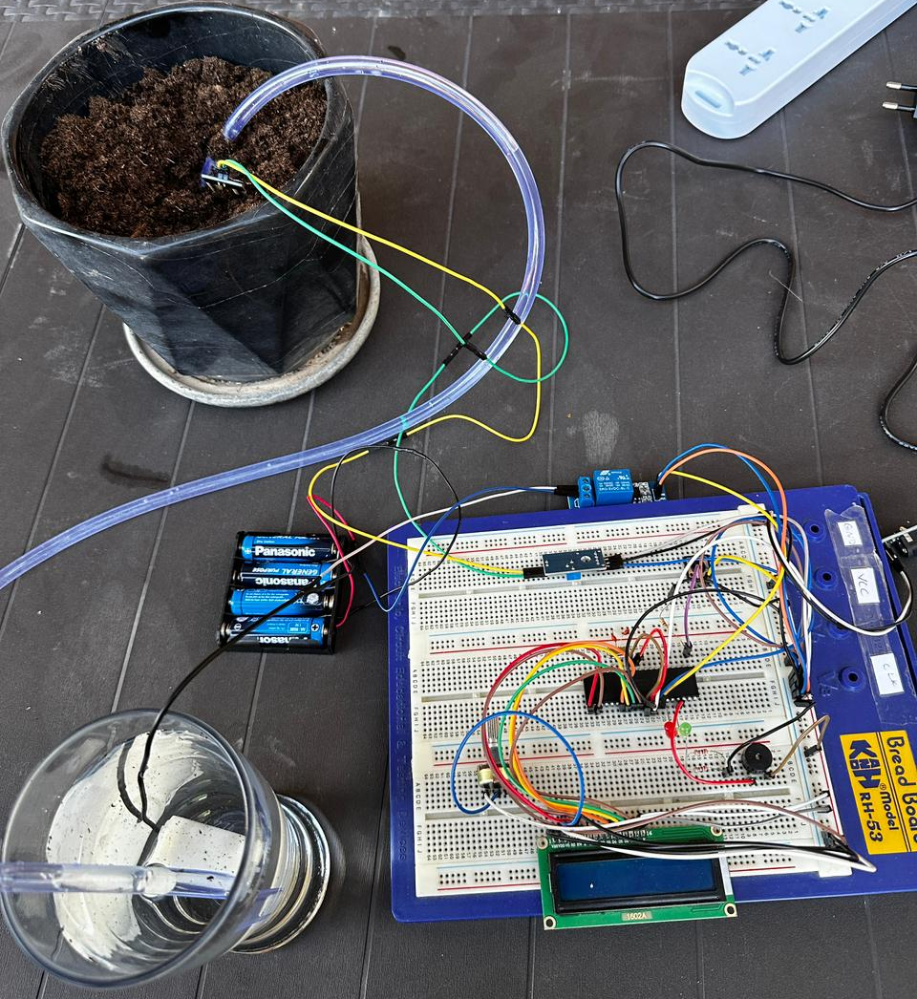
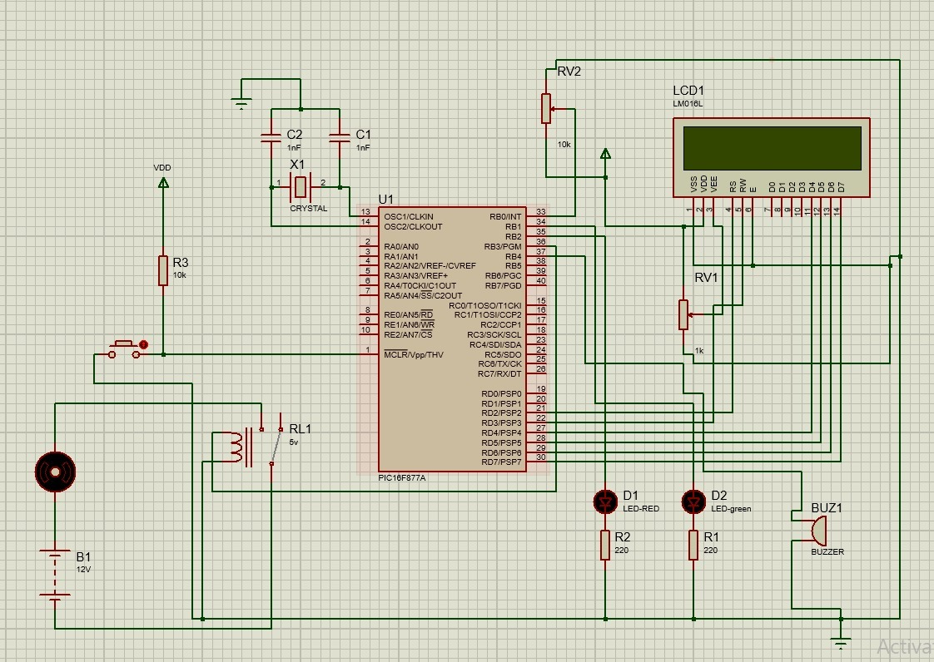
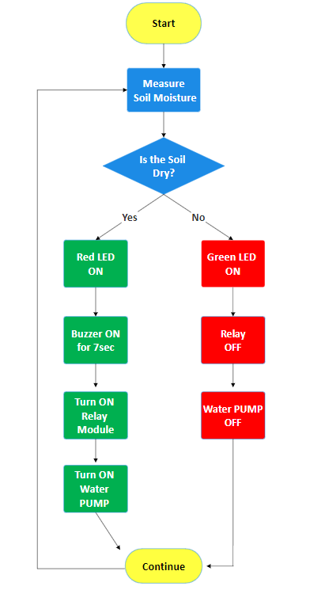
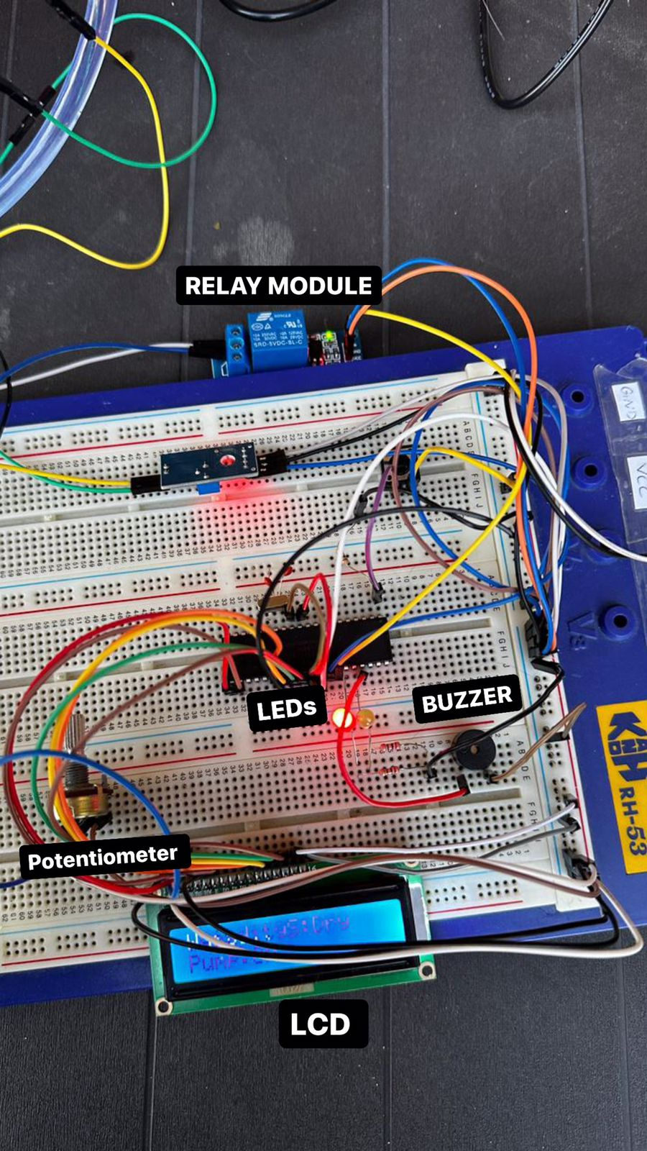
Intelligent Plant Watering System
D. Slehat, H. Aqqad, and R. Batarseh
Supervisors: Dr. Belal Sababha, Dr Anastassia Gharib
Embedded Systems Final Design Project, Fall 2023
King Abdullah II School of Engineering
Princess Sumaya University for Technology
Introduction
Gardeners globally encounter significant challenges when it comes to the precise regulation of watering practices. For gardeners, maintaining the right balance between managing resource restrictions and crop hydration offers a complex challenge. An intelligent plant watering system is a known innovative solution that can provide help to small gardeners. This automated device is designed to provide a systematic and efficient approach to watering plants, responding to triggers such as soil moisture levels. This system allows plant owners to ensure consistent and adequate hydration for their plants, without being over\under watered, even in their absence.
Results
As a final result our project was able to water the soil when it’s too dry. The moisture sensor is continuously monitoring the soil's moisture level, so when the moisture level falls below a specified threshold indicating that the soil is dry first the red LED will turn on, then the buzzer will start making a sound for 7 seconds, then the sensor triggers the relay module to activate the water pump. The water pump draws water from the water source and delivers it to the plant’s soil through the attached tube. When the water is the same as the threshold, the green LED will turn on.
Figure 3: Final Project Design
Figure 4: Flowchart
Design
This design is easy to enhance and more features can be added. It consists of moisture sensor, relay module, LEDs, buzzer, LCD, water pump, a long tube and of course a battery.
Figure 1: Electrical Design
Figure 2: A Close Up of the Connections
Conclusion
Our intelligent plant watering system was able to do what we intended for it to achieve. This system has shown that it can provide an efficient and practical solution for gardeners who struggle with plant watering levels or that cannot be present. This device will ensure that all the plants receive the appropriate amount of water without being over watered or under watered. For future enhancement, an mobile application can be added, it can help the users to check the soil moisture or in general the status of the system without being physically near their plants. Also customized thresholds can be added. Customized thresholds are very important as crops and plants have different needs of water, each plant has their own requirements of water level and varies depending on the weather too.
In conclusion, we believe that our project’s concept was as simple as possible with no complicity. We have effectively achieved our main objective, which involved utilizing our understanding of the PIC16F877A microcontroller, sensors, and system integration. This system can help many users to worry less about their plant care and ensure that their crops and plants will live longer.

