Slide 1
🛡️
SAFEDEPTH
Zero-Hardware Worker Safety System
Team SafeDepth
Abubakar Shahid Iqbal | B.Tech AI & Data Science, 3rd Year | Anjuman College, Nagpur
Zaid | Frontend Developer
Prototype 3.0 by Artificix @ GHRCEMN • April 7, 2026
github.com/abubakarop461-bit/safedepth

Slide 2
THE PROBLEM
Worker Safety in Confined Spaces
1000+
₹50,000
90%
Deaths/year
in India
Cost of IoT
safety kits
MSMEs that
cannot afford it
MSMEs running mines, tanks, sewers & industrial plants have NO affordable
safety solution. Workers enter confined spaces with zero monitoring.
⚠️ Delayed detection of gas leaks, accidents, or health emergencies leads to fatalities.

Slide 3
THE SOLUTION
SafeDepth: A ₹0 Safety System
📱
📶
🚨
Zero Hardware
Local WiFi Only
Real-Time Alerts
Works on any Android/iPhone already in workers' pockets
No internet needed — runs on factory hotspot
YELLOW at 5min, RED CRITICAL at 10min no response
🆘
🖥️
💰
Emergency Button
Live Dashboard
₹0 Cost
One tap sends instant alert to supervisor dashboard
Supervisor monitors all workers from laptop
Replaces ₹50,000 IoT kits with free software

Slide 4
HOW IT WORKS
The Safety Flow
1
Supervisor registers worker on dashboard
TECH STACK
2
⚡ FastAPI + Python
Supervisor sends safety check request
🗄️ SQLite + SQLAlchemy
3
Worker sees request on phone, taps I'M SAFE
⚛️ Next.js 14
🎨 Vanilla CSS
4
No response in 5 min → YELLOW warning
🔄 10s Polling (no WebSockets)
5
No response in 10 min → RED critical alert
📡 Local WiFi / Hotspot
6
Emergency button available anytime

Slide 5
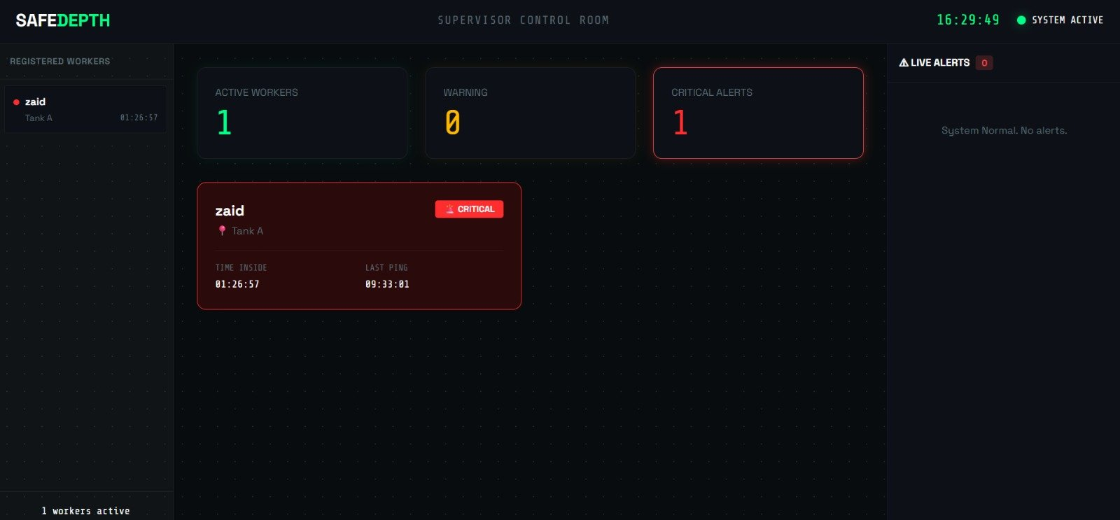
SUPERVISOR DASHBOARD
Real-Time Worker Monitoring
Live clock • Worker status • Critical alert panel • Session tracking

Slide 6
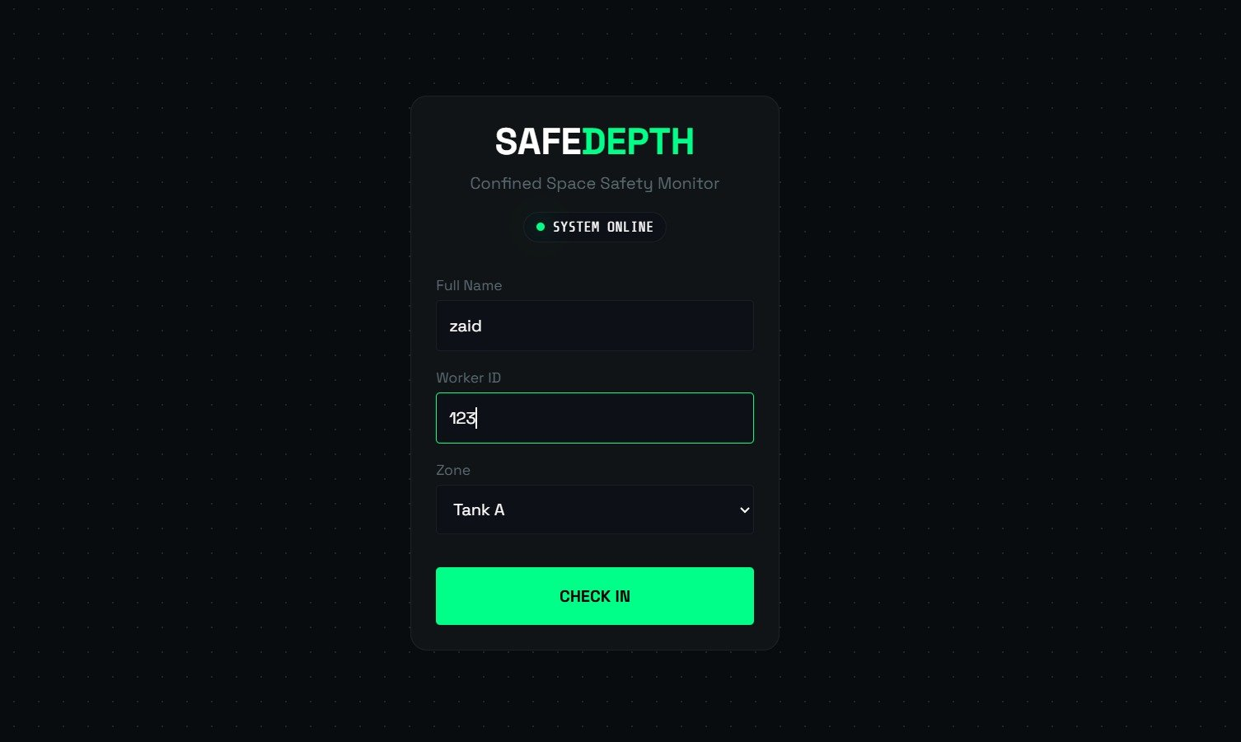
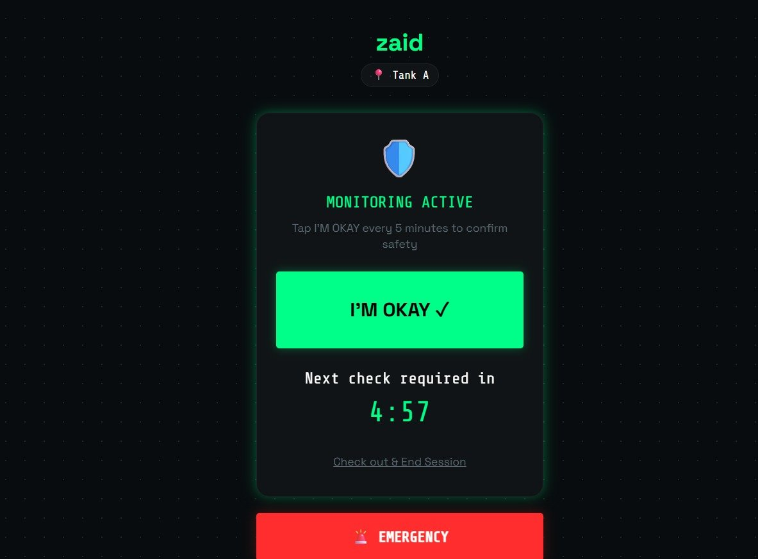
WORKER MOBILE INTERFACE
Designed for Gloved Hands in Harsh Conditions
Check-In Screen
Safety Check + Emergency

Slide 7
COMPETITIVE ADVANTAGE
SafeDepth vs Hardware IoT Solutions
 | IoT Hardware Kits | SafeDepth ✅
Cost | ₹50,000+ | ₹0
Setup Time | Days / Weeks | 5 Minutes
Hardware Required | Sensors, ESP32, LoRa | Just a Phone
Works Without Internet | ❌ | ✅
Target Market | Large Enterprises | Every MSME in India
Deploy Today | ❌ | ✅
"We replace a ₹50,000 IoT kit with a ₹0 app. Any MSME in India can deploy this today."

Slide 8
🛡️
SAFEDEPTH
Zero Hardware. Zero Cost. Zero Compromise.
1000+
₹0
5 min
Lives at risk yearly
Deployment cost
Setup time
"Just a phone and WiFi. That's 90% of the market nobody is serving."
github.com/abubakarop461-bit/safedepth

