Slide 1
GROUP-SAFE URDU NLP
Sentiment and Emotion
Classification on Noisy Urdu Tweets
A verified dual-task benchmark with separate pipelines, validation-only selection, and complete run artifacts.
36
2
8
M. Raqib Hayat | Abu Bakar
CSC-355 • Namal University Mianwali
official runs
classification tasks
evaluated models
Verified June 15, 2026
Notes:
Open with the verified scope: two tasks, eight models, 36 official runs.
Do not promise a grade; state that evidence coverage maps to the full rubric.

Slide 2
PROBLEM
A difficult NLP setting, not a clean benchmark
Weak labels, noisy Urdu text, duplicate structure, and extreme imbalance interact.
1,048,000
514,571
3 / 6
Weak
raw tweets
missing Category labels
sentiment / emotion classes
reference labels
Language challenges
Evaluation consequence
• Urdu script and Roman Urdu
• English code-mixing and spelling variation
• Sarcasm, negation, short context
• URLs, mentions, hashtags, and emojis
Accuracy alone rewards majority prediction. The project therefore selects by validation macro-F1 and preserves per-class reports, confusion matrices, predictions, and uncertainty.
Raw dataset and official split summaries
2
Notes:
Explain why this qualifies as a complex computational problem.
Emphasize that weak labels limit the meaning of any test score.

Slide 3
SYSTEM DESIGN
One shared cleaning policy, two isolated task pipelines
1
2
3
4
5
6
7
Raw CSV
→
Clean text
→
Group safety
→
Task split
→
8 models
→
Aggregate
→
Demo
1.048M rows
emoji removed
ID + text links
sentiment / emotion
3 families
validation rank
task selector
Isolation rule
Every task / family / model / seed writes to its own models, predictions, results, and metadata directory.
src/create_splits.py • src/run_experiments.py • src/aggregate_experiments.py
3
Notes:
Walk left to right.
The key engineering change is task and run isolation.

Slide 4
DATA INTEGRITY
Connected duplicate groups stay in one partition
Shared IDs or normalized text define connected components before splitting.
446,745
446,640
12
0
sentiment retained
emotion retained
cross-split checks
measured overlaps
Controls applied
Precise claim
• Remove emojis before feature extraction
• Exclude conflicting-label connected groups
• Deduplicate exact normalized text
• 70 / 15 / 15 group-level stratified split
Automated checks found zero shared IDs and zero shared normalized texts across each train / validation / test pair. This does not make weak labels human-gold.
outputs/{task}/results/split_summary.json
4
Notes:
Avoid the absolute phrase leakage-free.
State exactly what was measured and what remains uncertain.

Slide 5
EXPERIMENT DESIGN
Rigor where affordable, explicit constraints where not
Classical
Neural
Transformer
3 models × 3 seeds × 2 tasks
2 models × 3 seeds × 2 tasks
3 models × 1 seed × 2 tasks
18 runs
12 runs
6 runs
Selection rule
Rank by mean validation macro-F1. Test metrics never choose the model. Canonical seed = best validation seed; selected test predictions receive 1,000-sample bootstrap intervals.
reports/experiment_manifest.json
5
Notes:
Classical and neural use seeds 42, 52, 62.
Transformer pilots use seed 42, 50k rows, one epoch due to the 24–36 hour budget.

Slide 6
SENTIMENT RESULTS
Linear SVM ranks first on validation macro-F1
Three-class task: Positive, Negative, Neutral.
0.4578
validation macro-F1
0.4590
test macro-F1
Selected by validation, not test.
outputs/sentiment/results/model_comparison_leaderboard.csv
6
Notes:
Read the validation ranking, then reveal the test metric.
Text-CNN is second by validation mean but shows seed variation.

Slide 7
EMOTION RESULTS
Six-class emotion classification is substantially harder
Joy dominates; Angry, Fear, Disgust, Surprise, and Sad receive much less support.
0.2856
validation macro-F1
0.2854
test macro-F1
All eight models remain weak on rare classes.
outputs/emotion/results/model_comparison_leaderboard.csv
7
Notes:
Emotion macro-F1 is low despite high accuracy.
Use this slide to explain imbalance, not to hide it.

Slide 8
SELECTED MODELS
Test results with uncertainty and honest score semantics
SENTIMENT • LINEAR SVM
EMOTION • LINEAR SVM
0.4590
0.2854
test macro-F1
test macro-F1
95% bootstrap: [0.4456, 0.4742]
95% bootstrap: [0.2749, 0.2962]
Accuracy 0.8448 • Weighted-F1 0.8425
Accuracy 0.8282 • Weighted-F1 0.8301
SVM output is a decision score, not a calibrated probability.
1,000-sample non-parametric bootstrap on canonical test predictions
8
Notes:
State the intervals and the distinction between decision score and probability.
Bootstrap uncertainty does not remove weak-label uncertainty.

Slide 9
CLASS IMBALANCE
The majority label dominates both tasks
This explains why accuracy looks much stronger than macro-F1.
Macro-F1 gives each class equal importance; accuracy does not.
outputs/{task}/results/split_summary.json
9
Notes:
Point out Neutral and Surprise supports.
Class weighting helps, but cannot create information that weak rare labels do not contain.

Slide 10
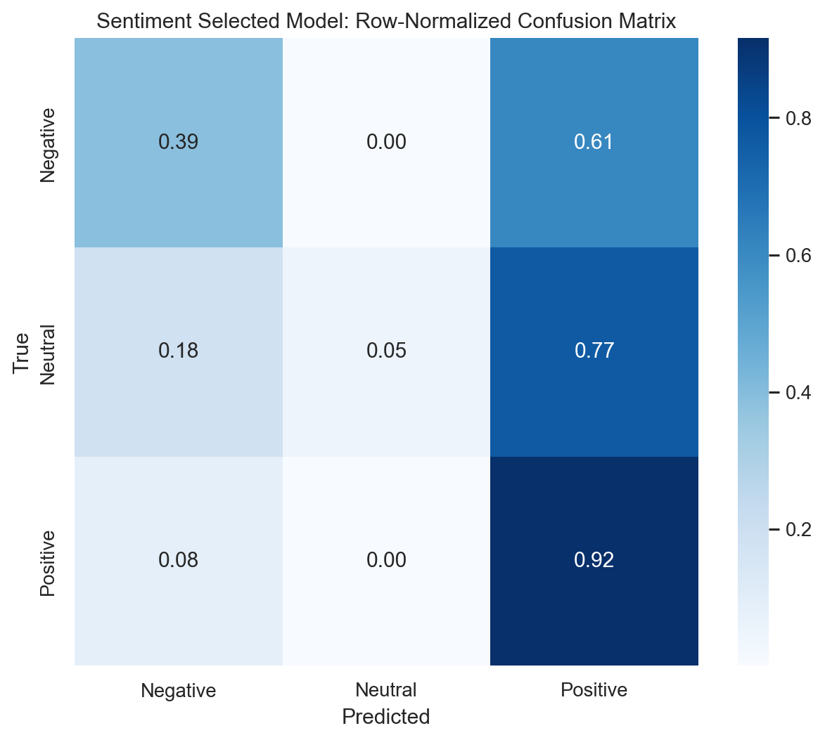
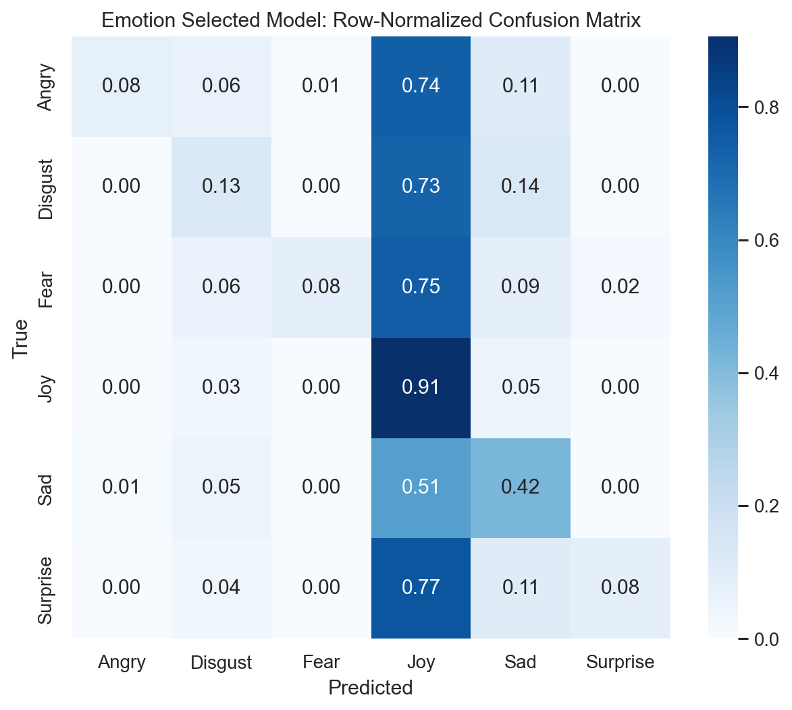
ERROR ANALYSIS
Selected Linear SVM confusion matrices
Confusions remain concentrated around dominant labels and rare-class under-recall.
Weak-reference disagreement ≠ guaranteed linguistic error
Canonical seed-42 test predictions and confusion matrices
10
Notes:
Discuss rare-class errors and majority bias.
Do not manually interpret disputed examples as gold mistakes.

Slide 11
DEMONSTRATION
One interface, separate pipelines and saved models
1
2
3
4
5
Choose task
Choose model
Enter Urdu text
Predict
Inspect evidence
Sentiment or Emotion
All eight saved models
Raw + cleaned view
Label + score semantics
Validation leaderboard
The app exposes the same preprocessing, validation ranking, weak-label disclosure, and task-specific artifacts used in this report.
app/streamlit_app.py
11
Notes:
Live path: switch task, select Linear SVM, enter Urdu text, show cleaning, predict, inspect leaderboard.
Mention that Transformer loading is local and may take longer.

Slide 12
CONCLUSION
Rigor changed the result story
Final results
The strongest defensible conclusion is not that one architecture solved Urdu emotion classification. It is that task isolation, duplicate controls, validation-only selection, repeated seeds, and complete artifacts produce a more honest benchmark.
Sentiment 0.4590
Emotion 0.2854
test macro-F1
Highest-priority next step
Create an independently annotated native-speaker test set, measure agreement, and rerun evaluation without changing the official training splits.
No human-gold evaluation is claimed in the current project.
Notes:
End with the concrete next step: human annotation.
Invite questions about the group-safe split, run matrix, or demo.

