Slide 1
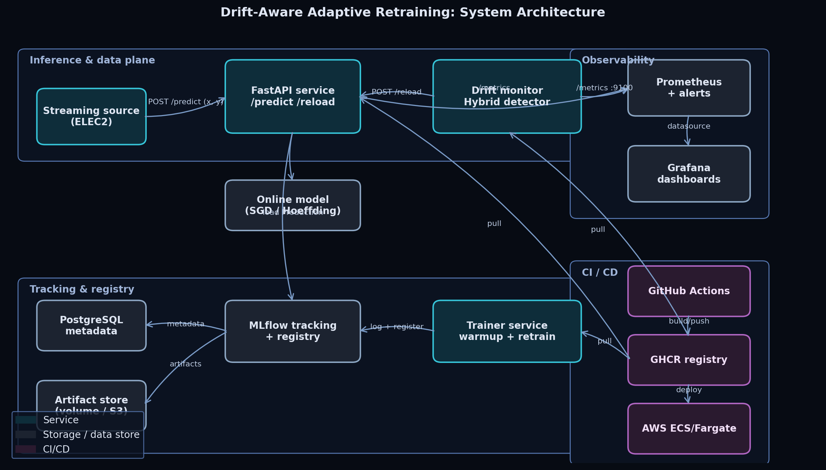
FINAL DEFENSE
Drift-Aware Adaptive Retraining MLOps Pipeline
A complete Track-II MLOps research project: HybridDD, MLflow, Docker, Prometheus, Grafana, CI/CD, experiments, IEEE paper, and live demo evidence.
100/100
36
3
rubric target
multi-seed benchmark runs
applicable statistical tests
Defense promise
Every grading category is tied to a working artifact, a repository path, and a demo step.
Repository evidence: README.md, docs/RUBRIC_MAPPING.md, paper/main.pdf
01

Slide 2
RUBRIC SCORECARD
The project is packaged to hit every weighted criterion.
This slide mirrors the evaluator's rubric so the grading logic is explicit.
Criterion
Weight
Target
Primary evidence
100
Research novelty
20
20/20
HybridDD, RQs, 19 references, IEEE paper
total target score
Technical implementation
25
25/25
FastAPI, MLflow, Docker, CI/CD
6/6
Design quality
15
15/15
Modular services and architecture diagrams
rubric sections covered
Monitoring depth
10
10/10
Prometheus, Grafana, alerts, drift service
0
Experimental rigor
15
15/15
Multi-seed runs plus Friedman/Nemenyi tests
mandatory gaps
Documentation
15
15/15
README, docs, paper, screenshots, demo video
Evidence map: docs/RUBRIC_MAPPING.md
02

Slide 3
RESEARCH PROBLEM
Static ML pipelines fail quietly when the stream changes.
The project studies concept drift as both a model-quality problem and an operations problem.
1
2
3
4
5
Train
Deploy
Drift
Observe
Adapt
Reference distribution
Model serves traffic
Feature or concept changes
Metrics expose degradation
Reload/retrain safely
Why it matters
Research framing
Deliverable fit
Without drift-aware monitoring, the model can remain technically healthy while the prediction boundary is already stale.
RQ1-RQ4 connect detector quality, monitoring reuse, latency and throughput trade-offs, and reproducibility.
The problem naturally requires experiment tracking, deployment, monitoring, CI/CD, and a research paper.
Research source: docs/RESEARCH.md and paper/main.tex
03

Slide 4
LITERATURE TO GAP
The literature motivates a hybrid alarm, not another isolated detector.
The bibliography covers concept drift, stream learning, MLOps readiness, MLflow, and statistical comparison.
Literature cluster
Representative concepts
Gap used in this project
Drift detection
ADWIN, DDM, EDDM, KSWIN, Page-Hinkley
Single detectors optimize different failure modes
Online learning
Prequential testing, Hoeffding tree, SGD
Evaluation must be stream-native
Production ML
Technical debt, ML readiness, deployment cases
Monitoring and adaptation need system evidence
Statistics
Friedman and Nemenyi comparisons
Detector claims need repeated blocks, not anecdotes
19 references
4 research questions
6 detectors compared
Novelty statement
HybridDD combines performance drift and feature-distribution drift with consensus, confidence override, and cooldown logic.
Bibliography: paper/refs.bib
04

Slide 5
HYBRIDDD CONTRIBUTION
HybridDD turns two weak signals into one safer retraining decision.
The detector is intentionally conservative: reduce retraining storms while still surfacing severe degradation.
Prediction error
Confidence override
DDM watches rising error rate.
Severe error can bypass consensus.
Consensus window
Drift event
Signals must agree within a recent window.
Trigger metrics and reload.
Feature shift
Cooldown
KSWIN watches distribution movement.
Suppresses repeated alarms.
Research trade-off
HybridDD is not designed to be the fastest possible detector in every short stream. It is designed to balance accuracy, false positives, and operational safety.
Core implementation: src/drift/detectors.py
05

Slide 6
SYSTEM ARCHITECTURE
The project is a deployable MLOps system, not a notebook demo.
Four planes separate inference, experiment tracking, monitoring, and delivery.
Inference
FastAPI /predict, /health, /reload, /metrics
Tracking
MLflow plus Postgres backend store
Monitoring
Prometheus, Grafana, drift metrics, alerts
CI/CD
Tests, lint, Docker build, paper build, ECS deploy
Architecture guide: docs/ARCHITECTURE.md
06

Slide 7
TECHNICAL IMPLEMENTATION
The mandatory stack is implemented end to end.
Each requirement has executable code, configuration, and demo evidence.
Requirement
Implementation
Repository evidence
MLflow
Training runs, metrics, artifacts, tracking server
src/pipelines/train.py; Dockerfile.mlflow
Docker
API, trainer, drift monitor, MLflow, Postgres
docker-compose.yml; deploy/docker/
Prometheus
API and drift monitor scrape targets
deploy/prometheus/prometheus.yml
Grafana
Provisioned model, drift, infra dashboards
deploy/grafana/dashboards/
CI/CD
Lint, tests, smoke experiment, Docker build, deploy
.github/workflows/
Deployment
Local Compose plus optional AWS ECS
.github/workflows/deploy.yml
Technical stack: README.md and docs/SETUP.md
07

Slide 8
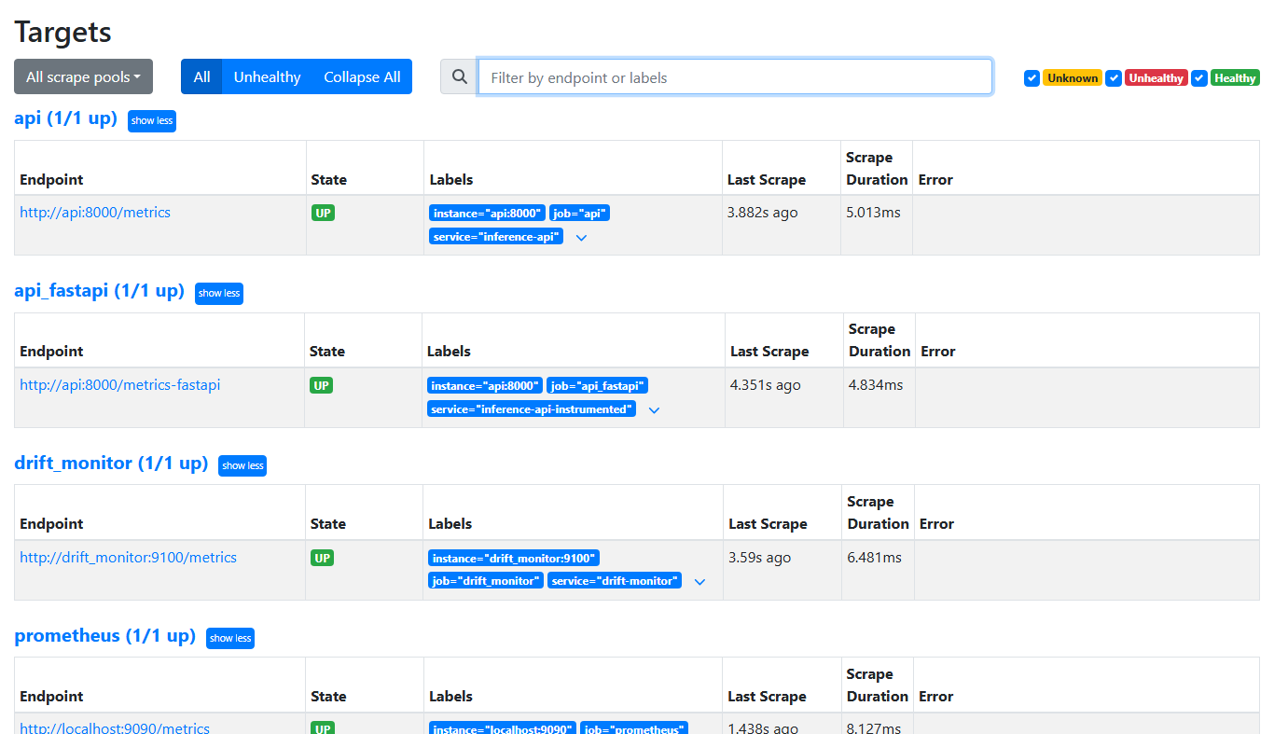
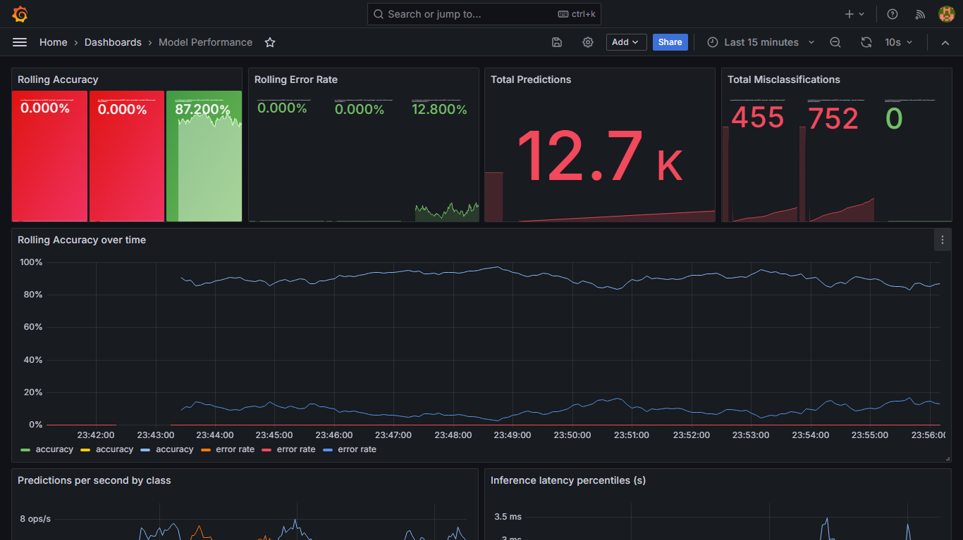
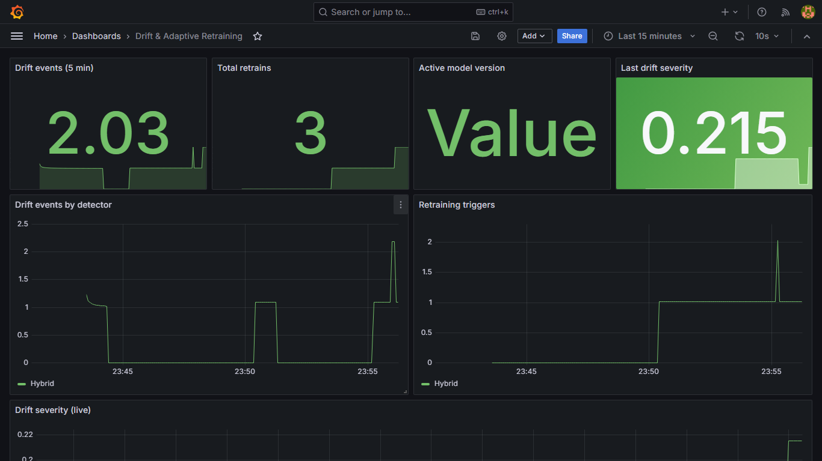
MONITORING AND OBSERVABILITY
Observability closes the loop between research and operations.
The same metrics support dashboards, alerts, and experimental measurement.
10+
3
4
Key signals: rolling accuracy, error rate, drift events, retrains, latency, throughput, model version.
Prometheus model and API metrics
Grafana dashboards
Prometheus alert rules
Monitoring guide: docs/MONITORING.md
08

Slide 9
EXPERIMENTAL RIGOR
The experiment harness evaluates drift as a stream, not a static split.
Prequential testing measures prediction first, then updates the online model with the observed label.
Stream
Predict
Detect
Adapt
Measure
Compare
SEA and rotating hyperplane
test-before-train
six drift detectors
reset or reload on event
accuracy, delay, FP, latency
Friedman/Nemenyi ranks
36
6
3
2
checked-in compact benchmark rows
detectors compared
seeds
synthetic drift streams
Why this matters
The refreshed stats file now has enough blocks for applicable tests across accuracy, penalized detection delay, and false-positive rate.
Reproducible command in docs/RESULTS.md
Harness: src/pipelines/experiment.py and src/pipelines/prequential.py
09

Slide 10
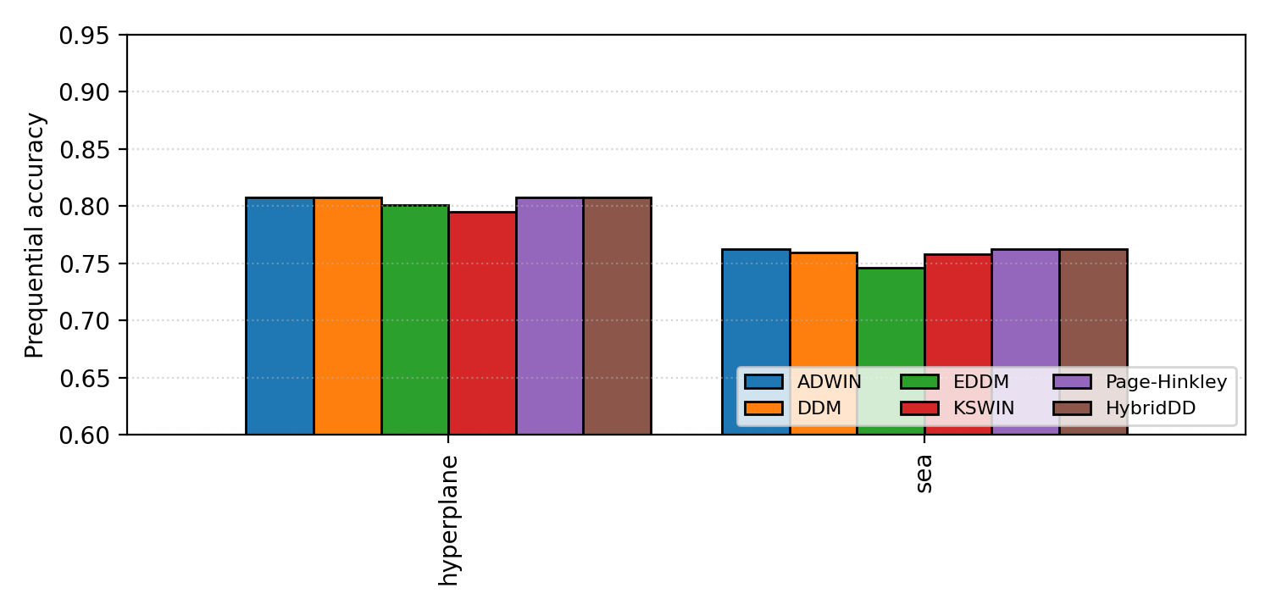
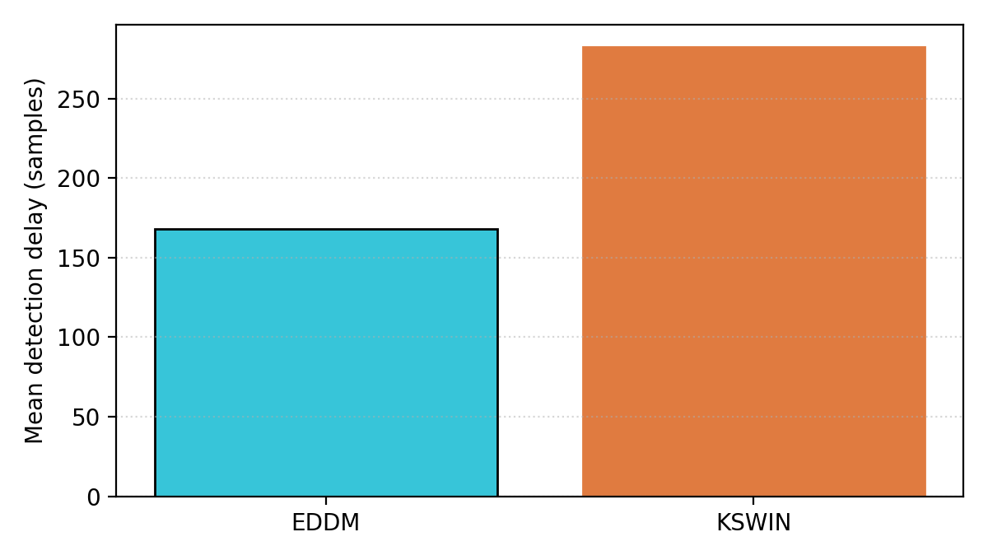
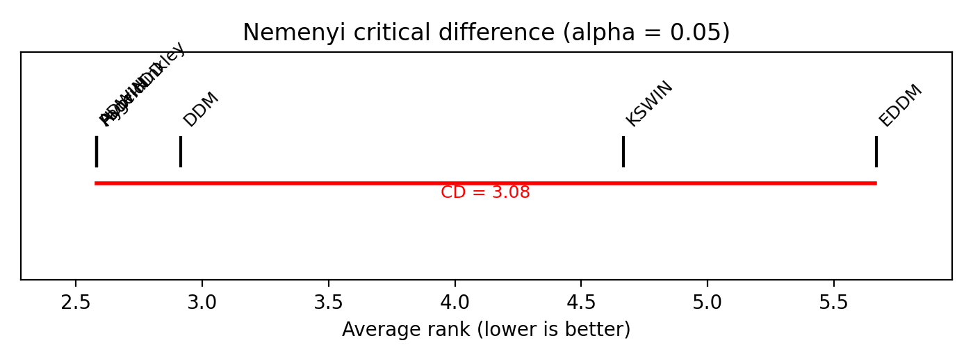
RESULTS AND STATISTICS
The refreshed benchmark makes the statistical analysis visible.
Compact multi-seed artifacts are checked in for review; the full benchmark command remains available for longer runs.
p=0.0010
p=0.00018
p=0.0013
Interpretation
HybridDD matches the top compact-run accuracy and zero false positives; KSWIN is faster on short synthetic delay but much noisier.
accuracy Friedman test
penalized delay test
false-positive-rate test
Results: experiments/results/results.csv and experiments/results/stats.json
10

Slide 11
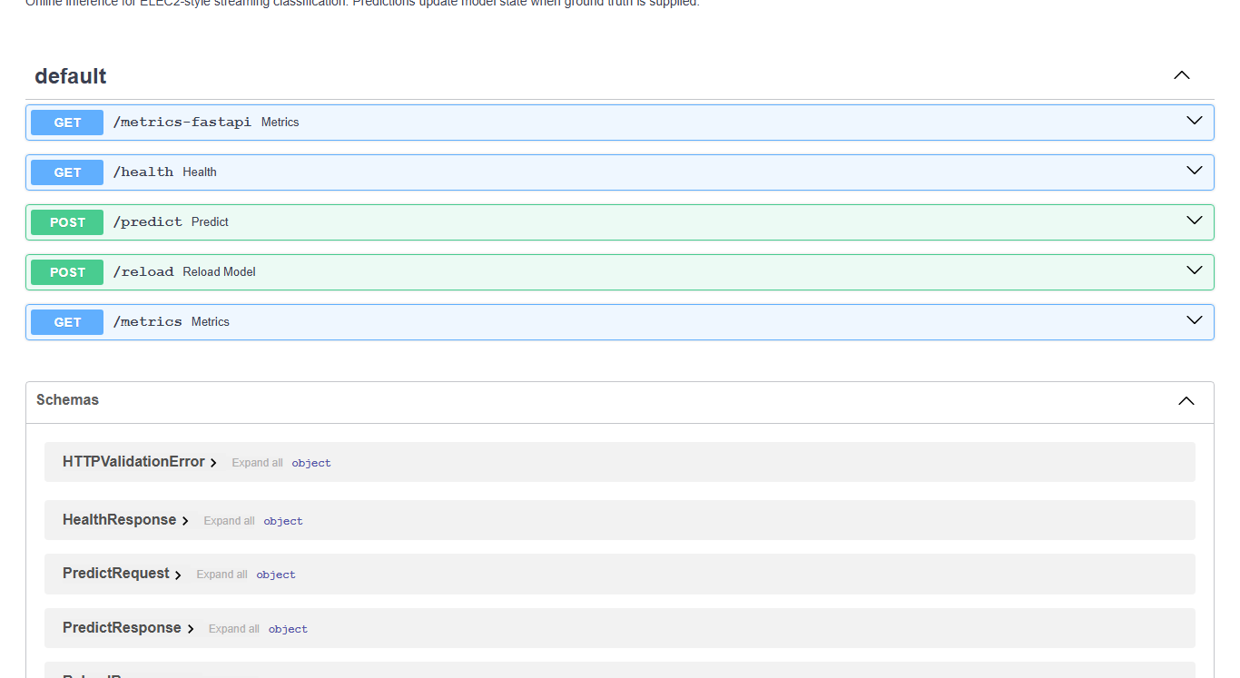
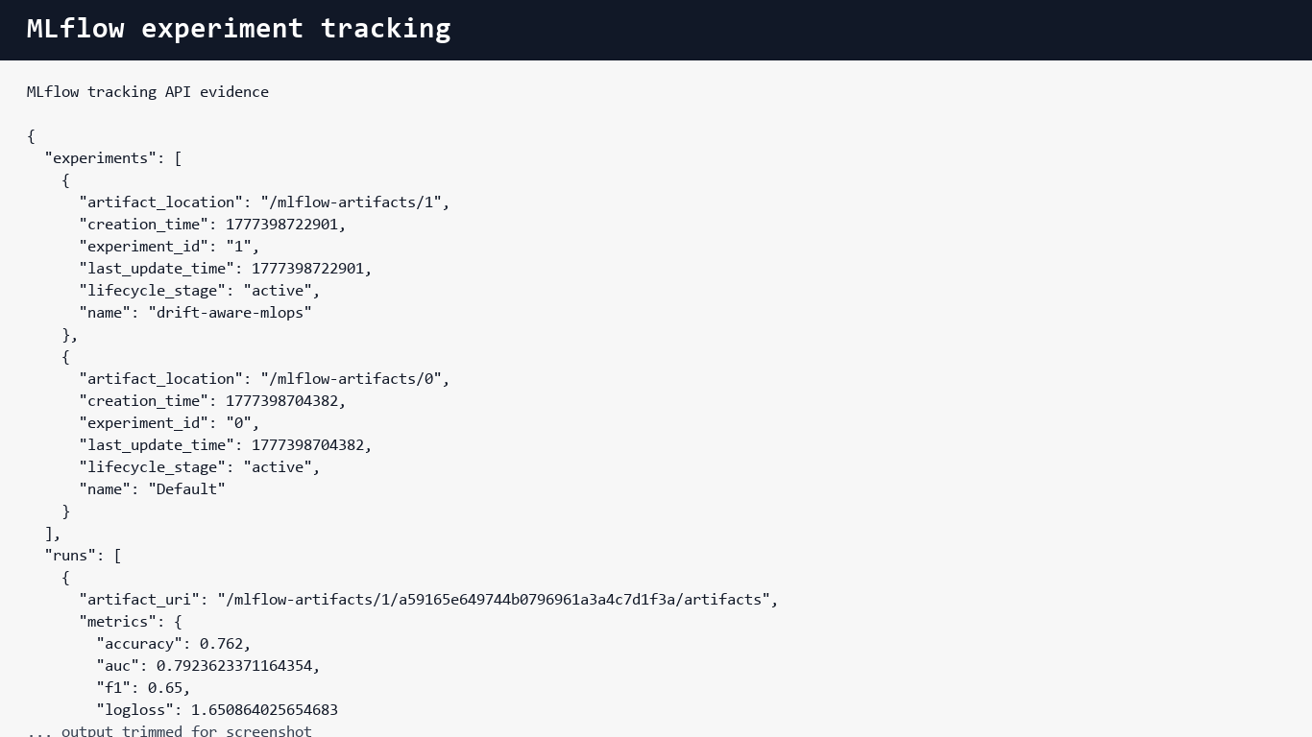
15-MINUTE PRESENTATION PLAN
The live demo sequence follows the rubric exactly.
Use the video/screenshots as fallback, then show the live stack if Docker is running.
0:00-2:00
Problem + novelty
HybridDD and research questions
2:00-5:00
Architecture
Docker services and data flow
5:00-8:00
Implementation
API, MLflow, CI/CD evidence
8:00-11:00
Monitoring
Prometheus targets and Grafana dashboards
11:00-14:00
Experiments
Results, stats, trade-offs
14:00-15:00
Rubric close
100/100 checklist and Q&A
Demo order
FastAPI docs -> /health -> /predict -> MLflow -> Prometheus targets -> Grafana dashboards -> results files.
Presentation script: docs/DEMO_GUIDE.md
11

Slide 12
FINAL CLOSE
The defense closes with evidence, trade-offs, and readiness.
The project can be graded from the repository, demonstrated live, and questioned from the research paper.
A
A
A
A
A
A
research novelty
implementation
design
observability
experiments
documentation
Q&A anchors
Final answer
1. Why HybridDD? 2. Why prequential evaluation? 3. Why penalized delay? 4. How does monitoring trigger adaptation? 5. What would change in AWS production?
This is a complete, reproducible MLOps research pipeline with a clear detector contribution and operational proof.
Ready for live presentation and final submission.
Final package: presentation/Drift-Aware-MLOps-Final-Defense.pptx
12

