Slide 1


Slide 2
Group Memembers
M.Umer
Abubaker
M Ahmad Ijaz

Slide 3
Introduction to Shopping Carts
In the world of e-commerce, a shopping cart is essential for a seamless customer experience. This presentation will explore the key features, functionality, and total price calculation methods that enhance the shopping journey

Slide 4
Key Features of Shopping Cart
Our shopping cart includes following features:
Add the product
Removal of product
View the cart
Product Recommendation
Total price of cart
Checkout
Expiration of cart

Slide 5
Adding and Removing Item
The ability to easily add or remove items from the cart is crucial.
Users should have a straightforward interface to adjust quantities or delete products, enhancing their control over the shopping process.

Slide 6
View & Product Recommendations
In this buyer has ability to view his cart to check its items in the cart.
In this various product recommendations given to the buyers according to the items he/she build her place in the shopping cart.

Slide 7
Total Price Calculation
Accurate total price calculation is vital for transparency.
This includes item prices, applicable taxes, shipping fees, and discounts.
A clear breakdown helps customers understand their total costs before checkout

Slide 8
Checkout & Expiration
Simply checkout means the bill of the cart
The purchaser checkout its cart when he purchase all produces according to his need.
Our product , also contains the feature at which after the some given time the cart is expired and not recover again.

Slide 9
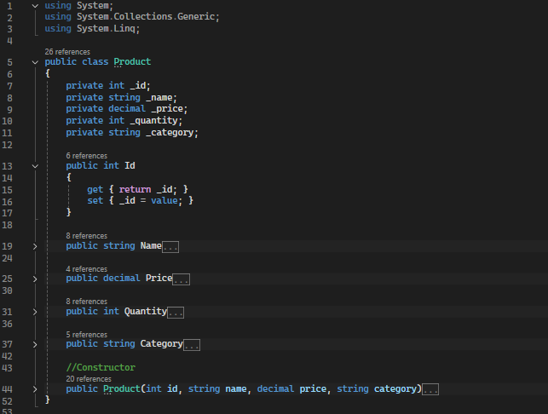
Minimized Code of Project

Slide 10
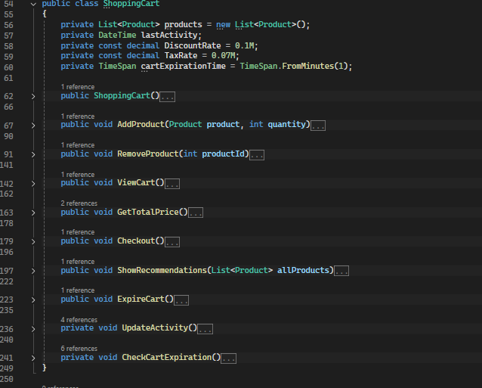

Slide 11
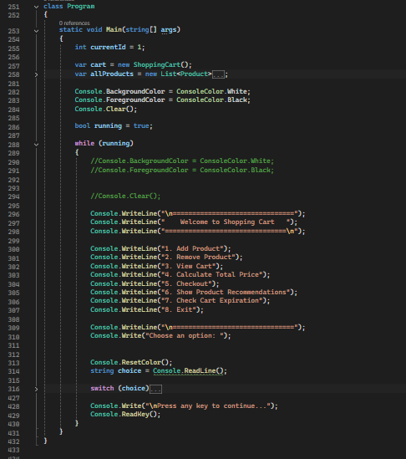

Slide 12
Conclusion
In conclusion, an effective shopping cart must prioritize :
user experience
security, and functionality.
By implementing the discussed features, businesses can create a more engaging and efficient shopping environment, ultimately driving sales.

Slide 13
Thank you
My All Fellows

Slide 14
Allah Hafiz

