Slide 1
University of Bahrain
College of Information Technology
Department of Information Systems
ITIS232 LAB – System Analysis and Design I
Semester 1, 2020/2021
Project “Case Study”
VINTAGE OAK FURNITURE INFORMATION SYSTEM

Slide 3
PROJECT OBJECTIVES
Introducing an Information System.
How to define a problem, analyze the problem, design a solution for the problem and implement the designed solution.
To build a customized furniture information system that looks forward to providing its customers with the best customized furniture.
To define the systems requirements, create data flow diagrams, use cases etc.

Slide 4
PROJECT SCENARIO:
Vintage Oak furniture aims to build an online delivery system that allows customers to place an order for their desired furniture piece. The owners develop a system that stores employee, customer, order, delivery, and inventory details. The system allows employee to log in with authorized access only which is a valid username and password in order to carry on with entering, updating, deleting etc. customers order and delivery information.
In the user interface, a customer has to sign up to create an account and provide details which include phone number and delivery address, with a username and password. After confirming this, they may log in using their sign in credentials. A pop-up message will appear offering membership which provides numerous perks including free delivery over 50BD orders, special updates and sales exclusive for members only etc. Whatever the customer choses, he or she can surf through the website as well as filter the search according to price and type.
The system opens the list accordingly along with availability status, whether the required piece is available or not. If unavailable, the customer can click the “notify me” option which would send a reminder via email or text when back in stock. On the other hand, when the item is available, the customer can place the order. The employee enters this order to the system along with their address.
The system provides cash on delivery, card or membership code as payment methods to the customer. He or she can continue with either of those, and finally receive an order number which is unique every time. A final bill is issued with the product details, like name, cost, and delivery charges, expected delivery time etc. and is shown on the screen and printed as well for both the customer and employer.
The system sends the order to the workshop where the furniture piece is prepared by the carpenter in the time required. When the process of making it is completed, it is sent to the delivery man. The workshop needs to confirm through the system that the item is received by the delivery person. Meanwhile, the customer is updated that the order is in transit through the system. The delivery person should confirm that the order was received successfully meeting all the requirements of the customer’s order. Once the customer receives the order the customer can revisit the website and give feedback.

Slide 5
FUNCTIONAL REQUIREMENTS:
F1 | User Interface
Description | The website will provide two interfaces. The user interface allows the user to access various functionalities of the website by using their log in credentials.
F2 | Admin Interface
Description | The second interface is the admin interface which allows employees with authorized access log in credentials. The admin interface provides multiple features like manipulation of records, addition, deletion or updating orders.
F3 | Customer detail manipulation
Description | This functionality allows the entering, updating, deletion of personal information even after the sign-up process of users like their name, address, phone number, username, password, email address.
F4 | Membership option
Description | This functionality lets the user choose if he would like to get special perks by applying for membership. The user has the freedom to browse through the website even without membership.
F5 | Search Facility
Description | The website provides a search engine facility for all our products, the user can also filter their searches by different options for their ease.
F6 | Notifications
Description | The website has a notification feature which the users can use to get notified of products availability that they have an interest in.

Slide 6
F7 | Place Orders
Description | This function allows the customer to place orders for multiple products, or view their order details.
F8 | Payment Methods
Description | The website allows for multiple payment methods for customers. It accepts credit cards, debit cards, cash on delivery or membership codes
F9 | Order Details
Description | The website issues the details of the customer’s order once the payment is done. It’s known as a printed receipt that includes customer’s name, expected delivery time and order details. These details can be viewed by both the customer and employee.
F10 | Workshop
Description | The order details are then sent to the workshop where the carpenter builds the furniture in the required time.
F11 | Order Information
Description | As soon as the order has passed the construction phase, it is then sent to the delivery man. The delivery man has to pass the order to the customer or in case if the order is to be sent to another country, then the order is sent to the company who’ll send the customer’s order.
F12 | Order Confirmation
Description | The workshop confirms whether the order is delivered to the delivery man so he can deliver it to the customer.

Slide 7
F13 | Order Tracker
Description | The customer is updated through the system that the order is ready and is transited. The customer can also see if the order is in construction phase or delivery phase.
F15 | Customer Feedback
Description | The website allows the customer to give feedback. It is done so that the system gets the chance to improve their performance and also making their customer’s happy.
F14 | Delivery man
Description | The delivery man/person has to make sure that the order was received successfully by the customer and met the customer’s requirement.

Slide 8
DATA FLOW DIAGRAMS
SCENARIO
Vintage Oak Furniture is an online customized furniture store. It aims to offer its customers with unique customized furniture designs. The steps for ordering from Vintage Oak are:
Firstly, when a customer wants to place an order, the customer is directed to Vintage Oak furniture’s website which has all the furniture designs that are in stock. The customer selects the furniture type and design. The system asks the customer to sign in using his email/name and password. Once the customer has signed in the system checks whether the customer has registered before or not. If the customer has registered before the system will proceed with the order otherwise it will ask the customer to sign up and fill in the details required to place the order.
Once the customer has finished placing the order. The system will check if the ordered furniture is in stock or out of stock. If the ordered furniture is in stock, the order is confirmed and if it is out of stock the customer is notified by sending a rejection email or message.
For the confirmed order an invoice will be created and sent to the customer by the system. When the customer receives the invoice, he can either pay online or at the delivery time. The customer can either change or cancel the order.
The order details are sent to the workshop by the system. The workshop informs the system that it has received the order details.
The workshop sends the built order to the delivery team and the delivery team notifies the workshop that it has received the customer’s order. The delivery team makes sure the order is sent to the right customer. The customer notifies the delivery team that he has received the order. Lastly, the system will send an email to request customer’s feedback.

Slide 9
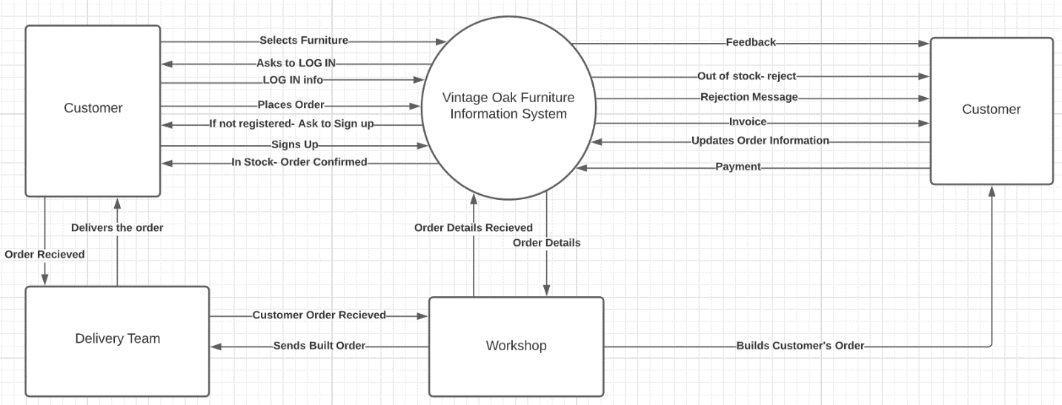
CONTEXT LEVEL DFD

Slide 10
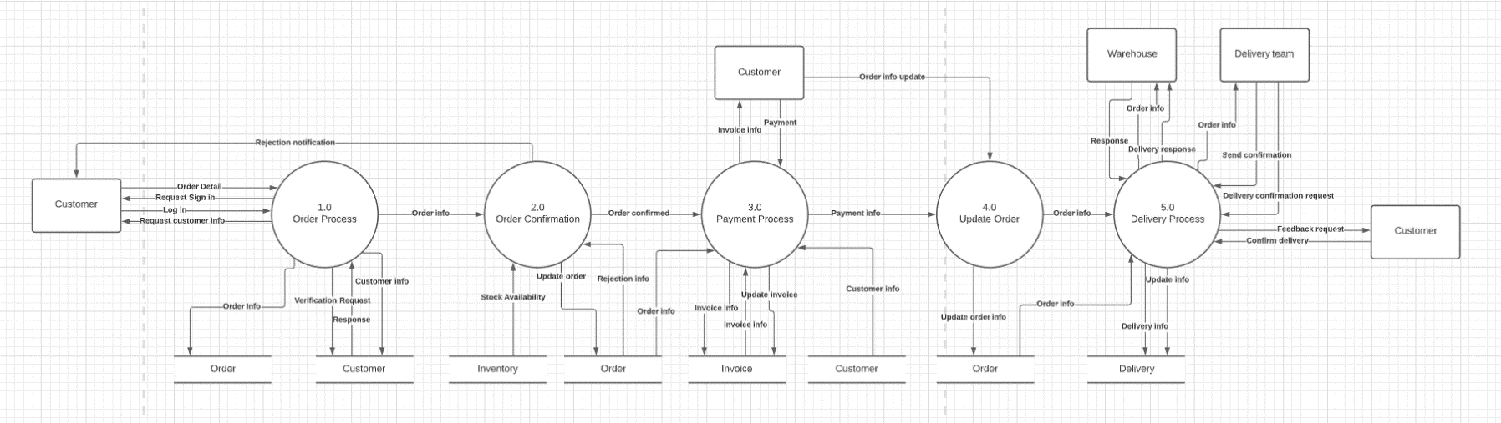
LEVEL 0 DFD

Slide 11
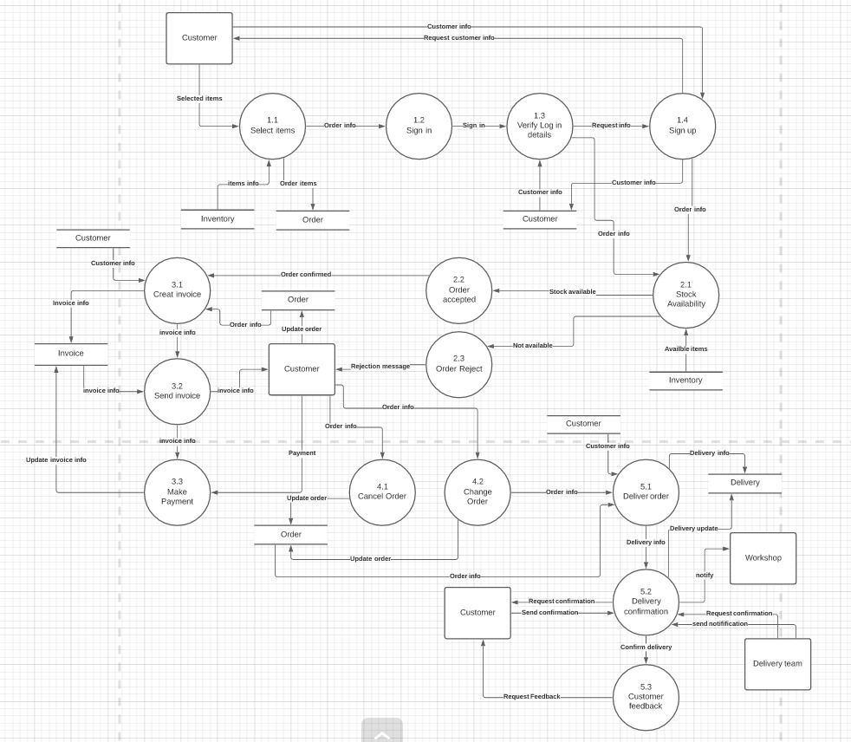
LEVEL 1 DFD

Slide 12
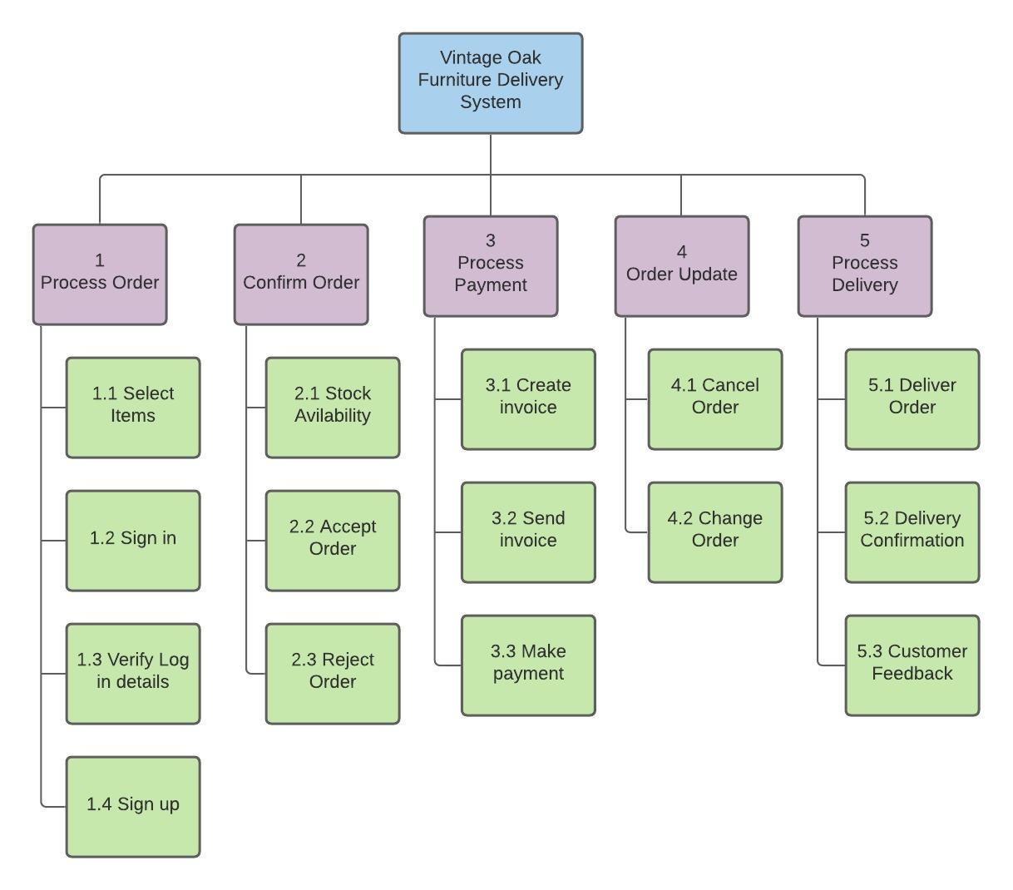
DECOMPOSITION DIAGRAM

Slide 13
PROCESS SPECIFICATION:
Process ID: | 1.1
Process Name: | Select Items
Process Description: | Get the selected items from the customer
Input: | Item selection from external entity customer Inventory information from inventory data store
Output: | Order Items to order data store Order information to process 1.2
Logic:
Remark:
Process ID: | 1.2
Process Name: | Sign in
Process Description: | Get Sign in information from the customer
Input: | Order info from process 1.1
Output: | Sign in information to process 1.3
Logic:
Remark:

Slide 14
Process ID: | 1.3
Process Name: | Verify Log in Details
Process Description: | Determine if the customer Log in details are verified
Input: | Sign in detail from process 1.2 Customer information from customer data store
Output: | Order information to process 2.1 Sign up information request to process 1.4
Logic: | CHECK if customer is verified THEN go to process 2.1 ELSE go to process 1.4
Remark:
Process ID: | 1.4
Process Name: | Sign up
Process Description: | Request sign up details from the customer
Input: | Information request from process 1.3 Customer information from external entity customer
Output: | Request information from external entity customer Customer information to customer data store Order information to process 2.1
Logic:
Remark:

Slide 15
Process ID: | 2.1
Process Name: | Stock Availability
Process Description: | Determine if the items are available in stock or not
Input: | Order information from process 1.3 Order information from process 1.4 Item information from inventory data store
Output: | Items available to process 2.2 Items not available to process 2.3
Logic: | CHECK if items are available THEN go to process 2.2 ELSE go to process 2.3
Remark:
Process ID: | 2.2
Process Name: | Accept Order
Process Description: | Checks whether the order is accepted or not. If accepted the proceeds the order
Input: | Available stock information from process 2.1
Output: | Confirmed order to process 3.1
Logic:
Remark:

Slide 16
Process ID: | 2.3
Process Name: | Reject Order
Process Description: | Determines whether the order is rejected or not. If rejected send a rejection message
Input: | Stock Unavailability from process 2.1
Output: | Rejection Message to customer external entity
Logic: | IF order rejected THEN send rejection message to external entity customer
Remark:
Process ID: | 3.1
Process Name: | Create Invoice
Process Description: | Generates an invoice for the customer’s order
Input: | Confirmed order from process 2.2 Customer information from Customer data store Order information from order data store
Output: | Invoice information to invoice data store Invoice information to process 3.2
Logic:
Remark:

Slide 17
Process ID: | 3.2
Process Name: | Send Invoice
Process Description: | Sends the generated invoice to the customer
Input: | Invoice information from Invoice data store Invoice information from process 3.1
Output: | Invoice information to external entity customer Invoice information to process 3.3
Logic:
Remark:
Process ID: | 3.3
Process Name: | Make Payment
Process Description: | Determines whether the customer has paid for the order or not
Input: | Invoice information from process 3.2 Payment from external entity customer
Output: | Updated invoice information to invoice data store
Logic:
Remark:

Slide 18
Process ID: | 4.1
Process Name: | Cancel Order
Process Description: | Customer decides to cancel the order
Input: | Order information from customer external entity
Output: | Updated order information to order data store
Logic: | IF order is cancelled THEN send order update to order data store
Remark:
Process ID: | 4.2
Process Name: | Change Order
Process Description: | Customer decides to change order
Input: | Order information from customer external entity
Output: | Updated order information to order data store
Logic: | IF order is changed THEN send order update to order data store
Remark:

Slide 19
Process ID: | 5.1
Process Name: | Delivery Order
Process Description: | Final order is delivered to customer
Input: | Customer information from customer data store Order information from process 4.2 Order information from order data store
Output: | Delivery information to delivery data store Delivery information to process 5.2
Logic:
Remark:
Process ID: | 5.2
Process Name: | Delivery Confirmation
Process Description: | Order delivered to customer successfully
Input: | Delivery information from process 5.1 Confirmation requested by external entity delivery team Notification received from external entity delivery team Confirmation sent by external entity customer
Output: | Delivery information updated in delivery data store Send notification to external entity customer Request confirmation from customer external entity Delivery confirmation to process 5.3
Logic:
Remark:

Slide 20
Process ID: | 5.3
Process Name: | Customer feedback
Process Description: | Customer is required to send feedback
Input: | Delivery confirmed from process 5.2
Output: | Feedback request to customer external entity
Logic:
Remark:

Slide 21
Data Dictionary:
Customer = CustID + name + address + {phone} +(email)
Inventory = ItemID + Item_Name + Price + Item_Quantity
Order = OrderNo + CustID + {Order_Items} + [Payment_Method] + (Credit_Card_Type) + (Credit_Card_No) + [Order_Status]
Invoice = InvoiceNO + CustID + name + ItemID + Item_Name + Item_Quantity + Price + Total
Delivery = DeliveryID + CustID + ItemID + OrderID + Delivery_Date + [Delivery_Status] + Address

Slide 22
Decision Table:
Verify Customer Order:
SCENARIO:
Vintage Oak Furniture wants to create a decision table to verify the customer’s order process. In order to verify the customer’s order the system will check for 3 conditions. These are sealed order, properly addressed and confirmed order. The system will check for the sealed order, properly addressed and confirmed order.
The actions taken during this process are Accepted or Rejected. If the 3 conditions are met the order will be accepted and the order will be rejected if any one of the conditions is not met.
CONDITIONS:
C1: Sealed Order (Y, N)
C2: Properly addressed (Y, N)
C3: Confirmed order (Y, N)
NUMBER OF RULES:
2*2*2 = 8
ACTIONS:
A1: Order sent
A2: Order not sent

Slide 23
DECISION TABLE:
C1 : Sealed order (Y, N) | Y | Y | Y | Y | N | N | N | N
C2 : Properly Addressed (Y,N) | Y | Y | N | N | Y | Y | N | N
C3: Confirmed Order (Y,N) | Y | N | Y | N | N | Y | Y | N
A1 : Order Sent | X
A2 : Order Not Sent |  | X | X | X | X | X | X | X

