Slide 1
PUBLIC TRANSPORTATION ANALYSIS

Slide 2
INTRODUCTION
The project involves analyzing public transportation data to assess service efficiency, on time performance, and passenger feedback.
The objective is to provide insights that support transportation improvement initiatives and enhance the overall public transportation experience.
This project includes defining analysis objectives, collecting transportation data, designing relevant visualizations in IBM Cognos, and using code for data analysis.

Slide 3
DESIGN THINKING
Analysis Objectives
Data Collection
Visualization Strategy
Code Integration

Slide 4
ANALYSIS OBJECTIVE
To collect the data of number of trips, what are the route from the user and collecting information from user such as starting point and ending point from the user and finally from the bus management getting the number of passengers from each trip with complete details

Slide 5
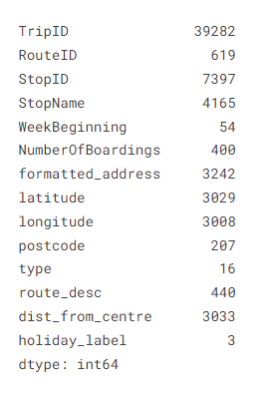
DATA COLLECTION
THE DATASET WHICH IS PROVIDED IS https://www.kaggle.com/datasets/rednivrug/unisys?select=20140711.CSV
The data fields in the given file are:
TripID
RouteID
StopID
StopName
WeekBeginning
NumberOfBoarding
Latitude Longitude
Type
PostCode
RouteDesc

Slide 6
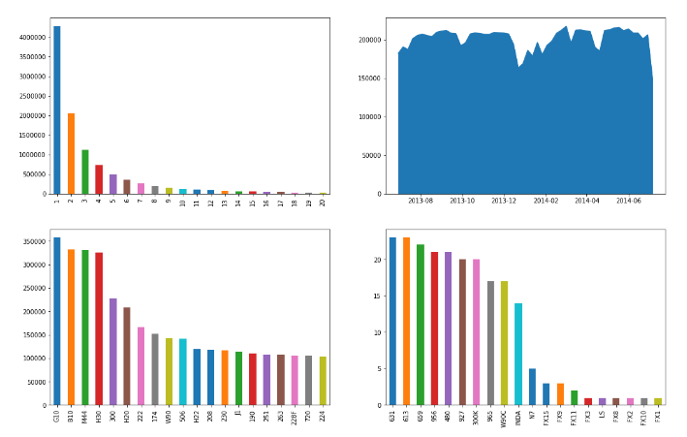
VISUALIZATION STRATEGY

Slide 7
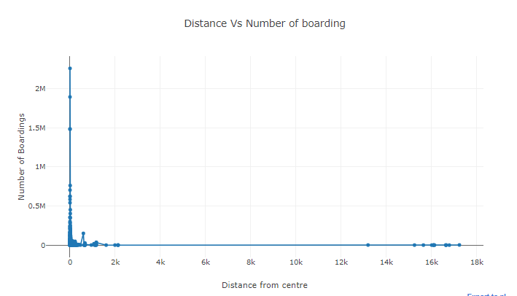
VISUALIZATION STRATEGY

Slide 8
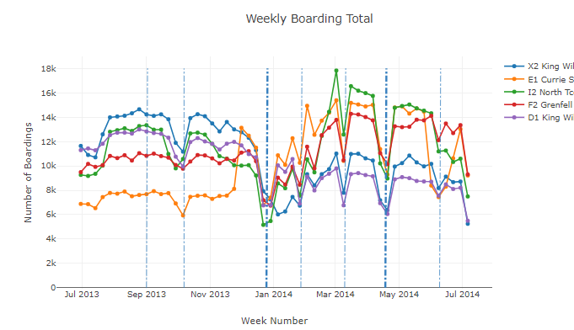
VISUALIZATION STRATEGY

Slide 9
CODE INTEGRATION
Linear regression
A linear regression model describes the relationship between a dependent variable, y, and one or more independent variables, X. The dependent variable is also called the response variable. Independent variables are also called explanatory or predictor variables.
LSTM
Long Short-Term Memory (LSTM) models are a type of recurrent neural network (RNN) that have gained popularity in the field of deep learning due to their ability to handle long-term dependencies in sequence data.

Slide 10
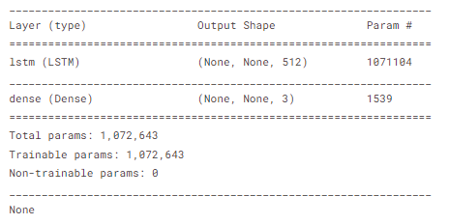
LSTM VISUALIZATION

Slide 11
CONLUSION
Therefore it Calculates the number of people commuting within a specific route.
It shows the accuracy means of commute based upon market information.

