Slide 1

Calculation The Interval Between Two External Signals

Slide 2
Team Members
1. Islam Atef Mohamed 2. Ahmed Galal Mahmoud 3. Ahmed Mohamed Abo Bakr 4. Ahmed Ezzat fadl 5. Ahmed Heshmat kamel 6. Esraa Rizk samhan 7. Aya Gamal hamed 8. Asmaa Ahmed Mohamed

Slide 3
Idea
Measuring the time in terms of milliseconds between two predefined external input signals that come from a bush button.

Slide 4
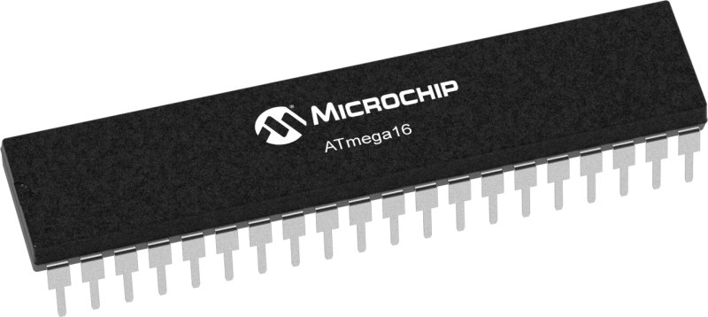
AVR Atmega16
is an 8-bit high performance microcontroller from the Atmel’s Mega AVR family and has 3 timers : timer0,timer1,timer2.
( timer0 and timer 2 are 8-bit but timer1 is 16-bit.)
There are 32 I/O (input/output) lines which are divided into four 8-bit ports designated as PA, PB, PC and PD.

Slide 5
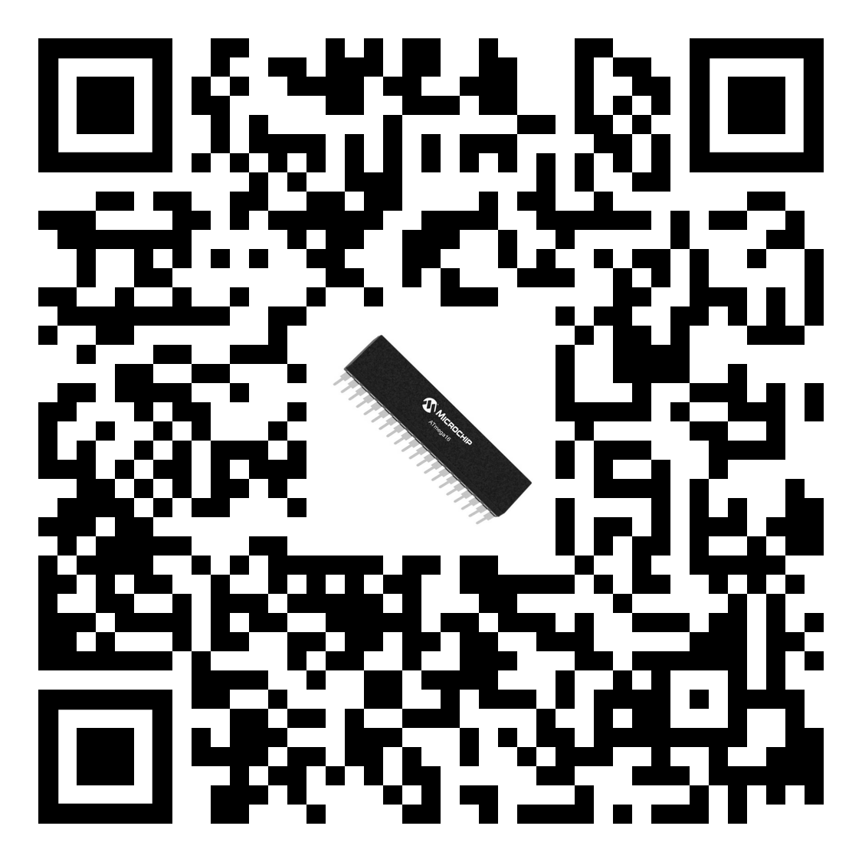
AVR Atmega16
Scan here to view datasheet

Slide 6
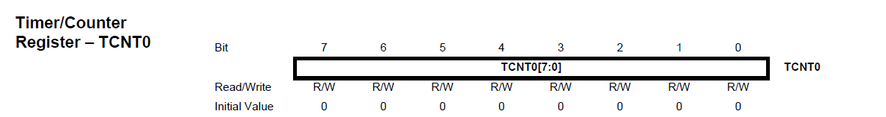
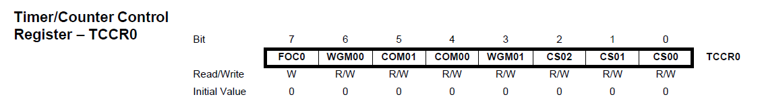
Timer0
TCNT0 is register that hold value of timer
TCCR0 is the control Register

Slide 7
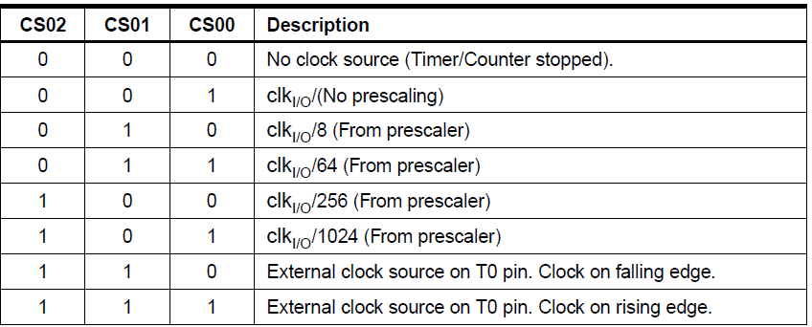
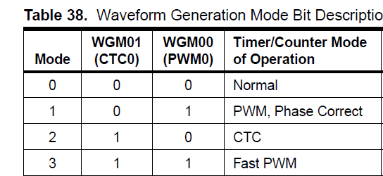
Prescaler Select and Modes Select

Slide 8
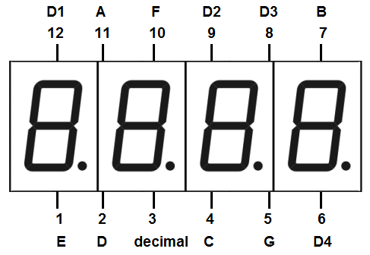
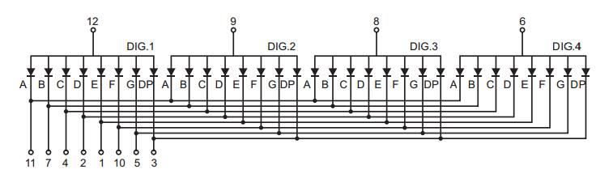
Display the time on 4 bit seven segment

Slide 9
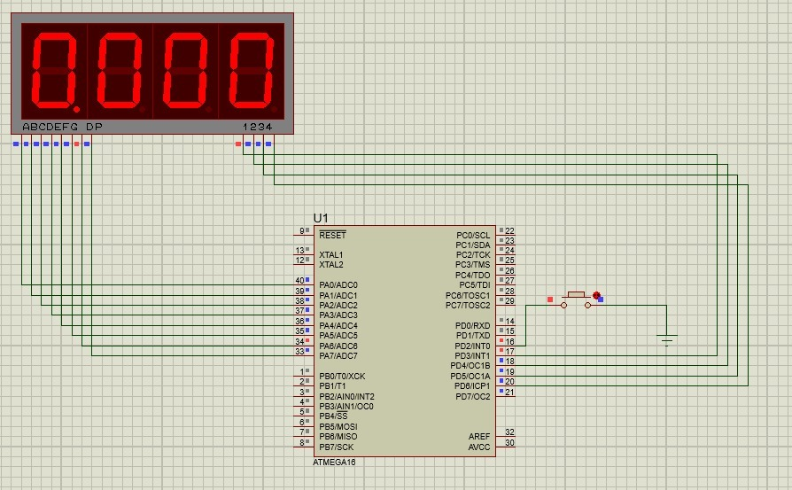
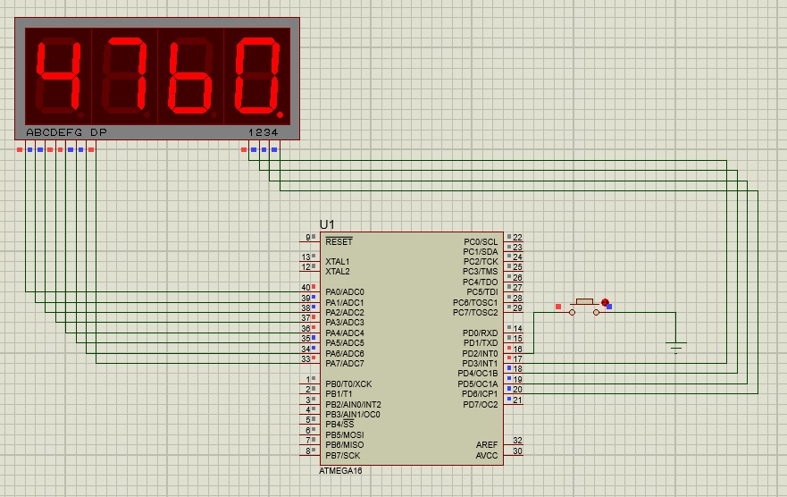
Simulation Circuit

Slide 10
Thanks

