Slide 1
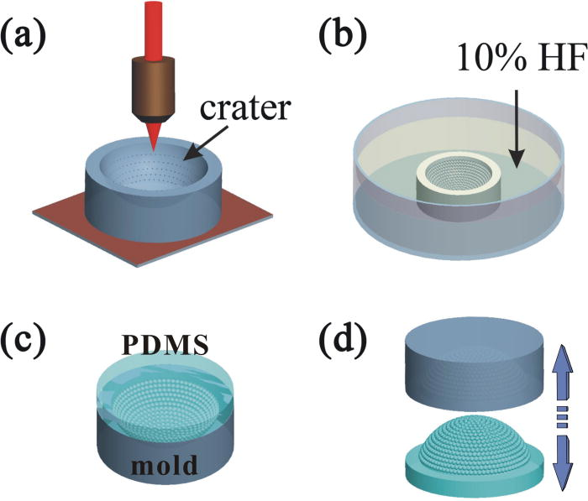
From: Direct fabrication of compound-eye microlens array on curved surfaces by a facile femtosecond laser enhanced wet etching process
Appl. Phys. Lett.. 2016;109(22). doi:10.1063/1.4971334
^{Date of Download: 5/22/2023}
Copyright © 2023 . All rights reserved.
Notes:
Figure Legend: Schematic illustration of the fabrication process of the compound eye inspired curved microlens array. (a) Femtosecond laser point-by-point exposures on the curved lens. (b) 10% HF solution ultrasonic bath for the wet etching process to produce concave microlens array-in-lens. (c) PDMS pouring and solidifying. (d) Peeling replication mold and obtain an artificial compound eye.

