Slide 1

Deveopment in electronics industry under
Invention vs Innovation

Slide 2
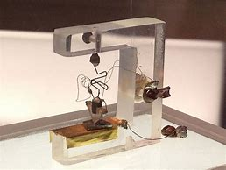
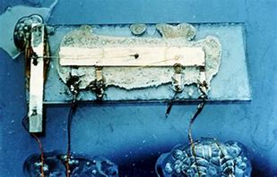
First transistor
100 µm – 1947(Bell labs)
…..
8 nm – 2015 (Intel)
First IC
Only one transistor (+R+C) - 1958
…..
>10^9 transistor – 2017 (Intel)

Slide 3
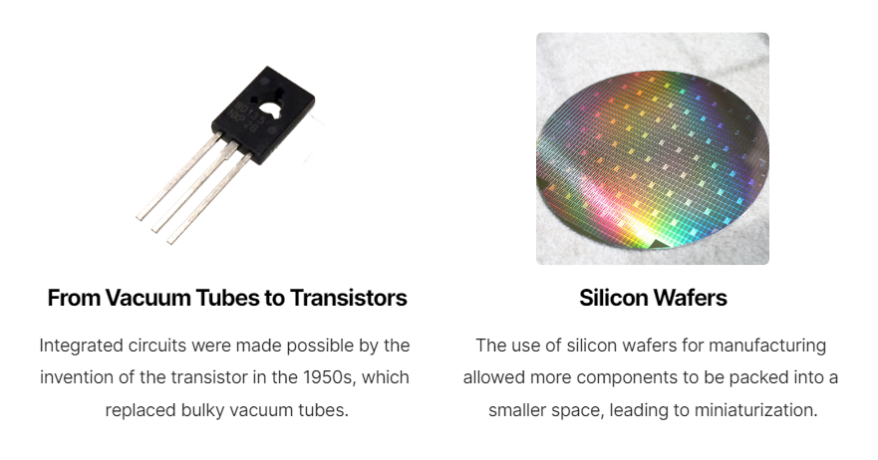

Slide 4
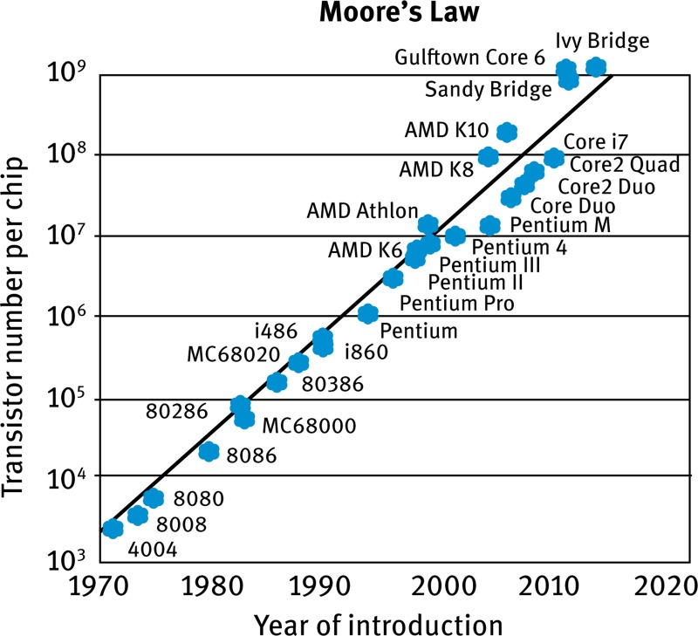
MOSFET scaling
(process nodes)
100 µm - 1947
10 µm – 1971
1 µm – 1984
130 nm – 2001
65 nm – 2005
32 nm – 2009
22 nm – 2012
14 nm – 2014
10 nm – 2016
7 nm – 2018
5 nm – 2020
3 nm – 2022 Future 2 nm ~ 2024

Slide 5
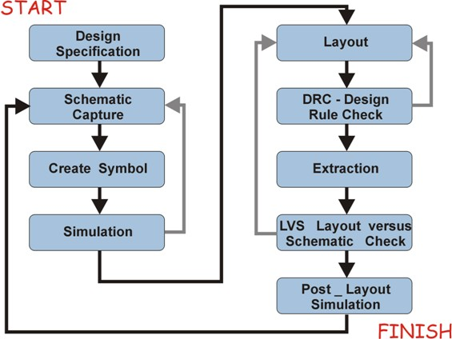
GP scope
Automation
Creating Automation scripts for design cycle
(schematic/layout)

Slide 6


Why is layout is so important ?
Good design + Good layout
Successful Product
Good design + bad layout
Faulty Product

