Slide 1
Design and Automation of VGA
Presented To :
Presented By :Mario Samir
Presented On:

Slide 2
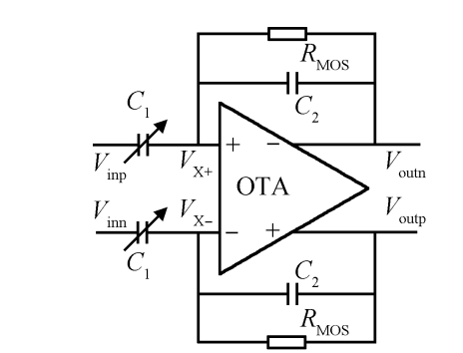
Project’s Scope
Designing layout of a fully differential Variable Gain Amplifier (VGA).
Using layout concepts and techniques such as:
Floor planning.
Detailed Routing.
Global Routing.
Matching.
Shielding.
Calculating current capacities for routes…etc.
Running post layout sims (PEX).
Creating Automation scripts for the VGA design cycle (schematic/layout).

Slide 3
Timeline and Steps
Obtaining schematic for VGA.
Each candidate will:
Design Block’s Floorplan.
Design matching patterns for differential pairs, current mirrors…etc.
Place devices based on Floorplan.
Route signals and Power Grid.
Clean the block LVS/DRC.
Run post-layout sims : parasitics extraction (PEX).
Write a script for automation flow for schematic/layout design.

Slide 4
Thank you

