Slide 1

Proposal Presentation Phylogenetic Trees Analysis Pipeline Project
By Andrius Bubelis
CAP5510 BIOINFORMATICS
03.16.2015

Slide 2
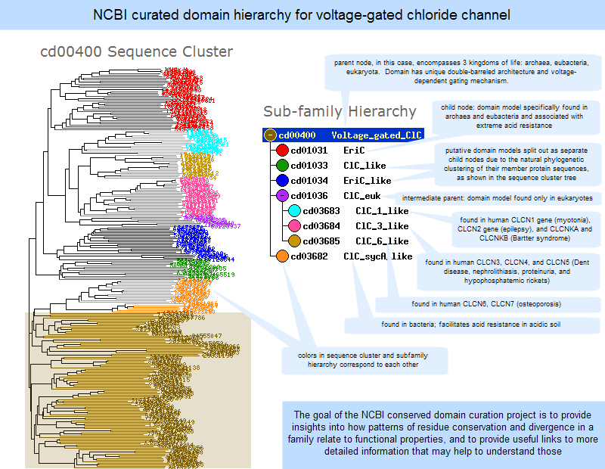
Genomic and proteomic data complexity
52,276,468 protein sequences (NCBI)
14831 protein families (PFAM)
51,661 Organisms (NCBI)
More than 20% of all protein domains are currently annotated as “domains of unknown function”
Tremendous amount of unprocessed and unanalyzed biological data is piling up. There is a huge need for extraction and analysis of a valuable bio content.
My application will address and try to contribute in helping biological data processing.
www.ncbi.nlm.nih.gov

Slide 3
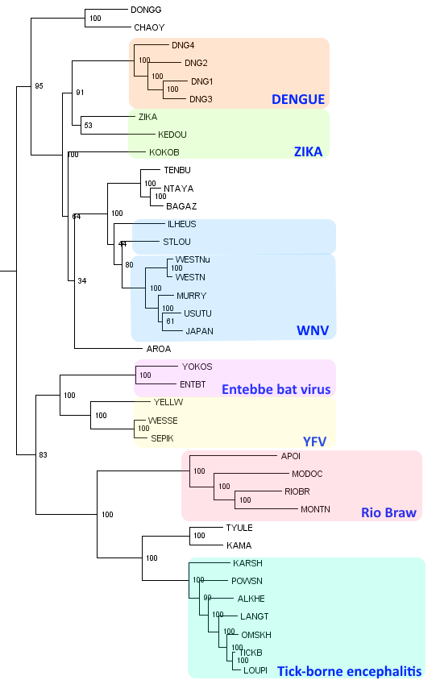
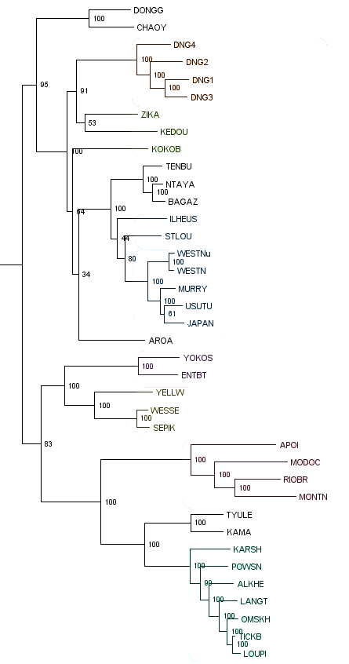
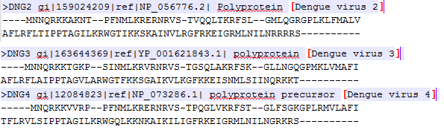
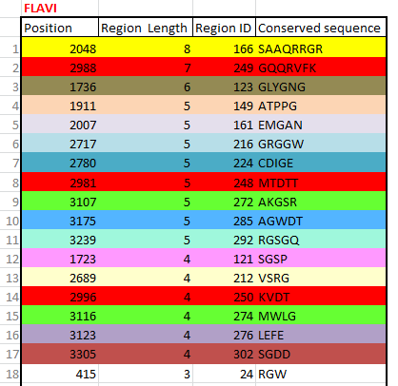
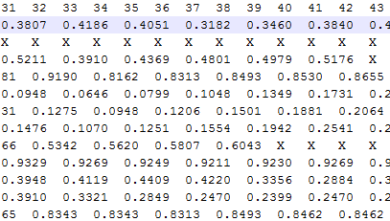

Proposed pipeline would analyze and process phylogenetic trees
Pipeline would be written as Python/Linux application for streamline mass analysis of phylogenetic trees with corresponding fasta sequences and traits
INPUT FILES (3 files):
*.tree (newick) , *.fa corresponding fasta files (sequence)
*.[trait] corresponding file (e.g. O/D, phosphorylation)
INPUT PARAMETERS: conservation (1-100%), auto clade location,
minimum number of amino acids per conserved region
OUTPUT FILES: 1. summary file
2. global conserve (AA/OD) region file
3. clade comparative analysis
4. for each clade generate files:
a) summary profile per clade
b) newick (sub)tree
c) fasta
d) clade conserve regions file
e) clade trait analysis (e.g. O/D)
+
=
ANALYSIS: location of clades, conserved region collection given consensus parameter, clade trait analysis, summary calculation

Slide 4

Example of Files:
+
=

Slide 5
Main goals:
Locate annotated or auto-locate orthologous clades within a phylogenetic protein tree
Find conserved regions within tree? Big Question -What is conserved region?
Calculate amino acid conservation per clade given consensus – How to calculate consensus?
Calculate trait conservation per clade given consensus
Run comparative analysis between clades. (e.g. rate change between clades)
Allow quick way to analyze massive trees and create data files for next level statistic analysis
To be integratd in a bigger project that is being developed in Dr.Liberles lab

Slide 6
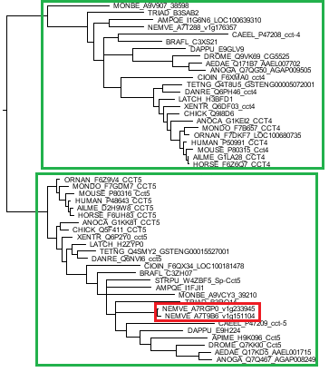
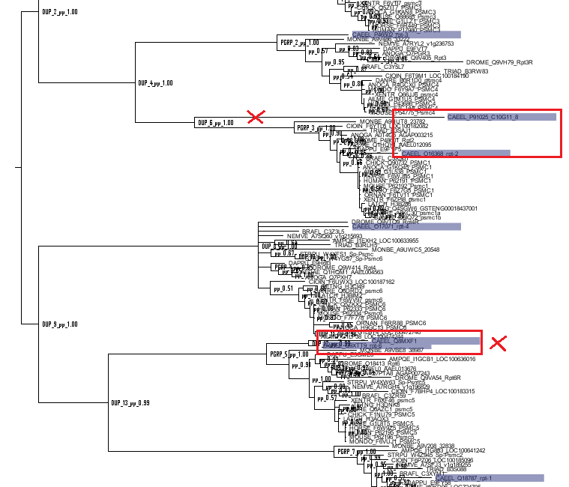
Finding orthologous clades with respect of gene duplication
Some of algorithmic challenges:
false trees, false rerouting, duplication after speciation, singletons, unresolved phylogenetic trees,
time/space complexity, traversing issues (misconstrued trees) etc.
Trees files are curtesy of Joseph Ahrens

Slide 7
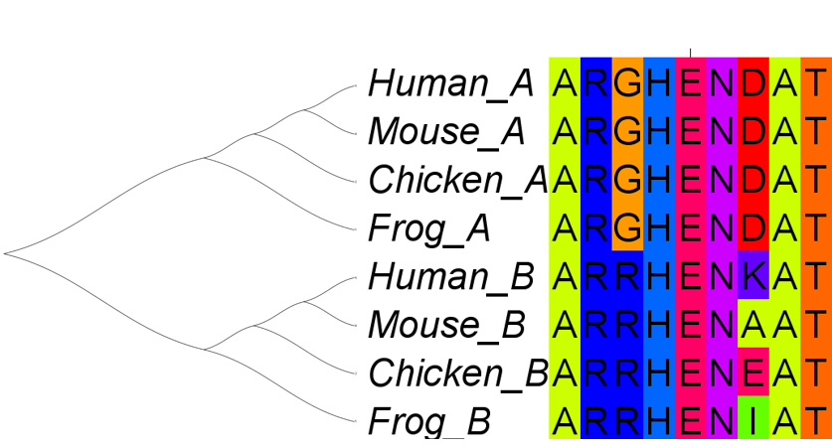
Clade conservation analysis Identification of clade specific conserved regions
Strict conservation per site
Aim:
Identify sites that are not likely to change in amino acid sequence per clade
Identify the corresponding nucleotide regions
Identify within these nucleotide regions, the conserved, or the least variable, regions.
These regions could be used for primer design, or in viruses to identify potential broadly neutralizing drug targets.
Sequence

Slide 8
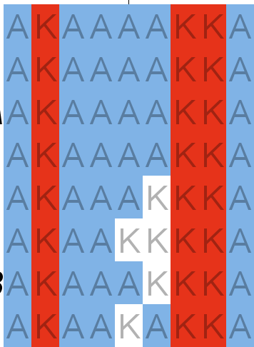
Trait analysis Identification of sites and regions important for functional divergence.
From simple measures of conservation per site to Bayesian substitution rates per site as estimated from alignment and clade topology.
Aim:
Identify sites that are changing rates between clades (each site would be assigned rate per clade)
Identify sites that are changing conserved physicochemical character or trait among sites between clades.
Sequence Binary trait

Slide 9
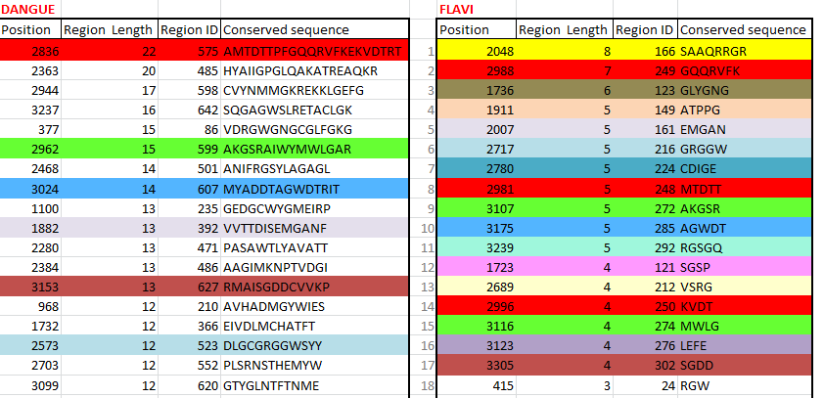
Clade conservation analysis (more examples)
Locate amino acid conserved regions globally in MSA and relate to clade conservation
e.g.
Dengue Clade region (red) conserved
is split into 3 sub red regions (red) within Flavi family (on the right)

Slide 10
Where an application could be used?
Analyzing virus families for Anti-Virus compound development
Show changes in conservation in protein families
Important for understanding protein evolution
Understanding functional divergence
Clustering sequenced based on conservation
As inner piece for larger pipeline implementation

