Slide 1


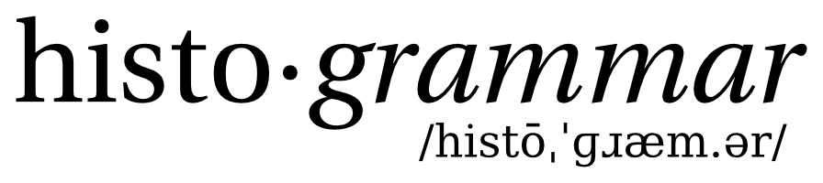
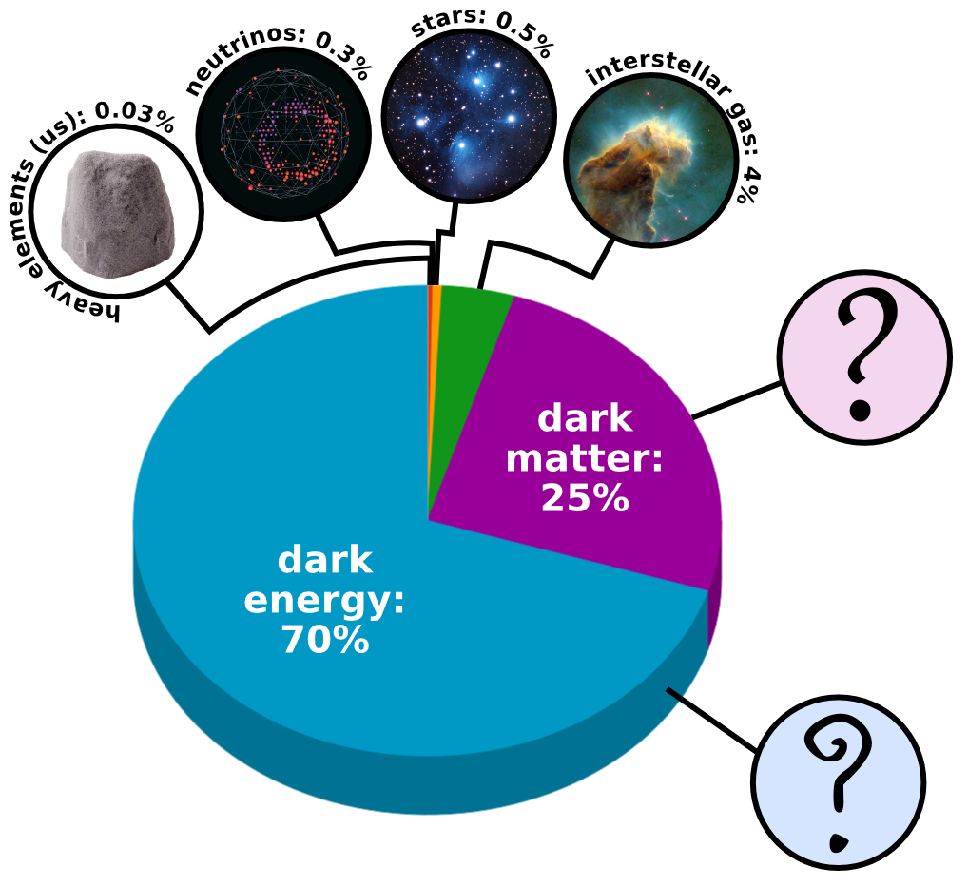
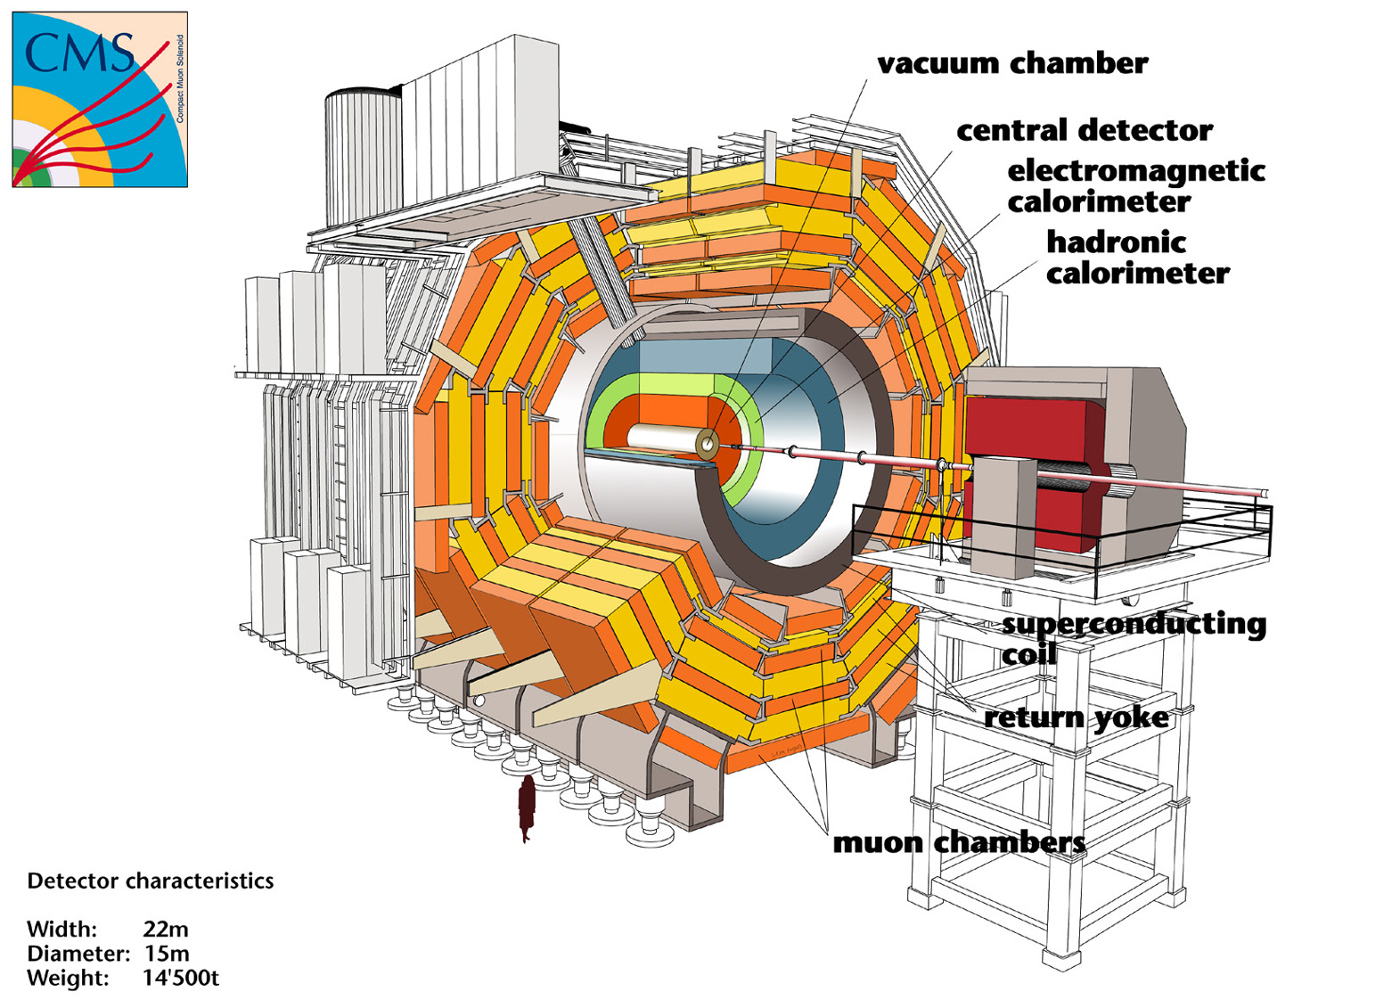
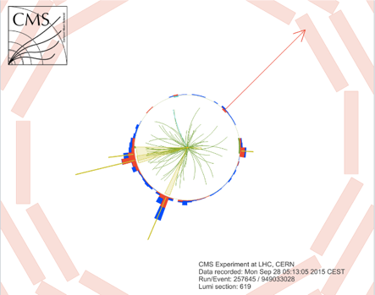
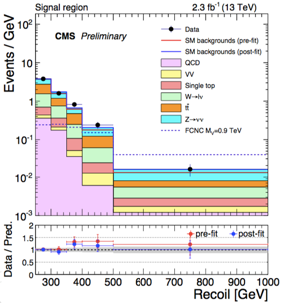
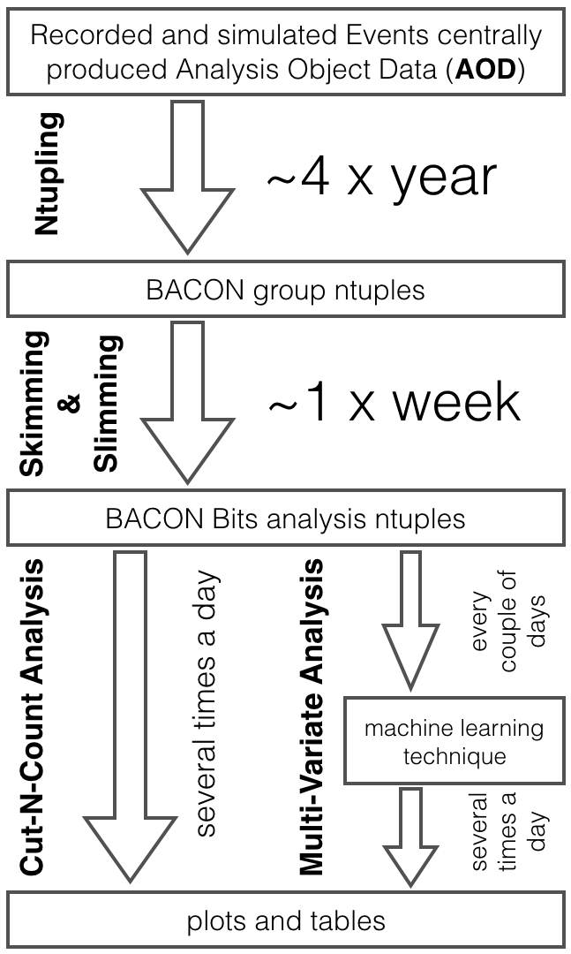
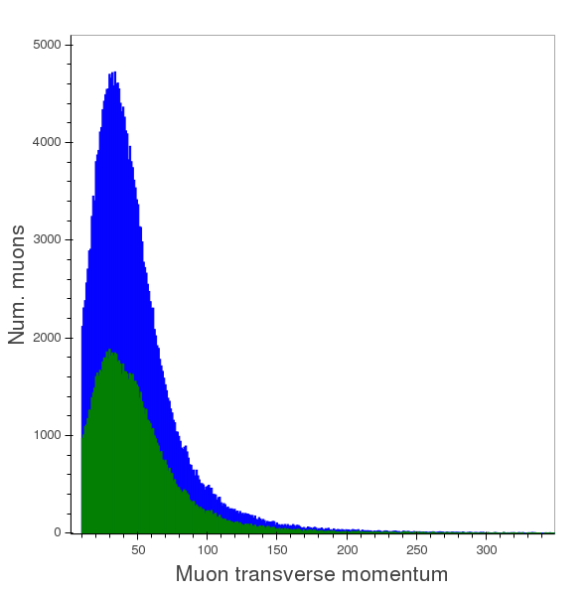
How Big Data allows particle physicists to concentrate on science
Matteo Cremonesi(**), Oliver Gutsche(**), Bo Jayatilaka (**), Jim Kowalkowski(**), Cristina Mantilla(**), Jim Pivarski(*),
Saba Sehrish(**), Alexey Svyatkovskiy(*)
(*) Princeton (**) Fermilab
Histogrammar is a grammar of composable histogram pieces that together provide all of the capabilities expected in a HEP histogram aggregation package. These pieces, called "primitive aggregators," are all commutative monoids, so any composition of them can be filled in any order on any partitioning of the data. We can therefore use the entire Spark cluster for data exploration and final plots without being limited to a few plot types.
Histogrammar is only an aggregation tool– we linked it to Bokeh to draw the plots. http://histogrammar.org for more.
Abstract
Using Spark
In this poster, we evaluate Apache Spark for High Energy Physics (HEP) analyses using an example from the CMS experiment at the Large Hadron Collider (LHC) in Geneva, Switzerland. HEP deals with the understanding of fundamental particles and the interactions between them and is a very compute- and data-intensive statistical science. Our goal is to understand how well this technology performs for HEP-like analyses. Our use case focuses on searching for new types of elementary particles explaining Dark Matter in the universe. We provide different implementations of this analysis workflow; one using Spark on the Hadoop ecosystem, and the other using Spark on high performance computing platforms. The analysis workflow uses official experiment data formats as input and produces publication level physics plots. We compare the performance and productivity of the current analysis with the two above-mentioned approaches and discuss their respective advantages and disadvantages.
Spark on Hadoop
Apache Spark on an SGI Hadoop Linux cluster consisting of 6 data nodes and 4 service nodes all with Intel Xeon CPU E5-2680 v2 @ 2.80GHz, each CPU processor core on a worker node having 256 GB of memory. Configure the Hadoop cluster without single
points of failure using two separate machines as name nodes. Deploy Spark applications
using YARN resource manager, store data in HDFS.
Scala and Python based analysis workflows
Input data: the most common format in HEP is ROOT TTrees. Develop a library to convert ROOT trees to Apache Avro row-based format readable by Spark
Spark operations and APIs: perform skimming and slimming on the input data by means of Spark’s map, flatMap and filter transformations. Use modern Dataset and Dataframe APIs taking advantage of advanced Catalyst query optimizer and direct operations on serialized data, available in Spark 2.0. Use Apache Parquet columnar format to store intermediate results between stages of the calculation in HDFS, allowing to easily ingest data into Dataframes and Datasets
Statistical analysis and plotting: make plots using the distributed histogrammar package
Introduction to the CMS Dark Matter search
In a particle collision, Dark Matter would be produced in association with visible particles. Dark Matter particle(s) would propagate through the detector undetected while visible particles would leave signals in the CMS detector.
The signature we search for in Dark Matter production at CMS is an energy imbalance, or “missing transverse energy” associated with detectable particles.
This signature is commonly referred to as “monoX” where “X” can be a light quark or gluon, a vector boson, or a heavy quark such as a bottom or top quark.
We focus our search on the “monoTop” signature, where the detectable particle is a top quark
Challenges of the analysis:
Top quarks are relatively rare: we need to identify collisions producing top quarks with high efficiency
Advanced computational techniques such as artificial neural networks and boosted decision trees can greatly improve the efficiency of the top identification process
Large backgrounds stemming from known processes will still dominate any present signal
Further enhancement of any potential signal can be achieved by optimizing the collision selection via advanced computational techniques
Spark on NERSC
Apache Spark setup is available on Cori and Edison at NERSC.
Initial studies are done on Edison; a Cray XC30, with a peak performance of 2.57
petaflops/sec, 133,824 compute cores, 357 terabytes of memory, and 7.56 petabytes
of disk. Input data files are are stored in GPFS.
Input data: Convert the n-tuple format (ROOT TTrees) to the HDF5 format
Column-oriented data using multiple datasets per group per HDF5 file for faster access for certain analysis (one group per particle type)
Custom HDF5 reader to read in each group into a Spark DataFrame
Spark operations and APIs: Read DataFrames, then perform skimming and slimming using map, flatMap and filter transformations.
Intermediate results stored in CSV files (smaller dataset)
Statistical analysis and plotting: Read intermediate data into Spark Dataframes or Datasets, and make plots using R and the distributed histogramming package.
Matter-Energy Composition of the Universe
The CMS detector
Missing transverse energy
Visible particles
Example of selected collision
Publication physics plot
Problem description/Solution using ROOT
This figure shows the output of the use case workflow on the Hadoop ecosystem. It shows Muon transverse momentum distributions for di-boson simulated samples.
Reconstructing and analyzing HEP collisions
Physics analyses require collisions both recorded by the detector and simulated using Monte Carlo techniques
A C++ software framework is used to reconstruct recorded and simulated detector signals, based on a statistics toolkit also uses to persist objects in files
Reconstructed objects represent particles in a collision (called event) and are used in the analysis step
Recorded data and simulations are processed centrally and the output is analyzed by all physicists looking for a wealth of different physics signals
Dark Matter analysis use case
Step 1: Ntupling
Input:
Recorded events: Analysis Object Data (AOD) event format (400kB/event)
C++ objects describing the analysis products
500,000,000 simulated events for backgrounds and signal (200 TB)
Processing time: 27,777.7778 CPU hours
Output:
ROOT files in custom ``Bacon'' format (2 TB)
Event and physics objects information stored in vectors and float types
Step 2: Skimming ( reduce number of events) and Slimming ( reduce event content)
Apply analysis pre-selection
Output: flat ROOT ntuples with only necessary information
Step 3: Final analysis is performed using the flat ROOT ntuples
Output: publication grade plots and tables
Results and Findings
Conclusion and Future Work
Ease of Use:
A distributed processing environment with task and data distribution and assignment abstracted from end user
High level API
Performance at NERSC using 140 cores
Test 1: Sum of weights for events => 2 sec
Test 2: count the number of events => ~1sec
Test 3: creating and saving the skimmed/slimmed datasets
=> 1-6 min
Performance at Princeton using 140 cores:
Test 1: Sum of weights for events => 14 sec
Big Data technologies are promising to shorten "time to physics": Spark reduces book keeping overhead and has potential to optimize analysis of very big datasets.
We have observed good scalability, data and task orchestration and support of high level API in Spark
Next steps on the way to a full feasibility study:
Optimize analysis workflow to the new big data technology paradigm
Demonstrate multi-user capabilities on Petabyte datasets
This study is supported by the Department of Energy (DOE). The CMS collaboration is supported by DOE, NSF, and international funding agencies. Histogrammer is supported through the DIANA project by NSF. NERSC is supported by DOE.

