Slide 1
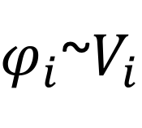
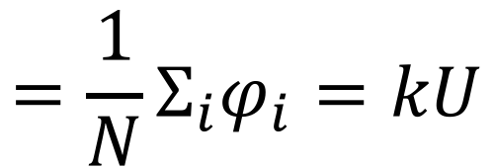
$$={\frac{1}{N}Σ}_{i}φ_{i}=kU$$
$φ_{i}$~$V_{i}$
Notes:
-To compare the network perfomance with the epileptogenic slices we constructed the LFP generated by the network
-We used the dipole theory to derive the single pyramidal neuron contribution to the field. In this approximation each cells contributes to the field by the dipole formed by the difference between the somatic and dendritic voltage.
-The total LFP signal is computed as the sum of all dipoles in the network.

