Slide 1
Health Information System
Presented By: Samuel Carson Abudho
Date: 26.04.2025

Slide 2
Understanding the Task
Develop a system to manage clients and health programs (e.g., TB, Malaria, HIV).
Key requirements:
Create health programs.
Register new clients.
Enroll clients into one or more programs.
Search for clients and view detailed profiles.
Expose client profile via API for external integrations.

Slide 3
Approach Used
Adopted an API-First Design using FastAPI for scalability and easy integration.
Built a responsive frontend using React.js and Bootstrap for a smooth user experience.
Ensured clear separation of concerns between frontend and backend.
Focused on:
Data validation.
User experience enhancements.

Slide 4
System Architecture
Frontend: I used the react framework to handle user interaction and send API requests.
Backend: Manages business logic, data storage, and API exposure.
Database: Stores clients, programs, and enrollment data.

Slide 5
Tech Stack
Frontend: React.js, Axios, React Router, Bootstrap.
Backend: FastAPI, SQLAlchemy, SQLite, Uvicorn.
API Documentation: Swagger UI (auto-generated).

Slide 6
Features of the System
Create, list, and manage health programs.
Register new clients with simple forms.
Enroll clients into programs with validation.
Search clients by name.
View detailed client profiles with enrolled programs.
Expose RESTful API endpoints for other systems.
Interactive API documentation for developers.
Dynamic UI with success/error feedback.

Slide 7
Innovations and Optimizations
Used dropdowns for better user experience.
Used the React framework for the UI.
Prevented duplicate enrollments with backend validation.
Implemented color-coded alerts for clear user feedback.
Active navigation highlighting using NavLink.

Slide 8
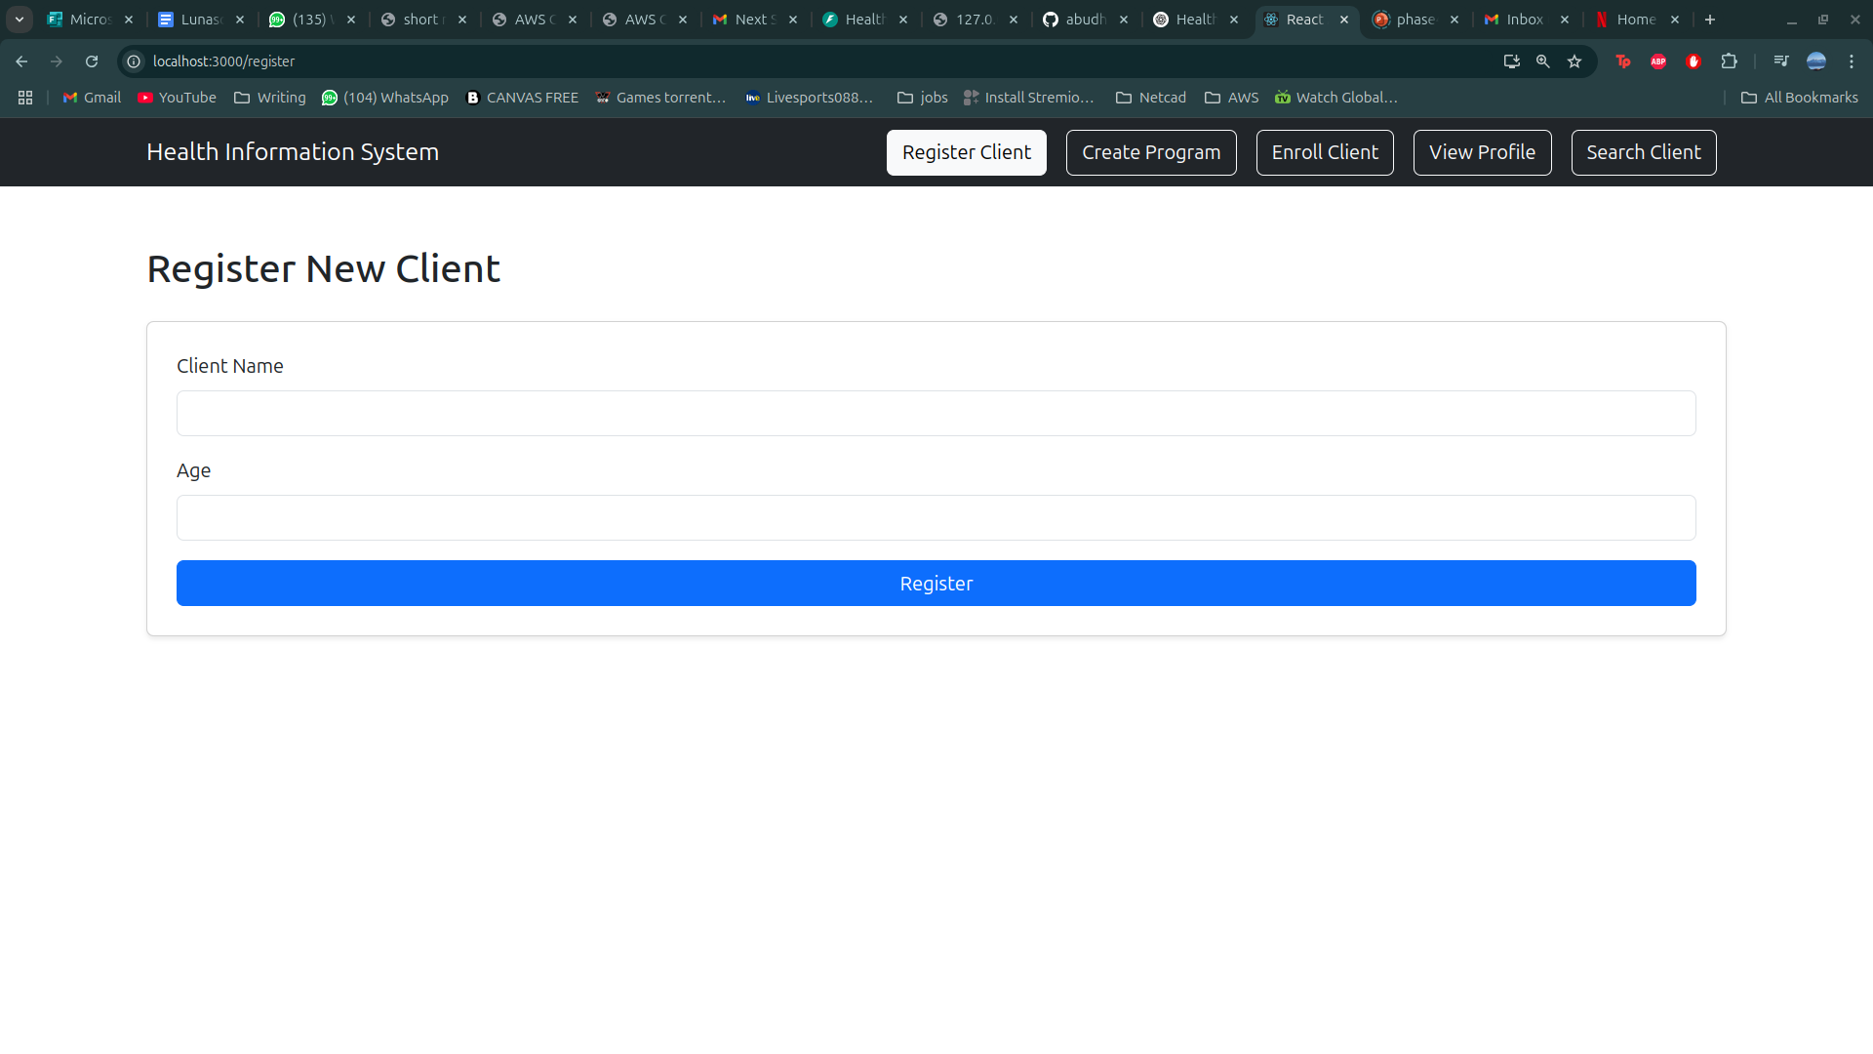
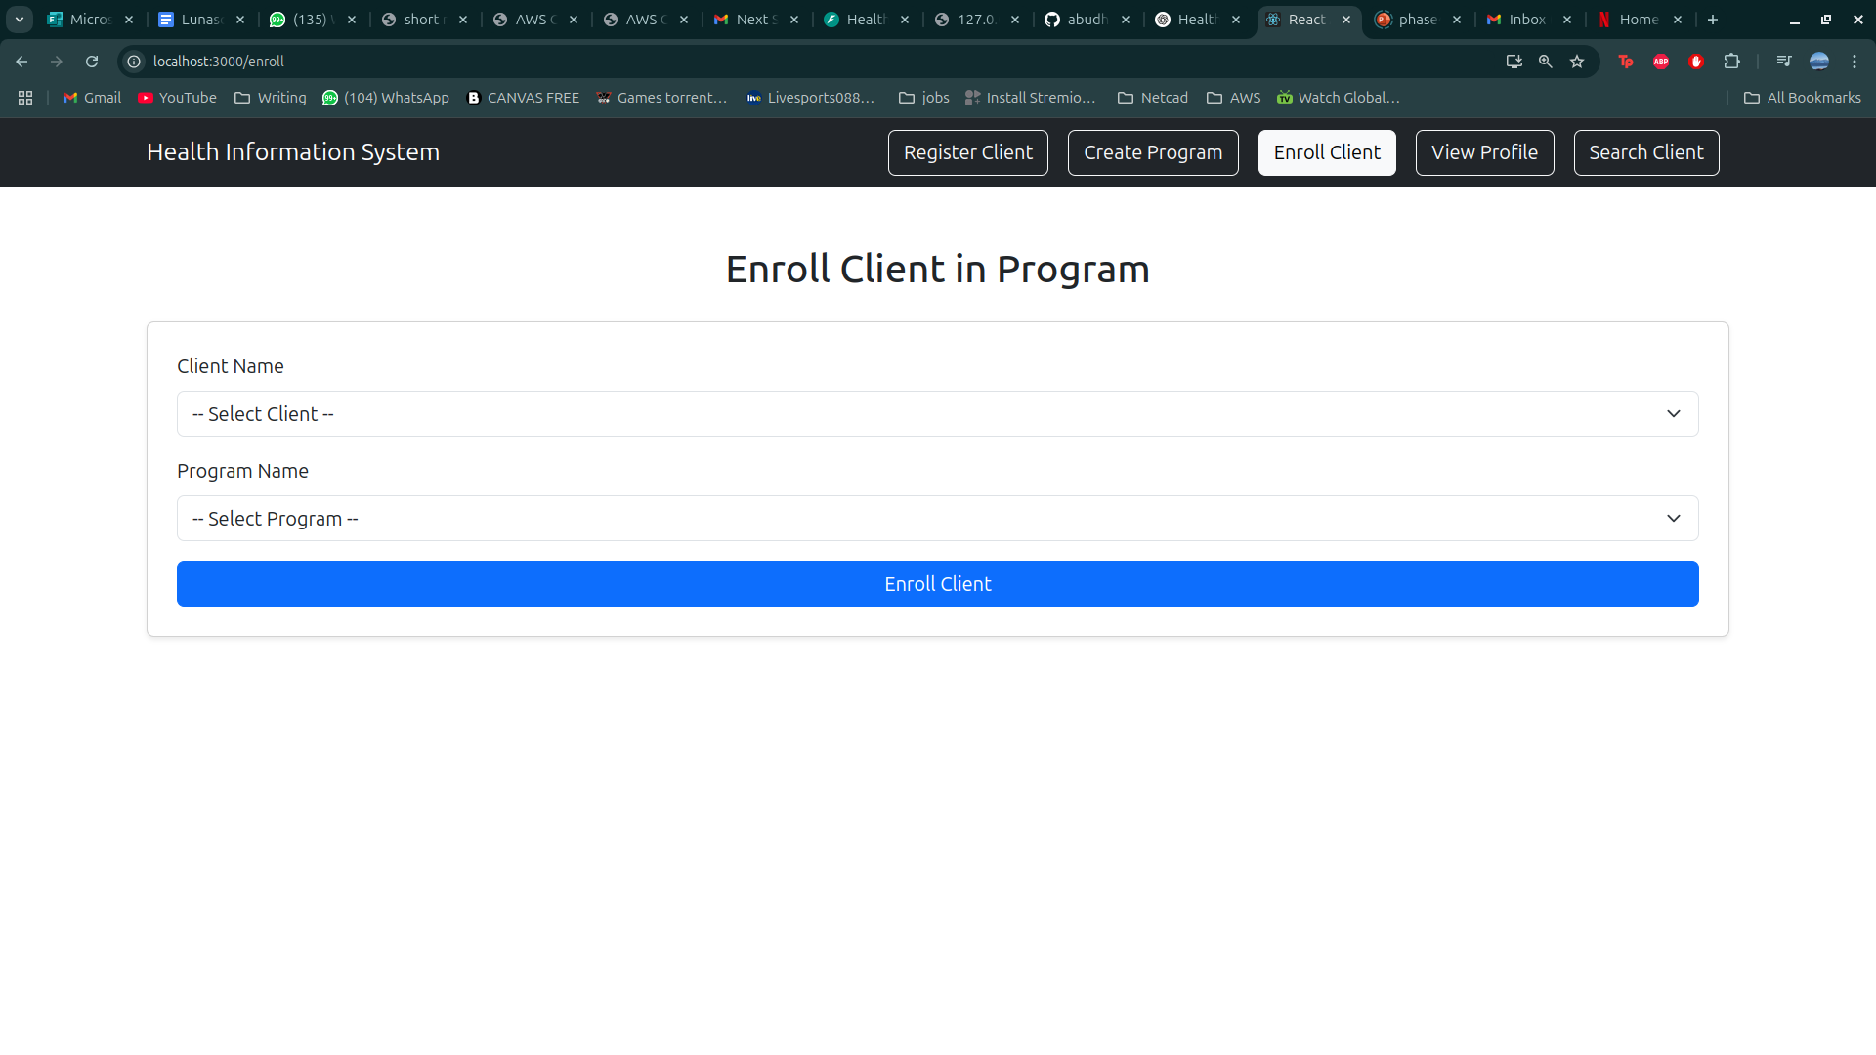
Screenshots of the application
Register Client

Slide 9
Thank You

