Slide 1

Machine Learning as a web service using Flask
Birmingham Data Architecture and Data Science Meetup Jason Eisele, Data Scientist @ MBUSI
For up to date imagery please refer to https://mapcms.e.corpintra.net/bmbds/en/dynamic/searchview.html?currentTab=asset&category=media
Notes:
Wifi network name and password?

Slide 2

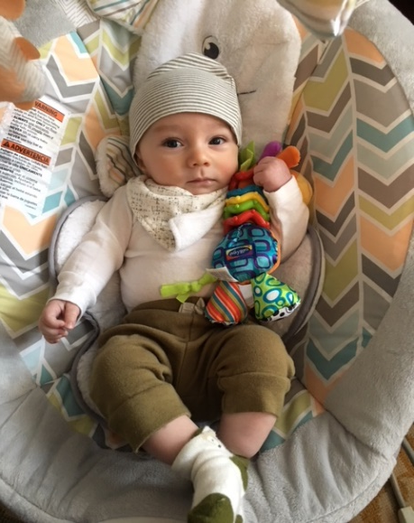

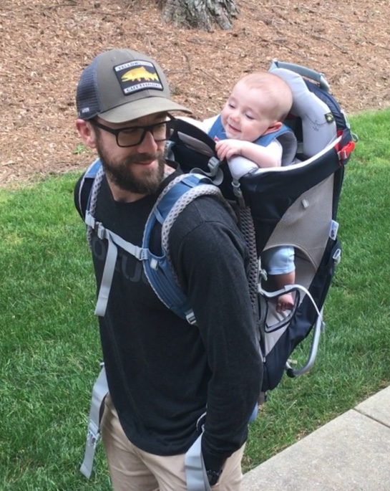
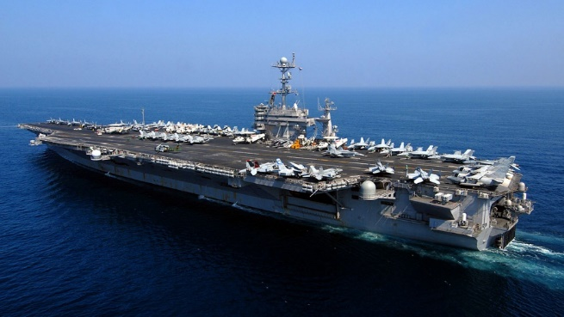
Bio
Tampa, FL native
US Navy Veteran
New parent
MBA @ Syracuse, specialization in Business Analytics
Previous Roles:
BI Developer
Reliability Engineer

Slide 3
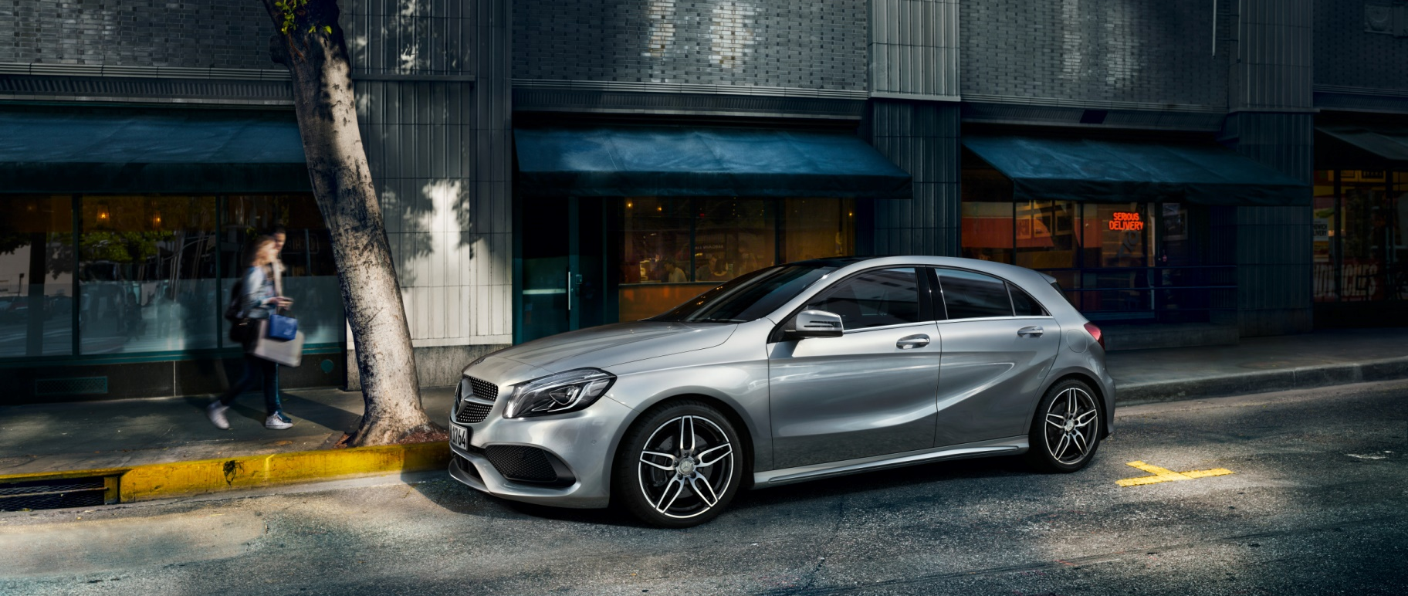
Motivation for developing an on-prem flask service for model hosting
Cloud service too expensive
Data governance prevents cloud
Incorporate into existing web serv.
Showcase your skills
You don’t have a web dev team
You don’t want to learn web dev

Slide 4
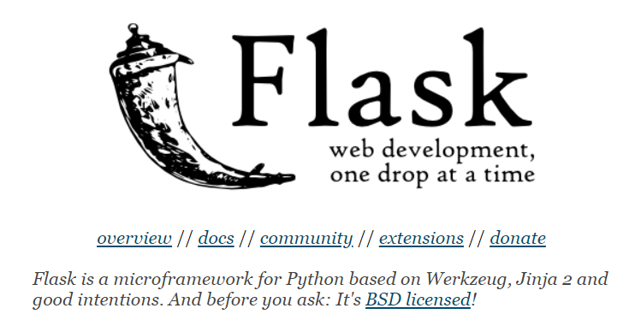

What is Flask and why?
http://flask.pocoo.org/
Extremely light weight micro framework
Unlike Django, Flask allows you to use only what you need hence the “one drop at a time”
“Flask is like a Somalia pirate ship where as Django is like a Navy Fleet”
https://www.djangoproject.com/

Slide 5
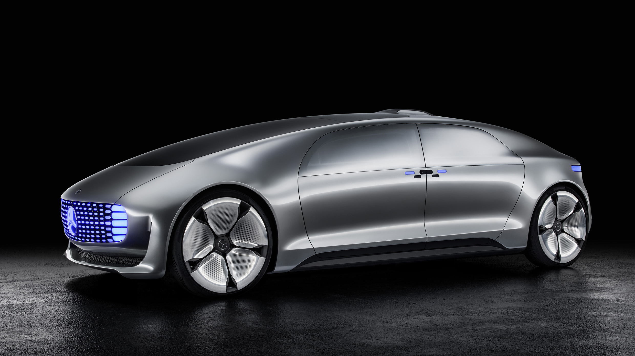
Talk is cheap, show me the code!

