Slide 1
PROJECT REPORT

Slide 2
Data Preparation and Pre-processing
Dataset is to be processed and cleaned through the help the data pre-processing that I have learnt so far in this intern-ship.
The missing data in the dataset are to be checked and replaced with corresponding dataset.

Slide 3
Data Filtering
Since we are concerned about the reason why employees tends to leave the organisation after so many years of working experience, the dataset is further filtered by setting constraints the following attributes.
Satisfaction Level
Time spent at the company

Slide 4
IMPLEMENTATION
To predict the type of employees that are leaving and which ones are prone to leave next, I propose to use the K-means algorithm.

Slide 5
Reason for choosing K-means
The dataset provided has only independent variables and no dependent variable included. There is need for an un-supervised machine learning algorithm that would help to group employees on the basis of their similarities. These groupings presents us with clusters to be used to identify the type of employees that are leaving and eventually, we can then predict the ones that are prone to leave next.

Slide 6
K-means clustering analysis.
The objective of k-means is to group similar employees together and discover underlying patterns by performing the following iteration.
1.Choose the number of k-clusters
2.Identify the centroid of each cluster
3.Assign each data-point to closest centroid that will form k-clusters
4.Compute and place a new centroid to each cluster
5.Re-assign each data point to new closest centroid

Slide 7
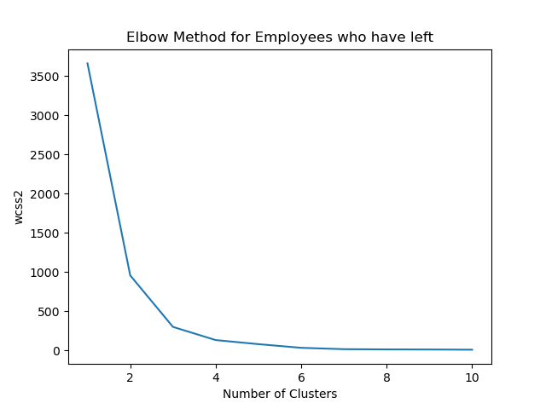
Results
The elbow graph above shows that the optimal k-value is 6.

Slide 8
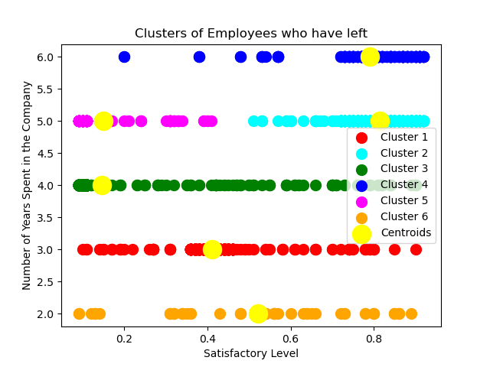
Visualizations
This graph depicts the cluster analysis of employees who have left.

Slide 9
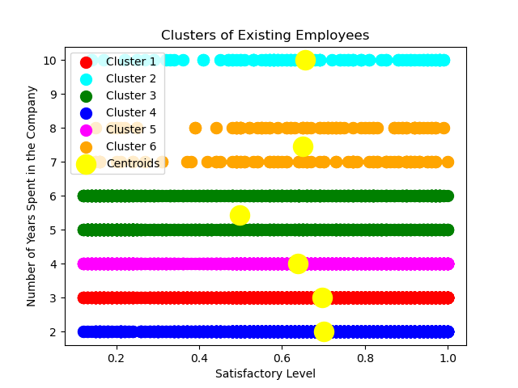
This graph depicts the cluster analysis of existing employees.

Slide 10
Compare and contrast.
Using the “employees who have left cluster” graph, the types of employees who are leaving are as follows:
Cluster 1: Employees whose satisfactory level is between 0.6 and 0.8 and have spent 3 years in the company.
Cluster 2: Employees whose satisfactory level is between 0.8 and 0.9 and have spent 5 years in the company.
Cluster 3: Employees whose satisfactory level is between 0 and 0.2 and have spent 4 years in the company.
Cluster 4: Employees whose satisfactory level is between 0.7 and 0.8 and have spent 6 years in the company.
Cluster 5: Employees whose satisfactory level is between 0.1 and 0.2 and have spent 5 years in the company.
Cluster 6: Employees whose satisfactory level is between 0.5 and 0.6 and have spent 2 years in the company.

Slide 11
The clusters in the “Existing Employees” graph are as follows
Cluster 1: Employees whose satisfactory level is between 0.6 and 0.8 and have spent 3 years in the company. (This is a match in both graph)
Cluster 2: Employees whose satisfactory level is between 0.6 and 0.7 and have spent 10 years in the company.
Cluster 3: Employees whose satisfactory level is between 0.4 and 0.6 and have spent between 5 and 6 years in the company.
Cluster 4: Employees whose satisfactory level is between 0.7 and 0.8 and have spent 6 years in the company. (This is a match in both graph)
Cluster 5: Employees whose satisfactory level is between 0.6 and 0.7 and have spent 4 years in the company.
Cluster 1: Employees whose satisfactory level is between 0.6 and 0.7 and have spent more than 7 years in the company.

Slide 12
Conclusion
Using the comparism between the “Employees who have left” cluster graph and the “Existing Employees” cluster graph, the types of employees who are prone to leave next are the ones that fall in the categories below:
Cluster 1: Employees whose satisfactory level is between 0.6 and 0.8 and have spent 3 years in the company.
Cluster 4: Employees whose satisfactory level is between 0.7 and 0.8 and have spent 6 years in the company.
Reason: Employees in the two clusters above(1 and 4) are prone to leave next because their properties in the two graphs correlate with each other.

