Slide 1
High Performance Computing
Lecture 1

Slide 2
How many digits is in n!
0<n<10^7

Slide 3
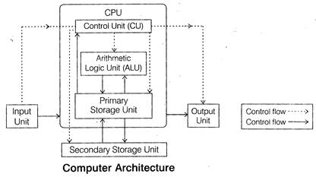

Slide 4
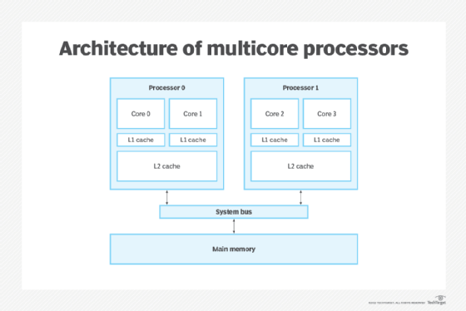

Slide 5
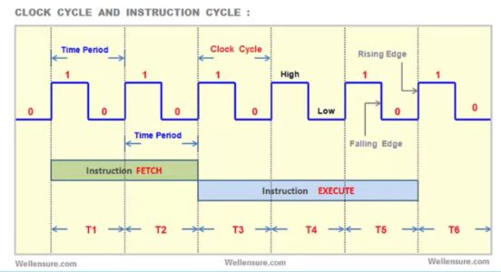
CPU Clock Cycle

Slide 6


Slide 7
#include <stdio.h>
#define MAX 12345
int main()
{
int ar[MAX]={2,4,3,…….,3456}
int sum = 0;
for(int i=1;i<MAX;i++)
sum += ar[i];
printf(“%d”,sum);
return 0;
}

Slide 8
#include <stdio.h>
#define MAX 12345
int main()
{
int ar[MAX]={2,4,3,…….,3456}
int sum = 0;
for(int i=1;i<MAX;i++)
sum += ar[i];
printf(“%d”,sum);
return 0;
}

Slide 9
#include <stdio.h>
#define MAX 12345
int main()
{
int ar[MAX]={2,4,3,…….,3456}
int sum = 0;
for(int i=1;i<MAX;i++)
sum += ar[i];
printf(“%d”,sum);
return 0;
}

Slide 11


Slide 12
Challenge?

Slide 13
Challenge?
Algorithm

Slide 14
Challenge?
Debugging

Slide 15
Challenge?
Shard Resources

Slide 16
How about how to write such program in code?

