Slide 1
High Performance Computing
Lecture 2

Slide 2
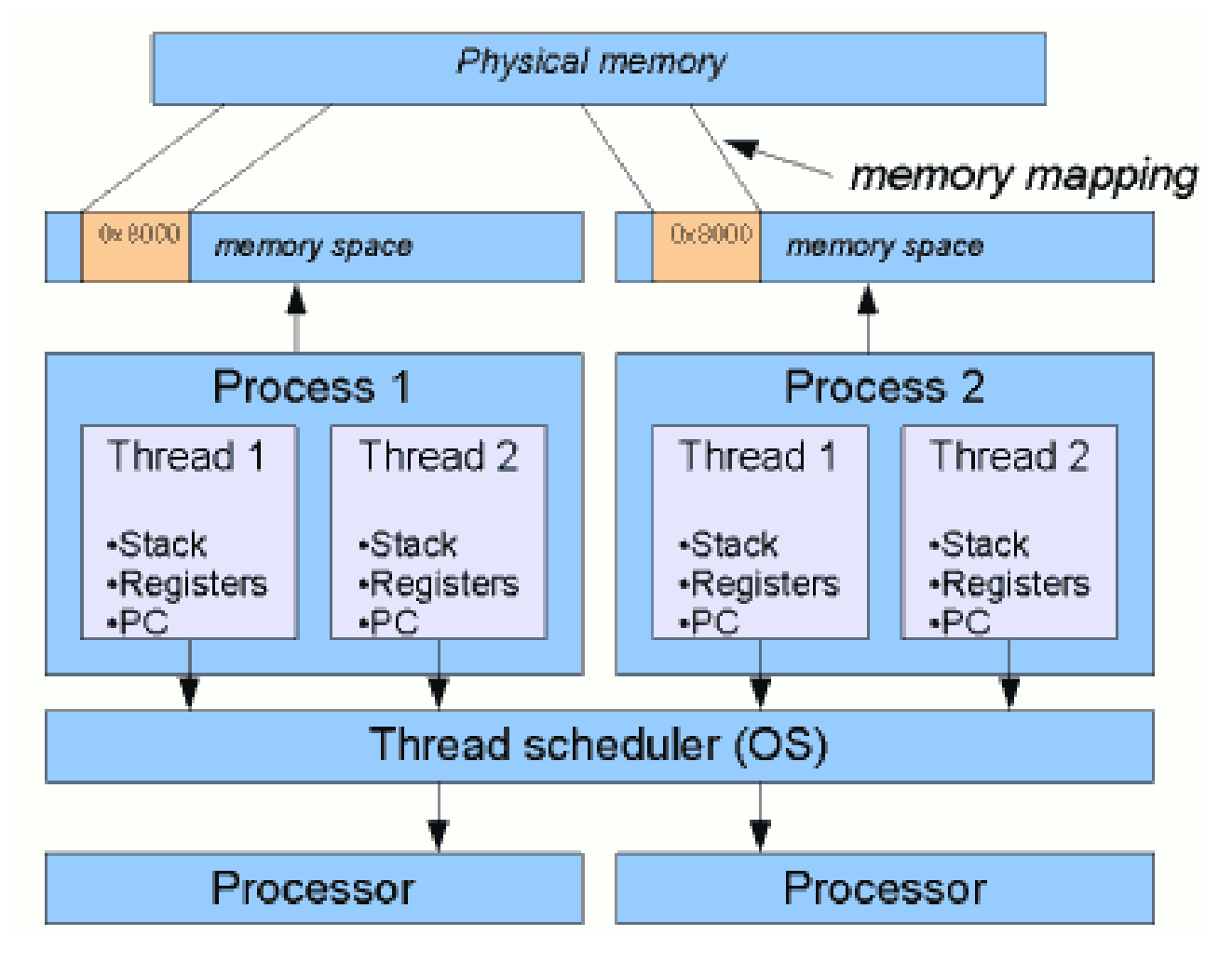

Process VS. Thread

Slide 3
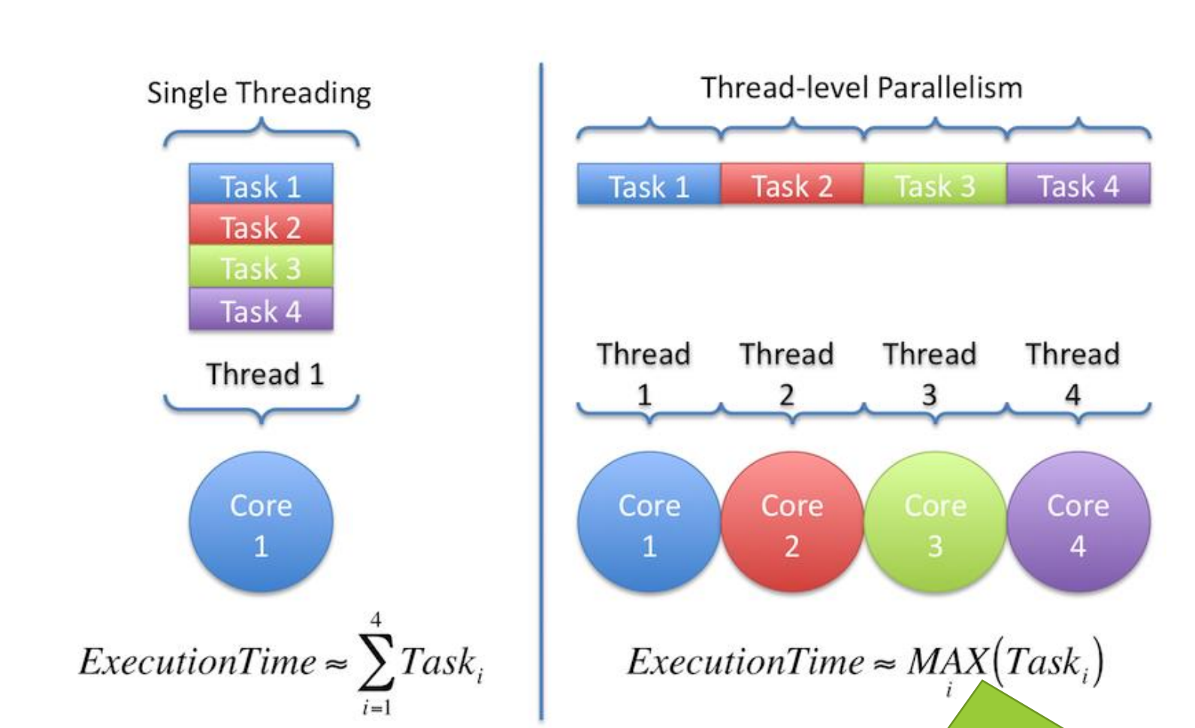
Parallel VS. Concurrent Programming

Slide 4
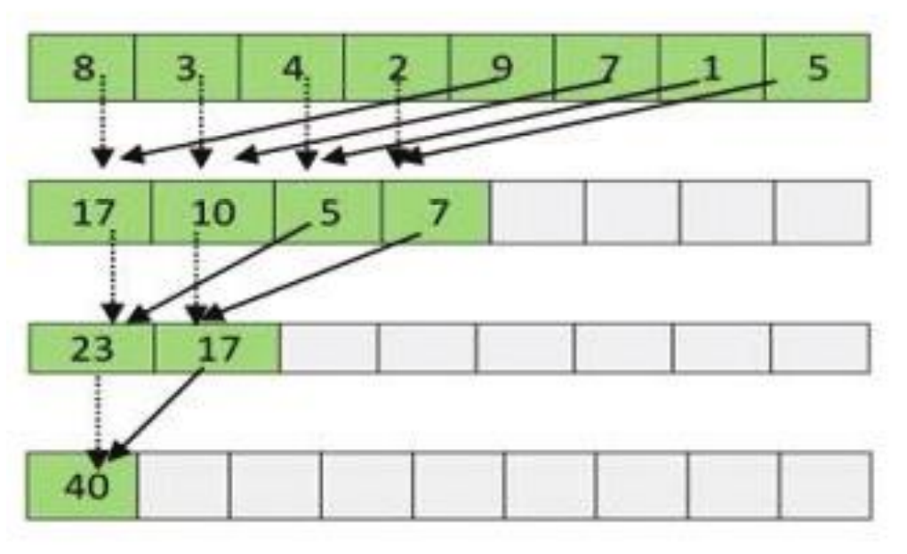
Concurrent Solution

Slide 5
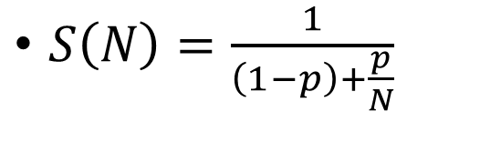
Amdahl’s Law
$S\left(N\right)=\frac{1}{\left(1−p\right)+\frac{p}{N}}$
Where,
S(N) is the speedup of the concurrent execution over the sequential execution
P is the percentage of the application that can be run in parallel
N is the number of processor (parallel thread) that can execute at a time

Slide 6
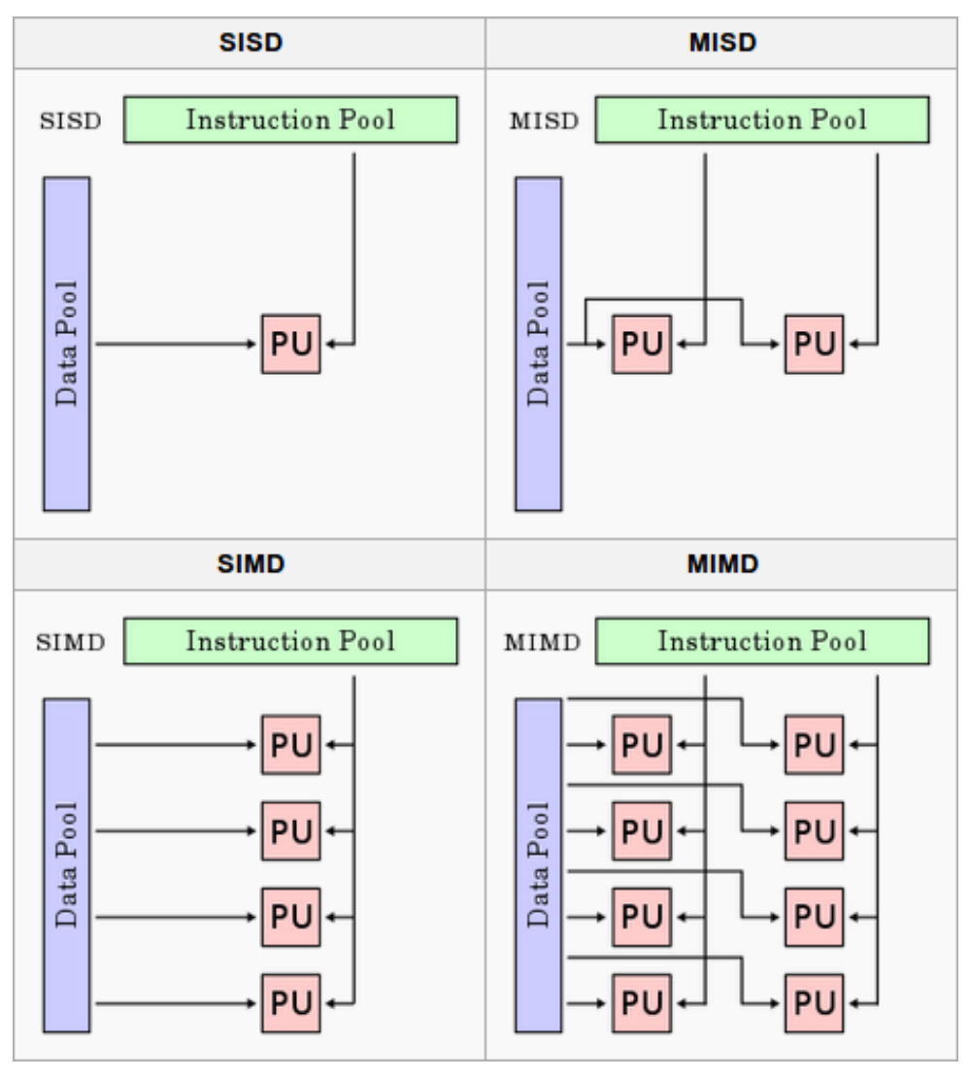
Flynn’s Taxonomy

