Slide 1
High Performance Computing
Lecture 3

Slide 2
Sequential Application
String[] sites = {"site1.db", "site2.db", … , "siten.db"};
Set words = new HashSet();
for (String site: sites)
{
readDB(site, words);
}
function readDB(String dbName, Set words)
{
dbScanner input = new DBScanner(new DBFile(file));
while (input.hasNext())
{
String word = input.next();
words.add(word);
}
}

Slide 3
Parallel Application
String[] sites = {"site1.db", "site2.db", … , "siten.db"};
Set words = new HashSet();
for (String site: sites)
{
Thread t = new Thread (readDB(site, words));
t.start();
}
function readDB(String dbName, Set words)
{
dbScanner input = new DBScanner(new DBFile(file));
while (input.hasNext())
{
String word = input.next();
words.add(word);
}
}

Slide 4
Shared Resource and ThreadSafeNess
String[] sites = {"site1.db", "site2.db", … , "siten.db"};
Set words = new HashSet();
for (String site: sites)
{
Thread t = new Thread (readDB(site, words));
t.start();
}
function readDB(String dbName, Set words)
{
dbScanner input = new DBScanner(new DBFile(file));
while (input.hasNext())
{
String word = input.next();
words.add(word);
}
}

Slide 5
Critical Section (CS)
x = x+a => x++ ; x+=3; etc.
a = x-y;
b = x + y;
x = x*x;
y = y*a

Slide 6
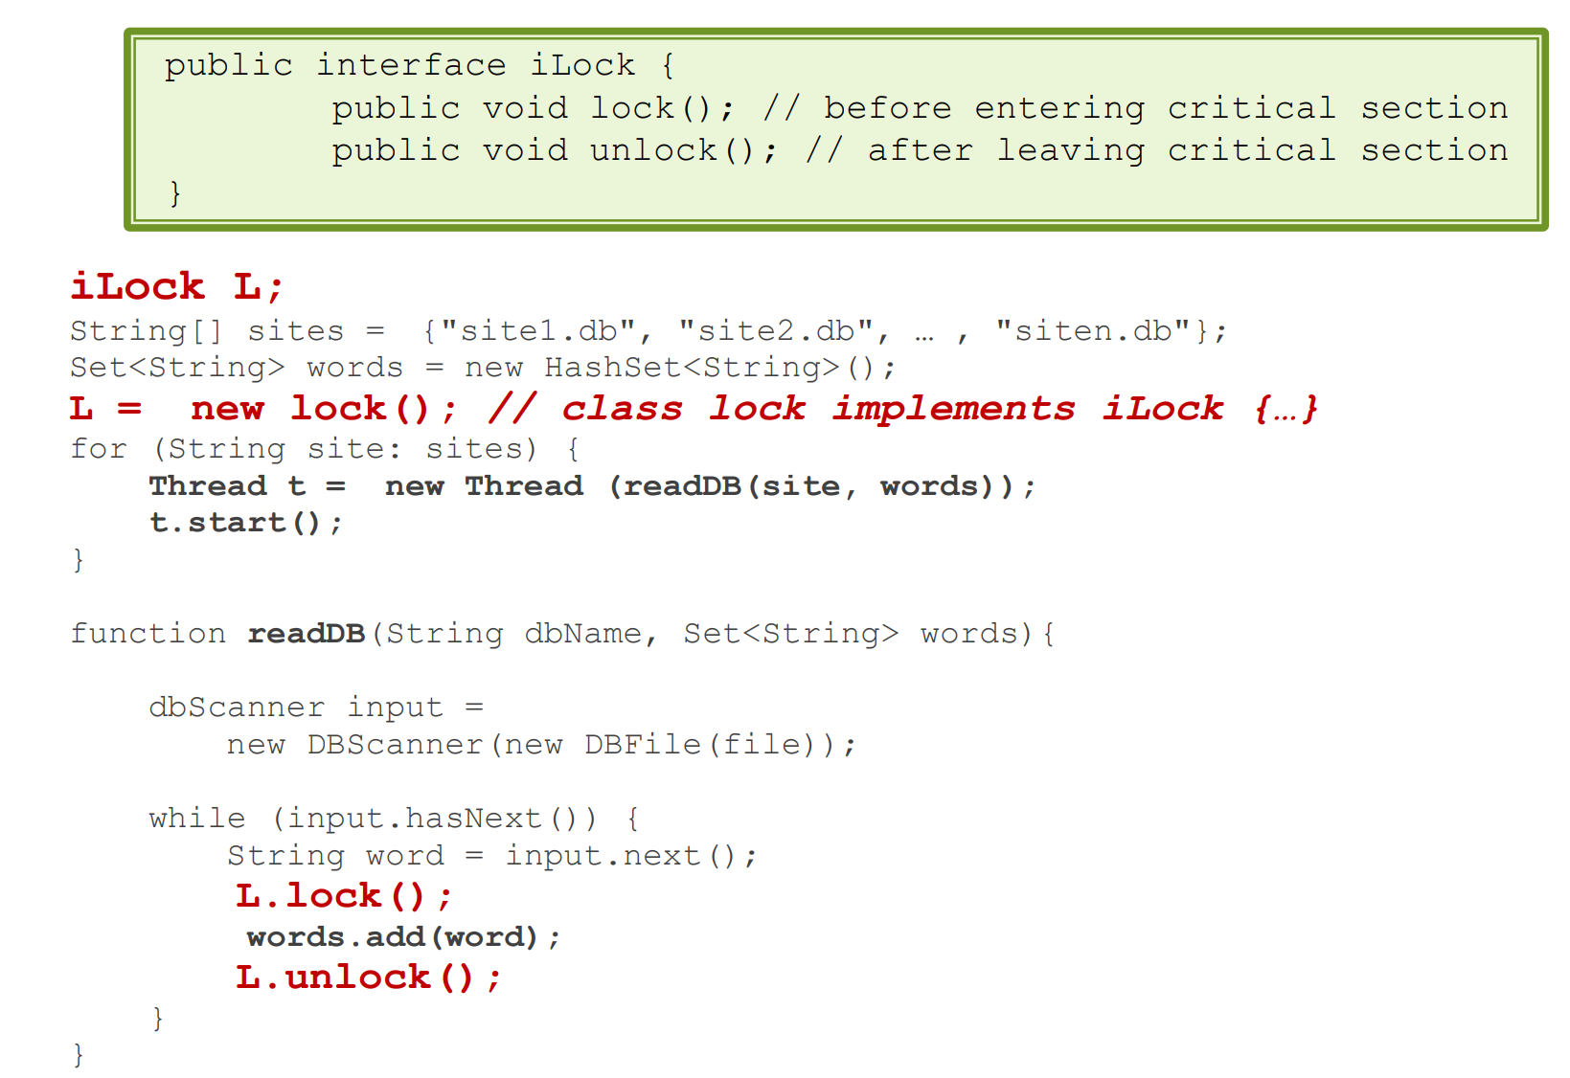
Lock

Slide 7
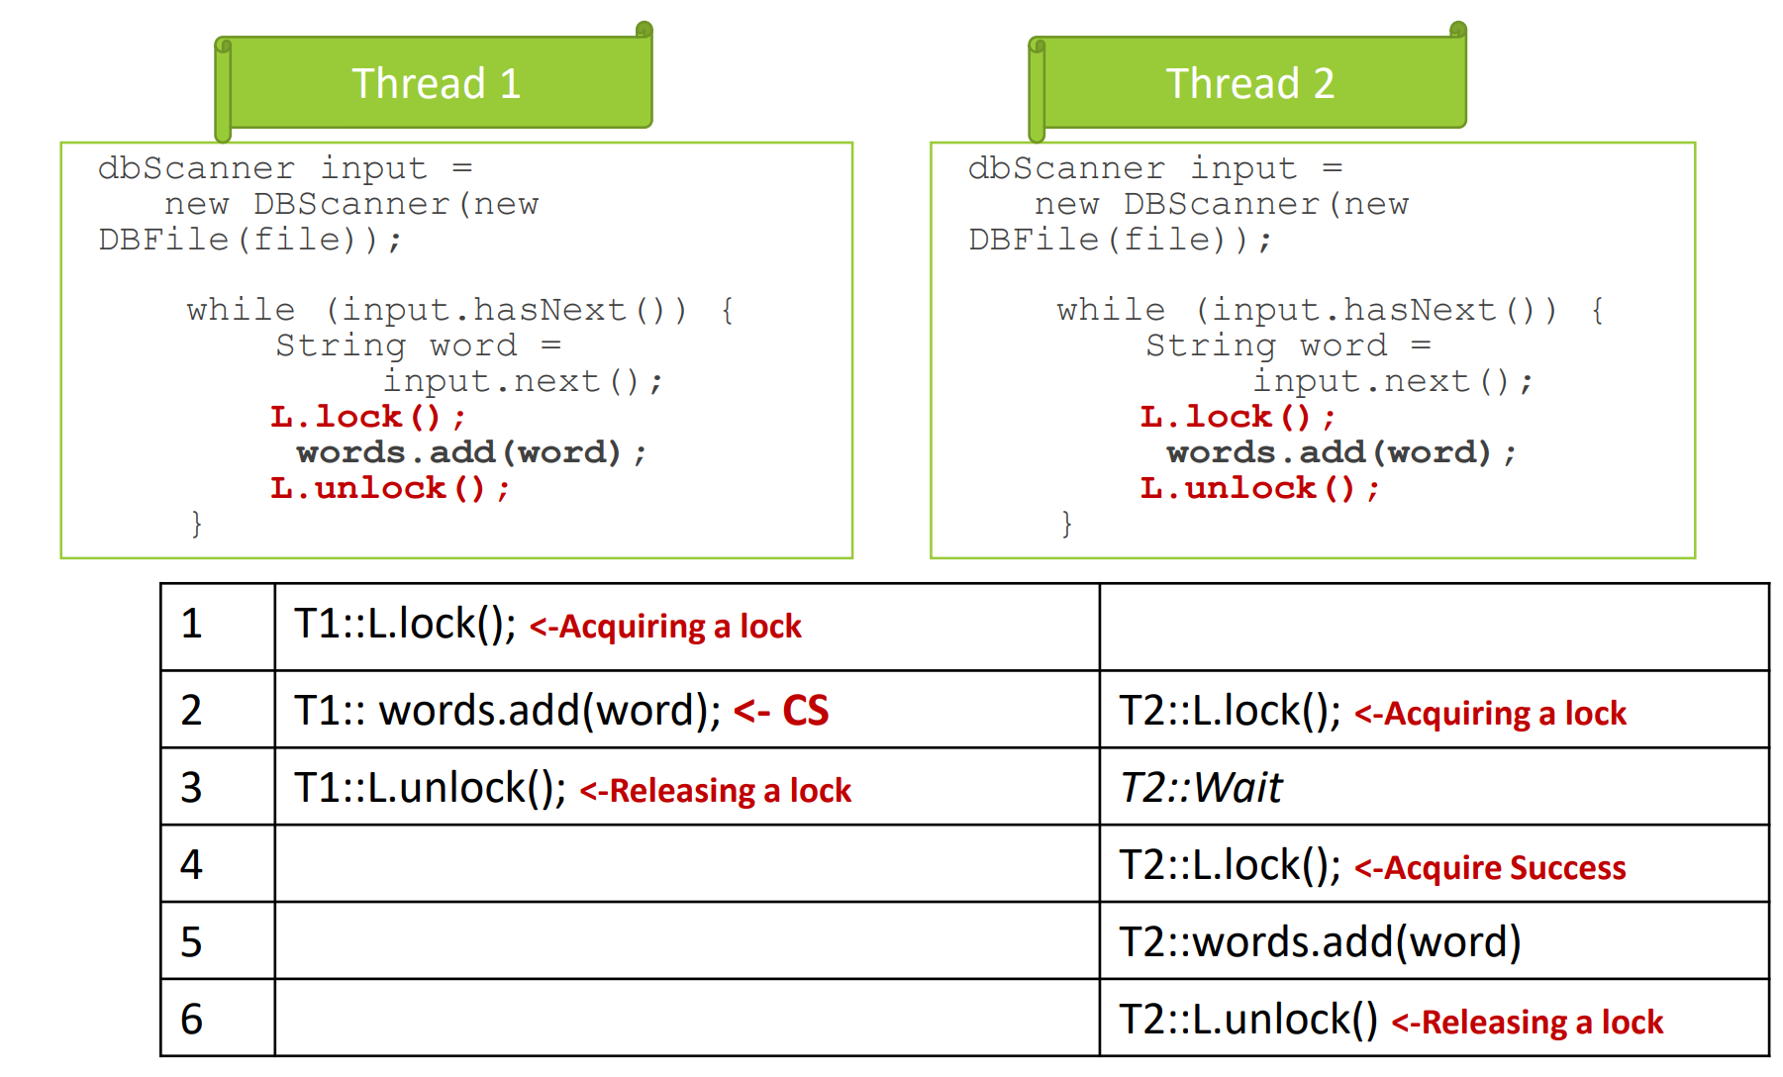
Lock Working Principle
Exact Same time
1 Before 2
1 After 2

Slide 8
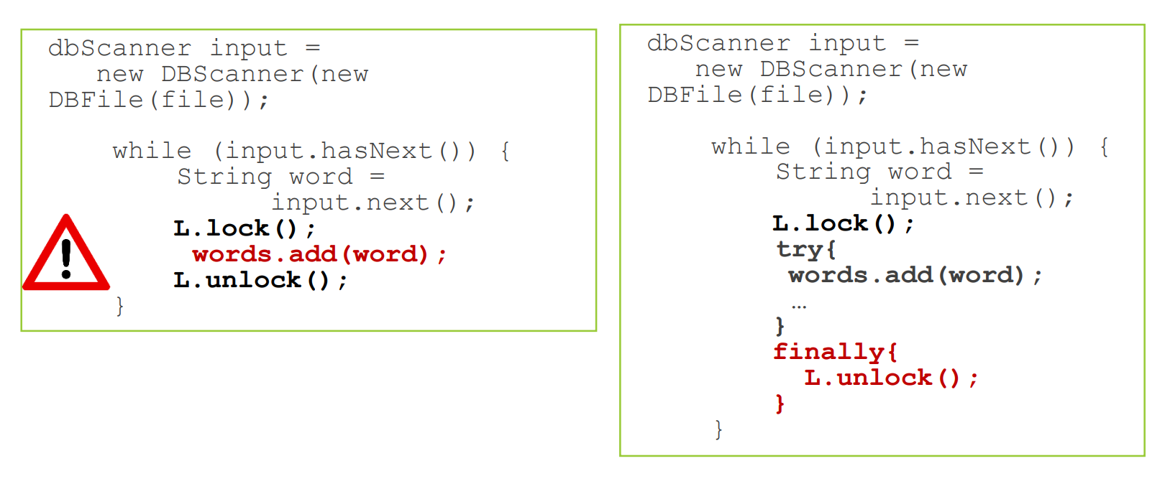
Ensure Unlocking

