Slide 1
High Performance Computing
Lecture 4

Slide 2
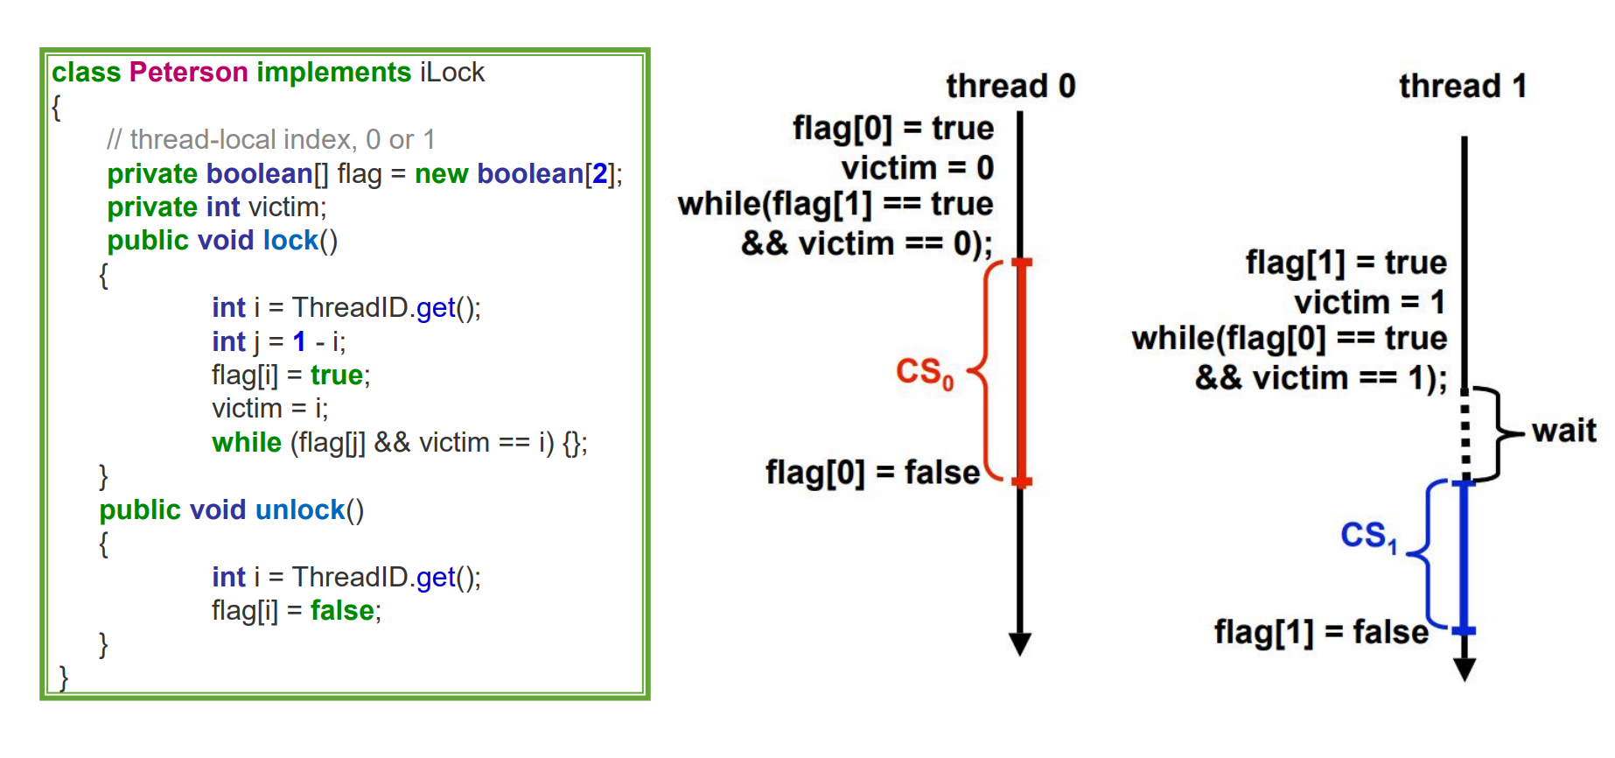
Peterson Lock

Slide 3
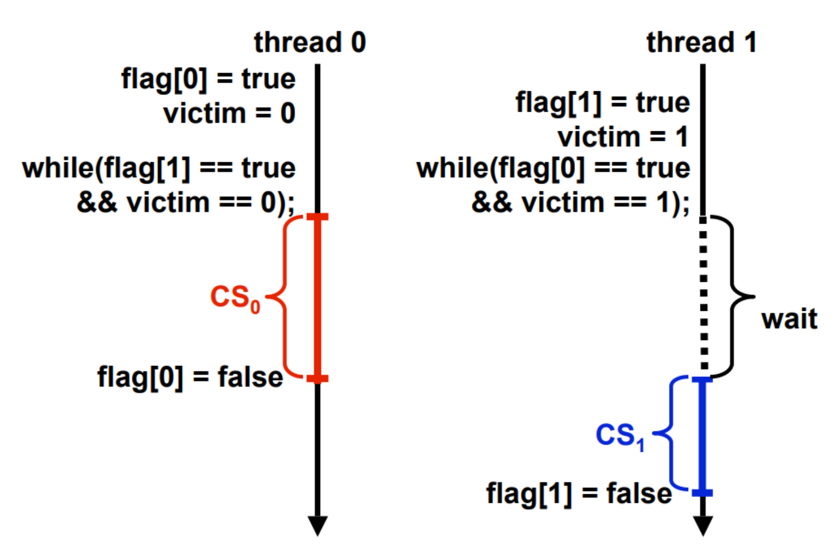
Peterson Lock (Concurrent Acquires)

Slide 4
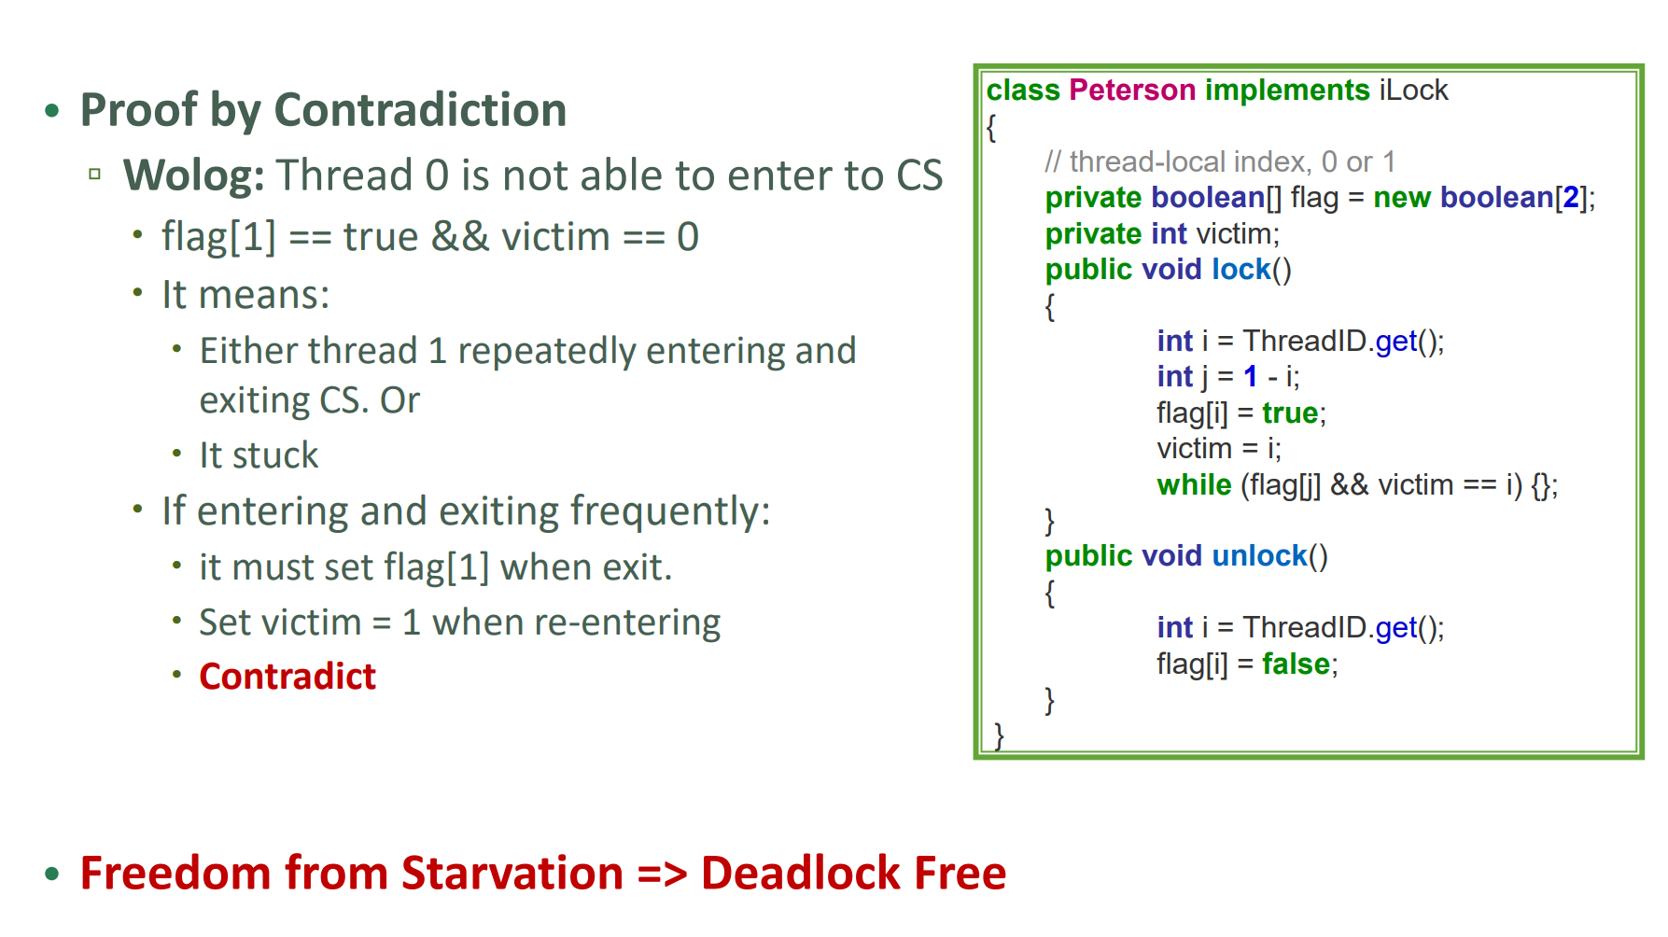
Paterson Lock: Freedom of Starvation

Slide 5
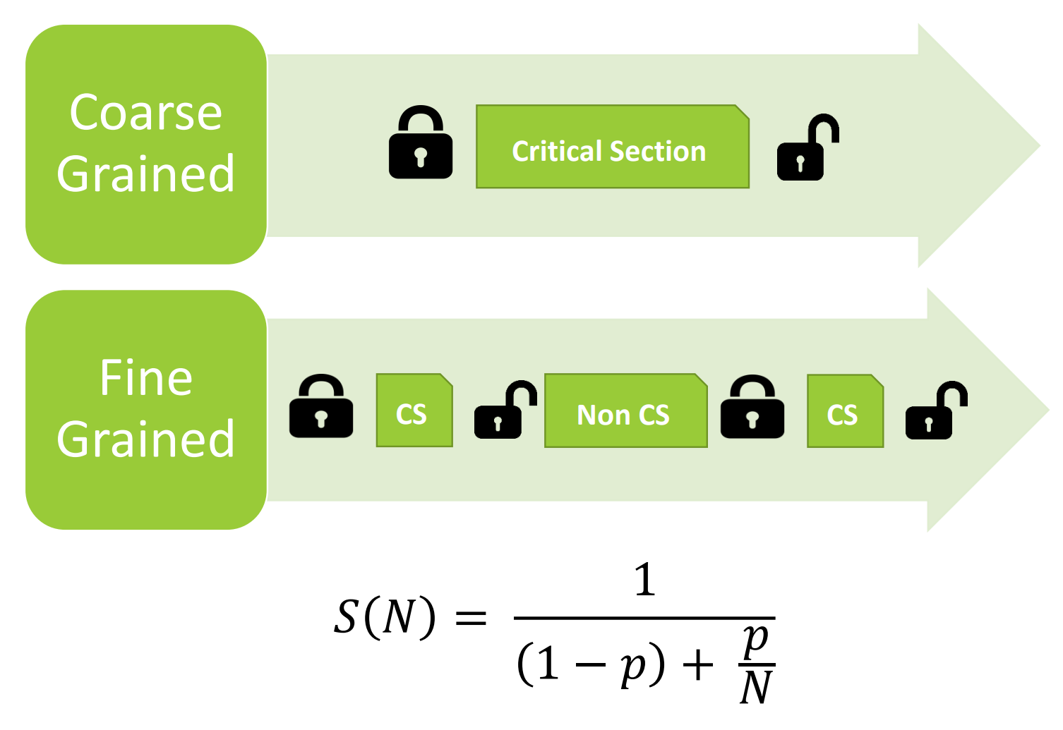
Locking Mechanism

