Slide 1
AMPC

Slide 2
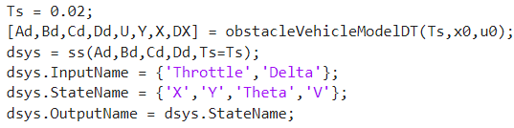
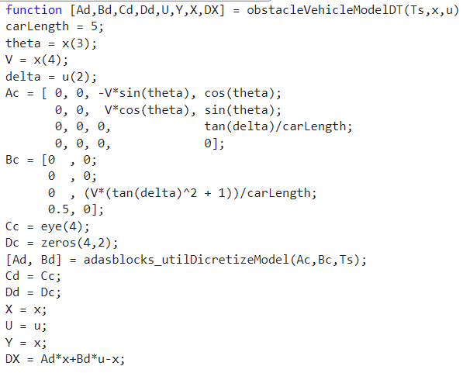
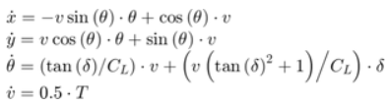


Slide 3
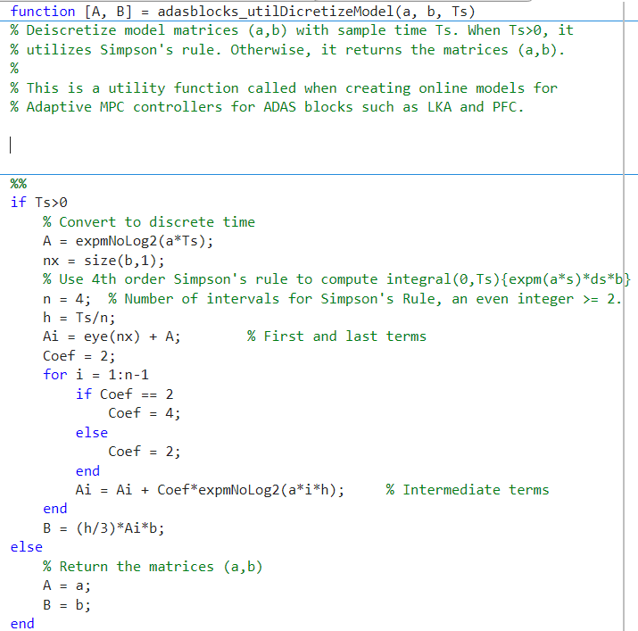
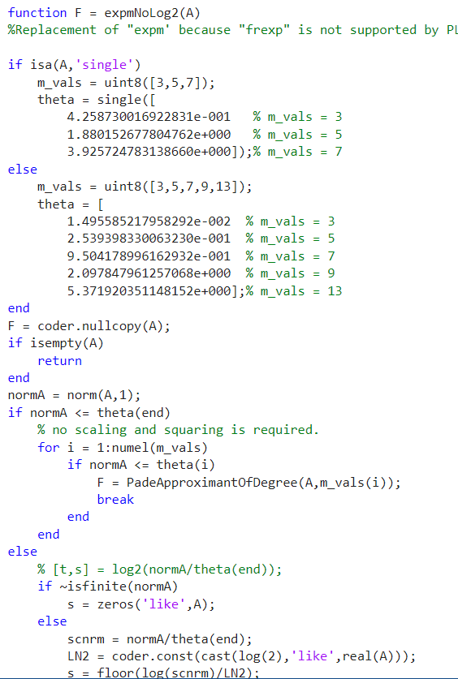
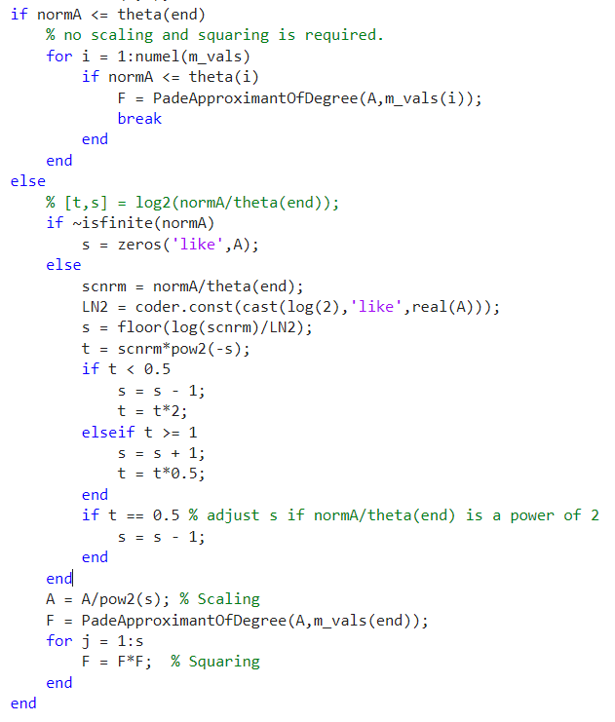
Continuous to discrete

Slide 4
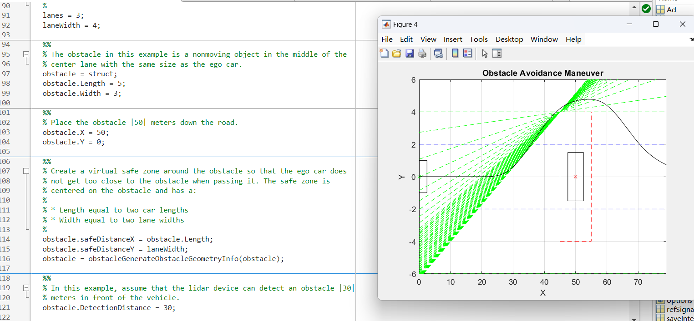

Slide 5
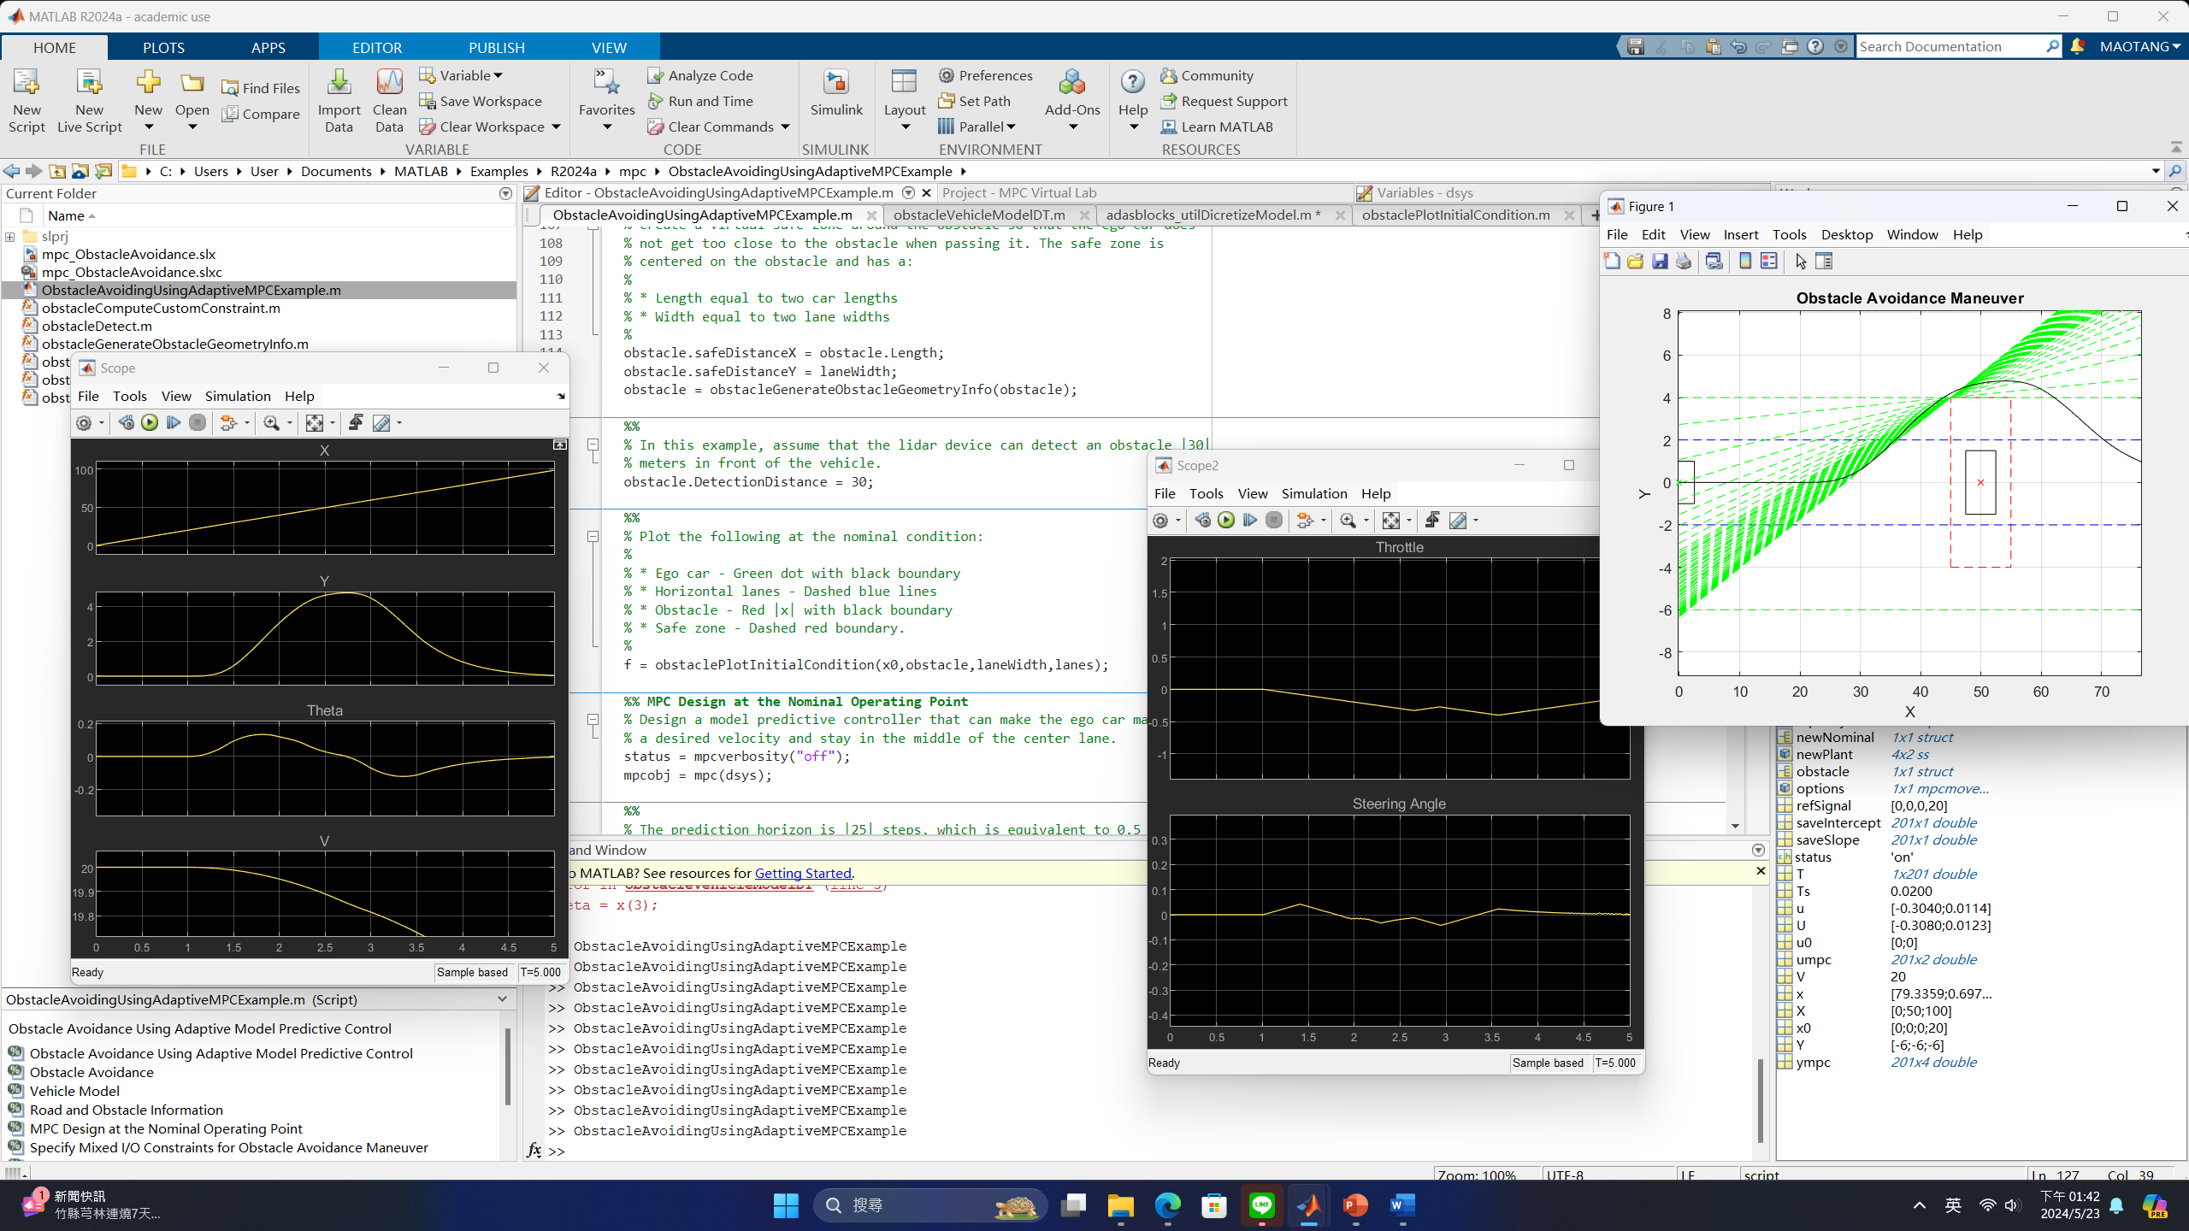
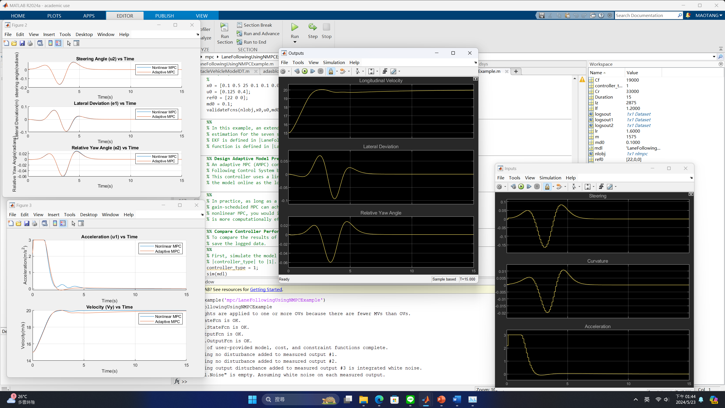

Slide 6
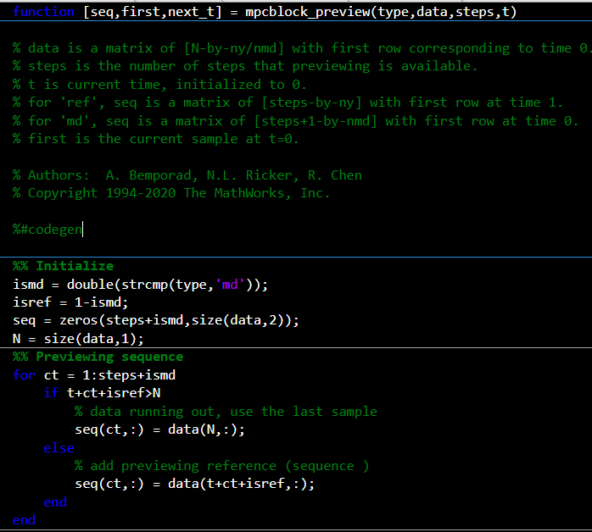

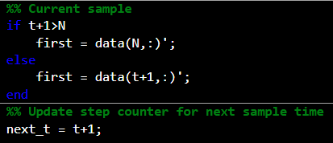
ismd:iftype for'md',butismd for1, otherwise0。
isref:iftype for'ref',butisref for1, otherwise0。
seq: Initialize preview sequence matrix, size is[steps + ismd, data number of columns]。
N：data The number of rows of the matrix.
loop: sequence=data(t+Preview steps+The value of the discriminant parameter)，dataUse the last column after running
First: Initial state, the next time will use the state output at the previous time.

Slide 7
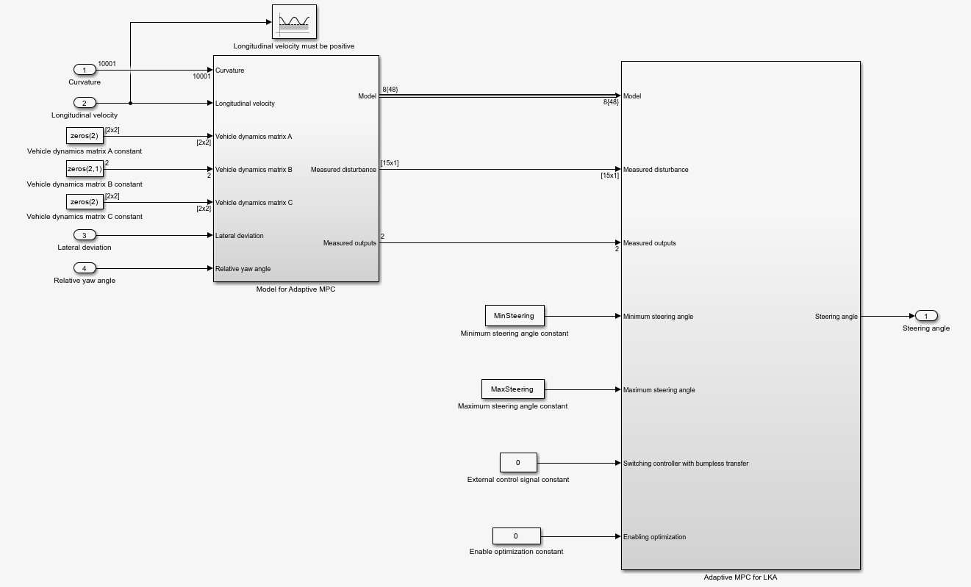

Slide 8
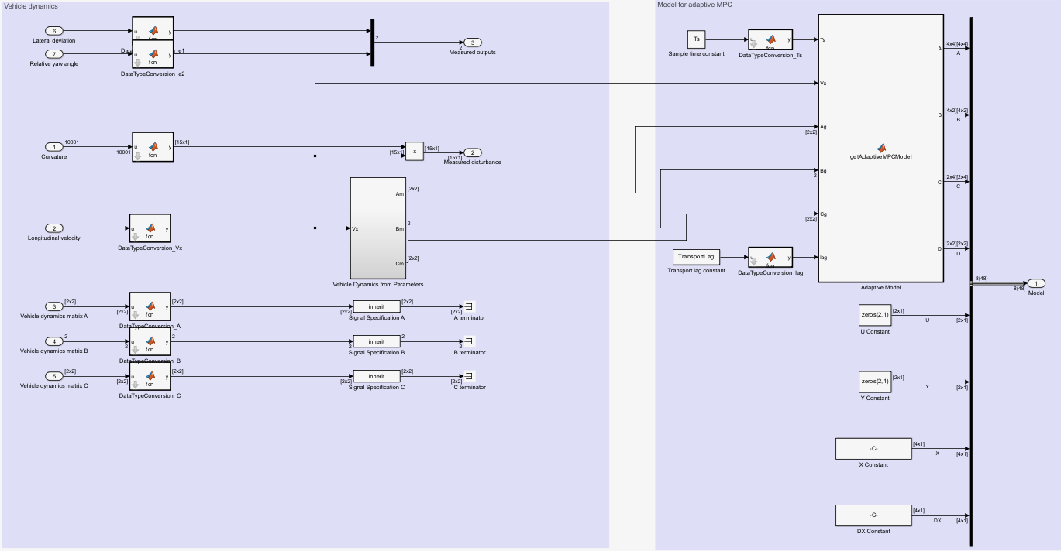

Slide 9
