Slide 1
8086 Pipeline Architecture
Microprocessor & Microcontroller
Course code: CSE 303
Presented By
Ismail Hossain
ID: 2030020013
Abu Jafor
ID: 203002048
Presented To
MS. Fatema Tuj Johra
Lecturer
Green University of Bangladesh

Slide 2
Table of Content
Summary
Instructions Execution Sequence
Instructions Pipelining
Pipelining Architecture
Advantage
Disadvantage
Conclusion

Slide 3
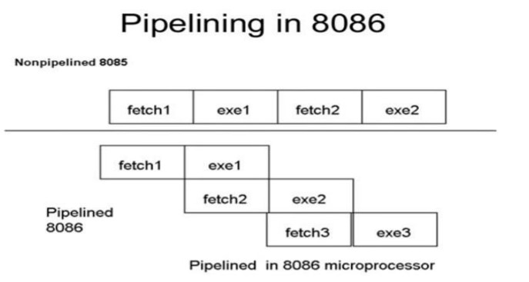
Summary About 8086 Pipeline
Pipeline in 8086 is a technique which is used in advanced microprocessors, were the microprocessor execute a second instruction before the completion of first. That is many instruction are simultaneously pipelined at different processing stage.

Slide 4

Instructions Execution Sequence
The Instructions Execution Sequence are:
IF
ID
AG
DF
EX
WB

Slide 5
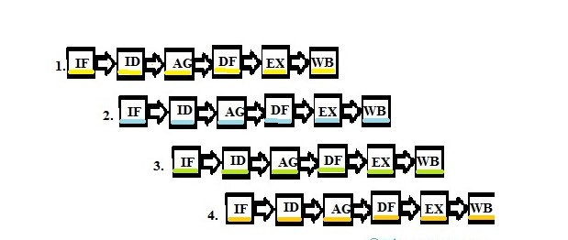
Instructions Pipelining
Let us look the way instructions are processed in pipelining. This can be easily understood by the diagram below.

Slide 6
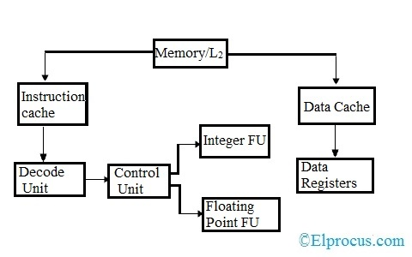
Pipelining Architecture
6
Pipelined Processor Unit

Slide 7
Advantages of Pipelining
Instruction throughput increases.
instructions executed simultaneously
Faster ALU can be designed
Pipelined CPU’s works at higher clock frequencies than the RAM.
Pipelining increases the overall performance of the CPU.

Slide 8
Disadvantages of Pipelining
pipelined processor is complex
increases in pipelined processors
problem of hazard for branch instructions

Slide 9
Conclusion
Pipelining benefits all the instructions that follow a similar sequence of steps for execution. Processors that have complex instructions where every instruction behaves differently from the other are hard to pipeline.

Slide 10


Slide 11
Thank You
Reference:
Course Materials
Wikipedia
Infoeng .com
Stuocu. com

