Slide 1

Project Presentation on Spell Checker
Md. Abu Jafor
ID:

Slide 2
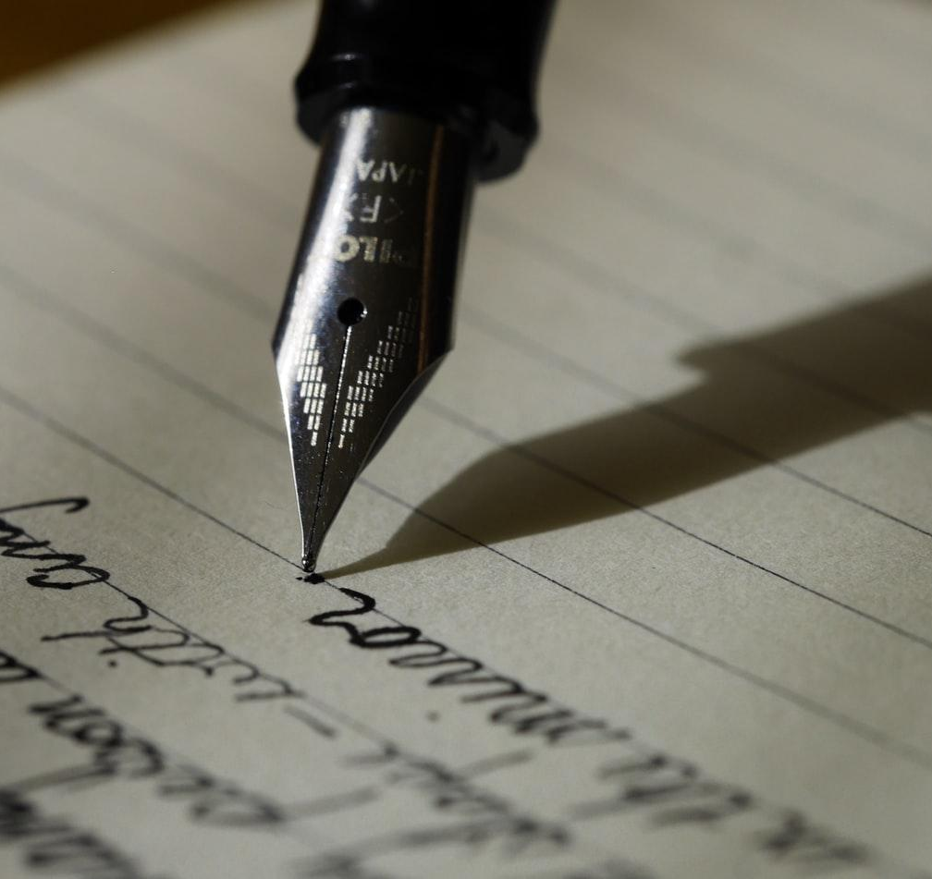
Spelling Checker
checks the spelling of the word provided by the user
making a text-editor

Slide 3
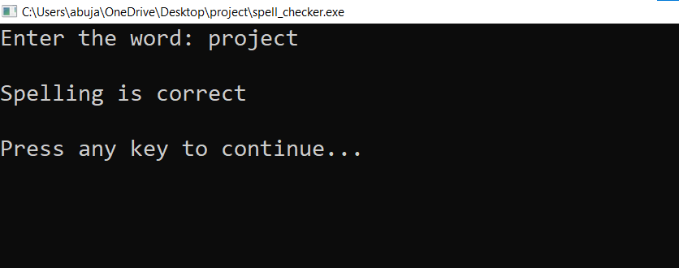

Slide 4
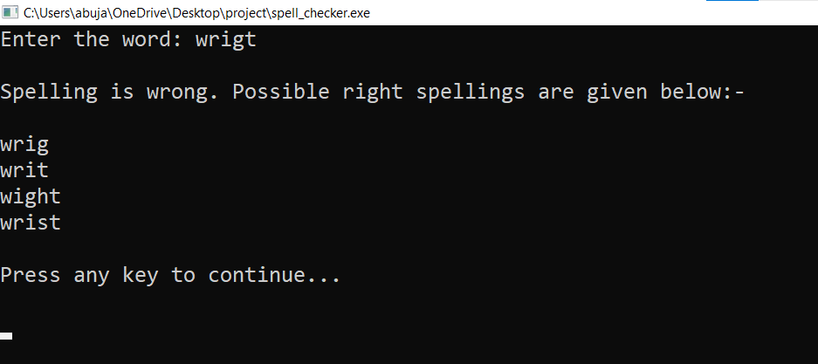

Slide 5

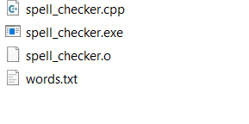
How the program works?
Ask enter the word
Convert all Upper-case alpha to lower case alpha.
Check the existence of the file
If the

Slide 6
If file exist
int correct = 0;
while (getline (words, line)) {
//words is an ifstream object
// running loop till words are copying // to line (a string ). }

Slide 7
If file exist
Int len = Input.slze(); //length of the word entered by user.
int flen = line.size(); //length of word taken from file.
if (line == input) then correct = 1;
if (line != input) then continue loop;
if (correct == 1) spelling is correct
if (correct == 0) spelling is incorrect
if (correct == 0 ) print suggestion

Slide 8
Some Error the program finds
Missing Character
Extra character
Mixture missing & extra character
Exchanged character

Slide 9
Missing Character
example: STCK "A" is missing from spelling of STACK.
int found = = 0;
Run loop a to z
Now add the 1st character and the string together look like this Tinput = S + ACKT = SACKT
Then compared its length with the file word
Then do same thing adding b to z
Now complete both the string and print
String r not equal continue.
Example: stck
After adding A end of the word STCKA

Slide 10
Thanks

