Slide 1
Cardio vascular disease prediction using Machine learning Algorithms
Name: Mohammed Abujar
ID: 2200562

Slide 2
Introduction
The aim of this project is to utilize certain predictors to determine whether an individual is affected with cardiovascular disease, as well as identify the factors that are associated with the disease.
By using this we can get to know the concerning factors affecting the cardio vascular disease and with this it is possible for early prevention or detection of the disease.
Mainly in this project I am comparing the Machine learning algorithms and checking the accuracy so that we can identify which algorithm is better performing and suitable for developing a model with the data.

Slide 3
Dataset overview
The dataset we have is obtained from Kaggle(Machine learning and data science community ). The link for the data is below: Cardiovascular Disease dataset | Kaggle. The data was recorded at the moment of medical examination.
The dataset consists of total 70000 rows and 13 columns.
The target variable(cardio) given is binary variable where (0 – person with no cardio vascular disease)and (1 – person with cardio vascular disease).

Slide 4
Data preprocessing
Upon checking for missing values/Null values there are no missing values present in the data
The percentage of the cardio(target variable) with persons having the cardio vascular disease and not having the cardio vascular disease is 49.07 & 50.03 respectively.
The concerning factors based on the correlation matrix are age, ap_hi(systolic pressure),ap_lo (diastolic pressure), BMI and gender and dealt with the outlier values present in the data.
The other columns data in the dataset is mostly skewed

Slide 5
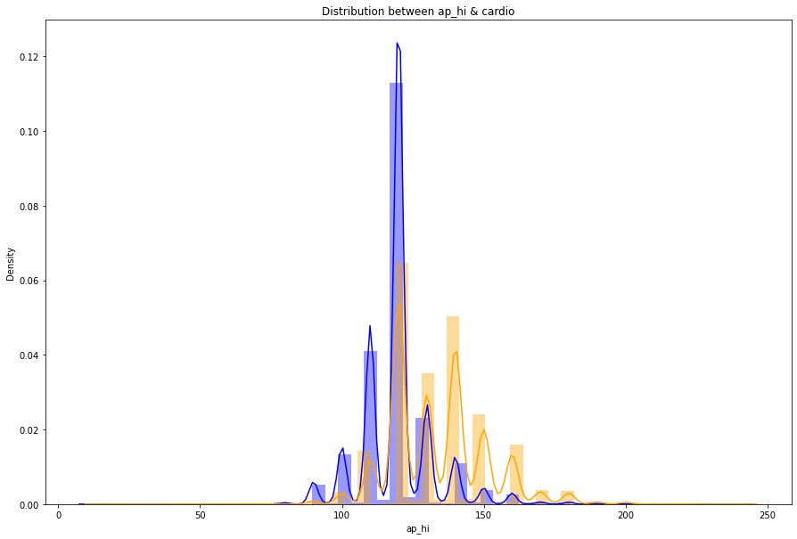
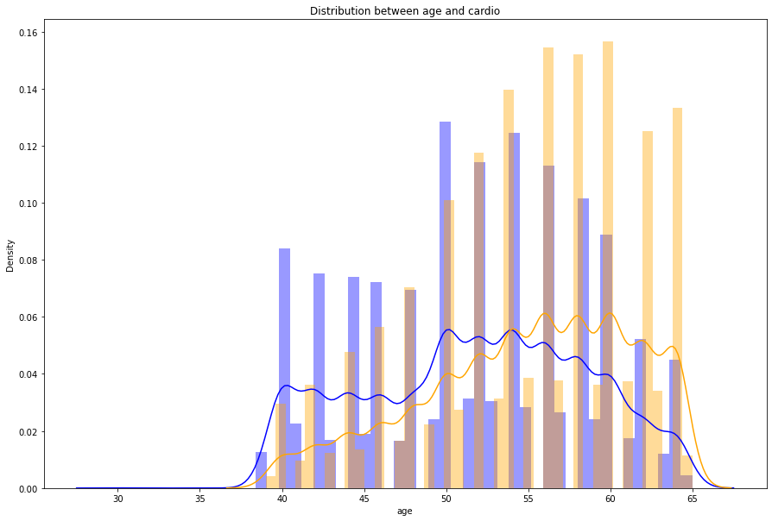
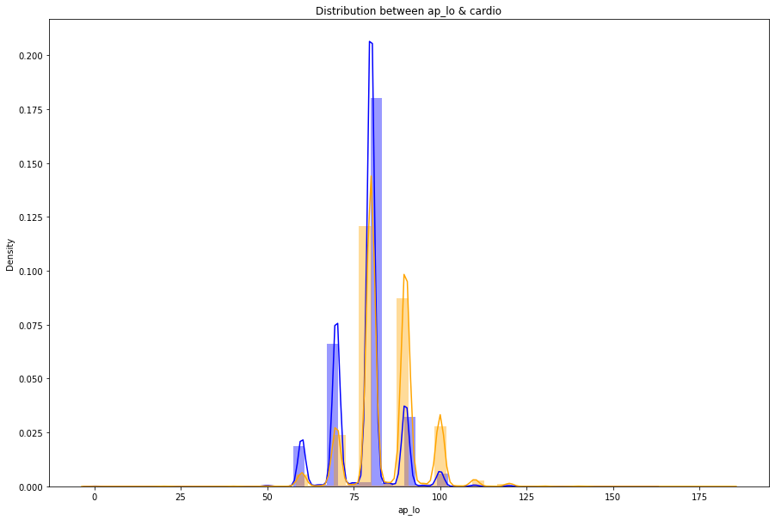
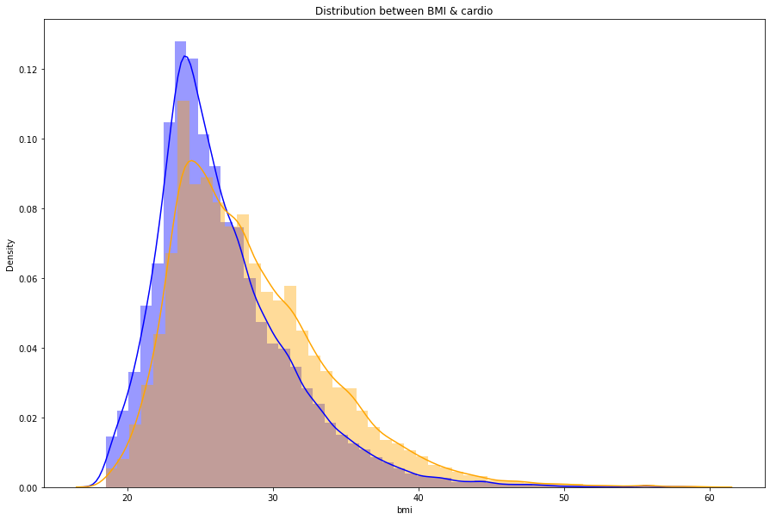
EDA plots:

Slide 6
Machine learning models:
The dataset has been split into the general used ratio 80:20 for both training and test data.
Hyperparameter tuning is done for the models so that the accuracy will be more and can avoid problems like overfitting.
The feature selection is done so that we can get to know the most concerning features for the cardiovascular disease based on the dataset

Slide 7
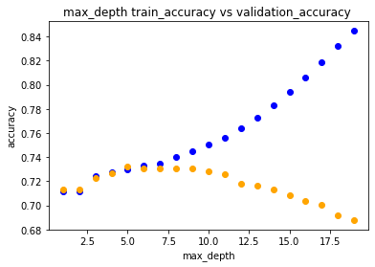
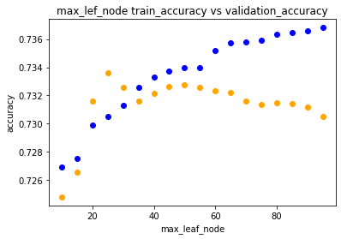
Decision tree
The accuracy obtained with the basic decision tree model is : 64%
The parameters max_depth and max_leaf_nodes are tuned i.e., max_depth = 5, max_leaf_nodes = 25 the accuracy is: 73%

Slide 8
Random forest
Basic implementation of random forest by randomly selecting the parameters.
Accuracy = 68.04%
Tuning:
Upon hyperparameter tuning using the GridSearchCV the accuracy for the random forest is quiet increased. The most concerning features are max_depth, max_leaf_nodes, n_eastimators, and max_features.
Accuracy = 73.04%

Slide 9
Feature importance:
Upon checking with both random forest and decision tree the most concerning feature which are effecting the cardio vascular disease are.
ap_hi(systolic blood pressure)
ap_lo(Diastolic blood pressure)
Age(persons age)
BMI(Body mass index)

Slide 10
Standardized the train and test sets so that the mean value will be 0 and standard deviation to 1.
It is used particularly for KNN and SVM models in order to obtain the better accuracy.
KNN : accuracy : 73% and sensitivity : 71.4%
SVM : accuracy :73.5% and sensitivity: 67.6%

Slide 11
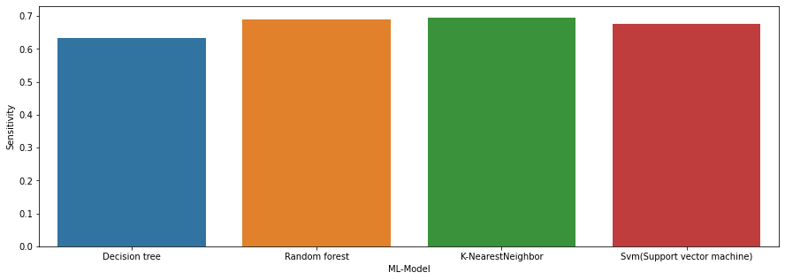
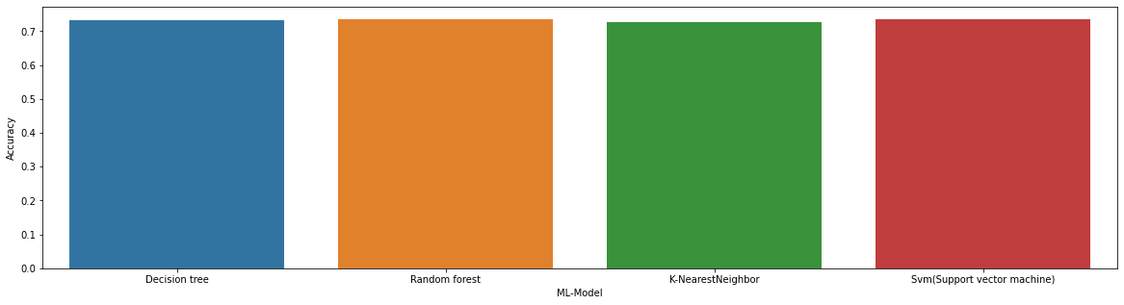
Results and conclusion:
Based on the accuracy and sensitivity values random forest and SVM are performed slightly better compared to the other two algorithms. The plots are as shown.

Slide 12
Thank you

