Slide 1
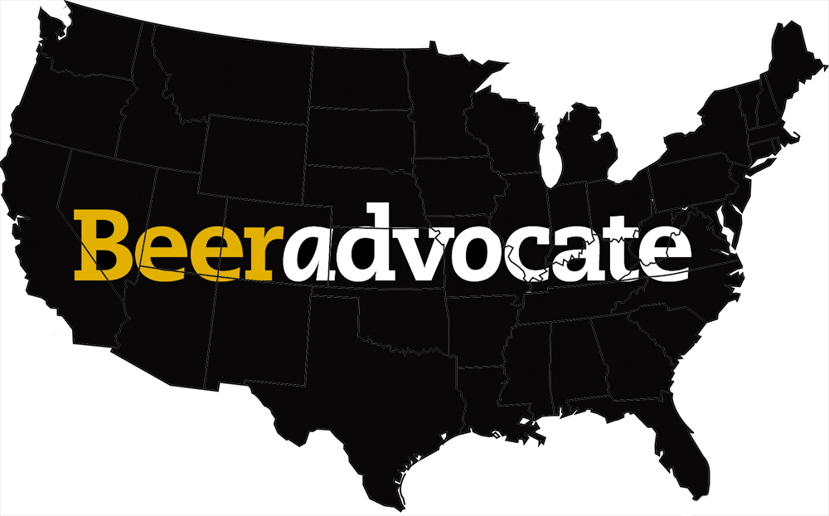
DSO 545 Statistical Computing & Data Visualization: Spring 2017 USC Marshall School of Business Beers of the United States
Jason Badgley
Jared Beck
Alex Bujold
Jeff Sontag
Gev Tarakchyan
*Data Source: www.beeradvocate.com

Slide 2
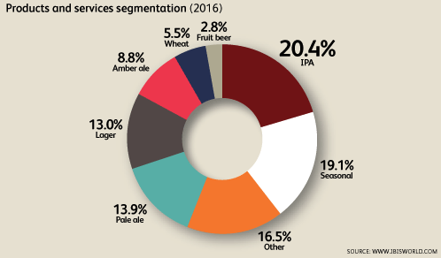
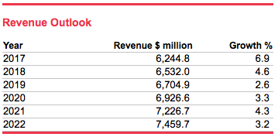
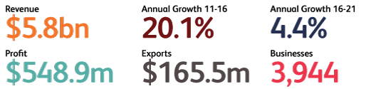
US Craft Beer Production
Why Craft Beer?
Fastest growing beer Segment over the past 10 years
Almost $6 Billion dollar industry segment
We love it!
*IBISWorld Industry Report OD4302 – Craft Beer Production – August 2016

Slide 3
Craft Brewery Production Business Scenario:
We are a family of home-brewing hobbyists with a long lineage of brewing expertise.
We have a portfolio of beer recipes developed and perfected on a small scale.
Our portfolio also includes a 100 year old family recipe for Rye Beer that we believe is our mission to share with the world (it’s that good).
We are looking to start a craft brewery.
We don’t have a lot of clout in the industry or a lot of start-up money.
We need to figure out what market is a good point of entry.

Slide 4
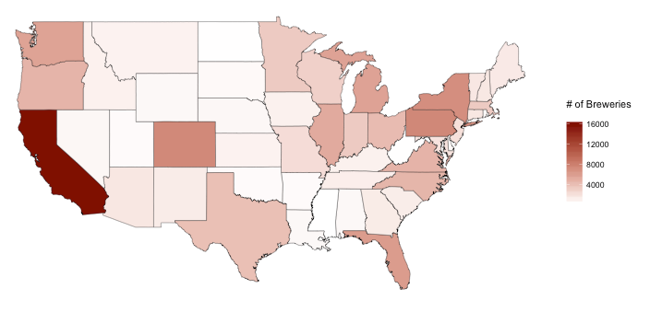
we want to start a craft brewery…. But Where?

Slide 5
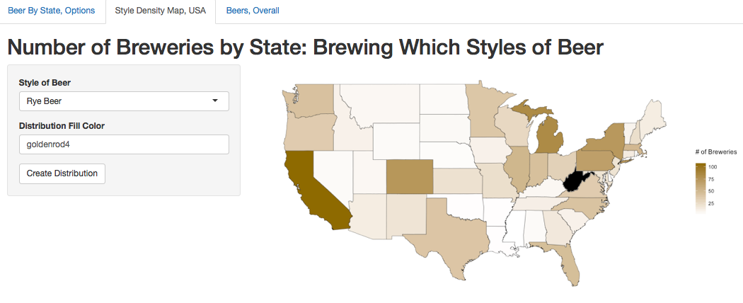
We have a secret family recipe for Rye Beer… Let’s look at the competitive landscape:
Takeaways:
California and Michigan have highest density of brewers making Rye Beer
West Virginia has no breweries currently brewing Rye Beer
…. Let’s Explore West Virginia

Slide 6
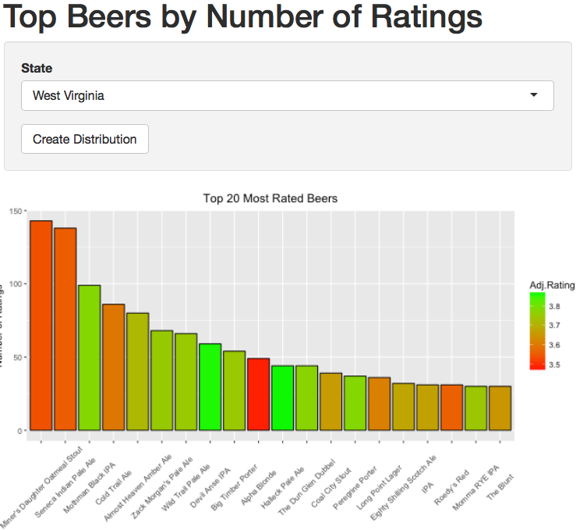
Top 20 Most Rated Beers: West Virginia
Takeaways:
West Virginians like to try heavy stouts and IPA’s (although doesn't mean the rate them high)

Slide 7
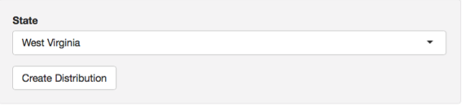
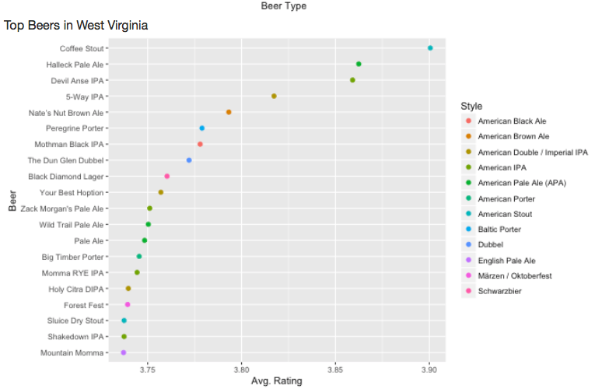
Top 20 Rated Beers: West Virginia
Takeaways:
Stouts and heavy IPA’s are popular in the region

Slide 8
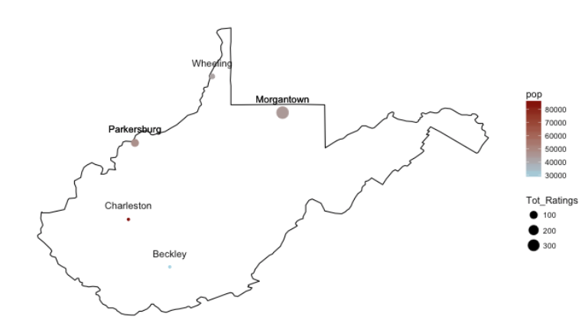
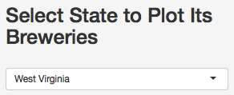
West Virginia Brewing Cities
Takeaways:
Charleston is the most populated city
Morgantown has more beer aficionados
…. Morgantown, WV looks like a promising entry market!
Now lets check out the local competition.

Slide 9
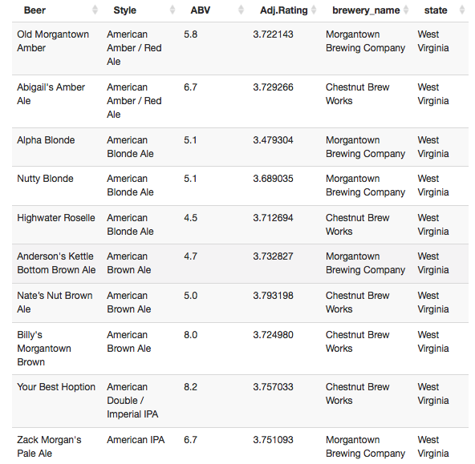
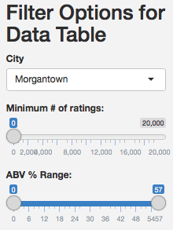
Morgantown Breweries:
Takeaways:
There are TWO major local brewers
Morgantown prefers American Amber/Red Ale and Blonde Ale
…. Rye Beer has a similar taste profile to IPA and some Amber Ales.
What does all this new information mean?

Slide 10
Morgantown, wv
Future Home of The Best Rye Beer™ in the United States

