Slide 1

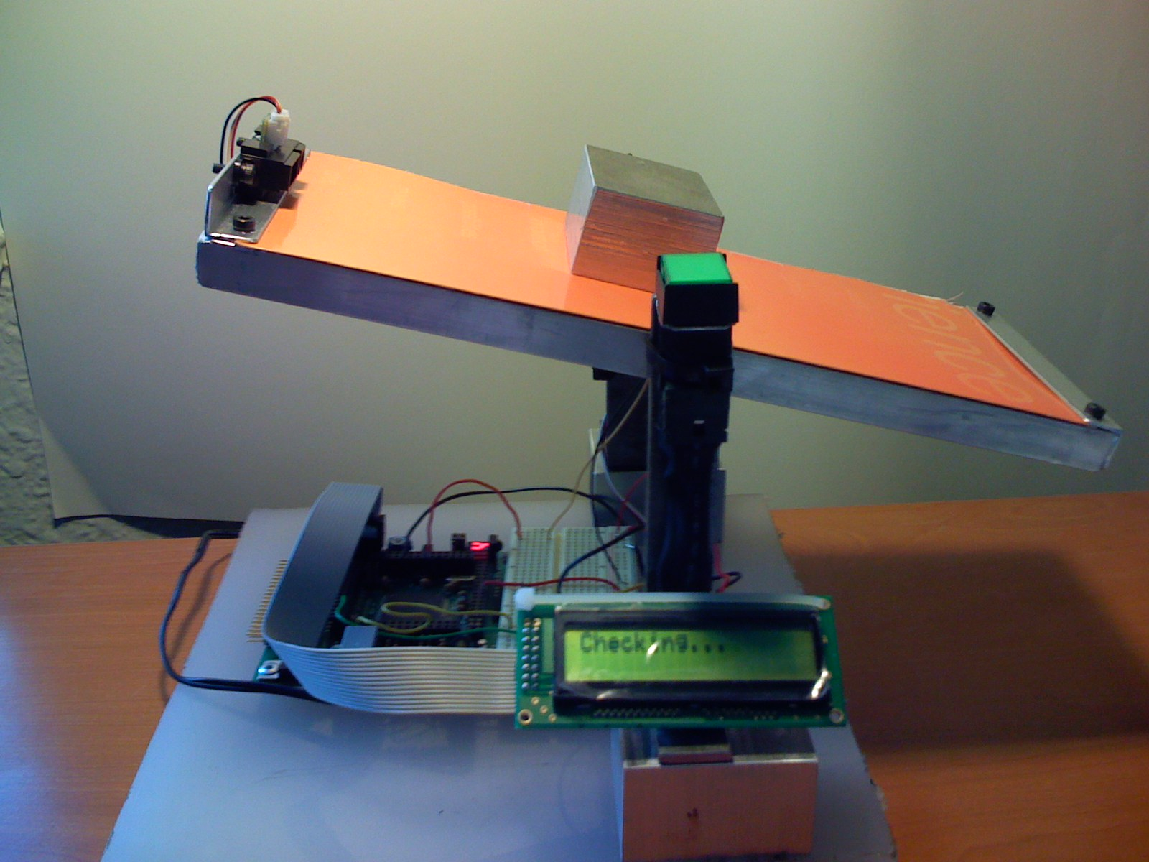
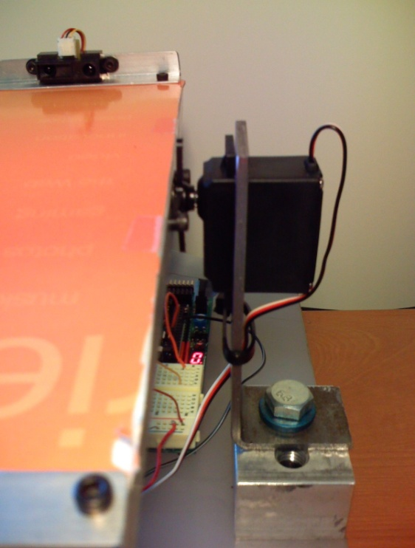
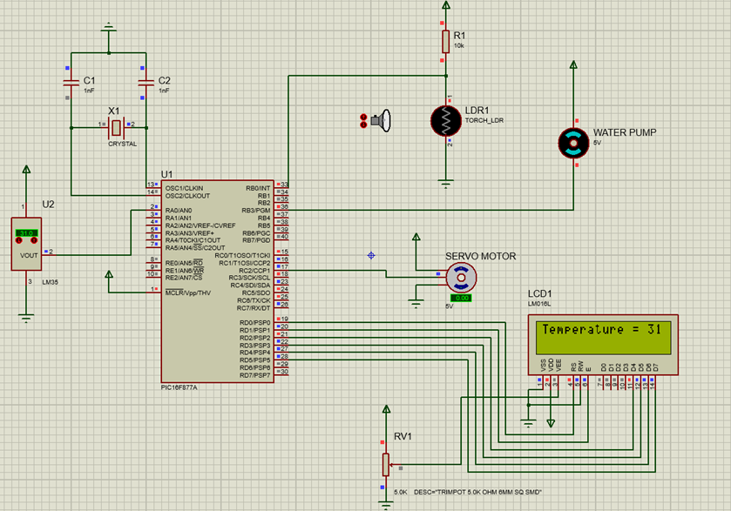
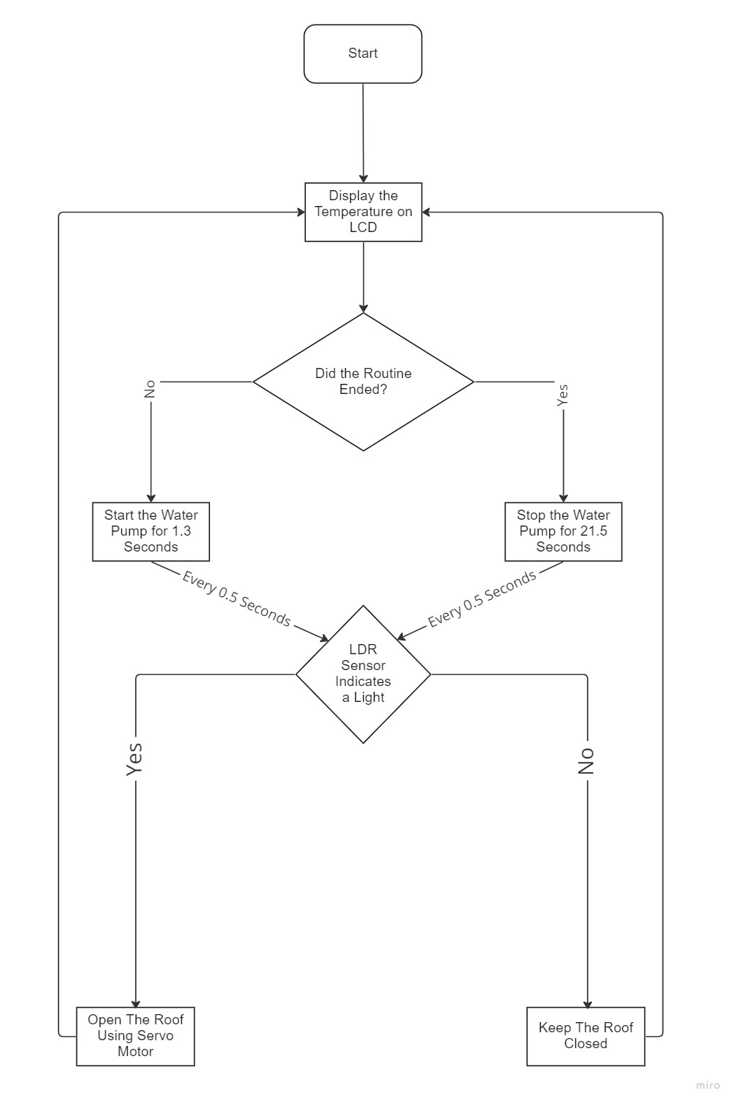
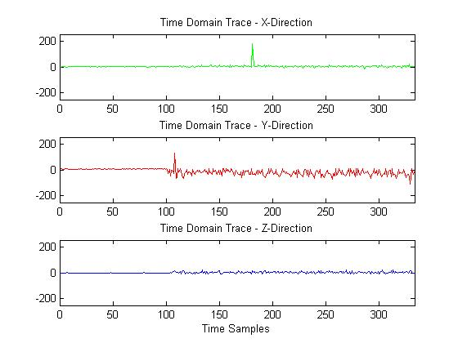
Greenhouse Control System
L. Alkhdour, O. Abujumaa, and M. Azzam
Supervisor: Dr. Belal Sababha
Embedded Systems Final Design Project, Fall 2022
King Abdullah II School of Engineering
Princess Sumaya University for Technology
Introduction
Greenhouses could be thought of as a shelter for plants from extreme and devastating weather conditions. This project is aimed to build a PIC microcontroller (MCU) autonomous system that controls the internal atmosphere of a greenhouse. PIC16F877A MCU will be used and will be the core component of the system that controls different peripherals used.
The servo motor will be responsible for the movement of the ceiling. When the LDR sensor sense light, the servo motor will rotate 90 degrees to open the ceiling. The ceiling will remain as it is until the LDR does not sense any light. The servo motor will then rotate 90 degrees in the opposite direction and the ceiling will close. The water pump will pump water every amount of time to the plants.
Results
The figures below show what the final project looks like. The LCD worked just as desired, with the surrounding temperature displayed as shown in figure 3.
Figure 3: Temperature
Figure 4 (a) shows when the ceiling is closed with the message “Roof is closed. This happens when the LDR does not sense any light. Figure 4 (b) shows the state when the ceiling opens with the message “Roof is open
Figure 4: Roof is opened (a) Roof is closed (b).
Figure 5 shows when the water pump works. The LCD displays the message “Water pump on” while the pump allows the flow of water.
Figure 5: The water pump is on.
IR Sensor
Servo motor
SW Button
miniDragon+
board
LCD
Design
(a)
(b)
(c)
Figure 1: Schematic Diagram
Figure 2: Flow chart
Conclusion
This project mimics how a typical Greenhouse could be autonomously controlled by a digital system. The system could be made more efficient and reliable if certain enhancements to the model are made. The water pump can be improved by adjusting the time period of each cycle. The servo motor could be replaced with a much stronger component that is able to lift heavier ceilings.

