Slide 1
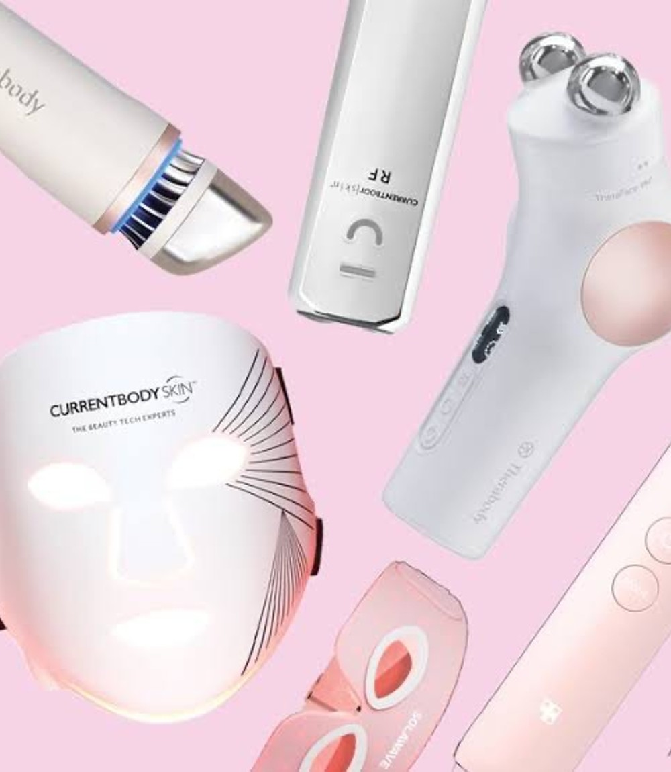
THE FUTURE OF SKINCARE
How technology is changing beauty and skin health
TANYA ABU KAMAL • CSIT 100 01 / 12

Slide 2
WHY I CHOSE THIS TOPIC
Skincare is part of everyday life, but more and more of it now involves technology. I wanted to learn how those tools work and whether they really help.
TANYA ABU KAMAL • CSIT 100 02 / 12

Slide 3
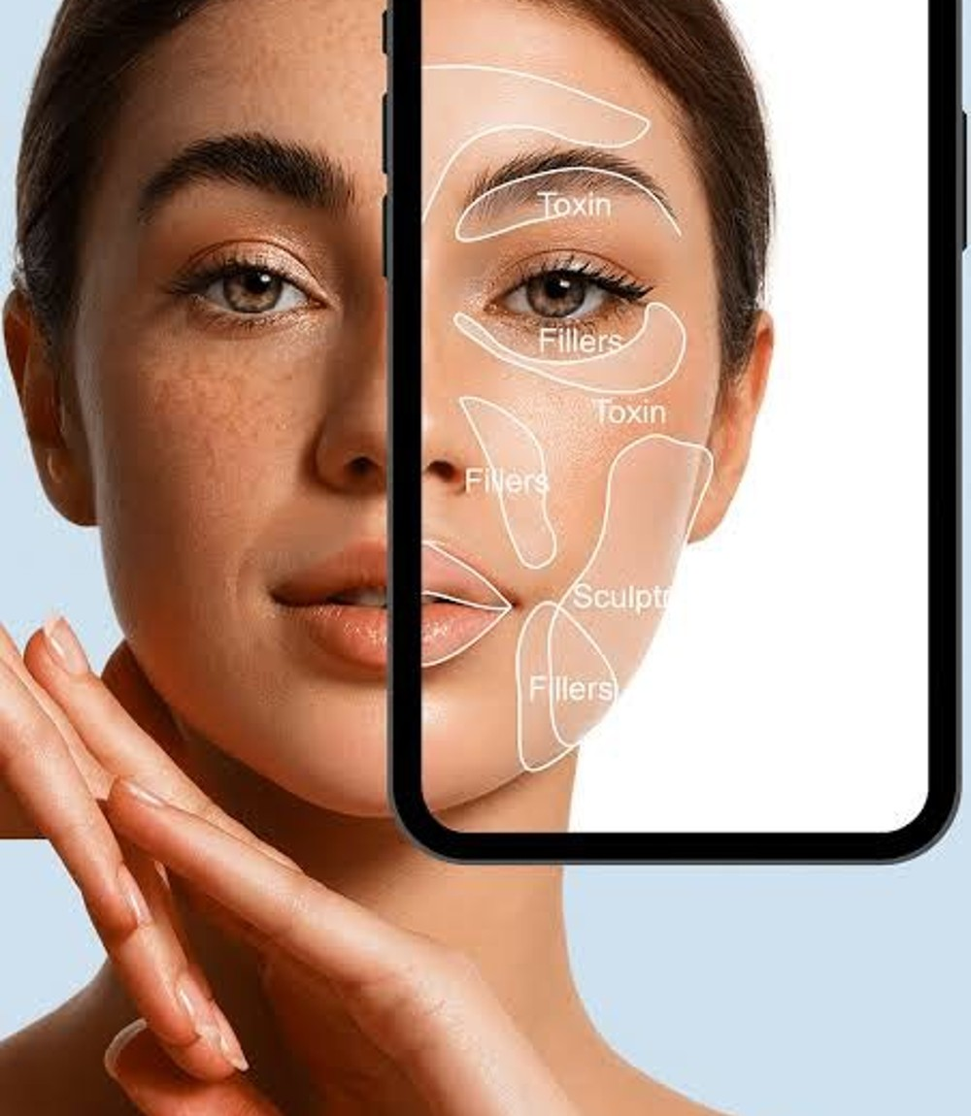
THREE AREAS I RESEARCHED
01 Artificial intelligence and skin analysis
02 Smart skincare devices and LED therapy
03 Teledermatology and online care
TANYA ABU KAMAL • CSIT 100 03 / 12

Slide 4
AI AND SKIN ANALYSIS
Apps can use photographs and computer vision to look for patterns in skin. Results depend on the quality of the image and the information used to train the system.
TANYA ABU KAMAL • CSIT 100 04 / 12

Slide 5
WHY AI IS NOT ALWAYS ACCURATE
Lighting, camera quality, and skin-tone representation can change results. An app recommendation is not the same as a medical diagnosis.
TANYA ABU KAMAL • CSIT 100 05 / 12

Slide 6
SMART SKINCARE DEVICES
Some devices use LEDs, sensors, timers, or connected apps. These tools can make routines easier to track, but product claims still need evidence.
TANYA ABU KAMAL • CSIT 100 06 / 12

Slide 7
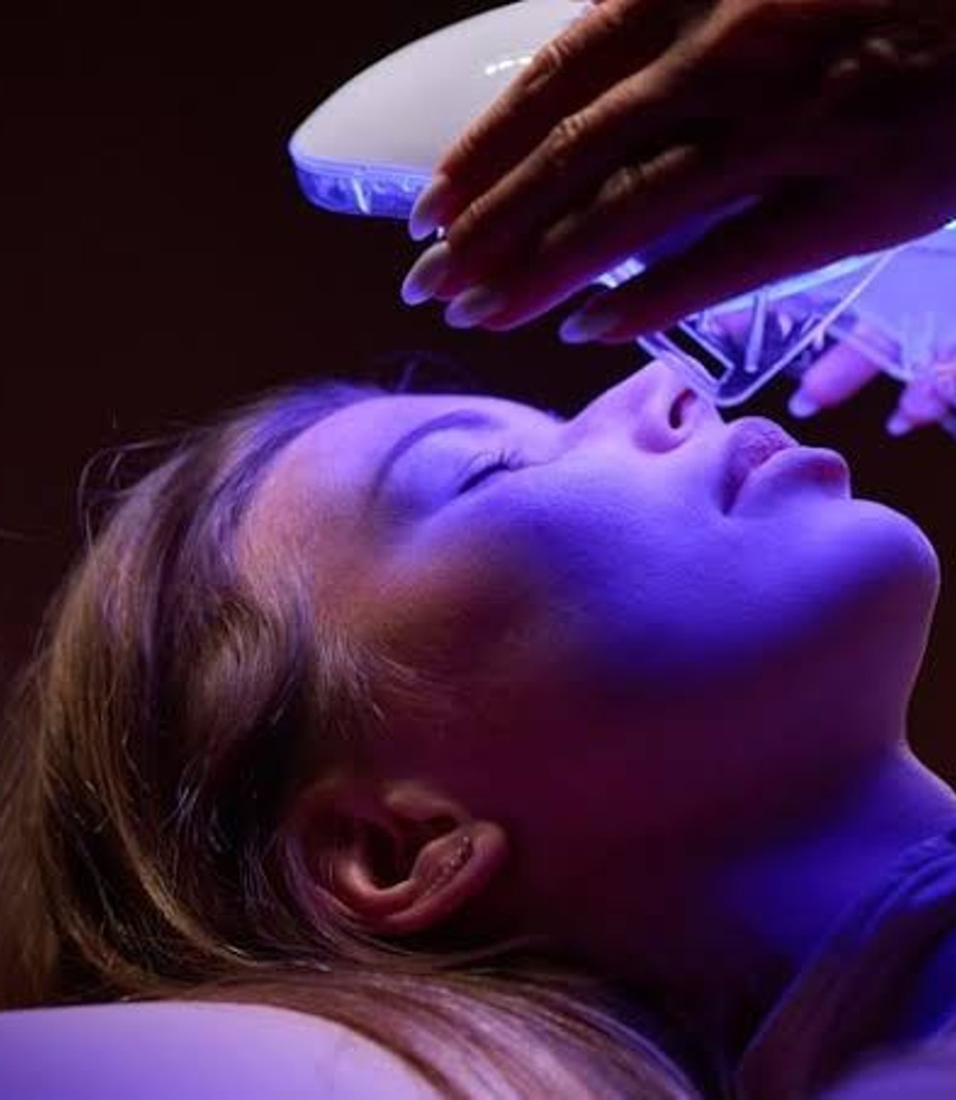
LED LIGHT THERAPY
Some light-based treatments may help with acne. The results depend on the device and treatment, and at-home devices do not replace professional care.
TANYA ABU KAMAL • CSIT 100 07 / 12

Slide 8
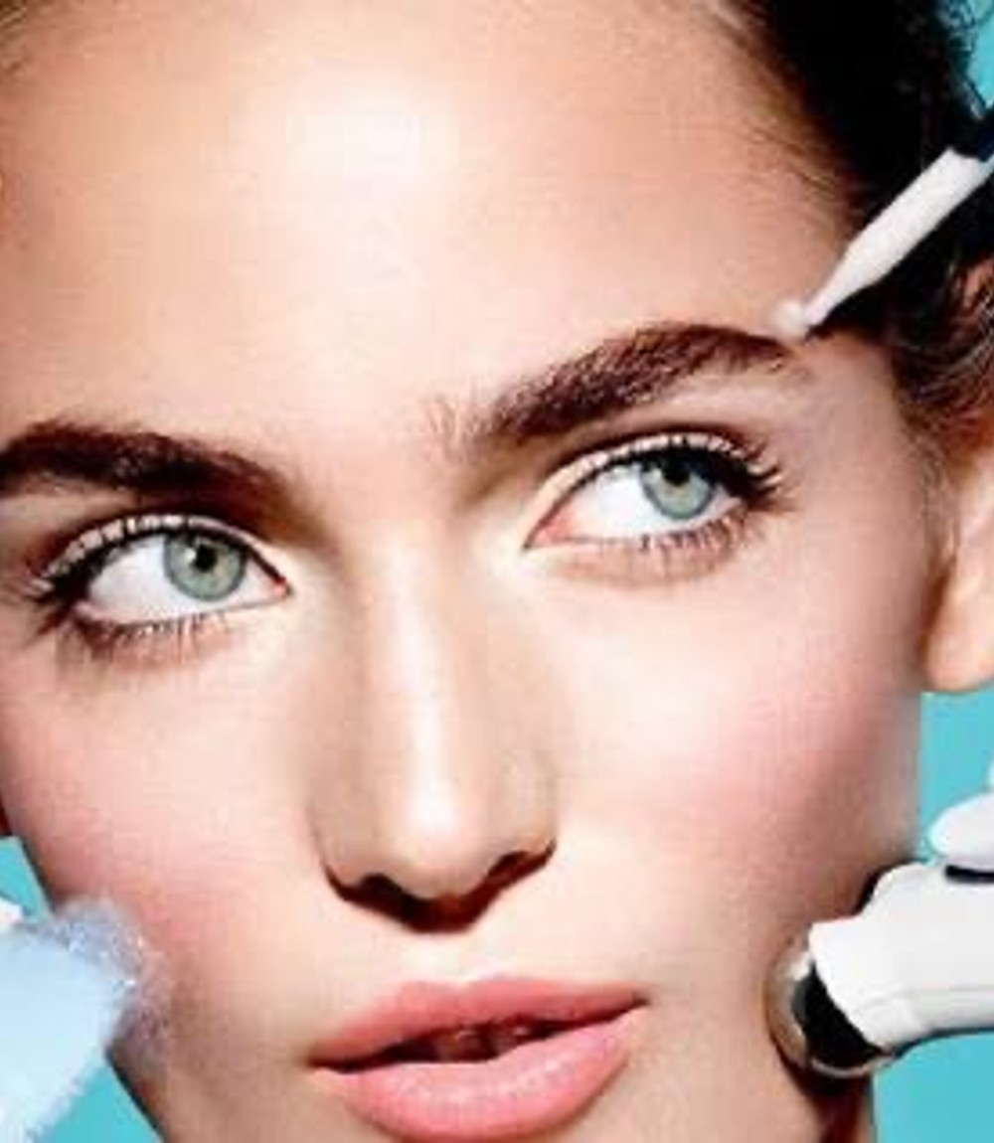
TELEDERMATOLOGY
Online dermatology visits make it easier to connect with a specialist. Photos and video can help, although some conditions still need an in-person examination.
TANYA ABU KAMAL • CSIT 100 08 / 12

Slide 9
BENEFITS OF TECHNOLOGY
• Easier access to information
• More convenient appointments
• Tools to follow a routine
• New ways to study skin conditions
TANYA ABU KAMAL • CSIT 100 09 / 12

Slide 10
CHALLENGES TO THINK ABOUT
• Privacy of face photos and health details
• Unequal accuracy across skin tones
• High device costs
• Misleading advertising claims
TANYA ABU KAMAL • CSIT 100 10 / 12

Slide 11
WHAT I LEARNED
Technology can be useful in skincare, but it works best when people understand its limits and use trustworthy information.
TANYA ABU KAMAL • CSIT 100 11 / 12

Slide 12
THANK YOU!
Tanya Abu Kamal | CSIT 100 | November 16, 2026
Sources and full explanations are included in the research paper and webography.
TANYA ABU KAMAL • CSIT 100 12 / 12

