Slide 1

جامعة القصيم • كلية الحاسب • قسم تقنية المعلومات
Qassim University • College of Computer • IT Department
THIQA CAR INSURANCE
An Intelligent, Multi-Agent Car-Insurance Recommendation Platform
Supervisor Dr. Abdullah Alaraj
B.Sc. Graduation Project — Qassim, Saudi Arabia — 1447 (2026)

Slide 2



01 | INTRODUCTION
Choosing car insurance has become harder, not easier
In today’s digital market, drivers face many policies, coverage limits, exclusions and deductibles. Most platforms only display static quotes — leaving the customer to compare and decide alone, often without truly understanding the differences.
THIQA
means “trust” in Arabic
Motor-insurance focus
A smart platform that compares live insurance offers and returns the single most suitable package — clearly, neutrally, and instantly.
Scoped entirely to car insurance — TPL, comprehensive and usage-based options.
Data-driven & personalized
Uses driver and vehicle data to tailor every recommendation.
3 cooperating AI agents
Transparent by design
Explains, in plain language, why a policy was chosen.
THIQA
02

Slide 3


02 | DIRECTION
Our Vision & Mission
VISION
MISSION
To make car-insurance decisions in Saudi Arabia simple, transparent and trustworthy for every driver.
Pull live offers directly from licensed insurers
Score every package against the customer’s real profile
Recommend the single most suitable policy
Explain the choice in clear, non-technical language
Aligned with Vision 2030 goals for digital financial services and a cashless, innovation-driven economy.
THIQA
03

Slide 4




03 | PROBLEM STATEMENT
Why drivers struggle to pick the right policy
Too many variables
Low policy literacy
Coverage limits, exclusions, deductibles and prices are hard to weigh side-by-side.
Drivers often can’t tell TPL from comprehensive or judge which add-ons matter.
Wrong-fit choices
No real guidance
Users overpay for unneeded cover — or pick the cheapest option and stay under-protected.
Existing platforms compare on price alone; they rarely explain the best fit.
THIQA
04

Slide 5




04 | LITERATURE REVIEW
The landscape we studied
The review surveyed e-commerce in insurance, motor-insurance fundamentals, and the technologies reshaping the industry.
E-Commerce in Insurance
Car-Insurance Concepts
Auto InsurTech
Online quotation, purchase, renewal, digital payments and the risks they introduce.
TPL, comprehensive, collision, theft & fire, UBI and optional add-ons.
AI, telematics, IoT, computer vision and APIs transforming the value chain.
Digital Transformation
Telematics & UBI
Saudi Ecosystem
Automation, data-driven risk assessment, fraud detection, blockchain & cybersecurity.
Driving-behaviour data enabling personalized, usage-based pricing.
Vision 2030, SAMA regulation, the insurance sandbox and local aggregators.
THIQA
05

Slide 6



05 | RELATED WORK
Market & existing solutions
Global InsurTech Patterns
Saudi Ecosystem
Aggregators such as Tameeni and BCare let drivers compare and buy motor policies online; insurers like Tawuniya and Takaful Al-Rajhi are digitizing fast.
Digital quotation engines & mobile-first apps
Automated, AI-assisted claims workflows
Driver-scoring and telematics-based pricing
Computer-vision vehicle damage assessment
Embedded insurance via mobility platforms
The Gap
Current platforms filter by price and company name only. They rarely deliver intelligent, explainable, personalized recommendations that weigh driving behaviour, mileage and prior claims.
THIQA
06

Slide 7
06 | METHODOLOGY
A multi-agent recommendation approach
THIQA is an API-driven, multi-agent system. Three specialized agents work as a one-directional pipeline — collect, decide, explain — so each stage stays simple and easy to extend.
1
2
3
Data Receiver & Retrieval
→
Recommendation Agent
→
Explainer Agent
Validates the customer’s data, queries every insurer API in parallel, and merges live JSON offers into one unified quote set.
Filters eligible packages, scores each on 8 weighted criteria, ranks them, and selects the highest-scoring policy.
Maps the winning criteria to plain language — why this package won and why the alternatives did not.
THIQA
07

Slide 8
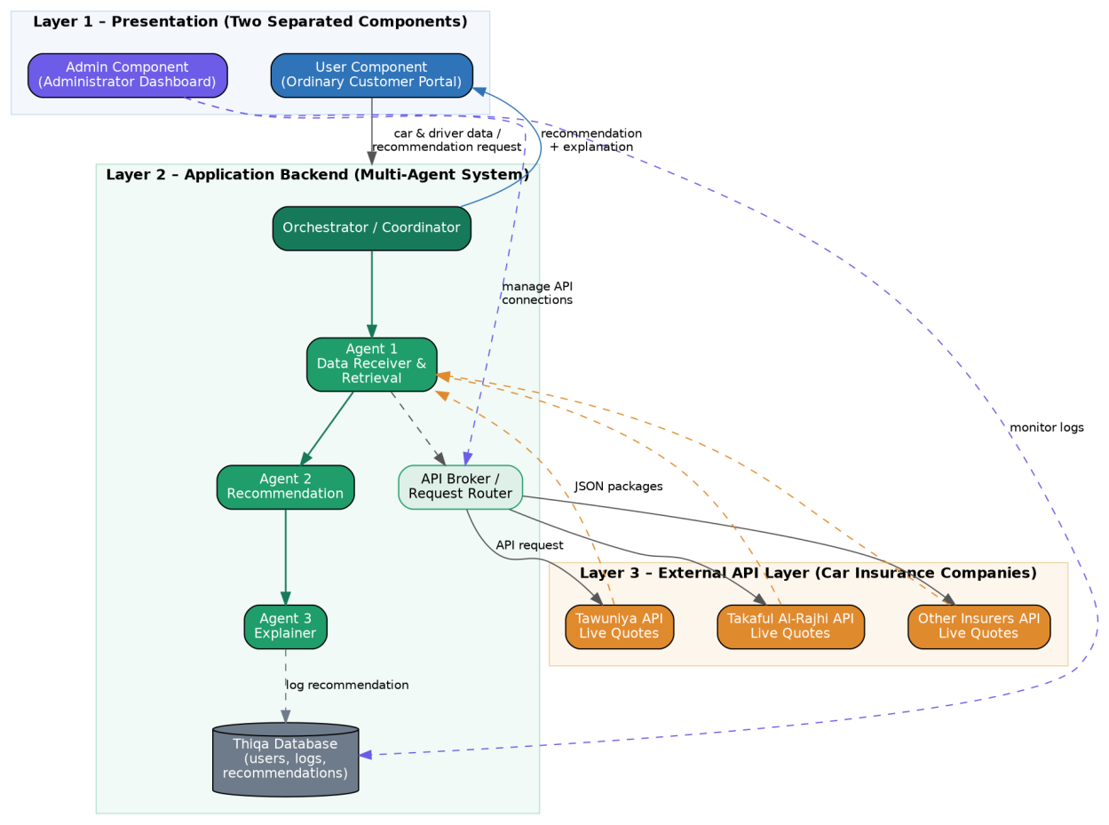



07 | DESIGN — SYSTEM ARCHITECTURE
Three-layer, API-driven architecture
Layer 1 — Presentation
Two separated components: the User portal and the Admin dashboard.
Layer 2 — Application Backend
Orchestrator plus the three intelligent agents (the multi-agent system).
Layer 3 — External APIs
Live pricing & coverage from insurers (Tawuniya, Takaful Al-Rajhi, …).
Figure 3.1 — Three-layer platform architecture
THIQA
08

Slide 9
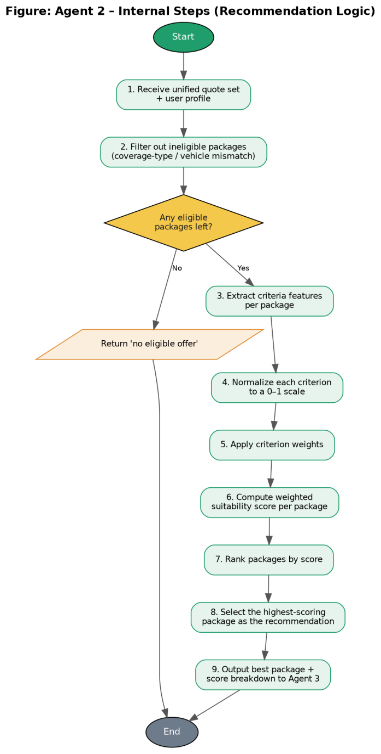
07 | DESIGN — RECOMMENDATION LOGIC
Inside Agent 2 — scoring & ranking
Each eligible package is scored on eight criteria, then ranked — premium and coverage carry the largest weights.
Suitability score S = Σ ( wᵢ × xᵢ ) where Σ wᵢ = 1
HIGHEST WEIGHT
HIGHEST WEIGHT
1. Premium (price)
2. Coverage type & scope
Annual cost — a lower premium raises the score, weighed against coverage.
Comprehensive or TPL, plus the range of risks: collision, theft, fire, natural events.
3. Coverage-to-price value
4. Deductible (per claim)
5. Add-ons & benefits
6. Fit to driver / vehicle
7. Provider reliability
8. Availability & freshness
Figure 3.6 — Agent 2 internal steps (recommendation logic)
Steps 4–8 above implement this weighted scoring: normalise → weight → sum → rank → select.
THIQA
10

Slide 10
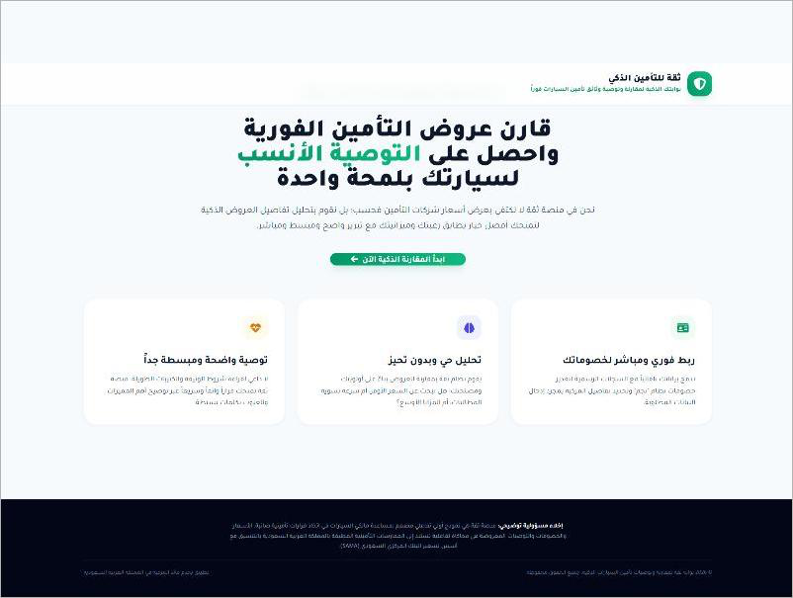

07 | DESIGN — USER INTERFACE
Landing page
One clear call-to-action
The page states the value in a single line and guides the customer straight into the smart comparison — no technical detail.
Clear & simple recommendation
Neutral, unbiased analysis
Direct connection to insurers
Figure 3.14 — Thiqa landing page (User Component)
THIQA
11

Slide 11
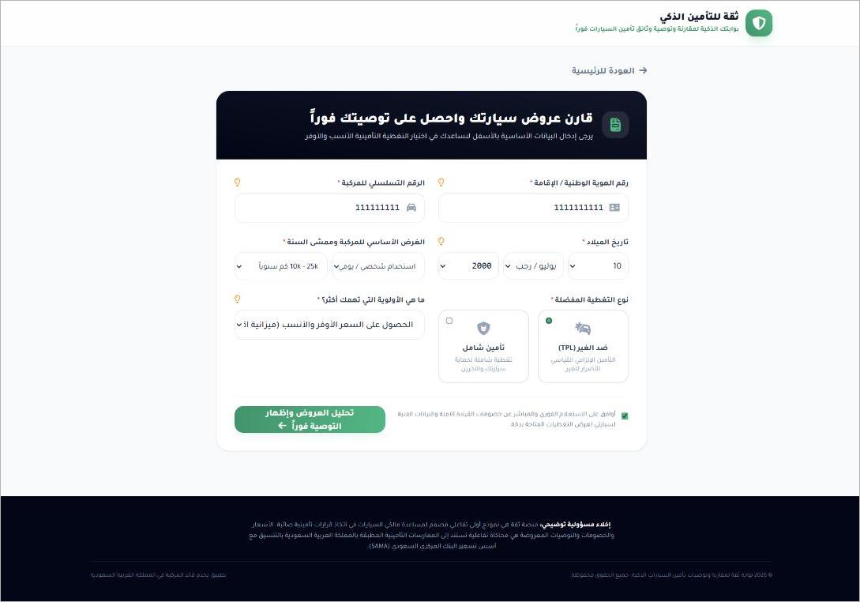
07 | DESIGN — USER INTERFACE
Car & driver data-entry page
A single short form
It collects exactly the fields insurers need to price a policy — kept to one form so the journey stays fast.
National ID / Iqama
Date of birth
Vehicle serial (chassis) no.
Manufacturing year
Purpose of use & mileage
Coverage type — TPL / Comprehensive
Main priority (e.g. lowest suitable price)
Figure 3.15 — Data-entry page (User Component)
THIQA
12

Slide 12
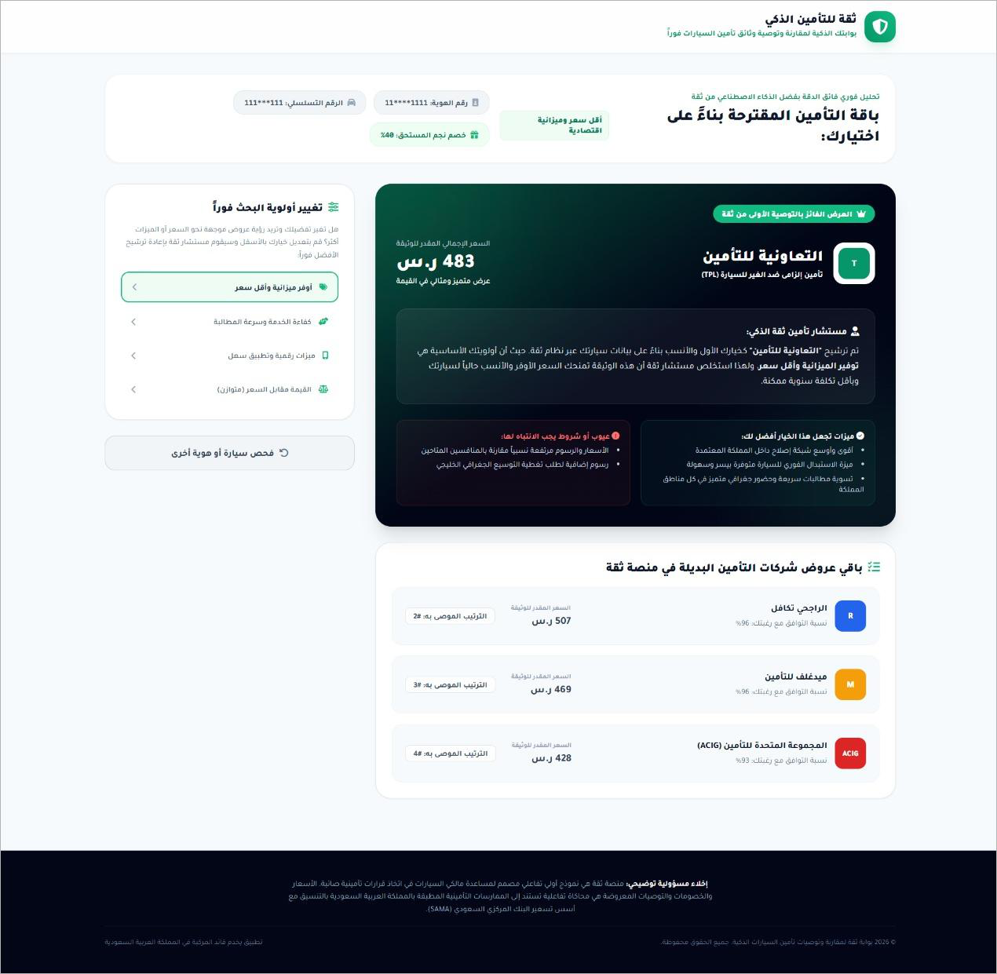
07 | DESIGN — USER INTERFACE
Recommendation & explanation page
Winner
Tawuniya — TPL SAR 483/yr
Chosen for the best coverage-to-price balance — not the cheapest, but the most suitable for this customer.
Ranked alternatives in the same session
Takaful Al-Rajhi
SAR 507
Medgulf
SAR 469
ACIG
SAR 428
Figure 3.16 — Recommendation & explanation page
THIQA
13
\

Slide 13


08 | REQUIREMENT ANALYSIS
What the system must do — and how well
Functional
Non-Functional
Authentication; separate User & Admin
Car & driver data entry
Live offer retrieval from insurer APIs
Scoring & best-package recommendation
Plain-language explanation
Simple result display
Admin control & logging of results
Response time — result within a few seconds
Reliability — works if one insurer API is down
Scalability — more users & insurers, no redesign
Usability — intuitive for non-technical users
Security — protects user data & API keys
Data accuracy — relies on live retrieved data
Flexibility — adapts to API changes
THIQA
14

Slide 14
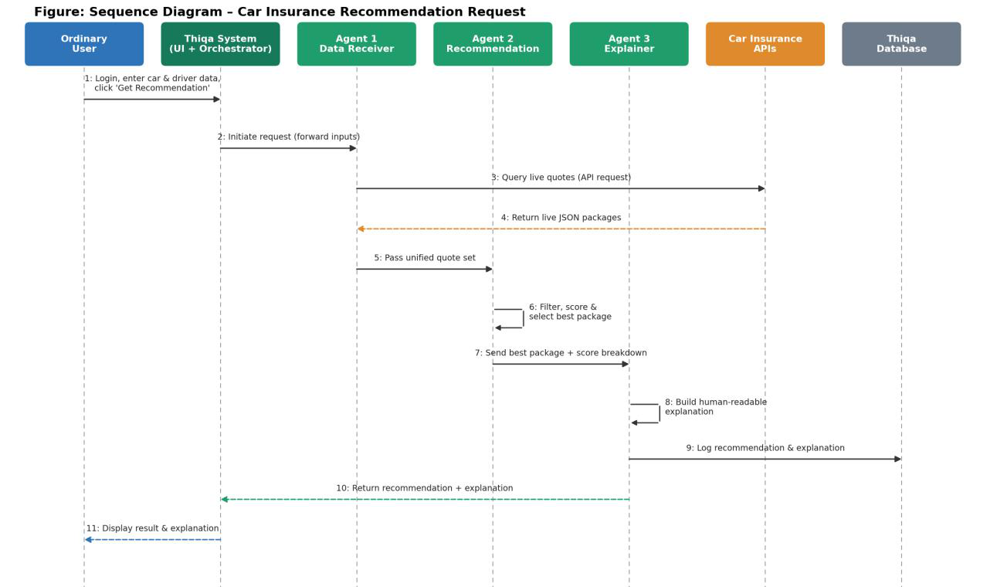
08 | SYSTEM MODELING
Sequence diagram — recommendation request
Figure 3.10 — Time-ordered messages: login → retrieve → score → explain → display
THIQA
15

Slide 15


09 | FUTURE WORK & CONCLUSION
Where THIQA goes next
FUTURE WORK
CONCLUSION
Telematics & UBI
Integrate real-time driving data for usage-based pricing.
THIQA brings live offer retrieval, intelligent scoring and explainable decisions together in one platform.
Live insurer integrations
Connect production APIs of Saudi insurers.
Simple for the customer
Organised, three-layer structure
Fast, dynamic & explainable recommendations
Smarter ranking
Learn criterion weights from user feedback.
Thank you • جامعة القصيم • 1447 (2026)

