Slide 1
Overarching goals: Investigate the cause of the post-sunset EIA merge associated with a substorm
Period: Feb 22-24, 2023
Methodology:
Data analysis (Jan):
TEC: Identify the EIA merge process in the Brazilian Sector (Madrigal)
FPI neutral wind
Numerical simulation:
FAC-driven GITM simulation using the FTA (Feb)
Need to include the FTA into the old version of GITM
Thermospheric simulation: Data-model comparison DMSP & FPI neutral wind
GITM-SAMI3 coupling (Mar - May):
Examine the EIA variation
Sensitivity test: wind or electric field

Slide 2
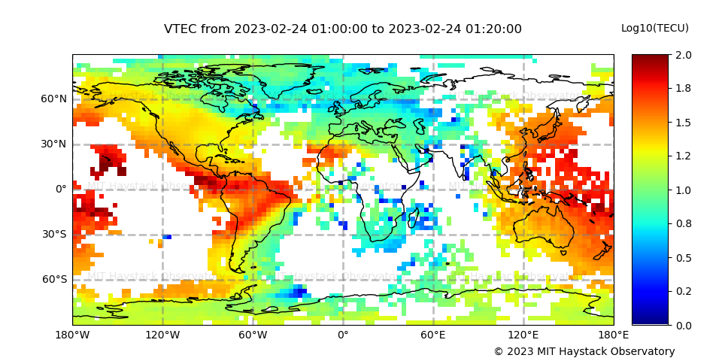
Step 1
15 MLON
Download TEC data between 02/22 and 02/24 in 2023;
On each day there will be 288 unique UTs. At each UT, extract data between 15-25 MLON and bin data according to MLAT (from -30 to 30 MLAT , 2 deg bins). Then you will have 288 UT x 60 MLAT data for each day and 864 UT x 60 MLAT data for three days.
Show (use pcolormesh) the TEC as a function of UT and MLAT.
Check the F10.7 (NASA OMNI), HP60 (https://kp.gfz-potsdam.de/en/), SMR and SME during this period (https://supermag.jhuapl.edu/indices/). Try to visualize it in one plot along with the TEC plot.

Slide 3
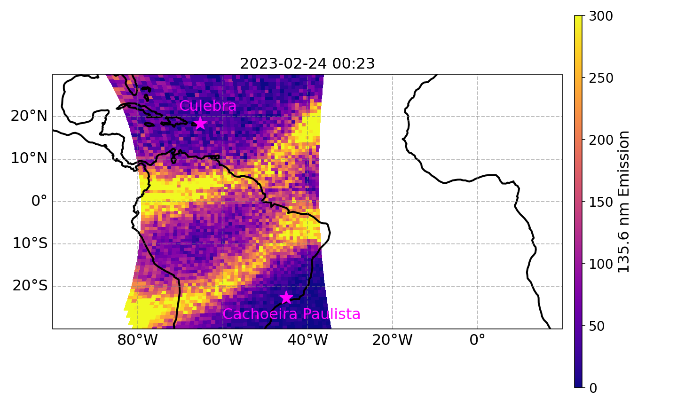
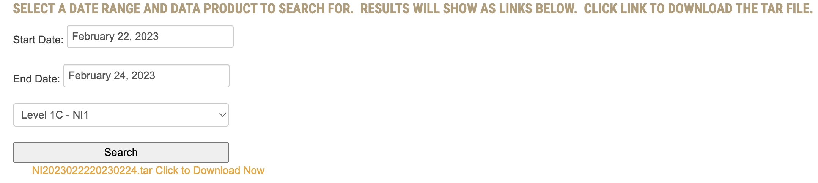
Step 2: GOLD data processing
Data Download: https://gold.cs.ucf.edu/data/search/
Documentation (Use the data products guide): https://gold.cs.ucf.edu/data/documentation/
Read papers using GOLD to study post-sunset EIA to better understand the dataset
Step 1: Determine the date
Step 2: Search to generate the tar
Step 3: Download the tar by clicking the orange text

Slide 4
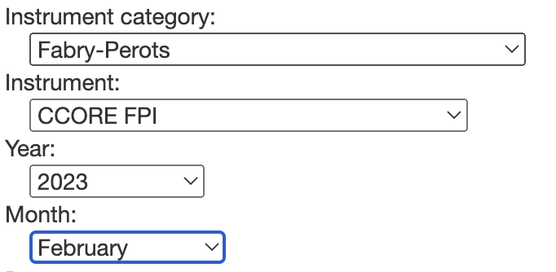
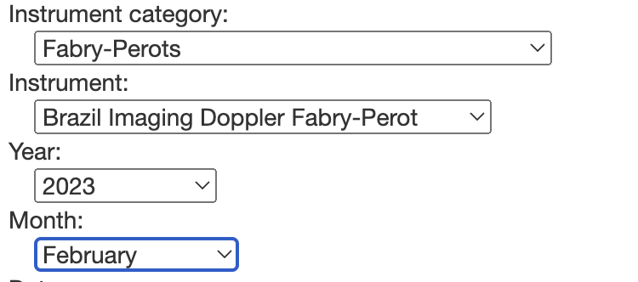
Step 3: FPI data (https://cedar.openmadrigal.org/single)
Download Feb 22-23, 2023
Santarem data in the shared folder ./data/fpi/str. A processing code for Santarem data is also available there

