Slide 1
Make REST API

Slide 2
-> Laravel Sanctum Install
-> php artisan install:api
User Model add This :
use Laravel\Sanctum\HasApiTokens;
class User extends Authenticatable
{
use HasApiTokens, HasFactory, Notifiable;
}
php artisan make:controller V1/BookingController --api --resource
php artisan make:model Booking -m

Slide 3
migrations table add
$table->string('title');
$table->date('date');
$table->string('status')->default('pending');
booking modal add
protected $fillable = ['title','date','status'];
make route in api.php
Route::resource('/v1/bookings',BookingController::class);
-> php artisan route:list
Make a controller method and add validation
public function store(Request $request)
{
$request->validate([
'title' => ['required']
]);
}

Slide 4
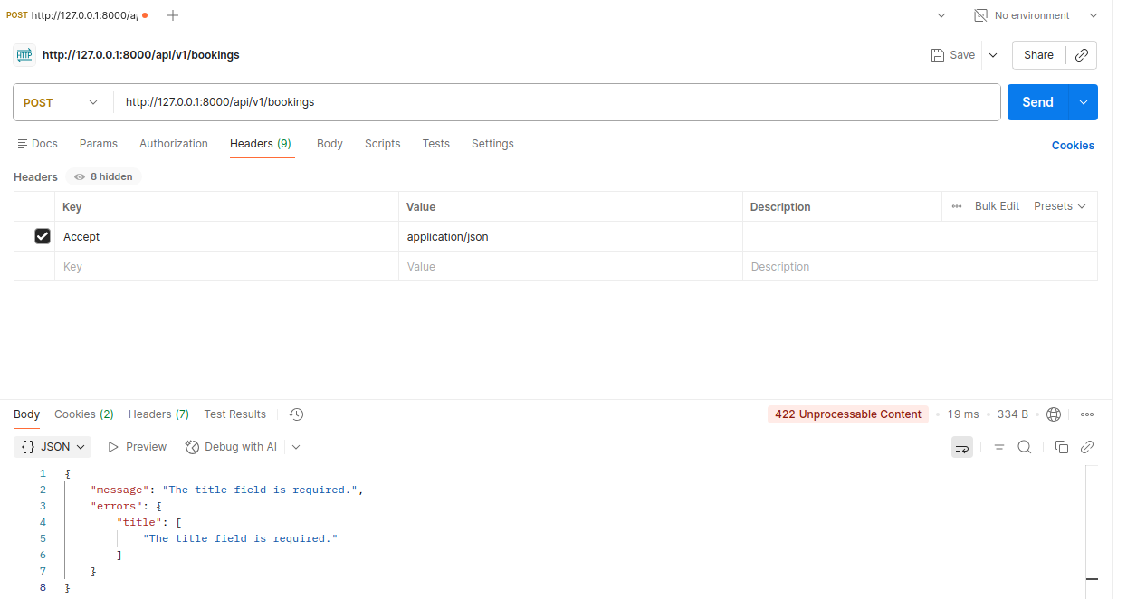

Slide 5
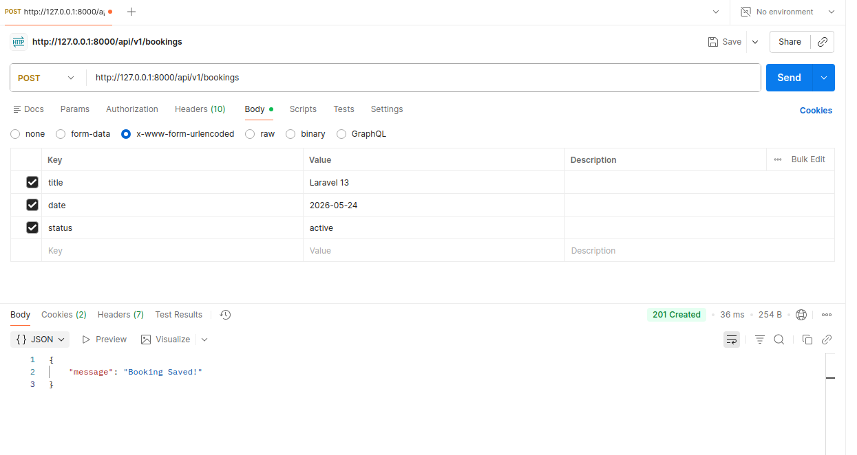

Slide 6
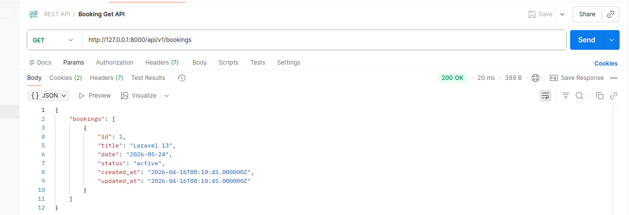
Add Get Method and check api
public function index()
{
$booking = Booking::all();
return response()->json([
'bookings'=>$booking
],200);
}

Slide 7
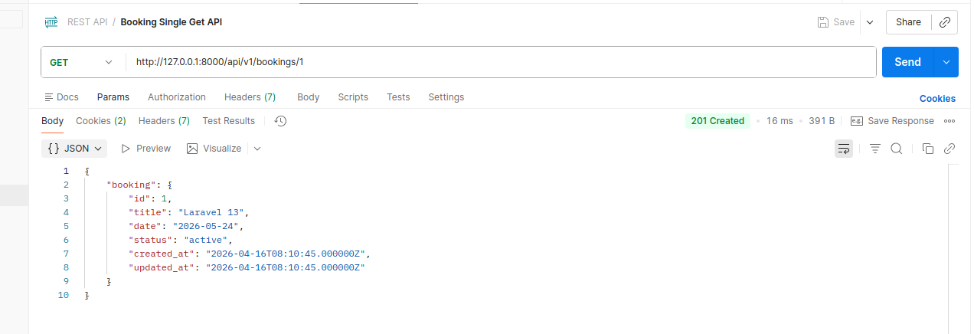
Write Show Method and Check this api
public function show(string $id)
{
$booking = booking::find($id);
return response()->json([
'booking' => $booking
],201);
}

Slide 8
Make PUT API Write this method
public function update(Request $request, string $id)
{
$request->validate([
'title' => ['required'],
'date' => ['required', 'date'],
'status' => ['required'],
]);
$booking = Booking::find($id);
// dd($booking);
$booking->update([
'title' => $request->title,
'date' => $request->date,
'status' => $request->status
]);
return response()->json([
'message' => 'Booking Updated!'
], 201);
}

Slide 9
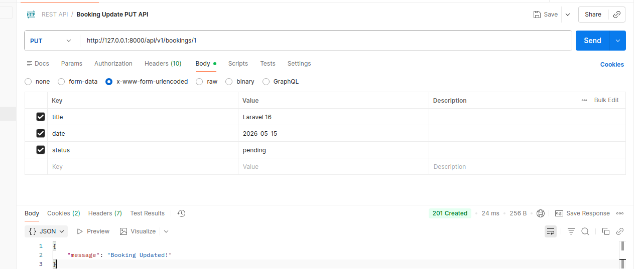

Slide 10
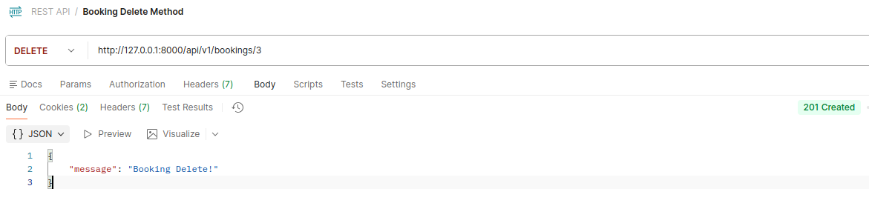
Delete API
public function destroy(string $id)
{
Booking::find($id)->delete();
return response()->json(
[
'message' => 'Booking Delete!'
],201);
}

Slide 11
Make API Most Secure
Eloquent: API Resources

Slide 12
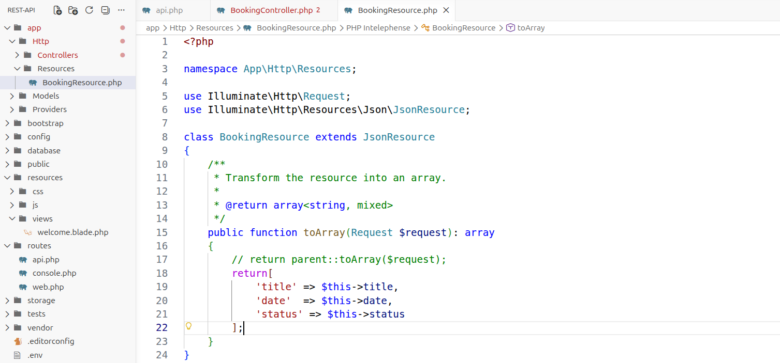
php artisan make:resource BookingResource

Slide 13
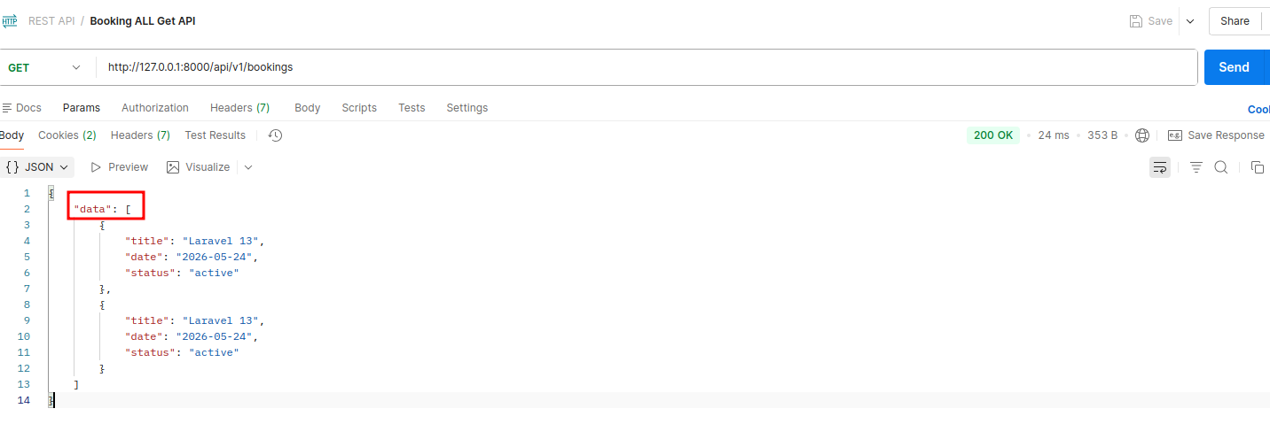
Go Controller and Use Booking Resource
use App\Http\Resources\BookingResource;
public function index()
{
$booking = Booking::all();
return BookingResource::collection($booking);
}
Check API and show a new data property wrap “data”

Slide 14
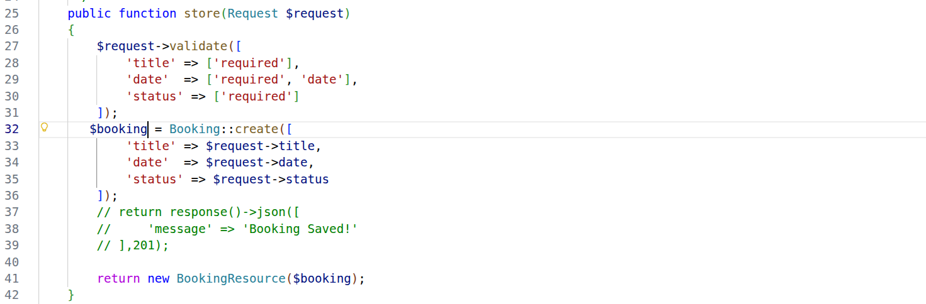
Create Method add Booking Resource

Slide 15
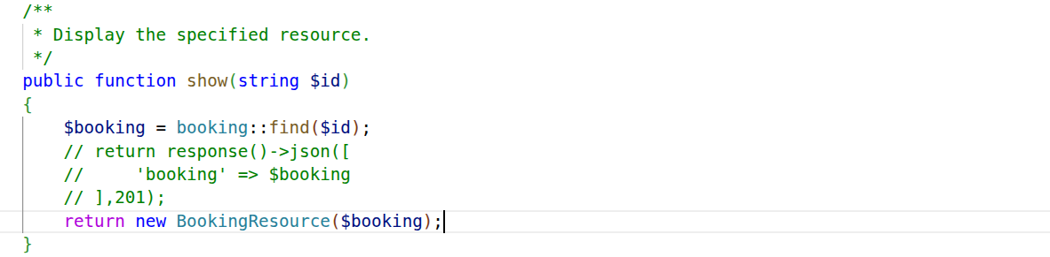
Show single Method add Booking Resource

Slide 16
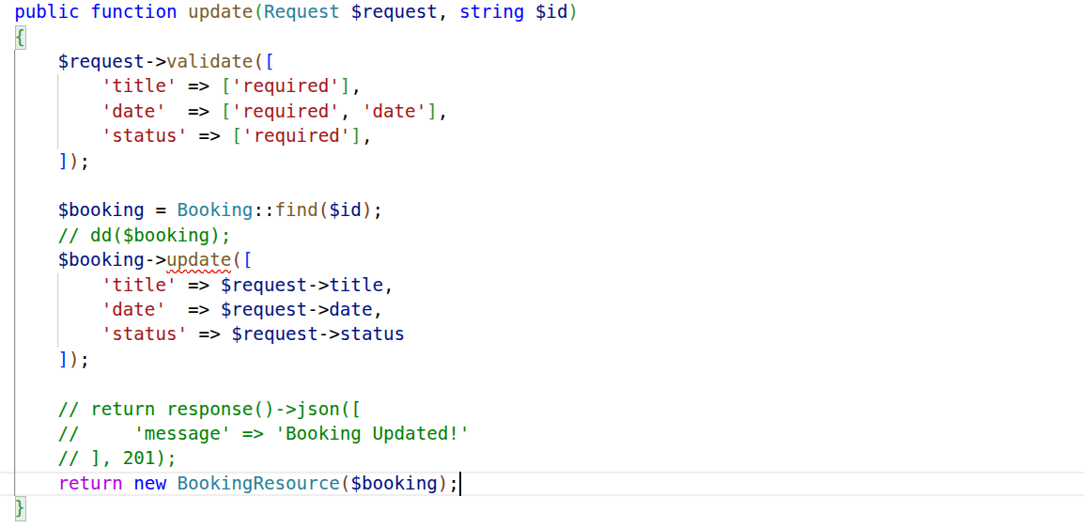
Update Method add Booking Resource

Slide 17
Use Token base Auth

Slide 18
-> php artisan make:controller API/V1/AuthenticationController.php
Move my booking Controller API/V1 Folder so route and controller namespace change path
Route::post('v1/register',[AuthenticationController::class,'register'])->name('register');
Go Authentication Controller and make register method
public function register(Request $request){
$request->validate([
'name' => ['required', 'string'],
'email' => ['required', 'string'],
'password' => ['required']
]);
$user = User::create([
'name' => $request->name,
'email' => $request->email,
'password' => Hash::make($request->password)
]);
return $user->createToken('api_token')->plainTextToken;
}

Slide 19
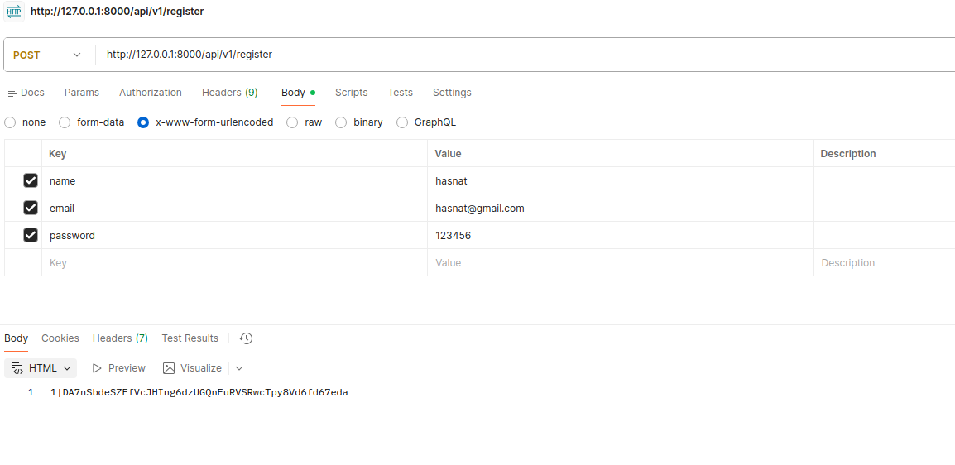
Copy this token start (DA7..................................................) and save this notepad

Slide 20
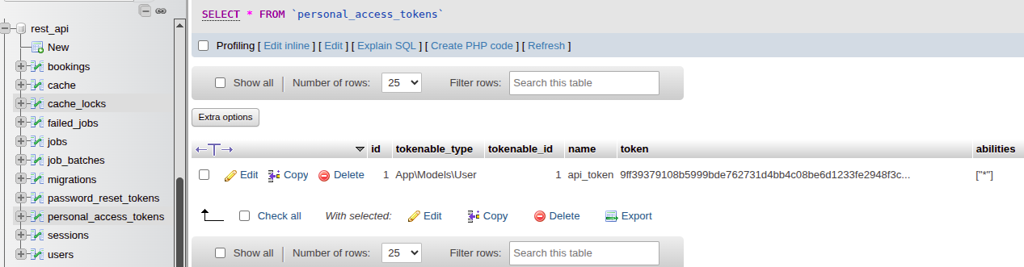
Check Database Have a encription token

Slide 21
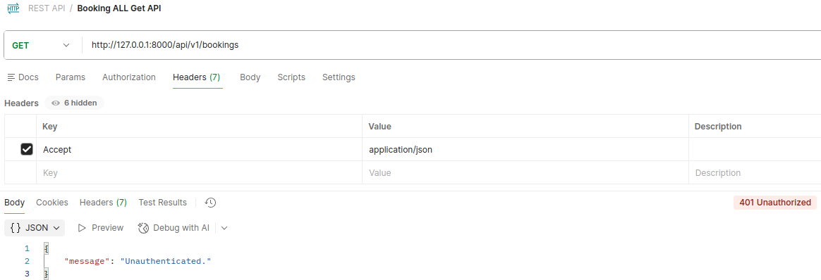
add auth sanctum
Route::resource('/v1/bookings',BookingController::class)->middleware('auth:sanctum');

Slide 22
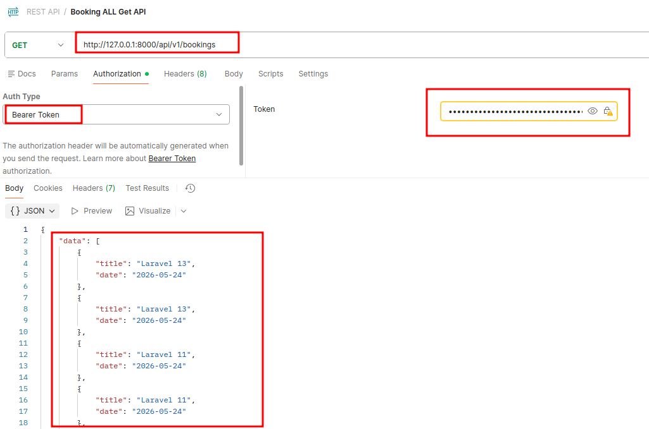
Now use token and and see products/booking etc, set notepad copyed token

Slide 23
Make a Login auth

Slide 24
Make Login Route:
Route::post('v1/login',[AuthenticationController::class,'login'])->name('login');
use Illuminate\Validation\ValidationException;
public function login(Request $request){
$request->validate([
'email' => ['required', 'email'],
'password' => ['required']
]);
$user = User::where('email', $request->email)->first();
if (! $user || ! Hash::check($request->password, $user->password)) {
throw ValidationException::withMessages([
'email' => ['The provided credentials are incorrect.'],
]);
}
return $user->createToken('api_token')->plainTextToken;
}

Slide 25
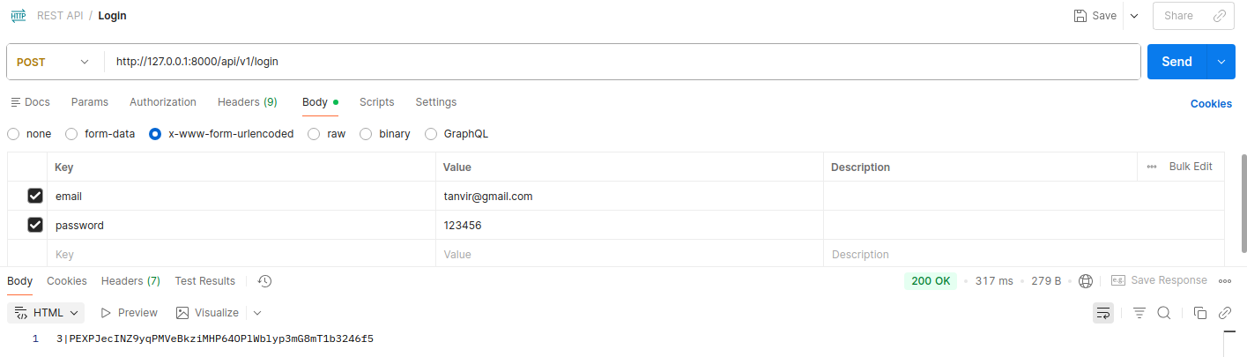

Slide 26
Revoke Token

Slide 27
Token Revoke
Route::post('v1/revoke-token',[AuthenticationController::class,'revokeToken']) ->name('revoke.token');
public function destroy(string $id)
{
Booking::find($id)->delete();
return response()->json(
[
'message' => 'Booking Delete!'
],201);
}

Slide 28
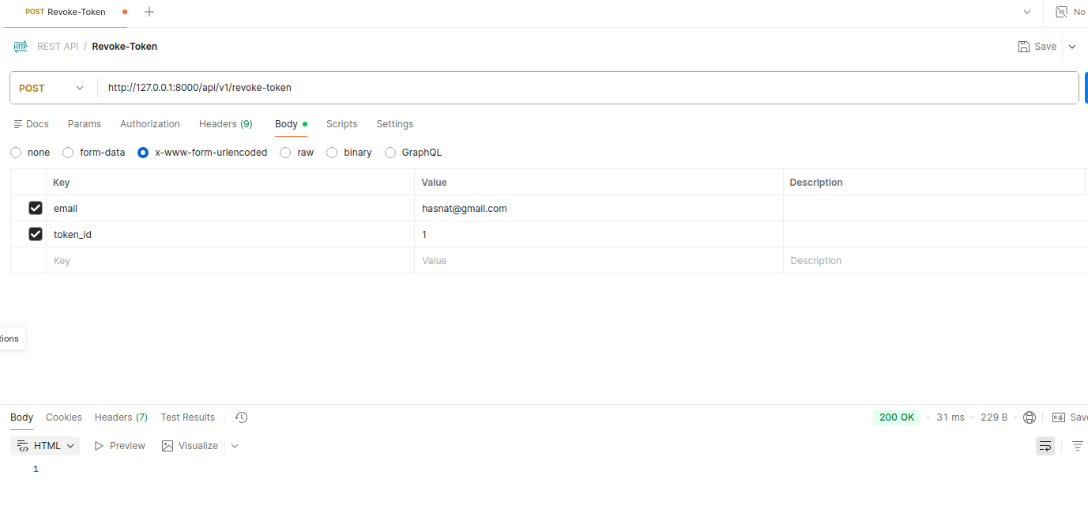
Token id check databse personal-access-token table

Slide 29
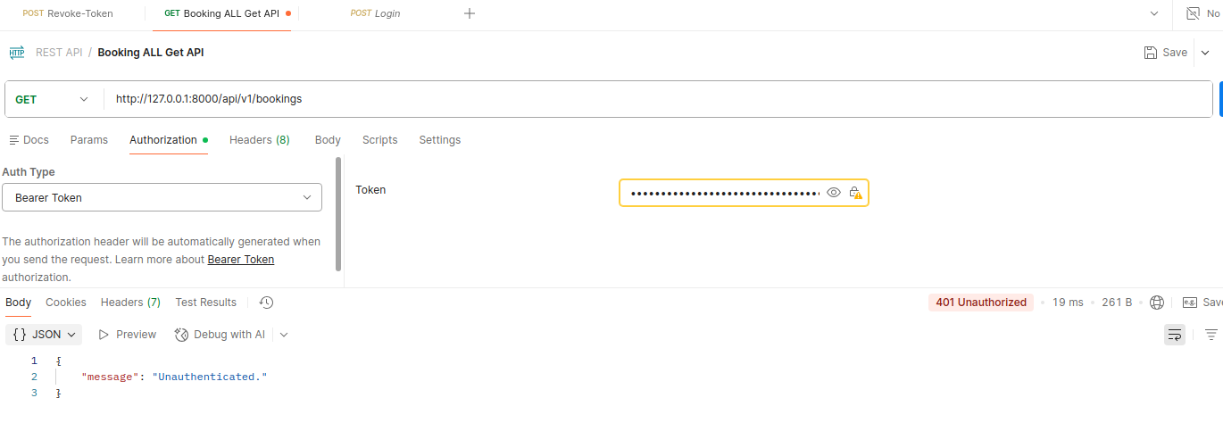
Now Check Bookings get api or post api or delete, threre are not work beause token are revoke

Slide 30
Now Check Again
Login Again and take token use this when you get,post,put or delete booking, you allowed to do this, but if you hit revoke-token api your token are destory and you have
no access to get,post,put or delete.

Slide 32
User Limit

Slide 33
1. Route::middleware([...])
This means all routes inside this group will use these middlewares.
auth:sanctum
This middleware checks user authentication using Laravel Sanctum
Only logged-in (authenticated) users can access these routes
If not logged in → ❌ access denied (401 Unauthorized)
Used for API authentication (token-based)
throttle
This middleware limits how many requests a user can make
Prevents spam or abuse
Example:
Default: ~60 requests per minute (depends on config)
If limit exceeded → ❌ 429 Too Many Requests
Route::middleware(['auth:sanctum','throttle'])->group(function(){
Route::resource('/v1/bookings',BookingController::class);
});

Slide 34
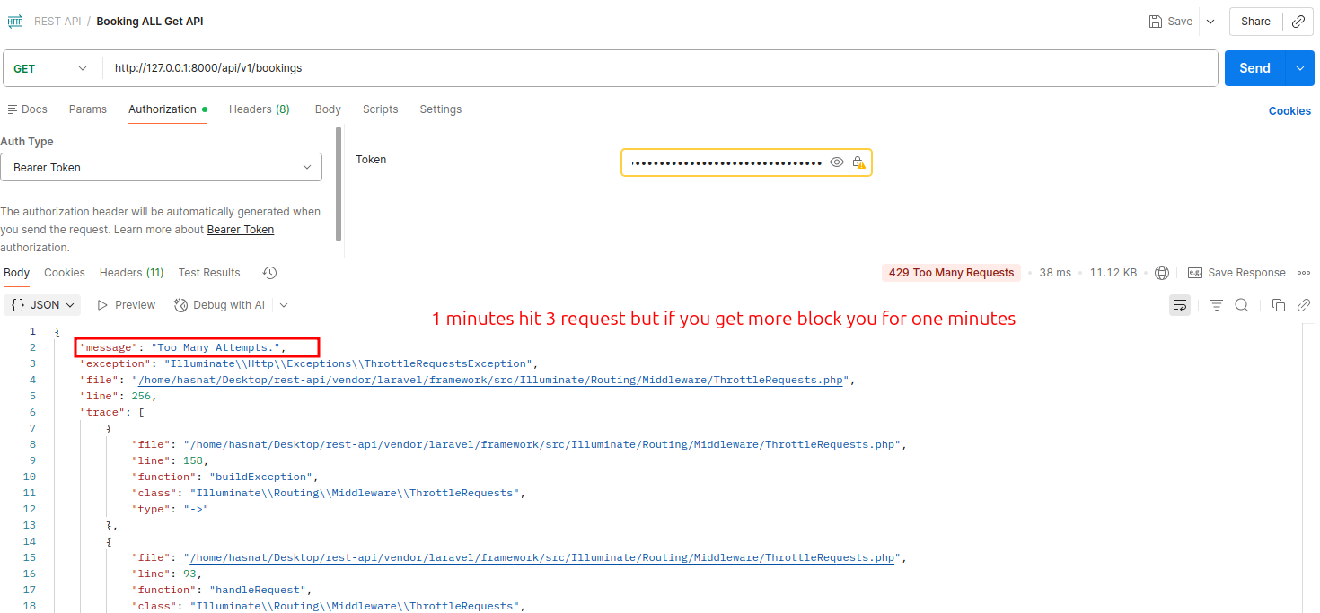
Route::middleware(['auth:sanctum','throttle:3,2'])->group(function(){
Route::resource('/v1/bookings',BookingController::class);
});
3 req for 2 minutes

Slide 36
Role Base/ Multiuser

Slide 37
Go App service provider
use Illuminate\Support\Facades\RateLimiter;
use Illuminate\Cache\RateLimiting\Limit;
public function boot(): void
{
RateLimiter::for('custom-booking-limit',function($request){
$user = $request->user();
if($user && $user->role === 'admin'){
//admins get more capacity
return Limit::perMinute(120)->by($user->id);
}
// RateLimiter::increment('custom-booking-limit:'.$user->id);
//guests or normal users get fewer requests
return Limit::perMinute(5)->by(optional($user)->id ?: $request->ip());
});
}

Slide 38
Add custom limit for roles in route throttle
Api.php
Route::middleware(['auth:sanctum', 'throttle:custom-booking-limit'])->group(function(){
Route::resource('/v1/bookings',BookingController::class);
});
Add a column user table name 'role'
php artisan cache:clear

Slide 39
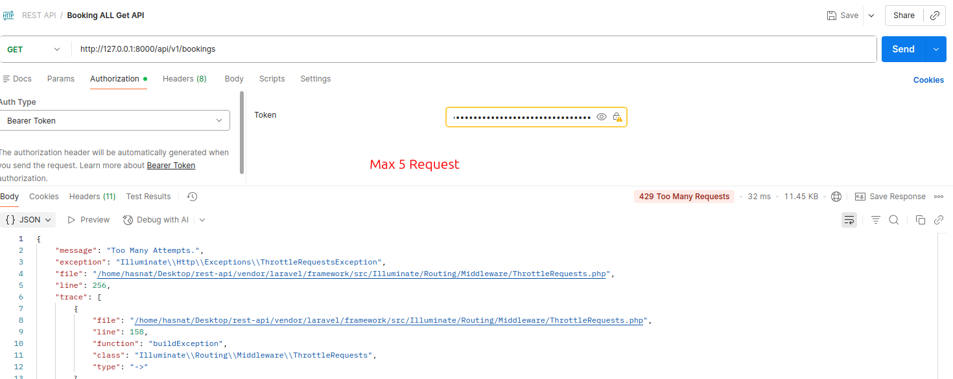
Hit Max 5 Request and 6 number request have many attempts
now you can change role admin and check how many request

Slide 40
add super user admin and set no limit
public function boot(): void
{
RateLimiter::for('custom-booking-limit',function($request){
$user = $request->user();
if($user && $user->role === 'super admin'){
//admins get more capacity
return Limit::none();
}
if($user && $user->role === 'admin'){
//admins get more capacity
return Limit::perMinute(10)->by($user->id);
}
// RateLimiter::increment('custom-booking-limit:'.$user->id);
//guests or normal users get fewer requests
return Limit::perMinute(5)->by(optional($user)->id ?: $request->ip());
});
}

Slide 42
API Authorization in Laravel

Slide 43
when limited method use get but when it curd functional need policy
---------------------------------------------------------------------------------------------------------
not use:
->php artisan make:policy BookingPolicy(have only class no method found)
use this:
->php artisan make:policy BookingPolicy --model=Booking (have all method)
Now Register Policy
Register Have Two Type one App service provider and another one use model file but now laravel
version 12,13 have some changes so need some configur and use controller

Slide 44
BookingPolicy.php
//booking only show user
public function viewAny(User $user): bool
{
return true;
}
//booking only create admin
public function create(User $user): bool
{
return $user->role == 'admin';
}
BookingController.php
// add this in top booking controller class
public function __construct()
{
$this->authorizeResource(Booking::class);
}

Slide 45
Controller.php
//and some functionality larvel version 12 have more change so red color text or parameter need add
use Illuminate\Routing\Controller as BaseController;
use Illuminate\Foundation\Auth\Access\AuthorizesRequests;
abstract class Controller extends BaseController
{
use AuthorizesRequests;
}
We Go Database and make it user and check booking create or post create use postman!

Slide 46
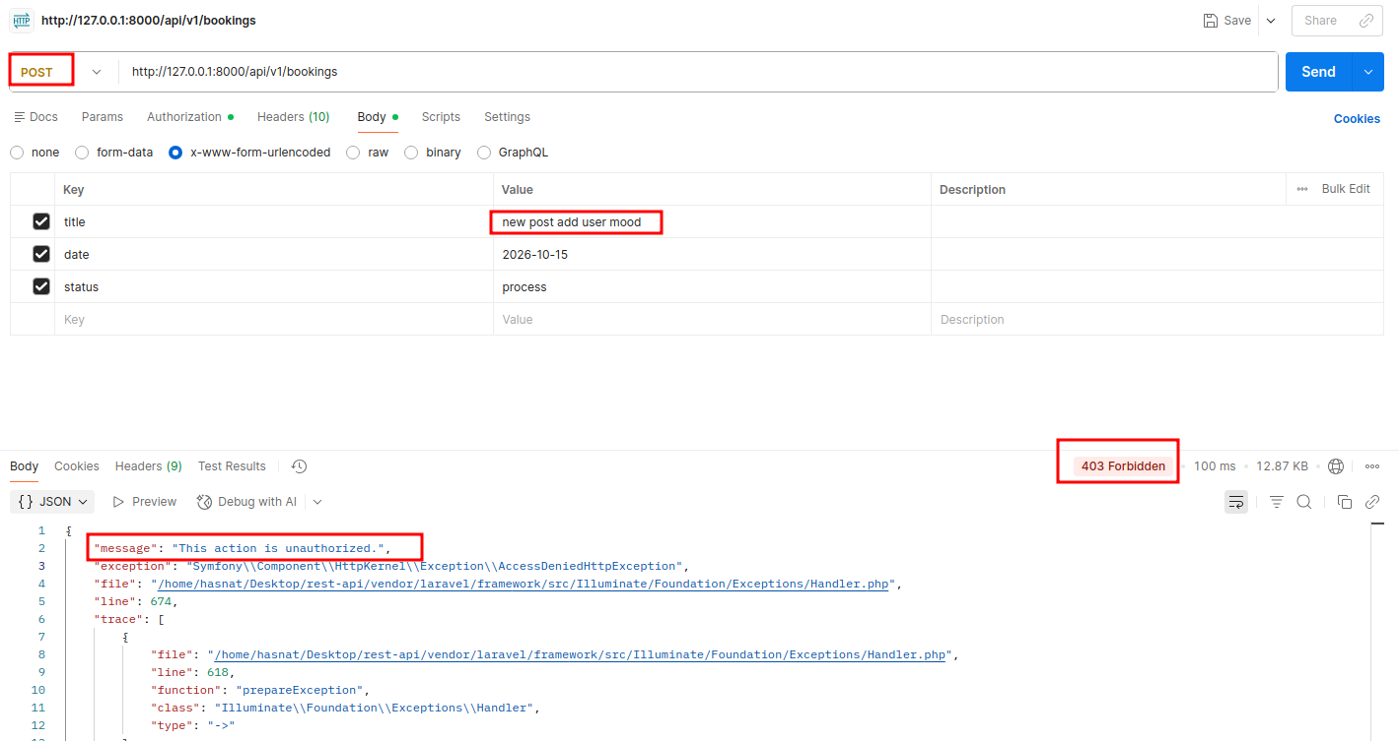
Finally it work user can't create or post any booking use only show data

Slide 47
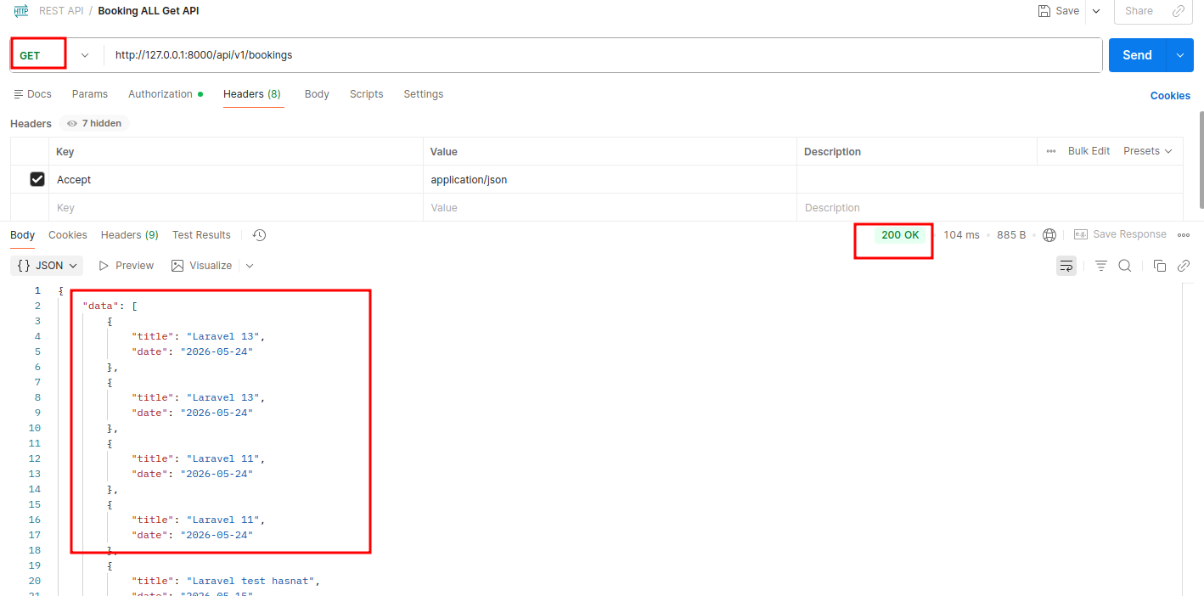
User only show Data

Slide 48
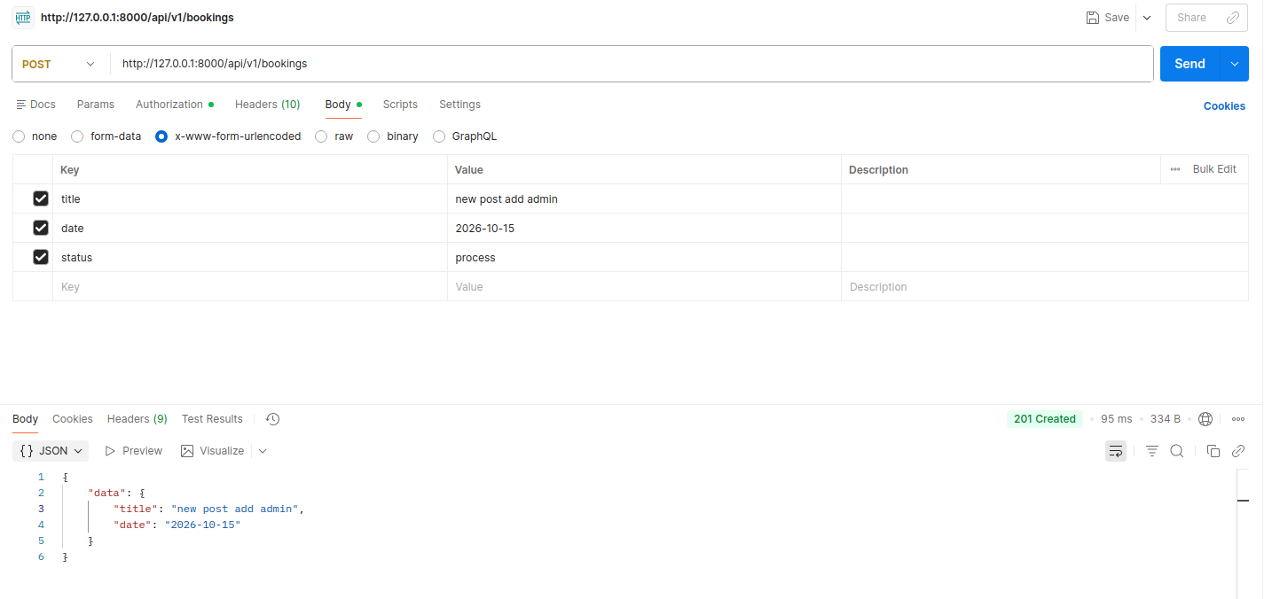
Go DataBase and change user role user to admin and now can make post or create booking

Slide 49
Have a issue Midewaller problem so add triat ValidatesRequests
use Illuminate\Routing\Controller as BaseController;
use Illuminate\Foundation\Auth\Access\AuthorizesRequests;
use Illuminate\Foundation\Validation\ValidatesRequests;
abstract class Controller extends BaseController
{
use AuthorizesRequests, ValidatesRequests;
}
BookingPolicy.php
# add update capabiliy for admin
public function update(User $user, Booking $booking): Response
{
return $user->role == 'admin' || $user->id === $booking->user_id
? Response::allow()
:Response::deny('You do not have permission to update this booking');
}

Slide 50
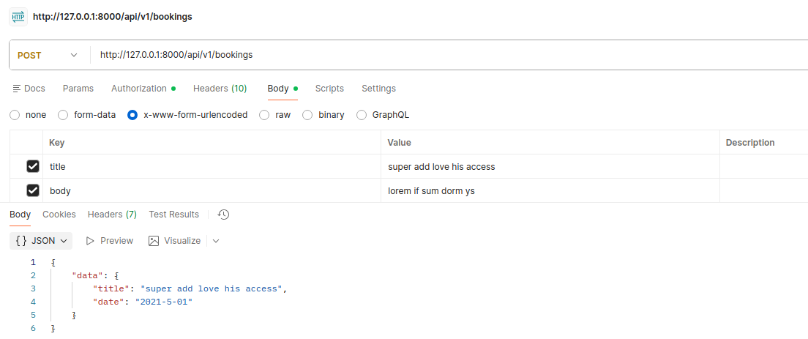
BookingPolicy.php (add new supper admin policy or method use laravel before method)
//super admin can do anything
public function before(User $user, $ability){
if($user->role === 'super admin'){
return true;
}
}

Slide 51
Laravel Documentation
https://scribe.knuckles.wtf/laravel/

Slide 52
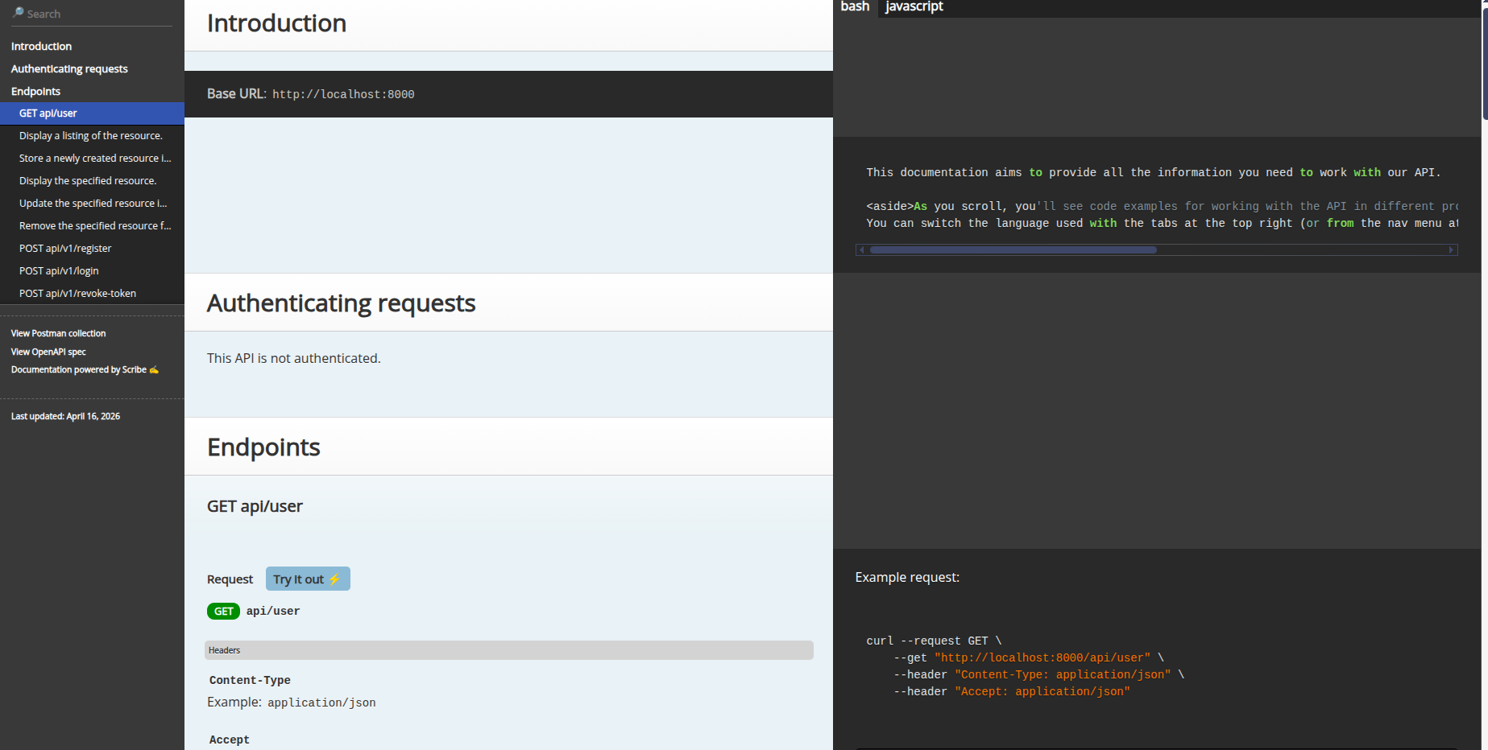
-> composer require knuckleswtf/scribe --dev
check other commad in scribe webise

