Slide 1
Representing Patterns in UML
Andy Bulka
www.atug.com/andypatterns
Technical Director
Austhink Software
www.austhink.com

Slide 2
IBM Rational - pattern instance itself is a first class modeling element
The pattern instance itself is a first class modeling element, and appears in the model and can be placed in a diagram and has relationships to other model elements that bind its parameters to actual model elements.
Having pattern instances in a model help designers understand which patterns have been applied (since many might have been).

Slide 3

The competitors
IBM Rational has “pattern instances” on your UML diagram and you can re-apply a pattern and it enforces it.
ObjectIf has some pretty cool design pattern support and uses roles and colors to indicate patterns.
EA (Enterprise Architect has design pattern support, though the merge feature is a bit buggy at the moment).
StarUML is free, and has a configurable patterns system.
ModelMaker, classic pattern “enforcer”, with code regions etc. Now a bit old, has only a limited number of patterns – to be improved in the next few months.

Slide 4
Applying Patterns to the workspace
Most have a clear, standard way of applying patterns i.e. you specify if you want to create a new class or merge a role with an existing class. UML diagram previews in the pattern wizards, too. And most tools also have a way of representing the pattern on the diagram e.g. collaboration lines or class stereotypes or association lines with role labels.
Rational has drag drop wiring – nice.

Slide 5
Pattern is comprised of
Classes (one or more)
Attributes
Methods
Code fragments within methods (aspects?)
Meta information tying all the above together

Slide 6
Ways of Representing the Grouping of classes
Shading areas behind classes, grouping them. (vlissedes)
Shaded areas can overlap to indicate classes performing different roles within different patterns i.e. a class can be part of more than one pattern
Sticky notes near classes
Role labels on properties (ObjectIf)

Slide 7
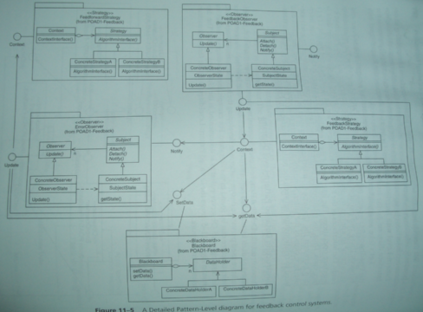
Ways of Representing the Grouping of classes
Collaboration objects (Rational)
Text Lists in a panel (ModelMaker)
Package diagrams with interfaces to the pattern exposed.

Slide 8
The Software Tools
Demo
Rational (by IBM and the inventors of UML)
ObjectIF – excellent pattern support. Gui overly redundant and confusing in some places, but community edition is free.
StarUML – free, poor code generation but has customisation facility in some javascript like language. Documentation poor.
Modelmaker – pattern support lags behind – missing complete set of GOF patterns. Check it again in 2007.
Enterprise Architect – pattern blending support poor, but good UML tool with good reverse engeneering and layout. Interface very messy though. Affordable.

Slide 9
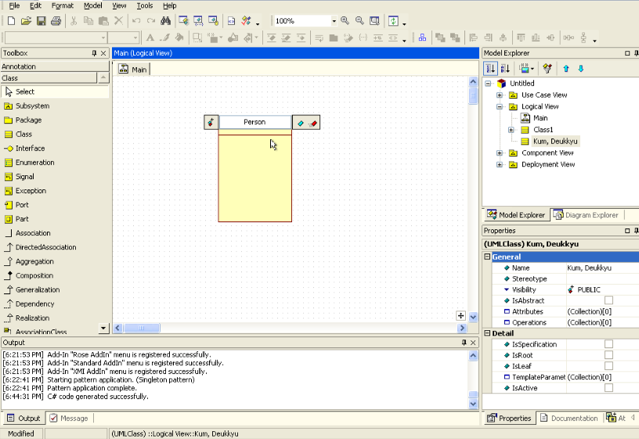
StarUML
Free tool

Slide 10
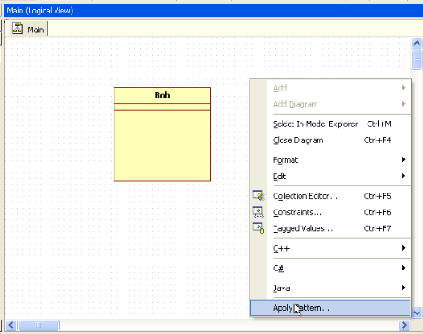
StarUML
R.click and select Apply Pattern

Slide 11
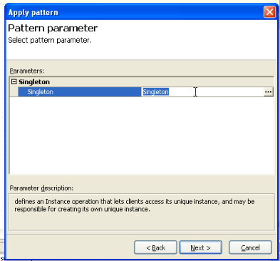
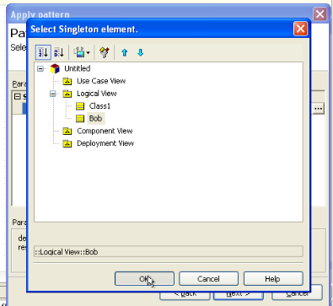
StarUML
Select the class you want to apply the singleton to. If you don’t select, a new class will be created.

Slide 12
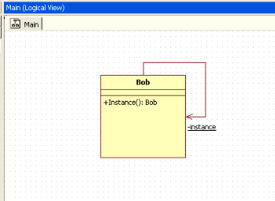
StarUML
Voila!

Slide 13
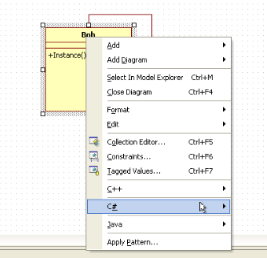
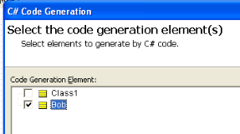
StarUML
To view the generated code, r.click

Slide 14
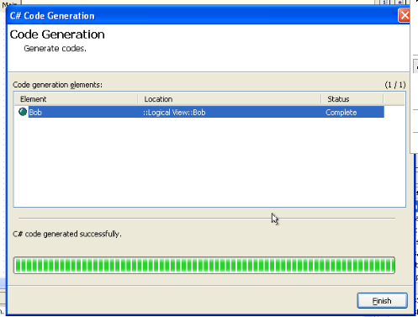
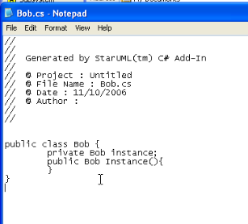
StarUML
Output not very correct in this case – missing private constructor.

Slide 15
Other demos
I demo’d all the 5 tools on the night, and there is a video of me doing them all. At the moment the only video released is on my website
is the Rational portion of the demo - see http://www.atug.com/andypatterns/pattern_automation_in_uml.htm

Slide 16
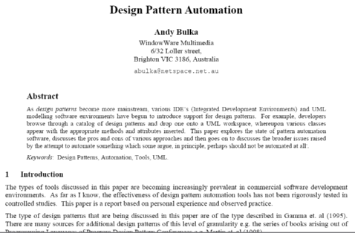
Final word
Also see
http://www.atug.com/andypatterns/patterns.htm
for paper on design pattern automation – pros and cons and is it a good idea in the first place.

