Slide 1
FINAL PROJECT PRESENTATION
BanglaFactGuard
A Multimodal Bangla Fact-Checking System
Md. Abul Kalam Azad / BSSE-1425
Supervisor
Toukir Ahammed
Lecturer, IIT, DU
Software Project Lab III
Institute of Information Technology, University of Dhaka
01
Notes:
Introduce the project, your identity and supervisor. Frame the system as evidence-assisted Bangla news verification. Source: report cover and abstract.
Source: BSSE_1425_BanglaFactGuard_Final_Report.pdf, supplied final report. Screenshots are original report figures.

Slide 2
How this presentation is organised
01
Problem statement
02
Proposed solution
03
Core features & functionality
02
Notes:
Explain how a believable logo or recycled date can conceal a changed claim. Manual checking involves finding the source, comparing the headline and checking context. Source: report section 1.1, page 10.
Source: BSSE_1425_BanglaFactGuard_Final_Report.pdf, supplied final report. Screenshots are original report figures.

Slide 3
Problem statement
Bangla news can look credible
before anyone checks the evidence.
01
Misleading presentation
Altered headlines, familiar outlet logos and old images can make false claims appear authentic.
02
Slow manual checking
Users must locate the original article and compare the wording, source and publication date.
03
Incomplete evidence
An automated prediction or missing search result cannot establish the truth of a claim.
02
Notes:
Explain how a believable logo or recycled date can conceal a changed claim. Manual checking involves finding the source, comparing the headline and checking context. Source: report section 1.1, page 10.
Source: BSSE_1425_BanglaFactGuard_Final_Report.pdf, supplied final report. Screenshots are original report figures.

Slide 4
Proposed solution
One platform for automated findings, published evidence and expert review.
01
Text & source
Compare a Bangla headline, article text and published date with news reports.
02
Photo card
Read the printed headline, outlet and date, then check the extracted claim against available evidence.
03
Text & image
Combine article text and an image to produce a preliminary Likely Real or Likely Fake prediction.
03
Notes:
Present the three entry points. Text and photocards use retrieved publisher evidence; text-and-image uses a trained multimodal classifier. Source: report abstract and sections 1.2, 5 and 10.3.
Source: BSSE_1425_BanglaFactGuard_Final_Report.pdf, supplied final report. Screenshots are original report figures.

Slide 5
Core features & functionality
Website
Chrome browser extension
Multimodal analysis
Photocard verification from available source data
Text verification from available source evidence
Expert voting mechanism & Escalation handling
Fact explorer
Notifications management
System Administration
Website and Chrome extension support the three verification methods.
Detailed reports, Fact Explorer, account submissions and personal result notifications.
Experts inspect evidence, explain their decisions and vote on submitted claims.
Admins manage experts, registered sources, voting rules and escalated decisions.
04
Notes:
Guests can submit. Registered accounts retain personal history and notifications. Expert and administrator responsibilities remain on the website. Source: report sections 1.5, 7 and 10.
Source: BSSE_1425_BanglaFactGuard_Final_Report.pdf, supplied final report. Screenshots are original report figures.

Slide 6
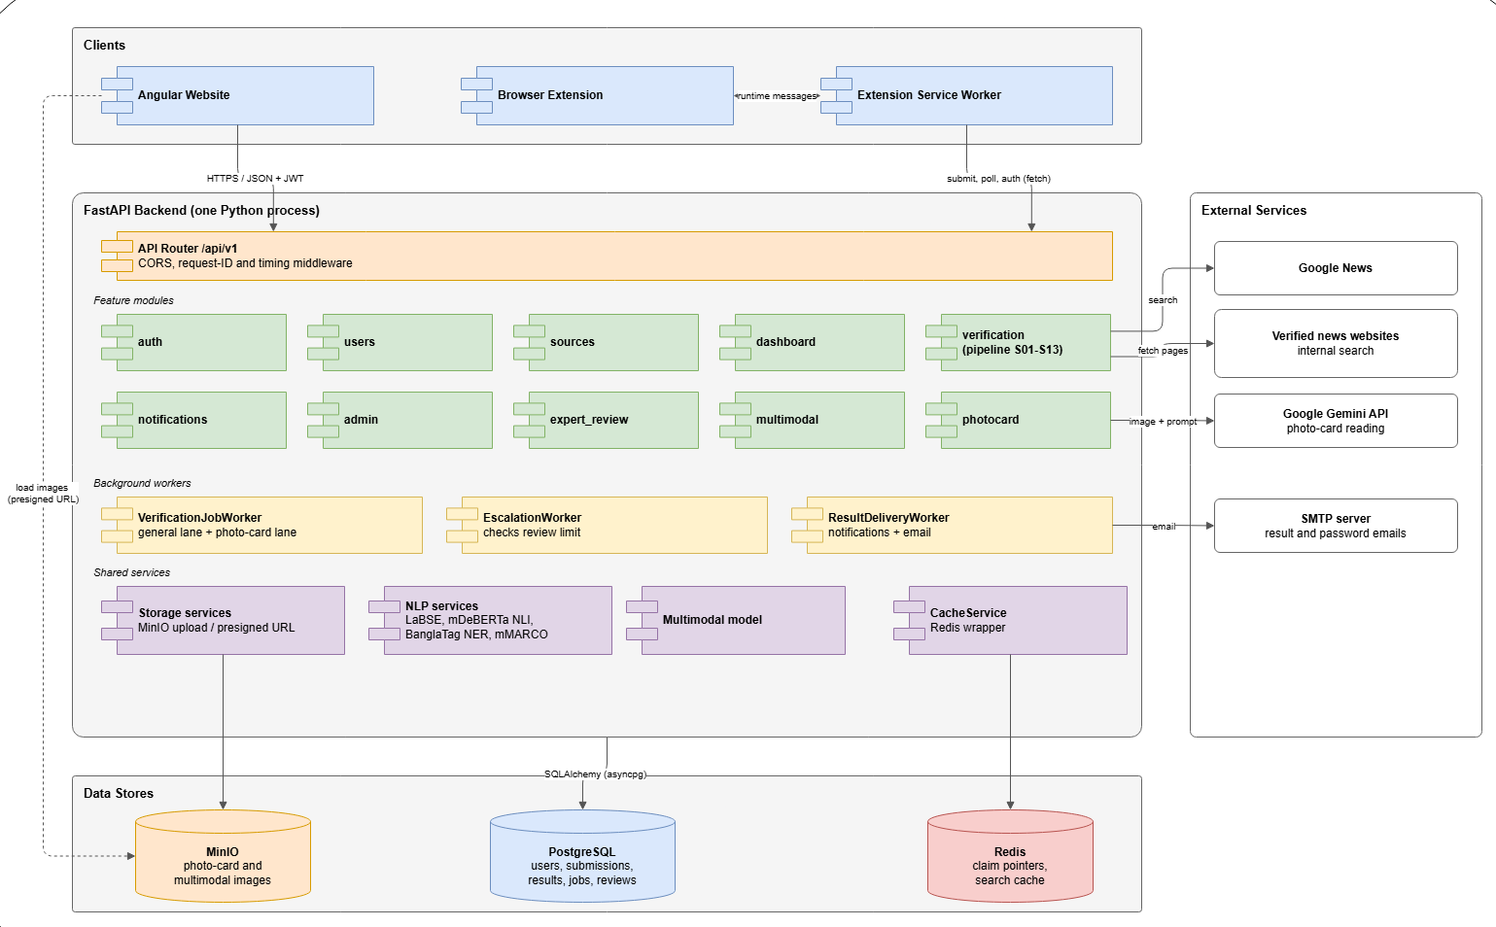
System overview
4 types of User
-Guest user
-Registered user
-Expert
-Admin
05
Notes:
Walk through the layers from browser to backend to verification services and persistence. PostgreSQL stores durable jobs; an in-process worker executes them. Gemini supports photocard reading. Source: report sections 6.1, 6.3 and 6.5.
Source: BSSE_1425_BanglaFactGuard_Final_Report.pdf, supplied final report. Screenshots are original report figures.

Slide 7
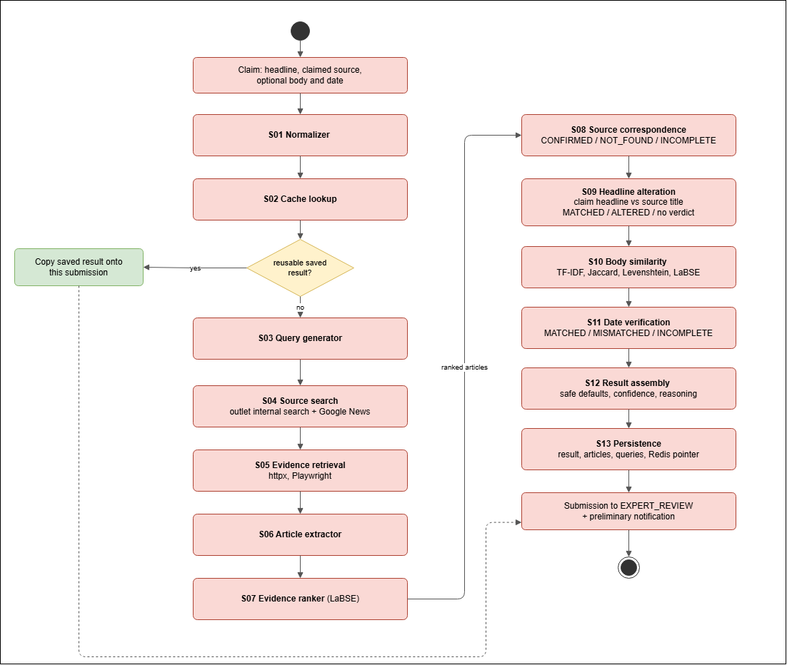
Verification pipeline
06
Notes:
Summarize stages S01-S13. Headline comparison uses the retrieved article title. Source correspondence, headline alteration and date consistency are separate findings. Similarity is not a probability of truth. Source: report section 5.2, pages 28-29.
Source: BSSE_1425_BanglaFactGuard_Final_Report.pdf, supplied final report. Screenshots are original report figures.

Slide 8
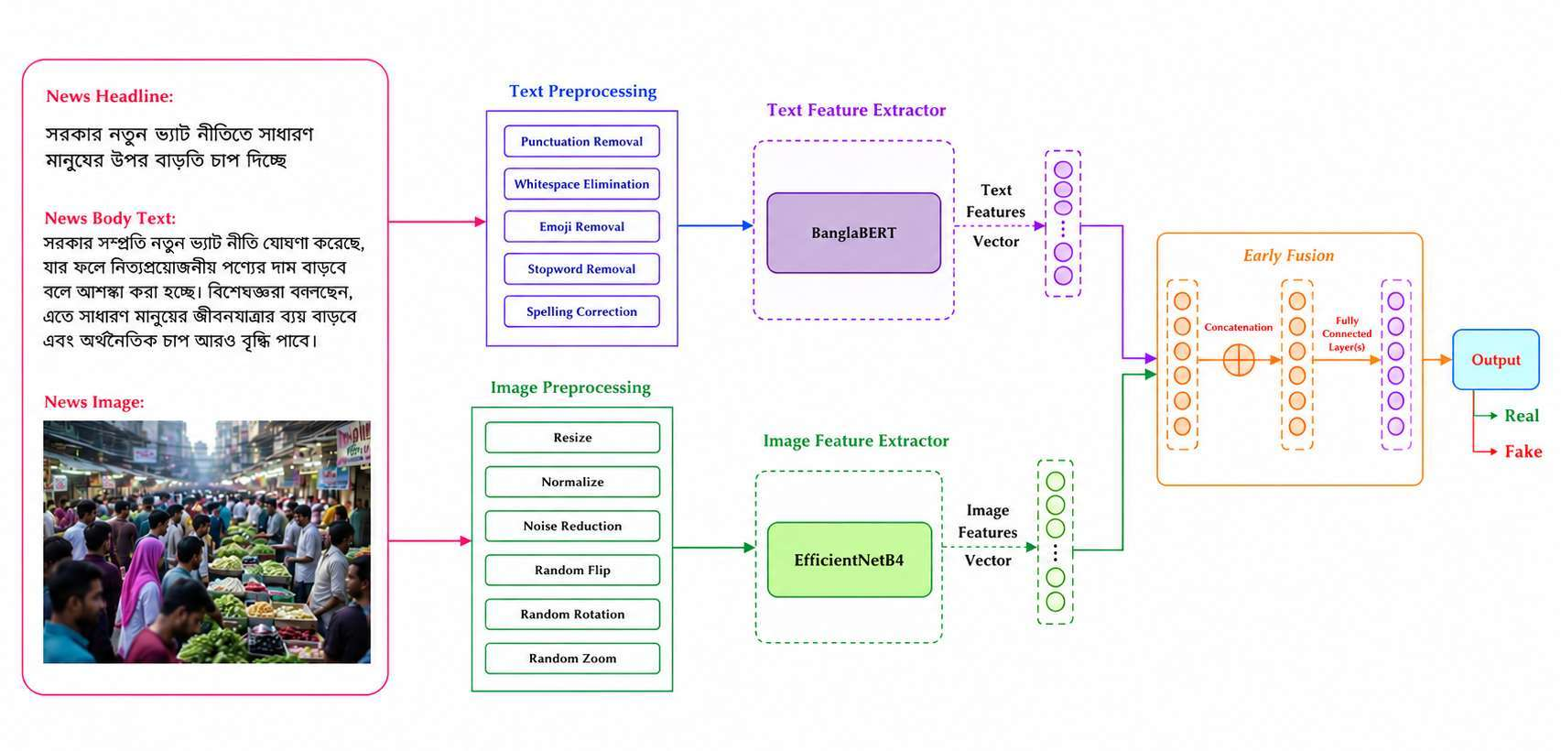
Multimodal analysis
07
Notes:
Explain that BanglaBERT encodes body text and EfficientNet-B4 encodes the image, then concatenate features for classification. The headline is retained for display. Source: report section 5.1.1, page 26.
Source: BSSE_1425_BanglaFactGuard_Final_Report.pdf, supplied final report. Screenshots are original report figures.

Slide 9
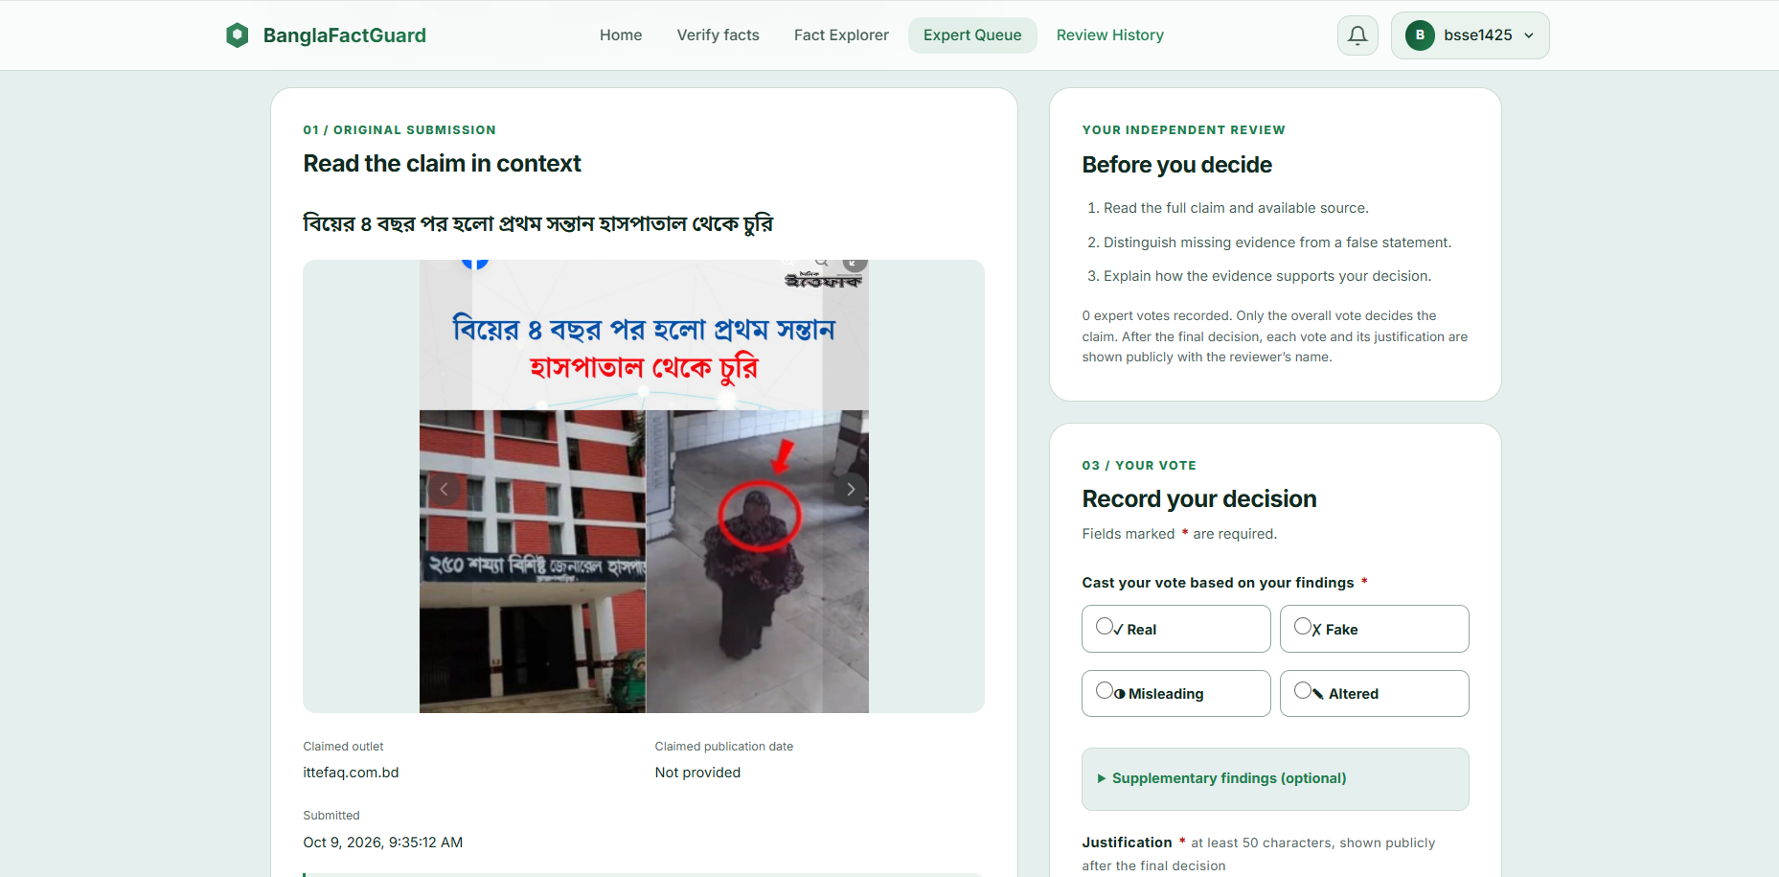
Expert review and final decisions
Automated assessment
Preliminary findings remain visible while a claim is under review.
Expert-finalized verdict
Real, Fake, Misleading or Altered
Unresolved cases can require an administrator decision.
08
Notes:
Experts review evidence and submit justified votes. Voting uses configured minimum participation, threshold and lead margin. Unresolved claims can escalate to administrators. Source: report sections 6.4.3, 8.3.4 and 10.8-10.9.
Source: BSSE_1425_BanglaFactGuard_Final_Report.pdf, supplied final report. Screenshots are original report figures.

Slide 10
Technology stack
Website
Angular 19, TypeScript, SCSS, Angular Material/CDK
Backend
Python, FastAPI, SQLAlchemy, Alembic, Pydantic
AI and NLP
PyTorch, Transformers, timm, LaBSE, NLI, NER, Gemini
Data services
PostgreSQL 17, Redis 7.2, MinIO
Browser extension
Preact, Vite 6, Chrome Manifest V3
Testing
pytest, Karma/Jasmine, Node test runner
09
Notes:
Describe technologies by their responsibilities. Source: report Table 8.1, page 52. Versions are those documented in the report.
Source: BSSE_1425_BanglaFactGuard_Final_Report.pdf, supplied final report. Screenshots are original report figures.

Slide 11
Live Demonstration
Website link: Banglafactguard
08
Notes:
Describe technologies by their responsibilities. Source: report Table 8.1, page 52. Versions are those documented in the report.
Source: BSSE_1425_BanglaFactGuard_Final_Report.pdf, supplied final report. Screenshots are original report figures.

Slide 12
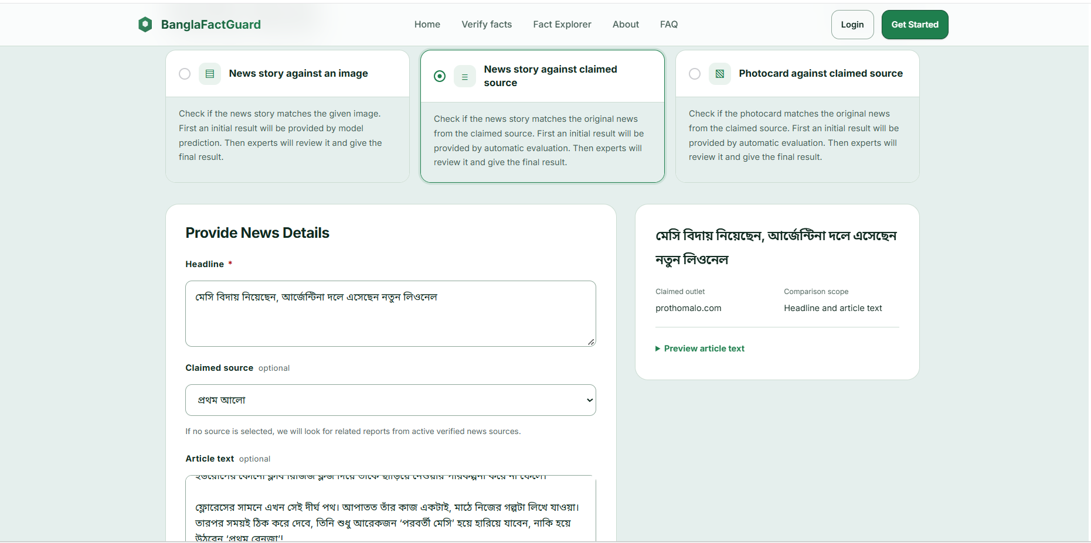
Demonstration: text submission
01
Enter a Bangla headline and select a source when known.
02
Optionally add article text and the claimed publication date.
03
Submit the claim and show its processing status.
11
Notes:
Live demonstration, about 60 seconds. Open http://localhost:4200/verify. Use a prepared claim with a known source article. Explain that a job continues after leaving the form. If retrieval takes longer, open a saved report while the new job runs. Screenshot: report Figure 7.5, page 46.
Source: BSSE_1425_BanglaFactGuard_Final_Report.pdf, supplied final report. Screenshots are original report figures.

Slide 13
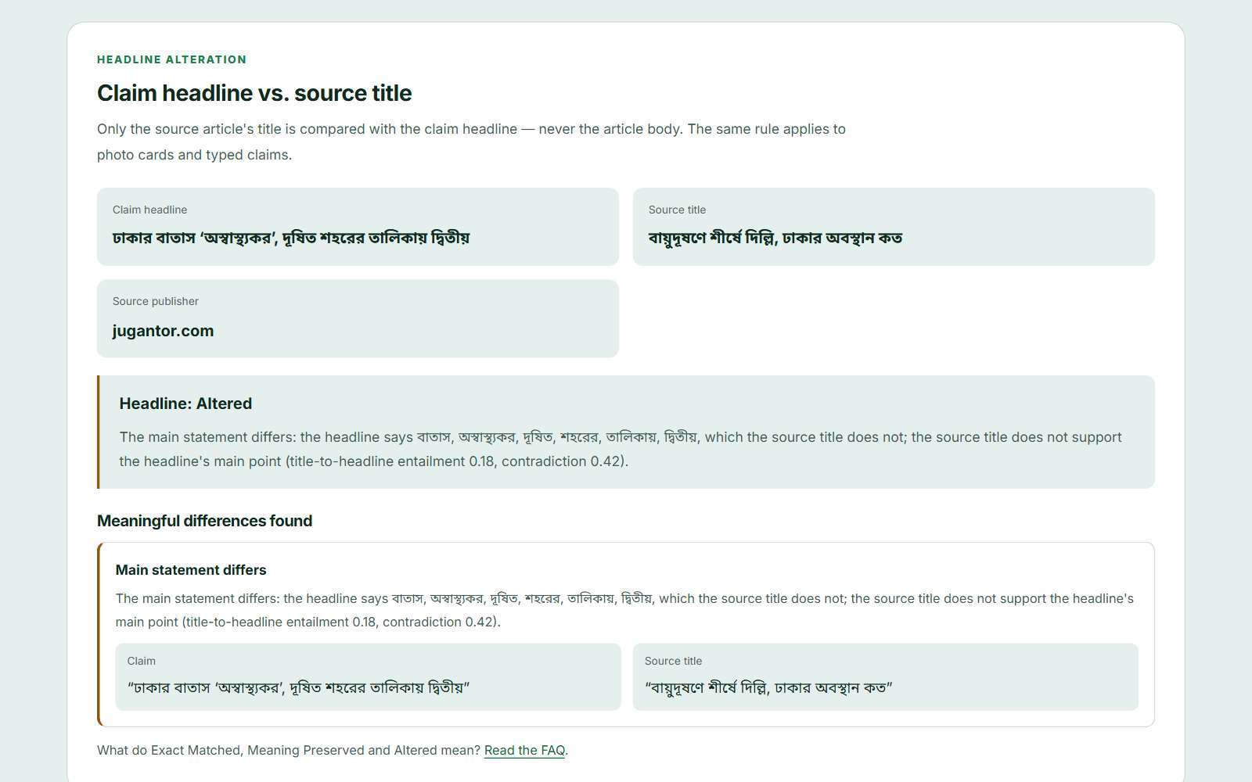
Demonstration: evidence report
01
Open a completed result and follow its source evidence.
02
Compare the submitted headline with the source article title.
03
Explain the finding and the separate expert-review status.
12
Notes:
Live demonstration, about 45 seconds. The report screenshot shows an Altered headline finding. Explain the specific difference displayed, without treating the screenshot as a new independent fact-check. Source: Figure 10.5, page 66.
Source: BSSE_1425_BanglaFactGuard_Final_Report.pdf, supplied final report. Screenshots are original report figures.

Slide 14
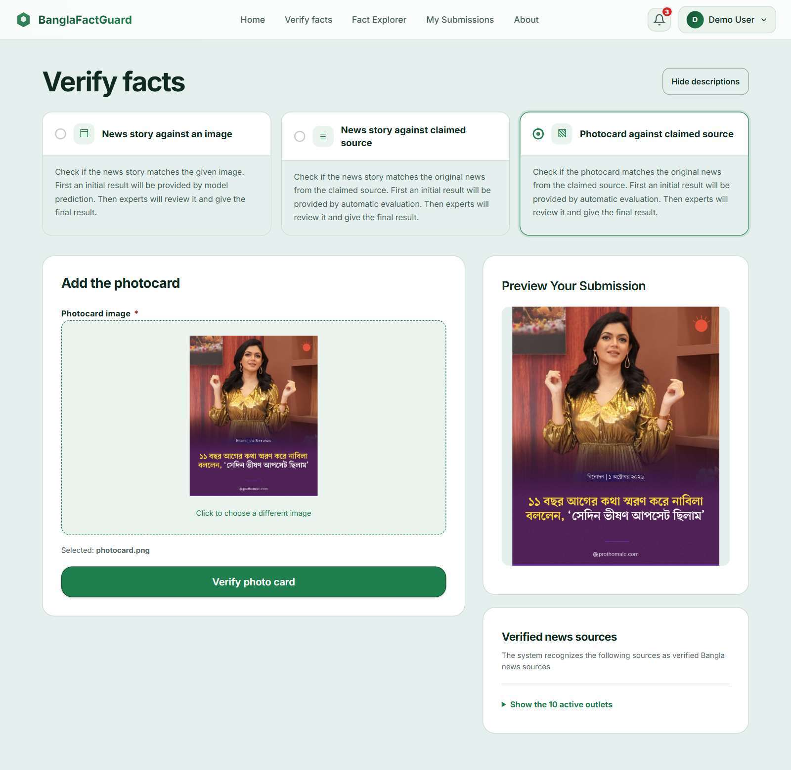
Demonstration: photo card
01
Upload a prepared Bangla news photocard.
02
Review the preview and submit the image for checking.
03
Show the extracted claim and available source, headline and date findings.
13
Notes:
Live demonstration, about 45 seconds. Prepare a readable photocard in advance and verify Gemini availability. If image extraction fails, show the explicit failure reason instead of calling the claim fake. Source: sections 10.3.2 and Figure 10.3, page 64.
Source: BSSE_1425_BanglaFactGuard_Final_Report.pdf, supplied final report. Screenshots are original report figures.

Slide 15
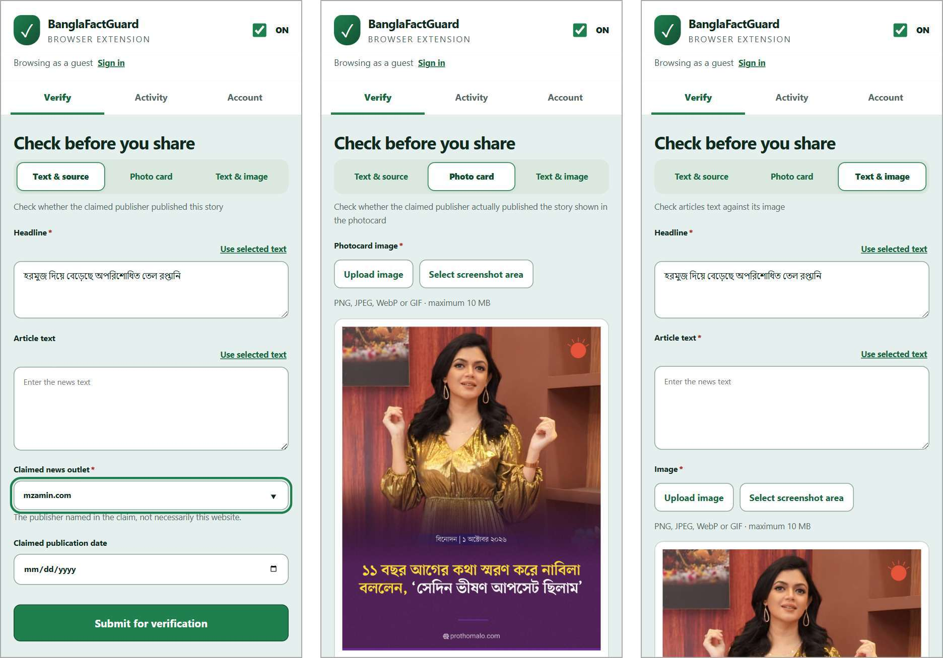
Demonstration: Chrome extension
Verify while browsing
Import selected text
Capture a selected image area
Track results in Activity
Open the full evidence report
14
Notes:
Live demonstration, about 45 seconds. Pin the extension and open the side panel on the intended website. Select text or a screenshot area, preview the input, submit and show Activity. Open the full report using its website link. Show all three modes without waiting for three fresh jobs. Source: section 10.7 and Figure 10.10, page 69.
Source: BSSE_1425_BanglaFactGuard_Final_Report.pdf, supplied final report. Screenshots are original report figures.

Slide 16
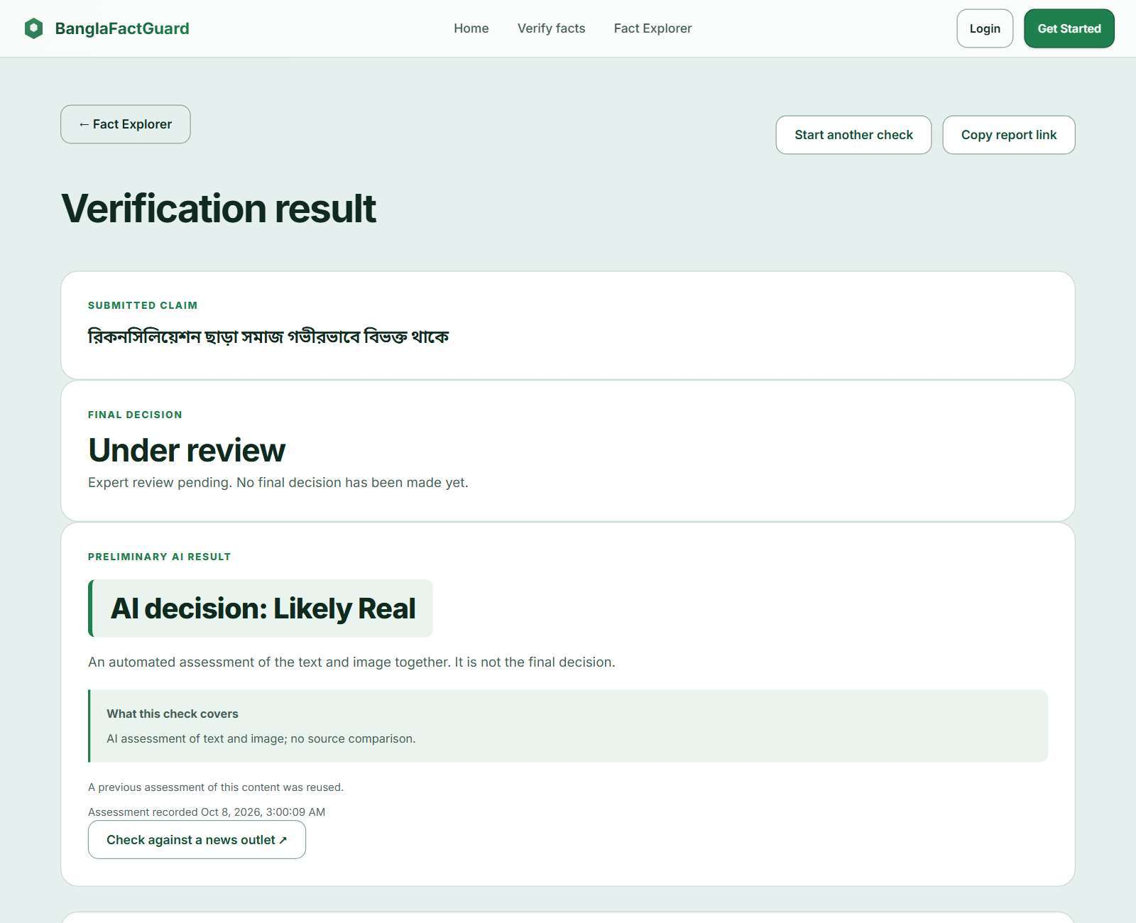
Demonstration: text and image
01
Enter article text and upload the accompanying image.
02
Show the preliminary Likely Real or Likely Fake assessment.
03
Point out the review status and any reused-assessment notice.
15
Notes:
Live demonstration, about 45 seconds. Model inference uses article body text plus the image. Explain that the result is preliminary, and that the report screenshot illustrates reuse of a compatible previous assessment. Source: section 10.3.3 and Figure 10.4, pages 64-65.
Source: BSSE_1425_BanglaFactGuard_Final_Report.pdf, supplied final report. Screenshots are original report figures.

Slide 17
Limitations and future work
01
Evidence coverage
Expand registered sources and evaluate complete verification outcomes on labelled Bangla claims.
02
Photocard extraction
Improve handling of unclear layouts, low-quality images and incomplete printed information.
03
Processing time
Reduce retrieval and model latency, then measure behavior under concurrent load.
04
Deployment readiness
Extend real-model testing and validate a public deployment beyond the current local setup.
16
Notes:
State limits candidly. End-to-end outcomes depend on extraction, retrieval and review. Local deployment is documented; the report does not claim a public production deployment. Source: sections 9.7, 11.8 and 12.
Source: BSSE_1425_BanglaFactGuard_Final_Report.pdf, supplied final report. Screenshots are original report figures.

Slide 18
Thank You
Questions
17
Notes:
Open the repository during the presentation if needed. The repository link matches both report section 11.1 and the local Git origin. Demo addresses are local and require the project services to be running. Close with questions.
Source: BSSE_1425_BanglaFactGuard_Final_Report.pdf, supplied final report. Screenshots are original report figures.

