Slide 1
CRICKET SCOREBOARD
Presented By :
Md. Abul Kalam Azad
BSSE-1425
Session : 2021-22
IIT , Dhaka University
Supervised By :
Dr. Naushin Nower
Professor
IIT , Dhaka University

Slide 2
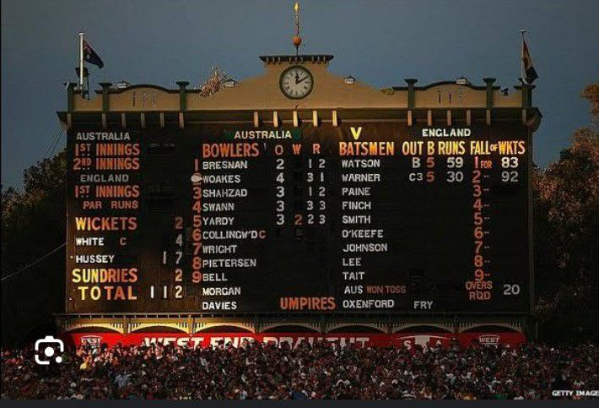
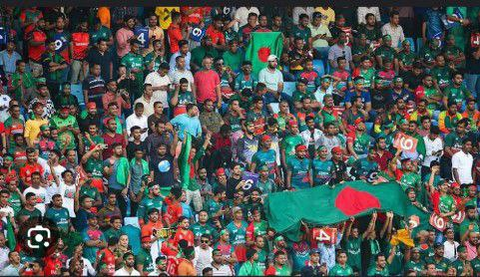
Introduce with Cricket….
“Cricket” is the second most popular sports in the world
About 2.60 billion people follow cricket all over the world
Sport websites like “ESPNcricinfo” or “cricbuzz” more than 20 million times visited by the user in a month

Slide 3
FEATURES OF CRICKET SCOREBOARD PROJECT
Upcoming Match List
Cricket Tournament Scheduling
Team and Player Information
Score Update and Match Summary
Player Ranking
Win Prediction

Slide 4
Upcoming Match List :
Full schedule of upcoming cricket matches with
Venues
Dates
Timings
13/09/2023 3:30 PM
BAN vs IND
R. Premadasa Stadium

Slide 5
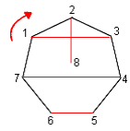
Cricket Tournament Scheduling :
Here I design a Round-Robin Cricket Tournament that can schedule BPL , IPL , PSL and other premier League
What is Round-Robin Algorithm ?
Round robin tournament is a competition where every team plays against each other.
It ensures fairness and allows teams to compete with all opponents.
Each team gets an equal number of matches in the tournament.

Slide 6
Team and Player Information :
Comprehensive team profiles and player statistics
Player bios, career stats, and performance records
Insights into team strategies and playing styles
Player Information : Tamim Iqbal
Age : 35 years Runs : 8431
Role : Batsman Avg : 36.60
Mats : 241 S/R : 78.7
50s : 51 100s : 15
Country : Bangladesh

Slide 7
Score Updates and Match Summary :
Ball by ball score updates of ongoing cricket matches
Detailed information on runs, wickets, and overs
Depth analysis of player performances
Close tracking of match progress and dynamics
Predict total scores based on current condition of a ongoing cricket match
Show match progress and summary with the use of
Table and Graph
IND vs | BAN | 250/3 | 33.4 | Bruvneswar | 43/5.4
Shakib | 56/40 | Mushfiq | 40/42 | 4 1 0 6 | 137.3kph

Slide 8
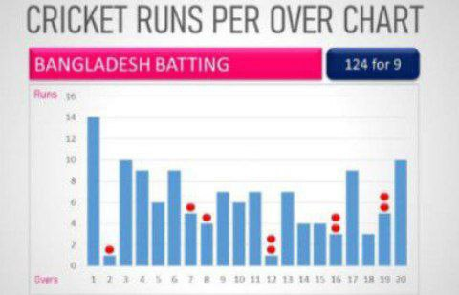
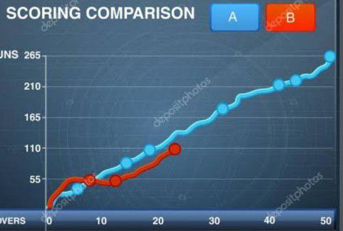
To summarize match progress the following graph will be used :
BAN 323/8 (50)
===============
Tamim 77/55 Bumrah 25/3
Shakib 70/45 Ashwin 40/2
Mushfiq 50/53 Pandya 50/1
=======================
IND 290/9 (50)
===============
Virat 103/90 Taskin 33/4
Rohit 54/60 Hasan 30/2
Pandya 35/25 Shakib 46/1
=======================
Bangladesh win the match by 33 run
Bar Graph
Ogive Graph

Slide 9
Player Ranking :
Ranking means arranging the players in a descending order based on the ratings they have got. Here the function is….
Rating system to distinguish top performers
Track player consistency and form
Rank players based on performance metrics
Compare rankings across different formats

Slide 10
Win Prediction:
Random forest Regression a Machine Learning Algorithm used to predict outcomes
Builds multiple decision trees and merges them together to get a more accurate and stable prediction
Random forest regression can be applied to predict the winner of a cricket match
It takes into account various factors like team performance , player statistics and match condition

Slide 11
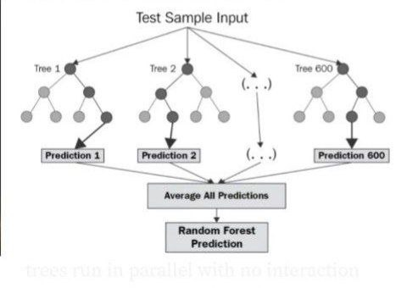
Random Rorest Regression:

Slide 12
Github Link :
https://github.com/abulkalamazad1425

Slide 13
Thank You

