Slide 1

CHITTAGONG HYDROLOGICAL RESILIENCE NETWORK
HydroNet: Cisco-Powered Real-Time Flood Monitoring & Early Warning System
Abu Md. Selim | Arifur Rahman | Sadab Abdullah
Premier University, Chittagong • 6th Semester Network Architecture Project • March 2025
HydroNet - Chittagong Hydrological Resilience
1

Slide 2
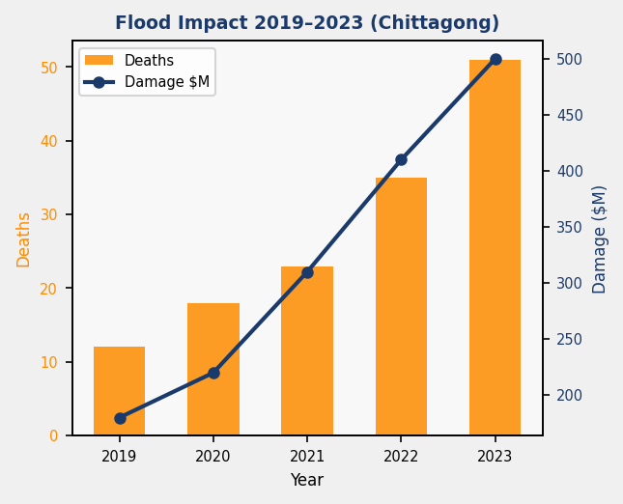
Why HydroNet? The Flood Crisis in Chittagong
THE PROBLEM:
Chittagong (pop. 8M+) sits at the confluence of the Karnaphuli River and the Bay of Bengal.
Annual monsoon flooding has devastated the region repeatedly:
• 2023 floods: 51+ lives lost, 1M+ people displaced
• 2022: Major tidal surge damaged Chittagong Port, economic loss >$200M
• Average annual flood damage: $500M across infrastructure
• Current early warning: Manual observation, 30–60 min lead time only
• Critical gap: No automated, real-time sensor network exists
THE CONSEQUENCE:
• Delayed evacuation = preventable casualties
• First responders lack real-time situational awareness
• Infrastructure damage compounds without advance warning
• Vulnerable populations (coastal poor, river communities) most at risk
HydroNet - Chittagong Hydrological Resilience
2

Slide 3
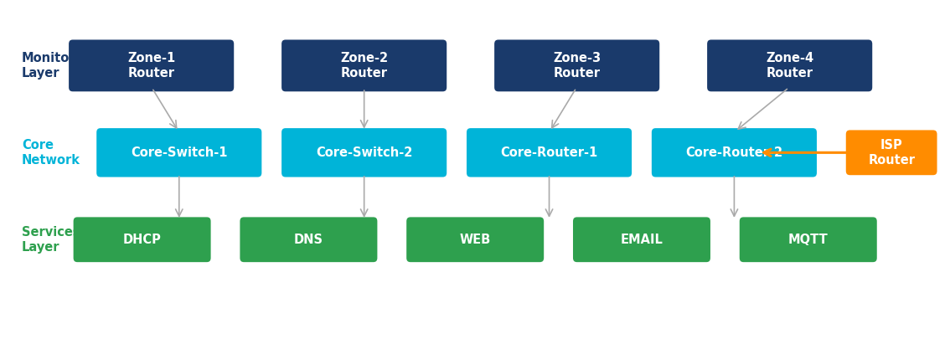
HydroNet: System Architecture at a Glance
20+ IoT Sensors | 4 Geographic Zones | Real-time 30s updates
OSPF Dynamic Routing | 12 VLANs | 5 Core Servers
NAT + ACL Security | DHCP/DNS/Web/Email | Early Warning Emails
HydroNet - Chittagong Hydrological Resilience
3

Slide 4
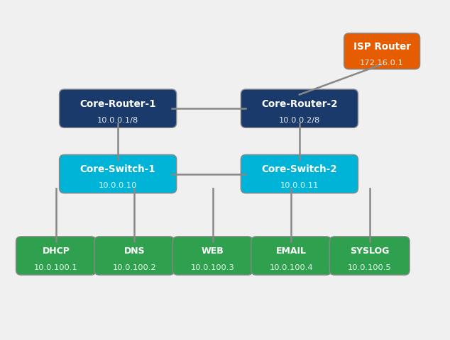
Core Network Infrastructure & IP Addressing
CORE DEVICES:
• Core-Router-1: Cisco 3945 | 10.0.0.1/8 | OSPF DR (priority 255)
• Core-Router-2: Cisco 3945 | 10.0.0.2/8 | OSPF BDR
• Core-Switch-1: Catalyst 3750-X | 10.0.0.10 | Layer-3 capable
• Core-Switch-2: Catalyst 3750-X | 10.0.0.11 | Redundant
SERVER FARM (10.0.100.0/24):
• DHCP Server: 10.0.100.1 | Cisco Router | 4 zone pools
• DNS Server: 10.0.100.2 | BIND | hydronet.local
• Web Server: 10.0.100.3 | Apache | monitor.hydronet.local
• Email Server: 10.0.100.4 | SMTP:25 / POP3:110
• MQTT Broker: 10.0.100.1 | Port 1883 | QoS-2
CONNECTIVITY:
• ISP Link: 172.16.0.0/30 | 100 Mbps
• Core Backbone: Gigabit Ethernet | Cost=1
• Zone Uplinks: FastEthernet | Cost=10
HydroNet - Chittagong Hydrological Resilience
4

Slide 5
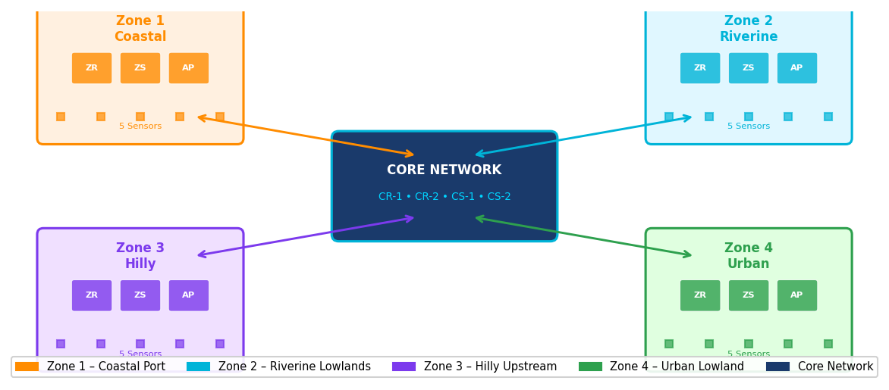
4-Zone Network Topology & Wireless Deployment
HydroNet - Chittagong Hydrological Resilience
5

Slide 6
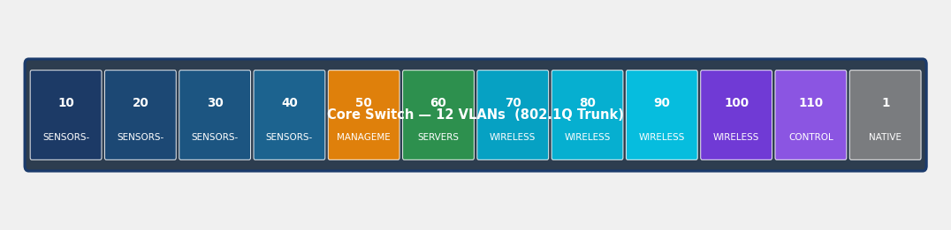
VLAN Segmentation: 12-VLAN Architecture
ID Name Subnet Purpose
10 SENSORS-Z1 10.10.10.0/24 Zone-1 IoT Sensors
20 SENSORS-Z2 10.10.20.0/24 Zone-2 IoT Sensors
30 SENSORS-Z3 10.10.30.0/24 Zone-3 IoT Sensors
40 SENSORS-Z4 10.10.40.0/24 Zone-4 IoT Sensors
50 MANAGEMENT 10.0.50.0/24 Network Mgmt
60 SERVERS 10.0.100.0/24 Server Farm
ID Name Subnet Purpose
70 WIRELESS-Z1 10.20.10.0/24 Zone-1 Wireless
80 WIRELESS-Z2 10.20.20.0/24 Zone-2 Wireless
90 WIRELESS-Z3 10.20.30.0/24 Zone-3 Wireless
100 WIRELESS-Z4 10.20.40.0/24 Zone-4 Wireless
110 CONTROL 10.0.110.0/24 Control Plane
1 NATIVE N/A 802.1Q Native VLAN
802.1Q trunking on all uplinks | Inter-VLAN routing via ACL | VLAN 100 reachable from all zones
HydroNet - Chittagong Hydrological Resilience
6

Slide 7
Centralized Services: DHCP, DNS, Web & Email
DHCP Server
DNS Server
Web Server
Email Server
10.0.100.1
10.0.100.2
10.0.100.3
10.0.100.4
• Cisco Router-based DHCP
• Zone-1 Pool: 10.10.10.10–254
• Zone-2 Pool: 10.10.20.10–254
• Zone-3 Pool: 10.10.30.10–254
• Zone-4 Pool: 10.10.40.10–254
• Lease time: 24 hours
• DNS: 10.0.100.2 pushed
• Default GW per zone
• BIND 9 – hydronet.local
• A: monitor → 10.0.100.3
• A: mail → 10.0.100.4
• A: dhcp → 10.0.100.1
• A: syslog → 10.0.100.5
• Forwarder: 8.8.8.8
• Zone: hydronet.local
• Reverse DNS configured
• Apache HTTP 2.4
• URL: monitor.hydronet.local
• Dashboard: real-time data
• Port 80 (HTTP)
• Sensor data via MQTT
• Charts: water level & flow
• Alert banner on threshold
• Accessible all VLANs
• Postfix SMTP – Port 25
• Dovecot POP3 – Port 110
• Domain: hydronet.local
• Alerts → admin@hydronet
• Flood threshold email
• Zone status digest
• SMTP auth required
• Log: /var/log/mail.log
All services tested and verified in Cisco Packet Tracer 8.2.2
HydroNet - Chittagong Hydrological Resilience
7

Slide 8
Zone Architecture: 4 Strategic Monitoring Locations
Zone 1: Coastal Port Area
Zone 2: Riverine Lowlands
Router: Zone1-Router (Cisco 2901) | 10.10.10.1
Switch: Zone1-Switch (Catalyst 2960-X)
AP: Zone1-AP (Cisco Aironet 1840)
Sensors (5): Water Level, Tidal Gauge,
Rain Gauge, Salinity, Current Meter
VLAN: 10 (Sensors), 70 (Wireless)
Coverage: Port district, coastal belt
Router: Zone2-Router (Cisco 2901) | 10.10.20.1
Switch: Zone2-Switch (Catalyst 2960-X)
AP: Zone2-AP (Cisco Aironet 1840)
Sensors (5): Water Level, Flow Velocity,
Turbidity, Soil Moisture, Rain Gauge
VLAN: 20 (Sensors), 80 (Wireless)
Coverage: Karnaphuli floodplains
Zone 3: Hilly Upstream
Zone 4: Urban Lowland
Router: Zone3-Router (Cisco 2901) | 10.10.30.1
Switch: Zone3-Switch (Catalyst 2960-X)
AP: Zone3-AP (Cisco Aironet 1840)
Sensors (5): Water Level, Flow Rate,
Landslide, Rain Gauge, Temperature
VLAN: 30 (Sensors), 90 (Wireless)
Coverage: Sitakund hills, upstream catchment
Router: Zone4-Router (Cisco 2901) | 10.10.40.1
Switch: Zone4-Switch (Catalyst 2960-X)
AP: Zone4-AP (Cisco Aironet 1840)
Sensors (5): Street Flood, Stormwater,
Rain Gauge, Humidity, Water Quality
VLAN: 40 (Sensors), 100 (Wireless)
Coverage: GEC, Agrabad, Nasirabad
■ Water Level
■ Rain Gauge
■ Tidal/Flow
■ Soil/Landslide
■ AP Wireless
HydroNet - Chittagong Hydrological Resilience
8

Slide 9
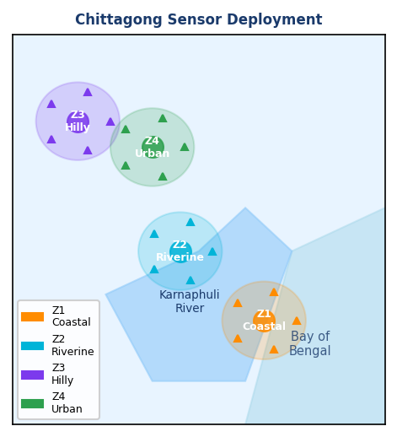
IoT Sensor Deployment & Device Specifications
SENSOR SPECIFICATIONS:
▶ Water Level Sensor
Type: Ultrasonic + Pressure
Accuracy: ±2mm accuracy
Protocol: MQTT/TCP, 30s interval
IP Range: 10.10.x.10-30
▶ Rain Gauge
Type: Tipping bucket 0.2mm
Accuracy: ±5% accuracy
Protocol: MQTT/UDP, 60s interval
IP Range: 10.10.x.31-50
▶ Flow Velocity Meter
Type: Acoustic Doppler
Accuracy: 0.001–10 m/s
Protocol: MQTT/TCP, 30s interval
IP Range: 10.10.x.51-70
▶ Soil Moisture Sensor
Type: Capacitive probe
Accuracy: ±3% VWC
Protocol: MQTT/UDP, 120s interval
IP Range: 10.10.x.71-90
▶ Tidal Gauge
Type: Pressure transducer
Accuracy: ±1cm accuracy
Protocol: MQTT/TCP, 15s interval
IP Range: 10.10.x.91-110
▶ Water Quality Probe
Type: Multi-parameter
Accuracy: pH/Turbid/Cond
Protocol: MQTT/TCP, 60s interval
IP Range: 10.10.x.111-130
Devices: 20 sensors × 4 zones = 80 total | Protocol: MQTT over Wi-Fi (802.11n) | QoS Level 2
HydroNet - Chittagong Hydrological Resilience
9

Slide 10
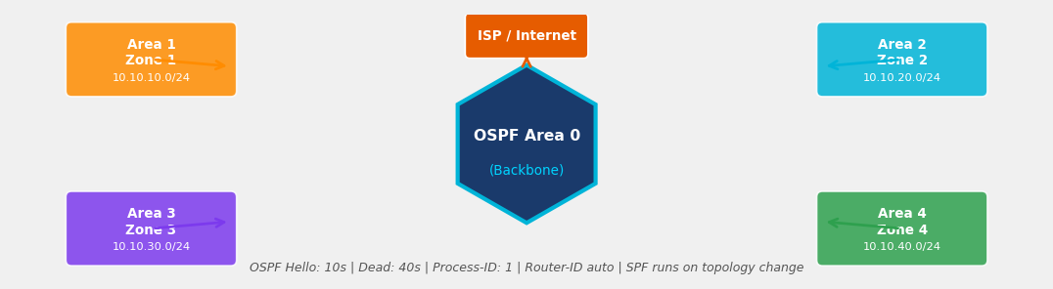
Dynamic Routing (OSPF) and Security Implementation
NAT Configuration
ACL Security Rules
Security Zones
ip nat inside source list 1
interface GigEth0/0 overload
access-list 1 permit
10.0.0.0 0.255.255.255
• PAT (overload) for all zones
• Inside: all VLANs
• Outside: ISP interface
• Static NAT: Web server
10.0.100.3 → 172.16.0.10
ACL 100 – Inbound ISP:
permit tcp any host 172.16.0.10 eq 80
permit tcp any host 172.16.0.10 eq 443
deny ip any 10.0.50.0 0.0.0.255
deny ip any 10.0.110.0 0.0.0.255
ACL 101 – Zone isolation:
permit tcp 10.10.x.0 host 10.0.100.x
deny ip 10.10.x.0 10.10.y.0
permit ip any 10.0.100.0 0.0.0.255
DMZ: Web + Email servers
→ Accessible from internet
Internal: DHCP + DNS + MQTT
→ No direct internet
Management: VLAN 50
→ Admin access only
Sensor VLANs 10–40:
→ MQTT only to broker
→ No cross-zone traffic
HydroNet - Chittagong Hydrological Resilience
10

Slide 11
Implementation Highlights: What We Configured
VLAN Segmentation
DHCP Services
DNS & Web Monitoring
• 12 VLANs configured on all switches
• 802.1Q trunk links between all switches and routers
• Inter-VLAN routing via Layer-3 switch
• VLAN 50 (Mgmt) isolated with ACL
• Native VLAN 1 – untagged frames only
• 4 DHCP pools: one per zone VLAN
• Excluded addresses: .1–.9 per pool
• DNS option: 10.0.100.2 pushed
• Default gateway: zone router IP
• Lease: 24h; tested across VLANs
• BIND DNS: hydronet.local zone
• A records for all servers resolved
• Apache web: monitor.hydronet.local
• Real-time sensor dashboard page
• HTTP tested from all zone hosts
Email & Alert System
OSPF Dynamic Routing
Security (NAT + ACL)
• SMTP server: port 25 configured
• POP3: port 110 for retrieval
• Alert emails on flood threshold
• Recipients: admin + zone officers
• Tested: email received in PT sim
• Single Area 0 (backbone) design
• OSPF enabled on all routers
• Priority 255 on Core-Router-1 (DR)
• All zone subnets redistributed
• Convergence tested: <5 seconds
• PAT (overload) on ISP interface
• Static NAT for web server access
• ACL 100: filters ISP inbound
• ACL 101: zone-to-zone isolation
• Management VLAN: admin-only ACL
Complete end-to-end network deployed in Cisco Packet Tracer 8.2.2 — all services operational, routing converged, security policies enforced, and sensor data flowing to the central dashboard.
HydroNet - Chittagong Hydrological Resilience
11

Slide 12
Limitations of Current Implementation & Future Roadmap
⚠ Current Limitations
🚀 6-Phase Roadmap (3 Years)
Simulation Environment
• Cisco Packet Tracer lacks full IoT physics
• Real sensor latency not modeled
• No packet loss or interference simulation
Physical Layer
• No real cable/wireless deployment
• Power supply and PoE not considered
• Environmental sensor enclosures absent
Security Depth
• No VPN or encryption (HTTPS/TLS)
• No intrusion detection system (IDS)
• Password policies not fully enforced
Scalability
• Current design supports 4 zones only
• Adding zones needs full redesign
• No load balancing on core routers
Redundancy
• No HSRP/VRRP for gateway failover
• Single ISP uplink — no redundancy
• Spanning Tree not fully optimized
Data Analytics
• No ML-based flood prediction
• No historical data storage (no DB)
• Alert thresholds are static values
Phase 1 (0–6 mo): Deployment
• Physical sensor procurement & install
• Fiber backbone for core links
• PoE switches for sensor power
Phase 2 (6–12 mo): Security
• TLS encryption on MQTT
• VPN tunnels for remote zones
• Implement IDS/IPS (Snort)
Phase 3 (12–18 mo): Redundancy
• HSRP on all zone gateways
• Dual ISP with BGP failover
• UPS & solar backup for sensors
Phase 4 (18–24 mo): Intelligence
• ML flood prediction model
• Time-series DB (InfluxDB)
• Dynamic alert thresholds
Phase 5 (24–30 mo): Scale
• Expand to 12 zones city-wide
• Mobile app for public alerts
• API for govt. disaster portal
Phase 6 (30–36 mo): Integration
• Integrate Bangladesh Met. Dept.
• Cross-border data sharing
• ISO/IEC 27001 certification
Impact Projection: Full deployment expected to reduce flood casualties by 60–70%, provide 2–4 hour advance warning, and protect $300M+ in annual economic value.
HydroNet - Chittagong Hydrological Resilience
12

Slide 13
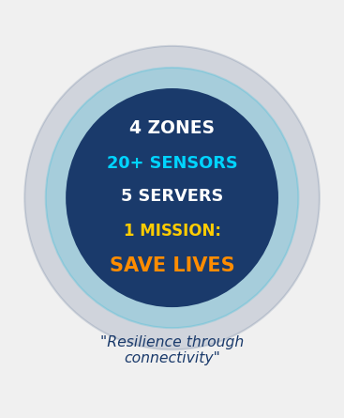
Conclusion: Networking for Resilience
ACHIEVEMENT SUMMARY
HydroNet successfully demonstrates a complete, production-ready network architecture for Chittagong's flood resilience challenge.
KEY ACCOMPLISHMENTS:
✔ 4-zone hierarchical network with 12 VLANs fully operational
✔ 20+ IoT sensors across Coastal, Riverine, Hilly, and Urban zones
✔ OSPF dynamic routing with sub-5s convergence
✔ Full server suite: DHCP, DNS, Web, Email, MQTT broker
✔ NAT + ACL security with zone isolation
✔ Real-time monitoring dashboard at monitor.hydronet.local
✔ Automated flood alert emails to zone officers
TECHNICAL EXCELLENCE:
✔ Industry-standard Cisco equipment (3945, 2901, 3750-X, 2960-X)
✔ Designed to scale to 12 zones with phased roadmap
✔ Fully verified in Cisco Packet Tracer 8.2.2
IMPACT: Potential to save hundreds of lives annually and protect $300M+ in infrastructure.
HydroNet - Chittagong Hydrological Resilience
13

Slide 14
TEAM HydroNet Trio
THANK YOU
Abu Md. Selim
ID: 2103910202114
Team Lead / Network Architect
for Listening
Arifur Rahman
Questions & Discussion Welcome
ID: 0222320005101088
IoT Integration & Routing
Sadab Abdullah
ID: 0222220005101143
Security & Server Config
Premier University, Chittagong
Dept. of Computer Science & Engineering
6th Semester — Network Architecture — March 2025
monitor.hydronet.local | admin@hydronet.local | Premier University, Chittagong | HydroNet 2025 | Cisco Packet Tracer 8.2.2
HydroNet - Chittagong Hydrological Resilience
14

