Slide 1

Algorithm
Filling Your Shopping Card
Daffodil International University
Department Of CSE
Level 2, Term 2
Md. Salauddin Khondokar ( 201-15-13958 )
Abu Naim Md. Rayhan Siddique ( 201-15-13860 )
Tahmid Hossain ( 201-15-14146 )
MD. Moynul Hasan ( 201-15-14141 )

Slide 2
Introduction
Currently there are many online based markets for shopping. But people rarely buy from these markets. The main reason for this is that people do not get the facility that they get when they shop in the market online. Apart from this, due to many other problems, people do not buy from the online based market.
We have tried to solve this problem in our online market.
The facilitation you will get is that if you decide to go shopping, you will be asked to choose a bag and tell its capacity. After that we will tell you which products you will benefit from if you take them in the bag. With this you will see in a table how much you can take a product and how much it is worth. At the end of the day, the total price of the product will be shown.
In this way we will make online shopping more practical.

Slide 3
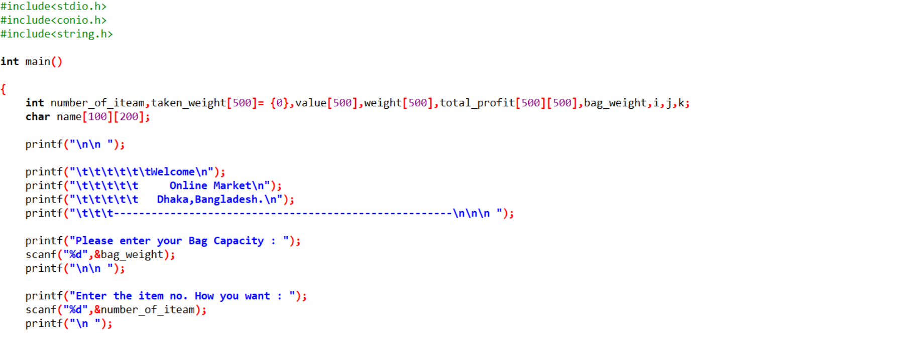
Start Point

Slide 4
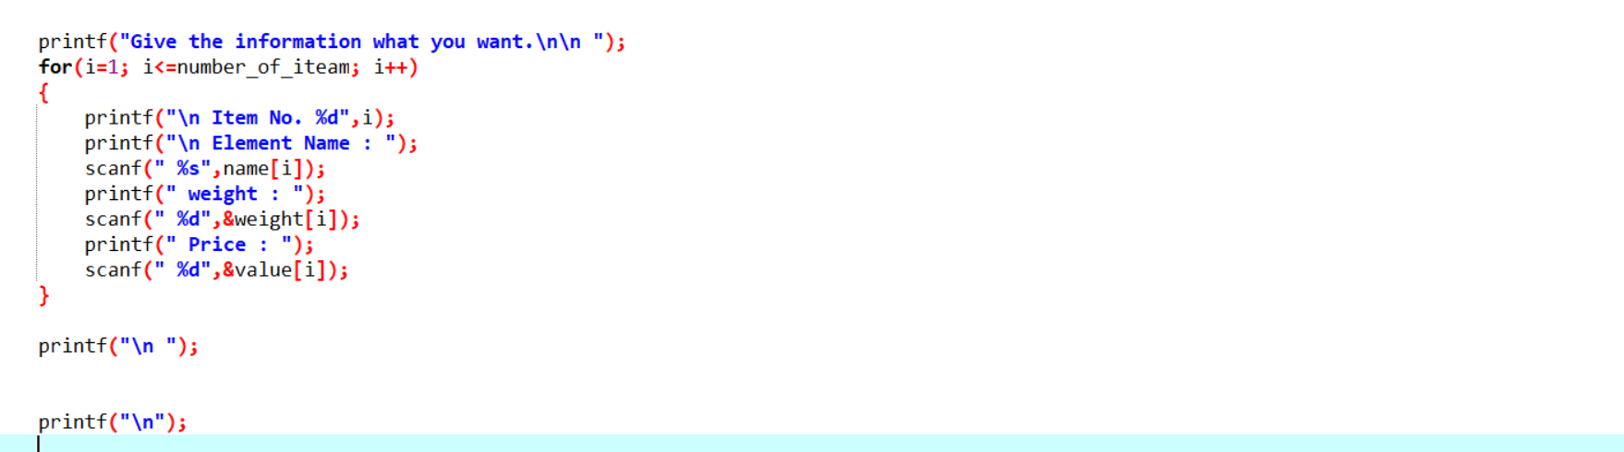

Slide 5
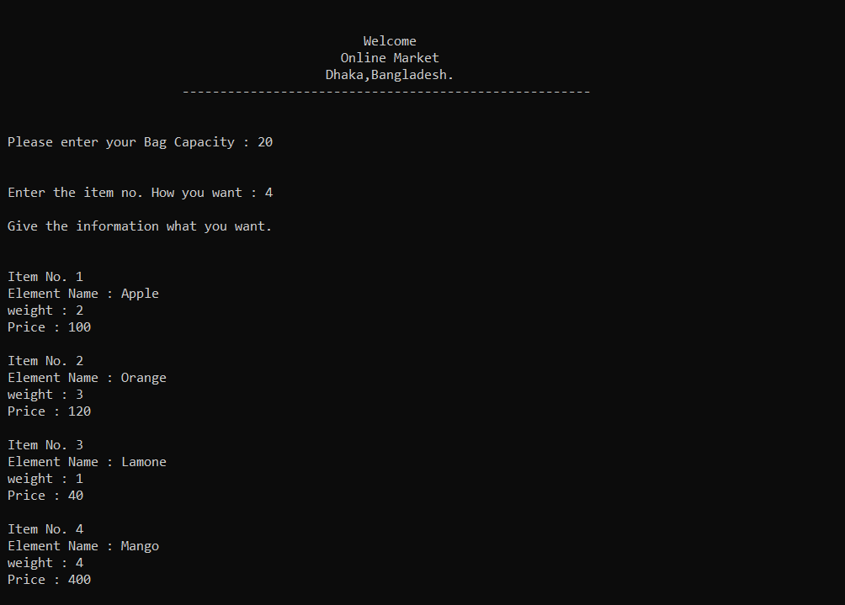
User Provide Information

Slide 6
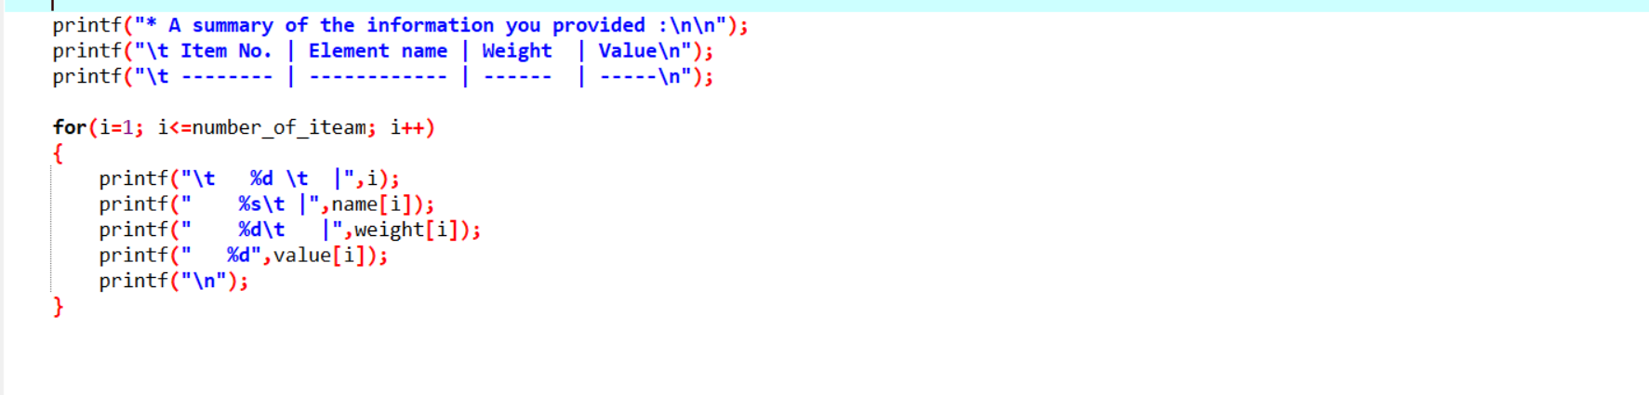
Show the Information (Code )

Slide 7
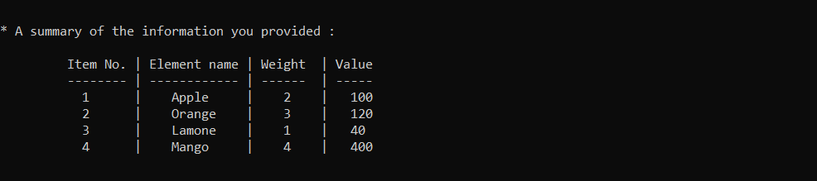
Show the Information (Output)

Slide 8
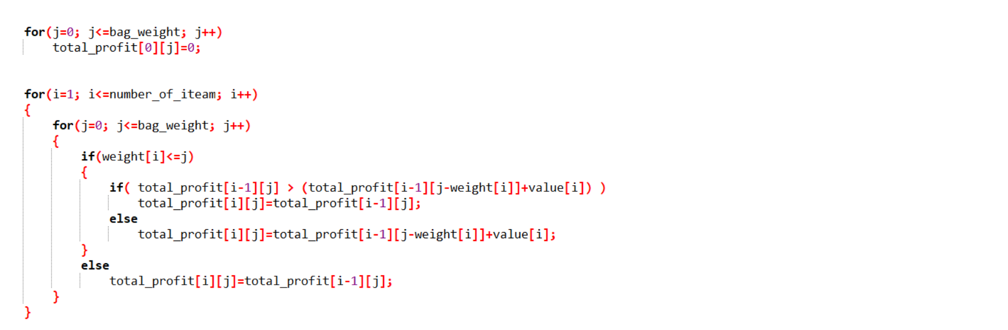
Main Part

Slide 9
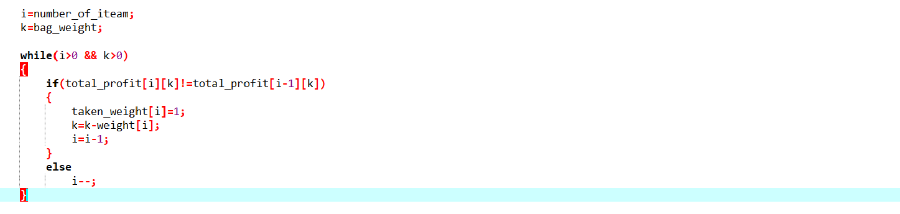

Slide 10
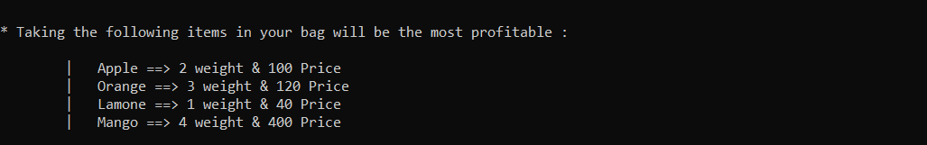
Main Part (output)

Slide 11
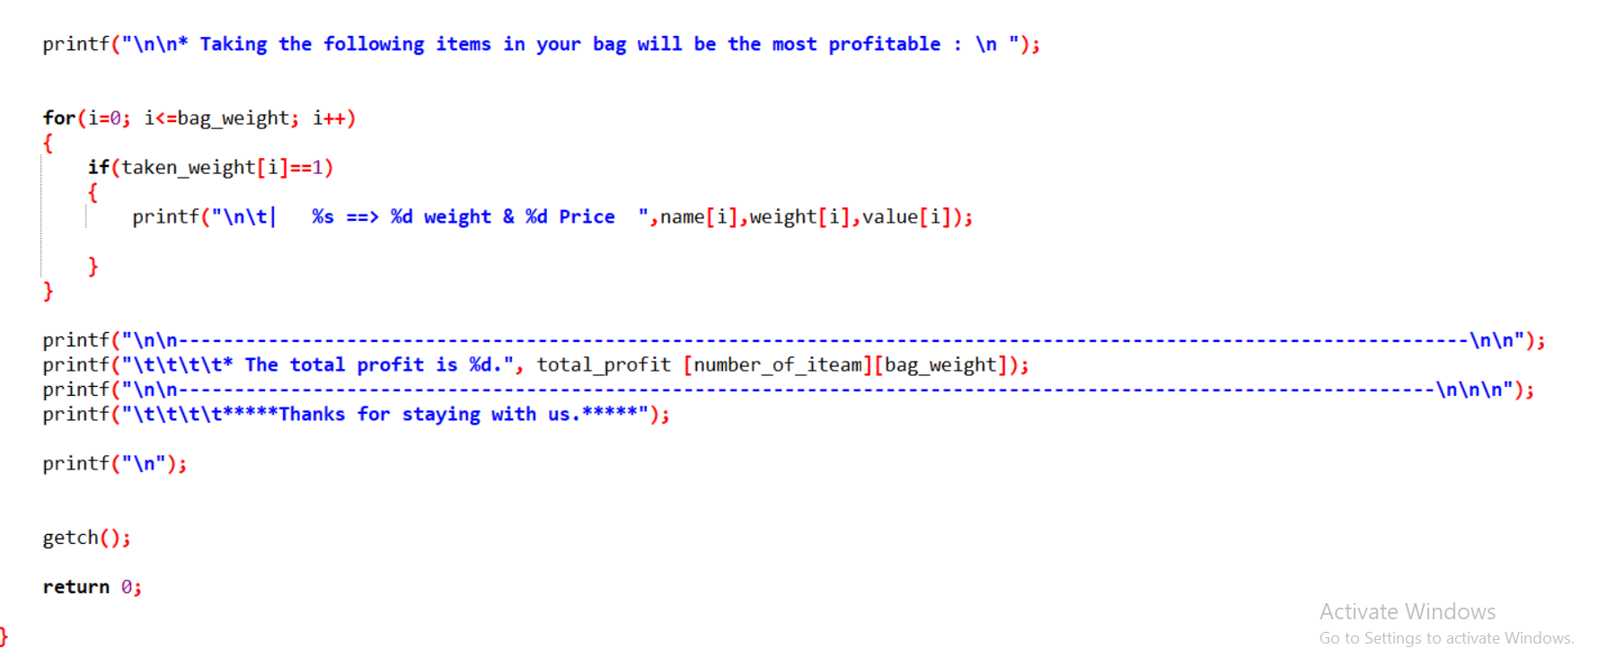
Last Part

Slide 12
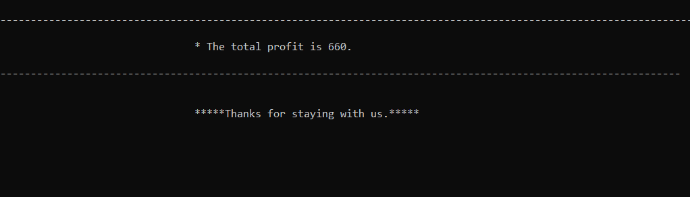

Slide 13
Conclusion Part
Finally we can say, We think this shop is different from all the other shops . We think if someone creates such a project for a shop, then the sellers will be able to sell the product successfully.

