Slide 1
S32K3 RTD training - LCU
Automotive Applications Team
Created: Mar 2021
Last Update: Mar 2021

Slide 2
Agenda
LCU Overview
RTD configuration
Main API functions
Example Code
LUT Configuration Tips

Slide 3
LCU Overview

Slide 4
S32K3xx LCU Overview
Logic Control Unit (LCU) comprises logic cells with programmable logic that operates outside the speed limitations of software execution.
Logic cell takes up to 4 input signals and through the Look Up Table (LUT) generates 4 output signals
Input sources are a combination of the following:
I/O pins
Peripheral outputs
Register bits
Output can be directed internally to peripherals and to an output pin.
Combinatorial Logic:
Any 16 x 4 Truth Table such AND, NAND, AND-OR, AND-OR-INVERT, OR-XOR, OR-XNOR and their combinations
Latches:
S-R, D-flip flop, JK-flip flop
Advanced:
Incremental encoder, ACIM, PMSM & BLDC motor controllers

Slide 5
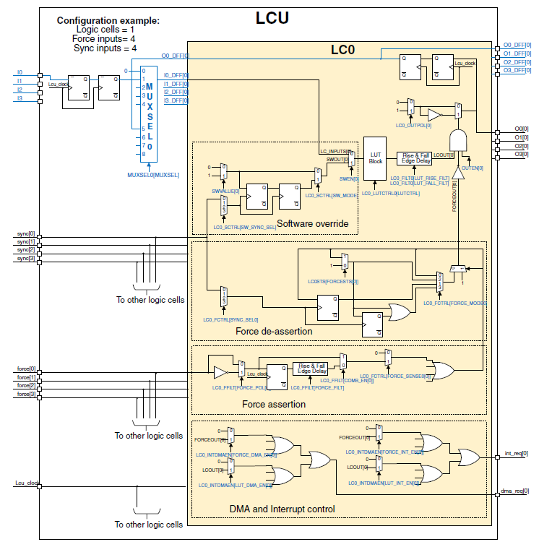
S32K3xx LCU Overview
The LCU is used to create small combinatorial sequential logic circuits.
The logic operation can be programmed by software.
Hardware resource:
Up to 6 LCs (Logic Cells)
Each LC contains 4 LTUs (Look-up Table) attached with 4 inputs and outputs.
Software override option included to allow software input to logic functions
Force control support for motor control / power conversion applications

Slide 6
LCU Example Project
How to use the LCU module to generate a complementary pair PWM signal?
LCU
comp. pairs
Death time
Fault
PWM_LS
eMIOS
TGMUX
PWM
PWM_HS

Slide 7
RTD configuration

Slide 8
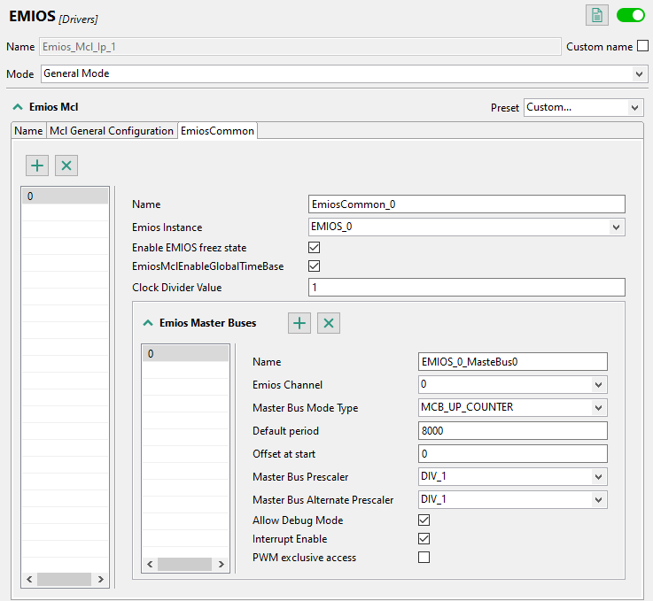
eMIOS_Mcl component Configuration(1)-Counter Bus
eMIOS Channel: Select 0 to generate the counter bus B
Master Bus Mode Type: Select the MCB_UP_COUNTER to generate counter bus B
Default period: Specified the counter bus B period
1
2
3

Slide 9
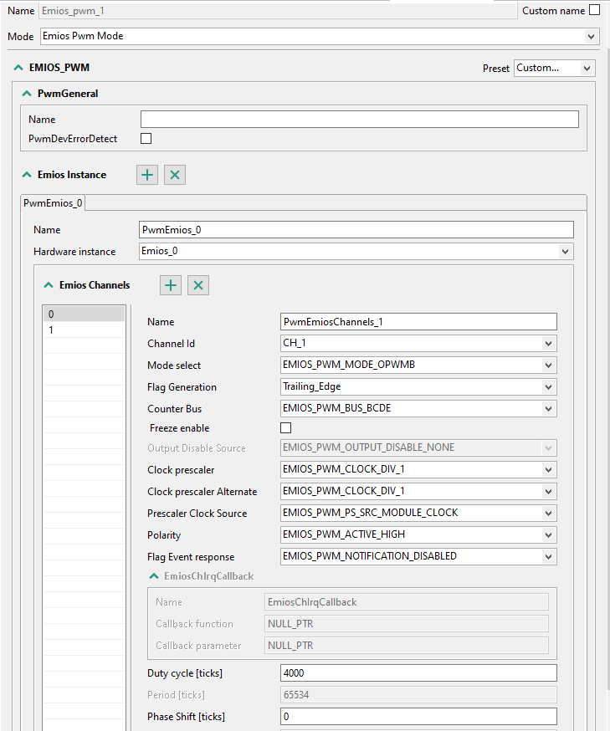
eMIOS_pwm component Configuration(1)-PWM generation
Channel Id: Specified which channel used to PWM generation
Mode Select: Select the OPWMB mode to generate a PWM signal
Counter Bus: Specified the reference counter bus
Duty Cycle: Specified the duty cycle of generated PWM signal
1
2
3
4

Slide 10
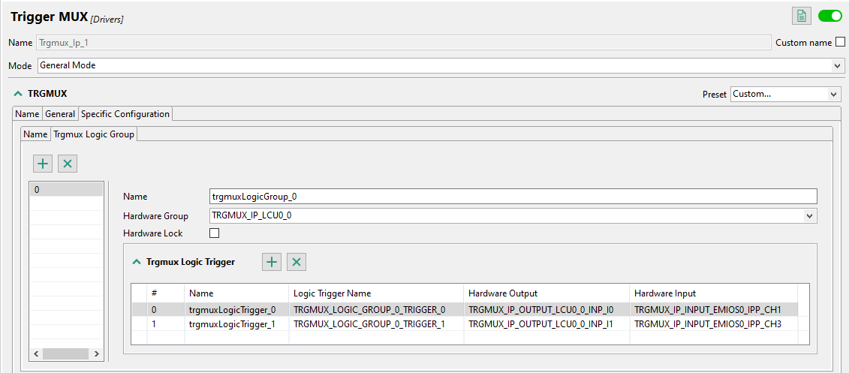
Trgmux component Configuration(1)-Routing PWM to LCU
Hardware Group: Specified the LCU group
Hardware Input: Specified which eMIOS channel will be routed to LCU
Hardware Output: Specified which logic cell and input connected to the eMIOS channel
1
3
2

Slide 11
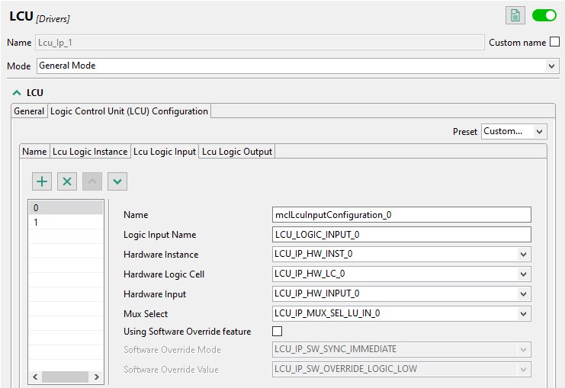
LCU Component Configuration(1)-Lcu Logic Input
LCU Hardware Module: select the LCU instance to use
LCU_0
LCU_1
Logic Cell: select the logic cell of each LCU instance to use
LC_0/1/2
Hardware Input: select the input of each logic cell
INPUT_0/1/2/3
Mux Select: selects the sources for inputs to the LCs
SEL_LOGIC_0
SEL_LU_IN_0/1/2/3/4/5/6/7/8/9/10/11
Software Override: check to enable SW override feature
Input software override logic to override external inputs
User needs to click “+” to add a LCU Input configuration
1
2
3
4
5

Slide 12
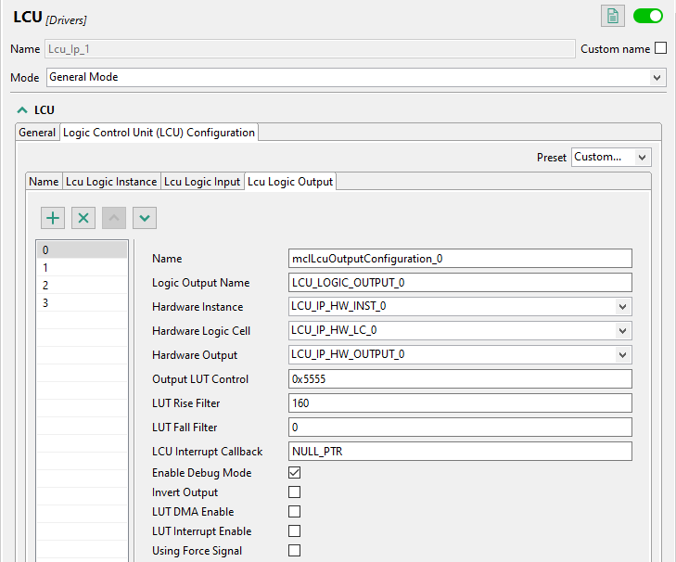
LCU Component Configuration(2)-Lcu Logic Output
Hardware Output: select the output of each logic cell
OUTPUT_0/1/2/3
LUT Control:
Specifies the LUT positions, based on the combined LC input value, that result in assertion of this output.
LUT Rise Filter: Specifies the rising edge thresholds for LC output filters
0 – 65535 LCU clocks
Used to configure dead-time
LUT Fall Filter: Specifies the falling edge thresholds for LC output filters
0 – 65535 LCU clocks
Enable Debug Mode: check to enable outputs to continue operation in Debug mode
Unchecked: Inactive
Checked: Continue normal operation
User needs to click “+” to add a LCU Output configuration
1
2
3
4
5

Slide 13
Main API functions

Slide 14
Main RTD API Functions & Usage
The LCU component provides the following main API functions
Lcu_Ip_ReturnType Lcu_Ip_Init(const Lcu_Ip_InitType * const pxLcuInit)
It initialize the input/output configuration and should be called before invoking all other API functions.
Lcu_Ip_ReturnType Lcu_Ip_Deinit(void)
It resets all logic cells to default.
Lcu_Ip_ReturnType Lcu_Ip_SetSyncInputSwOverrideEnable(const Lcu_Ip_SyncInputValueType List[], const uint8 Dimension)
This function is called for enable software override function.
Lcu_Ip_ReturnType Lcu_Ip_SetSyncInputSwOverrideValue(const Lcu_Ip_SyncInputValueType List[], const uint8 Dimension)
Specifies the software override value for each logic cell input.
Lcu_Ip_ReturnType Lcu_Ip_SetSyncInputMuxSelect(const Lcu_Ip_SyncInputValueType List[], const uint8 Dimension)
Selects the source of the logic cell input.
Lcu_Ip_ReturnType Lcu_Ip_SetSyncOutputEnable(const Lcu_Ip_SyncOutputValueType List[], const uint8 Dimension)
Enables logic cell outputs.

Slide 15
Main RTD API Functions & Usage
The LCU component provides the following main API functions
Lcu_Ip_ReturnType Lcu_Ip_SetSyncOutputPolarity(const Lcu_Ip_SyncOutputValueType List[], const uint8 Dimension)
Specifies the polarity of the outputs.
Lcu_Ip_ReturnType Lcu_Ip_SetSyncOutputFallFilter(const Lcu_Ip_SyncOutputValueType List[], const uint8 Dimension)
Specifies the number of consecutive clock cycles the filter output must be logic 0 before the output signal goes low.
Lcu_Ip_ReturnType Lcu_Ip_SetSyncOutputRiseFilter(const Lcu_Ip_SyncOutputValueType List[], const uint8 Dimension)
Specifies the number of consecutive clock cycles the filter output must be logic 1 before the output signal goes high.
Lcu_Ip_ReturnType Lcu_Ip_SetSyncOutputLutControl(const Lcu_Ip_SyncOutputValueType List[], const uint8 Dimension)
Specifies the LUT positions, based on the combined LC input value, that result in assertion of this output.
Lcu_Ip_ReturnType Lcu_Ip_GetSyncLogicInput(Lcu_Ip_SyncInputValueType List[], const uint8 Dimension)
Indicates states of logic cell inputs.
Lcu_Ip_ReturnType Lcu_Ip_GetSyncSwOverrideInput(Lcu_Ip_SyncInputValueType List[], const uint8 Dimension)
Indicates states of logic cell inputs or software-overridden inputs, depending upon the state of the SW override function.

Slide 16
Example Code

Slide 17
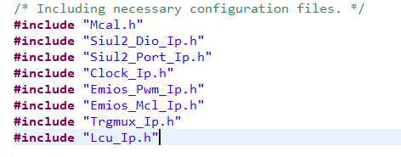
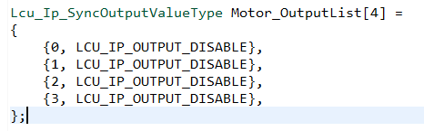
Example Project—Application Codes
① Include “Lcu_Ip.h”—user config data and API function declare
② Declare a Lcu_Ip_SyncOutputValueType variable representing the output state of the LCU

Slide 18
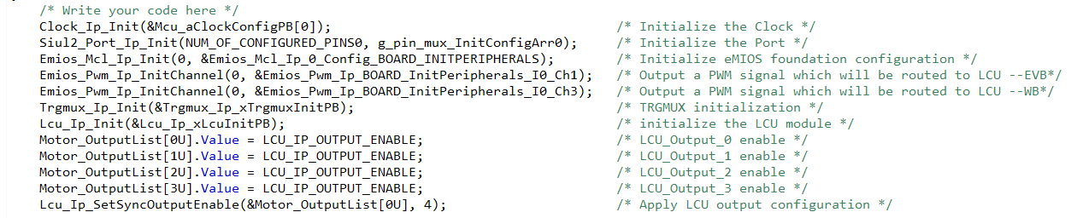
Example Project—Application Codes
③ Initialize the LCU module and enable the output

Slide 19
Example Project—Dependency and HW requirements
Dependent RTD components
Siul2_Dio: provide the GPIO pin operation API functions;
Siul2_Port: provide the GPIO PORT configuration API functions;
Clock: configure system clocks;
Emios_Pwm: provide the PWM output configuration API function;
Emios_Mcl: provide the eMIOS basic configuration API function;
Trgmux: provide the Trgmux configuration API function.
HW requirements
S32K344-WB( schematic: SPF-47478 Rev.A )
S32K3X4EVB-Q257(schematic: SPF-47651 Rev.B)
Support by two different .mex file, need to open in S32_CT and re-generate the configuration codes.

Slide 20
LUT Configuration Tips

Slide 21
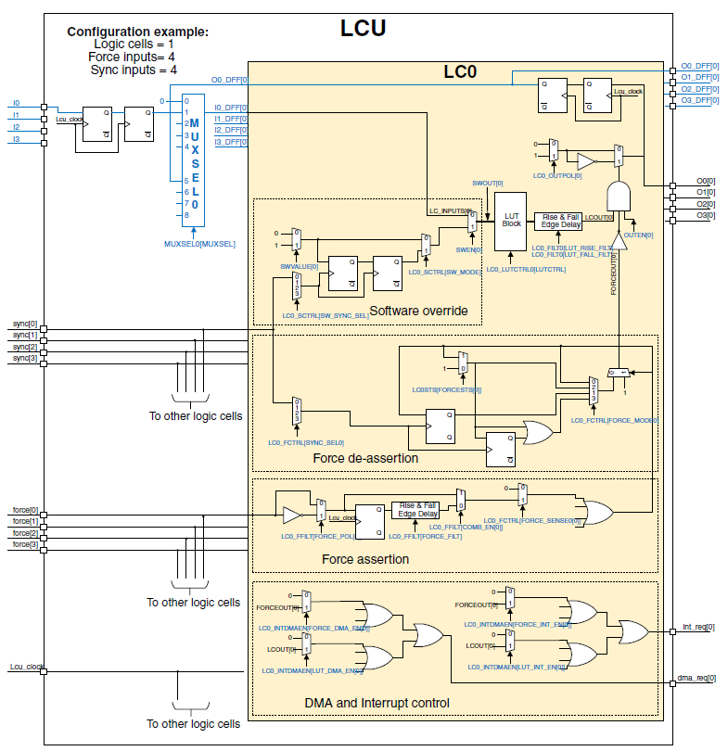
LUT Configuration Tips
Logic cell 0 O0= not I0_DFF
O1= I0_DFF
Inputs |  |  |  |  | Outputs
I3 | I2 | I1 | I0 |  | O0 | O1 | O2 | O3
Not related | Not related | Not related | PWM |  | PWM_LS | PWM_HS | Not related | Not related
0 | 0 | 0 | 0 |  | 1 | 0 | 0 | 0
0 | 0 | 0 | 1 |  | 0 | 1 | 0 | 0
0 | 0 | 1 | 0 |  | 1 | 0 | 0 | 0
0 | 0 | 1 | 1 |  | 0 | 1 | 0 | 0
0 | 1 | 0 | 0 |  | 1 | 0 | 0 | 0
0 | 1 | 0 | 1 |  | 0 | 1 | 0 | 0
0 | 1 | 1 | 0 |  | 1 | 0 | 0 | 0
0 | 1 | 1 | 1 |  | 0 | 1 | 0 | 0
1 | 0 | 0 | 0 |  | 1 | 0 | 0 | 0
1 | 0 | 0 | 1 |  | 0 | 1 | 0 | 0
1 | 0 | 1 | 0 |  | 1 | 0 | 0 | 0
1 | 0 | 1 | 1 |  | 0 | 1 | 0 | 0
1 | 1 | 0 | 0 |  | 1 | 0 | 0 | 0
1 | 1 | 0 | 1 |  | 0 | 1 | 0 | 0
1 | 1 | 1 | 0 |  | 1 | 0 | 0 | 0
1 | 1 | 1 | 1 |  | 0 | 1 | 0 | 0
LUT register value |  |  |  |  | 0x5555 | 0xAAAA | 0x0000 | 0x0000

