Slide 1
Individual Neural Network

Slide 2
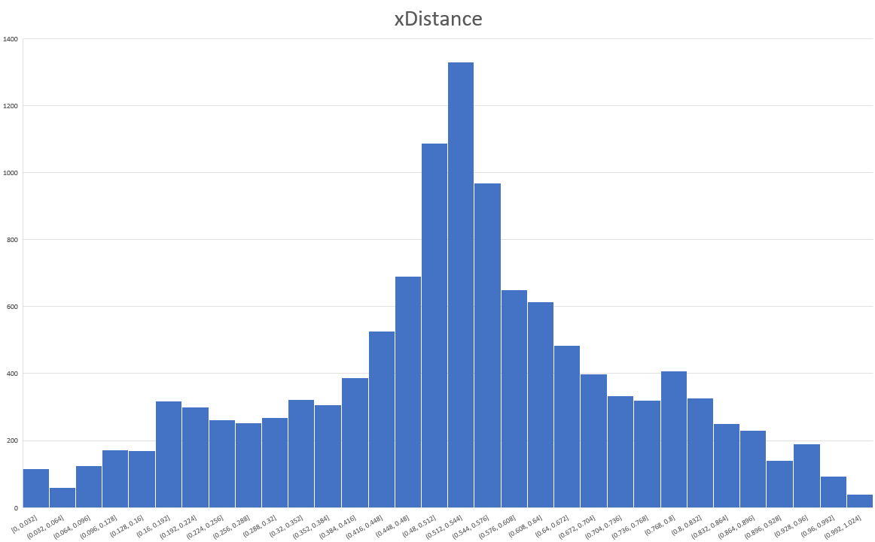
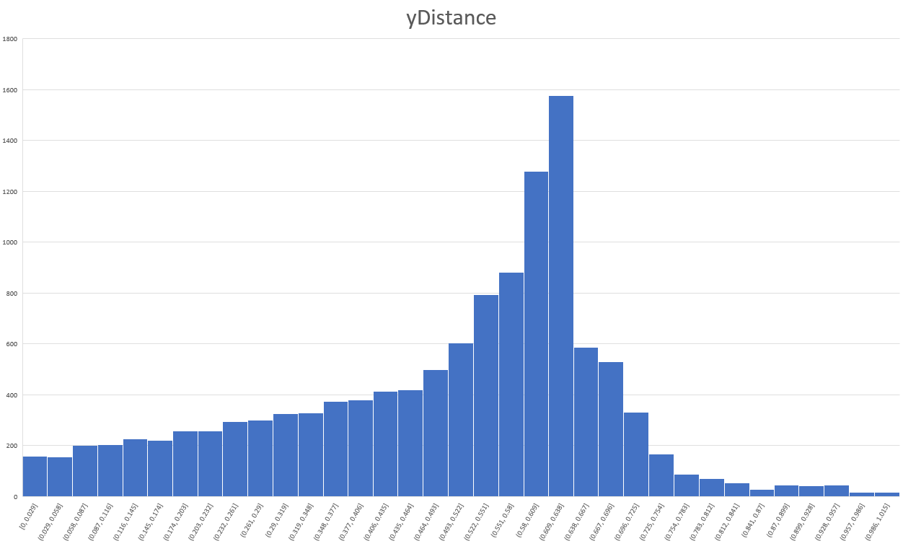
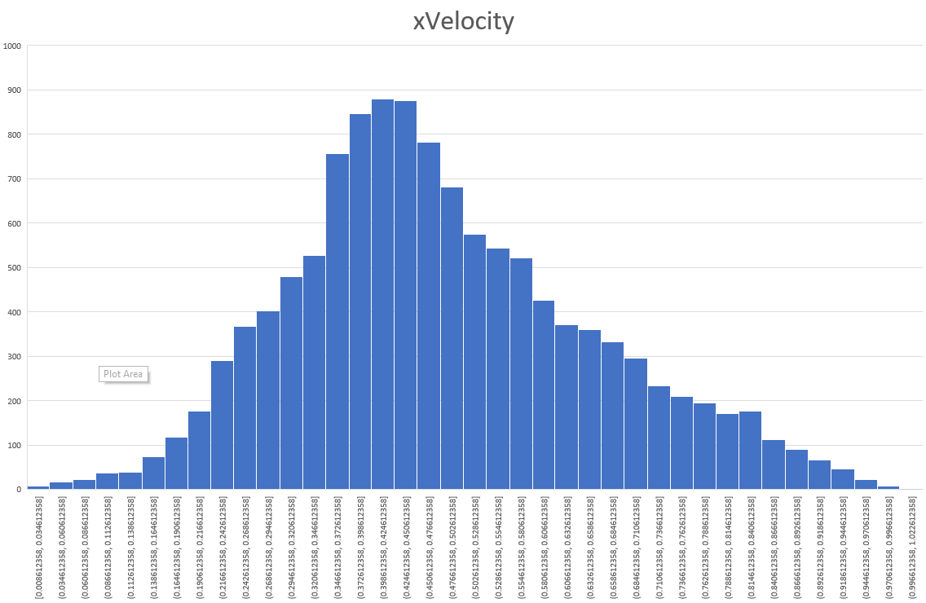
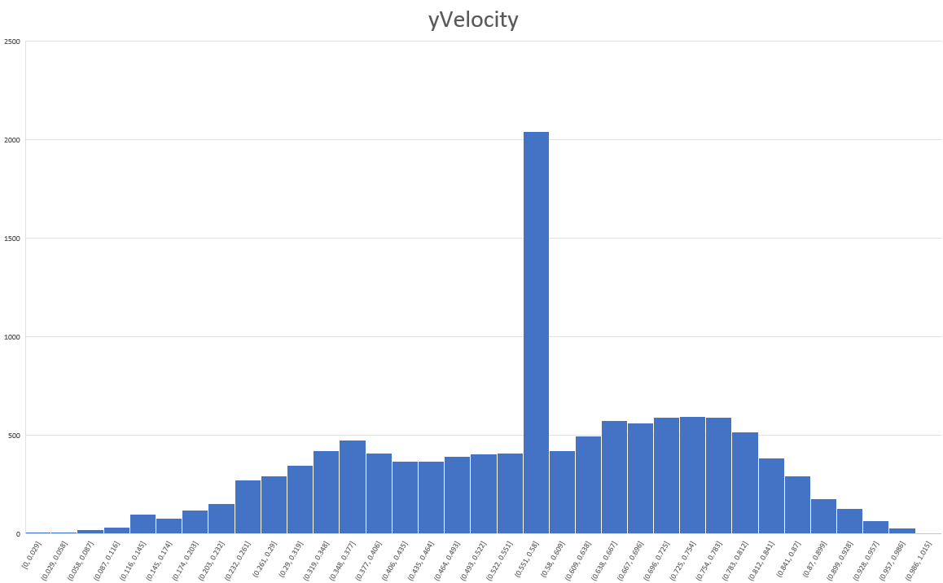
Normalized training data
Skewness: -0.1592
Skewness: -0.59018
Skewness: 0.40988
Skewness: -0.30328

Slide 3
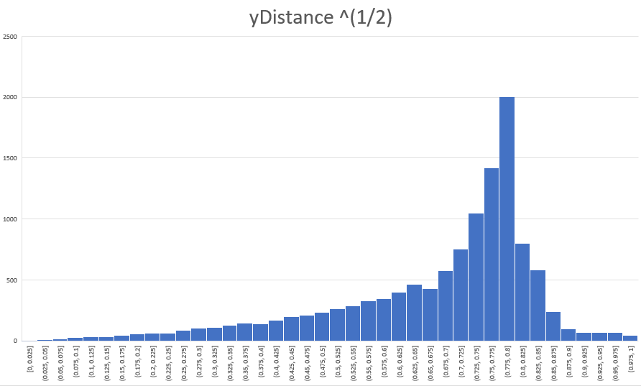
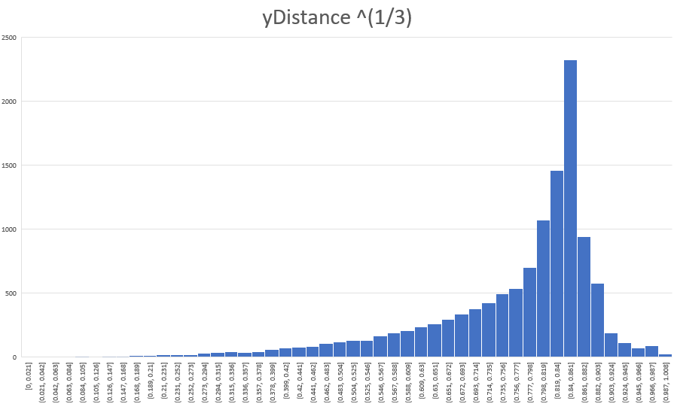
Correction of skewness in y-distance (training data)
Skewness: -1.27501
Skewness: -1.62384

Slide 4
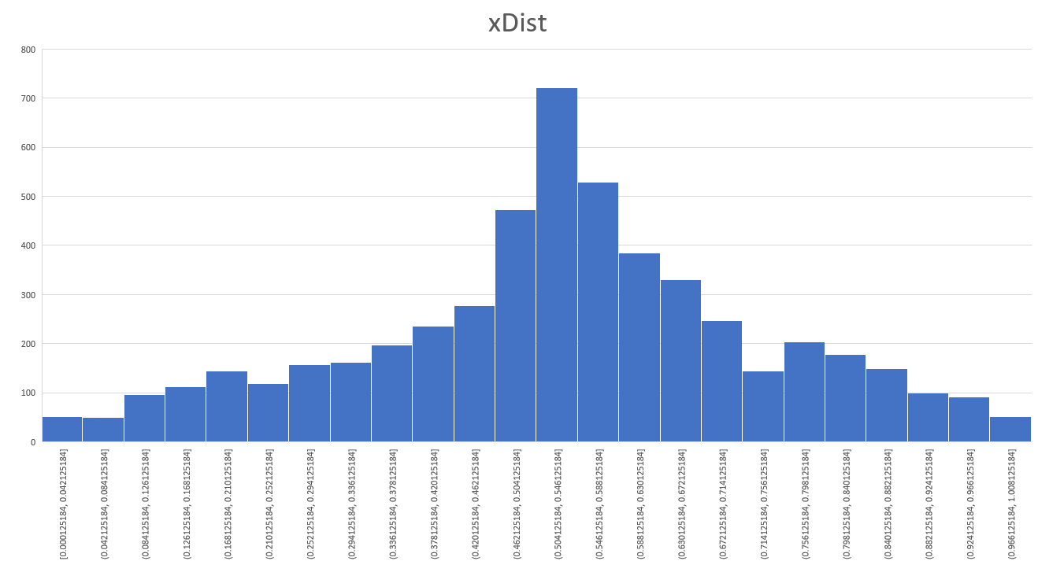
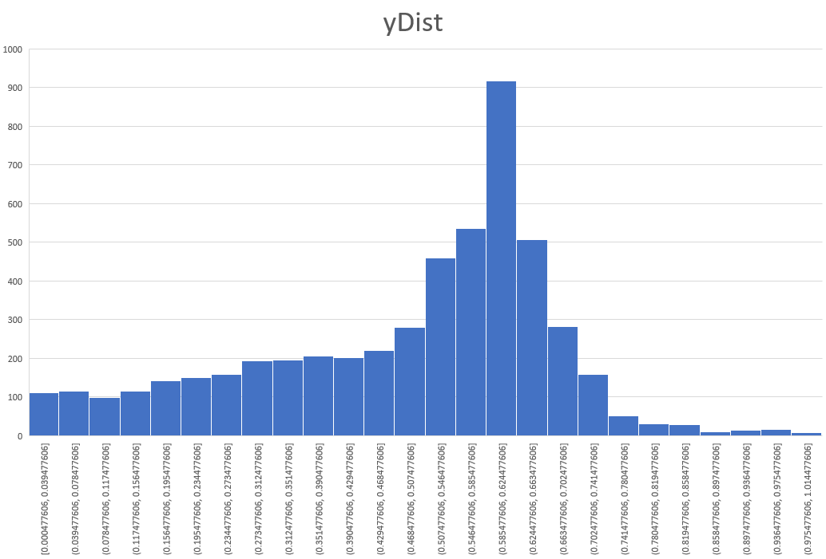
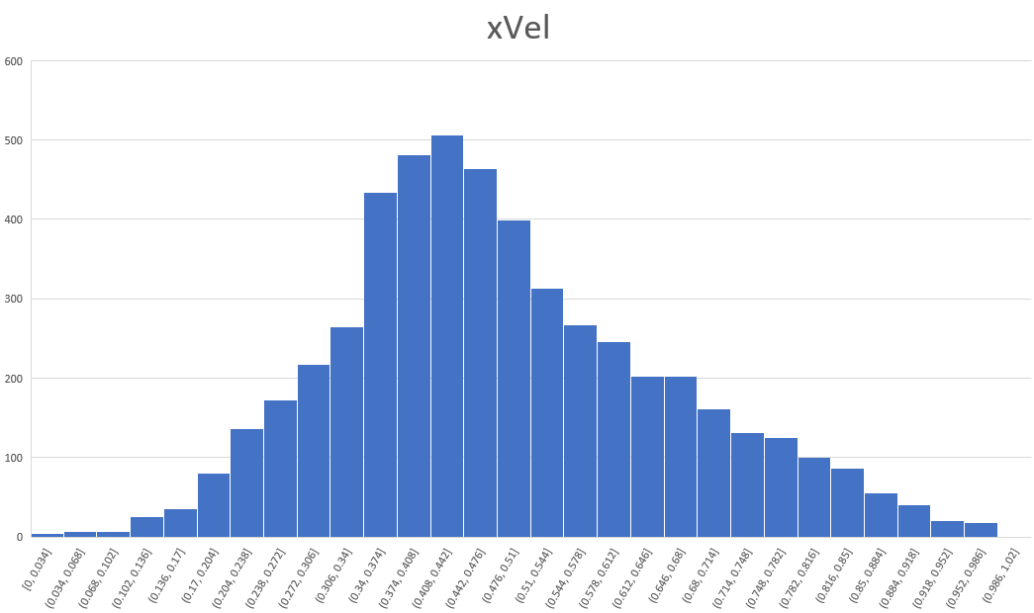
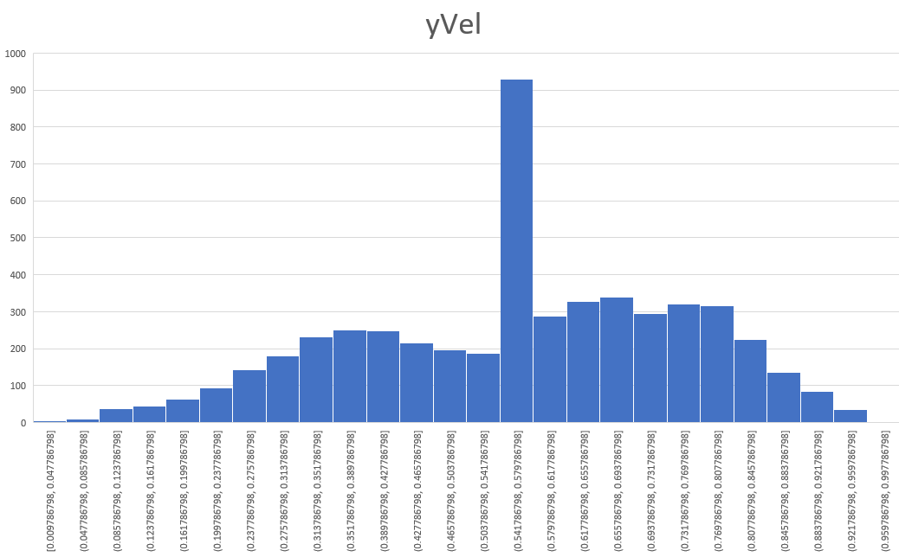
Normalized validation data
Skewness: -0.1845
Skewness: -0.68065
Skewness: -0.430378
Skewness: -0.32723

Slide 5
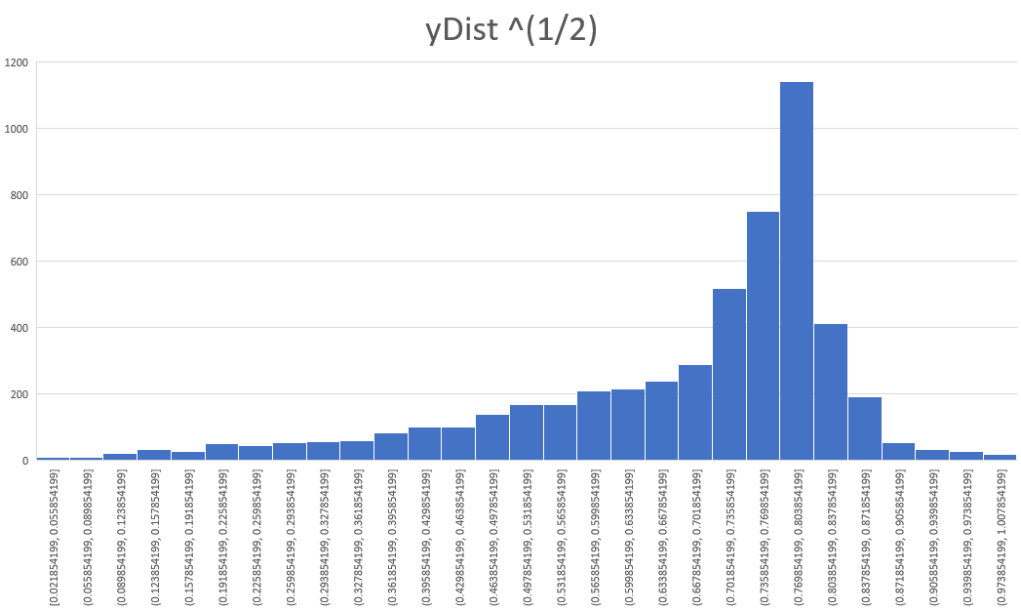
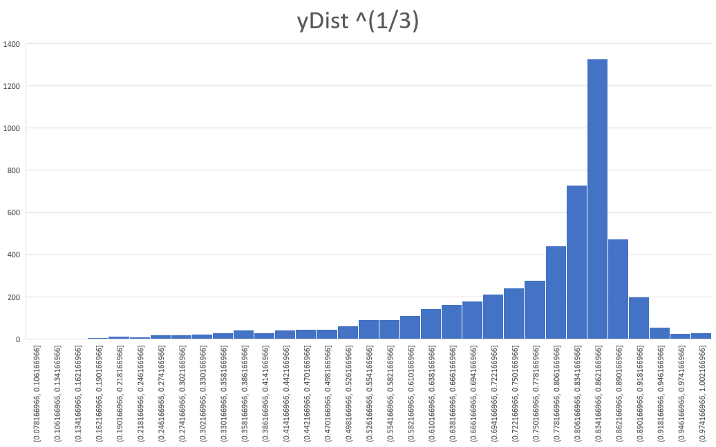
Correction of skewness in y-distance (validation data)
Skewness: -1.35973
Skewness: -1.70296

Slide 6
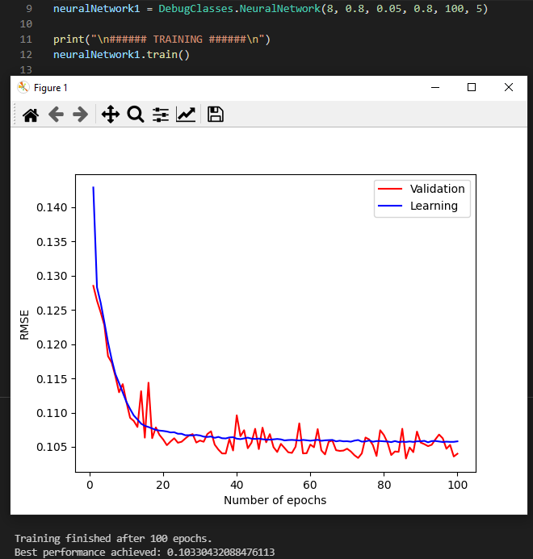
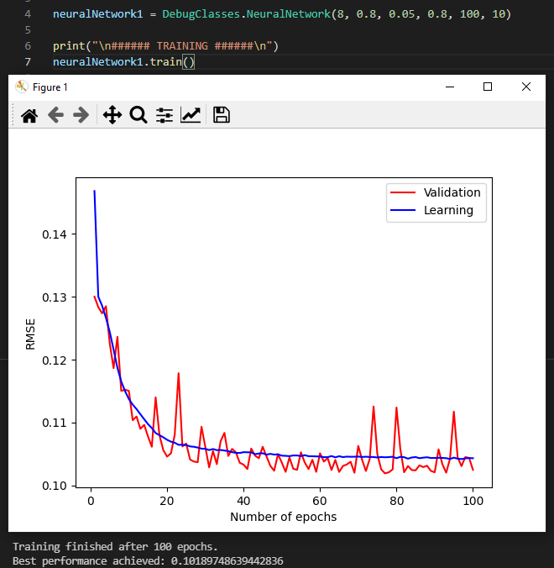
Evidence

Slide 7
