Slide 1
EVALUATING LOW RISK AIRCRAFT FOR PORTFOLIO EXPANSION

Slide 2
INTRODUCTION
Overview
The presentation evaluates key risks across aircraft models and provides actionable recommendations to ensure a strong, low-risk start for the aviation business expansion.
This will help us make informed decisions on aircraft acquisition—balancing safety, reliability, and financial viability.
Questions to address
The presentation aims at answering the following questions:
1.Has the number of accidents decreased over time?
2.Do certain flight purposes correlate with higher accident rates?
3.Which is the safest Make and Model of aircraft?
4.Do Instrument Meteorological Conditions (IMC) contribute to accidents compared to Visual Meteorological Conditions (VMC)?
5.Does the number of engines impact accident severity?

Slide 3
DATA UNDERSTANDING
The Aviation Accident Database & Synopses, up to 2023 Data was downloaded from Kaggle as a Zip file and later extracted into CSV files
The data was provided by the National Transportation Safety Board .
It contained aviation accident data from 1962 to 2023 about aviation accidents in the U.S and aviation waters.
The Aviation data was later loaded to Jupyter notebook as a data frame for further cleaning, manipulation and analysis

Slide 4
DATA PREPARATION, CLEANING AND MANIPULATION
We loaded the aviation dataset and
1. Cleaned the column names, fixing date formats, and adding a "Year" column
2.Removed columns with too much missing information
3.Imputation of important columns such as engine types, models
4.Checked for duplicates and standardized the categories
5. Prepared a clean, well-structured dataset ready for trend analysis and studying flight risks.
6. Finally imported the cleaned data set

Slide 5
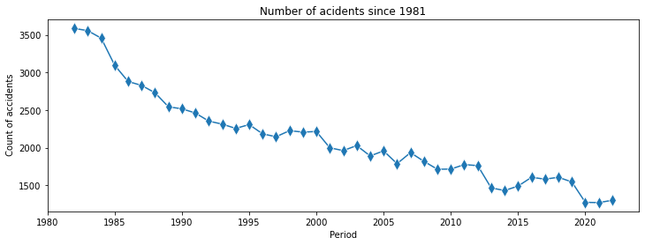
DATA ANALYSIS
Trend Analysis of Accidents over Years
There has been tremendous reduction in number of accidents since 1981.
While there could be other underlying factors, technology has really advanced over time. This could explain why we have this phenomena

Slide 6
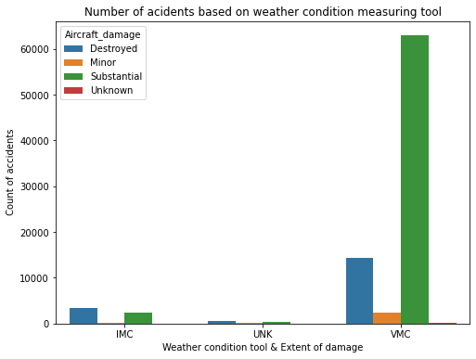
Accident Counts and Weather Condition Tools
Accidents were rampant when the pilots decided to navigate visually without relying on instruments (VMC).
For accidents where pilots used the instruments, we can see the cases were very minimal.

Slide 7
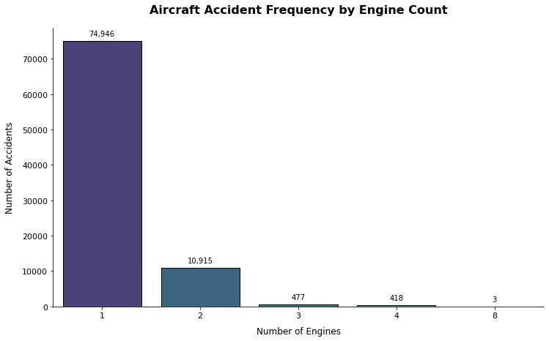
Accident Frequency by Engine Count
Aircraft with 1 engine account for the highest accident rates.2- and 4-engine aircraft show significantly fewer accidents.
Accident rates decrease disproportionately with added engines with 8-engine aircraft recording the lowest accident counts.

Slide 8
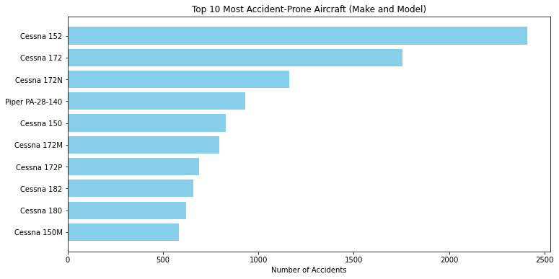
Most Accident Prone Aircraft (Make and Models)
Cessna models are prone to accidents with the highest number of accidents since 1981. Piper PA-28-140 is also prone to accident
Models of Fairchild(KR-31,M 62A-3,M-62A (PT-19), M62A (PT-19)) and Zwicker Murray R have only had 1 cases of accidents.

Slide 9
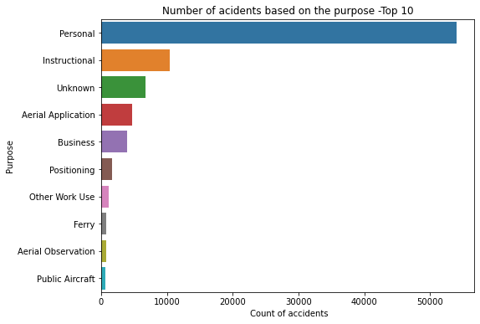
Purpose of Aircraft and Accident Counts
Aircraft used for personal and training/instructional topped the accidents.
Public aircraft had the least accidents. It is evident that there is
much care, expertise, conforming to standards for this aircraft.

Slide 10
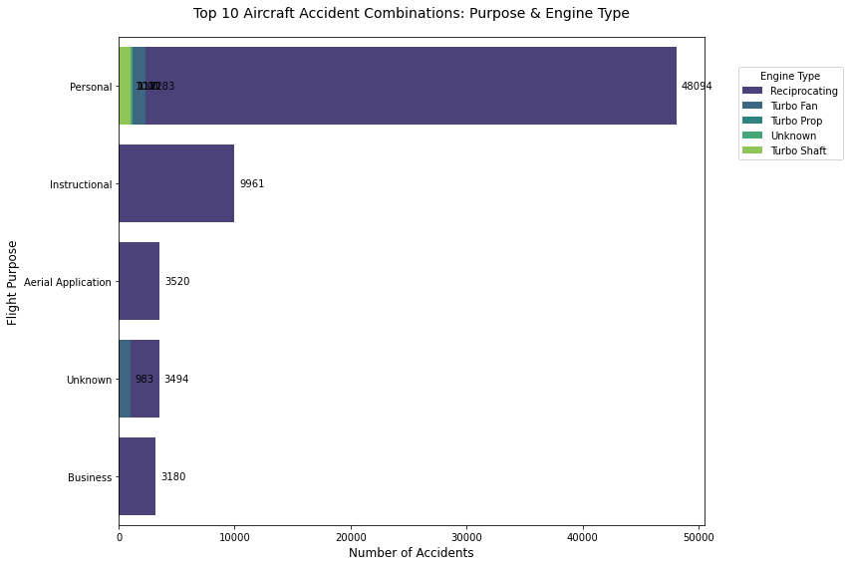
Purpose and Engine Types Vs Accident Counts
Aircrafts with reciprocating engines had the highest number of accidents.
48094 accidents in Personal aircrafts were directly linked to the Reciprocating engine, 9961 in instructional,3494 in aircrafts with Unknown Purpose and 3180 accidents in flights meant for business.

Slide 11
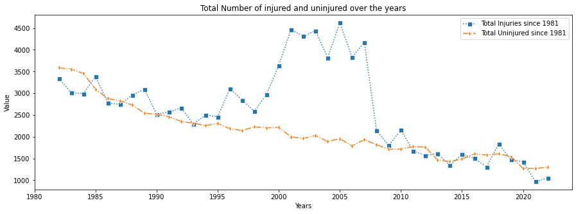
Number of injuries and the uninjured
There have been steady decline in the number of injuries due to aircraft accidents since 2005.
The number of uninjured have however been steadily decreasing since 1981 depicting a worrying trend.

Slide 12
RECOMMENDATIONS
From the analysis, we can draw the following actionable insights:
1.The company should consider purchasing either Fairchild or Zwicker Murray R.The company needs to be careful when purchasing any model of Cessna.
2. The company should invest in Aircrafts with 6 or 8 Engine Count and avoid Single-Engine with Reciprocating Engines Aircraft
3. With the higher risks associated to the Personal Aircrafts, the company should consider investing more in Commercial Aircrafts.
4. The company should heavily invest in Instruments Meteorological Conditions Tools and encourage their pilots to always use IMC as opposed to VMC

Slide 13
THANKS!
Any questions?
You can find me at
Email Address: abuonodindo2030@gmail.com
Linkedin: Username-Jacob Abuon

