Slide 1

A Data-Budget-Aware and Explanation-Stable Lightweight Deep Learning Framework for Plant Disease Detection
M.E. Project Review • November 2026
Presented by: A. BOWSIYA (911625405001)
Guide: Mrs. P. JONE JENIFER M.E., Assistant Professor
Department of Computer Science and Engineering, Mother Terasa College of Engineering and Technology
Notes:
Introduce the project title, yourself and your guide.

Slide 2




Why a new approach is needed
Manual diagnosis is slow
Farmers depend on visual inspection or lab tests that need experts and several days.
20–40%
Accurate models are heavy
AlexNet, VGG and ResNet have 25–138 M parameters – too large for low-cost devices.
of global crop production is lost to pests and plant diseases every year (FAO).
Labelled data is costly
Most studies train on the full dataset and never show how accuracy falls with fewer images.
Early, cheap and trustworthy detection directly protects farmers' income.
Predictions are a black box
Heat maps are shown as pictures, but their stability is never measured.
Notes:
Explain the four gaps that motivate the project.

Slide 3






Project objectives
Lightweight model
Data-budget aware
Explainable
Detect 38 leaf classes with MobileNetV3-Small (1.56 M parameters).
Train and evaluate under controlled budgets (B20–B100) with leaf-group splits.
Show a Grad-CAM heat map for every prediction.
Explanation stability
Web application
Reliable and tested
Measure whether heat maps stay the same under flip, brightness and rotation.
Flask app with login, upload, result, report and history.
Input validation, low-confidence warning and automated tests.
Notes:
Read the six objectives; stress the two novel ones: data budget and explanation stability.

Slide 4
Literature survey
Author (year) | Method | Result | Gap
Mohanty et al. (2016) | GoogLeNet, transfer learning | 99.35% on PlantVillage | Drops to ~31% on other images; large model
Ferentinos (2018) | VGG on 87,848 images | 99.53% | >100 M parameters
Barbedo (2018) | Effect of dataset size | Small data → poor generalisation | No budget protocol
Too et al. (2019) | DenseNet-121 fine-tuning | 99.75% | Full data only; heavy
Selvaraju et al. (2017) | Grad-CAM | Class heat maps for any CNN | Stability not guaranteed
Pal et al. (2025) | Mob-Res (3.51 M params) + Grad-CAM | 99.47% | Qualitative explanations; no data budget
Notes:
Summarise each paper's contribution and the gap this project fills.

Slide 5

Existing system vs proposed system
Existing system
Proposed system
Manual inspection or slow laboratory tests
Large CNNs (AlexNet, VGG, ResNet) trained on the full dataset
Only overall accuracy reported
Random image splits can leak near-duplicate leaves
No explanation, or heat maps that are never checked
Instant prediction in a web browser
MobileNetV3-Small: 1.56 M parameters, 22 ms on CPU
Accuracy, macro precision, recall and F1 per class
Leaf-group splits with duplicate audit; data budgets B20–B100
Grad-CAM with measured explanation stability
Notes:
Contrast the disadvantages of the existing approach with the advantages of the proposed one.

Slide 6
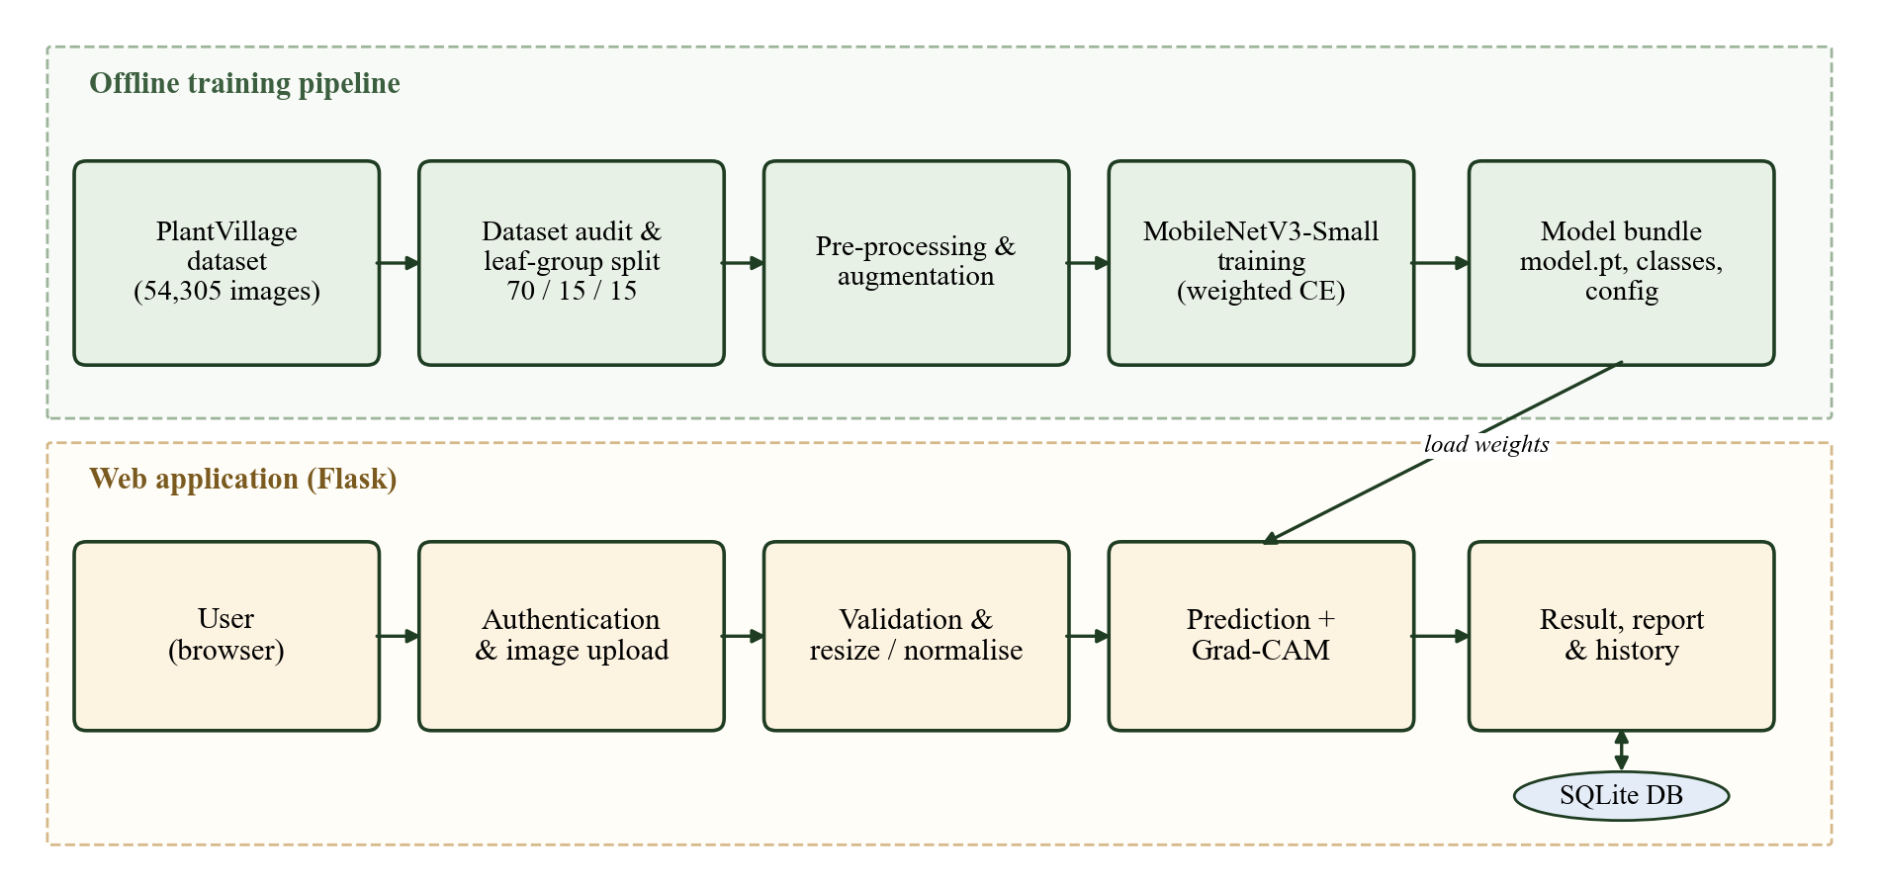
System architecture
Notes:
Offline: audit and split dataset, preprocess and augment, train MobileNetV3-Small, export bundle. Online: Flask app loads the bundle and serves login, upload, prediction with Grad-CAM, report and history.

Slide 7
Dataset and data budget
54,305
leaf images
38
classes
14
Images of the same leaf never cross splits. The model is trained on a 40% budget (B40) – only 15,240 images – to show that a small, cheap training set is enough.
crop species
Notes:
PlantVillage, 38 classes. Leaf-group split avoids leakage. Budgets B20 to B100; we trained on B40.

Slide 8



Model and training
Leaf image
Training settings
resize, crop to 160×160, normalise
Budget: B40 – 15,240 images
Epochs: 5 (best at epoch 5)
Optimiser: AdamW, lr 3e-4, cosine schedule
Class weights: ∝ 1/√(class count)
Augmentation: random crop, flip, colour jitter
Hardware: CPU only – 30 minutes
MobileNetV3-Small
ImageNet weights, inverted residuals, SE blocks
38-class head
softmax probabilities, top-5 classes
Notes:
Transfer learning with MobileNetV3-Small; class weighting handles imbalance; trained in 30 minutes on CPU.

Slide 9
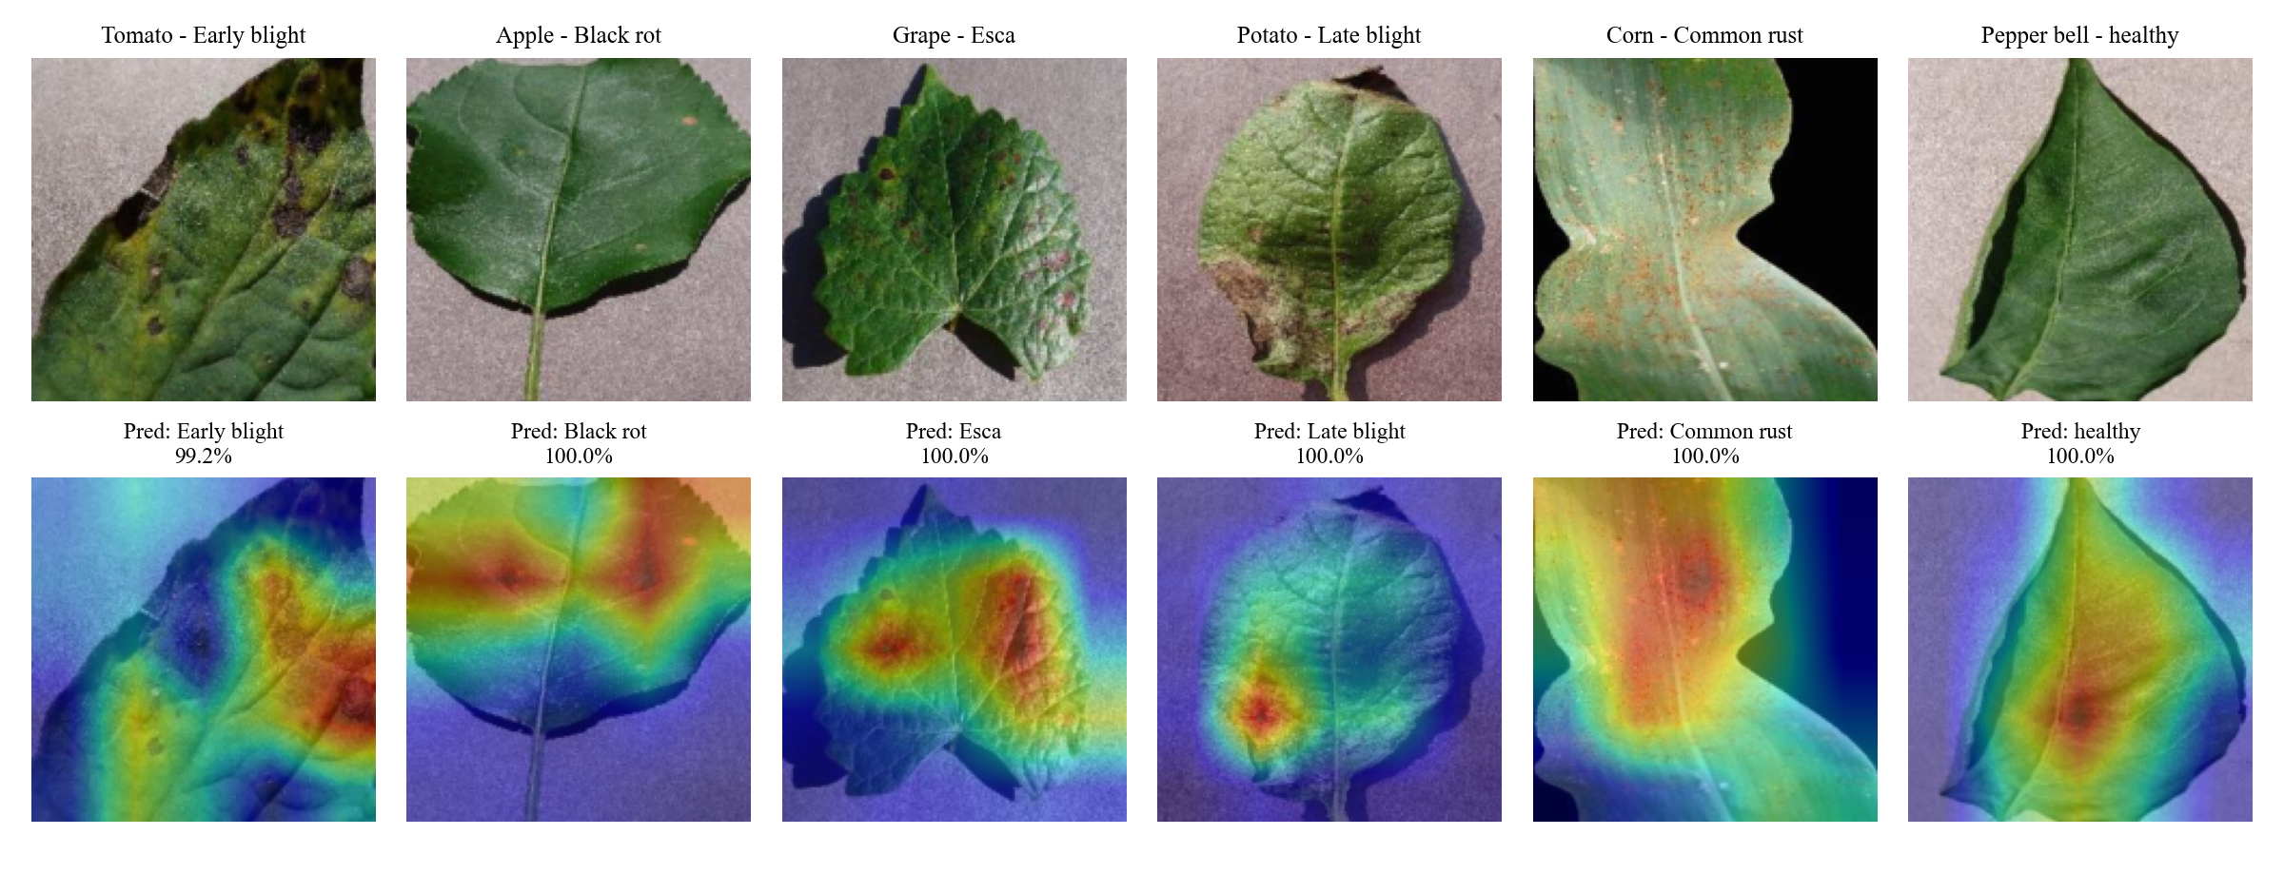
Grad-CAM and explanation stability
1
Grad-CAM: Gradients of the predicted class weight the last feature maps → heat map
2
Perturb: Same leaf flipped, 15% brighter, rotated 10°
3
Compare: Prediction agreement, Pearson r of heat maps, top-20% IoU
Notes:
Grad-CAM highlights the lesion area. Stability: we change the image slightly and check that both the prediction and the heat map stay the same.

Slide 10





Implementation modules
Authentication
Upload and validation
Register, login, logout; salted password hashes in SQLite
Type, size (8 MB), corrupt-file and minimum-size checks
Prediction
Grad-CAM
MobileNetV3-Small, top-5 classes, warning below 50% confidence
Heat map overlay on the uploaded leaf
Report
History
Printable report – save as PDF
Every prediction stored per user
Notes:
Walk through the six modules of the Flask application.

Slide 11
Results on 8,050 unseen test images
98.30%
97.74%
Test accuracy
Macro F1-score
22 ms
6.36 MB
per image on CPU
model size
Notes:
98.30% accuracy with only 40% of the training data. Our model is 88 times smaller than VGG-16 and less than half the size of Mob-Res.

Slide 12

Explanation stability results
Stable under flip and lighting
Predictions agree 98–99% and heat maps correlate at r ≥ 0.95.
Rotation is the weak point
91.8% agreement, r = 0.81 – rotation augmentation is future work.
Notes:
This is the novel contribution: we measure, not just show, explanation stability.

Slide 13
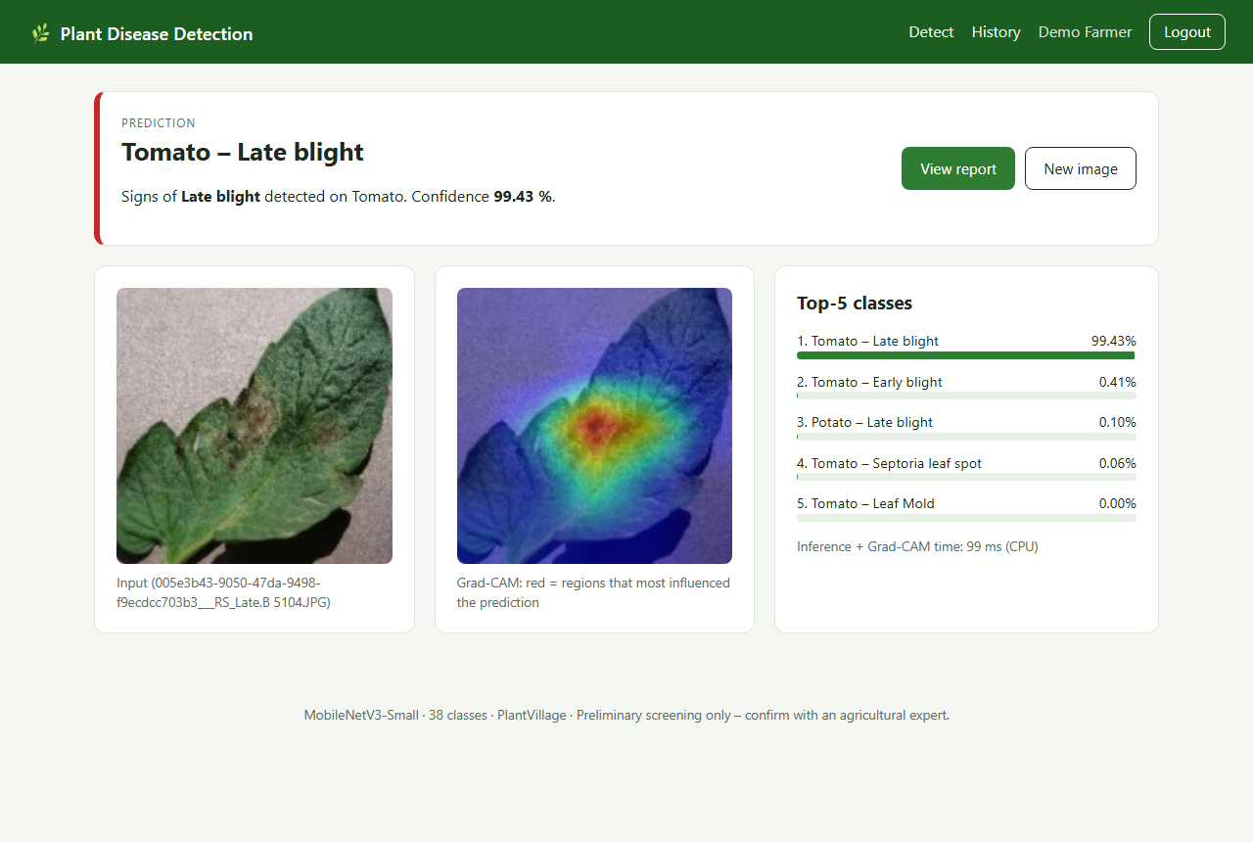
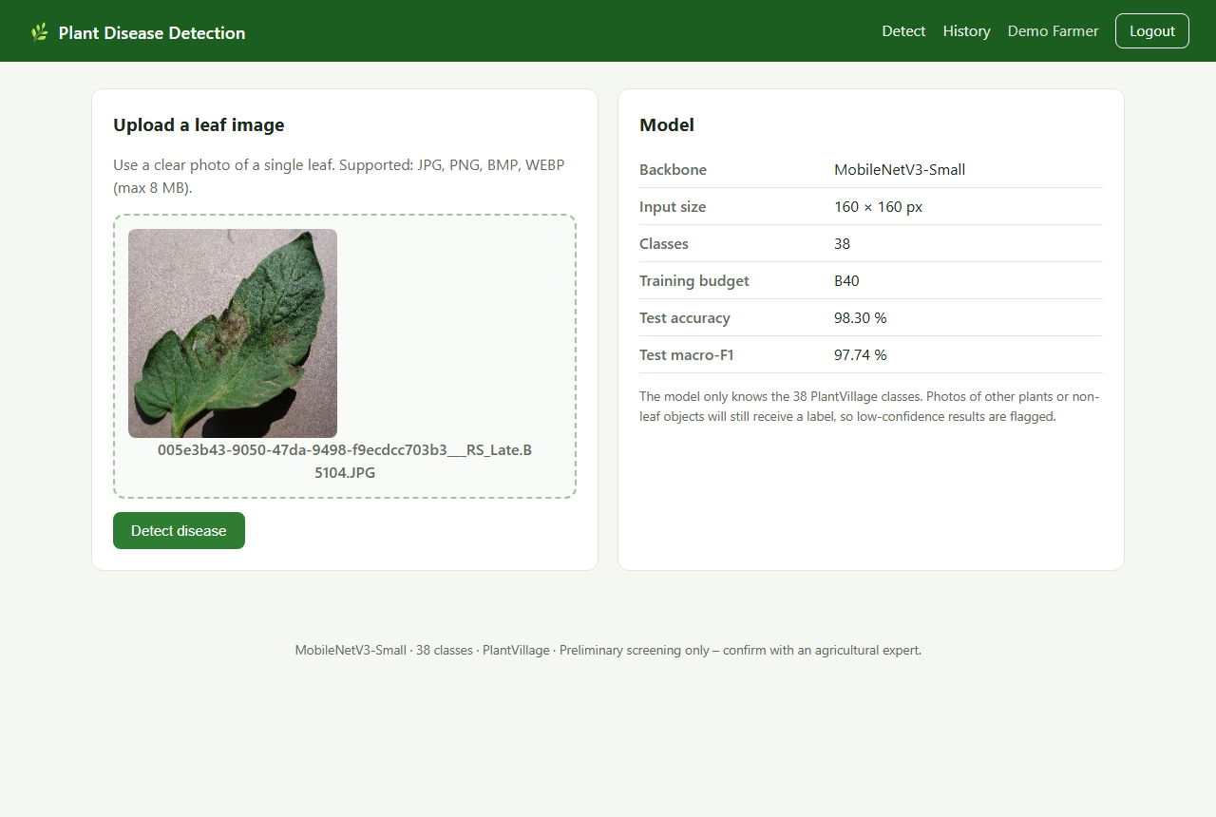
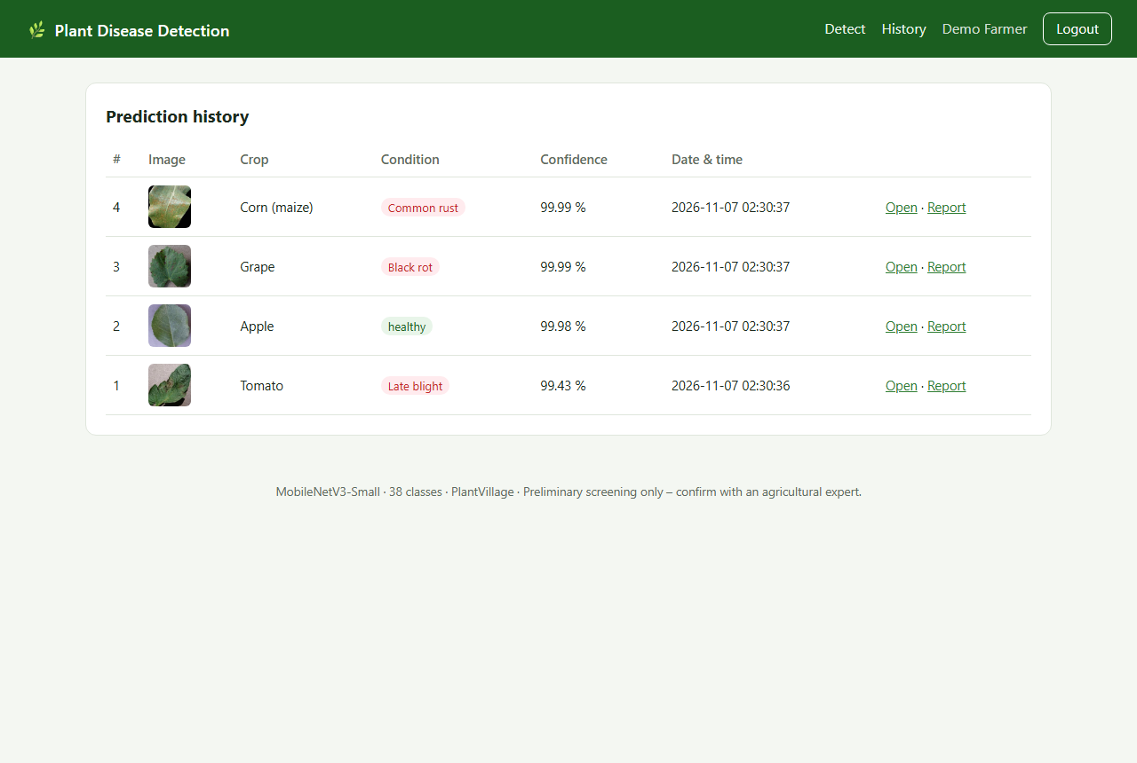
Web application
Upload a leaf image
Prediction with confidence and Grad-CAM
Per-user prediction history
Notes:
Built with Flask, SQLite and PyTorch; run_app.bat installs and starts it on any Windows laptop; code is on GitHub. Demo flow: login, upload a leaf, see disease, confidence and heat map, open the report, check history.

Slide 14

Testing
Test case | Observed result | Status
Login with a wrong password | “Invalid email or password” | Pass
Register an existing email | “Account already exists” | Pass
Upload Tomato Late blight leaf | Correct class, Grad-CAM, report | Pass
Upload healthy Apple leaf | Reported as healthy | Pass
Upload a corrupt .jpg / a .txt file | Clear error message | Pass
Open another user's result | HTTP 404 – access denied | Pass
16 / 16
test cases passed
Unit, integration and functional tests, plus 8 automated pytest cases.
Notes:
All functional and security test cases passed.

Slide 15

Conclusion and future work
Conclusion
Future work
98.30% accuracy using only 40% of the training data
1.56 M-parameter model, 22 ms per image on a CPU
Grad-CAM explanations measured as stable for flip and lighting
Complete, tested web application
Train with rotation augmentation to improve stability
Test on real field photographs
Android app with on-device inference
Regional-language advice for farmers
Thank you • Questions?
Notes:
Summarise the contributions, the limitation (rotation) and the future work. Invite questions.

