Slide 1

House Price Prediction Using Machne learning Algorithm
NAME :SOTON ABU RAYHAN
ID : 2017490105
Supervisor - Jie Li
School of Intelligent Technology and Engineering
Chongqing University of Science and Technology

Slide 2
CONTENTS
Introduction Propose Model Model Benefit Algorithm analysis Implementation Data description Tools and libraries

Slide 3
INTRODUCTION
House Price Prediction is commonly used to estimate the changes in housing price. Since housing price is strongly correlated to other factors such as location, area, population, it requires other information apart from HPI to predict individual housing price.
In the present papers i discuss about the House prices Prediction using machine learning algorithm. For the selection of prediction methods, I compare and explore various prediction methods.

Slide 4
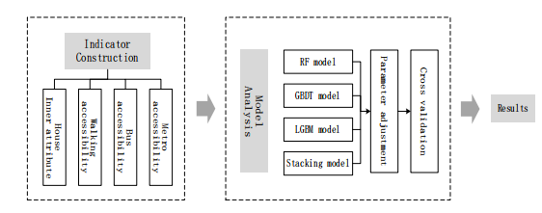
Propose Model

Slide 5
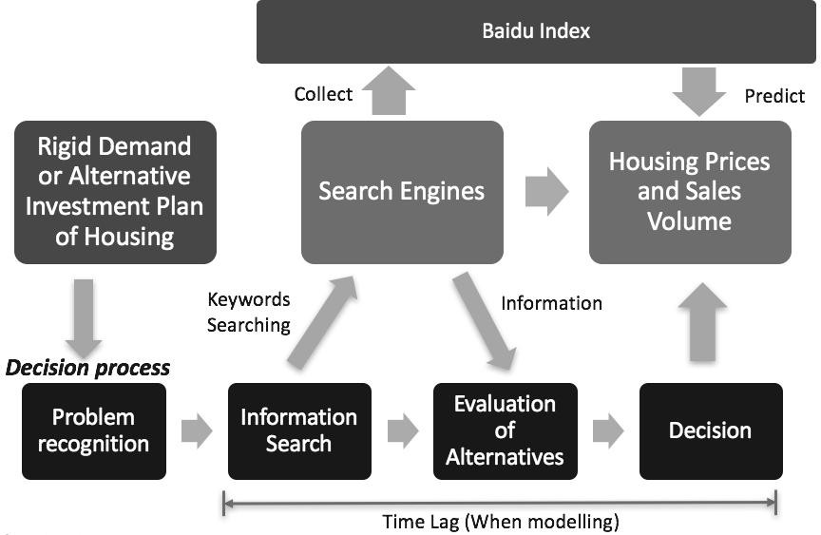
Model of Benefit

Slide 6

Algorithm
1. Linear regression
2. Random forests
3. Extra Trees Regression
4. Diction Tree
5. Gradient Boosting algorithm

Slide 7
analysis
The field of Data Science is rather young, having taken form over the last half century as a discipline distinct from statistics. It is also rapidly growing with many interesting advancements in recent years, most notably within Machine Learning (ML). This has resulted in an increase in media attention as well as funding of AI related businesses and research projects.
In 50 years of Data Science comments on the history of Data Science and questions whether it is really different from statistics. With regards to Machine Learning, he points to a study he conducted that compared a set of highly-cited and glamorous classifier methods such as Random Forests and k-Nearest neighbor to a simple linear classifier applied on the same problem. The study found that the simpler method did not only perform similarly, but had a lower worst-case regret.

Slide 8
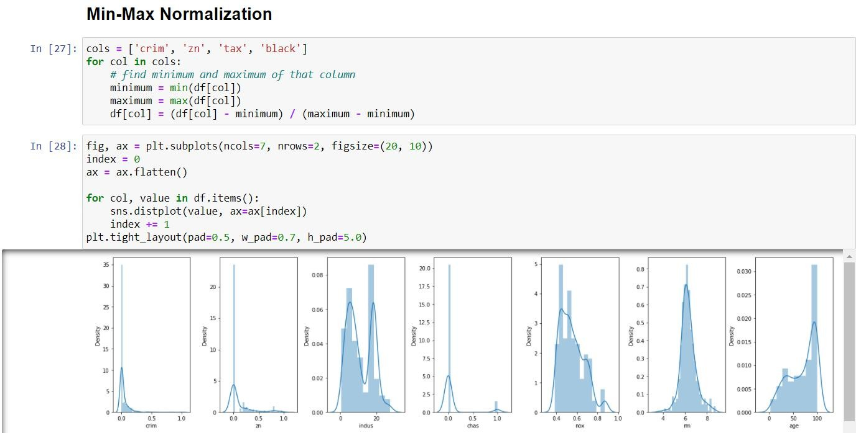
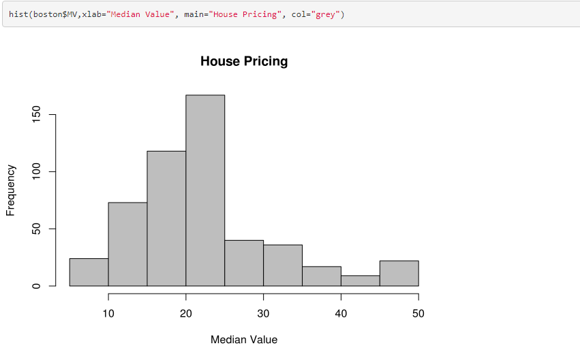
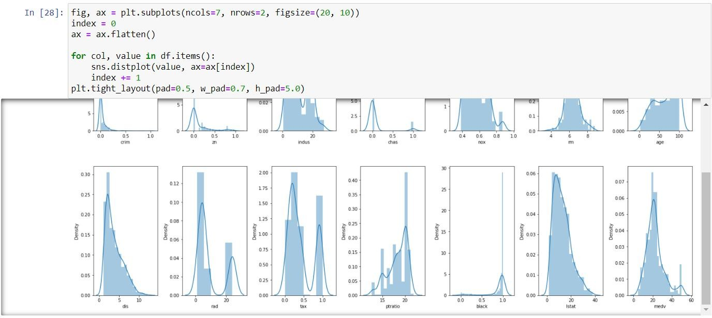
Implementation
.

Slide 9
Data description
The Boston data frame has 506 rows and 14 columns.
Source
Harrison, D. and Rubinfeld, D.L. (1978) Hedonic prices and the demand for clean air. J. Environ. Economics and Management 5, 81–102.
Belsley D.A., Kuh, E. and Welsch, R.E. (1980) Regression Diagnostics. Identifying Influential Data and Sources of Collinearity. New York: Wiley.

Slide 10
TOOLS AND LIBRARIES
Microsoft Office: It's software helps to write documents.
Microsoft Office also has other features like PPT, Doc, Excel, Etc. I use this software to write, plan my graduation project.
Python is very useful in the machine learning field for its flexibility, platform independence, and a wide community.
Libraries: I am going to use several python libraries for my thesis work such as Python, Anaconda.
Programming Language: There are several programming languages such as java, python,Programming C etc. But for my work, I used python for severalreasons.

Slide 11


