Slide 1

MyRewards Premium Cards®
Union Financial
Executive Review • July 2026
Notes:
Title slide. No data.

Slide 2
MyRewards Premium Cards®
Enrollments · Retention · Revenue
Notes:
Section divider (MyRewards Premium Cards®). No data.

Slide 3
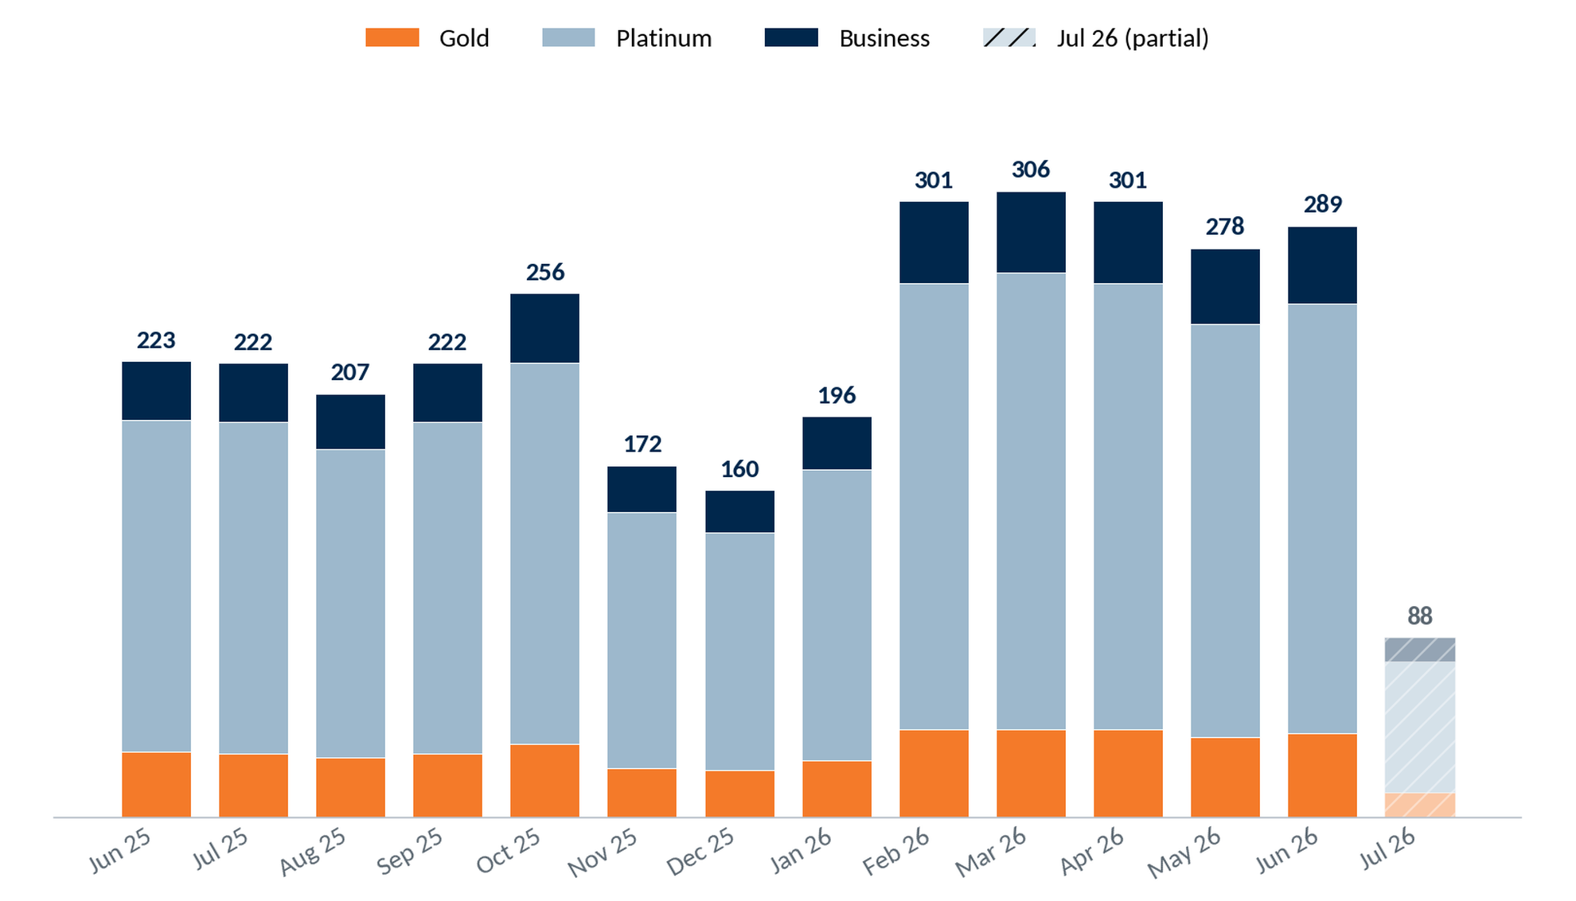
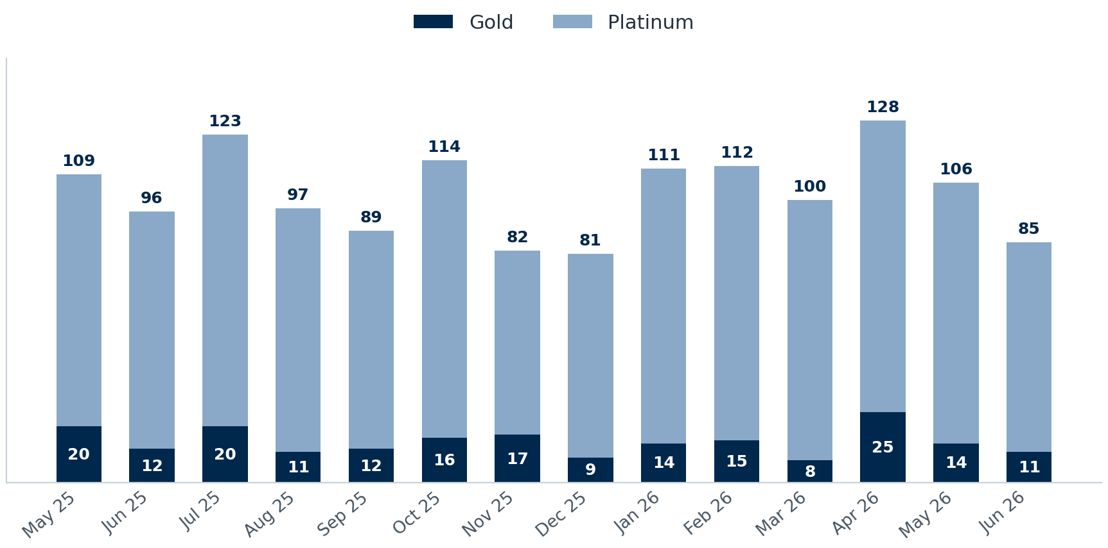
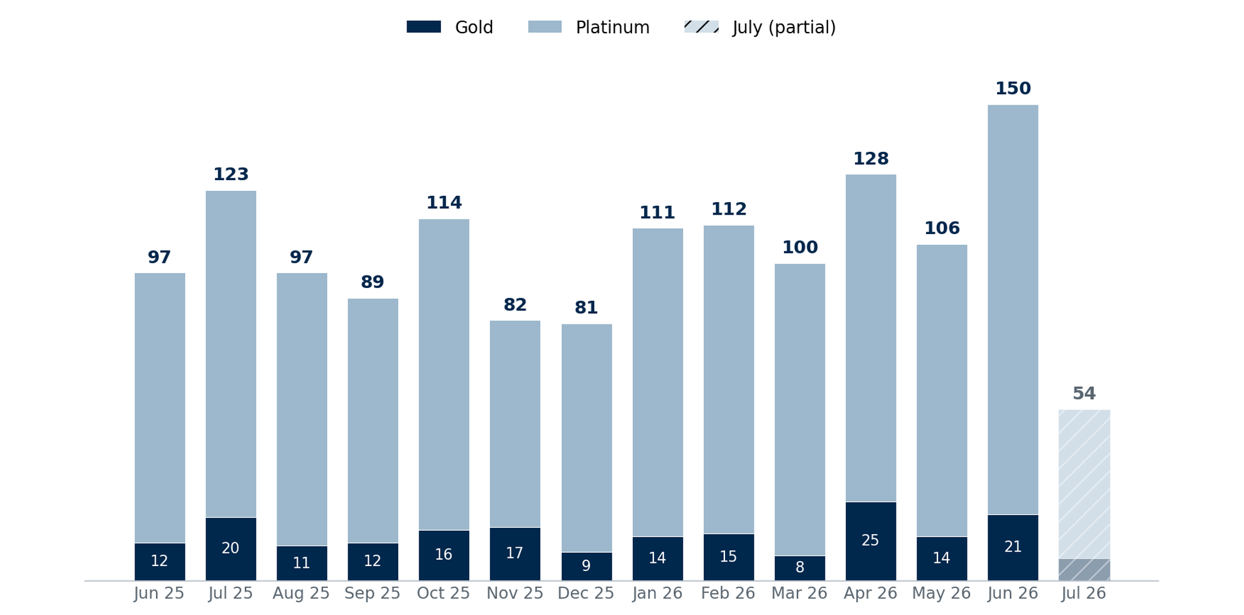
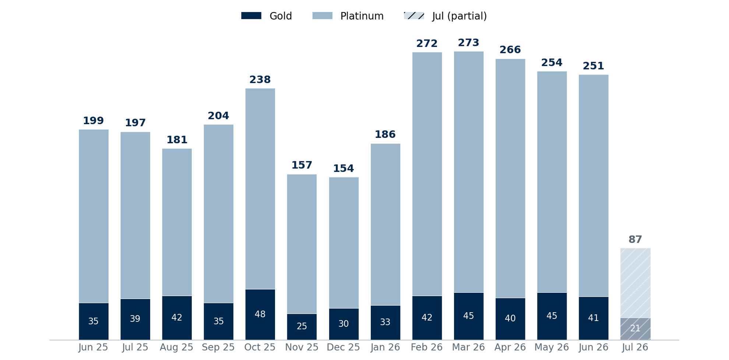
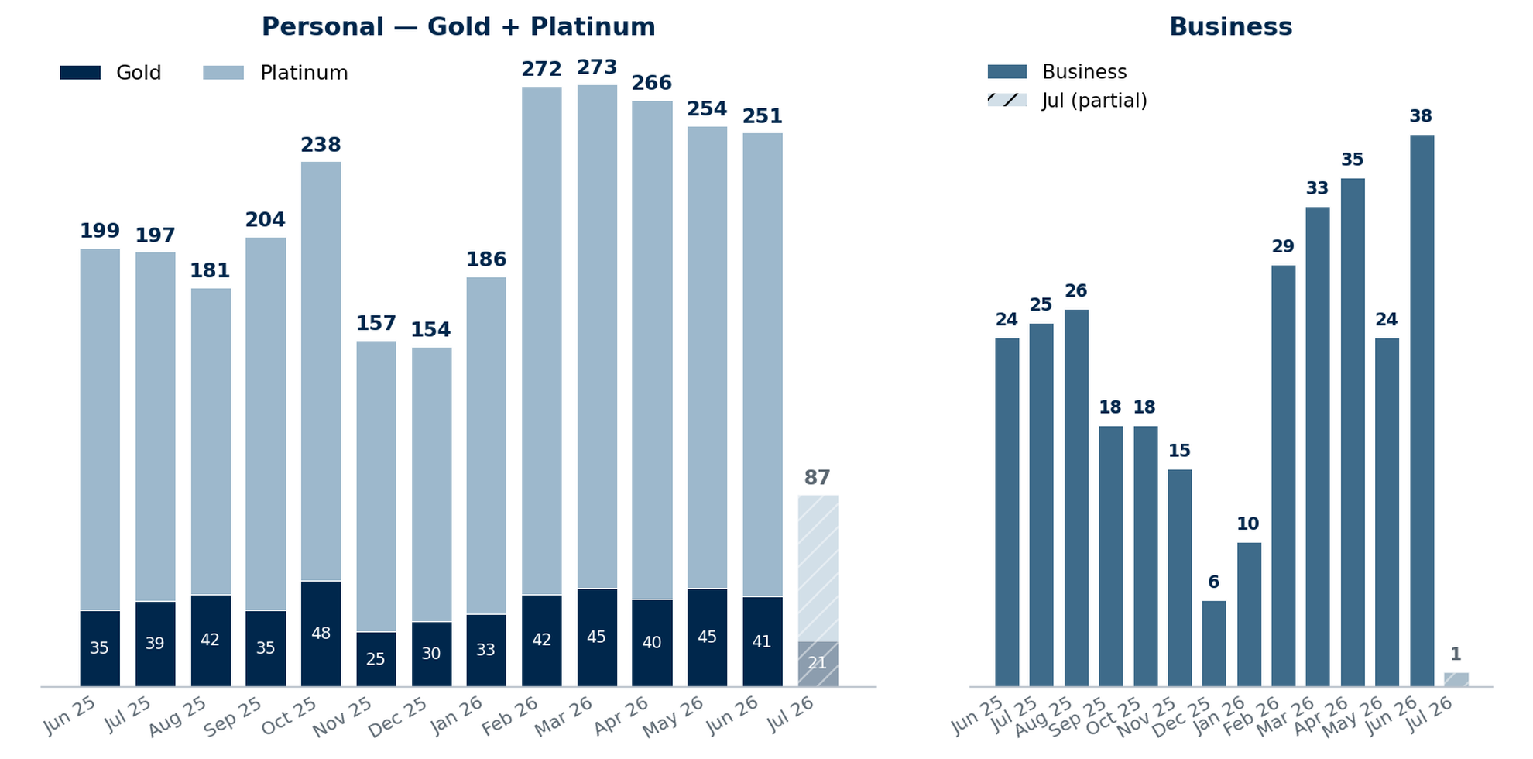
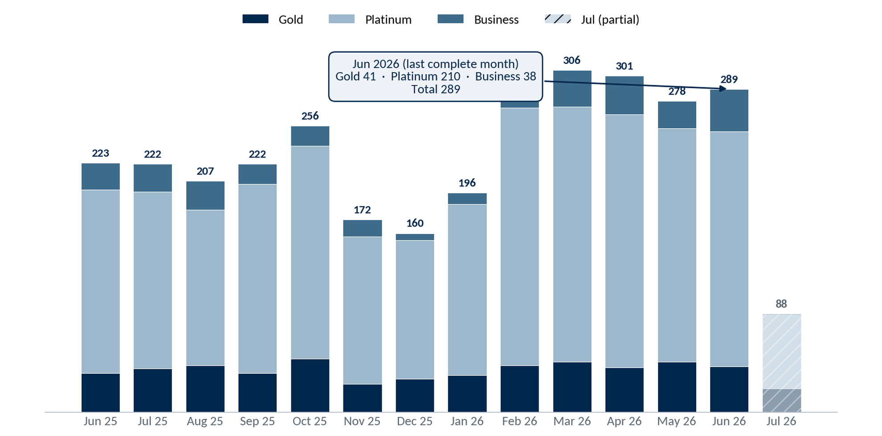
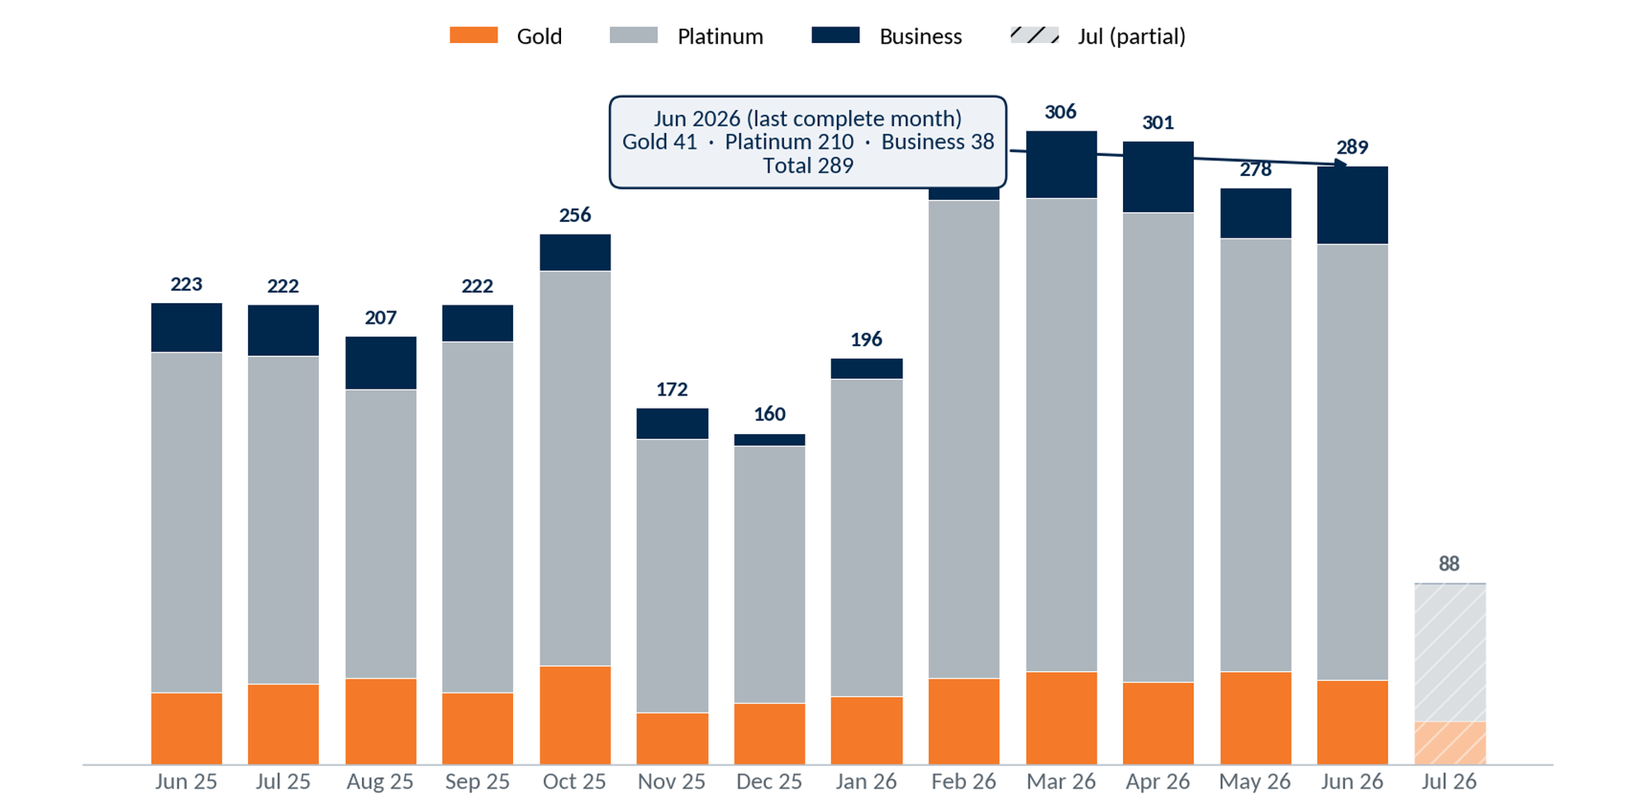
MRPC Enrollments by Month
Gold + Platinum (personal) and Business enrollments by month, last 14 months (Jun 2025 – Jul 2026); July is a partial month.
Gold
41
Jun 2026
Platinum
210
Jun 2026
Business
38
Jun 2026
3
Notes:
Source — VIP MyRewards Premium Cards dashboard (MRPC Enrollments) for Union Financial (1075), pulled 2026-07-10. Single stacked chart: Gold + Platinum + Business; callout shows Jun 2026 (last complete month) totals. Jul 2026 partial. Selection: Gold + Platinum (personal) and Business enrollments by month, last 14 months (Jun 2025 – Jul 2026). VIP, as of July 2026. Callout = Jun 2026, the last complete month; July is partial. Selection: Gold + Platinum (personal) and Business enrollments by month, last 14 months (Jun 2025 – Jul 2026). VIP, as of July 2026. Callout = Jun 2026, the last complete month; July is partial.

Slide 4
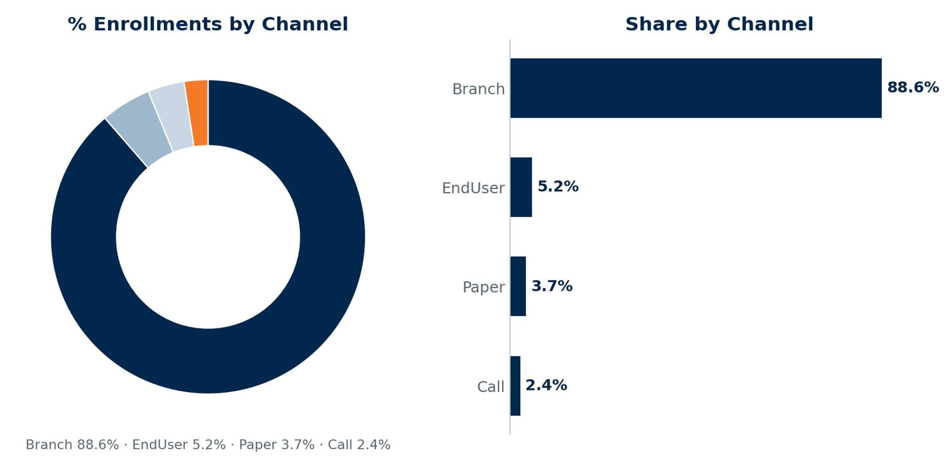
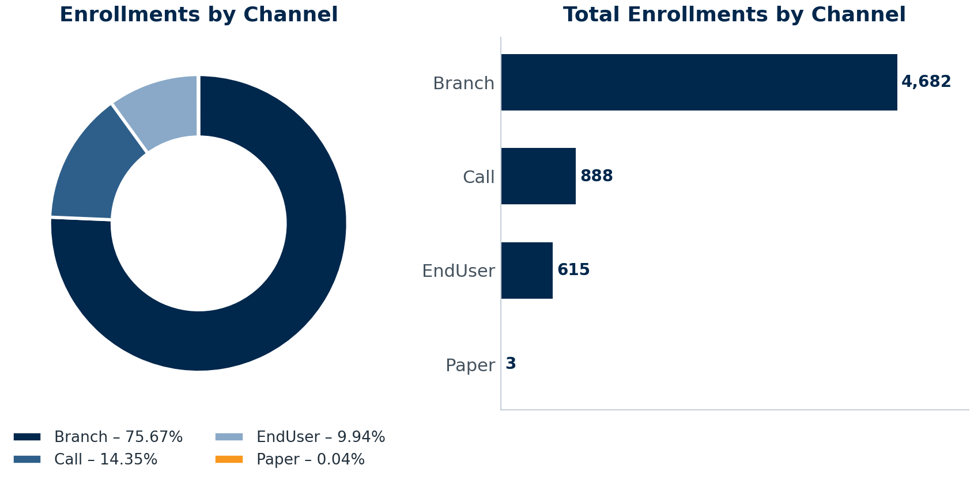
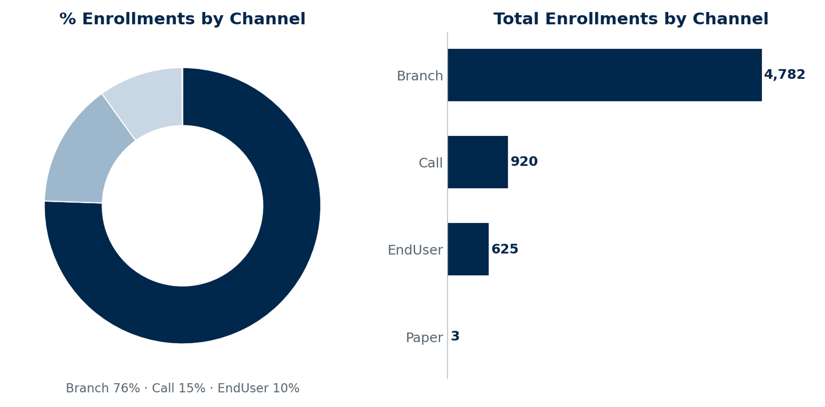
MRPC Enrollments by Channel
4
Notes:
Source — VIP MyRewards Premium Cards dashboards (Enrollments, Performance, Retention, Revenue to FI) for Union Financial (1075), pulled 2026-07-10; MRPCPM Analysis workbook. MRPC Enrollments by Channel (Branch 88.6% / EndUser 5.2% / Paper 3.7% / Call 2.4%). Selection: consumer enrollments by origination channel, program-to-date (VIP, July 2026). The branch network drives 88.6% of MRPC enrollments.

Slide 5
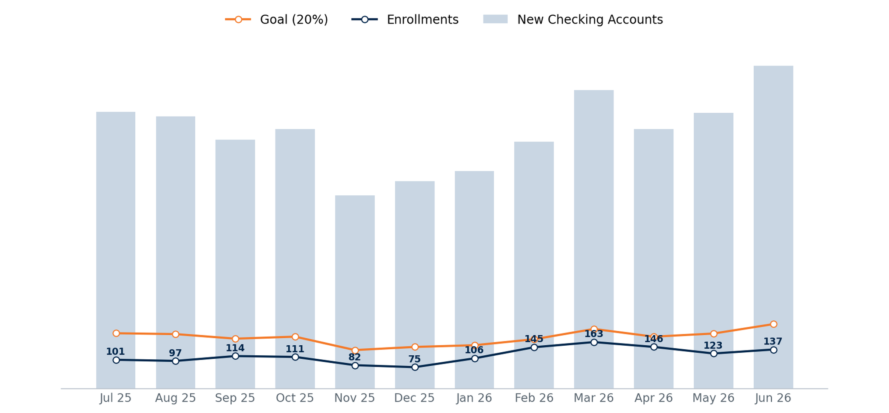
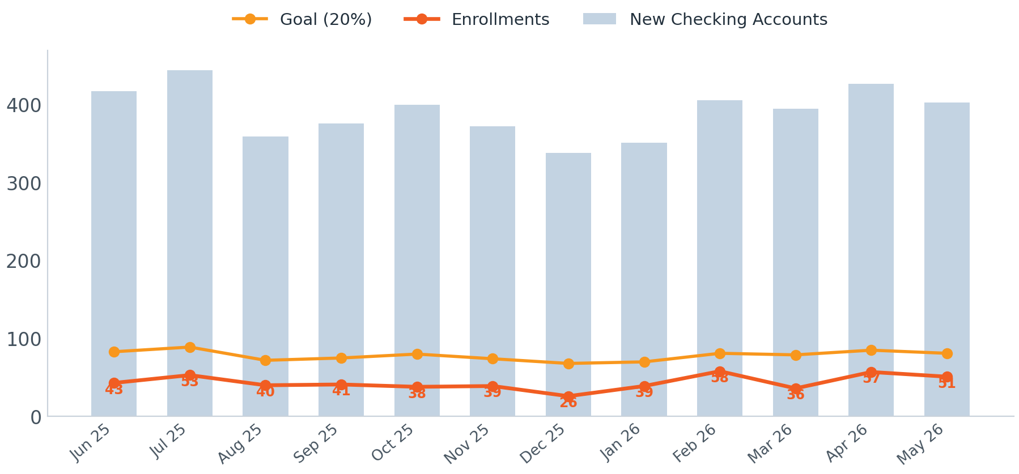
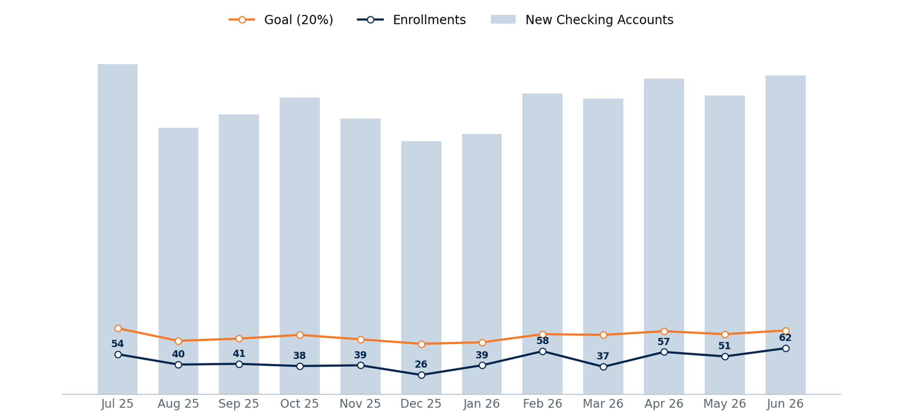
MRPC Enrollment Performance vs. Goal
New checking accounts (bars) vs the 20% enrollment goal and actual enrollments. Enrollment penetration averages ~55% of goal, peaking at 72% in Feb 2026.
5
Notes:
Source — VIP MyRewards Premium Cards dashboards (Enrollments, Performance, Retention, Revenue to FI) for Union Financial (1075), pulled 2026-07-10; MRPCPM Analysis workbook. MRPC Enrollment Performance vs 20% goal, 12 mo. Selection: new checking accounts vs. the 20% MRPC enrollment goal, 13 months (Jul 2025 – Jun 2026). VIP, as of July 2026.

Slide 6
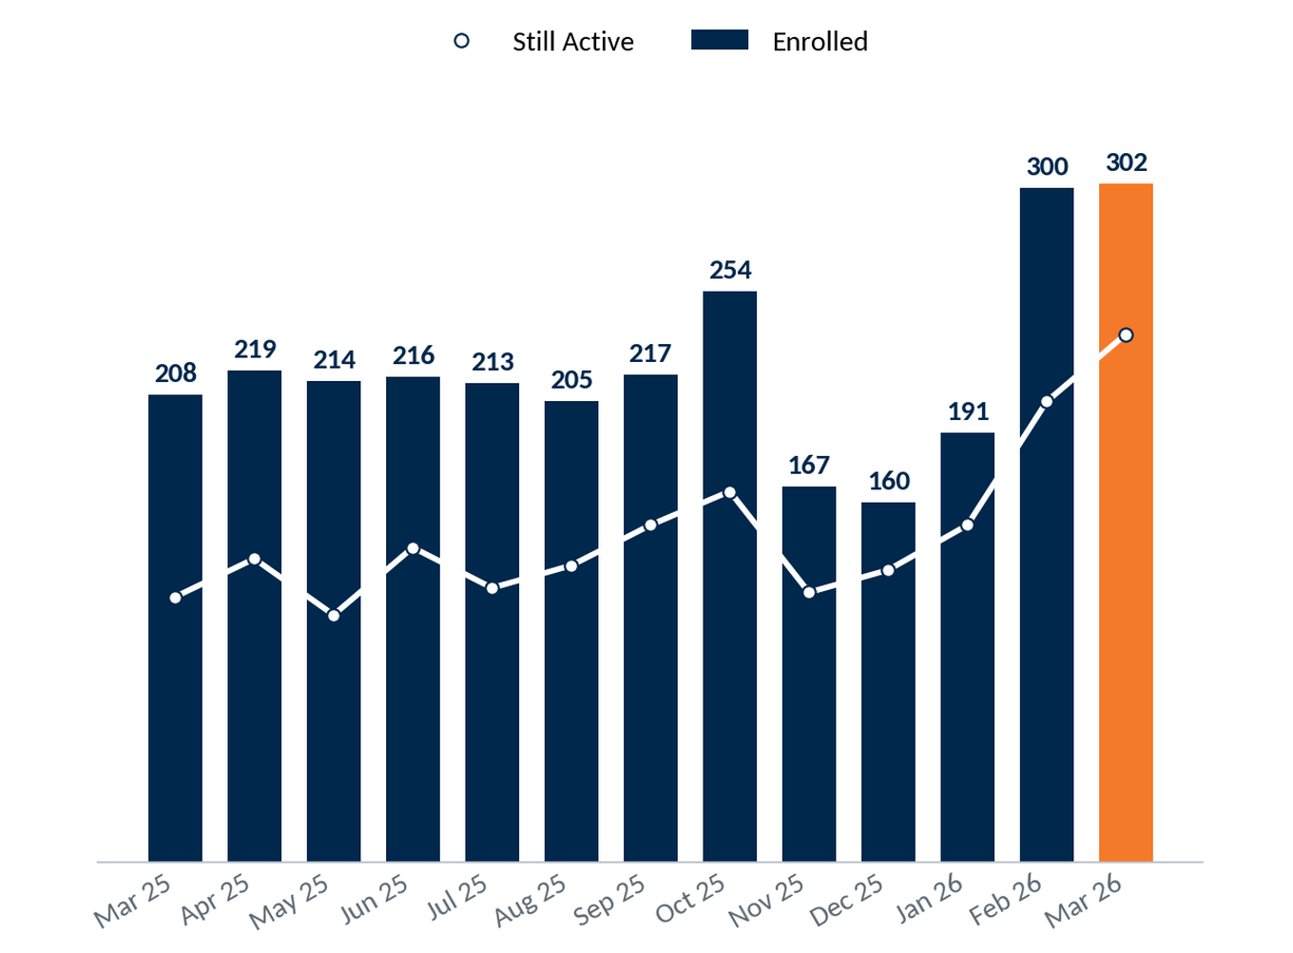
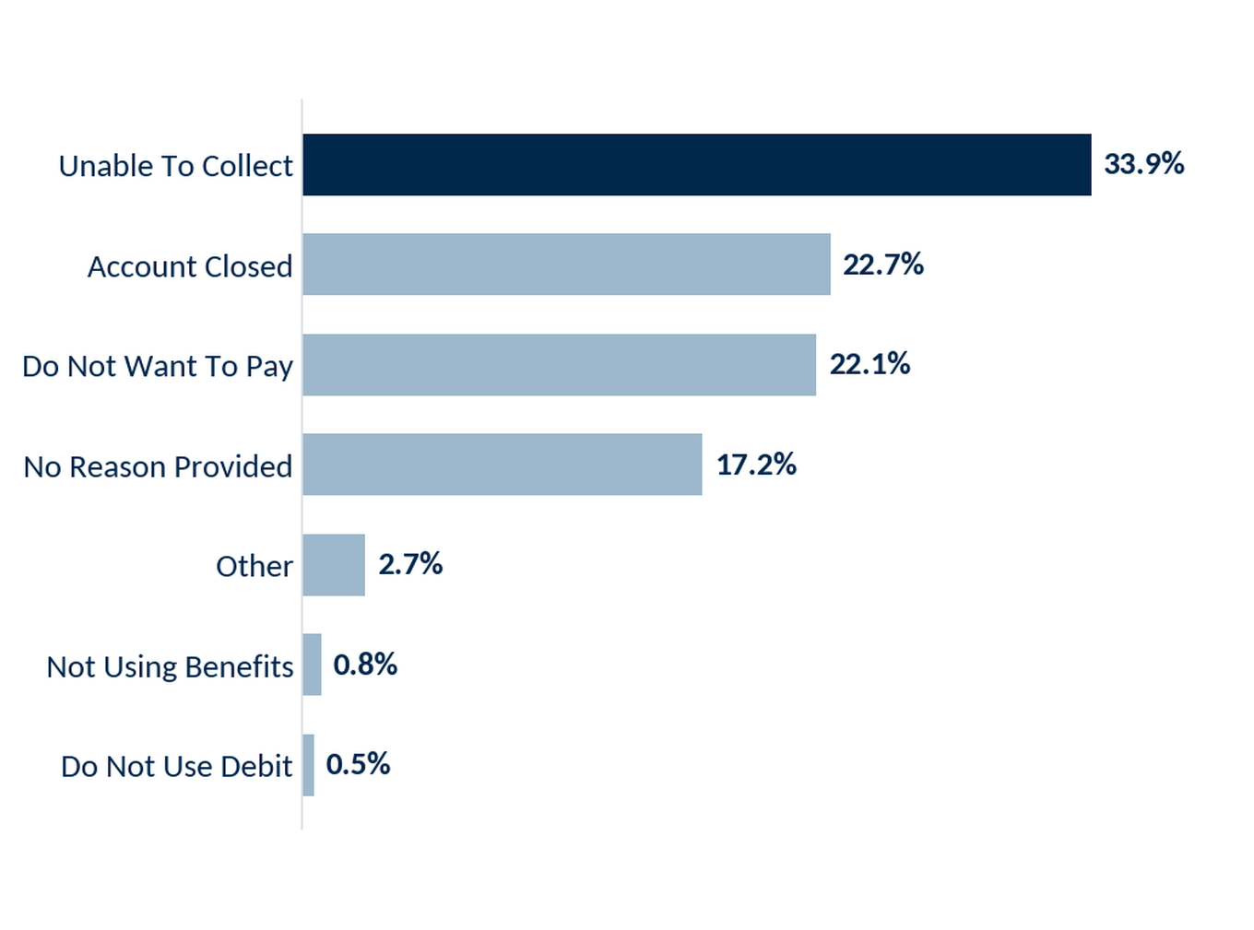
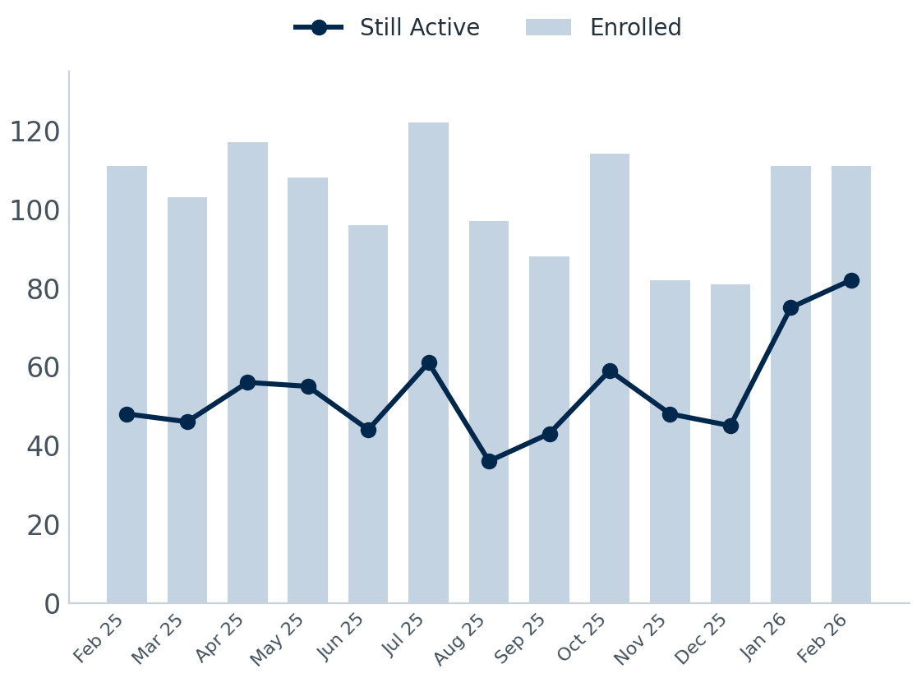
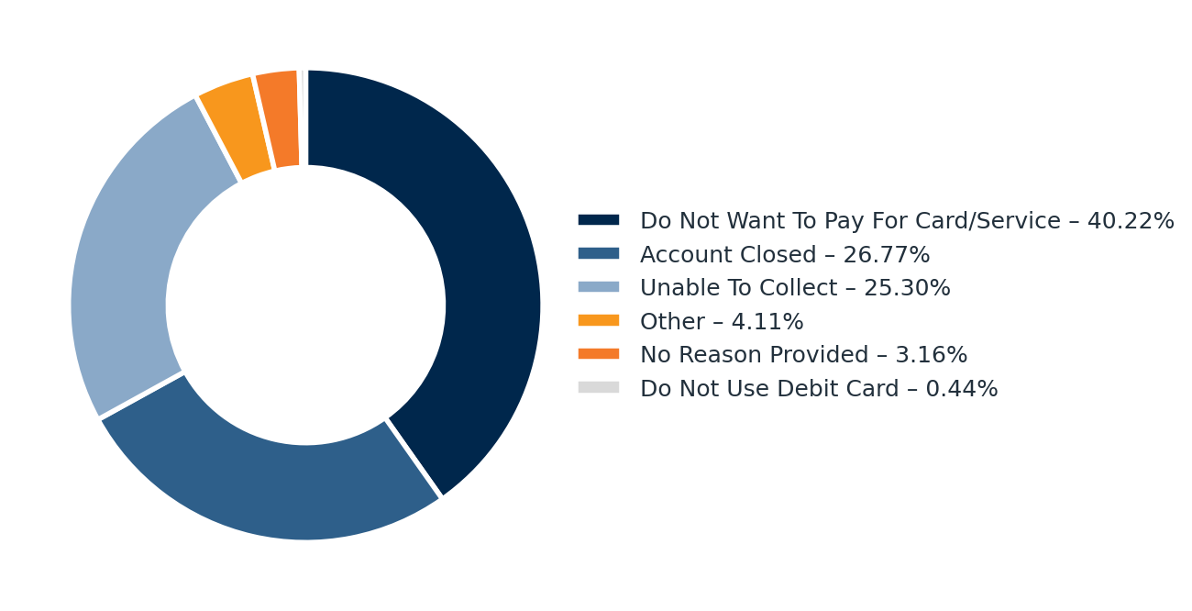
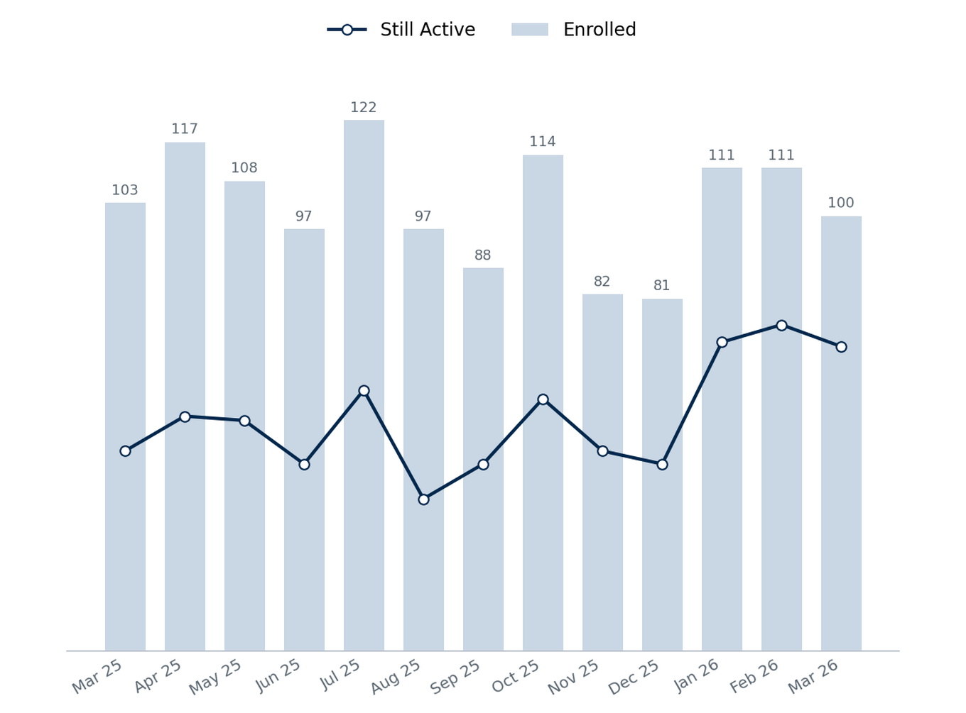
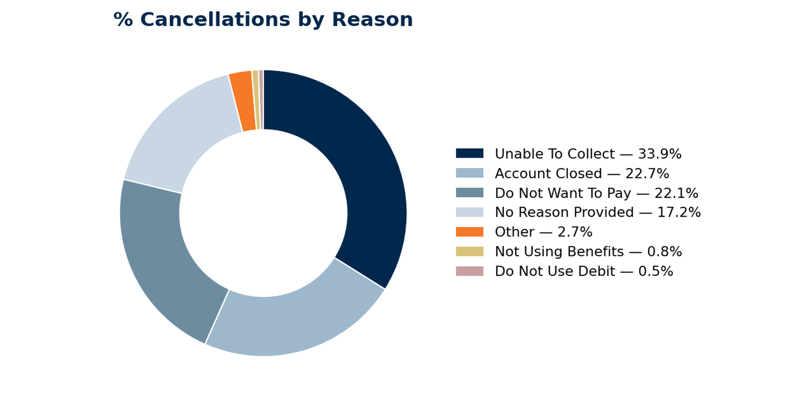
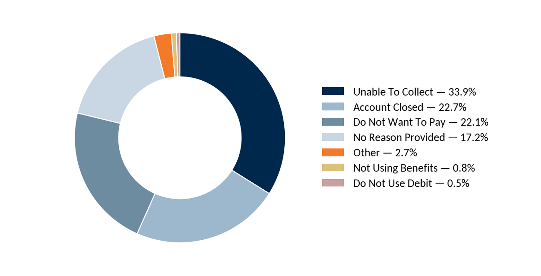
MRPC Retention
Retention by Month Enrolled
Cancellations by Reason
6
Notes:
Source — VIP MyRewards Premium Cards dashboards (Enrollments, Performance, Retention, Revenue to FI) for Union Financial (1075), pulled 2026-07-10; MRPCPM Analysis workbook. MRPC Retention by cohort month + cancellations by reason. Selection: enrolled MRPC members by enrollment-cohort month (Mar 2025 – Mar 2026), with count still active now. VIP, as of July 2026.

Slide 7
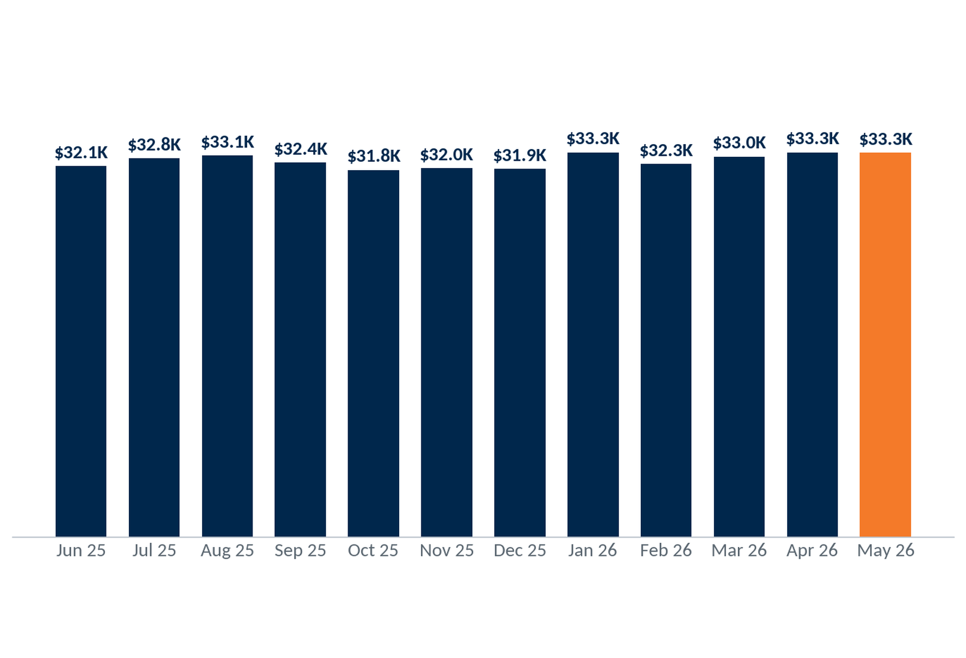
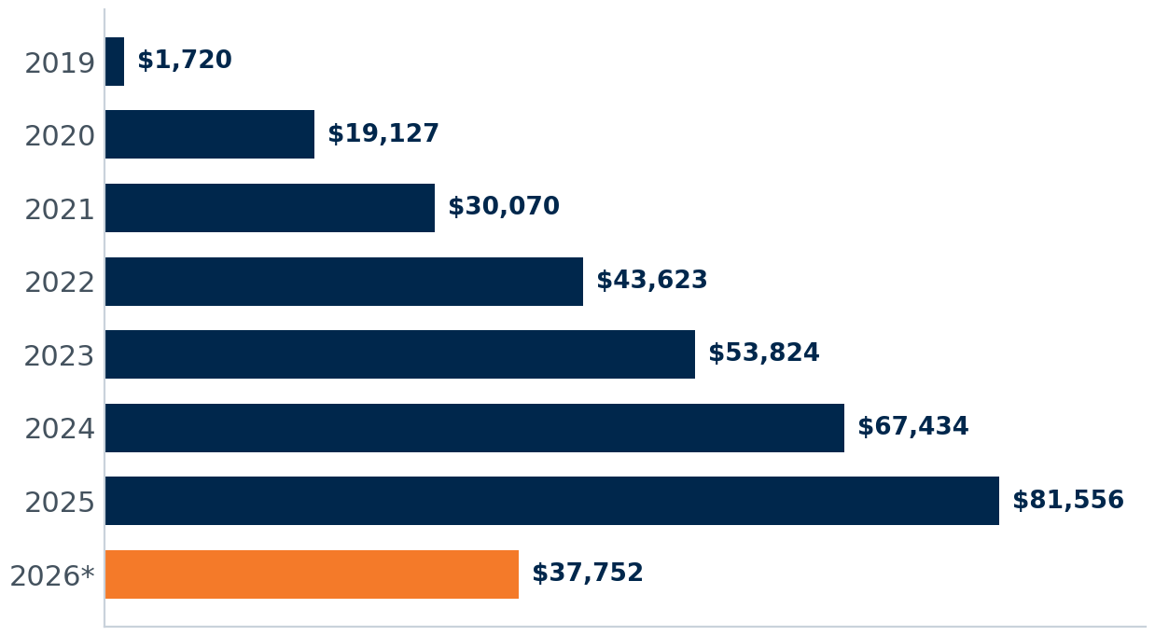
MRPC Revenue by Year to Union Financial
$380,695
2025 Revenue (~$31,700/mo)
$2,385,808
Life-of-Program Revenue
Revenue has grown across the life of the program to $380.7K in 2025 — $2.39M life-of-program. 2026 is at $165.3K through June.
* 2026 is year-to-date through June.
7
Notes:
Source — VIP MyRewards Premium Cards dashboards (Enrollments, Performance, Retention, Revenue to FI) for Union Financial (1075), pulled 2026-07-10; MRPCPM Analysis workbook. MRPC Revenue by year; 2025 $380,695, life-of-program $2,385,808, 2026 YTD $165,270. Pre-2025 annual bars approximate. Selection: MRPC program revenue to Union Financial; annual, with 2026 year-to-date through June.

Slide 8
MRPC Revenue by Month to Union Financial
$380,695
2025 Revenue (~$31,700/mo)
$2,385,808
Life-of-Program Revenue
Revenue has grown across the life of the program to $380.7K in 2025 — $2.39M life-of-program. 2026 is at $165.3K through June.
* 2026 is year-to-date through June.
8

Slide 9
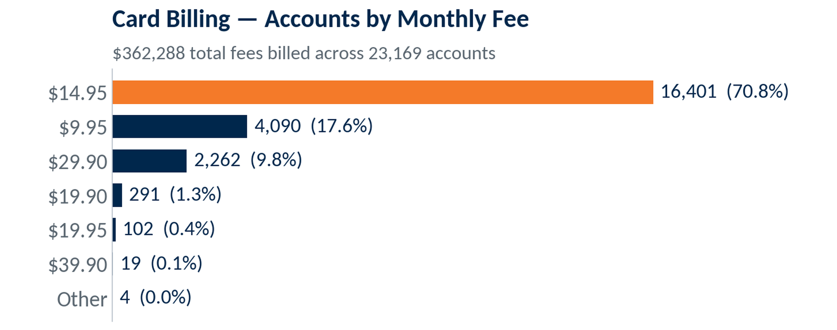
MRPC Card Portfolio
As of July 2026
$31,725
2,910
7,196
Avg Monthly Revenue
Enrollments, Trailing 12 Mo
Active Enrollments
27,800
Total Enrollments Program-to-Date
Program enrollments across all card tiers, life of program.
9

Slide 10
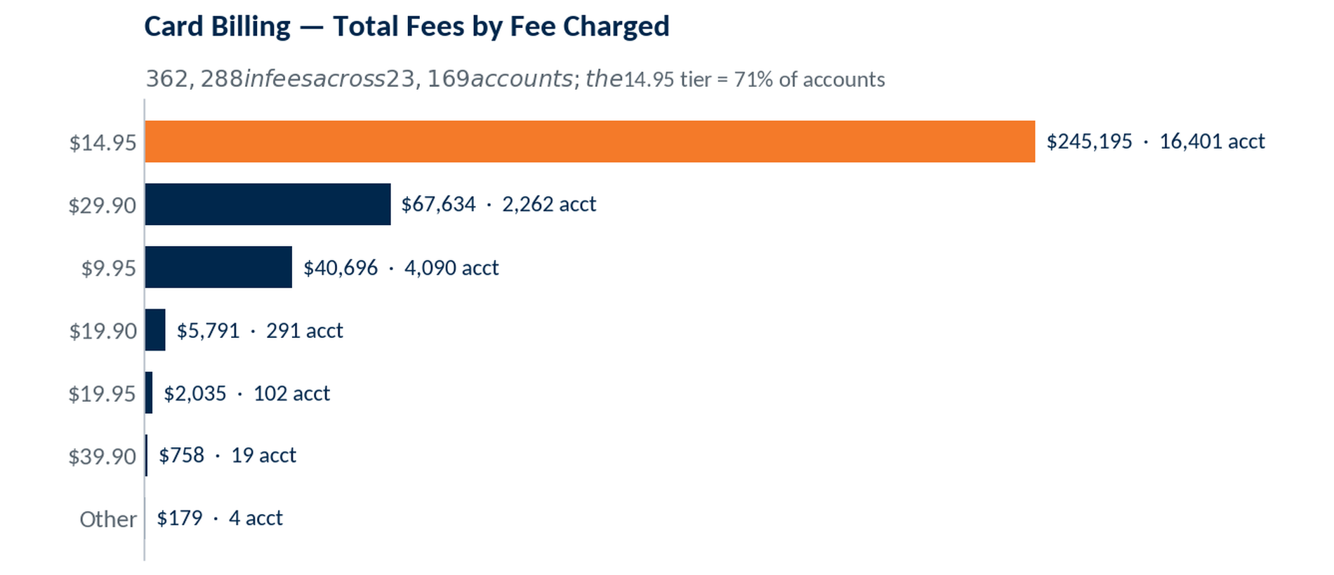
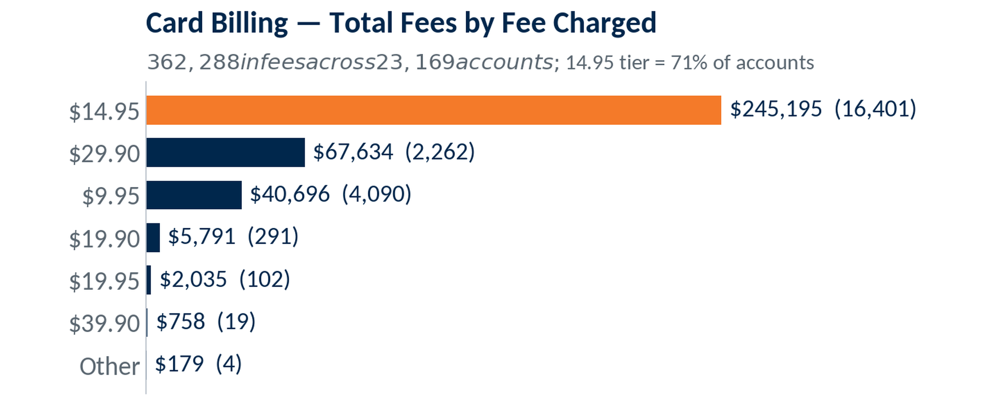
MRPC Key Metrics
As of July 2026
$31,725
2,910
7,196
Avg Monthly Revenue
Enrollments, Trailing 12 Mo
Active Enrollments
Tier Mix (Program to Date)
27,800
Platinum — 16,401 (71%)
Gold — 4,090 (18%)
Business Platinum — 102 (0%)
Multiple Cards — 2,576 (11%)
Total Enrollments Program-to-Date
Program enrollments across all card tiers, life of program.
Cross-sale: 11.1% of accounts hold more than one card.
10
Notes:
Source — VIP MyRewards Premium Cards dashboards (Enrollments, Performance, Retention, Revenue to FI) for Union Financial (1075), pulled 2026-07-10; MRPCPM Analysis workbook. MRPC Key Metrics: avg monthly revenue $31,725; trailing-12 2,910; active 7,196; tier mix (trailing) Gold 521/Platinum 2,398; PTD ~27,800 (VERIFY). Selection: consumer-only program (no business tier); measurement window noted per metric. Card billing (Total Fees by Fee Charged) from VIP MyRewards dashboard, Union Financial (1075), pulled 2026-07-10: $362,287.55 total fees across 23,169 accounts; $14.95 tier = 16,401 acct / $245,194.95.

Slide 11
Questions & Discussion
Union Financial • July 2026
Notes:
Discussion slide. No data.

Slide 12
Contact Us
Aaron Burgard
Client Service Manager
910-617-1984
aaron.burgard@csiweb.com

