Slide 1

Account Revenue Solution®
Invitation Checking® System
MyRewards Premium Cards®
Union Financial
Executive Review • July 2026
Notes:
Source: program metadata. Reporting month = generation month (Jul 2026).

Slide 2



Boston, MA August 31-September 1, 2026
About the Summit
Community financial institutions are competing for consumer relationships in a market where growth is harder to win and easier to lose. Success depends on connected strategies and practical solutions that turn everyday account activity into long-term value.
The Executive Summit brings banking and credit union leaders together to explore real-world strategies for acquisition, debit activation, deposits, overdraft strategy, cash-flow solutions, and relationship growth. See how peers are using technology, data, and solutions from Velocity Solutions, now part of CSI, to drive measurable results.
Session Topics Include
Your Hosted Experience Includes
Early engagement, referrals, and account acquisition
Onboarding and account activation
Debit engagement and primary relationship growth
Deposit growth and consumer engagement
Behavioral data and overdraft strategy
Cash-flow solutions for today's consumers
Peer discussions around shared challenges and growth opportunities
Welcome Reception at Fenway Park while enjoying a Boston Red Sox game
Hotel accommodations at Hotel Commonwealth
Executive Summit sessions and peer discussions
Breakfast, lunch, and refreshments
Airfare reimbursement up to $600 for qualified attendees
This summit is complimentary to qualified attendees, including airfare reimbursement up to $600, hotel accommodations, and meals.
©2026 CSI. All Rights Reserved
Notes:
Source: standard ARS Executive Review front matter (static).

Slide 3
Agenda
1
Account Revenue Solution®
Program performance, mailing insights, debit card & Reg E review
2
Invitation Checking® System
Referral trend, account value, ROI & financial results
3
MyRewards Premium Cards®
Enrollments, channel mix, retention & revenue
4
Questions & Discussion
3
Notes:
Source: standard ARS Executive Review front matter (static).

Slide 4
Account Revenue Solution®
Mailings · Debit Card · Reg E
Notes:
Source: ODD extract 999 Union Financial (demo data; Jul23-forward), Jun 2026 snapshot — responder / new-account analytics; associational, not causal where noted.

Slide 5
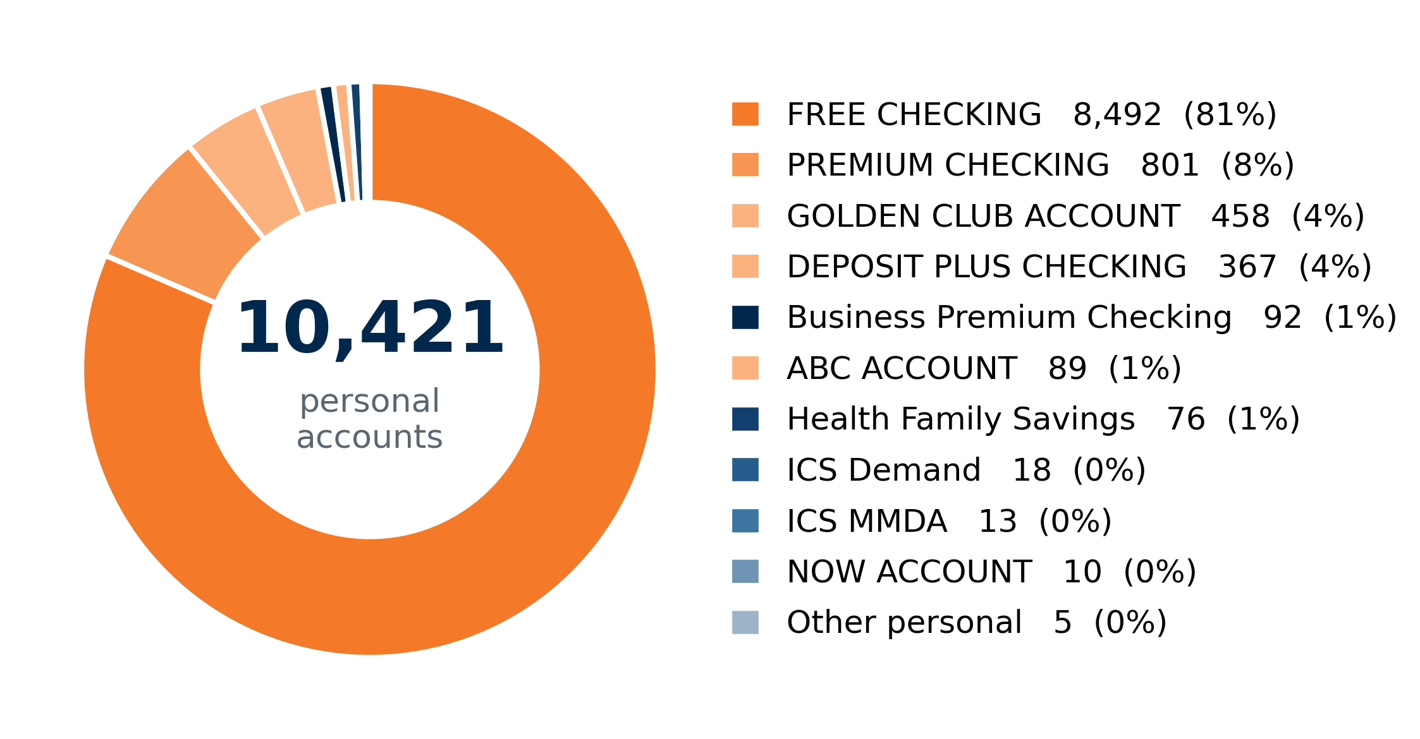

Product Mix & ARS Eligibility
June 2026 Data
Open deposit accounts by product. ARS eligibility reflects the current program eligibility flag.
12,391
8,920
72%
5
Open accounts
ARS-eligible accounts
Eligible share of open
Eligible products (of 27)
Products & ARS Eligibility
Product | Open | ARS-Elig.
FREE CHECKING | 8,492 | 7,291
PREMIUM CHECKING | 801 | 772
GOLDEN CLUB ACCOUNT | 458 | 427
DEPOSIT PLUS CHECKING | 367 | 345
ABC ACCOUNT | 89 | 85
All other products (22) | 2,184 | —
Total — open accounts | 12,391 | 8,920
5
Notes:
Source: ODD extract 999 Union Financial (demo data; Jul23-forward), Jun 2026 snapshot — open personal/business accounts by product; ARS eligibility = latest 'Jun26 Elig' = Yes.

Slide 6
Program Overview
PTD · June 2026
Union Financial has run Account Revenue Solution® for 226 months across 81 mailings since 2007.
8,920
71.0%
36.3%
18.8%
81
Eligible ARS Accounts
Debit Card Take Rate
Reg E Opt-In (Personal)
Avg Mailing Response
Mailings to Date
• Account Revenue Solution® has returned $5.69M in incremental profit program-to-date — a 5.7 : 1 profitability ratio.
• Card-holding accounts have grown over the last 36 months — 6,805 → 7,101 (+4.3%).
• Responders show durable behavior change: every recent mailing produced a positive monthly debit-spend increase per responder.
6
Notes:
Source: ARS Workbook 999 (999-2026.07-Union Financial-Workbook_DEMO.xlsx) — Executive Financials / All Months Rollup (PTD incremental revenue/profit, profitability, monthly incremental revenue). Data thru Jun 2026.

Slide 7
ARS Financial Performance
PTD · June 2026
$6.89M
$5.69M
5.7 : 1
PTD Incremental Revenue
PTD Incremental Profit
PTD Profitability
$57,270
$51,569
Revenue This Month
Profit This Month
• Account Revenue Solution® has generated $6.89M in incremental revenue and $5.69M in incremental profit program-to-date.
• Profitability of 5.7 : 1 is well above the 2 : 1 threshold — there is no deferred billing on this program.
• The program has run 226 months across 81 mailings, with $57,270 in incremental revenue this month.
7
Notes:
Source: ARS Workbook 999 (999-2026.07-Union Financial-Workbook_DEMO.xlsx) — Executive Financials / All Months Rollup (PTD incremental revenue/profit, profitability, monthly incremental revenue). Data thru Jun 2026.

Slide 8
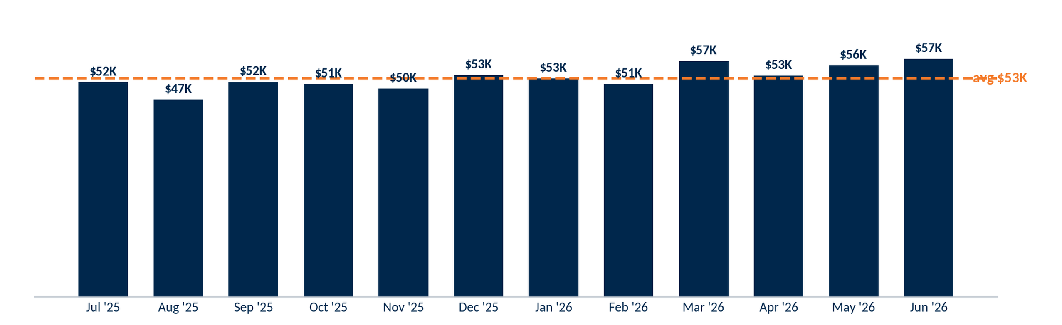
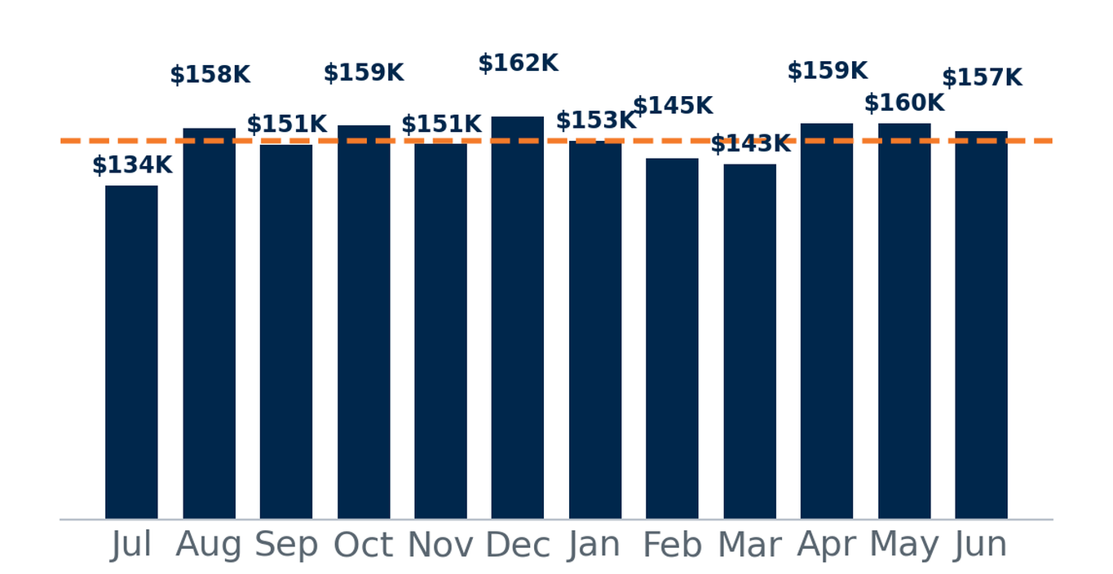
Monthly Summary — Last 12 Months
07-2025 · 06-2026
Selection: monthly incremental revenue, most recent 12 months (SM revenue model).
Monthly incremental revenue averaged $53K over the last 12 months, totaling $632K in program contribution.
8
Notes:
Source: ARS Workbook 999 (999-2026.07-Union Financial-Workbook_DEMO.xlsx) — All Months Rollup / Executive Financials (monthly incremental revenue, most recent 12 months).

Slide 9
Debit Usage Segmentation by Swipe Tier
Avg
Selection: ARS-eligible personal accounts. Monthly figures are 3-month averages (Apr – Jun 2026), the most recent transaction data available.
Segment | Accounts | % of Accts | Swipes | % of Swipes | Spend | % of Spend | MTD NSFs | % of NSFs
No Debit Card | 2,586 | 29% | 123 | 0% | $10K | 0% | 207 | 11%
Non-User | 1,445 | 16% | 138 | 0% | $17K | 0% | 63 | 3%
1-5 | 866 | 10% | 2,162 | 1% | $190K | 3% | 124 | 6%
6-10 | 491 | 6% | 3,905 | 2% | $258K | 3% | 93 | 5%
11-15 | 382 | 4% | 4,943 | 3% | $274K | 4% | 83 | 4%
16-20 | 298 | 3% | 5,367 | 3% | $310K | 4% | 88 | 4%
21-25 | 284 | 3% | 6,537 | 4% | $354K | 5% | 147 | 7%
26+ | 2,568 | 29% | 136,444 | 85% | $6,025K | 81% | 1,155 | 59%
Total | 8,920 | 100% | 159,618 | 100% | $7,438K | 100% | 1,961 | 100%
9
Notes:
Source: ODD extract 999 Union Financial (demo data; Jul23-forward), Jun 2026 snapshot — debit swipes/spend by tier.

Slide 10
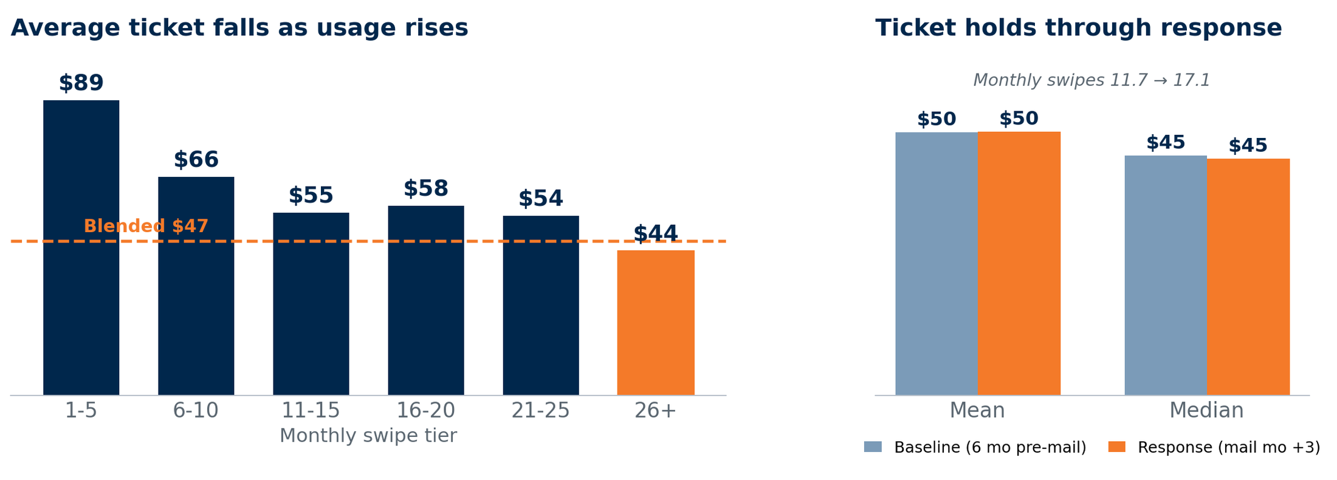
Average Ticket by Swipe Segment
Selection: ARS-eligible personal accounts with debit activity. Left: average spend per swipe by monthly-swipe tier (3-mo avg, Apr–Jun 2026). Right: mailing responders, ticket before vs. after response.
Spend per swipe declines as usage rises — light users (1-5/mo) average $89 per swipe versus $44 for heavy users (26+/mo), around the $47 blend. For responders, ticket holds through response (mean $50→$50, median $45→$45) while monthly swipes rise 11.7→17.1: the gain is more transactions, not larger ones.
10
Notes:
Source: ODD extract 999 Union Financial (demo data; Jul23-forward), Jun 2026 snapshot — debit swipes/spend by tier.

Slide 11
Mailing Insights
ARS Direct Mail Performance
Notes:
Source: ARS Workbook 999 (999-2026.07-Union Financial-Workbook_DEMO.xlsx) — Mail Response Summary + ODD extract 999 Union Financial (demo data; Jul23-forward), Jun 2026 snapshot mailing/response fields.

Slide 12
Mailing Response Summary
Most recent 12 of the program's 81 mailings (MM revenue model).
Mailing | NU 5+ | Threshold Met | Response %
Apr 2026 | 3.0% | 12.1% | 15.1%
Feb 2026 | 3.7% | 21.0% | 24.7%
Dec 2025 | 3.3% | 14.7% | 18.0%
Oct 2025 | 3.7% | 11.3% | 15.0%
Aug 2025 | 3.3% | 16.6% | 19.9%
Jun 2025 | 3.7% | 15.5% | 19.2%
Apr 2025 | 3.7% | 17.0% | 20.7%
Feb 2025 | 2.7% | 18.7% | 21.4%
Dec 2024 | 3.2% | 14.5% | 17.7%
Oct 2024 | 3.0% | 13.2% | 16.3%
Aug 2024 | 2.1% | 15.0% | 17.1%
Jun 2024 | 3.7% | 17.3% | 21.0%
Trailing 12-Mailing Avg | 3.3% | 15.6% | 18.8%
12
Notes:
Source: ARS Workbook 999 (999-2026.07-Union Financial-Workbook_DEMO.xlsx) — Mail Response Summary + ODD extract 999 Union Financial (demo data; Jul23-forward), Jun 2026 snapshot mailing/response fields.

Slide 13
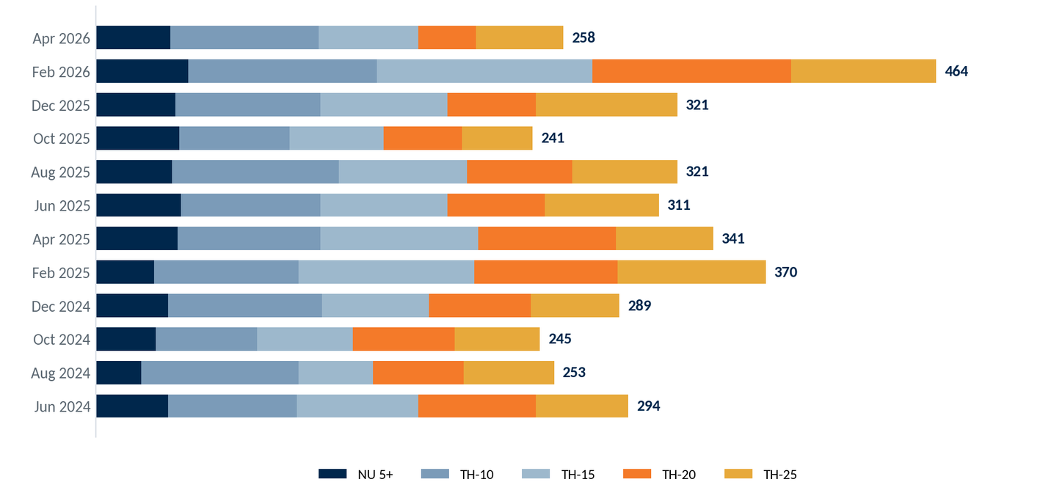
Mailing Response Ranking by Tier
Responders by tier (NU 5+ and Threshold goal met), shown chronologically — most recent mailing at top.
13
Notes:
Source: ARS Workbook 999 (999-2026.07-Union Financial-Workbook_DEMO.xlsx) — Mail Response Summary + ODD extract 999 Union Financial (demo data; Jul23-forward), Jun 2026 snapshot mailing/response fields.

Slide 14
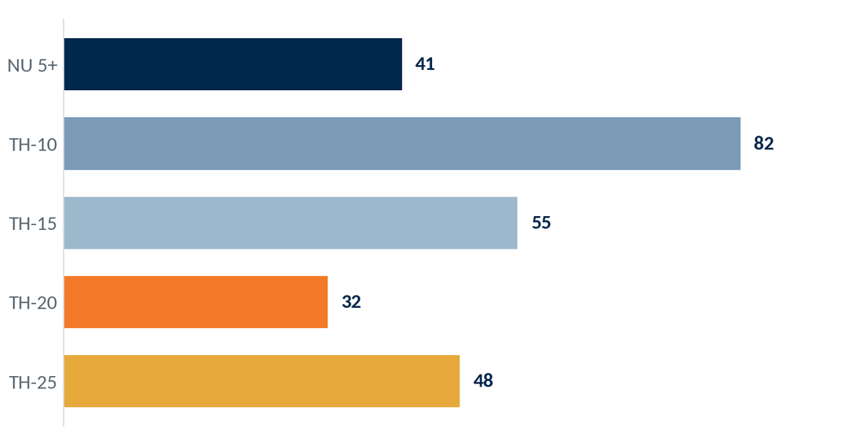
ARS Response — Apr 2026 Mailer
PTD · June 2026
Selection: the 3,154 accounts mailed in the Apr 2026 drop.
Responders by tier
3,154
Accounts Mailed
258
Responders
8.2%
Response Rate
The Apr 2026 mailing drew 258 responders (8.2% of those mailed), led by the higher threshold tiers.
14
Notes:
Source: ARS Workbook 999 (999-2026.07-Union Financial-Workbook_DEMO.xlsx) — Mail Response Summary + ODD extract 999 Union Financial (demo data; Jul23-forward), Jun 2026 snapshot mailing/response fields.

Slide 15
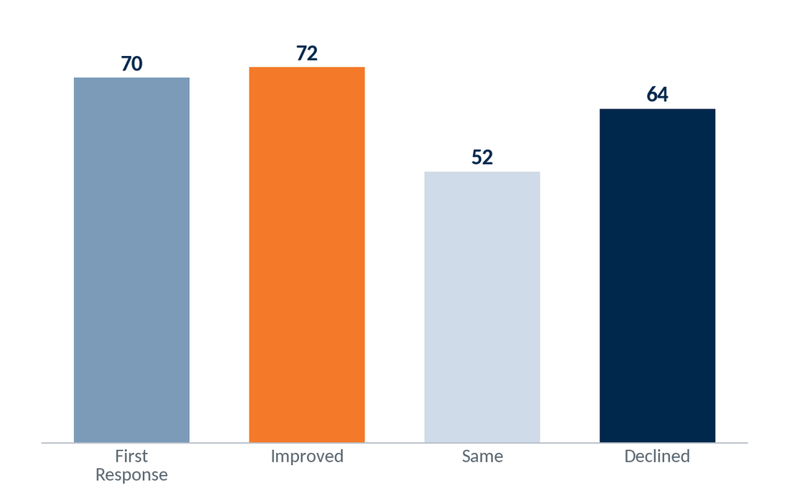
ARS Response — Apr 2026 Movement
PTD · June 2026
Selection: the 258 responders to the Apr 2026 mailing, compared with their prior mailing (first-time, improved, held steady, or declined).
70 were first-time responders (no prior response) and 72 improved their tier — together 55% of the 258 responders moved up or in for the first time.
15
Notes:
Source: ARS Workbook 999 (999-2026.07-Union Financial-Workbook_DEMO.xlsx) — Mail Response Summary + ODD extract 999 Union Financial (demo data; Jul23-forward), Jun 2026 snapshot mailing/response fields.

Slide 16
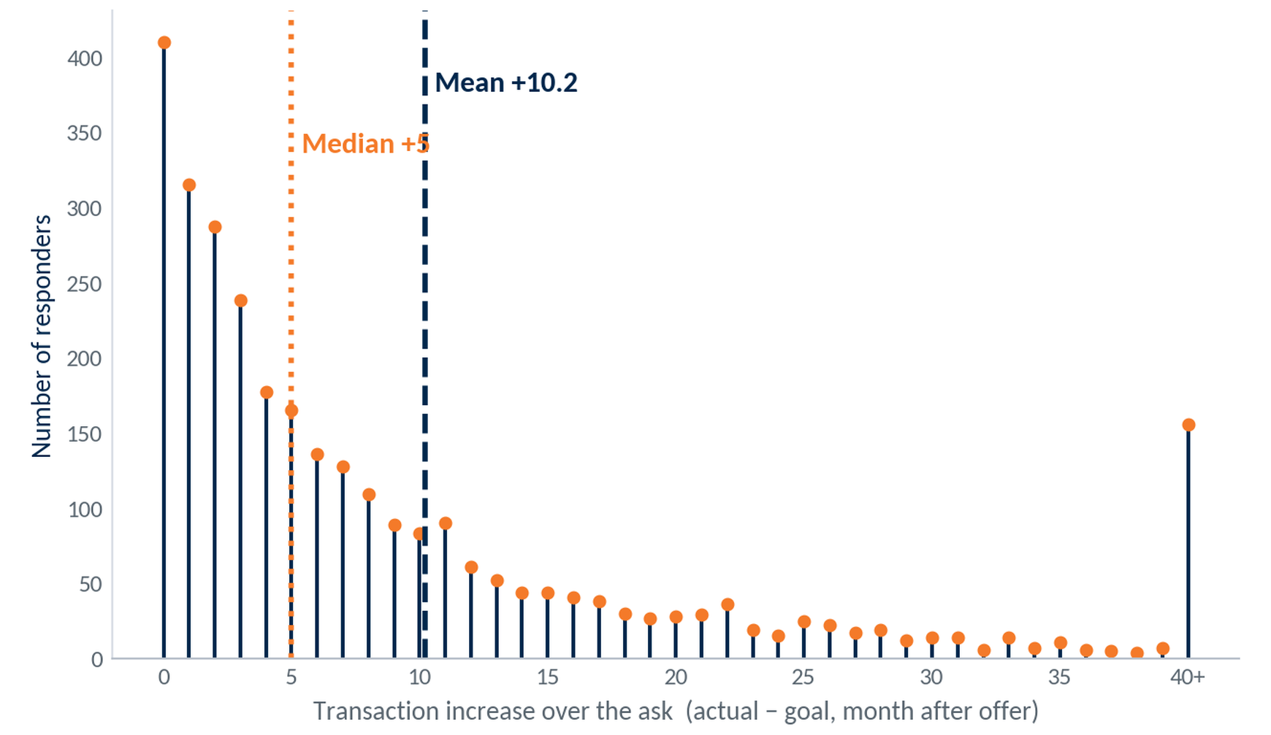
Transaction Increase Over the Ask
Selection: ARS responders (3,030). Increase = transactions in the month after the offer minus the goal — e.g., a non-user asked for 5 who does 11 = +6. One point per responder (latest offer).
+10.2
Mean increase (txns/mo)
14.7
Std deviation
+5
Responders don't just meet the ask — they beat it. Half clear their goal by 5+ transactions in the month after the offer and the average by 10, with a long tail of heavy over-performers (156 at +40 or more).
Median increase
16
Notes:
Source: ARS Workbook 999 (999-2026.07-Union Financial-Workbook_DEMO.xlsx) — Mail Response Summary + ODD extract 999 Union Financial (demo data; Jul23-forward), Jun 2026 snapshot mailing/response fields.

Slide 17
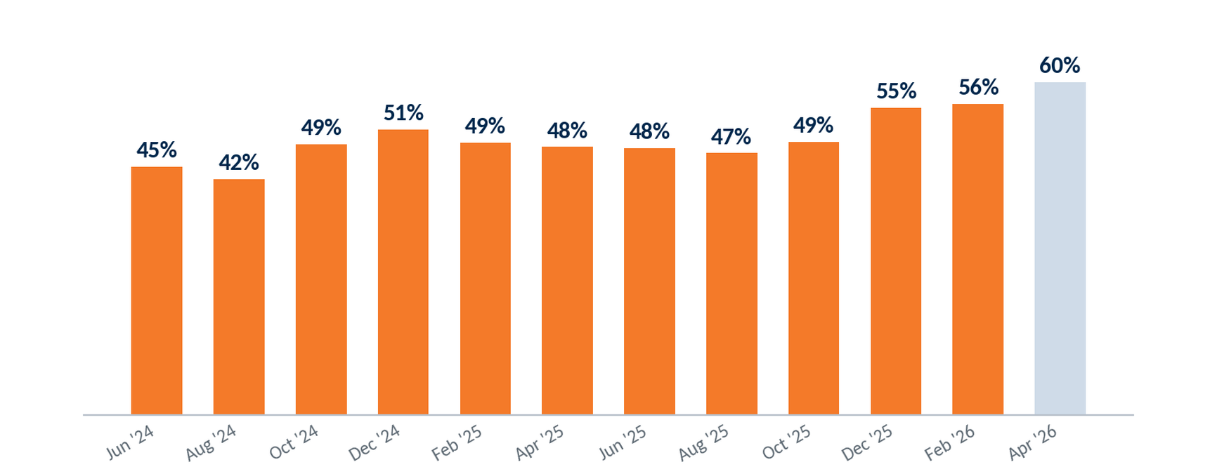
Sustained Respondent Activity by Mailing
Selection: ARS responders by mailing. Share still meeting their first-offer activity goal over the latest 3 months (Apr–Jun 2026); last bar not yet mature.
17
Notes:
Source: ARS Workbook 999 (999-2026.07-Union Financial-Workbook_DEMO.xlsx) — Mail Response Summary + ODD extract 999 Union Financial (demo data; Jul23-forward), Jun 2026 snapshot mailing/response fields.

Slide 18
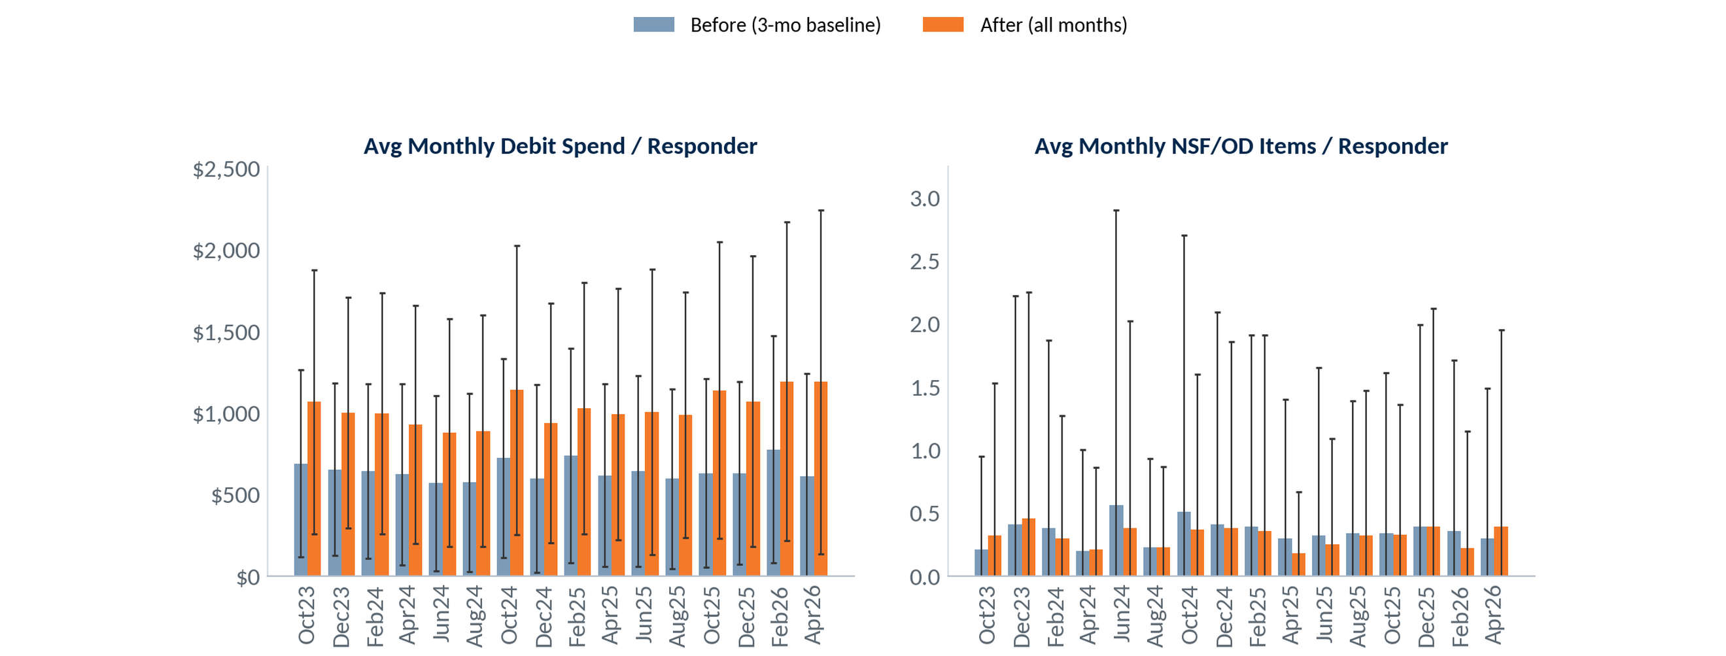
Responder Activity: Before vs After (Mean)
Selection: ARS mailing responders — average monthly debit spend and NSF/OD items per responder: 3-month pre-mailing baseline vs. every month after the mailing (through June 2026). Mailings Oct 2023 – Apr 2026. Debit spend winsorized at 3 SD; error bars = ±1 SD across accounts.
Debit spend rose after every mailing and held across all later months — $644/mo before vs $1,027 after (+59%); NSF/OD activity stayed roughly flat.
18
Notes:
Source: ARS Workbook 999 (999-2026.07-Union Financial-Workbook_DEMO.xlsx) — Mail Response Summary + ODD extract 999 Union Financial (demo data; Jul23-forward), Jun 2026 snapshot mailing/response fields.

Slide 19
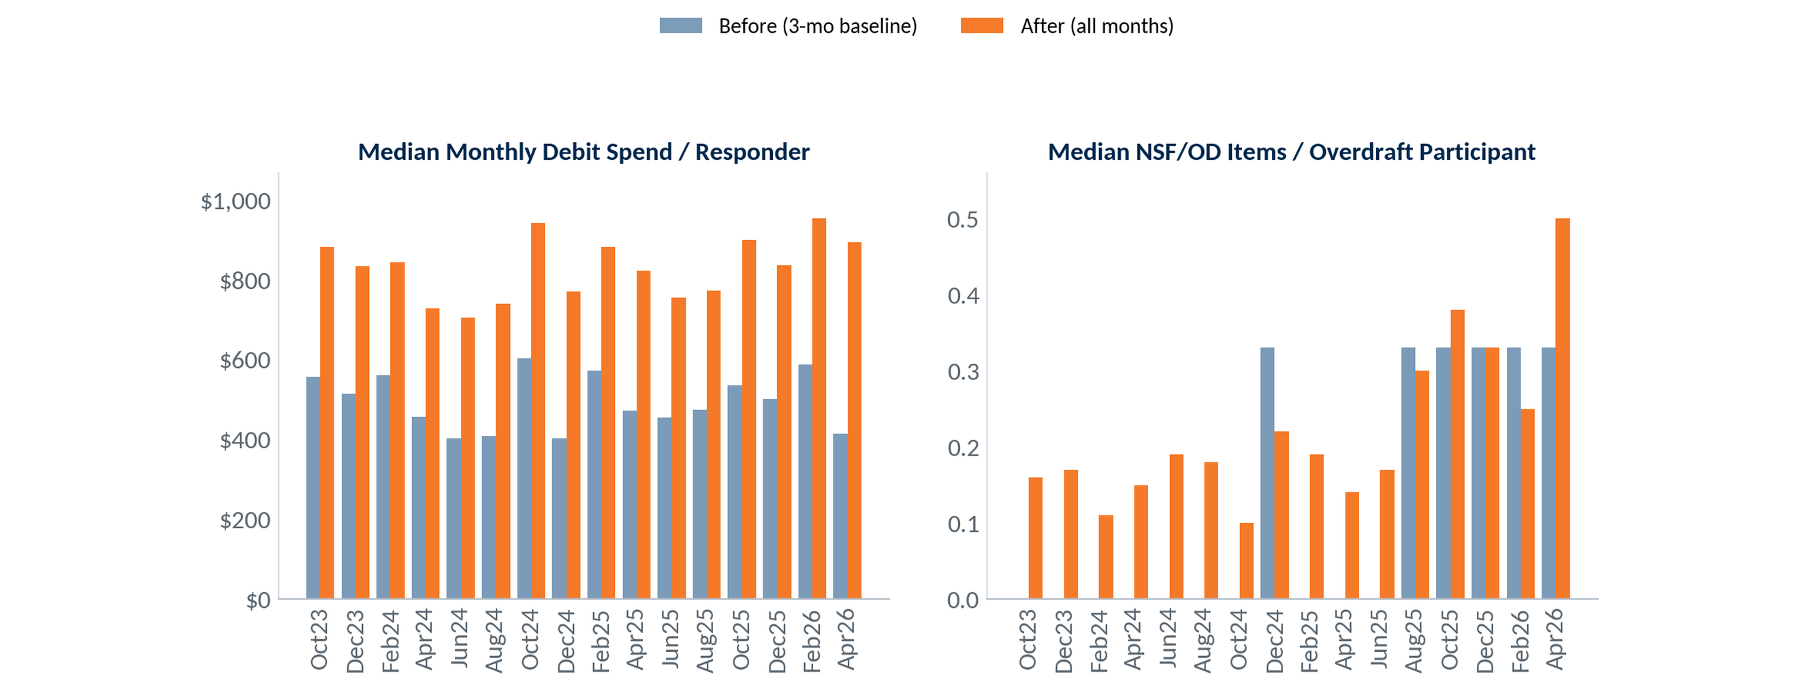
Responder Activity: Before vs After (Median)
Selection: ARS mailing responders — median monthly debit spend (all responders) and median NSF/OD items among overdraft participants: 3-month pre-mailing baseline vs. every month after the mailing (through June 2026). Mailings Oct 2023 – Apr 2026.
On a median basis, debit spend rose $495 → $829 per responder (+67%). Among overdraft participants, median NSF/OD items stayed low and roughly flat.
19
Notes:
Source: ARS Workbook 999 (999-2026.07-Union Financial-Workbook_DEMO.xlsx) — Mail Response Summary + ODD extract 999 Union Financial (demo data; Jul23-forward), Jun 2026 snapshot mailing/response fields.

Slide 20
Debit Card Review
Take Rate • Swipes & Spend
Notes:
Source: ODD extract 999 Union Financial (demo data; Jul23-forward), Jun 2026 snapshot — debit take rate (personal/business/by branch), swipes & spend, NSF/OD.

Slide 21
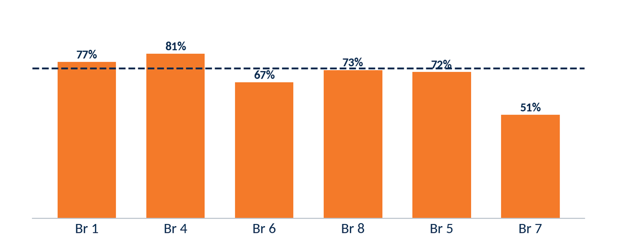
12-Month Eligible Take Rate — Personal
07-2025 · 06-2026
Selection: ARS-eligible personal accounts, trailing 12 months (Jul 2025 – Jun 2026).
73.7%
71.0%
707
186
12-Mo Take Rate
Historical Take Rate
Eligible Accounts
No Debit Card
Take rate by branch (personal, largest branches). Dashed line = 73.7% program average.
21
Notes:
Source: ODD extract 999 Union Financial (demo data; Jul23-forward), Jun 2026 snapshot — debit take rate (personal/business/by branch), swipes & spend, NSF/OD.

Slide 22
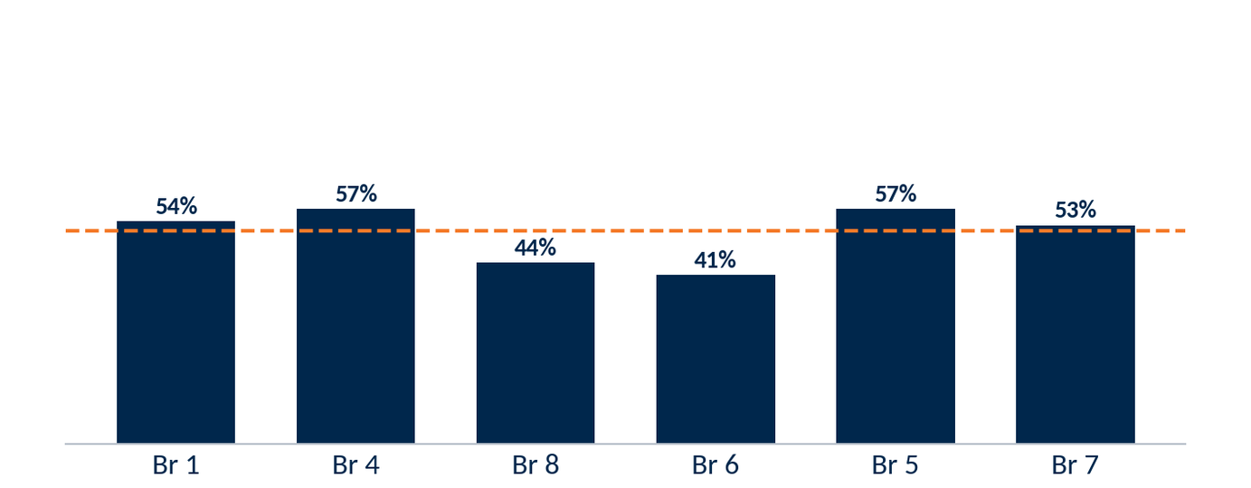
12-Month Eligible Take Rate — Business
07-2025 · 06-2026
Selection: business accounts opened Jul 2025 – Jun 2026 (new take rate) and all ARS-eligible business accounts (historical). 0 business accounts are ARS-eligible in the current book.
51.7%
0.0%
178
86
12-Mo Take Rate
Historical Take Rate
Eligible Accounts
No Debit Card
Take rate by branch (new business accounts, largest branches). Dashed line = 52% program average.
22
Notes:
Source: ODD extract 999 Union Financial (demo data; Jul23-forward), Jun 2026 snapshot — debit take rate (personal/business/by branch), swipes & spend, NSF/OD.

Slide 23
12-Month Take Rate by Branch
07-2025 · 06-2026
Selection: new ARS-eligible personal accounts by branch (opened last 12 months), monthly Aug 2025 – Jun 2026; six largest branches shown, Total across all branches.
Branch | Aug | Sep | Oct | Nov | Dec | Jan | Feb | Mar | Apr | May | Jun | Cards | Elig | Take%
Br 1 | 24 | 17 | 21 | 16 | 18 | 19 | 23 | 18 | 16 | 22 | 20 | 236 | 306 | 77%
Br 4 | 10 | 7 | 6 | 7 | 5 | 12 | 7 | 8 | 11 | 8 | 8 | 93 | 115 | 81%
Br 6 | 4 | 2 | 4 | 3 | 2 | 5 | 8 | 5 | 8 | 7 | 7 | 66 | 98 | 67%
Br 8 | 0 | 7 | 4 | 3 | 8 | 4 | 6 | 8 | 4 | 7 | 7 | 59 | 81 | 73%
Br 5 | 3 | 1 | 3 | 9 | 0 | 3 | 3 | 2 | 3 | 6 | 4 | 43 | 60 | 72%
Br 7 | 2 | 1 | 1 | 3 | 3 | 3 | 2 | 1 | 2 | 0 | 2 | 24 | 47 | 51%
Total (all branches) | 43 | 35 | 39 | 41 | 36 | 46 | 49 | 42 | 44 | 50 | 48 | 521 | 707 | 74%
23
Notes:
Source: ODD extract 999 Union Financial (demo data; Jul23-forward), Jun 2026 snapshot — debit take rate (personal/business/by branch), swipes & spend, NSF/OD.

Slide 24
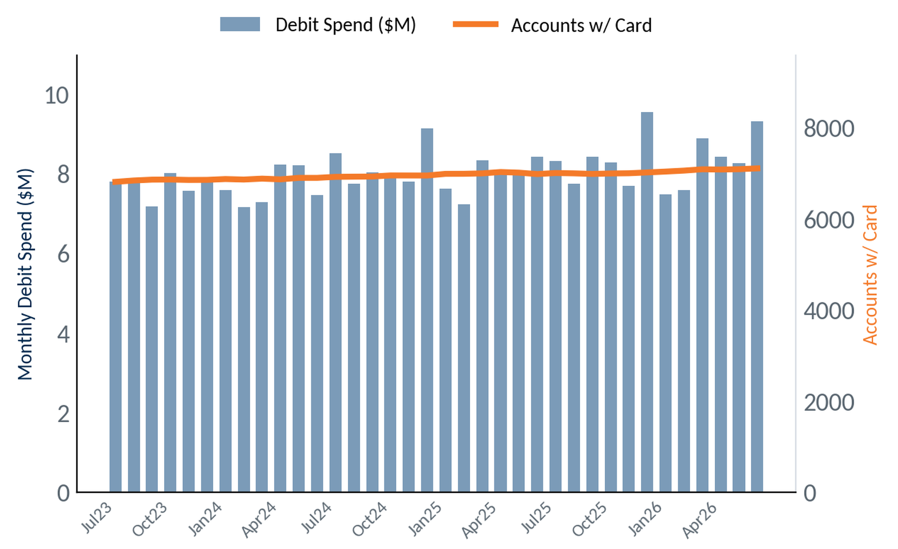
Overall Debit Swipes & Spend
Selection: all debit-card-holding accounts, program-wide. Monthly totals, Jul 2023 – Jun 2026 (36 months).
+4.3%
Accounts w/ Card, 36 mo
(6.8K → 7.1K)
$9.3M
Monthly debit spend
(June 2026)
+11%
Spend YoY
(Jun 25 → Jun 26)
24
Notes:
Source: ODD extract 999 Union Financial (demo data; Jul23-forward), Jun 2026 snapshot — debit take rate (personal/business/by branch), swipes & spend, NSF/OD.

Slide 25
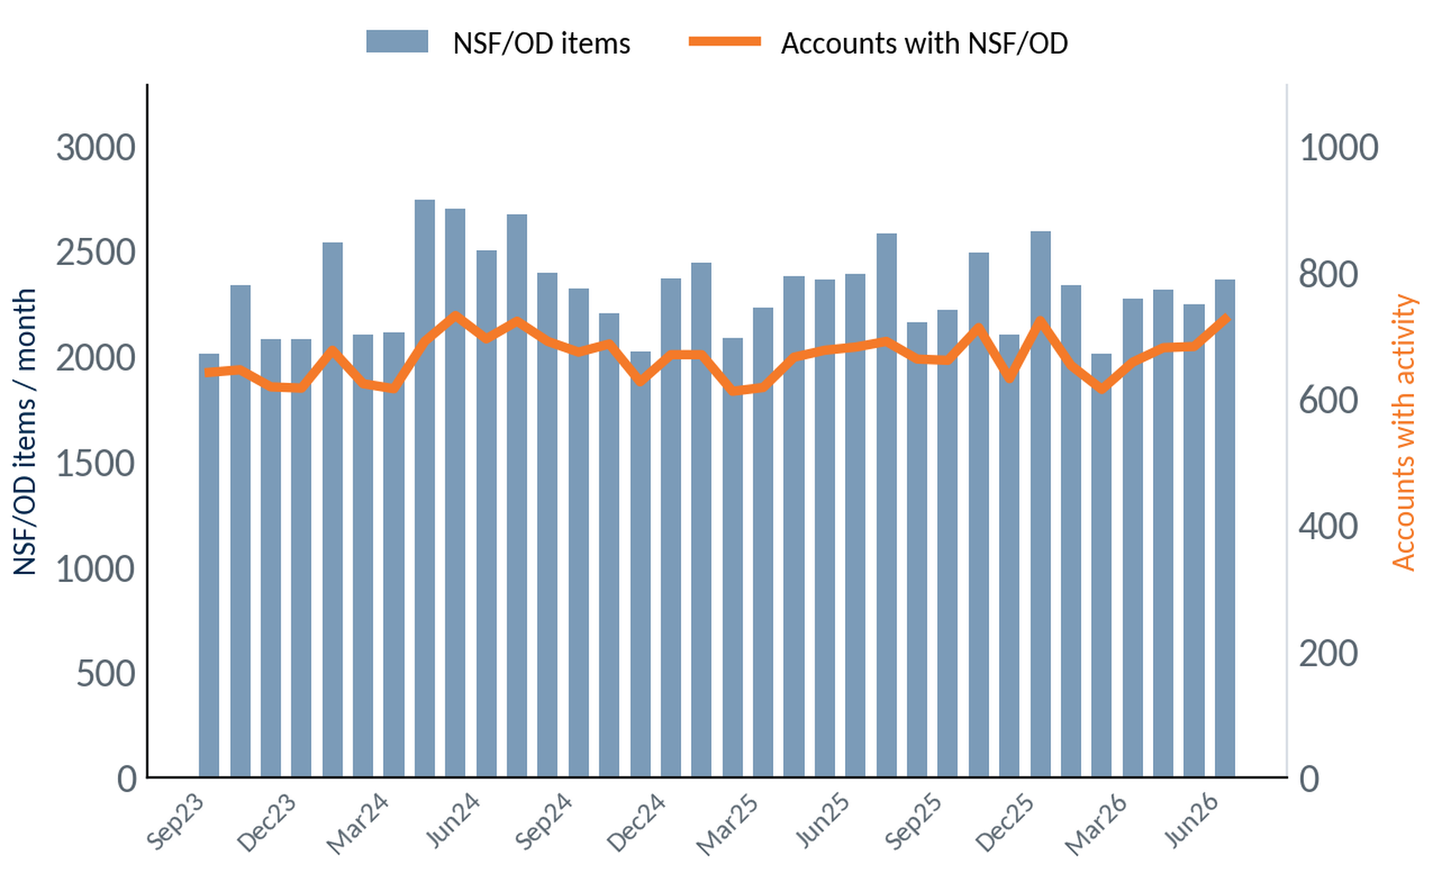
NSF/OD Activity Over Time
Selection: all accounts, program-wide. Monthly NSF/OD item volume (bars) and accounts with activity (line), Sep 2023 – Jun 2026.
2,360
NSF/OD items
(June 2026)
725
Accounts with
NSF/OD (June)
-1%
Items YoY
(Jun 25 → Jun 26)
25
Notes:
Source: ODD extract 999 Union Financial (demo data; Jul23-forward), Jun 2026 snapshot — debit take rate (personal/business/by branch), swipes & spend, NSF/OD.

Slide 26
Reg E Review
Overdraft Opt-In Performance
Notes:
Source: ODD extract 999 Union Financial (demo data; Jul23-forward), Jun 2026 snapshot — Reg E opt-in (standardized Opt In/Opt Out/Default); all personal / opened last 12 mo / by vintage.

Slide 27
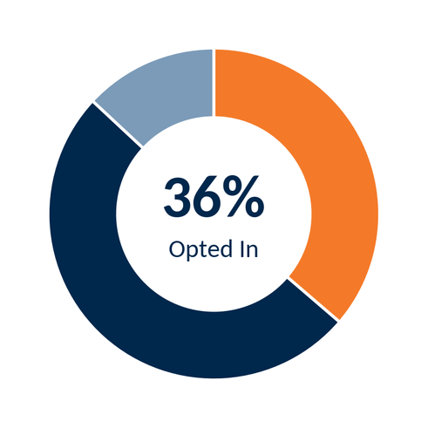
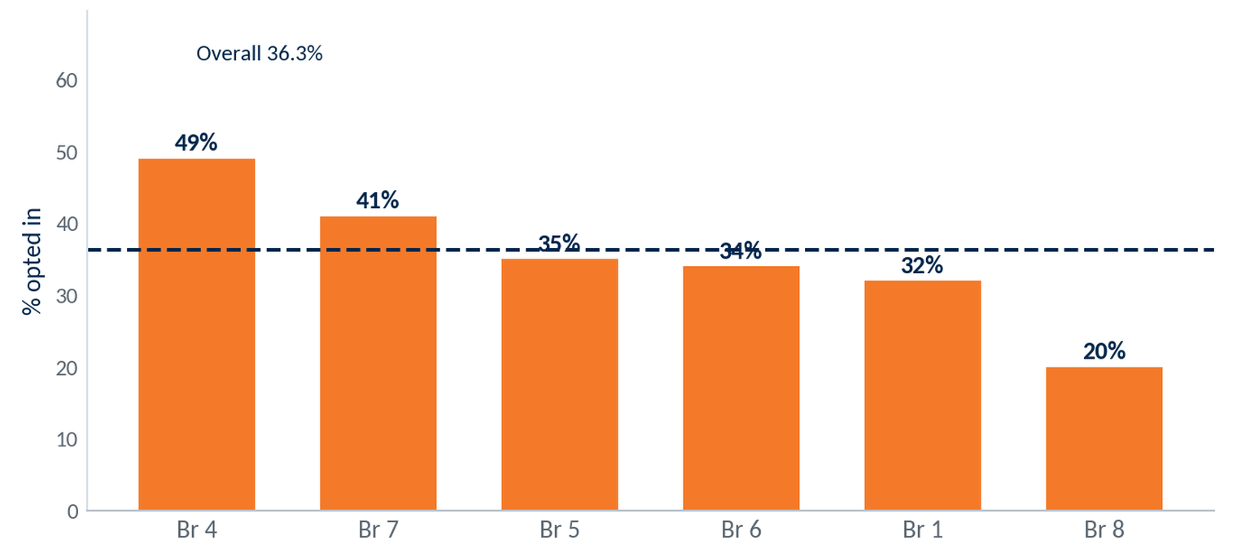
Reg E Opt-In — All Personal Accounts
Selection: all open personal accounts holding a debit card (6,192). Overdraft opt-in status as of June 2026 (point-in-time).
Opted In
Opted Out
No Election (default)
Opt-in rate by branch (branches with 40+ eligible accounts). Dashed line = 36.3% overall.
36.3% of open personal debit-card holders are opted in to overdraft — 2,247 of 6,192.
27
Notes:
Source: ODD extract 999 Union Financial (demo data; Jul23-forward), Jun 2026 snapshot — Reg E opt-in (standardized Opt In/Opt Out/Default); all personal / opened last 12 mo / by vintage.

Slide 28
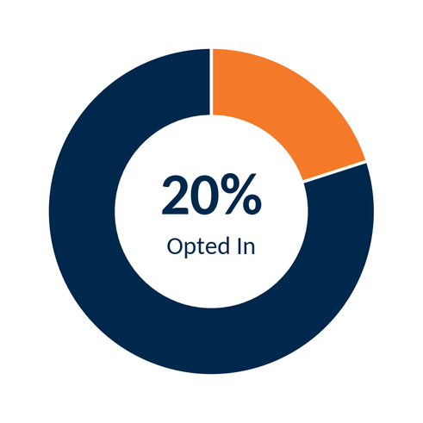
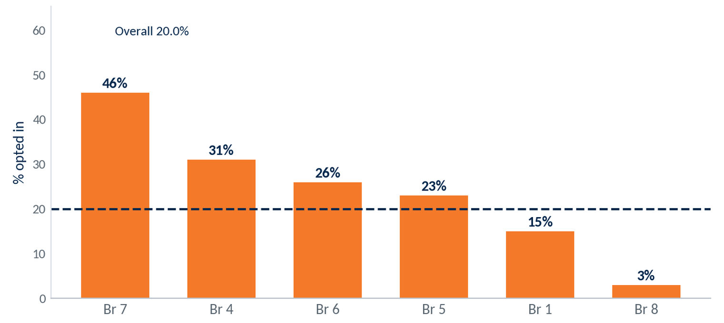
Reg E Opt-In — Opened in Last 12 Months
Selection: personal accounts holding a debit card, opened July 2025 – June 2026 and still open (519). Opt-in status as of June 2026.
Opted In
Opted Out
No Election (default)
Opt-in rate by branch, last-12-month accounts. Dashed line = 20.0% overall.
New-account opt-in runs below the book: 20.0% of accounts opened in the last 12 months — 104 of 519.
28
Notes:
Source: ODD extract 999 Union Financial (demo data; Jul23-forward), Jun 2026 snapshot — Reg E opt-in (standardized Opt In/Opt Out/Default); all personal / opened last 12 mo / by vintage.

Slide 29
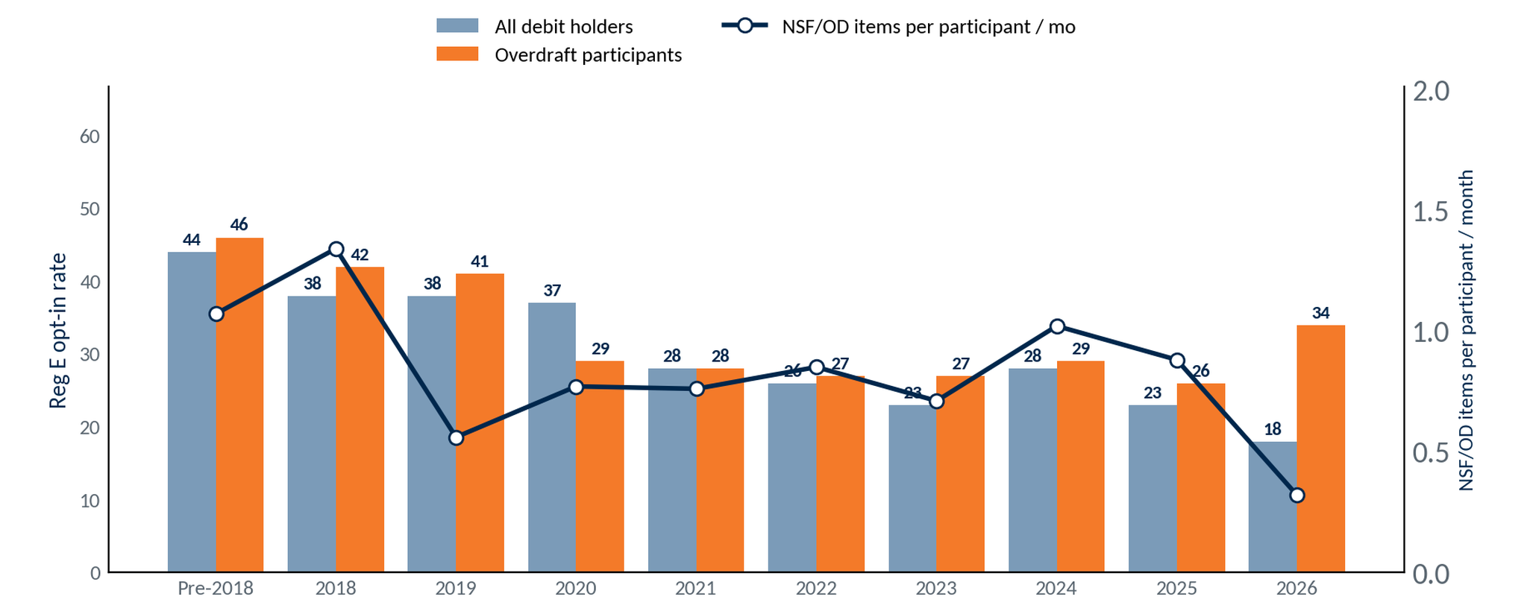
Reg E Opt-In by Account Vintage
Selection: open consumer debit-card holders (6,192), by year opened. Reg E opt-in for all holders (bars) vs. overdraft participants — accounts with ≥1 NSF/OD item, trailing 12 months. Line = NSF/OD items per overdraft participant per month (trailing 12 months).
Opt-in falls with each newer vintage — 44% (pre-2018) to 18% (2026); overdraft participants opt in at similar or higher rates.
29
Notes:
Source: ODD extract 999 Union Financial (demo data; Jul23-forward), Jun 2026 snapshot — Reg E opt-in (standardized Opt In/Opt Out/Default); all personal / opened last 12 mo / by vintage.

Slide 30
ARS Key Takeaways
Program Performance
Debit Card
Reg E
• 226 months, 81 mailings; 5.7 : 1 profitability
• $5.69M incremental profit program-to-date
• 18.8% recent mailing response
• Consistent response across 81 mailings since 2007
• 71.0% overall take rate
• New-account take rate 73.7%
• Card base +4.3% over 36 months
• Monthly spend $9.3M
• 36.3% opt-in (personal accounts)
• Best branches ~49% (Branch 4 49%)
• Opportunity at low-opt-in branches
• New-account opt-in 20.0%
Opportunity: raise Reg E opt-in at low-performing branches
30
Notes:
Source: summary of ARS Workbook 999 (999-2026.07-Union Financial-Workbook_DEMO.xlsx) financials + ODD extract 999 Union Financial (demo data; Jul23-forward), Jun 2026 snapshot metrics shown in this deck.

Slide 31
Invitation Checking® System
Referrals · Account Performance · Revenue
Notes:
Section divider. No data.

Slide 32
The Power of Referrals
PTD · July 15, 2026
Selection: checking referrals logged by branch staff — program-to-date and 2026 YTD.
1,212
Referrals Program-to-Date
Union Financial team members have generated 1,212 checking referrals since program inception — 205 year-to-date in 2026. June was a program high at 39.
205
2026 Year-to-Date
39
Previous Month (June)
54%
June vs Goal
32
Notes:
Source — VIP Invitation Checking® System → ICS Referral Data dashboard (Looker embed) and 999-2026.07-Union Financial-Invitation Checking Workbook v1.7.1-DM.xlsx for Union Financial (999), pulled 2026-07-15. Referrals PTD 1,212, YTD 205, June 39, monthly goal 72 (June vs goal 54%). VIP, current thru July (partial).

Slide 33
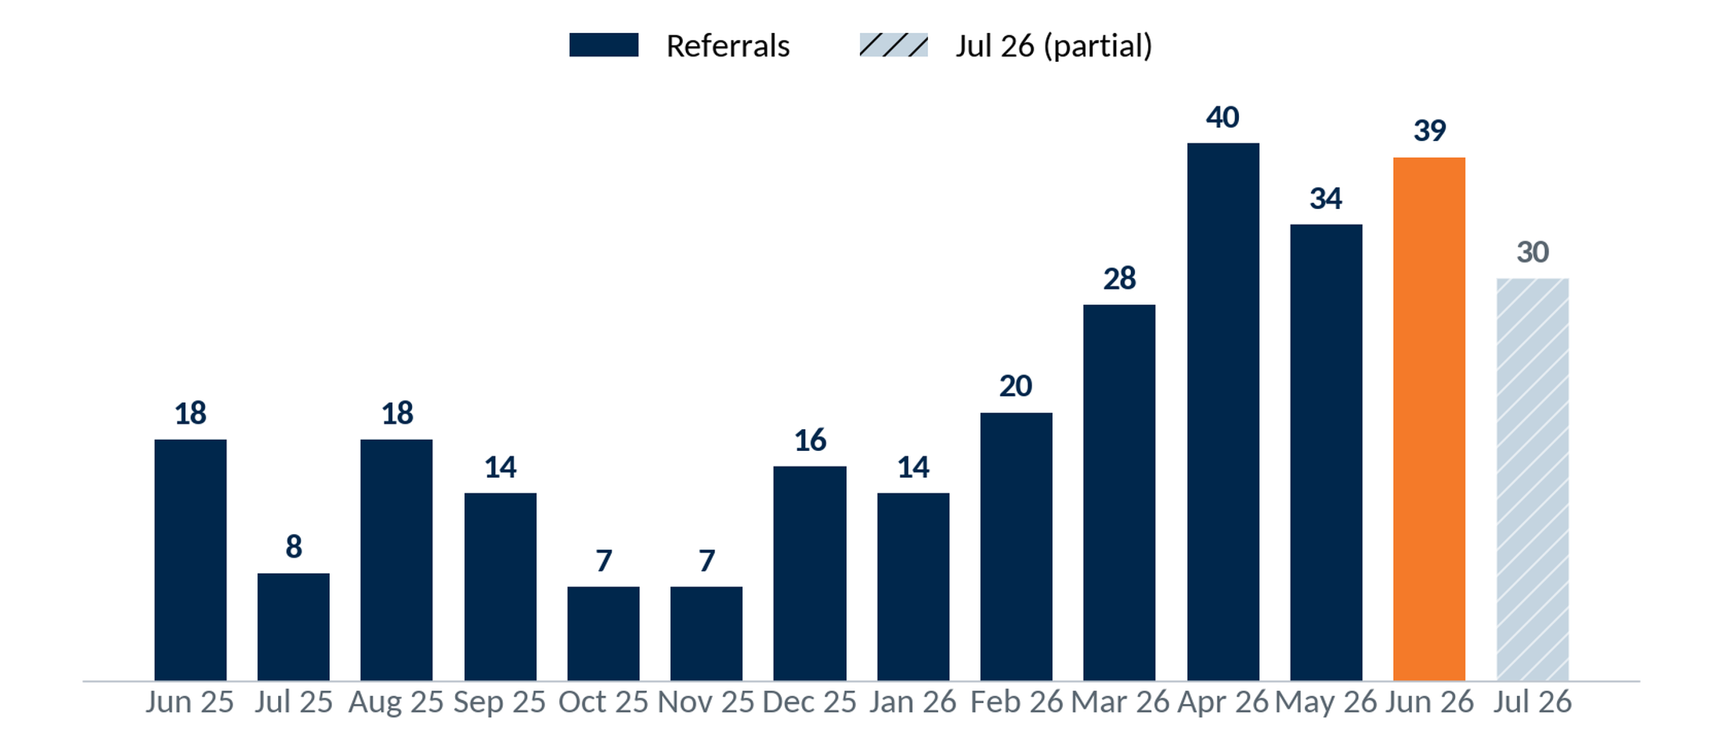
Referral Trend – Last 14 Months
PTD · July 15, 2026
Monthly checking referrals, Jun 25 – Jul 26; Jun 26 a program high at 39, Jul 26 partial. Goal 72/mo.
33
Notes:
Source — VIP Invitation Checking® System → ICS Referral Data dashboard (Looker embed) and 999-2026.07-Union Financial-Invitation Checking Workbook v1.7.1-DM.xlsx for Union Financial (999), pulled 2026-07-15. Monthly referrals vs the 72/mo goal. Bars navy, last complete month orange, partial month hatched. VIP.

Slide 34
Results by Branch – Year to Date
YTD · July 15, 2026
Branch | Referrals YTD | Goal | % of Goal
Branch 1 | 44 | 84 | 52%
Branch 2 | 39 | 48 | 81%
Branch 3 | 17 | 24 | 71%
Branch 4 | 16 | 84 | 19%
Branch 5 | 16 | 60 | 27%
Branch 6 | 16 | 84 | 19%
Branch 7 | 15 | 96 | 16%
Branch 8 | 14 | 96 | 15%
Top 8 Total | 177 | 576 | 31%
Selection: checking referrals by branch, year-to-date (top 8 branches).
34
Notes:
Source — VIP Invitation Checking® System → ICS Referral Data dashboard (Looker embed) and 999-2026.07-Union Financial-Invitation Checking Workbook v1.7.1-DM.xlsx for Union Financial (999), pulled 2026-07-15. Referrals by branch, YTD, vs each branch's YTD goal. Top branches by referrals. VIP; branch names reconciled to the Charts 'Goals' tab.

Slide 35
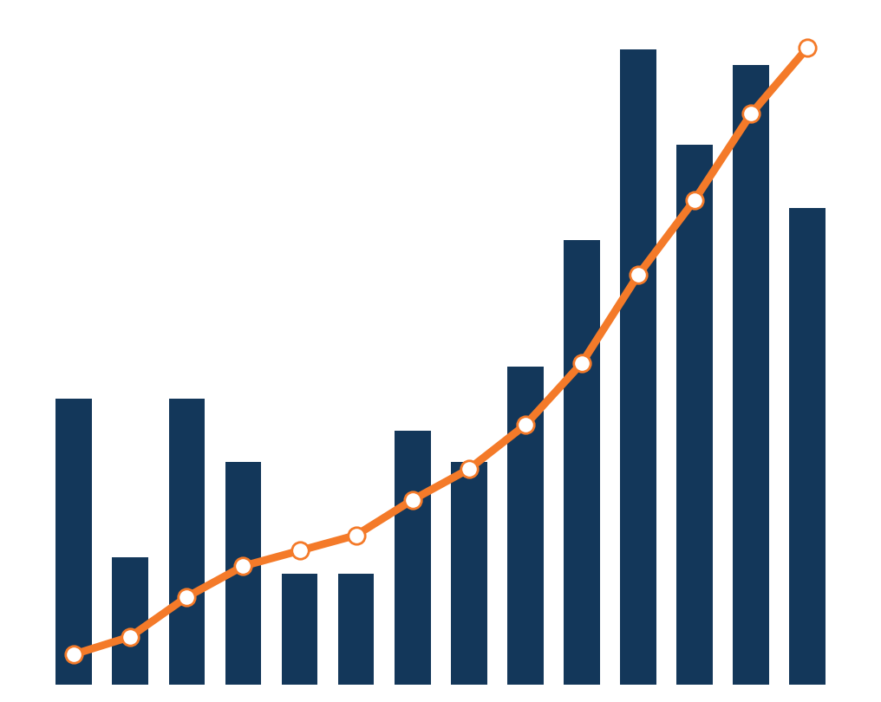
Performance of Accounts
• Drilling into the data
• Overall Profitability
• Breakdown of Revenue
• Breakdown by Month
• Comparisons
35
Notes:
Section intro to the ICS account-performance analysis (profitability, revenue breakdown, monthly detail, comparisons). Motif = monthly referrals (bars) + cumulative referrals (line), from the VIP referral trend. No figures on the slide face.

Slide 36
Performance of ICS Accounts
PTD · June 2026
Return on Investment — 8.97 to 1
$227.64
9.26 years
$2,107.95
Annual Profit per Account
Average Life of Accounts
Present Value per Account
• Accounts pay for themselves in ~12 months
• 34% longer than the 6.9-year average for all accounts
• Modeled from ICS account survival
• Using the 9.26-year modeled account life
• Acquisition Cost: $235
36
Notes:
Source — VIP Invitation Checking® System → ICS Referral Data dashboard (Looker embed) and 999-2026.07-Union Financial-Invitation Checking Workbook v1.7.1-DM.xlsx for Union Financial (999), pulled 2026-07-15. ROI recalculated (workbook ROI not used): PV/acct = annual profit $227.64 × 9.26 yr (velocity life, program <2 yr) = $2,107.95; PV total = $2,942,693; ROI = PV total ÷ ($235 × 1,396) = 8.97 : 1.

Slide 37
Program Results by Month Opened
PTD · June 2026
ICS-originated checking accounts by opening-month cohort — revenue and amortized acquisition expense.
Month Opened | Oct 25 | Nov 25 | Dec 25 | Jan 26 | Feb 26 | Mar 26 | Apr 26 | May 26 | Jun 26
Accounts Opened | 20 | 16 | 23 | 23 | 22 | 49 | 30 | 31 | 32
Avg Balance / Acct | $852 | $721 | $310 | $266 | $478 | $721 | $693 | $467 | $469
Spread on Deposits | $328 | $208 | $108 | $79 | $121 | $321 | $143 | $66 | $34
Interchange Income | $995 | $571 | $560 | $640 | $300 | $1,086 | $343 | $254 | $77
NSF / OD Fees | $384 | $768 | $1,376 | $2,112 | $512 | $2,272 | $320 | $320 | $32
Other Fees | $209 | $84 | $53 | $11 | $20 | $98 | $28 | $6 | $2
Account Profit Contribution | $1,916 | $1,631 | $2,097 | $2,842 | $952 | $3,777 | $834 | $647 | $145
Amortized Expense / Acct / Mo | $3.92 | $3.92 | $3.92 | $3.92 | $3.92 | $3.92 | $3.92 | $3.92 | $3.92
Months Open | 9 | 8 | 7 | 6 | 5 | 4 | 3 | 2 | 1
Amortized expense: $235 ÷ 60 months = $3.92 per account per month × time open.
37
Notes:
Source — VIP Invitation Checking® System → ICS Referral Data dashboard (Looker embed) and 999-2026.07-Union Financial-Invitation Checking Workbook v1.7.1-DM.xlsx for Union Financial (999), pulled 2026-07-15. Monthly Detail tab: revenue components, account profit contribution, amortized expense ($235 ÷ 60 = $3.92/acct/mo). Cohort by opening month.

Slide 38
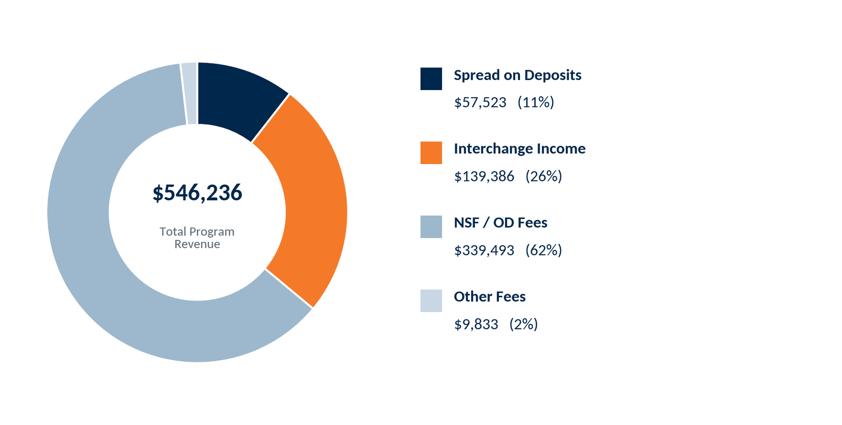
ICS Revenue
PTD · June 2026
Selection: ICS-originated checking accounts; revenue program-to-date.
38
Notes:
Source — VIP Invitation Checking® System → ICS Referral Data dashboard (Looker embed) and 999-2026.07-Union Financial-Invitation Checking Workbook v1.7.1-DM.xlsx for Union Financial (999), pulled 2026-07-15. PTD revenue by source: Spread on Deposits $57,523, Interchange Income $139,386, NSF / OD Fees $339,493, Other Fees $9,833; total $546,236. Workbook 'Monthly Detail'.

Slide 39
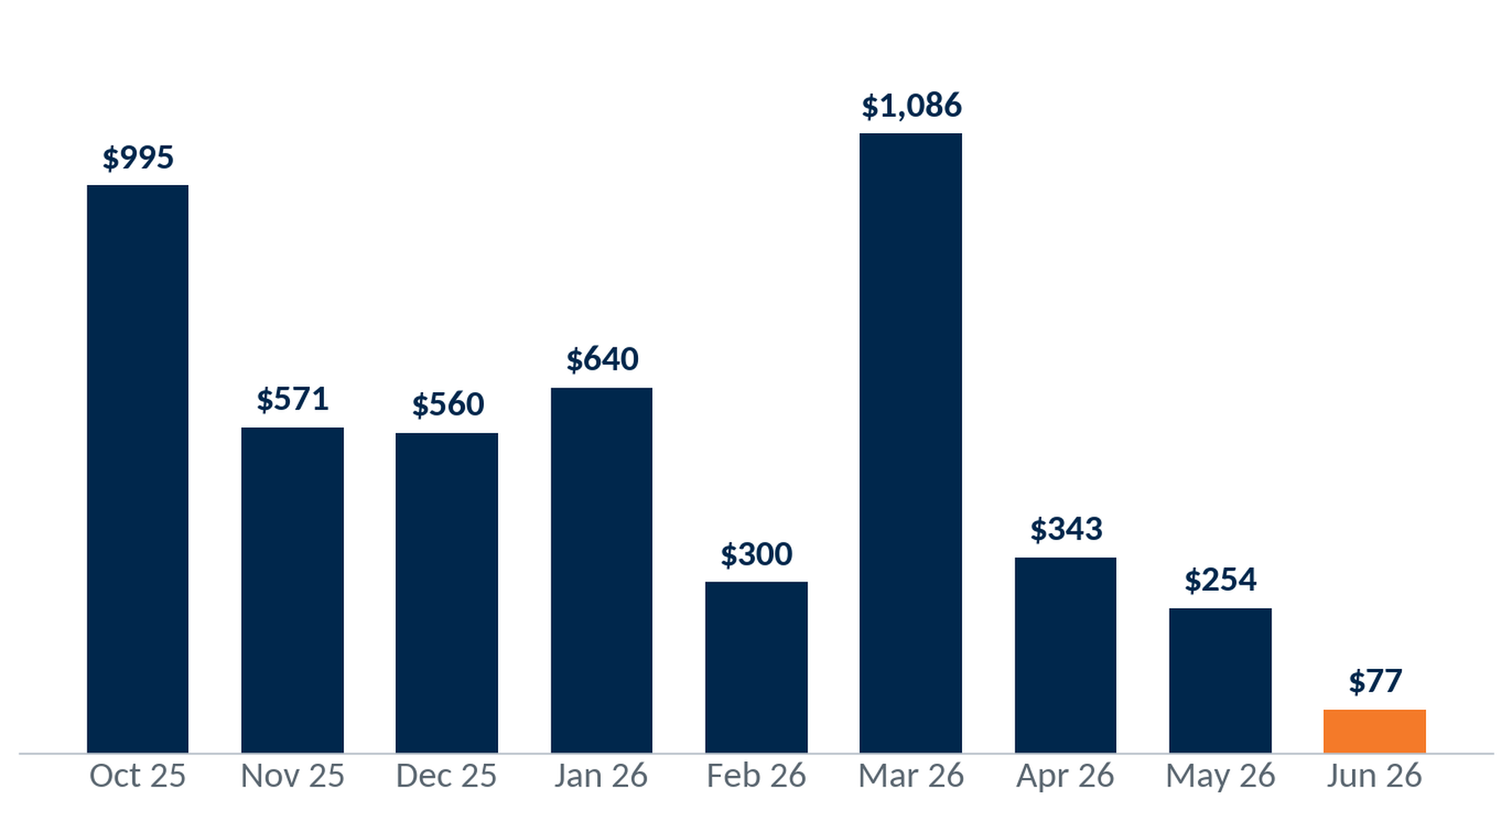
Total Interchange Revenue
Interchange revenue by cohort (opening month), program-to-date.
$4,825
Interchange PTD
1,396
ICS accounts
Interchange Income: Blended Rate × Debit Card Spend
39
Notes:
Source — VIP Invitation Checking® System → ICS Referral Data dashboard (Looker embed) and 999-2026.07-Union Financial-Invitation Checking Workbook v1.7.1-DM.xlsx for Union Financial (999), pulled 2026-07-15. Interchange revenue by cohort. Workbook 'Monthly Detail' (revenue only).

Slide 40
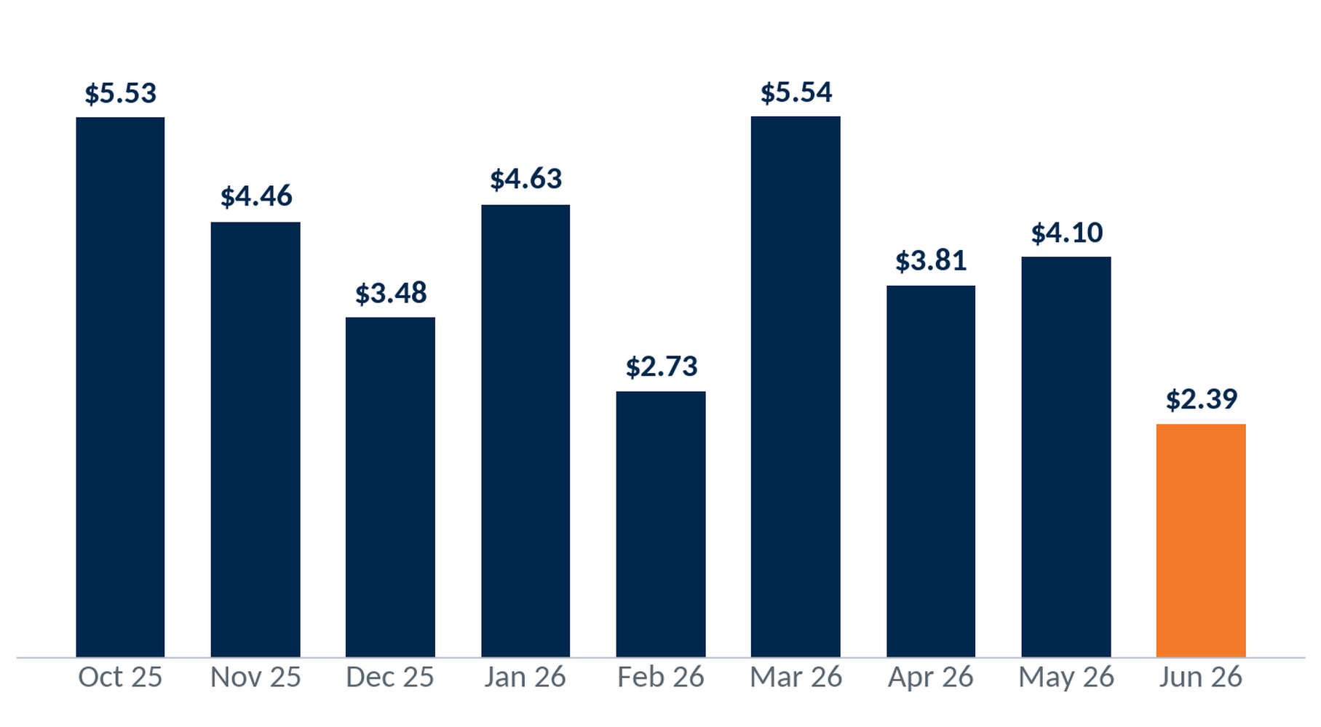
Interchange Revenue per Account per Month
Interchange revenue ÷ accounts opened ÷ months open, by cohort (e.g. Nov 25: $398.47 / 19 / 8 = $2.62).
$4.40
Blended / account / month
$3.46
Per account, life-to-date
Interchange Income: Blended Rate × Debit Card Spend
40
Notes:
Source — VIP Invitation Checking® System → ICS Referral Data dashboard (Looker embed) and 999-2026.07-Union Financial-Invitation Checking Workbook v1.7.1-DM.xlsx for Union Financial (999), pulled 2026-07-15. Interchange per account per month, cohort-normalized. Workbook 'Monthly Detail'.

Slide 41
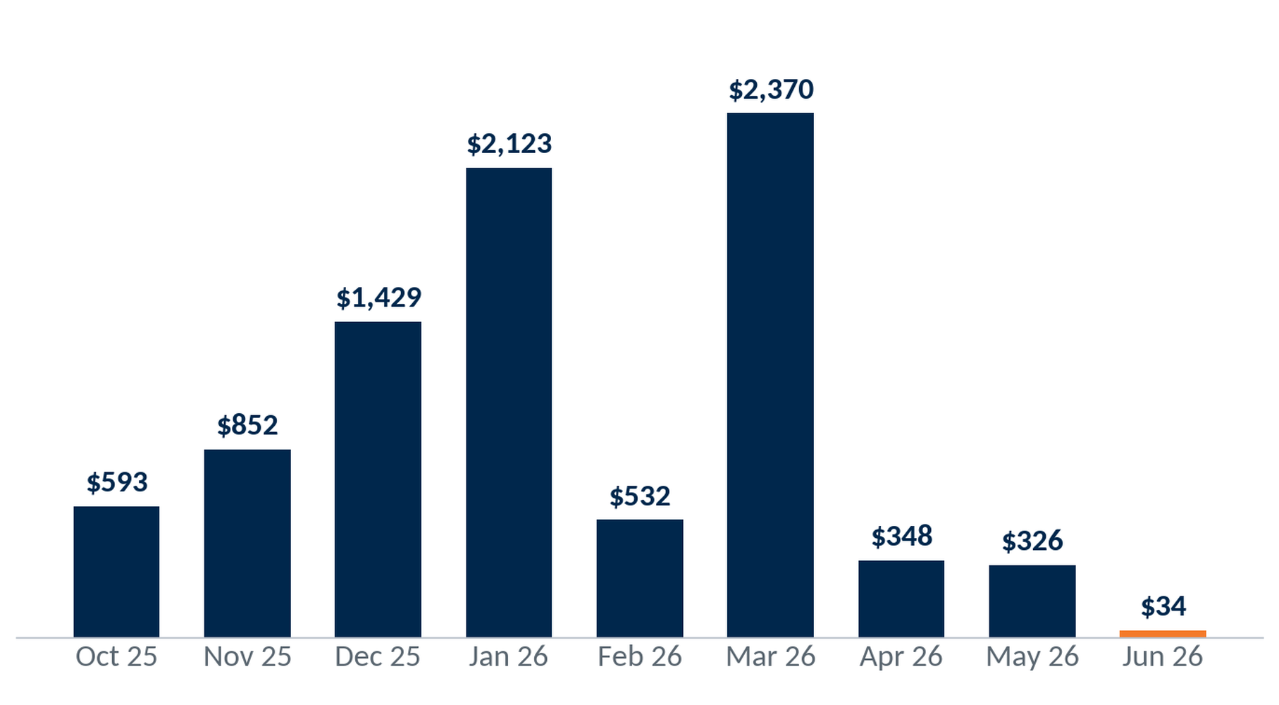
Total NSF/OD & Other Fee Revenue
NSF/OD fees plus other service charges by cohort (opening month), program-to-date.
$8,607
NSF/OD & Other PTD
1,396
ICS accounts
41
Notes:
Source — VIP Invitation Checking® System → ICS Referral Data dashboard (Looker embed) and 999-2026.07-Union Financial-Invitation Checking Workbook v1.7.1-DM.xlsx for Union Financial (999), pulled 2026-07-15. NSF/OD + other service charges by cohort. Workbook 'Monthly Detail' (revenue only).

Slide 42
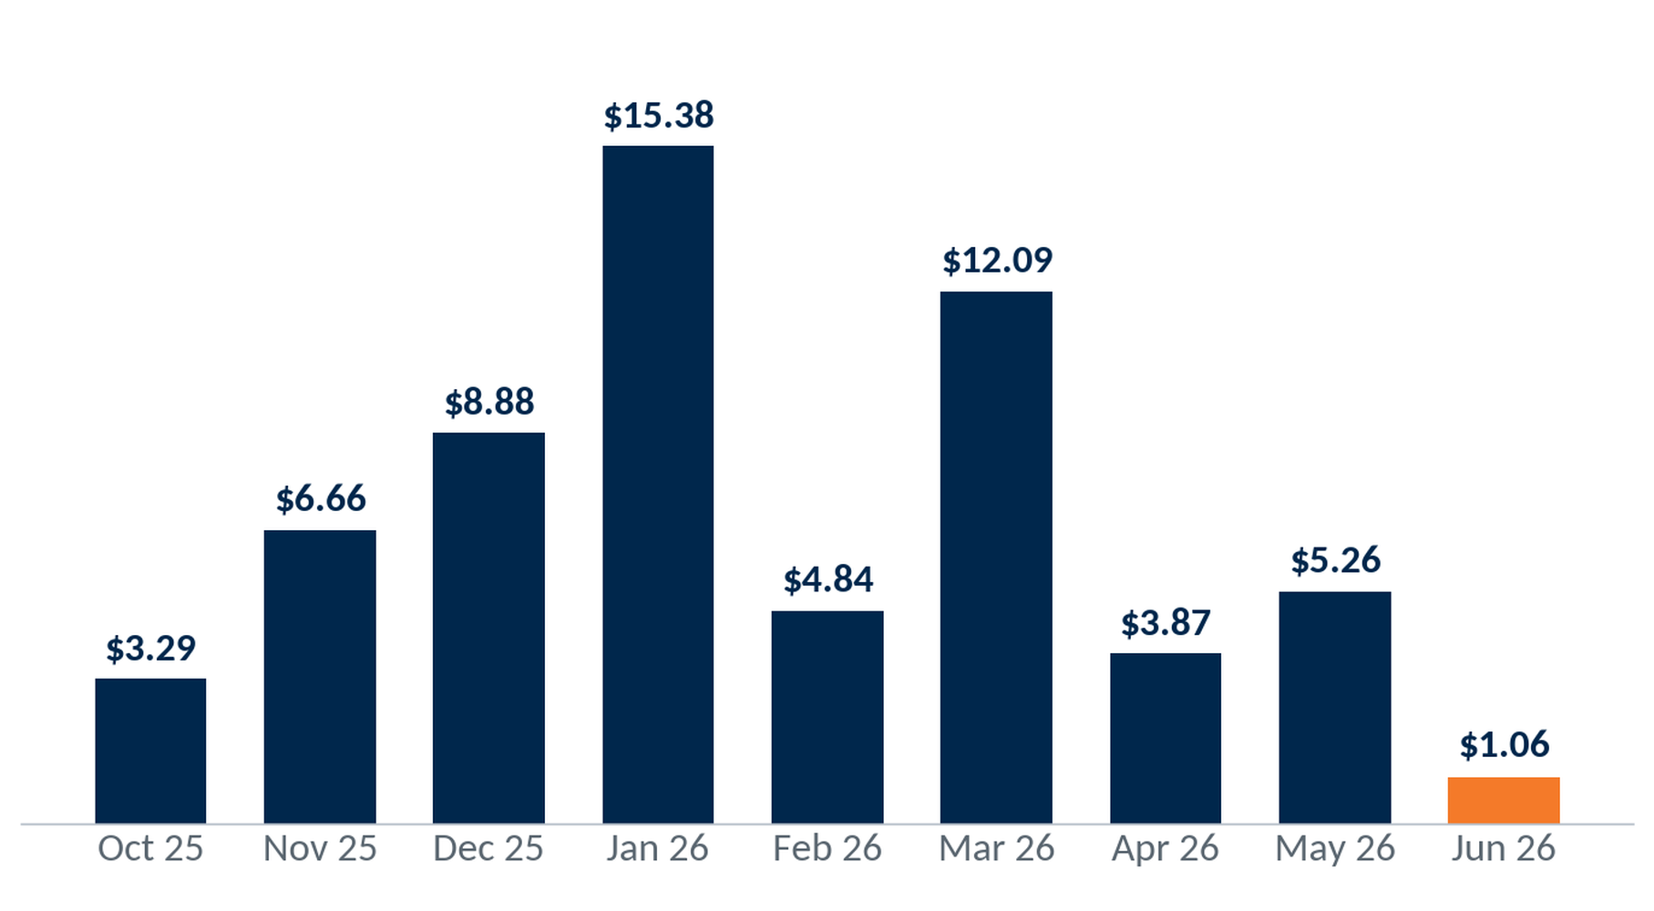
NSF/OD & Other Fees per Account per Month
(NSF/OD + other charges) ÷ accounts opened ÷ months open, by cohort (e.g. Nov 25: $593.00 / 19 / 8 = $3.90).
$7.85
Blended / account / month
$6.17
Per account, life-to-date
42
Notes:
Source — VIP Invitation Checking® System → ICS Referral Data dashboard (Looker embed) and 999-2026.07-Union Financial-Invitation Checking Workbook v1.7.1-DM.xlsx for Union Financial (999), pulled 2026-07-15. NSF/OD + other charges per account per month, cohort-normalized. Workbook 'Monthly Detail'.

Slide 43
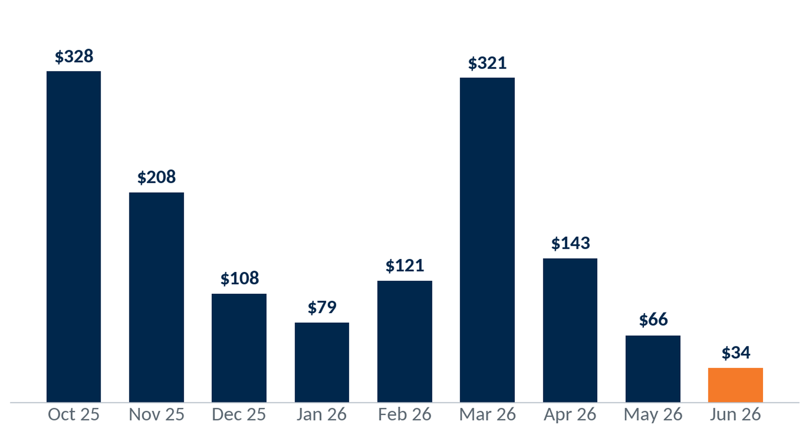
Total Spread Revenue
Spread revenue by cohort (opening month), program-to-date.
$1,409
Spread PTD
1,396
ICS accounts
Spread = 2.75% × avg month-end balance/account, summed monthly, net of interest paid.
43
Notes:
Source — VIP Invitation Checking® System → ICS Referral Data dashboard (Looker embed) and 999-2026.07-Union Financial-Invitation Checking Workbook v1.7.1-DM.xlsx for Union Financial (999), pulled 2026-07-15. Spread revenue by cohort. Workbook 'Monthly Detail'.

Slide 44
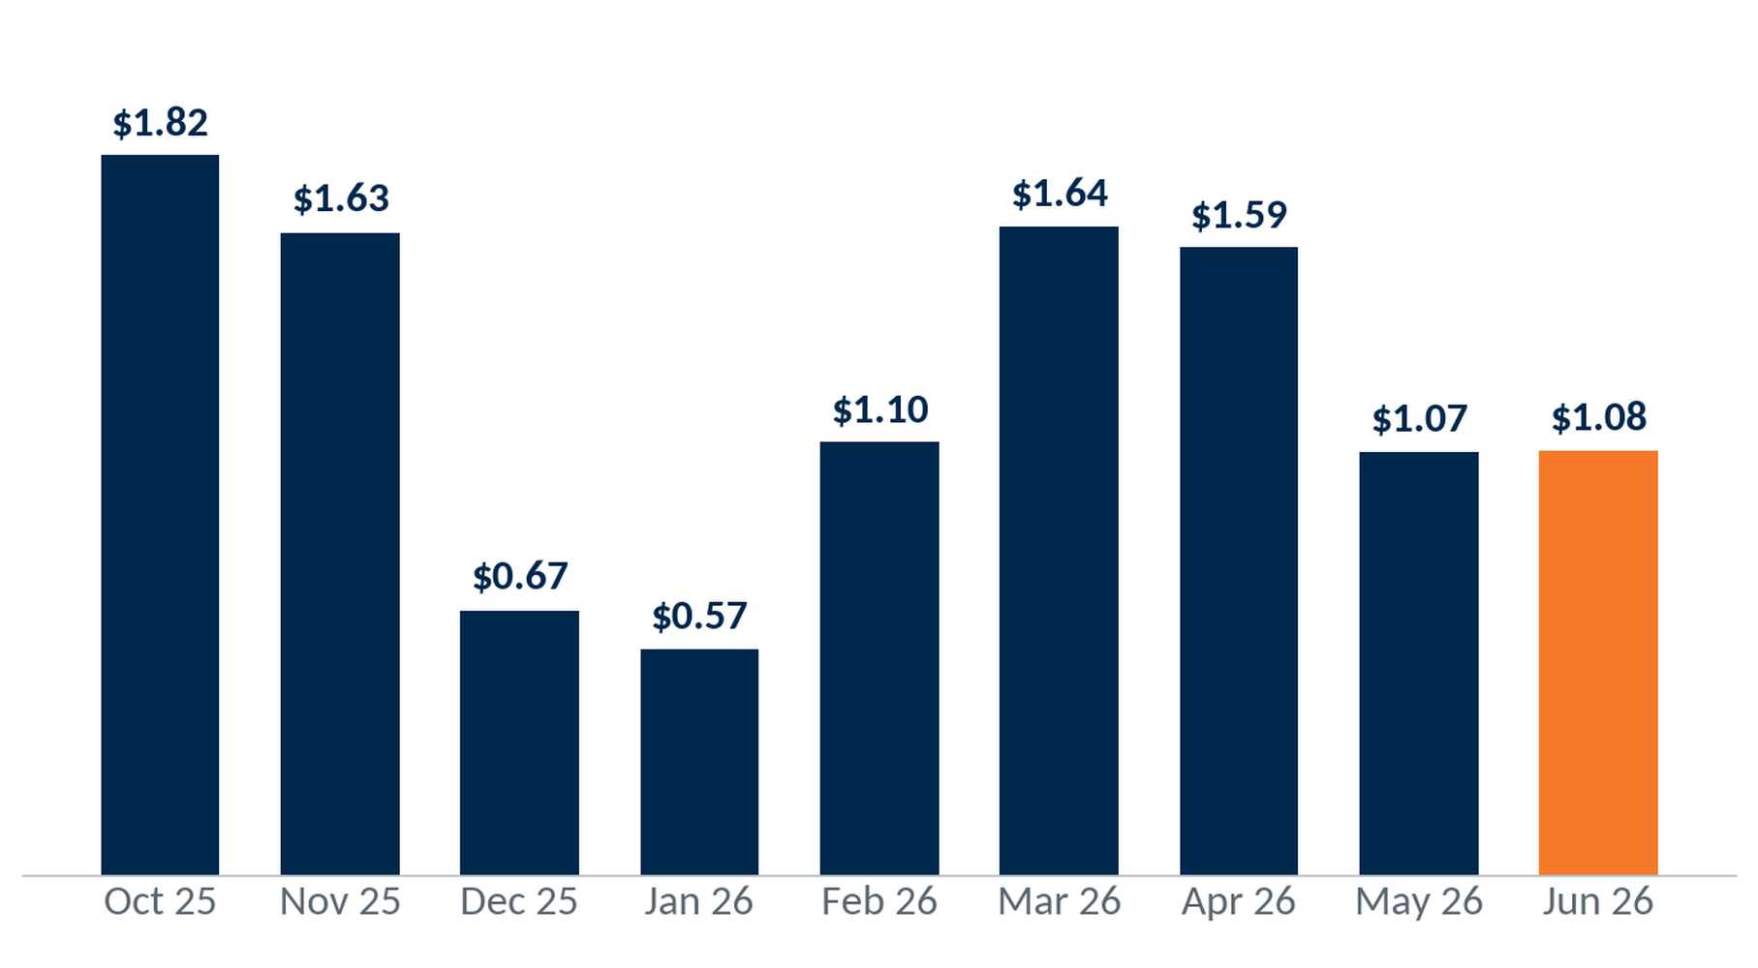
Spread Revenue per Account per Month
Spread revenue ÷ accounts opened ÷ months open, by cohort (e.g. Nov 25: $327.87 / 19 / 8 = $2.16).
$1.28
Blended / account / month
$1.01
Per account, life-to-date
Spread = 2.75% × avg month-end balance/account, summed monthly, net of interest paid.
44
Notes:
Source — VIP Invitation Checking® System → ICS Referral Data dashboard (Looker embed) and 999-2026.07-Union Financial-Invitation Checking Workbook v1.7.1-DM.xlsx for Union Financial (999), pulled 2026-07-15. Spread per account per month, cohort-normalized. Workbook 'Monthly Detail'.

Slide 45
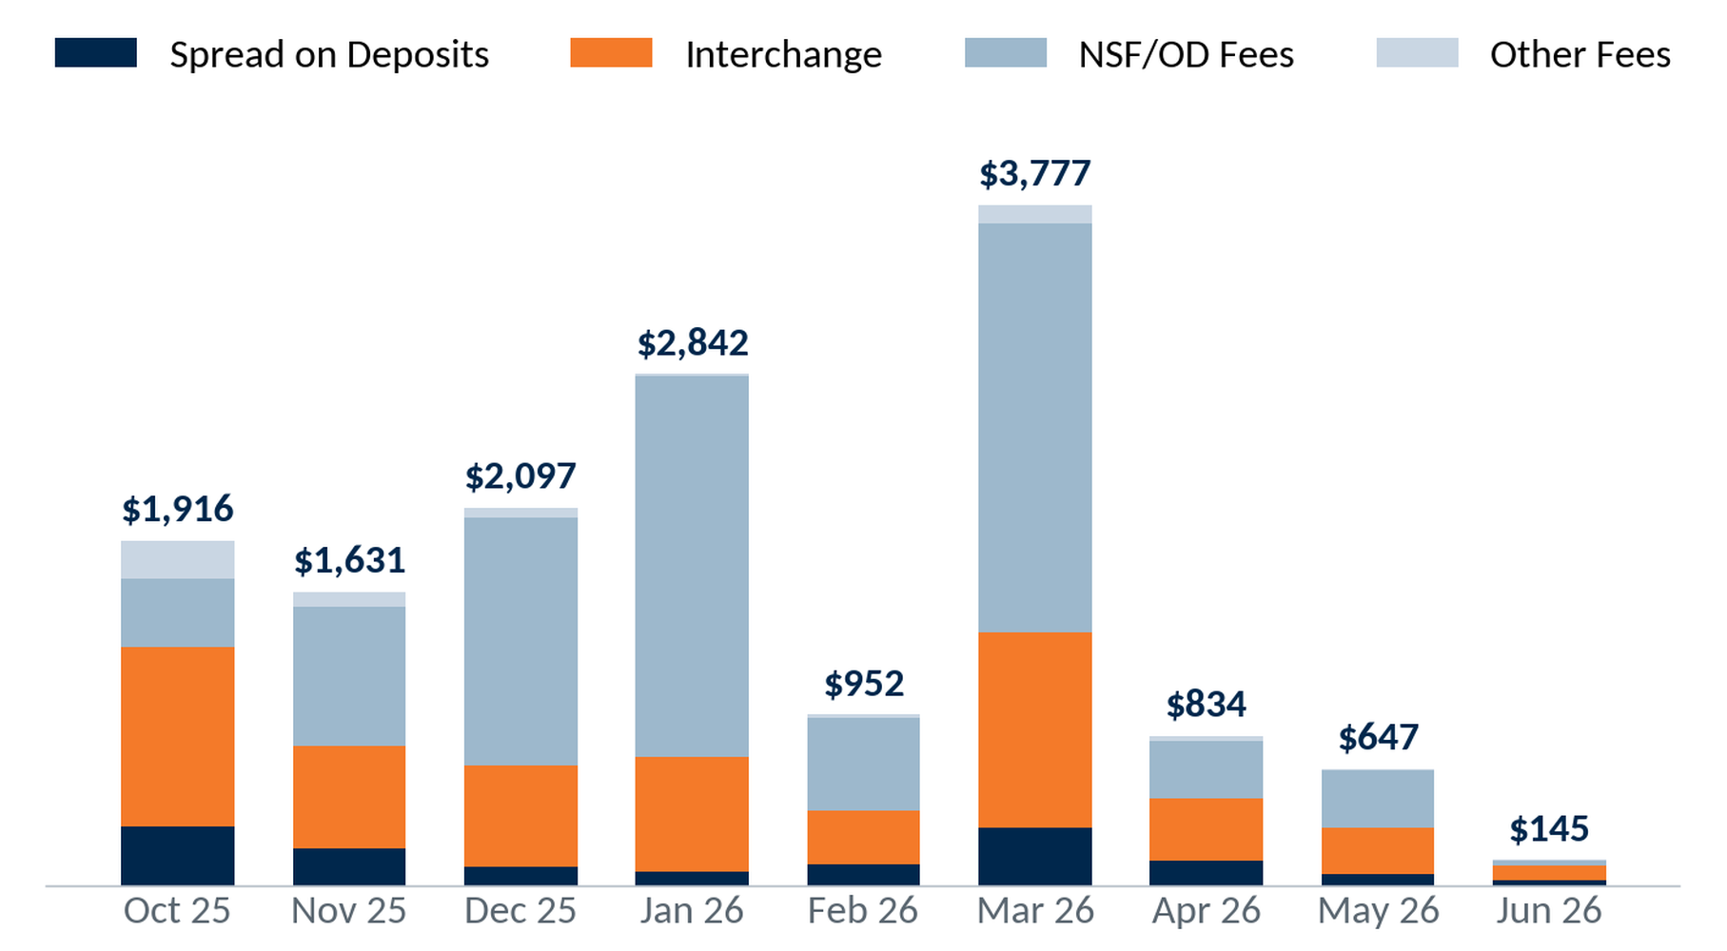
Revenue Composition by Month
Monthly revenue per referral by source: spread (net of interest), interchange, NSF/OD, other.
$14,841
Profit contribution PTD
1,396
ICS accounts
45
Notes:
Source — VIP Invitation Checking® System → ICS Referral Data dashboard (Looker embed) and 999-2026.07-Union Financial-Invitation Checking Workbook v1.7.1-DM.xlsx for Union Financial (999), pulled 2026-07-15. Monthly revenue composition by cohort. Workbook 'Monthly Detail'.

Slide 46
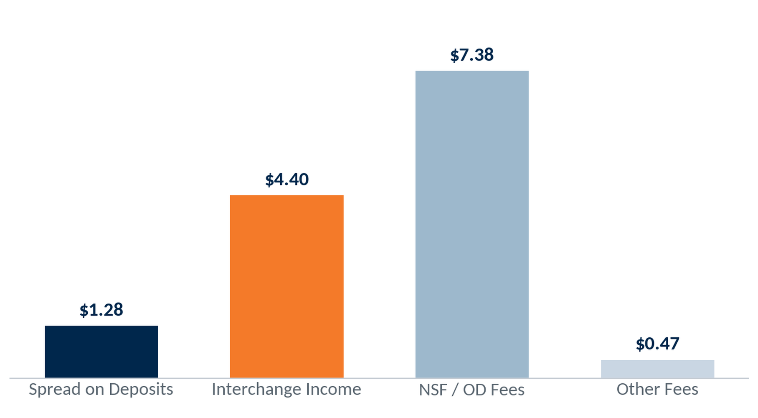
Revenue per Account per Month by Source
Blended revenue per account per month by source, life-to-date (cohort revenue ÷ account-months).
$13.53
All sources / acct / mo
1,396
ICS accounts
46
Notes:
Source — VIP Invitation Checking® System → ICS Referral Data dashboard (Looker embed) and 999-2026.07-Union Financial-Invitation Checking Workbook v1.7.1-DM.xlsx for Union Financial (999), pulled 2026-07-15. Per-account-per-month revenue compared across sources (spread, interchange, NSF/OD, other), life-to-date. Workbook 'Monthly Detail'.

Slide 47
ICS Financial Summary
PTD · June 2026
Selection: ICS-originated checking accounts; figures program-to-date.
Program to Date
1,396
ICS Accounts
$2.94M
Present Value
of New ICS Accounts
Account Profit Contribution
$546,236
Amortized Program Expense
$861
Average Balance
$115,162
Net Profit
$431,074
8.97 : 1
Return on Investment
Billed Expense for 1,396 Accounts
$328,060
Amortized expense: $235 ÷ 60 months = $3.92 per account per month × time open.
47
Notes:
Source — VIP Invitation Checking® System → ICS Referral Data dashboard (Looker embed) and 999-2026.07-Union Financial-Invitation Checking Workbook v1.7.1-DM.xlsx for Union Financial (999), pulled 2026-07-15. Contribution $546,236 − expense $115,162 = net $431,074; 1,396 accounts, avg balance $861. Present Value = $2,942,693 (annual profit × 9.26 yr × accounts); ROI 8.97:1 (recalculated, workbook ROI not used).

Slide 48
Comparisons
Velocity Clients' Average
Union Financial Data
29%
% of Total Openings
15%
$1,828
Lifetime Value
$2,108
6.7%
12 M Close Rate
0.9%
6.9 Years
Average Life of Account
9.26 Years
Note: your Non-ICS accounts' 12-month close rate = 0.9%.
48
Notes:
Source — VIP Invitation Checking® System → ICS Referral Data dashboard (Looker embed) and 999-2026.07-Union Financial-Invitation Checking Workbook v1.7.1-DM.xlsx for Union Financial (999), pulled 2026-07-15. Union Financial vs the Velocity ICS client average — openings/branch, lifetime value, 12-mo close rate (ICS 0.90% vs Non-ICS 0.90%), account life. Velocity averages are program-wide constants.

Slide 49

New in 2026: E-Learning Modules
Dynamic Learning- 5-10 minutes
Focused on one topic
On-the-go resources
Flexible schedule for lean teams
New content every quarter
49
Notes:
Program education / reference material. No client data.

Slide 50

E-Learning Library Guide
Leadership Training
  Description on Each Module
  Target Audience
  Length
  Link to Training
Invitation Checking System Training
  Description on Each Module
  Target Audience
  Length
  Link to Training
New Hire Training
  Description on Each Module
  Target Audience
  Length
  Link to Training
50
Notes:
Program education / reference material. No client data.

Slide 51
2026 New Releases
Leadership Training
Front Line Referrals
Quarter 1
How to Use the E-Learning Modules | The Power of Consistency: Driving Sustainable Referral Success
Accountability-Unlock Your Team’s Success | Same People? Turn Familiar Faces into Fresh Opportunities
Employee Engagement- Contests & More | Maximizing Referrals Through Social Media Engagement
Create A Calendar for Success | Incentive Accuracy: Avoiding Common Referral Reward Mistakes
Quarter 2
Referral Growth Strategies Outside the Branch- Who to Approach | Referral Conversations: Sales vs. Conversations
Referrals Outside the Branch- Preparation and Implementation | More Opportunities Using the 3-Steps Over the Phone
VIP-Referral Reporting Guide | Referral Quiz
Quarter 3
Coaching “THANK, ASK, OFFER” to Drive Referral Growth | The 3-Steps in Action
Just Say No- We Don’t Accept Excuses | Know the Tools: Empowering Conversations About Referrals
From Great to Greater- Coaching Your Best Performers | The Power of Personal Codes: Promotion, Usage & Results
Quarter 4
The Leadership Mirror-Leading by Example | Making Referral Flyers Work: Practical Tips for Referral Engagement
Meetings that Matter: Engaging Your Team | How Well Do You Know the Rewards Website?
Change Excuses to Excellence-Overcoming Objections | 3-Steps. Short on Time, Big on Impact: Fast Referral Promotion
51
Notes:
Program education / reference material. No client data.

Slide 52
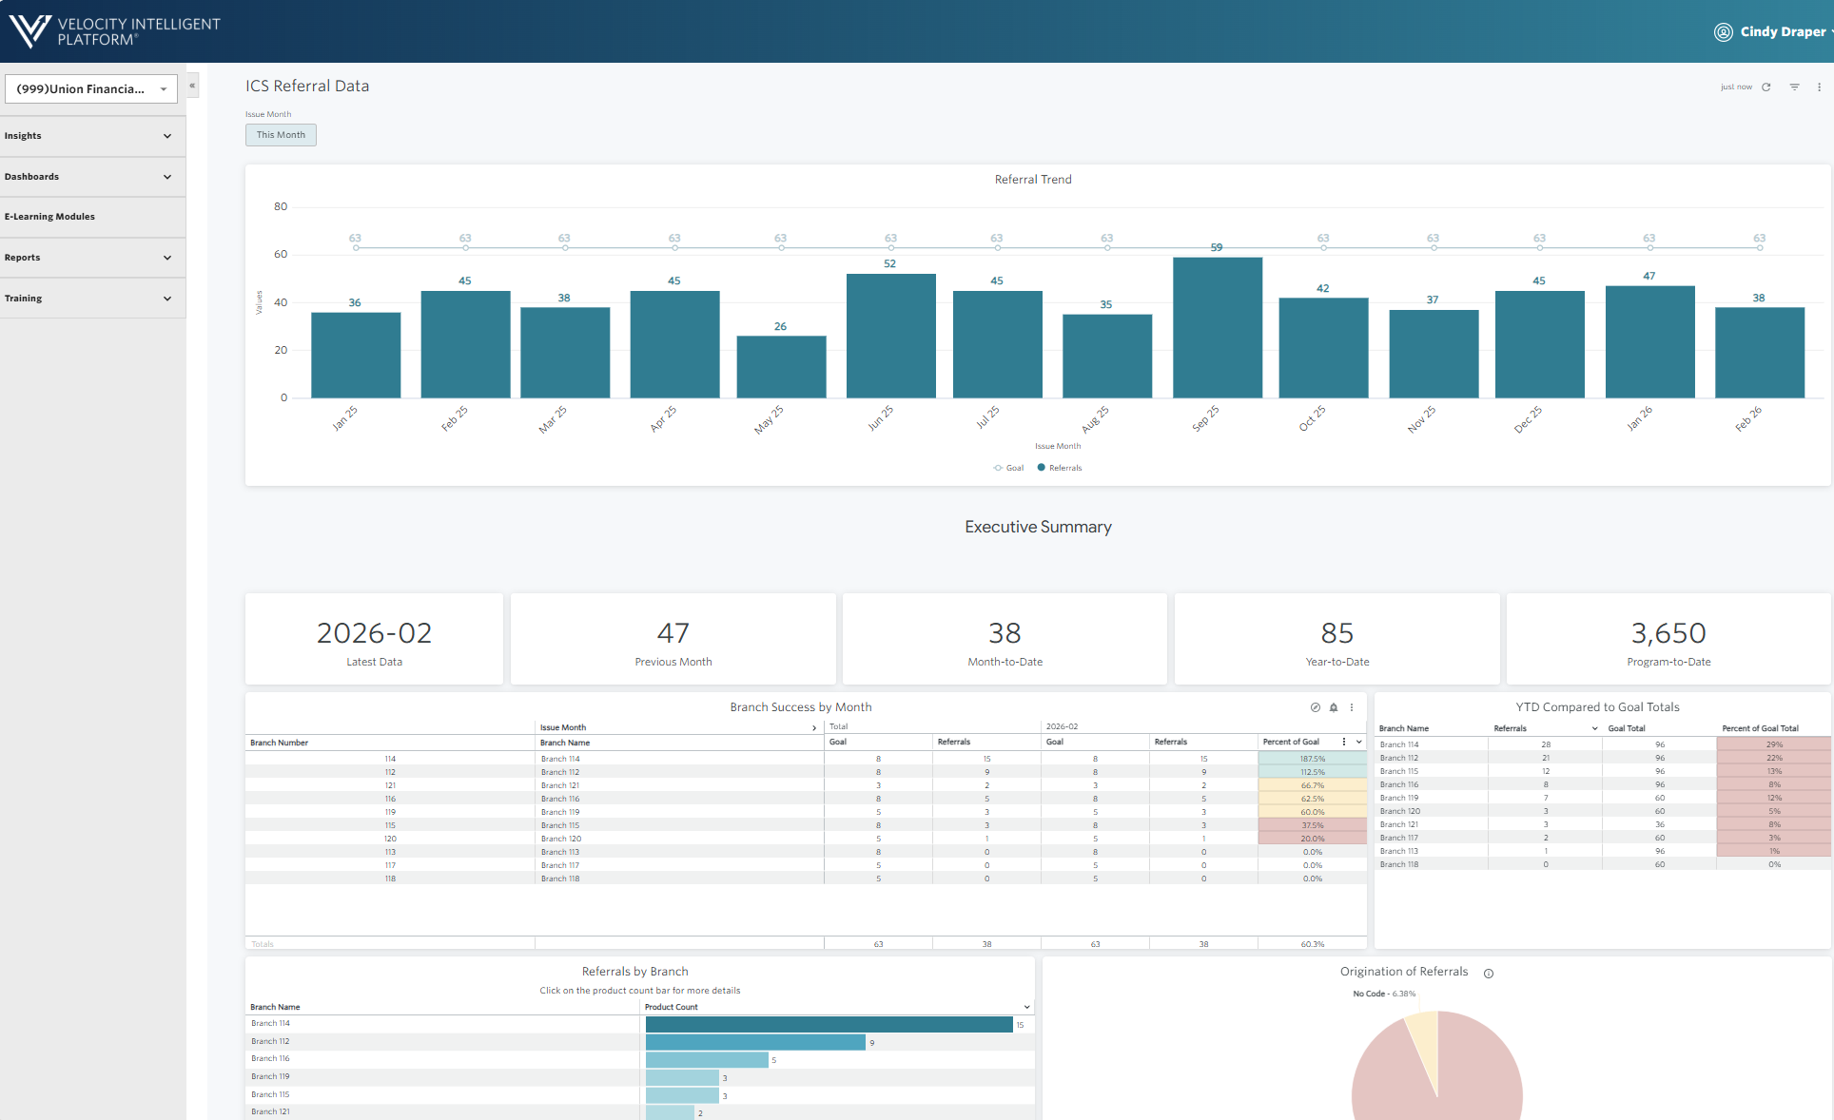
Reporting: VIP
Daily updates on referral activity
Monthly reports
Generate reports to be emailed to yourself
E-Learning Module Guides
Monthly Training Webinars/Newsletters
Reports
52
Notes:
Program education / reference material. No client data.

Slide 53
VIP Best Practices
Five habits that keep referral performance consistent across the organization.
1
Identify & Recognize Influencers
Spotlight the team members driving the most referrals.
2
Celebrate Success Across the Organization
Share wins widely to build momentum and friendly competition.
3
Reinforce Accountability
Set clear referral expectations for every branch and role.
4
Encourage Participation & Awareness
Keep the program top of mind with year-round touchpoints.
5
Conduct Periodic Audits
Review referral activity regularly and coach the gaps.
53
Notes:
Program education / reference material. No client data.

Slide 54
MyRewards Premium Cards®
Enrollments · Retention · Revenue
Notes:
Section divider (MyRewards Premium Cards®). No data.

Slide 55
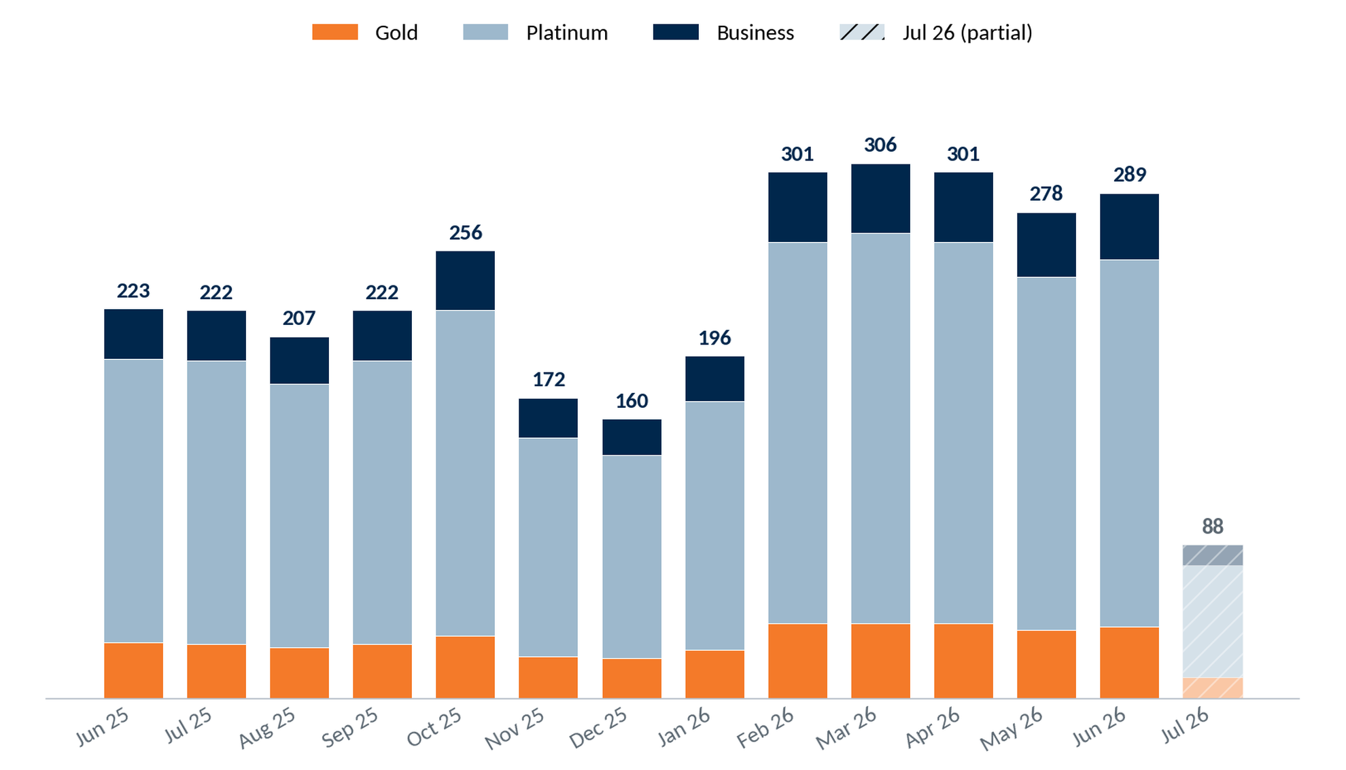
MRPC Enrollments by Month
Gold + Platinum (personal) and Business enrollments by month, last 14 months (Jun 2025 – Jul 2026); July is a partial month.
Gold
41
Jun 2026
Platinum
210
Jun 2026
Business
38
Jun 2026
55
Notes:
Source — VIP MyRewards Premium Cards dashboard (MRPC Enrollments) for Union Financial (1075), pulled 2026-07-10. Single stacked chart: Gold + Platinum + Business; callout shows Jun 2026 (last complete month) totals. Jul 2026 partial. Selection: Gold + Platinum (personal) and Business enrollments by month, last 14 months (Jun 2025 – Jul 2026). VIP, as of July 2026. Callout = Jun 2026, the last complete month; July is partial. Selection: Gold + Platinum (personal) and Business enrollments by month, last 14 months (Jun 2025 – Jul 2026). VIP, as of July 2026. Callout = Jun 2026, the last complete month; July is partial.

Slide 56
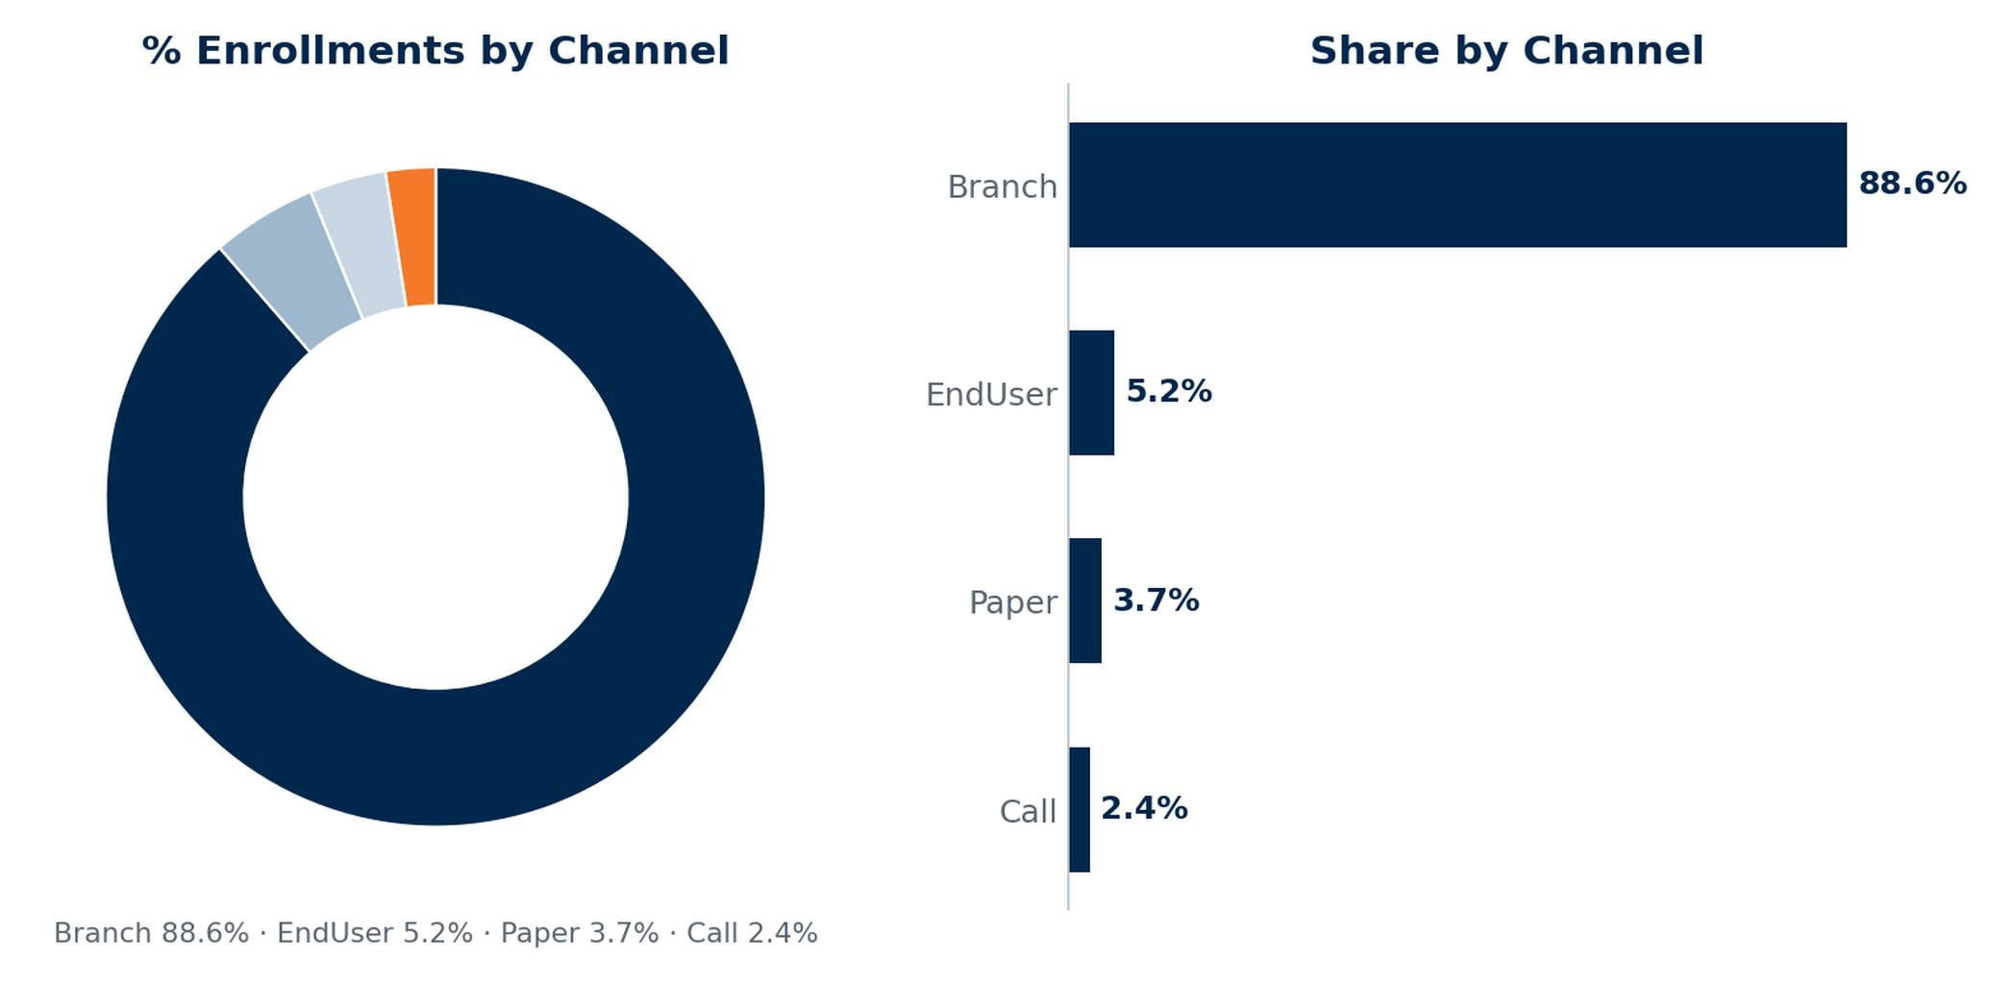
MRPC Enrollments by Channel
56
Notes:
Source — VIP MyRewards Premium Cards dashboards (Enrollments, Performance, Retention, Revenue to FI) for Union Financial (1075), pulled 2026-07-10; MRPCPM Analysis workbook. MRPC Enrollments by Channel (Branch 88.6% / EndUser 5.2% / Paper 3.7% / Call 2.4%). Selection: consumer enrollments by origination channel, program-to-date (VIP, July 2026). The branch network drives 88.6% of MRPC enrollments.

Slide 57
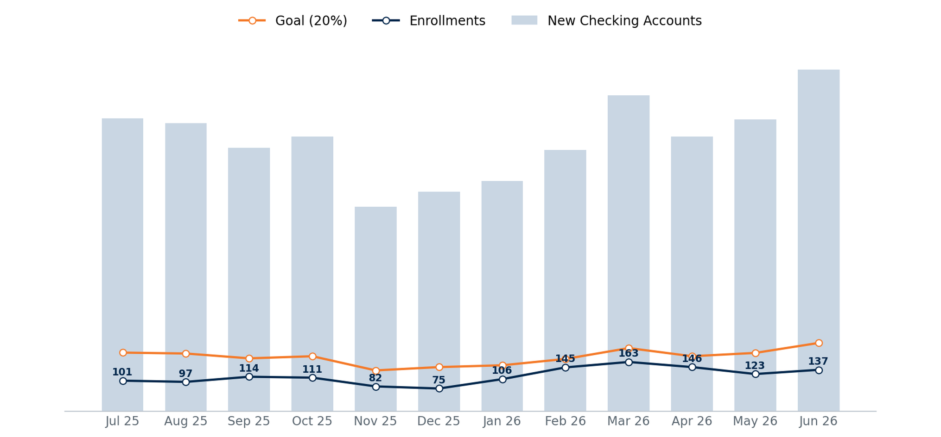
MRPC Enrollment Performance vs. Goal
New checking accounts (bars) vs the 20% enrollment goal and actual enrollments. Enrollment penetration averages ~55% of goal, peaking at 72% in Feb 2026.
57
Notes:
Source — VIP MyRewards Premium Cards dashboards (Enrollments, Performance, Retention, Revenue to FI) for Union Financial (1075), pulled 2026-07-10; MRPCPM Analysis workbook. MRPC Enrollment Performance vs 20% goal, 12 mo. Selection: new checking accounts vs. the 20% MRPC enrollment goal, 13 months (Jul 2025 – Jun 2026). VIP, as of July 2026.

Slide 58
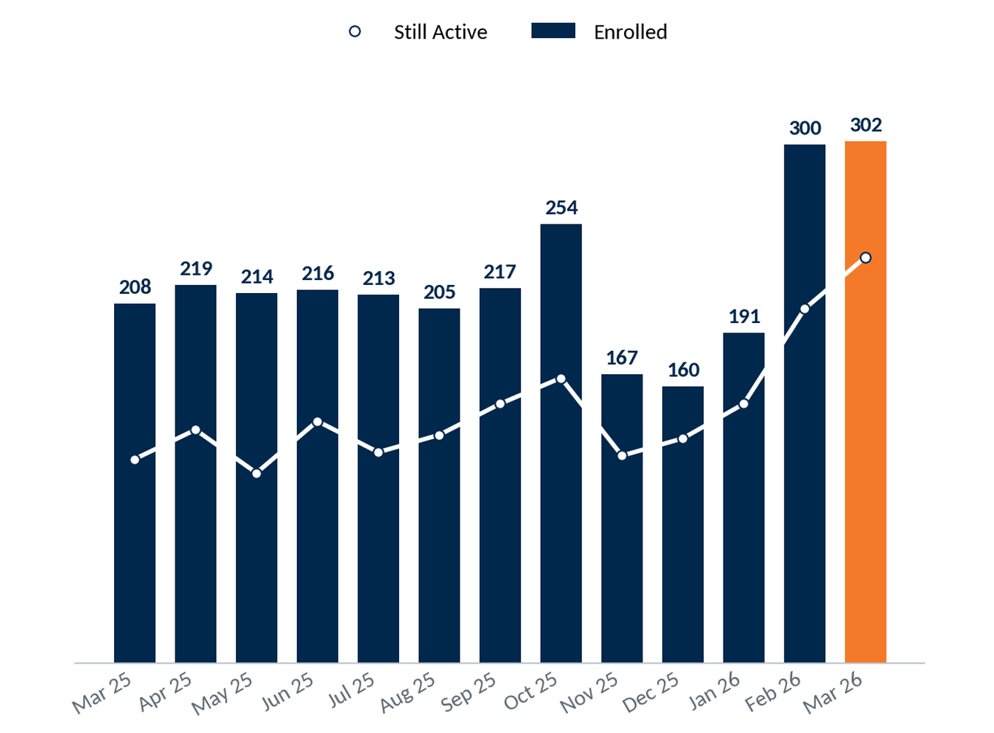
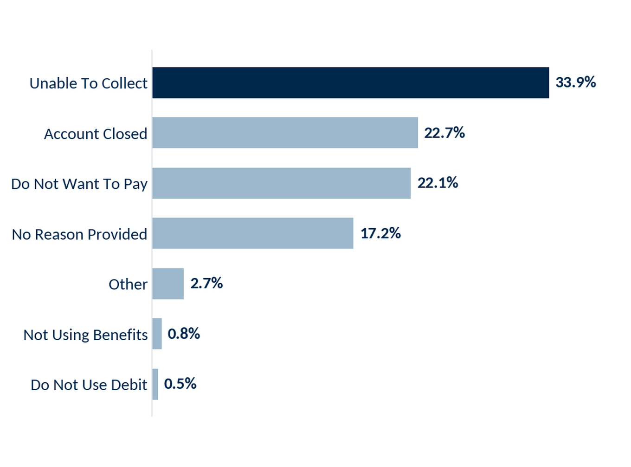
MRPC Retention
Retention by Month Enrolled
Cancellations by Reason
58
Notes:
Source — VIP MyRewards Premium Cards dashboards (Enrollments, Performance, Retention, Revenue to FI) for Union Financial (1075), pulled 2026-07-10; MRPCPM Analysis workbook. MRPC Retention by cohort month + cancellations by reason. Selection: enrolled MRPC members by enrollment-cohort month (Mar 2025 – Mar 2026), with count still active now. VIP, as of July 2026.

Slide 59
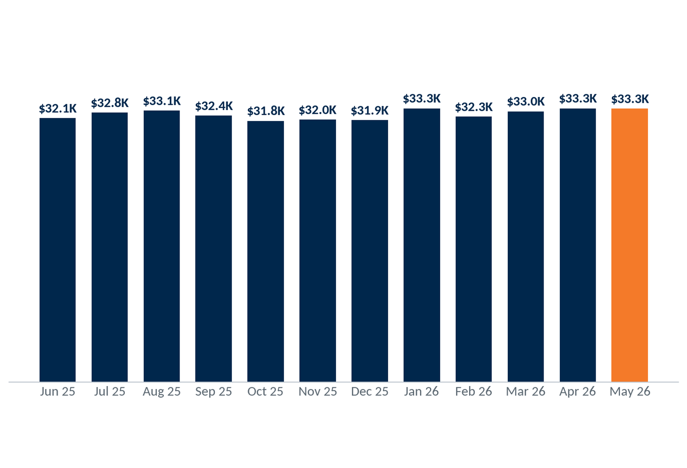
MRPC Revenue by Year to Union Financial
$380,695
2025 Revenue (~$31,700/mo)
$2,385,808
Life-of-Program Revenue
Revenue has grown across the life of the program to $380.7K in 2025 — $2.39M life-of-program. 2026 is at $165.3K through June.
* 2026 is year-to-date through June.
59
Notes:
Source — VIP MyRewards Premium Cards dashboards (Enrollments, Performance, Retention, Revenue to FI) for Union Financial (1075), pulled 2026-07-10; MRPCPM Analysis workbook. MRPC Revenue by year; 2025 $380,695, life-of-program $2,385,808, 2026 YTD $165,270. Pre-2025 annual bars approximate. Selection: MRPC program revenue to Union Financial; annual, with 2026 year-to-date through June.

Slide 60
MRPC Revenue by Month to Union Financial
$380,695
2025 Revenue (~$31,700/mo)
$2,385,808
Life-of-Program Revenue
Revenue has grown across the life of the program to $380.7K in 2025 — $2.39M life-of-program. 2026 is at $165.3K through June.
* 2026 is year-to-date through June.
60

Slide 61
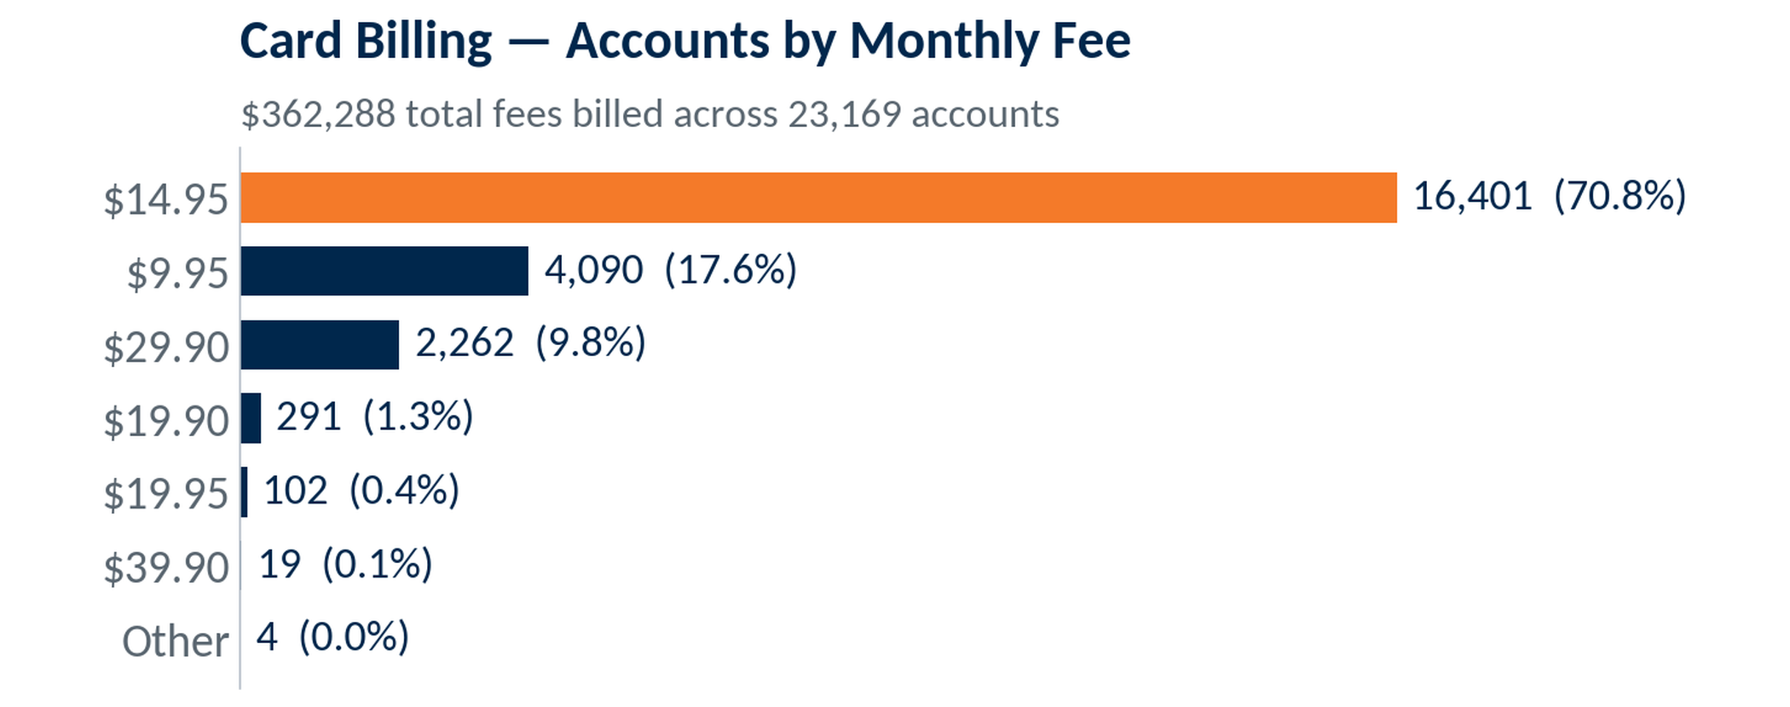
MRPC Card Portfolio
As of July 2026
$31,725
2,910
7,196
Avg Monthly Revenue
Enrollments, Trailing 12 Mo
Active Enrollments
27,800
Total Enrollments Program-to-Date
Program enrollments across all card tiers, life of program.
61

Slide 62
MRPC Key Metrics
As of July 2026
$31,725
2,910
7,196
Avg Monthly Revenue
Enrollments, Trailing 12 Mo
Active Enrollments
Tier Mix (Program to Date)
27,800
Platinum — 16,401 (71%)
Gold — 4,090 (18%)
Business Platinum — 102 (0%)
Multiple Cards — 2,576 (11%)
Total Enrollments Program-to-Date
Program enrollments across all card tiers, life of program.
Cross-sale: 11.1% of accounts hold more than one card.
62
Notes:
Source — VIP MyRewards Premium Cards dashboards (Enrollments, Performance, Retention, Revenue to FI) for Union Financial (1075), pulled 2026-07-10; MRPCPM Analysis workbook. MRPC Key Metrics: avg monthly revenue $31,725; trailing-12 2,910; active 7,196; tier mix (trailing) Gold 521/Platinum 2,398; PTD ~27,800 (VERIFY). Selection: consumer-only program (no business tier); measurement window noted per metric. Card billing (Total Fees by Fee Charged) from VIP MyRewards dashboard, Union Financial (1075), pulled 2026-07-10: $362,287.55 total fees across 23,169 accounts; $14.95 tier = 16,401 acct / $245,194.95.

Slide 63
Questions & Discussion
Union Financial • July 2026
Notes:
Source: section slide (static).

Slide 64
Contact Us
Aaron Burgard
Client Service Manager
910-617-1984
aaron.burgard@csiweb.com
64
Notes:
Source: CSI / Velocity Solutions contact information (static).

Slide 65
Appendix
Additional ARS Respondent Insights
Notes:
Source: section slide (static).

Slide 66
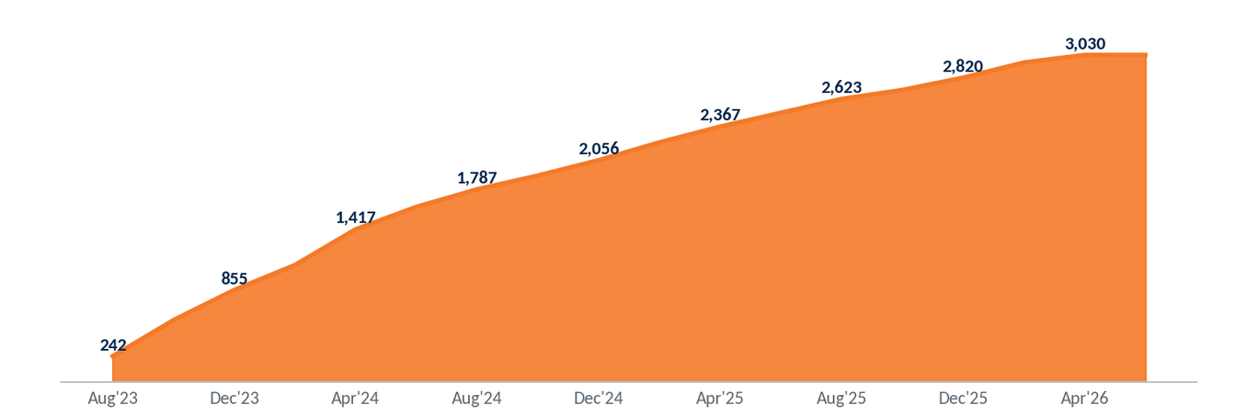
Program Reach — Cumulative Responders
Distinct customers who have responded to at least one ARS mailing, accumulated across the program.
3,030
Customers Reached
~178
Net-New per Mailing
66
Notes:
Source: ODD extract 999 Union Financial (demo data; Jul23-forward), Jun 2026 snapshot — responder / new-account analytics; associational, not causal where noted.

Slide 67
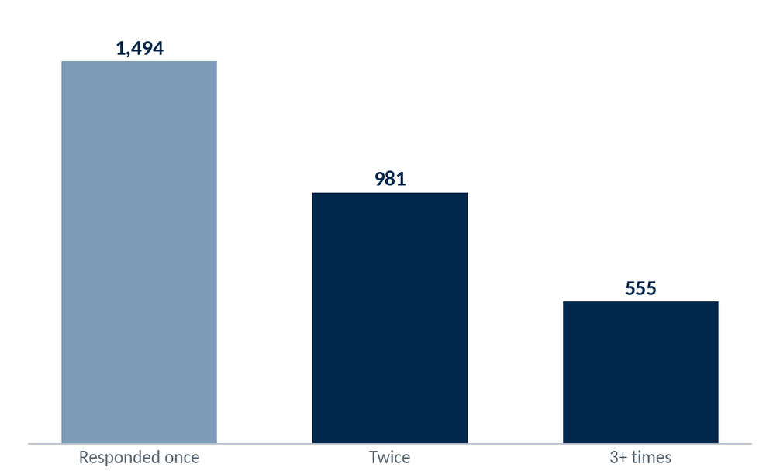
Depth of Engagement — Repeat Responders
50.7% of responders (1,536 customers) have responded to two or more mailings
67
Notes:
Source: ODD extract 999 Union Financial (demo data; Jul23-forward), Jun 2026 snapshot — responder / new-account analytics; associational, not causal where noted.

Slide 68
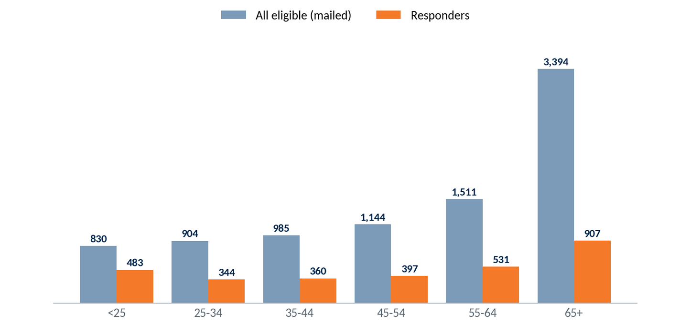
Responder Age Profile
Selection: ARS-eligible personal accounts (8,768 with age on file). Age mix — full eligible base vs. responders, as of June 2026.
Response rates are highest among younger accounts — 58% of under-25 eligibles respond versus 27% of those 65+ — even though the eligible base skews older (55+ = 56%).
68
Notes:
Source: ODD extract 999 Union Financial (demo data; Jul23-forward), Jun 2026 snapshot — responder / new-account analytics; associational, not causal where noted.

Slide 69
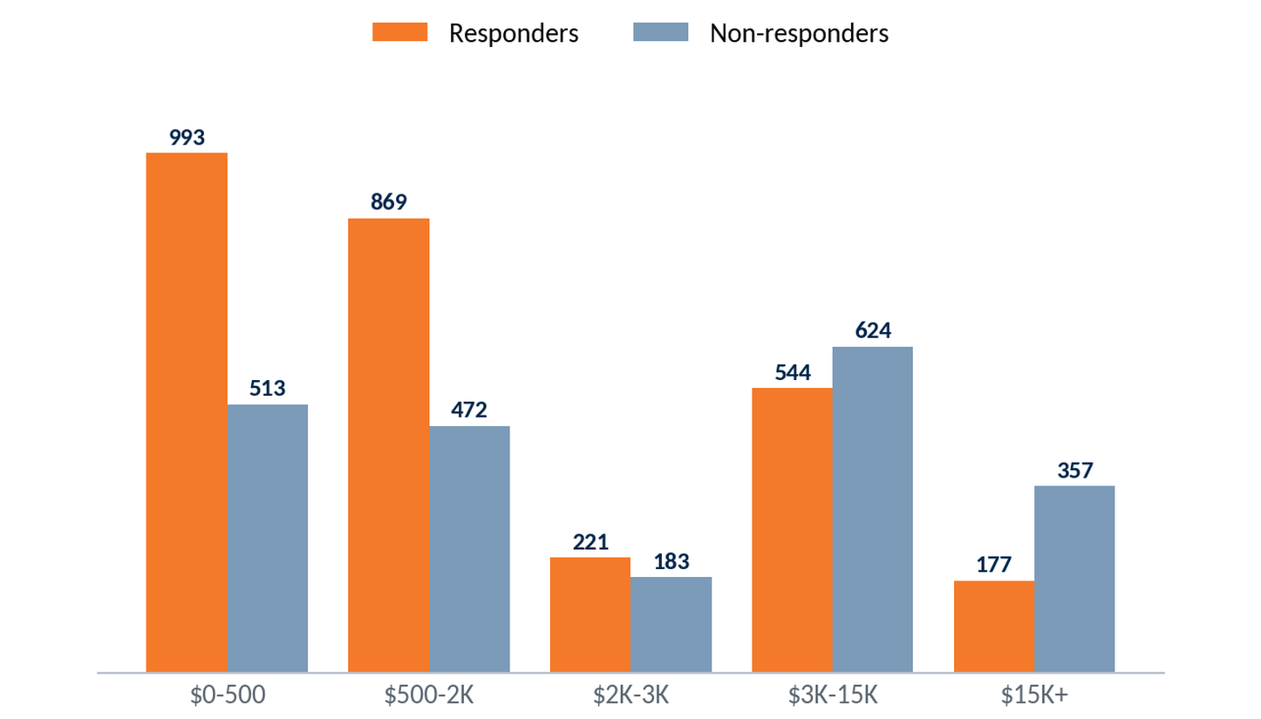
Who Responds — Balance Profile
Responders carry lower balances than non-responders (median $887 vs $2,409) — ARS engages transaction-reliant customers, not the highest-balance ones. (Eligibility = any account scored across the recent 12 mailings.)
69
Notes:
Source: ODD extract 999 Union Financial (demo data; Jul23-forward), Jun 2026 snapshot — responder / new-account analytics; associational, not causal where noted.

Slide 70
New Account Profile
Personal accounts opened July 2025 through June 2026
Notes:
Source: ODD extract 999 Union Financial (demo data; Jul23-forward), Jun 2026 snapshot — responder / new-account analytics; associational, not causal where noted.

Slide 71
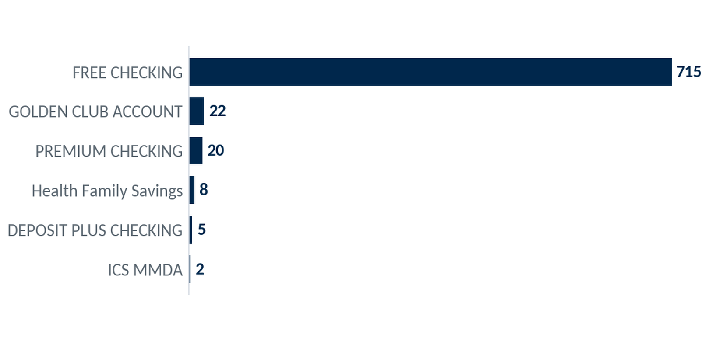
New Accounts by Product
Selection: personal accounts opened July 2025 – June 2026 (all product types). Checking products shown in orange.
772
New accounts opened
94%
Still open today
96%
FREE CHECKING makes up 93% of new personal accounts; checking products lead new growth.
Checking products
71
Notes:
Source: ODD extract 999 Union Financial (demo data; Jul23-forward), Jun 2026 snapshot — responder / new-account analytics; associational, not causal where noted.

Slide 72
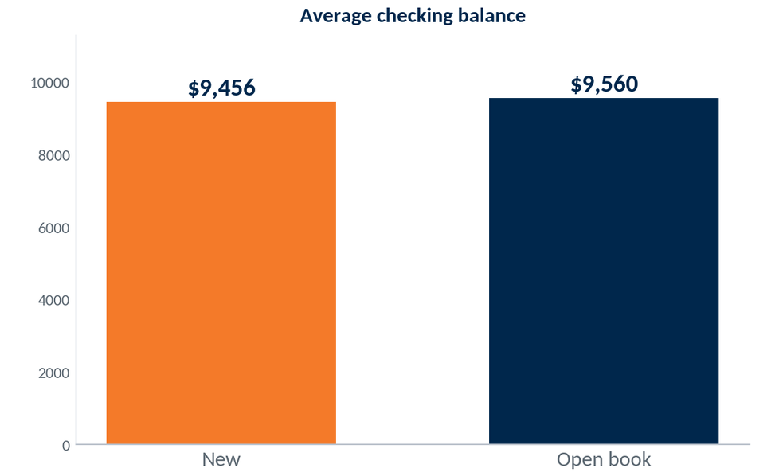
New Checking Balances vs. Existing Book
Selection: personal checking accounts. New (opened July 2025 – June 2026) vs. all open personal checking accounts. Average current balance.
$9,456
Avg bal, new checking
$9,560
Avg bal, open checking
93%
New checking accounts open near the existing book on balance ($9,456 vs $9,560); 93% are funded above zero.
New checking funded >$0
72
Notes:
Source: ODD extract 999 Union Financial (demo data; Jul23-forward), Jun 2026 snapshot — responder / new-account analytics; associational, not causal where noted.

Slide 73
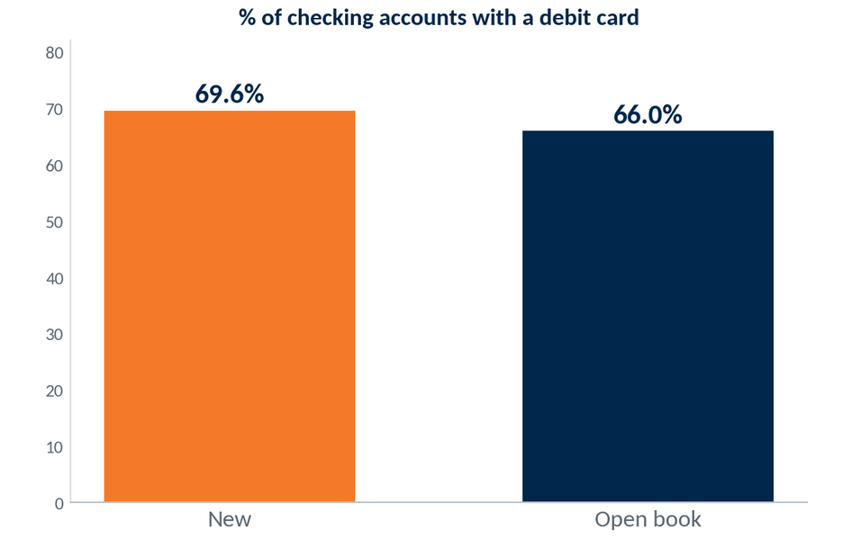
Debit Card Penetration — New vs. Book
Selection: personal checking accounts. New (opened July 2025 – June 2026) vs. all open personal checking accounts. Share carrying a debit card.
69.6%
New checking w/ debit
+3.6pt
vs. open book (66.0%)
New personal checking accounts carry a debit card 69.6% of the time — well above the 66.0% rate on the existing book.
73
Notes:
Source: ODD extract 999 Union Financial (demo data; Jul23-forward), Jun 2026 snapshot — responder / new-account analytics; associational, not causal where noted.

Slide 74
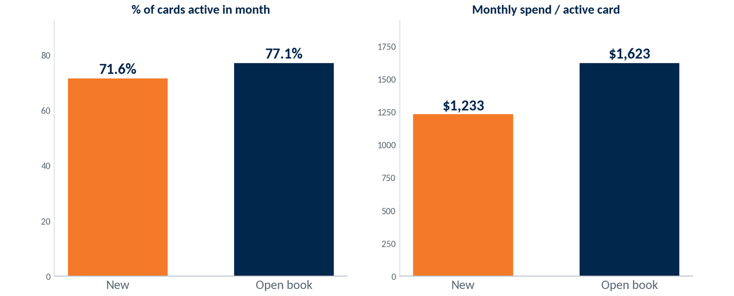
Debit Card Usage — New vs. Existing Book
Selection: personal debit-card holders, active in June 2026 (≥1 PIN/signature transaction). New (opened July 2025 – June 2026) vs. all open personal accounts, per active card.
71.6%
New cards active/mo
$1,233
Spend/active card/mo
82%
By their first year new personal cards are approaching the established book — 71.6% active in June versus 77.1%, at $1,233 spend per active card versus $1,623.
New cards ever swiped
74
Notes:
Source: ODD extract 999 Union Financial (demo data; Jul23-forward), Jun 2026 snapshot — responder / new-account analytics; associational, not causal where noted.

Slide 75
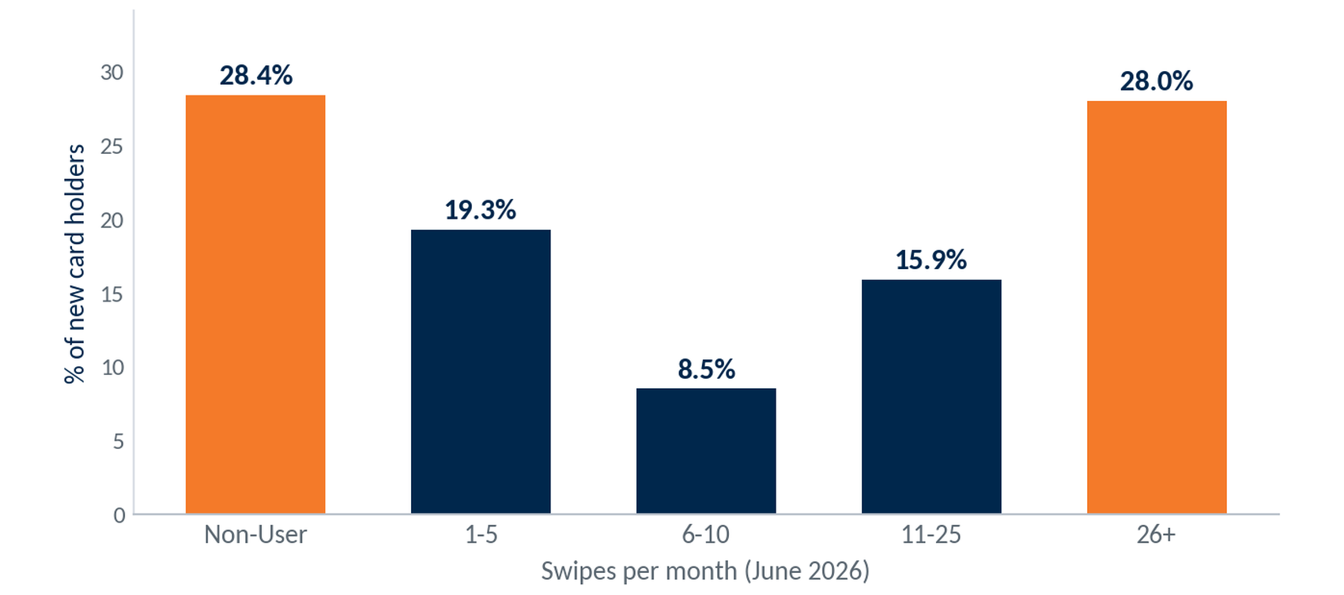
New-Account Debit Adoption — Swipe Segmentation
Selection: new personal accounts holding a debit card, opened July 2025 – June 2026 (n=529). Swipe activity for June 2026.
529
New card holders
71.6%
Swipe monthly (≥1/mo)
28.0%
Heavy users (26+/mo)
New-account debit use is split: 28% are already heavy users (26+ swipes/mo) while 28% are non-users, with the rest across the light tiers.
75
Notes:
Source: ODD extract 999 Union Financial (demo data; Jul23-forward), Jun 2026 snapshot — responder / new-account analytics; associational, not causal where noted.

Slide 76
New Account Profile — Summary
Personal accounts opened Jul 2025 – Jun 2026 (trailing 12 months)
Consumer checking leads new growth.
772 new personal accounts opened. FREE CHECKING makes up 93% of openings.
Most new checking accounts carry a debit card.
69.6% of new checking accounts carry a debit card, well above the 66.0% rate on the existing book.
Opening balances are near the book.
New checking accounts average $9,456 versus $9,560 on the book; 93% carry a balance above zero.
First-year card use is lighter.
71.6% of new cards are active monthly versus 77.1% on the book, at $1,233 spend per active card.
76
Notes:
Source: ODD extract 999 Union Financial (demo data; Jul23-forward), Jun 2026 snapshot — responder / new-account analytics; associational, not causal where noted.

Slide 77
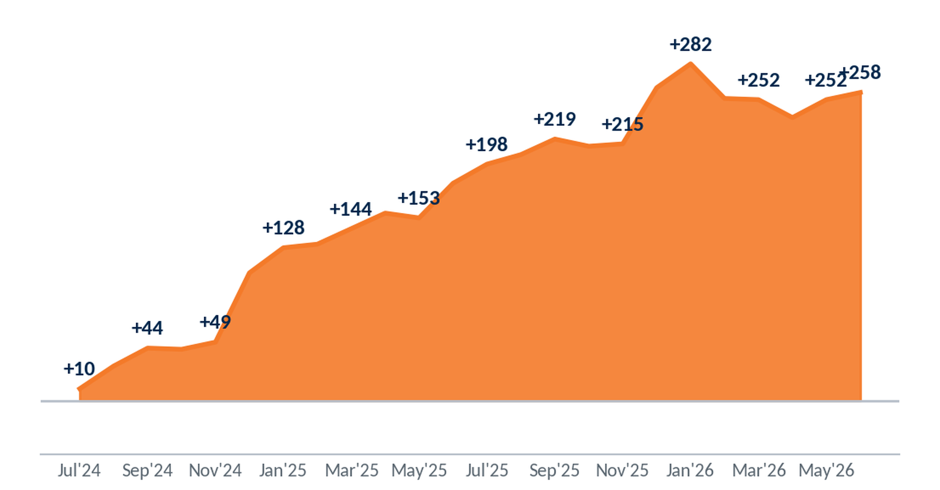
Account Growth — Openings vs. Closures
Selection: personal accounts. Openings and closures over the trailing 24 months (Jul 2024 – Jun 2026); line = cumulative net.
+258
Net new (24 mo)
1,548
Accounts opened
1,290
The personal book grew a net +258 over the trailing 24 months — roughly +11 accounts per month, with openings outpacing closures across the period.
Accounts closed
77
Notes:
Source: ODD extract 999 Union Financial (demo data; Jul23-forward), Jun 2026 snapshot — responder / new-account analytics; associational, not causal where noted.

Slide 78
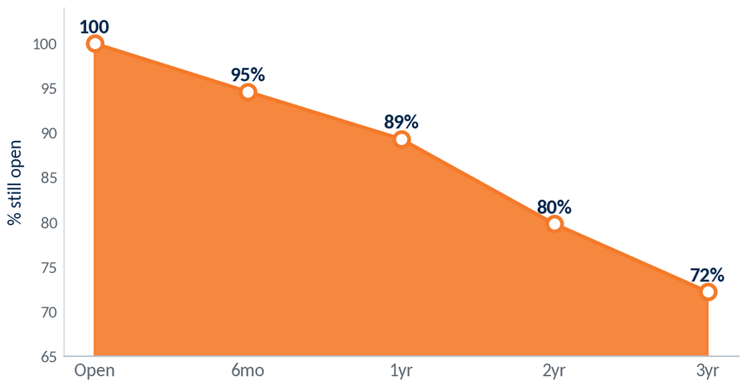
Account Retention — Survival by Tenure
Selection: personal accounts by months since opening. Kaplan-Meier survival for accounts opened since Jul 2021 (the window with fully-observed closings).
89%
Retained at 1 year
72%
Retained at 3 years
4.5 yr
First-year retention is 89%, easing to about 72% by year three. Half of closed accounts stayed open about 4.5 years — attrition is steady, not early.
Median lifespan (closed)
78
Notes:
Source: ODD extract 999 Union Financial (demo data; Jul23-forward), Jun 2026 snapshot — responder / new-account analytics; associational, not causal where noted.

Slide 79

First-Year Closure by Early Debit Use
Selection: consumer accounts opened Jul 2023 – Jun 2025 (n=1,466); ‘used debit early’ = ≥1 swipe in the first 3 months. Conditional closure probabilities updated from the 13.4% base rate (Bayes).
Early debit use tracks with better first-year retention — 10.3% close vs 17.4% for non-users.
79
Notes:
Source: ODD extract 999 Union Financial (demo data; Jul23-forward), Jun 2026 snapshot — responder / new-account analytics; associational, not causal where noted.

