Slide 1

Account Revenue Solution®
Union Financial
Executive Review • July 2026
Notes:
Source: program metadata. Reporting month = generation month (Jul 2026).

Slide 2

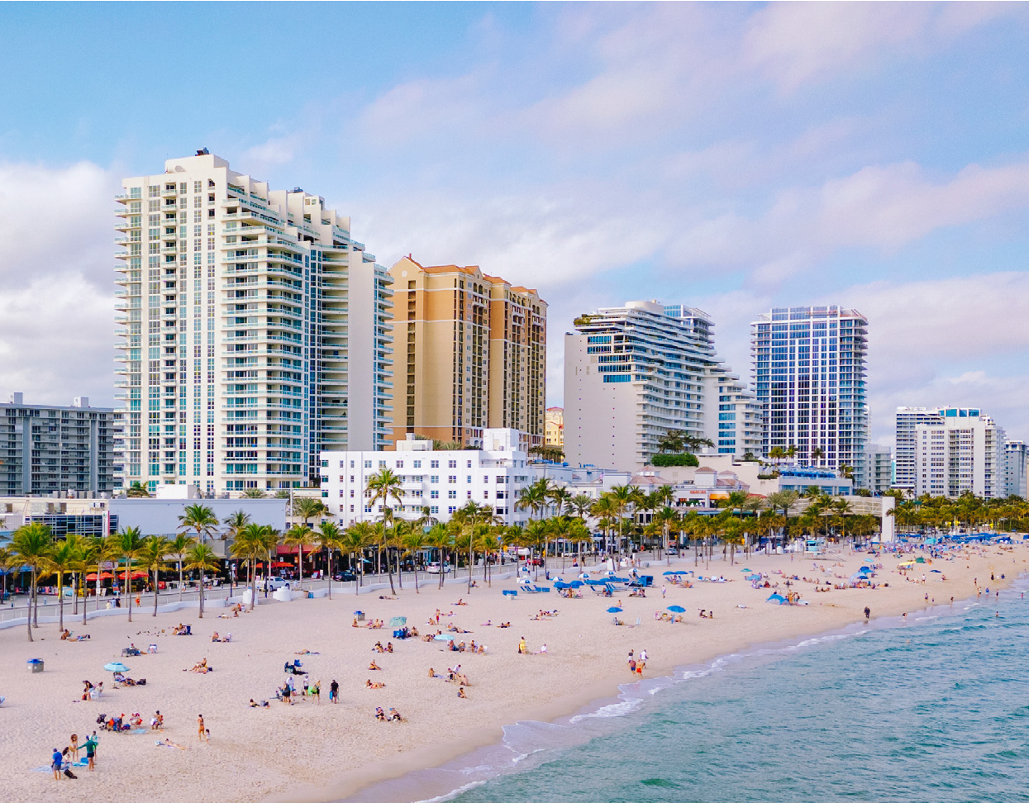




Executive Summit is an action-packed event!
Fort Lauderdale, FL November 4-5, 2026
The Executive Summit brings select banking and credit union leaders together to explore real-world strategies for growth, resilience, and innovation. Get an inside look at how your peers tackle complex challenges with bold ideas, modern technology, and the right partners. We’ll cover all this and more:
Account Acquisition
Retail Performance
Driving Deposits
Better Onboarding
Responsible Overdraft
Consumer Liquidity
Leveraging Core Data
Monetizing Debit
Engaging Consumers
Driving Transactions
Account Reacquisition
Lending
These events are complimentary to qualified attendees, including airfare (up to $600), hotel and meals.
©2026 CSI. All Rights Reserved
Notes:
Source — Executive Summit slide, build/assets/summit_slide.pptx (Fort Lauderdale, FL November 4-5, 2026). Standing front matter, identical in every deck; carries no client data.

Slide 3
Agenda
1
Program Performance
Overview, financial results, Monthly Summary, debit segmentation
2
Mailing Insights
Response summary, movement, sustained activity, before vs. after
3
Debit Card & Reg E Review
Take rate, swipes & spend, overdraft opt-in
4
Questions & Discussion
3
Notes:
Source: standard ARS Executive Review front matter (static).

Slide 4
Account Revenue Solution®
Mailings · Debit Card · Reg E
Notes:
Source: ODD extract 999 Union Financial (demo data; Jul23-forward), Jun 2026 snapshot — responder / new-account analytics; associational, not causal where noted.

Slide 5
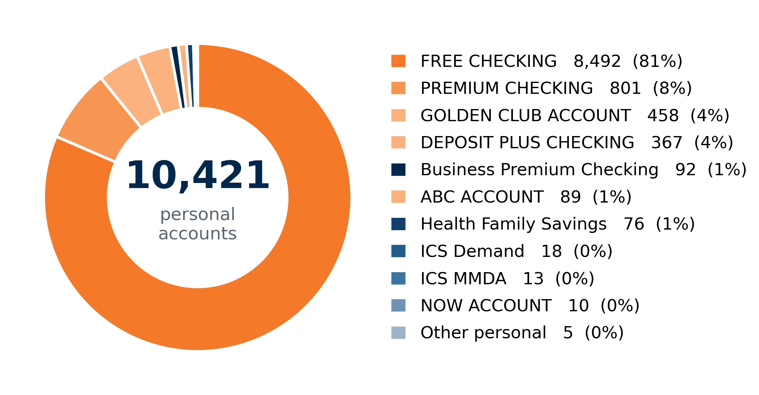

Product Mix & ARS Eligibility
June 2026 Data
Open deposit accounts by product. ARS eligibility reflects the current program eligibility flag.
12,391
8,920
72%
5
Open accounts
ARS-eligible accounts
Eligible share of open
Eligible products (of 27)
Products & ARS Eligibility
Product | Open | ARS-Elig.
FREE CHECKING | 8,492 | 7,291
PREMIUM CHECKING | 801 | 772
GOLDEN CLUB ACCOUNT | 458 | 427
DEPOSIT PLUS CHECKING | 367 | 345
ABC ACCOUNT | 89 | 85
All other products (22) | 2,184 | —
Total — open accounts | 12,391 | 8,920
5
Notes:
Source: ODD extract 999 Union Financial (demo data; Jul23-forward), Jun 2026 snapshot — open personal/business accounts by product; ARS eligibility = latest 'Jun26 Elig' = Yes.

Slide 6
Program Overview
PTD · June 2026
Union Financial has run Account Revenue Solution® for 226 months across 81 mailings since 2007.
8,920
71.0%
36.3%
18.8%
81
Eligible ARS Accounts
Debit Card Take Rate
Reg E Opt-In (Personal)
Avg Mailing Response
Mailings to Date
• Account Revenue Solution® has returned $5.69M in incremental profit program-to-date — a 5.7 : 1 profitability ratio.
• Card-holding accounts have grown over the last 36 months — 6,805 → 7,101 (+4.3%).
• Responders show durable behavior change: every recent mailing produced a positive monthly debit-spend increase per responder.
6
Notes:
Source: ARS Workbook 999 (999-2026.07-Union Financial-Workbook_DEMO.xlsx) — Executive Financials / All Months Rollup (PTD incremental revenue/profit, profitability, monthly incremental revenue). Data thru Jun 2026.

Slide 7
ARS Financial Performance
PTD · June 2026
$6.89M
$5.69M
5.7 : 1
PTD Incremental Revenue
PTD Incremental Profit
PTD Profitability
$57,270
$51,569
Revenue This Month
Profit This Month
• Account Revenue Solution® has generated $6.89M in incremental revenue and $5.69M in incremental profit program-to-date.
• Profitability of 5.7 : 1 is well above the 2 : 1 threshold — there is no deferred billing on this program.
• The program has run 226 months across 81 mailings, with $57,270 in incremental revenue this month.
7
Notes:
Source: ARS Workbook 999 (999-2026.07-Union Financial-Workbook_DEMO.xlsx) — Executive Financials / All Months Rollup (PTD incremental revenue/profit, profitability, monthly incremental revenue). Data thru Jun 2026.

Slide 8
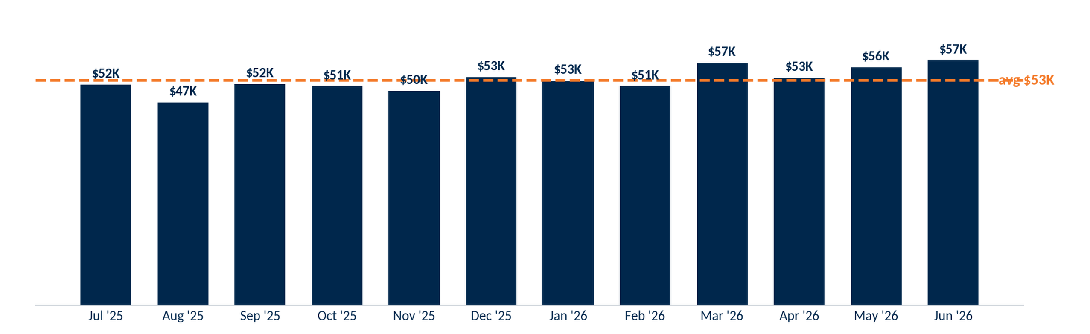
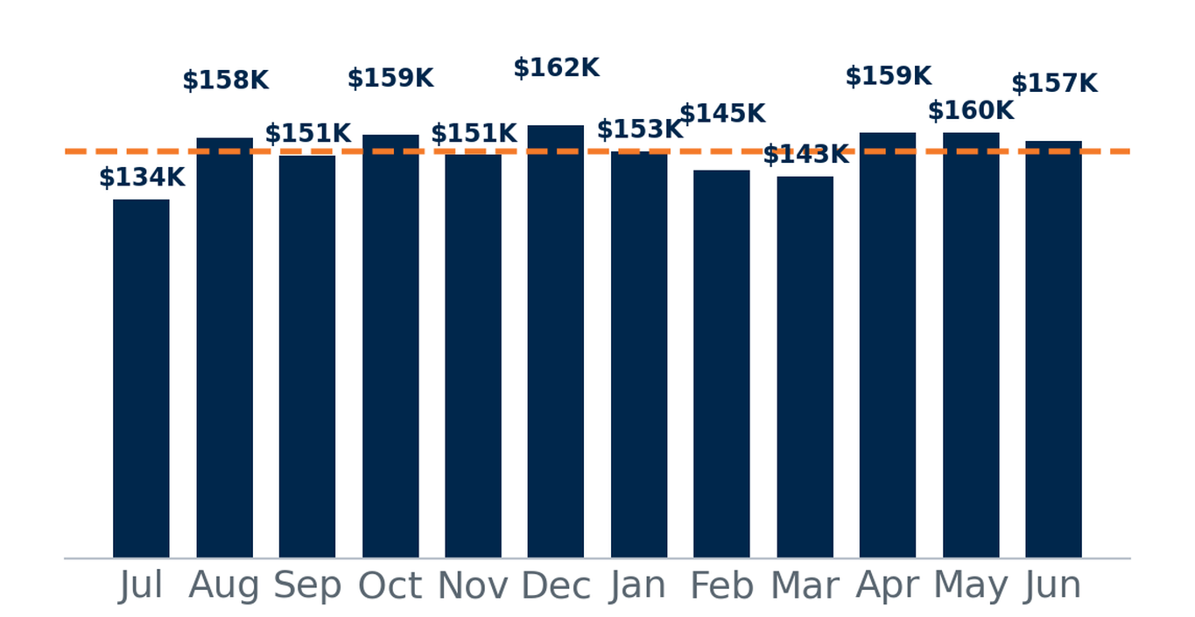
Monthly Summary — Last 12 Months
07-2025 · 06-2026
Selection: monthly incremental revenue, most recent 12 months (SM revenue model).
Monthly incremental revenue averaged $53K over the last 12 months, totaling $632K in program contribution.
8
Notes:
Source: ARS Workbook 999 (999-2026.07-Union Financial-Workbook_DEMO.xlsx) — All Months Rollup / Executive Financials (monthly incremental revenue, most recent 12 months).

Slide 9
Debit Usage Segmentation by Swipe Tier
Avg
Selection: ARS-eligible personal accounts. Monthly figures are 3-month averages (Apr – Jun 2026), the most recent transaction data available.
Segment | Accounts | % of Accts | Swipes | % of Swipes | Spend | % of Spend | MTD NSFs | % of NSFs
No Debit Card | 2,586 | 29% | 123 | 0% | $10K | 0% | 207 | 11%
Non-User | 1,445 | 16% | 138 | 0% | $17K | 0% | 63 | 3%
1-5 | 866 | 10% | 2,162 | 1% | $190K | 3% | 124 | 6%
6-10 | 491 | 6% | 3,905 | 2% | $258K | 3% | 93 | 5%
11-15 | 382 | 4% | 4,943 | 3% | $274K | 4% | 83 | 4%
16-20 | 298 | 3% | 5,367 | 3% | $310K | 4% | 88 | 4%
21-25 | 284 | 3% | 6,537 | 4% | $354K | 5% | 147 | 7%
26+ | 2,568 | 29% | 136,444 | 85% | $6,025K | 81% | 1,155 | 59%
Total | 8,920 | 100% | 159,618 | 100% | $7,438K | 100% | 1,961 | 100%
9
Notes:
Source: ODD extract 999 Union Financial (demo data; Jul23-forward), Jun 2026 snapshot — debit swipes/spend by tier.

Slide 10
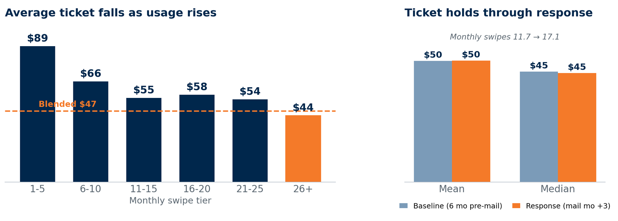
Average Ticket by Swipe Segment
Selection: ARS-eligible personal accounts with debit activity. Left: average spend per swipe by monthly-swipe tier (3-mo avg, Apr–Jun 2026). Right: mailing responders, ticket before vs. after response.
Spend per swipe declines as usage rises — light users (1-5/mo) average $89 per swipe versus $44 for heavy users (26+/mo), around the $47 blend. For responders, ticket holds through response (mean $50→$50, median $45→$45) while monthly swipes rise 11.7→17.1: the gain is more transactions, not larger ones.
10
Notes:
Source: ODD extract 999 Union Financial (demo data; Jul23-forward), Jun 2026 snapshot — debit swipes/spend by tier.

Slide 11
Mailing Insights
ARS Direct Mail Performance
Notes:
Source: ARS Workbook 999 (999-2026.07-Union Financial-Workbook_DEMO.xlsx) — Mail Response Summary + ODD extract 999 Union Financial (demo data; Jul23-forward), Jun 2026 snapshot mailing/response fields.

Slide 12
Mailing Response Summary
Most recent 12 of the program's 81 mailings (MM revenue model).
Mailing | NU 5+ | Threshold Met | Response %
Apr 2026 | 3.0% | 12.1% | 15.1%
Feb 2026 | 3.7% | 21.0% | 24.7%
Dec 2025 | 3.3% | 14.7% | 18.0%
Oct 2025 | 3.7% | 11.3% | 15.0%
Aug 2025 | 3.3% | 16.6% | 19.9%
Jun 2025 | 3.7% | 15.5% | 19.2%
Apr 2025 | 3.7% | 17.0% | 20.7%
Feb 2025 | 2.7% | 18.7% | 21.4%
Dec 2024 | 3.2% | 14.5% | 17.7%
Oct 2024 | 3.0% | 13.2% | 16.3%
Aug 2024 | 2.1% | 15.0% | 17.1%
Jun 2024 | 3.7% | 17.3% | 21.0%
Trailing 12-Mailing Avg | 3.3% | 15.6% | 18.8%
12
Notes:
Source: ARS Workbook 999 (999-2026.07-Union Financial-Workbook_DEMO.xlsx) — Mail Response Summary + ODD extract 999 Union Financial (demo data; Jul23-forward), Jun 2026 snapshot mailing/response fields.

Slide 13
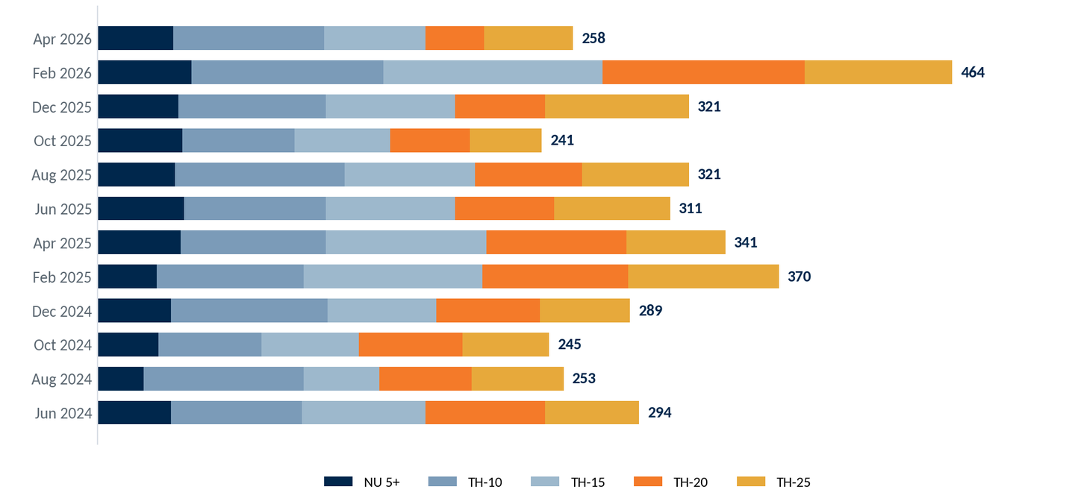
Mailing Response Ranking by Tier
Responders by tier (NU 5+ and Threshold goal met), shown chronologically — most recent mailing at top.
13
Notes:
Source: ARS Workbook 999 (999-2026.07-Union Financial-Workbook_DEMO.xlsx) — Mail Response Summary + ODD extract 999 Union Financial (demo data; Jul23-forward), Jun 2026 snapshot mailing/response fields.

Slide 14
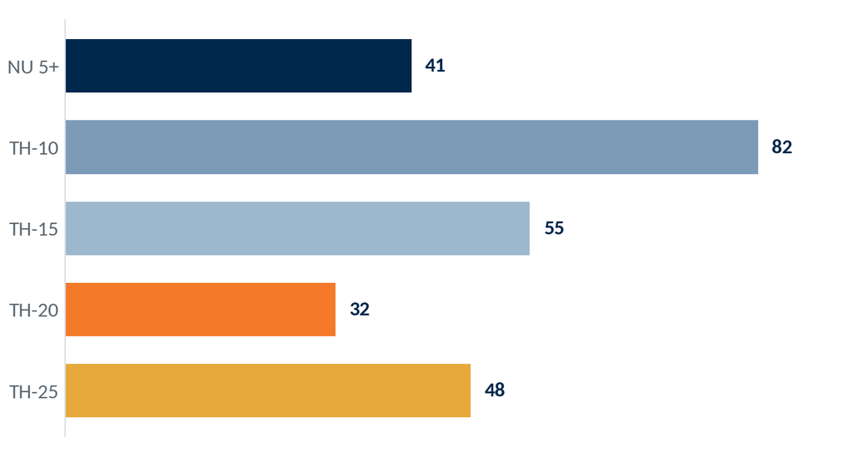
ARS Response — Apr 2026 Mailer
PTD · June 2026
Selection: the 3,154 accounts mailed in the Apr 2026 drop.
Responders by tier
3,154
Accounts Mailed
258
Responders
8.2%
Response Rate
The Apr 2026 mailing drew 258 responders (8.2% of those mailed), led by the higher threshold tiers.
14
Notes:
Source: ARS Workbook 999 (999-2026.07-Union Financial-Workbook_DEMO.xlsx) — Mail Response Summary + ODD extract 999 Union Financial (demo data; Jul23-forward), Jun 2026 snapshot mailing/response fields.

Slide 15
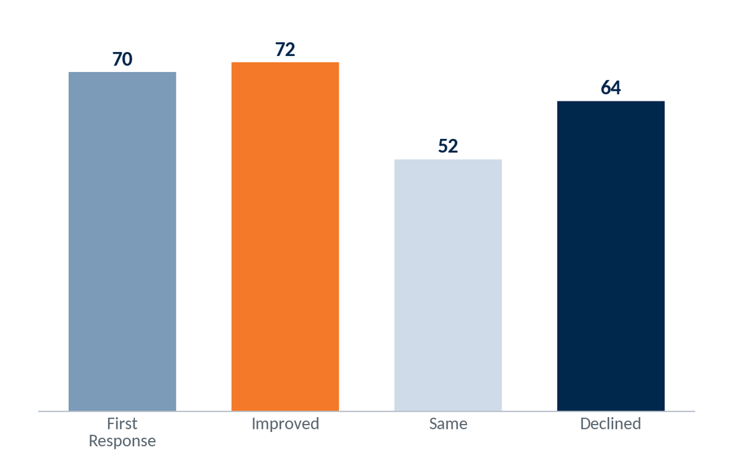
ARS Response — Apr 2026 Movement
PTD · June 2026
Selection: the 258 responders to the Apr 2026 mailing, compared with their prior mailing (first-time, improved, held steady, or declined).
70 were first-time responders (no prior response) and 72 improved their tier — together 55% of the 258 responders moved up or in for the first time.
15
Notes:
Source: ARS Workbook 999 (999-2026.07-Union Financial-Workbook_DEMO.xlsx) — Mail Response Summary + ODD extract 999 Union Financial (demo data; Jul23-forward), Jun 2026 snapshot mailing/response fields.

Slide 16
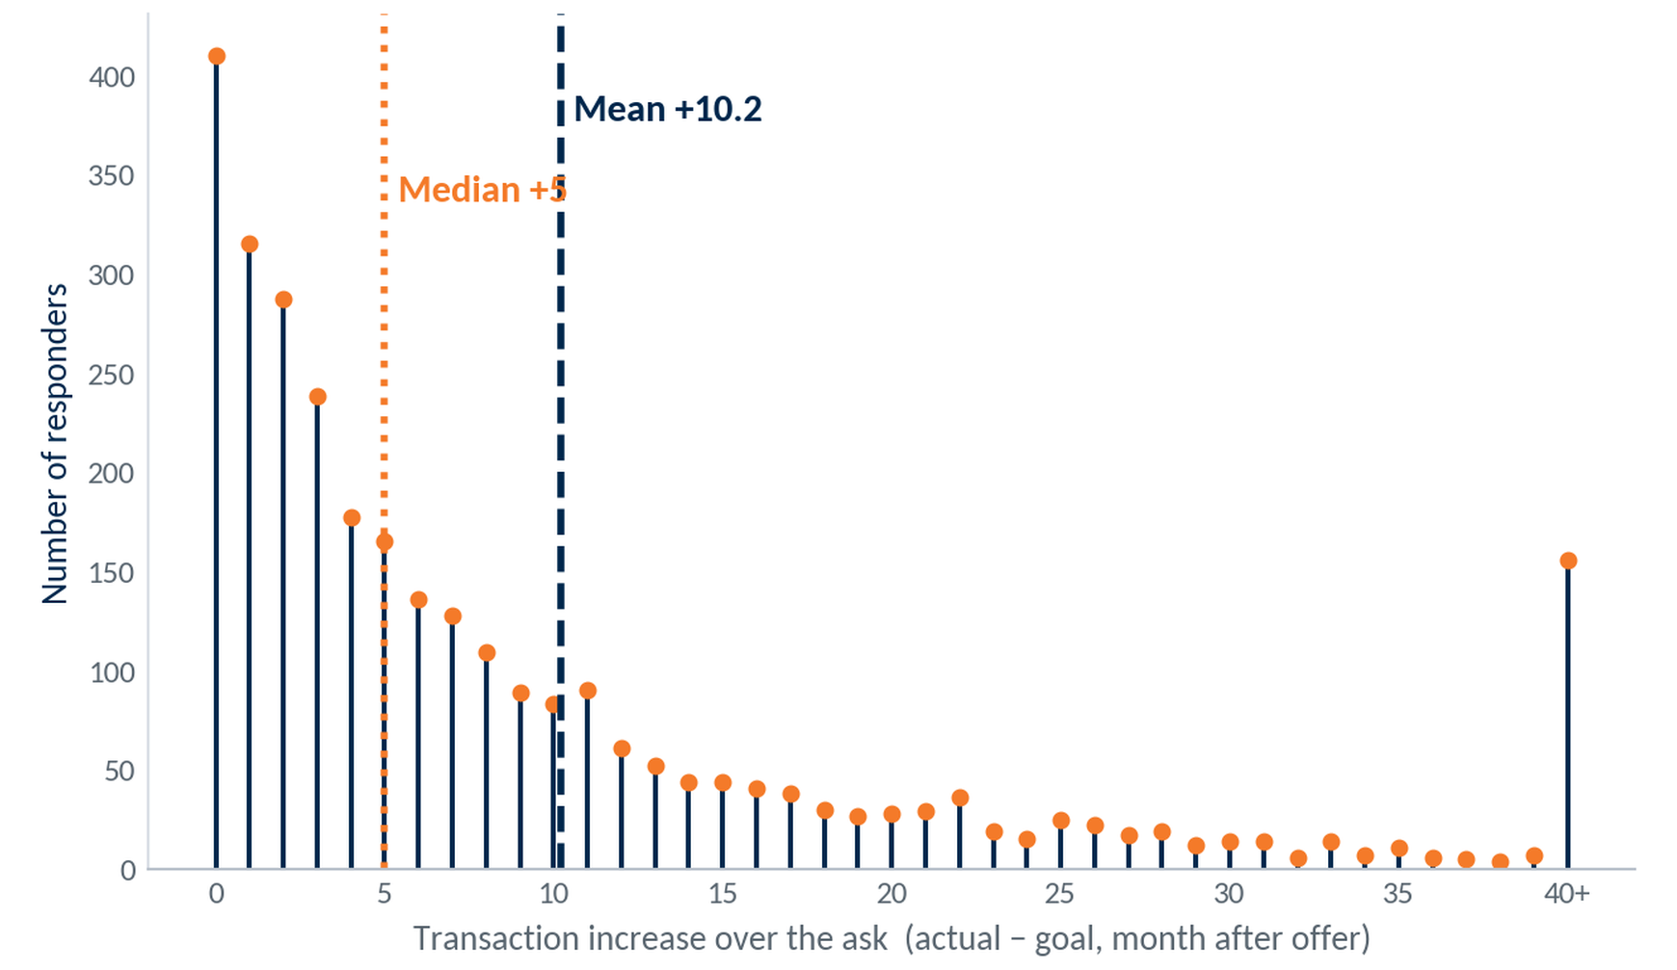
Transaction Increase Over the Ask
Selection: ARS responders (3,030). Increase = transactions in the month after the offer minus the goal — e.g., a non-user asked for 5 who does 11 = +6. One point per responder (latest offer).
+10.2
Mean increase (txns/mo)
14.7
Std deviation
+5
Responders don't just meet the ask — they beat it. Half clear their goal by 5+ transactions in the month after the offer and the average by 10, with a long tail of heavy over-performers (156 at +40 or more).
Median increase
16
Notes:
Source: ARS Workbook 999 (999-2026.07-Union Financial-Workbook_DEMO.xlsx) — Mail Response Summary + ODD extract 999 Union Financial (demo data; Jul23-forward), Jun 2026 snapshot mailing/response fields.

Slide 17
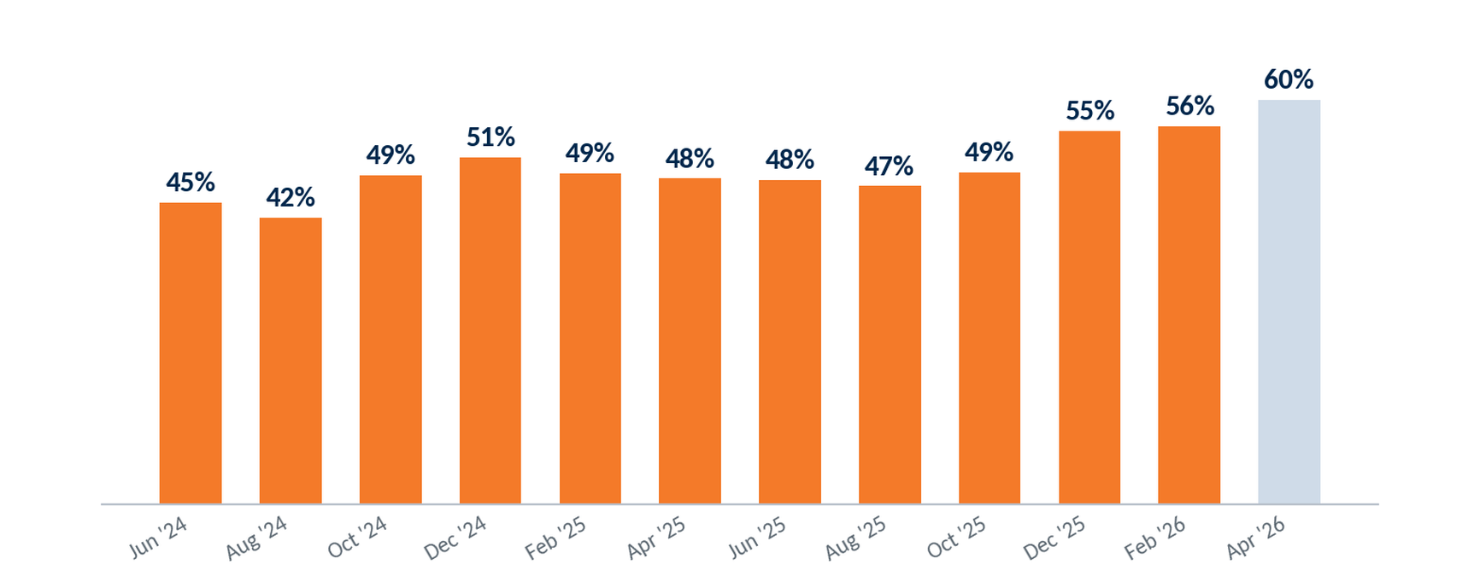
Sustained Respondent Activity by Mailing
Selection: ARS responders by mailing. Share still meeting their first-offer activity goal over the latest 3 months (Apr–Jun 2026); last bar not yet mature.
17
Notes:
Source: ARS Workbook 999 (999-2026.07-Union Financial-Workbook_DEMO.xlsx) — Mail Response Summary + ODD extract 999 Union Financial (demo data; Jul23-forward), Jun 2026 snapshot mailing/response fields.

Slide 18
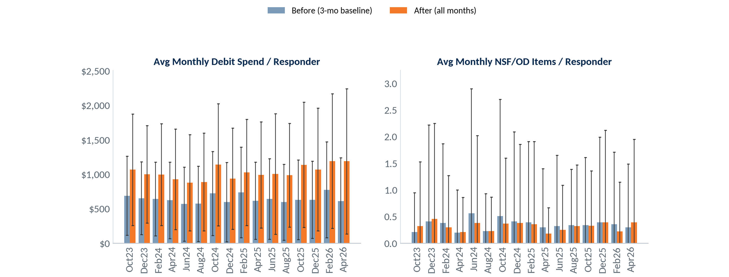
Responder Activity: Before vs After (Mean)
Selection: ARS mailing responders — average monthly debit spend and NSF/OD items per responder: 3-month pre-mailing baseline vs. every month after the mailing (through June 2026). Mailings Oct 2023 – Apr 2026. Debit spend winsorized at 3 SD; error bars = ±1 SD across accounts.
Debit spend rose after every mailing and held across all later months — $644/mo before vs $1,027 after (+59%); NSF/OD activity stayed roughly flat.
18
Notes:
Source: ARS Workbook 999 (999-2026.07-Union Financial-Workbook_DEMO.xlsx) — Mail Response Summary + ODD extract 999 Union Financial (demo data; Jul23-forward), Jun 2026 snapshot mailing/response fields.

Slide 19
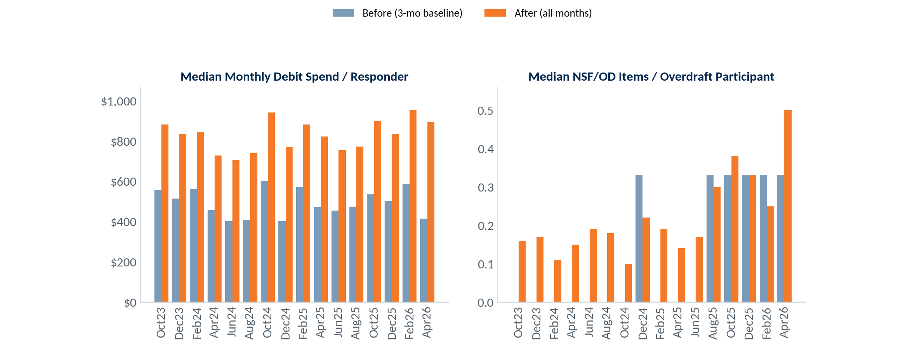
Responder Activity: Before vs After (Median)
Selection: ARS mailing responders — median monthly debit spend (all responders) and median NSF/OD items among overdraft participants: 3-month pre-mailing baseline vs. every month after the mailing (through June 2026). Mailings Oct 2023 – Apr 2026.
On a median basis, debit spend rose $495 → $829 per responder (+67%). Among overdraft participants, median NSF/OD items stayed low and roughly flat.
19
Notes:
Source: ARS Workbook 999 (999-2026.07-Union Financial-Workbook_DEMO.xlsx) — Mail Response Summary + ODD extract 999 Union Financial (demo data; Jul23-forward), Jun 2026 snapshot mailing/response fields.

Slide 20
Debit Card Review
Take Rate • Swipes & Spend
Notes:
Source: ODD extract 999 Union Financial (demo data; Jul23-forward), Jun 2026 snapshot — debit take rate (personal/business/by branch), swipes & spend, NSF/OD.

Slide 21
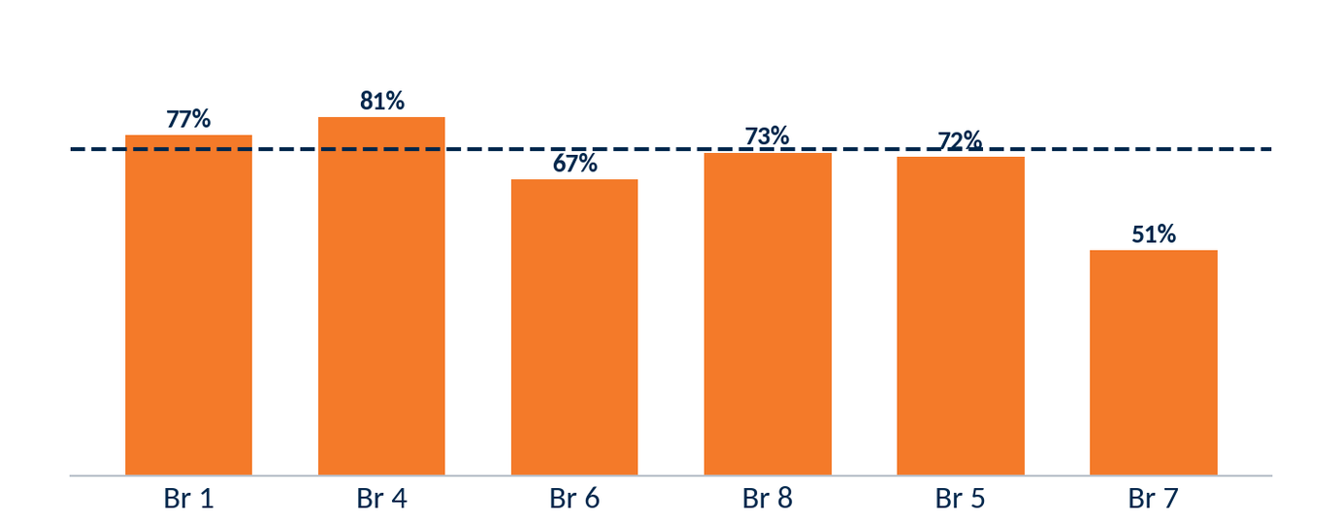
12-Month Eligible Take Rate — Personal
07-2025 · 06-2026
73.7%
71.0%
707
186
12-Mo Take Rate
Historical Take Rate
Eligible Accounts
No Debit Card
Take rate by branch (personal, largest branches).
Selection: ARS-eligible personal accounts, trailing 12 months (Jul 2025 – Jun 2026).
21
Notes:
Source: ODD extract 999 Union Financial (demo data; Jul23-forward), Jun 2026 snapshot — debit take rate (personal/business/by branch), swipes & spend, NSF/OD.

Slide 22
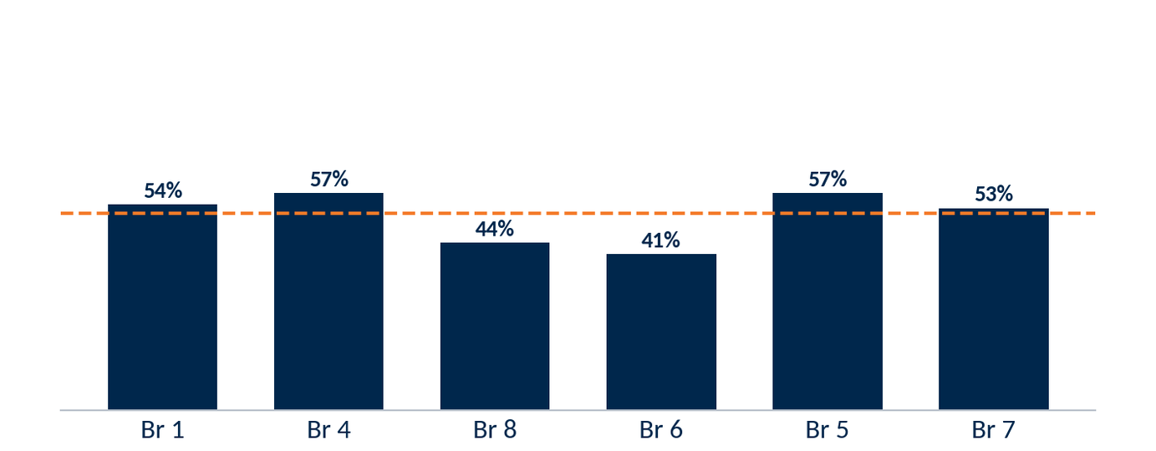
12-Month Eligible Take Rate — Business
07-2025 · 06-2026
51.7%
0.0%
178
86
12-Mo Take Rate
Historical Take Rate
Eligible Accounts
No Debit Card
Take rate by branch (new business accounts, largest branches).
Selection: business accounts opened Jul 2025 – Jun 2026 (new take rate) and all ARS-eligible business accounts (historical). 0 business accounts are ARS-eligible in the current book.
22
Notes:
Source: ODD extract 999 Union Financial (demo data; Jul23-forward), Jun 2026 snapshot — debit take rate (personal/business/by branch), swipes & spend, NSF/OD.

Slide 23
12-Month Take Rate by Branch
07-2025 · 06-2026
Selection: new ARS-eligible personal accounts by branch (opened last 12 months), monthly Aug 2025 – Jun 2026; six largest branches shown, Total across all branches.
Branch | Aug | Sep | Oct | Nov | Dec | Jan | Feb | Mar | Apr | May | Jun | Cards | Elig | Take%
Br 1 | 24 | 17 | 21 | 16 | 18 | 19 | 23 | 18 | 16 | 22 | 20 | 236 | 306 | 77%
Br 4 | 10 | 7 | 6 | 7 | 5 | 12 | 7 | 8 | 11 | 8 | 8 | 93 | 115 | 81%
Br 6 | 4 | 2 | 4 | 3 | 2 | 5 | 8 | 5 | 8 | 7 | 7 | 66 | 98 | 67%
Br 8 | 0 | 7 | 4 | 3 | 8 | 4 | 6 | 8 | 4 | 7 | 7 | 59 | 81 | 73%
Br 5 | 3 | 1 | 3 | 9 | 0 | 3 | 3 | 2 | 3 | 6 | 4 | 43 | 60 | 72%
Br 7 | 2 | 1 | 1 | 3 | 3 | 3 | 2 | 1 | 2 | 0 | 2 | 24 | 47 | 51%
Total (all branches) | 43 | 35 | 39 | 41 | 36 | 46 | 49 | 42 | 44 | 50 | 48 | 521 | 707 | 74%
23
Notes:
Source: ODD extract 999 Union Financial (demo data; Jul23-forward), Jun 2026 snapshot — debit take rate (personal/business/by branch), swipes & spend, NSF/OD.

Slide 24
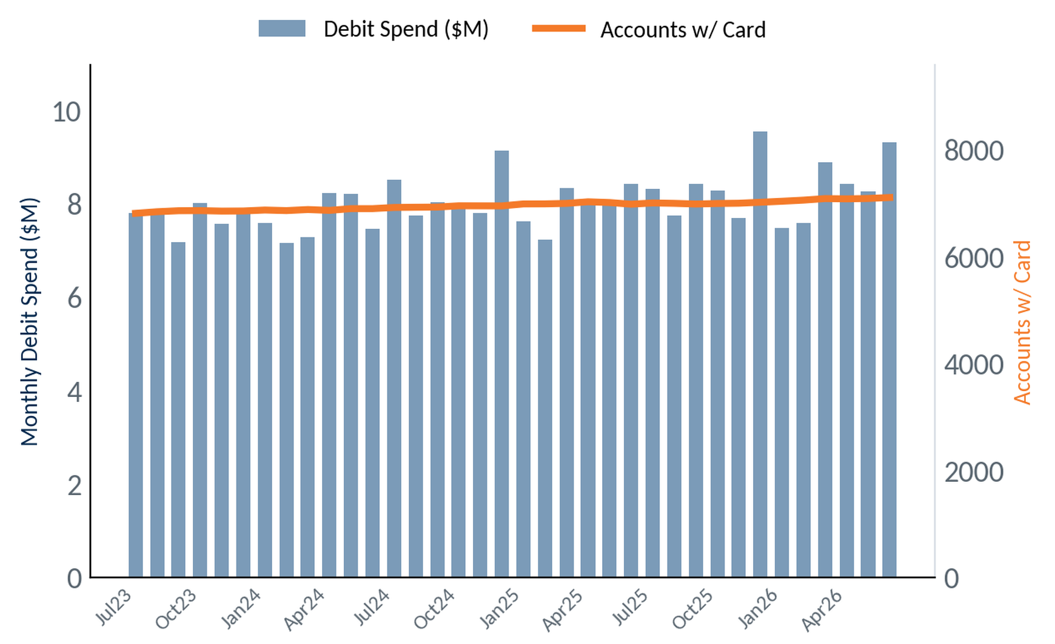
Overall Debit Swipes & Spend
Selection: all debit-card-holding accounts, program-wide. Monthly totals, Jul 2023 – Jun 2026 (36 months).
+4.3%
Accounts w/ Card, 36 mo
(6.8K → 7.1K)
$9.3M
Monthly debit spend
(June 2026)
+11%
Spend YoY
(Jun 25 → Jun 26)
24
Notes:
Source: ODD extract 999 Union Financial (demo data; Jul23-forward), Jun 2026 snapshot — debit take rate (personal/business/by branch), swipes & spend, NSF/OD.

Slide 25
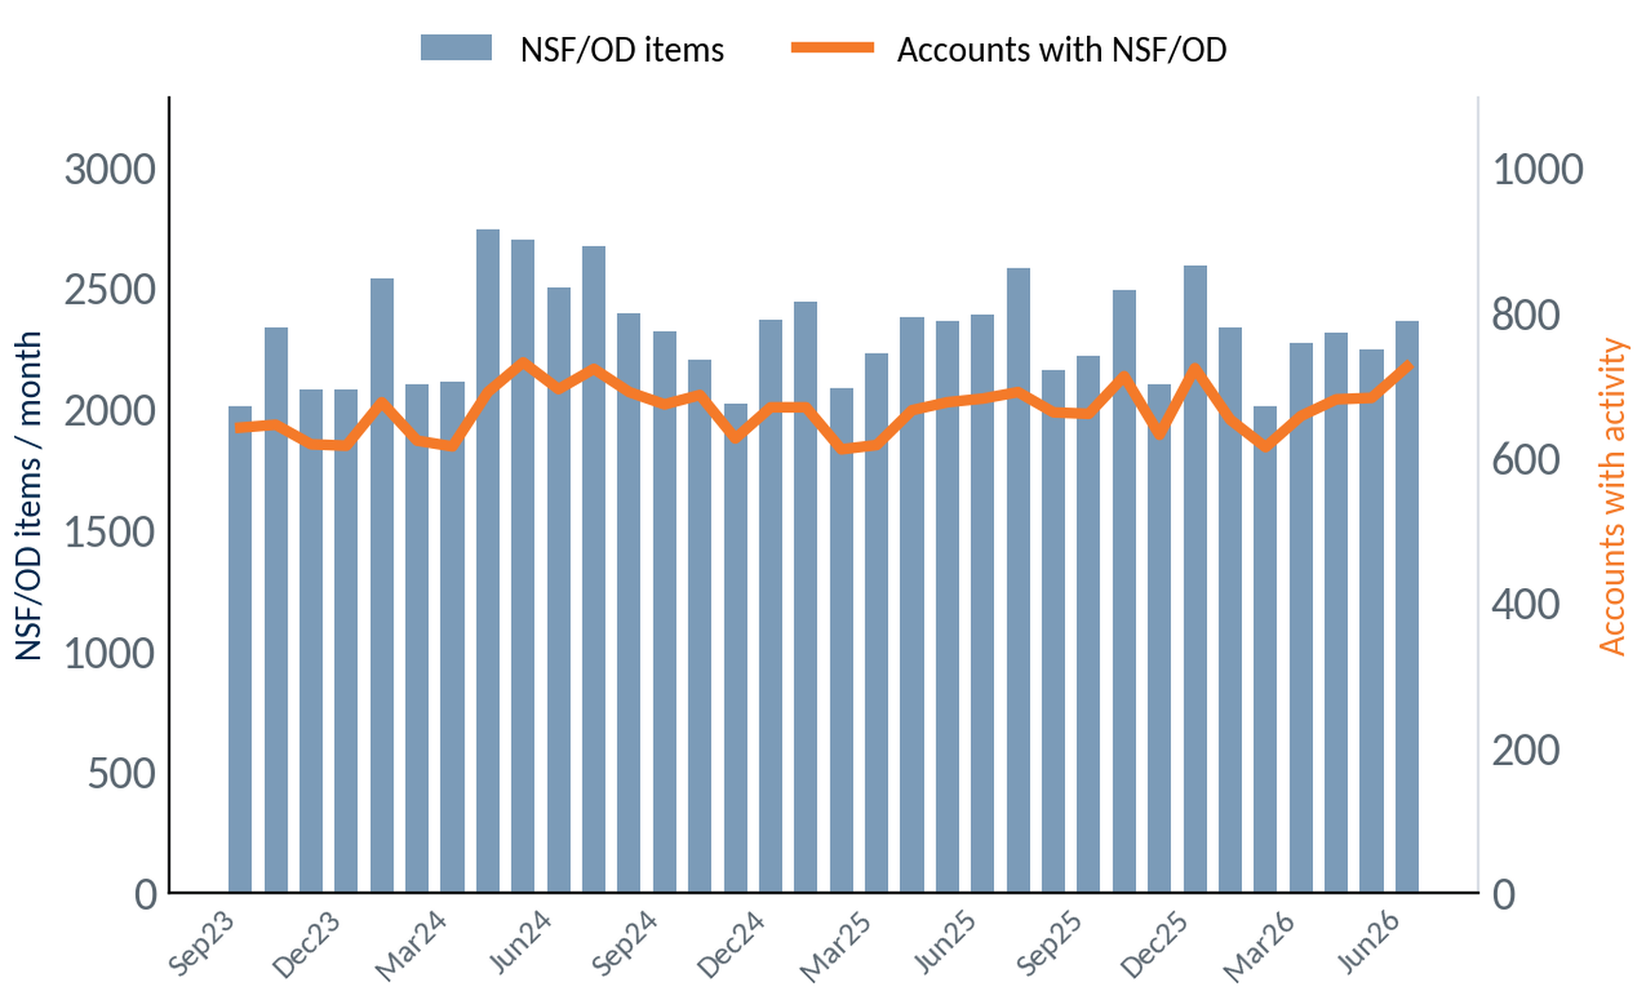
NSF/OD Activity Over Time
Selection: all accounts, program-wide. Monthly NSF/OD item volume (bars) and accounts with activity (line), Sep 2023 – Jun 2026.
2,360
NSF/OD items
(June 2026)
725
Accounts with
NSF/OD (June)
-1%
Items YoY
(Jun 25 → Jun 26)
25
Notes:
Source: ODD extract 999 Union Financial (demo data; Jul23-forward), Jun 2026 snapshot — debit take rate (personal/business/by branch), swipes & spend, NSF/OD.

Slide 26
Reg E Review
Overdraft Opt-In Performance
Notes:
Source: ODD extract 999 Union Financial (demo data; Jul23-forward), Jun 2026 snapshot — Reg E opt-in (standardized Opt In/Opt Out/Default); all personal / opened last 12 mo / by vintage.

Slide 27
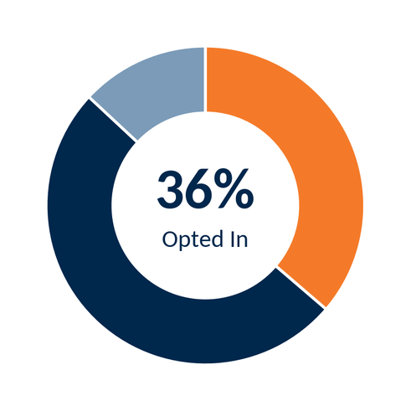
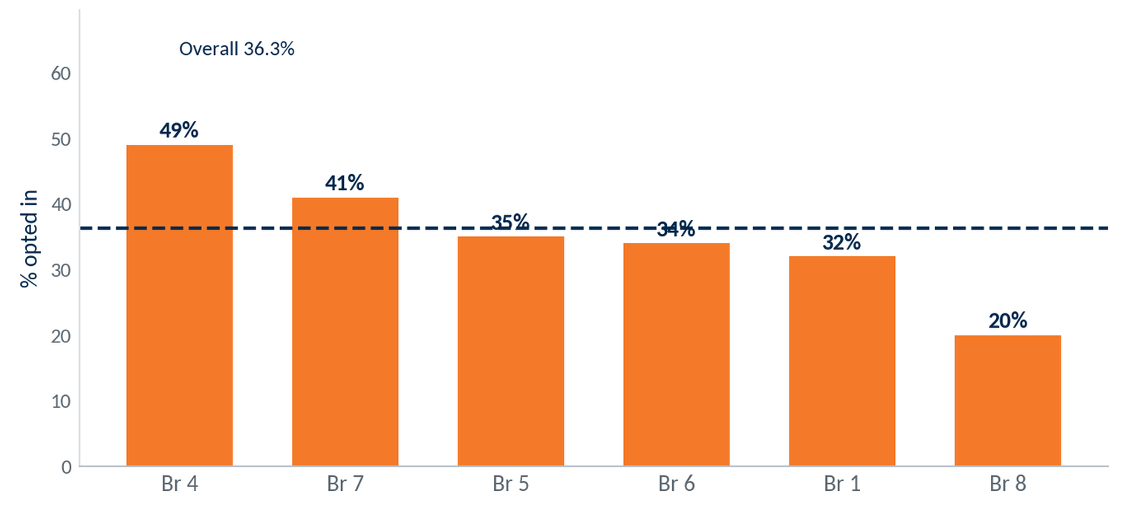
Reg E Opt-In — All Personal Accounts
Selection: all open personal accounts holding a debit card (6,192). Overdraft opt-in status as of June 2026 (point-in-time).
Opted In
36.3% of open personal debit-card holders have elected to extend their overdraft access to the debit card — 2,247 of 6,192.
Opted Out
No Election (default)
Opt-in rate by branch (branches with 40+ eligible accounts).
27
Notes:
Source: ODD extract 999 Union Financial (demo data; Jul23-forward), Jun 2026 snapshot — Reg E opt-in (standardized Opt In/Opt Out/Default); all personal / opened last 12 mo / by vintage.

Slide 28
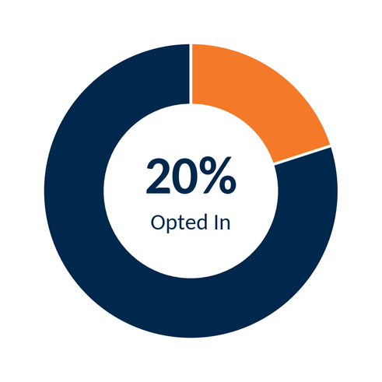
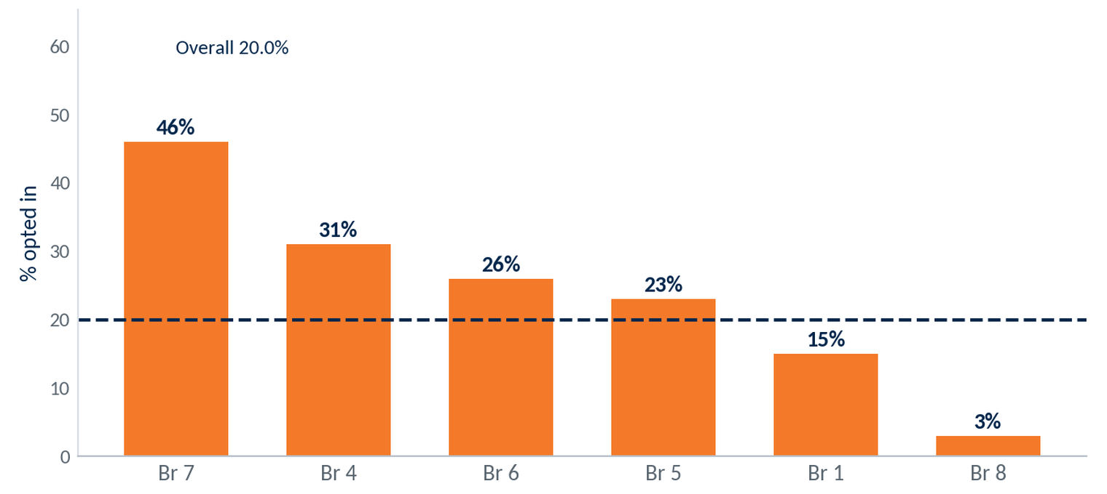
Reg E Opt-In — Opened in Last 12 Months
Selection: personal accounts holding a debit card, opened July 2025 – June 2026 and still open (519). Opt-in status as of June 2026.
Opted In
New-account opt-in runs below the book: 20.0% of accounts opened in the last 12 months — 104 of 519.
Opted Out
No Election (default)
Opt-in rate by branch, last-12-month accounts.
28
Notes:
Source: ODD extract 999 Union Financial (demo data; Jul23-forward), Jun 2026 snapshot — Reg E opt-in (standardized Opt In/Opt Out/Default); all personal / opened last 12 mo / by vintage.

Slide 29
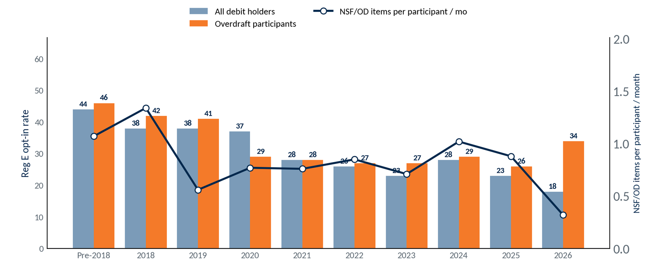
Reg E Opt-In by Account Vintage
Selection: open consumer debit-card holders (6,192), by year opened. Reg E opt-in for all holders (bars) vs. overdraft participants — accounts with ≥1 NSF/OD item, trailing 12 months. Line = NSF/OD items per overdraft participant per month (trailing 12 months).
Opt-in falls with each newer vintage — 44% (pre-2018) to 18% (2026); overdraft participants opt in at similar or higher rates.
29
Notes:
Source: ODD extract 999 Union Financial (demo data; Jul23-forward), Jun 2026 snapshot — Reg E opt-in (standardized Opt In/Opt Out/Default); all personal / opened last 12 mo / by vintage.

Slide 30
ARS Key Takeaways
Program Performance
Debit Card
Reg E
• 226 months, 81 mailings; 5.7 : 1 profitability
• $5.69M incremental profit program-to-date
• 18.8% recent mailing response
• Consistent response across 81 mailings since 2007
• 71.0% overall take rate
• New-account take rate 73.7%
• Card base +4.3% over 36 months
• Monthly spend $9.3M
• 36.3% opt-in (personal accounts)
• Best branches ~49% (Branch 4 49%)
• Opportunity at low-opt-in branches
• New-account opt-in 20.0%
Opportunity: raise Reg E opt-in at low-performing branches
30
Notes:
Source: summary of ARS Workbook 999 (999-2026.07-Union Financial-Workbook_DEMO.xlsx) financials + ODD extract 999 Union Financial (demo data; Jul23-forward), Jun 2026 snapshot metrics shown in this deck.

Slide 31
Questions & Discussion
Union Financial • July 2026
Notes:
Source: section slide (static).

Slide 32
Contact Us
Aaron Burgard
Client Service Manager
910-617-1984
aaron.burgard@csiweb.com
32
Notes:
Source: CSI / Velocity Solutions contact information (static).

Slide 33
Appendix
Additional ARS Respondent Insights
Notes:
Source: section slide (static).

Slide 34
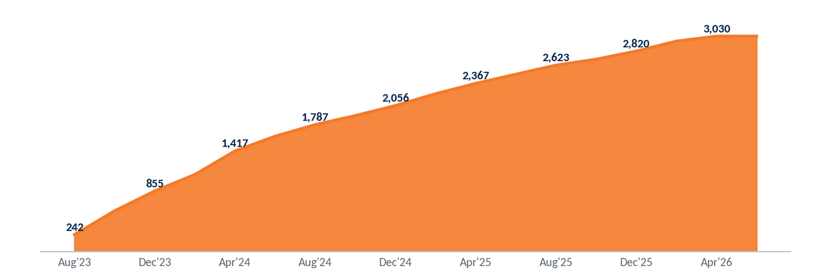
Program Reach — Cumulative Responders
Distinct customers who have responded to at least one ARS mailing, accumulated across the program.
3,030
Customers Reached
~178
Net-New per Mailing
34
Notes:
Source: ODD extract 999 Union Financial (demo data; Jul23-forward), Jun 2026 snapshot — responder / new-account analytics; associational, not causal where noted.

Slide 35
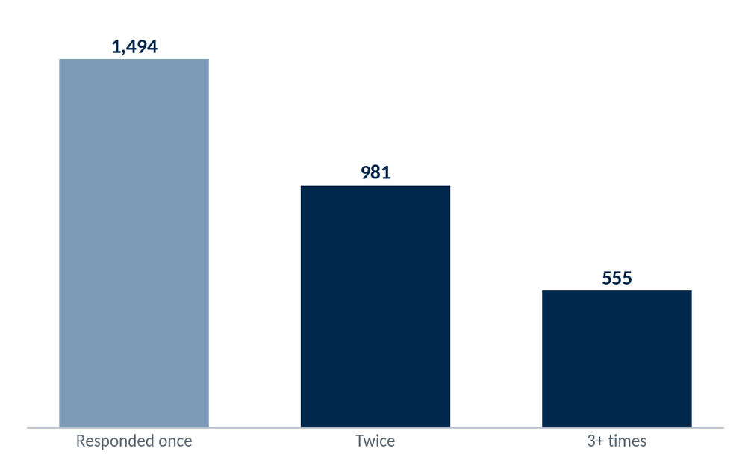
Depth of Engagement — Repeat Responders
50.7% of responders (1,536 customers) have responded to two or more mailings
35
Notes:
Source: ODD extract 999 Union Financial (demo data; Jul23-forward), Jun 2026 snapshot — responder / new-account analytics; associational, not causal where noted.

Slide 36
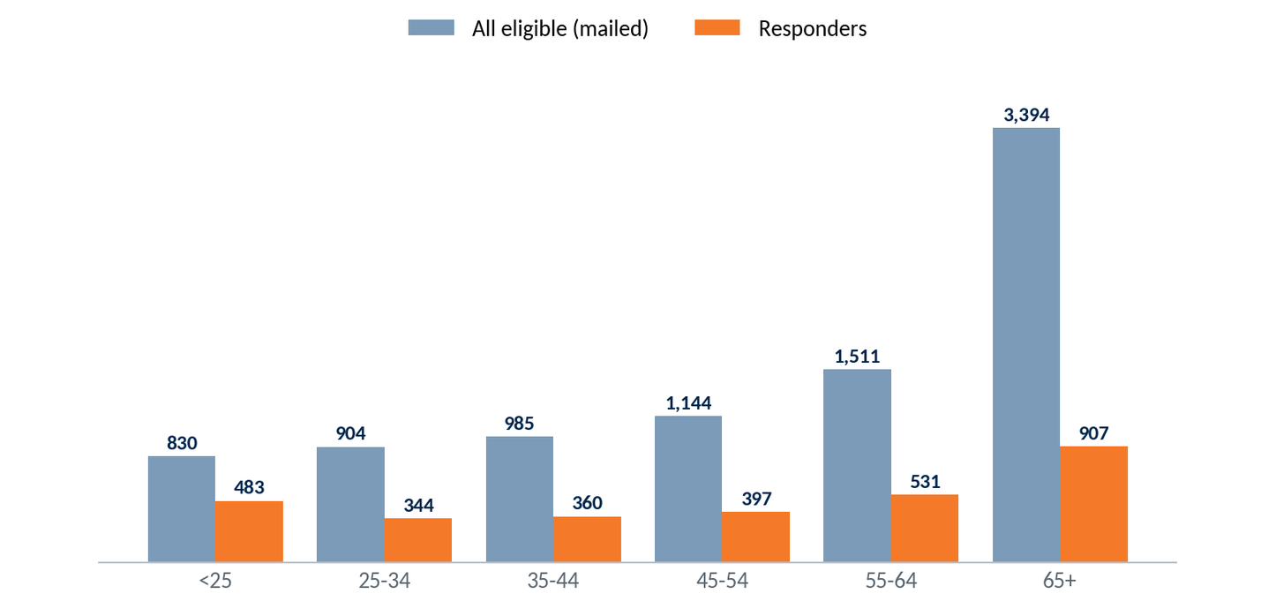
Responder Age Profile
Selection: ARS-eligible personal accounts (8,768 with age on file). Age mix — full eligible base vs. responders, as of June 2026.
Response rates are highest among younger accounts — 58% of under-25 eligibles respond versus 27% of those 65+ — even though the eligible base skews older (55+ = 56%).
36
Notes:
Source: ODD extract 999 Union Financial (demo data; Jul23-forward), Jun 2026 snapshot — responder / new-account analytics; associational, not causal where noted.

Slide 37
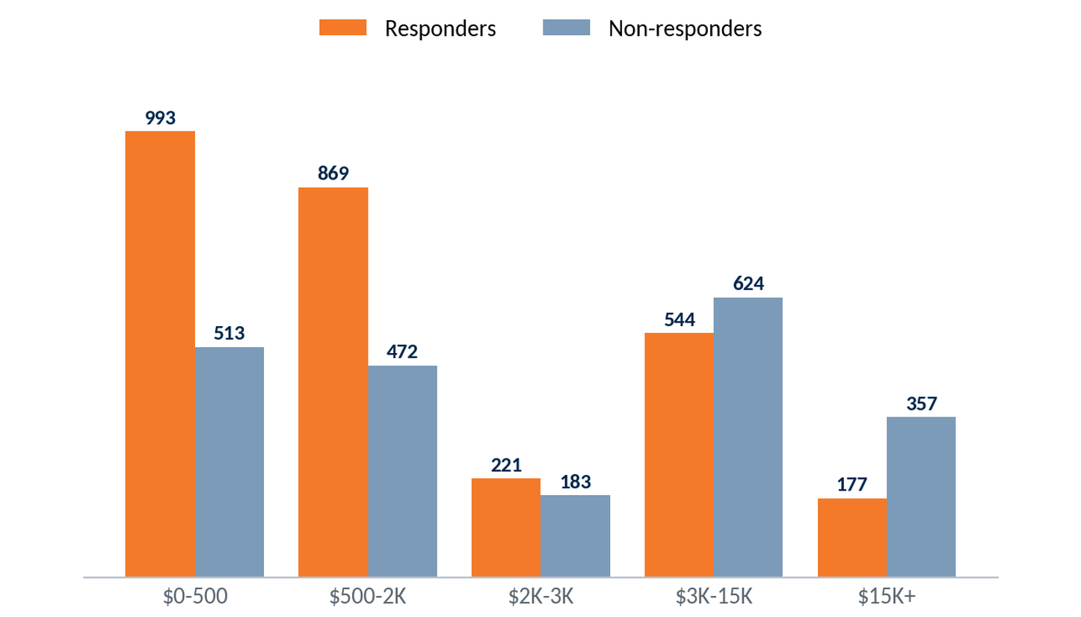
Who Responds — Balance Profile
Responders carry lower balances than non-responders (median $887 vs $2,409) — ARS engages transaction-reliant customers, not the highest-balance ones. (Eligibility = any account scored across the recent 12 mailings.)
37
Notes:
Source: ODD extract 999 Union Financial (demo data; Jul23-forward), Jun 2026 snapshot — responder / new-account analytics; associational, not causal where noted.

Slide 38
New Account Profile
Personal accounts opened July 2025 through June 2026
Notes:
Source: ODD extract 999 Union Financial (demo data; Jul23-forward), Jun 2026 snapshot — responder / new-account analytics; associational, not causal where noted.

Slide 39
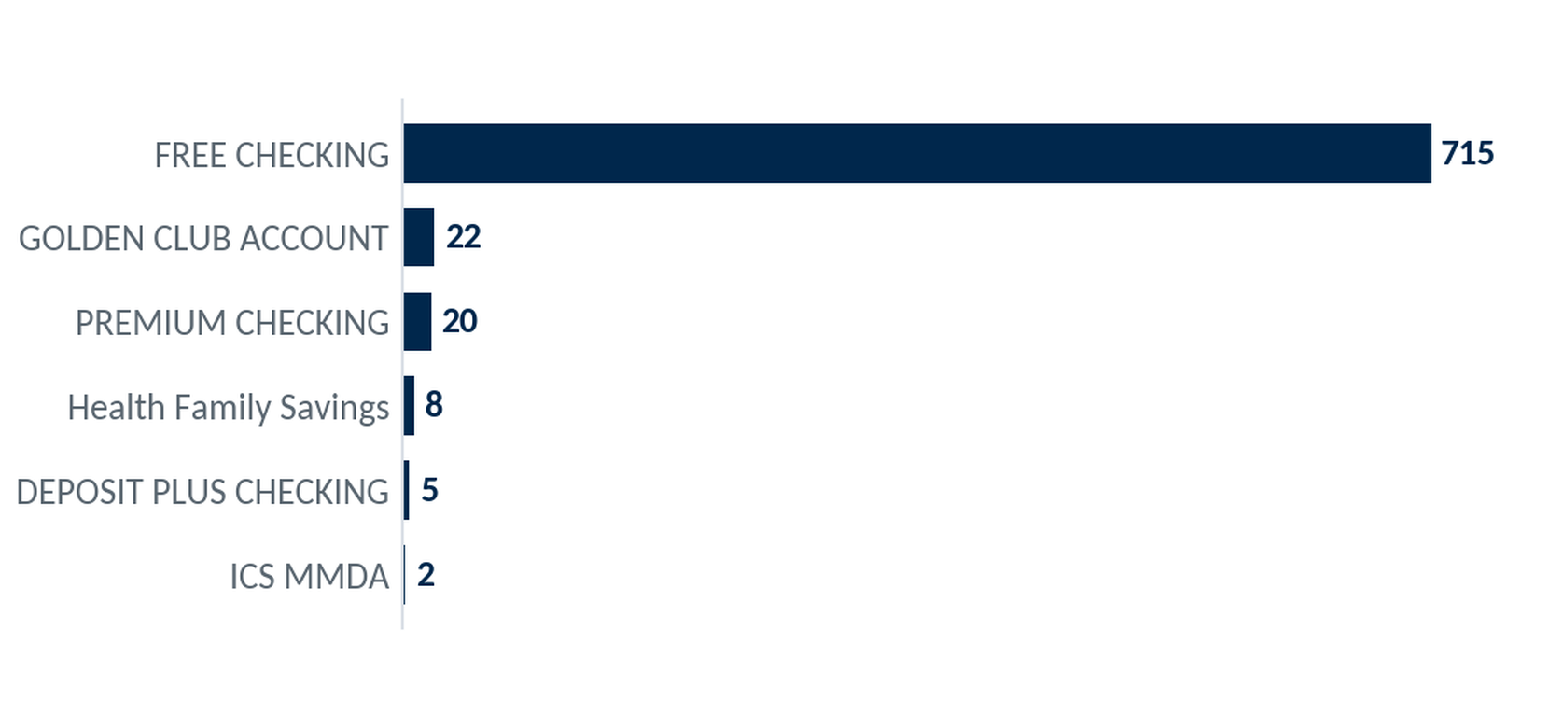
New Accounts by Product
Selection: personal accounts opened July 2025 – June 2026 (all product types). Checking products shown in orange.
772
New accounts opened
94%
Still open today
96%
FREE CHECKING makes up 93% of new personal accounts; checking products lead new growth.
Checking products
39
Notes:
Source: ODD extract 999 Union Financial (demo data; Jul23-forward), Jun 2026 snapshot — responder / new-account analytics; associational, not causal where noted.

Slide 40
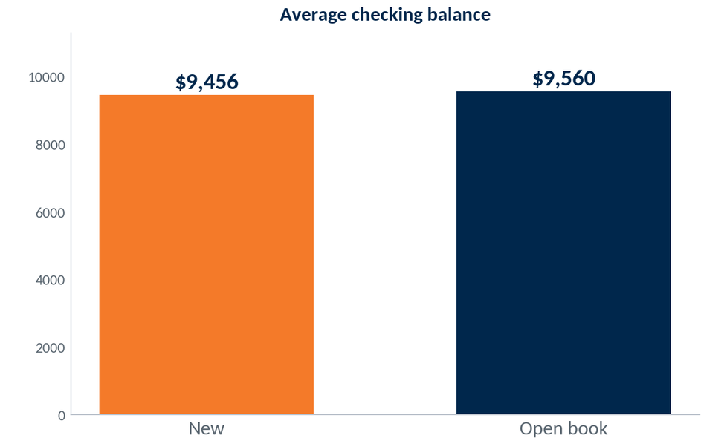
New Checking Balances vs. Existing Book
Selection: personal checking accounts. New (opened July 2025 – June 2026) vs. all open personal checking accounts. Average current balance.
$9,456
Avg bal, new checking
$9,560
Avg bal, open checking
93%
New checking accounts open near the existing book on balance ($9,456 vs $9,560); 93% are funded above zero.
New checking funded >$0
40
Notes:
Source: ODD extract 999 Union Financial (demo data; Jul23-forward), Jun 2026 snapshot — responder / new-account analytics; associational, not causal where noted.

Slide 41
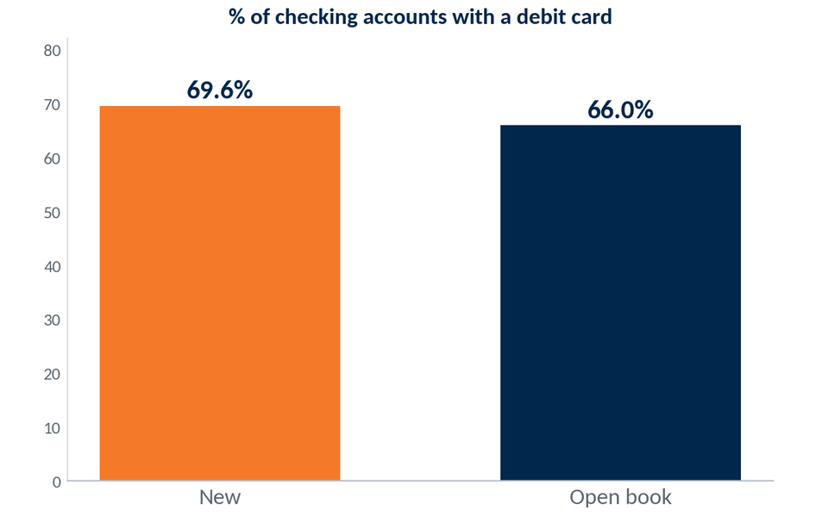
Debit Card Penetration — New vs. Book
Selection: personal checking accounts. New (opened July 2025 – June 2026) vs. all open personal checking accounts. Share carrying a debit card.
69.6%
New checking w/ debit
+3.6pt
vs. open book (66.0%)
New personal checking accounts carry a debit card 69.6% of the time — well above the 66.0% rate on the existing book.
41
Notes:
Source: ODD extract 999 Union Financial (demo data; Jul23-forward), Jun 2026 snapshot — responder / new-account analytics; associational, not causal where noted.

Slide 42
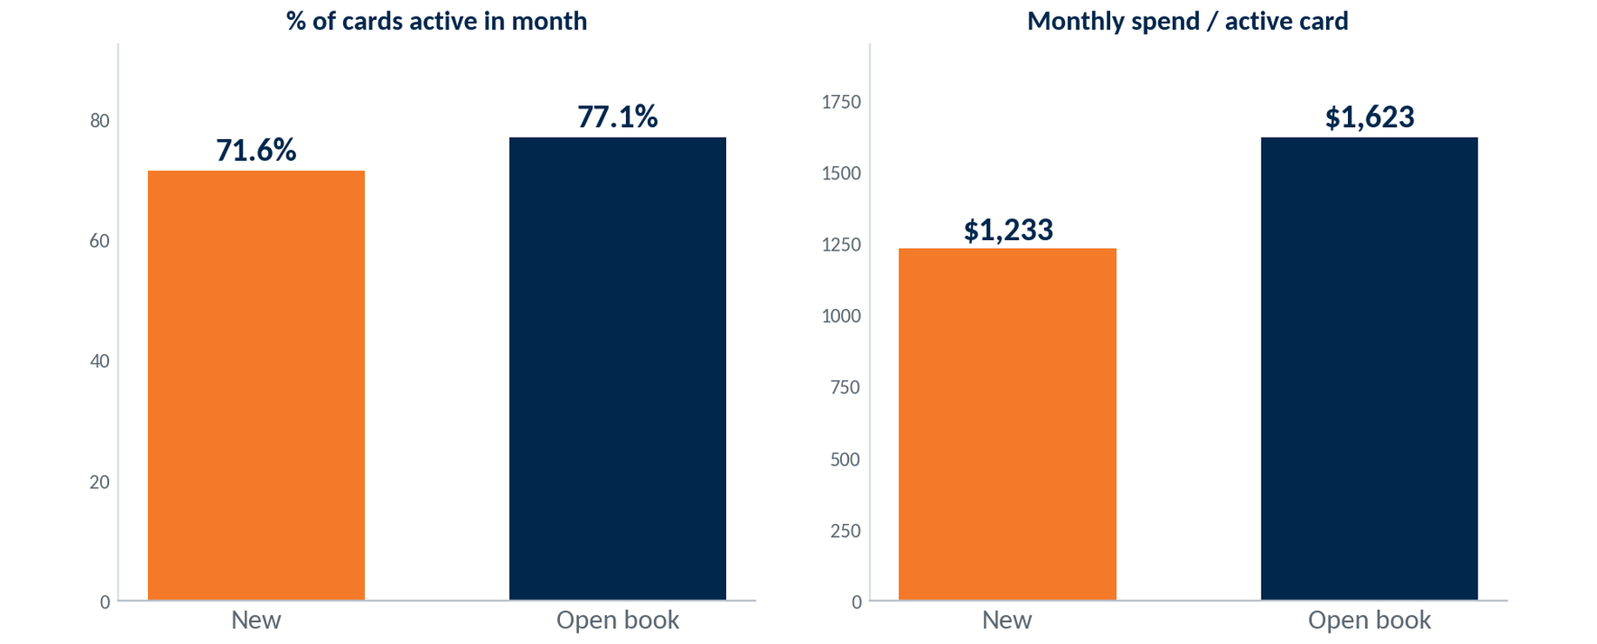
Debit Card Usage — New vs. Existing Book
Selection: personal debit-card holders, active in June 2026 (≥1 PIN/signature transaction). New (opened July 2025 – June 2026) vs. all open personal accounts, per active card.
71.6%
New cards active/mo
$1,233
Spend/active card/mo
82%
By their first year new personal cards are approaching the established book — 71.6% active in June versus 77.1%, at $1,233 spend per active card versus $1,623.
New cards ever swiped
42
Notes:
Source: ODD extract 999 Union Financial (demo data; Jul23-forward), Jun 2026 snapshot — responder / new-account analytics; associational, not causal where noted.

Slide 43
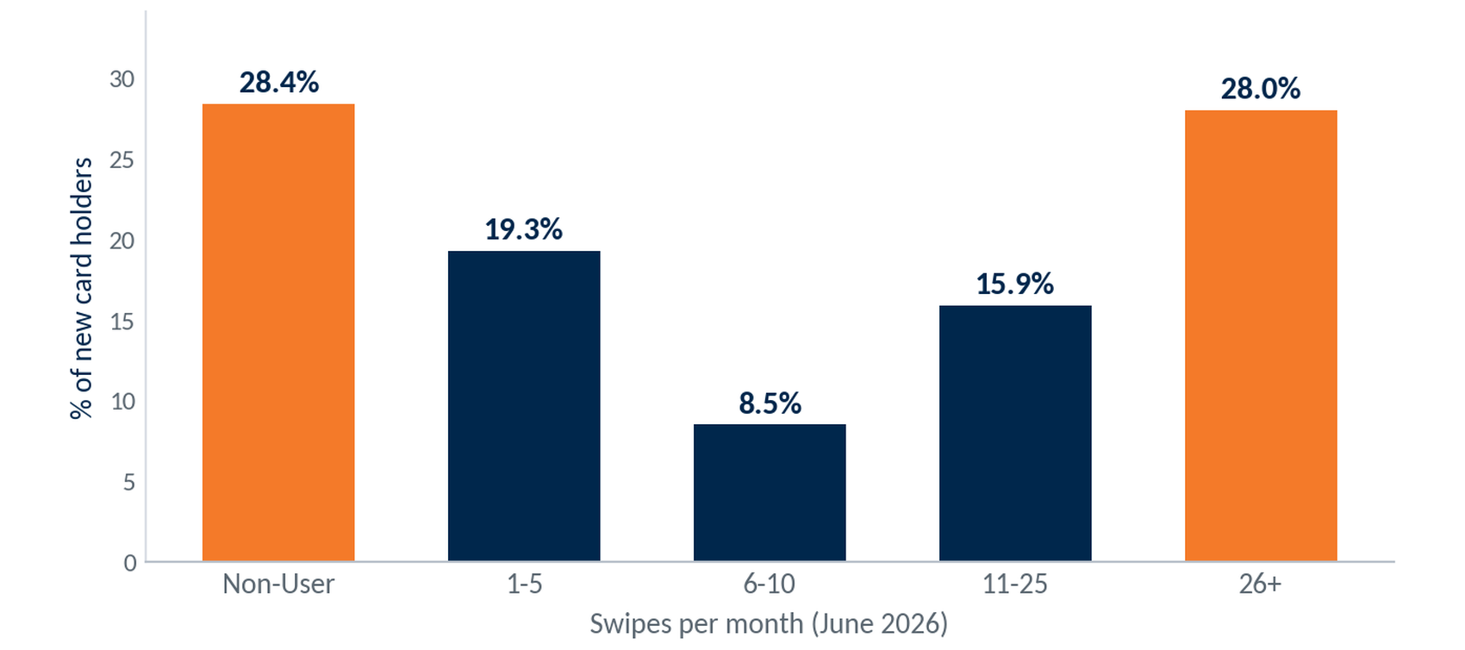
New-Account Debit Adoption — Swipe Segmentation
Selection: new personal accounts holding a debit card, opened July 2025 – June 2026 (n=529). Swipe activity for June 2026.
529
New card holders
71.6%
Swipe monthly (≥1/mo)
28.0%
Heavy users (26+/mo)
New-account debit use is split: 28% are already heavy users (26+ swipes/mo) while 28% are non-users, with the rest across the light tiers.
43
Notes:
Source: ODD extract 999 Union Financial (demo data; Jul23-forward), Jun 2026 snapshot — responder / new-account analytics; associational, not causal where noted.

Slide 44
New Account Profile — Summary
Personal accounts opened Jul 2025 – Jun 2026 (trailing 12 months)
Consumer checking leads new growth.
772 new personal accounts opened. FREE CHECKING makes up 93% of openings.
Most new checking accounts carry a debit card.
69.6% of new checking accounts carry a debit card, well above the 66.0% rate on the existing book.
Opening balances are near the book.
New checking accounts average $9,456 versus $9,560 on the book; 93% carry a balance above zero.
First-year card use is lighter.
71.6% of new cards are active monthly versus 77.1% on the book, at $1,233 spend per active card.
44
Notes:
Source: ODD extract 999 Union Financial (demo data; Jul23-forward), Jun 2026 snapshot — responder / new-account analytics; associational, not causal where noted.

Slide 45
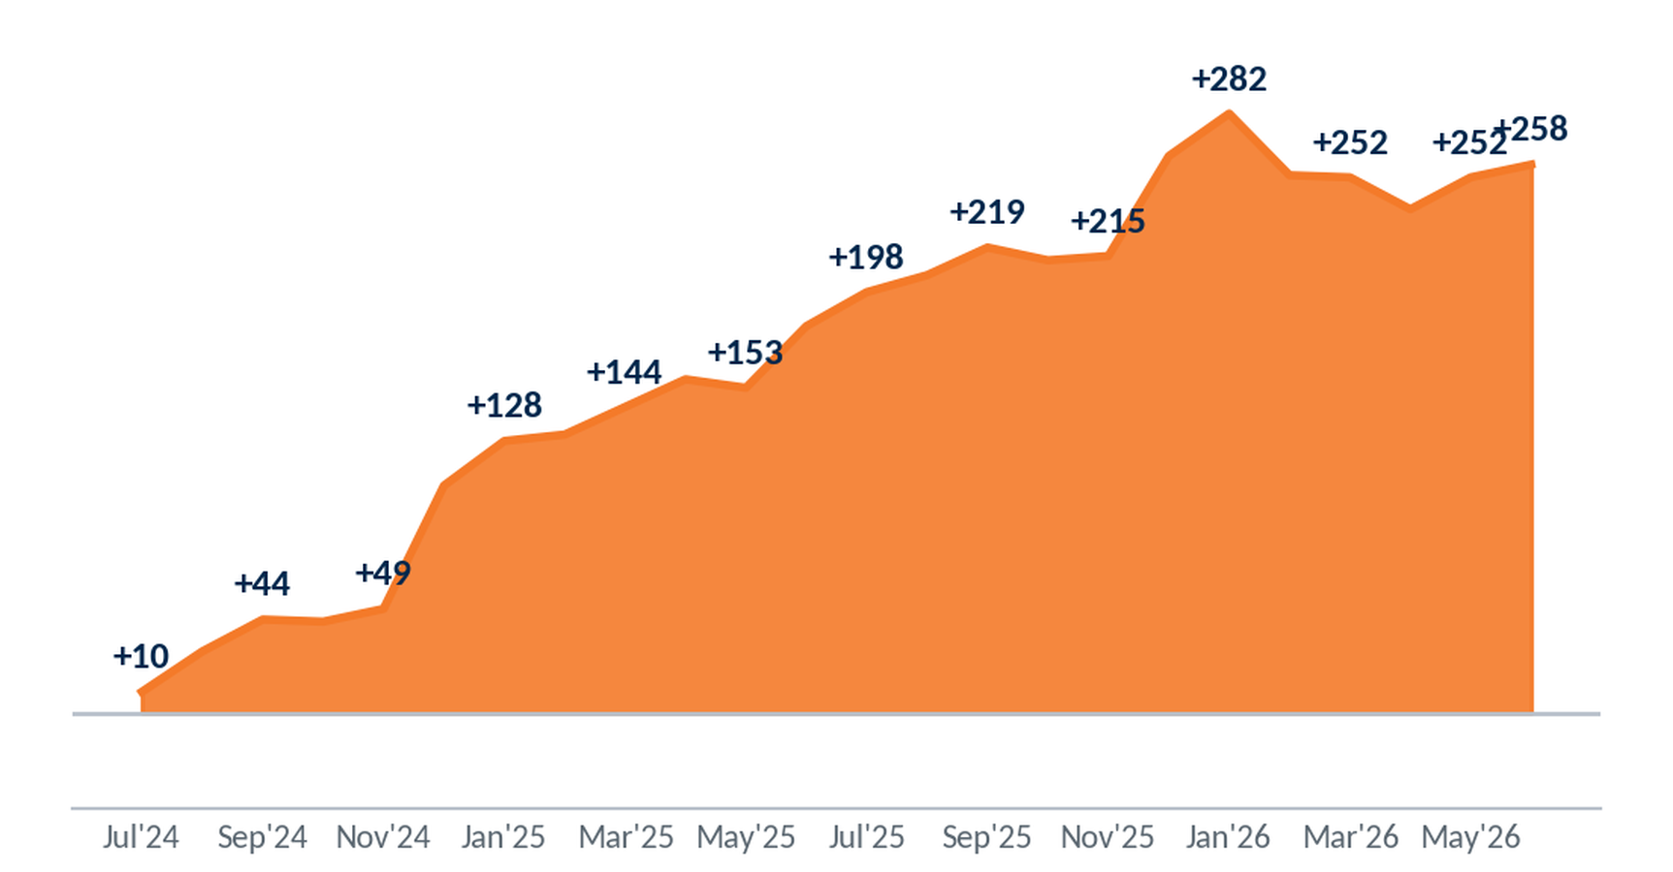
Account Growth — Openings vs. Closures
Selection: personal accounts. Openings and closures over the trailing 24 months (Jul 2024 – Jun 2026); line = cumulative net.
+258
Net new (24 mo)
1,548
Accounts opened
1,290
The personal book grew a net +258 over the trailing 24 months — roughly +11 accounts per month, with openings outpacing closures across the period.
Accounts closed
45
Notes:
Source: ODD extract 999 Union Financial (demo data; Jul23-forward), Jun 2026 snapshot — responder / new-account analytics; associational, not causal where noted.

Slide 46
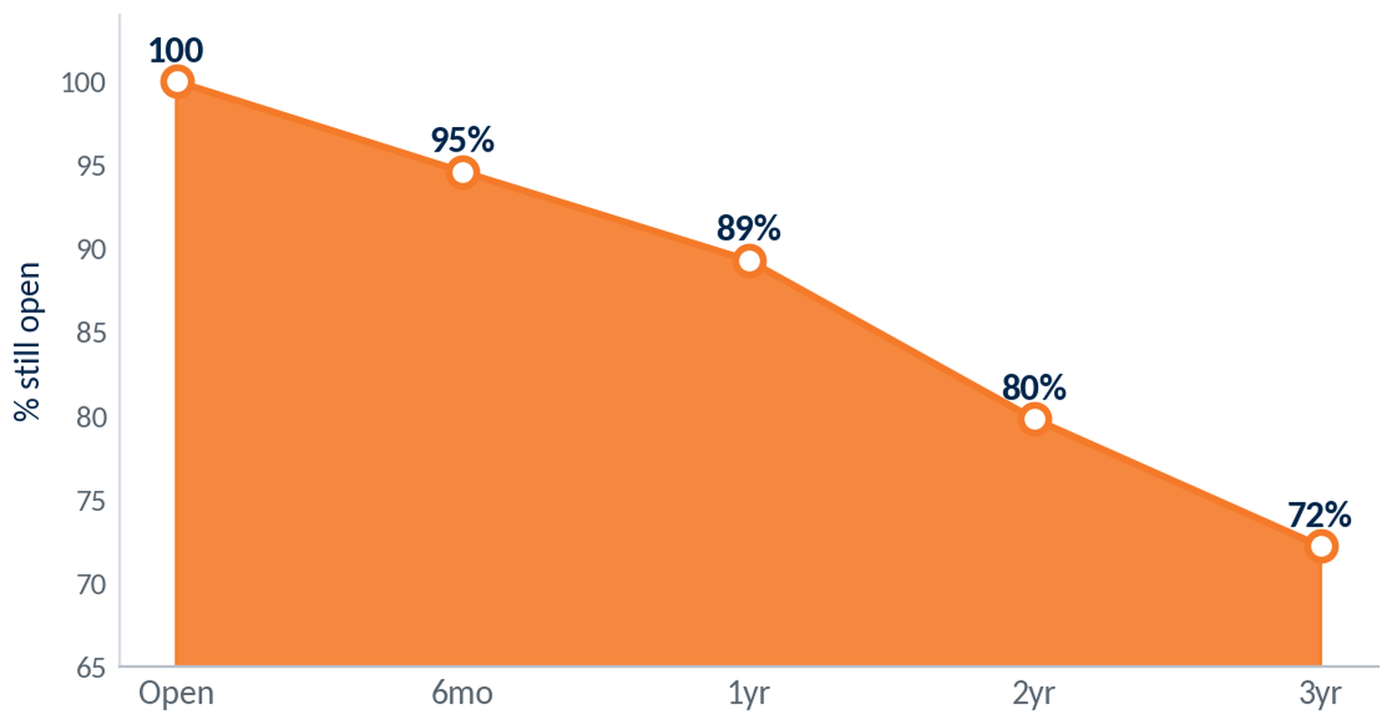
Account Retention — Survival by Tenure
Selection: personal accounts by months since opening. Kaplan-Meier survival for accounts opened since Jul 2021 (the window with fully-observed closings).
89%
Retained at 1 year
72%
Retained at 3 years
4.5 yr
First-year retention is 89%, easing to about 72% by year three. Half of closed accounts stayed open about 4.5 years — attrition is steady, not early.
Median lifespan (closed)
46
Notes:
Source: ODD extract 999 Union Financial (demo data; Jul23-forward), Jun 2026 snapshot — responder / new-account analytics; associational, not causal where noted.

Slide 47
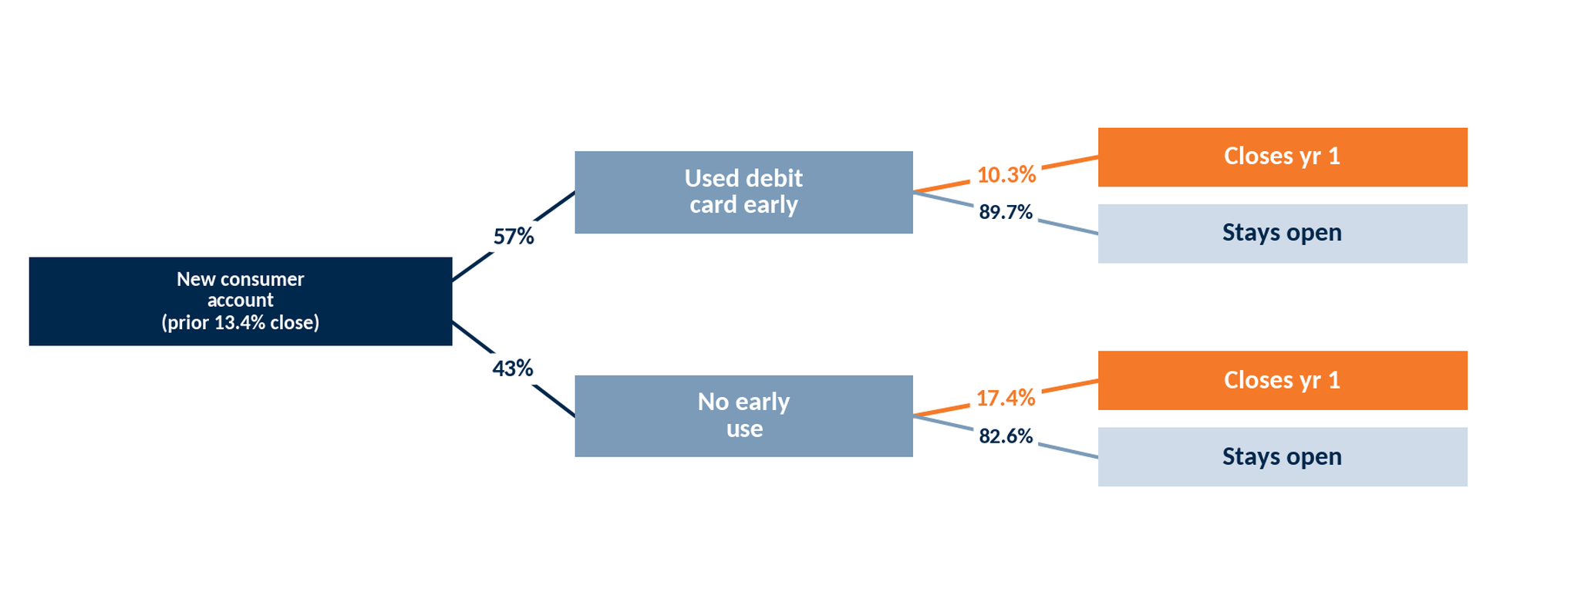
First-Year Closure by Early Debit Use
Selection: consumer accounts opened Jul 2023 – Jun 2025 (n=1,466); ‘used debit early’ = ≥1 swipe in the first 3 months. Conditional closure probabilities updated from the 13.4% base rate (Bayes).
Early debit use tracks with better first-year retention — 10.3% close vs 17.4% for non-users.
47
Notes:
Source: ODD extract 999 Union Financial (demo data; Jul23-forward), Jun 2026 snapshot — responder / new-account analytics; associational, not causal where noted.

